Slide 1
PLANNING FOR THE CLOSURE OF NP04
D. Macina
(on the behalf of the NP04 team at CERN)

Slide 2
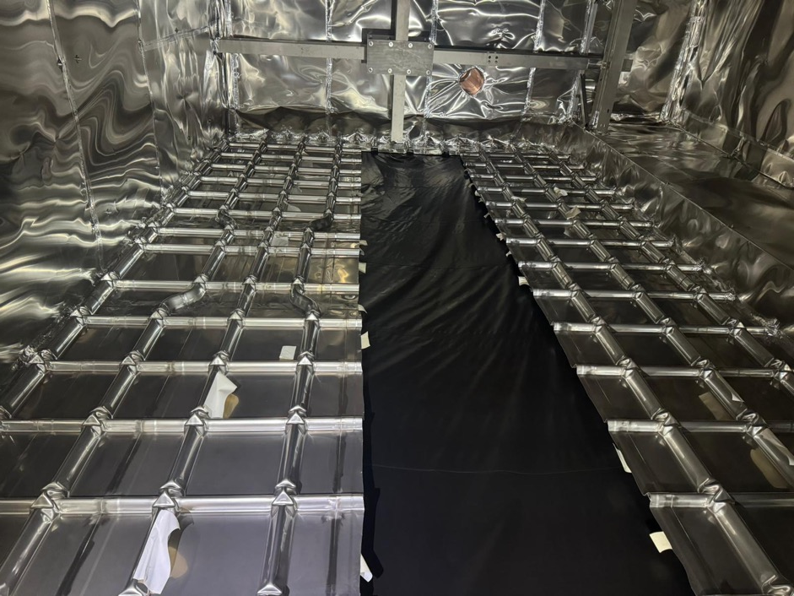
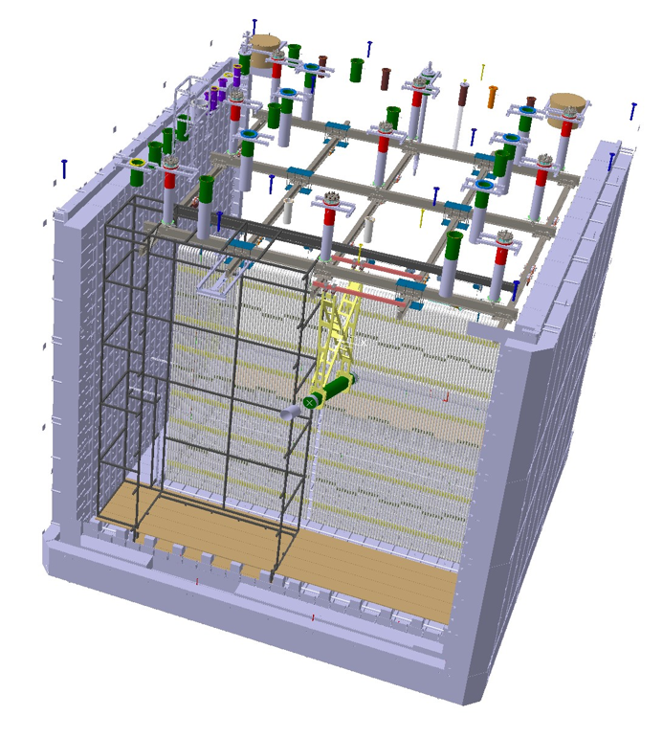
TCO closure: preparation
Dirty room
(detector protection)
for TCO closing

Slide 3
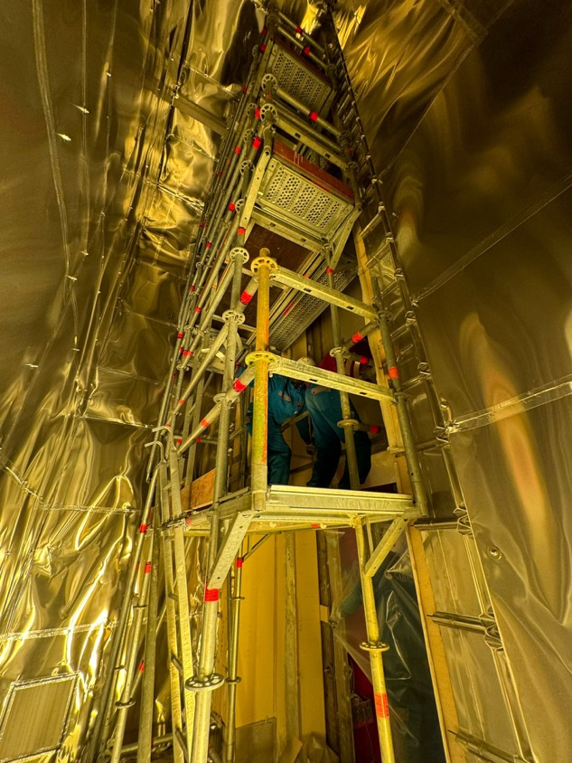
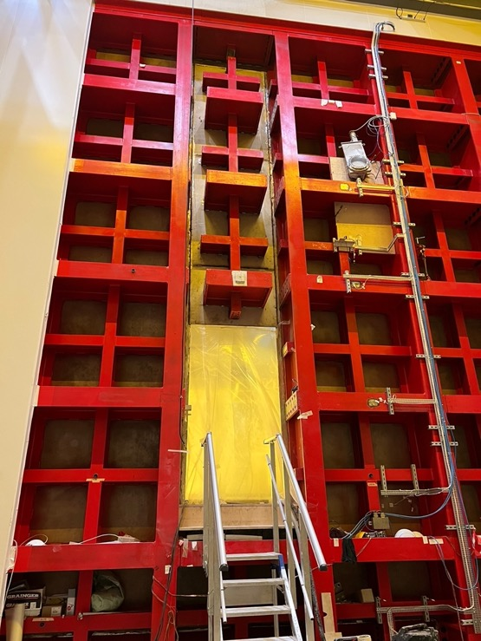
TCO closure
The 1 cm steel tertiary membrane and the outer structure steel (red) modules are installed by the NP team
The insulation layers and the primary membrane is installed by the GABADI external company
The whole work should take about 3 weeks and it is expected to end by the week of November 27th

Slide 4
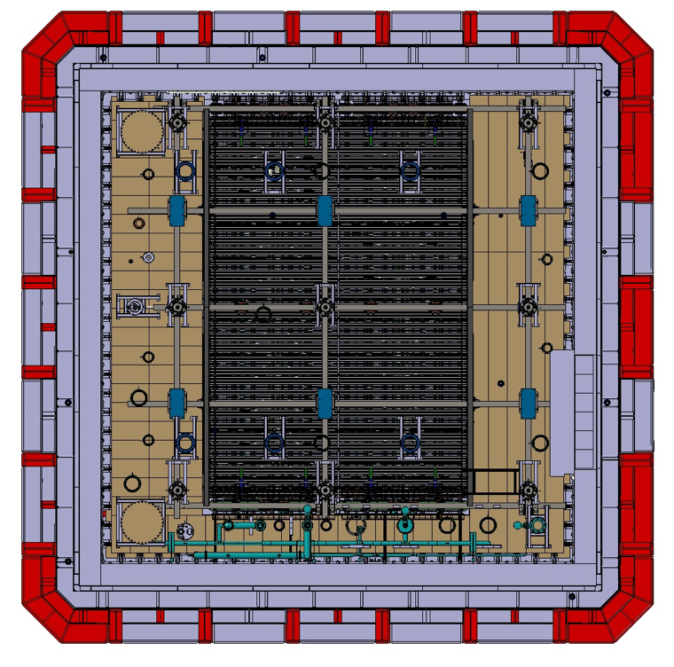
STEPS after the TCO closure
HV test (up to 15kV):
check continuity and assure there is no leakage by reading the current at the PS and at the output of the 12 termination boards of the FC. This test can be done also before the TCO closure outside working hours (no people in the cryostat)
Leakage test of the primary membrane (make vacuum and insert He in the insulation volume)
Removal of the ‘dirty room’
Installation of the cameras
Removal of the false floor, installation of the missing ground planes and test, removal of APA protection panels and cleaning
N.B. access to the cryostat is feasible also after the false floor removal. However, maximum attention must be paid when walking on the membrane and in the vicinity of the APAs
TCO

Slide 5
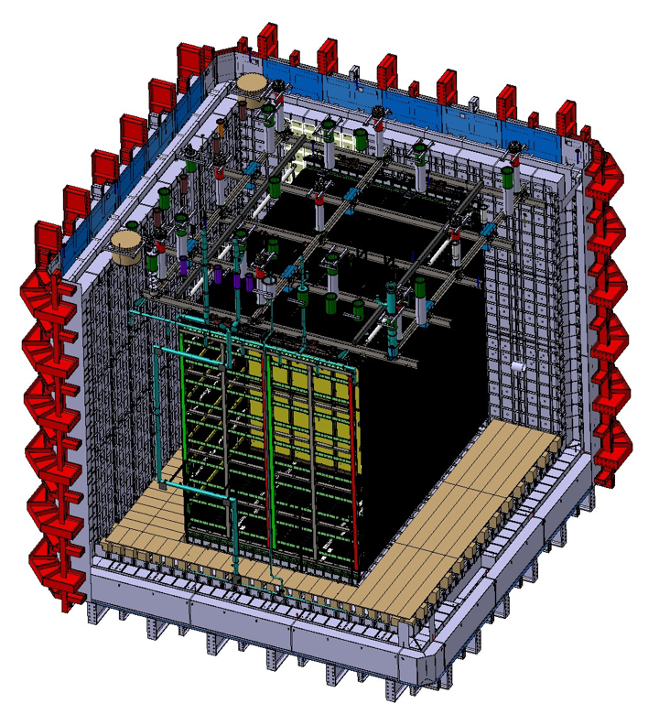
STEPS after the TCO closure
Installation of the IoL
Installation of the Purity Monitor
Installation of the ²⁰⁷Bi source (to be decided)
Sealing of all flanges (CE, PD and Tmon can start sealing at any time)
Leak test (He inserted in the cryostat via the purge manifold)
TCO

Slide 6
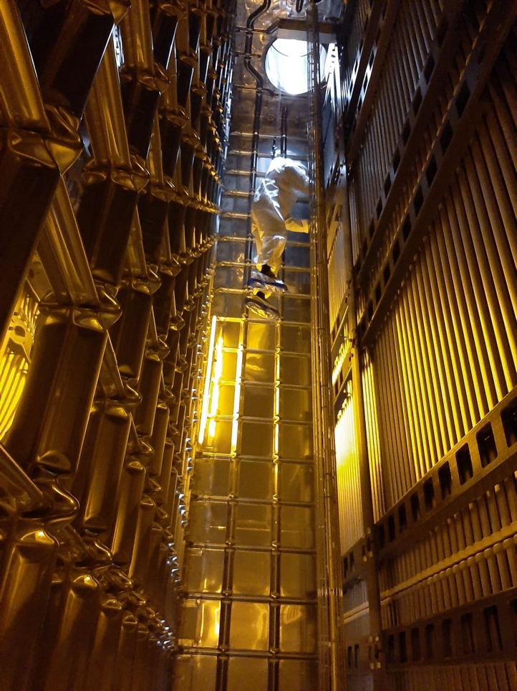
Access conditions
After the TCO closure, the access to the cryostat is done via the access hole on the Lausanne side and the scaffolding
After the removal of the false floor and the cleaning, the access to the cryostat is done via the access hole with the help of a pulley (short ad-hoc training is needed)

Slide 7
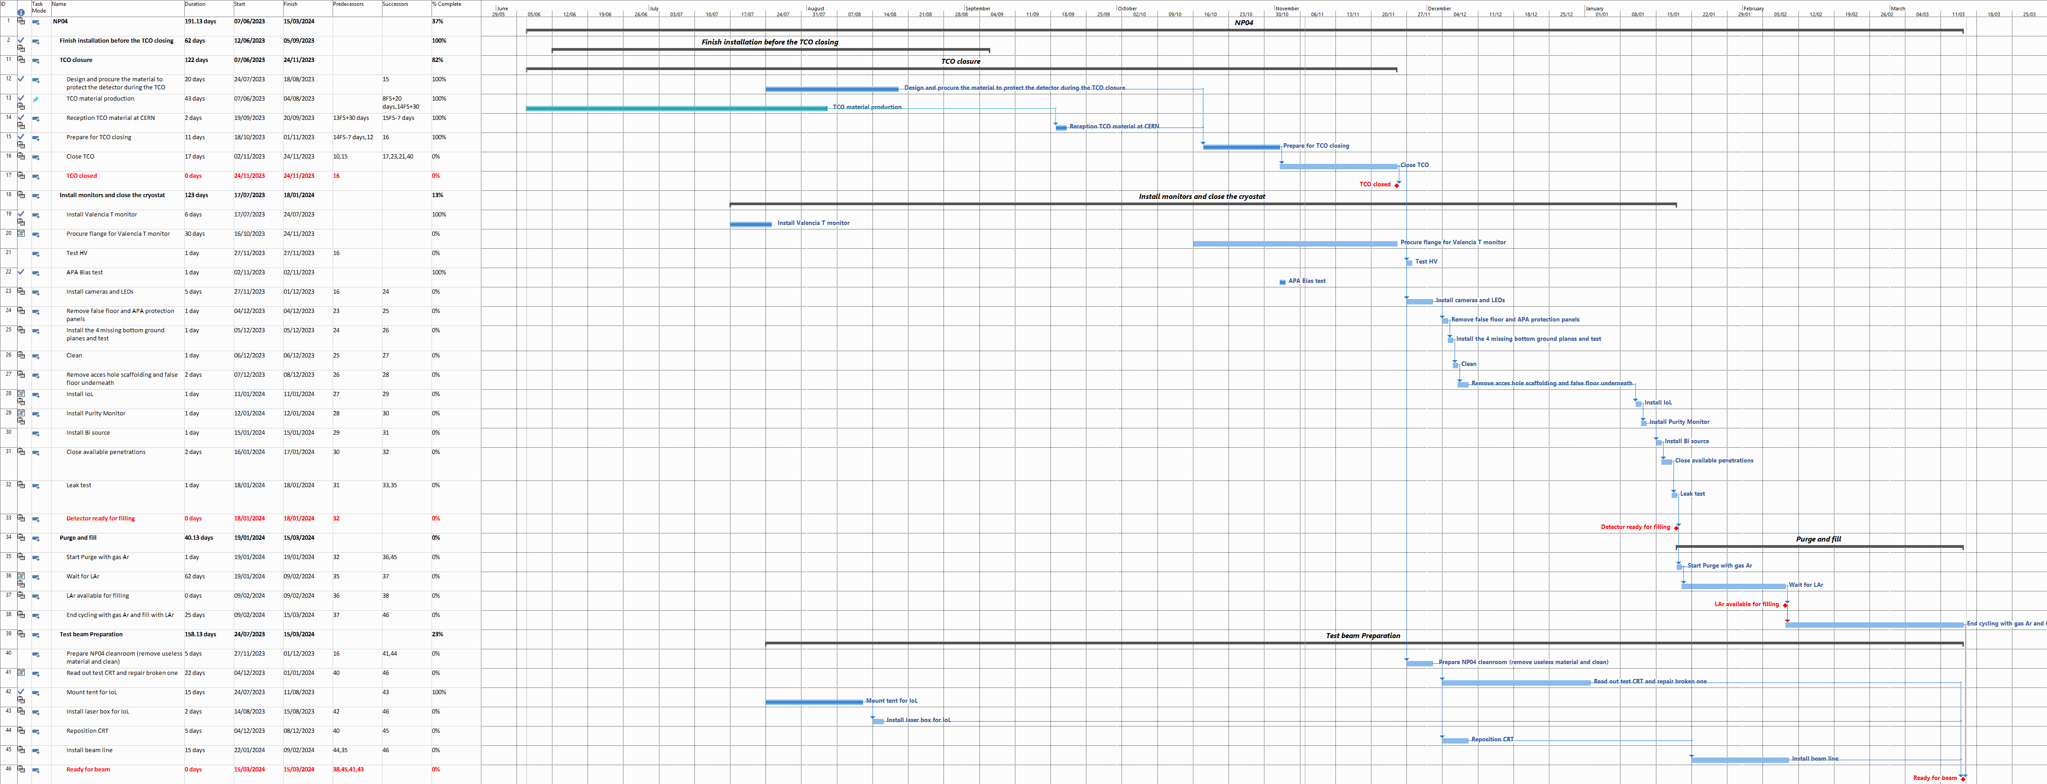
!N.B. date for LAr availability is not known yet.
This is just an educated guess!
Planning
Today

Slide 8
Planning
False floor removed and
cryostat Cleaned by Christmas
IoL, Purity Monitor, Bi source:
week of January 8th
Leak test + purge with GAr:
week of January 15th
CRT can be installed any time
between December 2023
and February 2024
Beam line installation takes 2 weeks
and can start as soon as the CRT
is in position

Slide 9
Summary and conclusions
TCO will be closed by November 27th
Cryostat clean and ready for the last detectors before Christmas
IoL and purity monitors installed just before purging with gas (to limit exposure to dust and air) after the Christmas break (week January 8th)
Start purging with GAr week January 15th
GAr purging will last until LAr will be available for NP04

