Slide 1
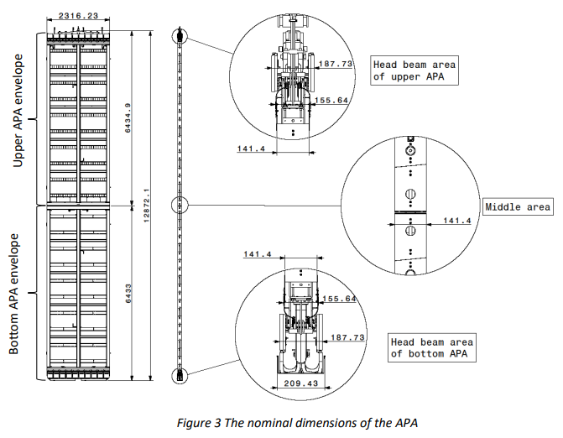
Proposal to Increase Distance Between APAs in APA Pair
KDZ
November 8, 2023
FD1 TB

Slide 2
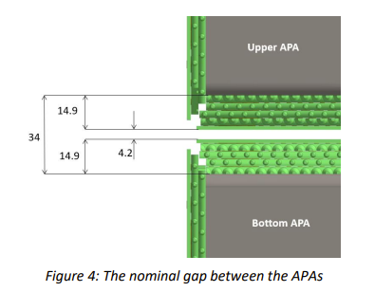
Introduction
As a reminder, the baseline nominal gap between two APAs in an APA Pair is 34mm (as shown in the left hand image).
At the foot tube, the “outside” surface of the frame is considered a boundary of the active area.
A proposal is made to increase this value by 6mm
Individual and Global envelopes For Upper, Bottom and Pair APA
https://edms.cern.ch/document/2787855/1
Document and images from D. Diyakov

Slide 3
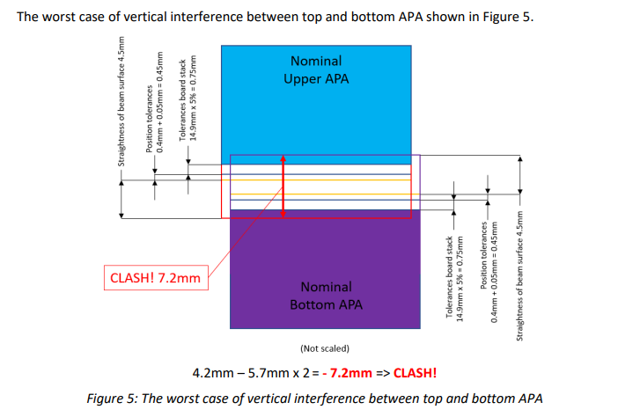
Motivation
One of the DUNE requirements for individual frame members is straightness of +/-4.5mm, regardless of length.
Thickness tolerance of circuit boards is 5%.
Using these two criteria, the baseline nominal gap (of ~4mm) is insufficient.
Keep in mind that a “long” frame member (side and middle tube) is 3x longer than a foot tube.
And we routinely achieve straight “long” frame members
A very quick and informal query of surveyed frames
(I couldn’t readily find member or frame data beyond these)
Image showing both APAs at their “worst” case
Frame # | Straightness Measured at Frame Survey (mm) + value is “convex” active area - value is “concave” active area
001-US | +0.3
002-US | +0.6
003-US | -1.1
004-US | +0.6
005-US | +0.8
0011-UK | +0.7
0013-UK | -0.4
0020-UK | +0.4
0020-UK (Portrait) | +0.2

Slide 4
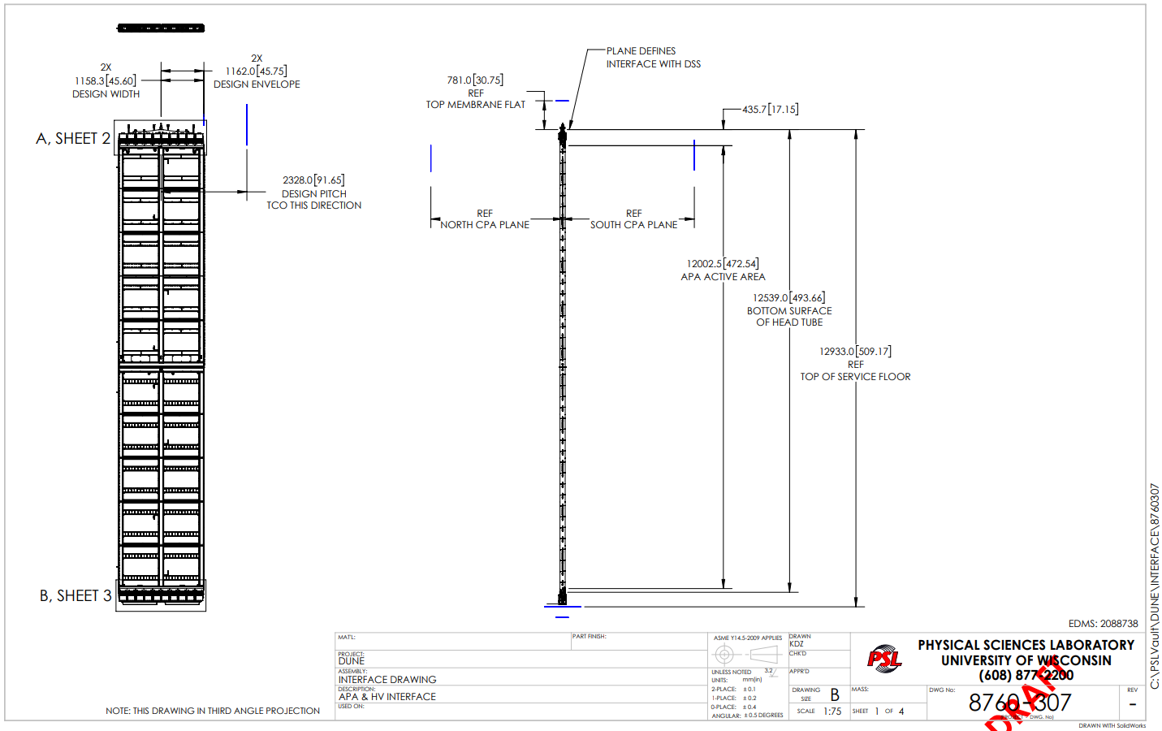
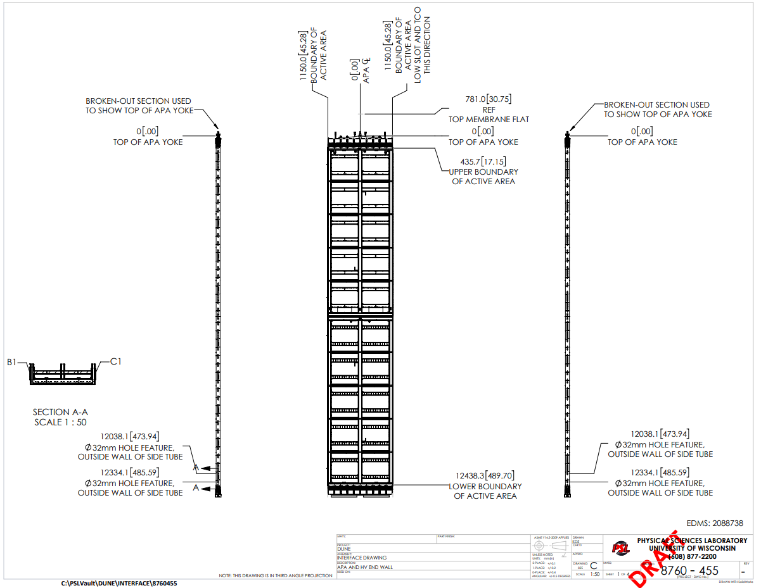
Implementation (1/2)
To add this small change (+6mm) into the detector several options to implement are available.
The proposed best method is to add the 6mm by lowering the Lower (bottom) APA
And keep the Upper APA, its yoke and all the rest unchanged
HV consortium has graciously agreed to allow this proposal to be made (within reason) with the understanding that said proposal won’t affect the HV design.
We will of course continue to verify this is okay… thus a TB presentation.
+6mm
+6mm
+6mm
+6mm
+6mm
FD1 APA and HV Interface Control Document
https://edms.cern.ch/document/2088738/5

Slide 5
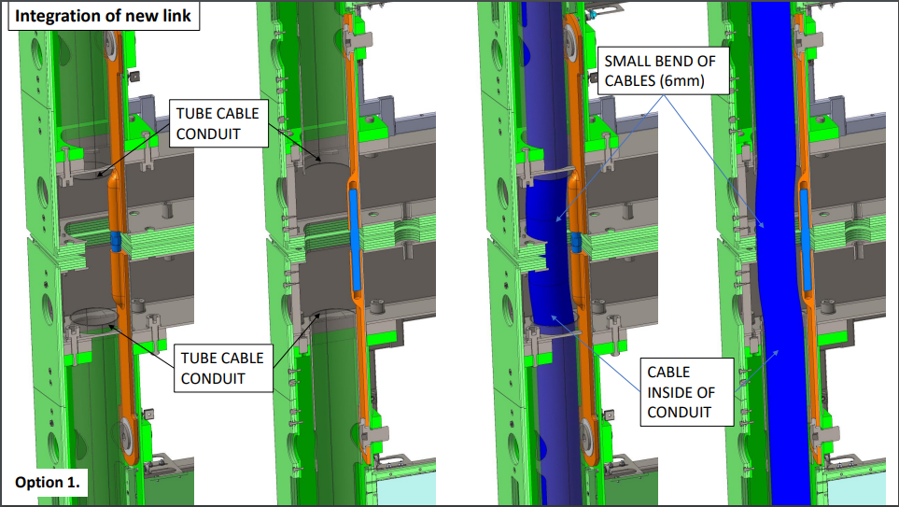
Implementation (2/2)
Pursuits of an adjustable APA linkage assembly (turnbuckle) are occurring with testing and validation at Ash River.
This allows for in situ adjustment such that an APA Pair is as straight as possible.
Note: An adjustable linkage isn’t absolutely necessary to implement the proposal presented here
Preliminary Investigations
https://edms.cern.ch/document/2958979/1
D. Diyakov

