Slide 1
SAD/ASE Status
Mary Convery
11/3/23

Slide 2
SAD/ASE status
The lab has decided not to operate the main accelerator complex until we have approved Safety Assessment Documents (SADs) and Accelerator Safety Envelope (ASE) documents which are compliant with DOE Order 420.2D which came out in September 2022
A dedicated team worked very hard to update the documents this summer. An Accelerator Readiness Review (ARR) was held and concluded that although we were on the right track, there is still a lot of work to be done.
An example of needed changes is to define the Maximum Credible Incident and specify what “credited controls” are needed to prevent exposure above the limits in the event of an accident (shielding, radiation safety system, specific rad monitors…)
Another change is that ODH requires a credited control

Slide 3
SAD/ASE project plan
A “project” has been formed, adding Marc Clay (Deputy COO and interim ES&H Division Director) as Project Director and myself (Mary) as PM to the existing team
The project has a schedule with milestones for when each piece of the accelerator will be able to resume operations
We have been advised by other labs based on their experience that this schedule is aggressive, but we are committed to resuming beam to users as quickly as possible
Machine | Review | Approval to run beam
Linac / MTA | SAD/ASE review Nov 27-Dec 1 | Jan 2
Booster/MI8/BNB/MI/NuMI | SAD/ASE review Jan 8-12 | Feb 7
Muon/SY120/Meson | SAD/ASE review Jan 22-26 | Feb 22
NM/SpinQuest | SAD/ASE review Jan 22-26 ARR Feb 12-16 | Mar 22
Accelerator Complex | ARR Feb 12-16 | validated compliance

Slide 4
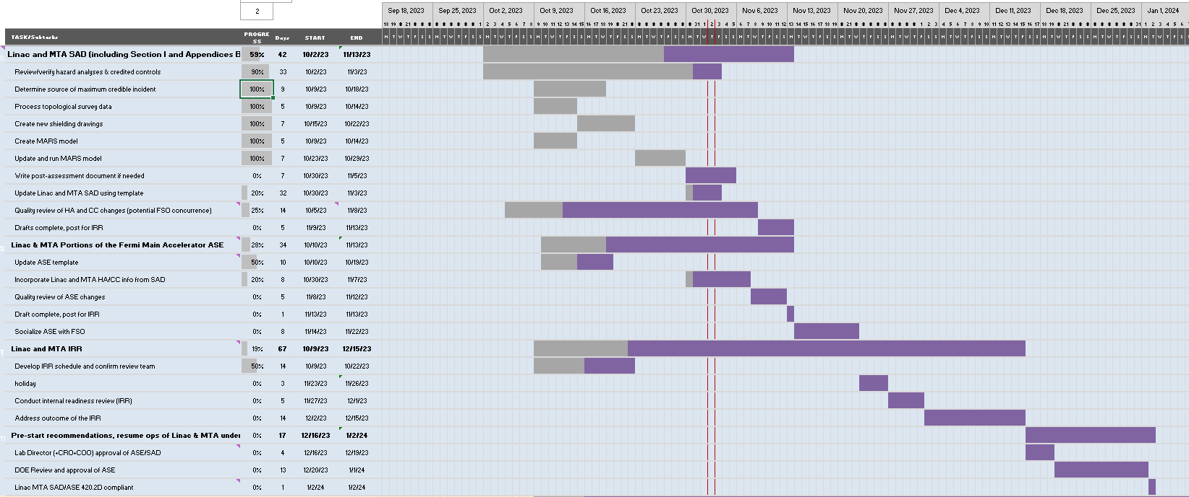
Example schedule for Linac/MTA

Slide 5
SAD/ASE team for the Accelerator Complex
Linac: John Stanton, Lionel Prost, CY Tan
MTA: Sue McGimpsey
Booster: Salah Chaurize, Lionel Prost
MI-8/Main Injector/Recycler: Dave Capista, Nino Chelidze, Marty Murphy
BNB: Jason Crnkovic, Tom Kobilarcik
NuMI: Phil Schlabach, Tom Kobilarcik, Kevin Lynch
Muon Campus: Jerry Annala
SY120/Meson: Mike Olander, Tom Kobilarcik
NeutrinoMuon: Sue McGimpsey
Operations: Todd Sullivan, Kelli Rubrecht
PPD coordinator: Evan Niner
John Anderson
former AD ES&H head
consulting

Slide 6
Summary
We have a plan to update SAD and ASE documents in order to resume operating the main accelerator complex and delivering beam to users as quickly as possible
We have a team in place with ES&H support and will not hesitate to ask for additional help if needed

