Slide 1
2023 Summer Shutdown
11/3/23
Cons Gattuso

Slide 2
Current Status and Projected Work Schedule
Grey Period

Slide 3
Enclosure Status
We will be completing valid secures of the following areas.
MI-8, MI-10, MI20-62
MTA
MI Re-coring will this afternoon
Please be out of the tunnel by 13:30 hrs
Return long term keys to MCR
Safety System Testing
Monday Nov 6th
MI-8/MI10/ Mi20-62
No access into MI while testing is occurring.
Testing to start ~07:30- ~03:30
Next week we will start other locations
Order and sequencing TBD.

Slide 4
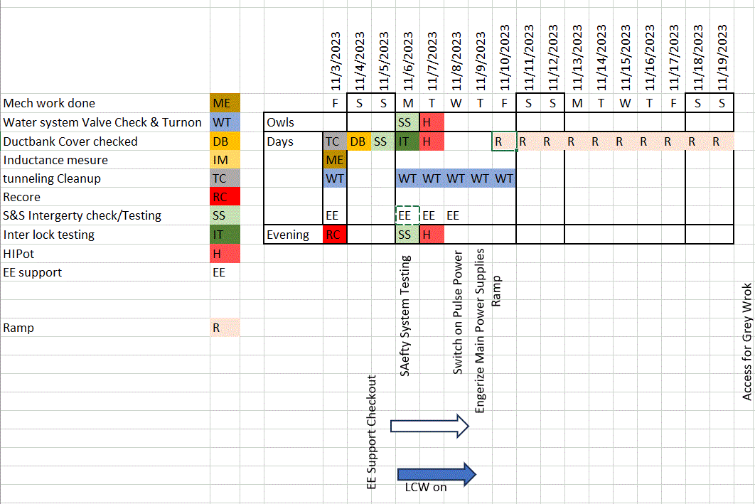
Major Activities
MI Q319 and Main power Supplies Ramps Studies
Grey Period
Time from when the Shutdown is over until we have permission to run beam
Shifting from Shutdown activities to Project drive activities
Grey work to be completed by Dec 15th
Accelerator will be placed in a standby state
“ALL” Tunnel activities complete
Safety System test completed
System Start-Up Sign-off sheets complete
Power Supply tests completed
Once we get closer to running beam focus will be put back on the accelerators
Typically, we will start this process 1-2 weeks prior to projected beam delivery date
Wild cards still in play
Gate installation to isolate the accelerator complex with the rest of the lab
Fencing around some buildings
Muon Campus
BNB
Booster
Ect.
These Activities are now scheduled to be complex by Nov 30th

Slide 5
Grey Period Tasks
Finish SD work
Projector Support
Linac
Klystron swap at the Debuncher
KRF2 Klystron tuning
Booster
BLM calibration
BPM impedance resistor repair
GMPS transformer heater installation
Corrector control chassis checkout
New Low level system testing
New GMPS FE testing
MI/RR
8 Gev line Multi Wire relocations
Dual PA Conversion for PIP II
Building new PIP-II era modulator power supplies
VCB replacement
PS studies
F-sector
Removal of Tevatron magnets in the F3 Tevatron sector where the PIP-II Beam Transfer Line will cross the Main Ring tunnel.
Muon Campus
Final installation of the extraction section
Opening and closing AP40 hatch
Remove EKIK (g-2 kicker)
Install ESS1
Change beam pipe in Q203
Re-introduce ESS2 to the DR vacuum system (it has been isolated since July)
Replace Q205 with rad hard replacement.
Complete De-oxygenation skid
SY
LCW HX Cleaning in F-Sector
LCW Leak Repairs
Lower M00U-1 and Q230 in F3 manhole and replace with beam pipe.
Inspect MSEP2D motor
Refill and Restart MS2 LCW System
MT5VT2 LCW Leak Repair
H202-4 Alignment
FAST/IOTA
Final LCW connections from beamline to header
Test LCW system
Build cooling lines for extension of proton driver

Slide 6
Da Plan
Linac
Maintain the secure status of the enclosure.
Continue with RF3 studies if needed.
Continue with turning on and checkout other RF stations.
Booster
Work planning for Water leak repair on Period 1 Girder 2 manifold
Work planning for Q9 Quad replacement
Quad has a water leak that cannot be fixed in place.
MI/RR
The main goal and priority for today and week is to the get the MILCW system up and running in preparation of establishing a MI ramp next week to test the Q333 Bolted quad.
Fill LCW system for magnets and get water circulating.
Friday ~13:00 hrs
Re-coring of the MI10, 20-62 and MI-8 enclosures back to operational key core sets. During this time no access are permitted in the above enclosures except the re-core crew.
If you have a long term key, please return it to the MCR. Also remove your locks from the LOTO Boxes in the MCR.
Weekend
Ops will complete a valid search and secure of the MI10, MI20-62 and Mi-8 enclosures.
Continue to monitor MI resistivity of the LCW system in MI.
Complete walk throughs of MI service building looking for water leaks.
Monday November 6th
Safety system testing will take place all day in MI. Keys to be issued only to the Interlocks group that day.
Muon Campus
Water leak repair in the Delivery Ring
Various Sextupole magnets that are leaking water are being changed out.
External Beam lines
As time and people become free, we will start addressing the water leaks and other mechanical issues.

Slide 7
Stuff I forgot….
…
…
….
?

Slide 8
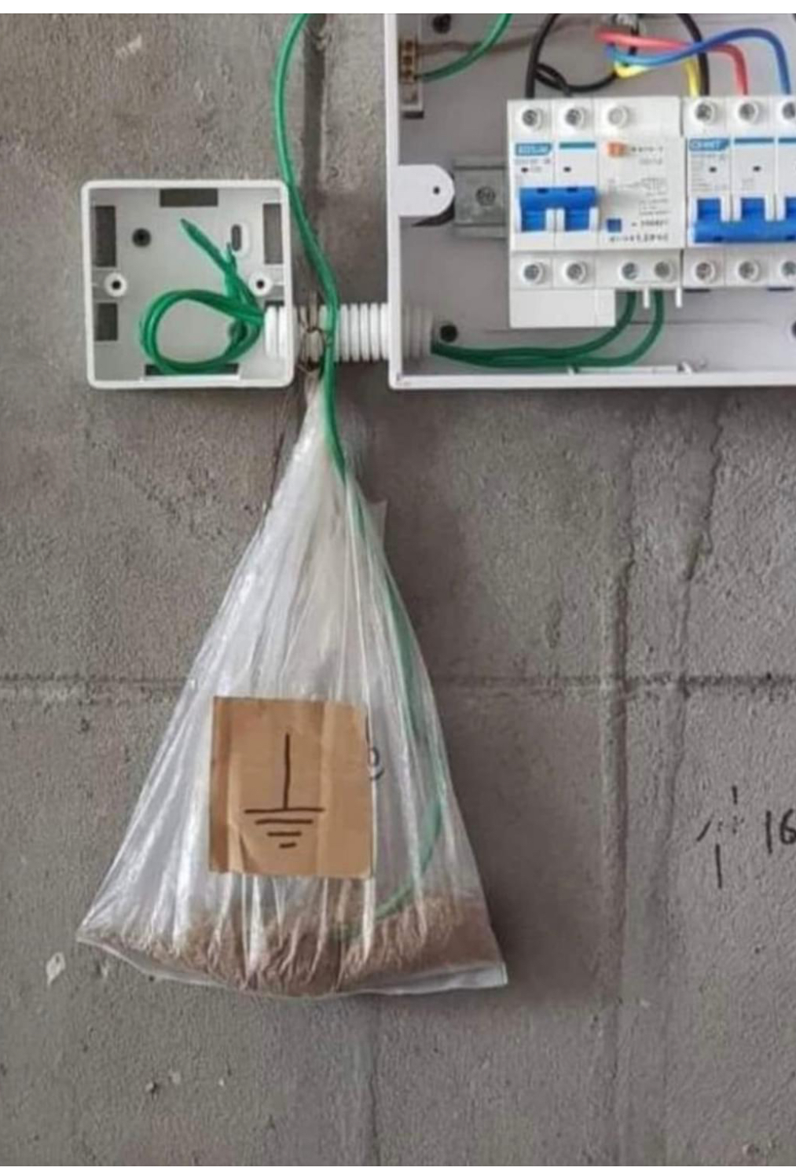
Electrical Walkthroughs
The value of completing electrical walk throughs.
Not at Fermilab

Slide 9
Any Questions ?

Slide 10
Schedule
Today
Nov
Thanksgiving
Dec
Dec 15
Jan
Jan 15
Linac
End of Grey period
Booster
Stand By or
Ready State
8 GeV
Muon Campus
F-sector &
Switchyard
Critical Path
PIPII
FAST/IOTA

Slide 11
Transitioning to Operations
New RunCo’s
George Deinlein
External Beam Delivery Department: Muon Campus
Email: deinlein@fnal.gov
X 6436
Jason Crnkovic
External Beam Delivery Department: Neutrino and Test Beam lines
Email: jcrnkovi@fnal.gov
x2469
Will occur once Beam has been established to BNB/NuMI
RunCo will handle day to day beam operations
ShutCo will help from behind the scenes with remaining shutdown/startup work.

Slide 12
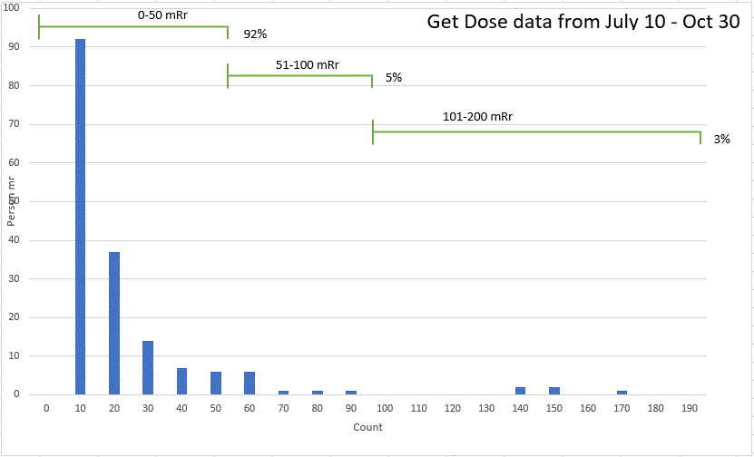
Dosimetry
MI Magnet Water leak repairs
in 30 straight section
MI Magnet Hose change
NuMI Target hall work
Opening Survey
There are some corrections that need to be made.
Two individuals look like that are adding absolute values from pocket dosimeters instead of differential.
3125

Slide 13
Shut down Job Summer
Tasks
Tasks Completed 1033 ~93%
Maintenance activities
Accelerator 30
Infrastructure 48
Total number of job 1111
No rad coverage needed 903 82 %
RCT coverage 105 9 %
RWP 77 7 %
ALARA Plan 23 2 %
Power outage (Completed 95.8 %)
Scheduled 72
Re-Scheduled/completed 6
Completed 69
Deferred until next year 4 (Tenant's request)

