Slide 1
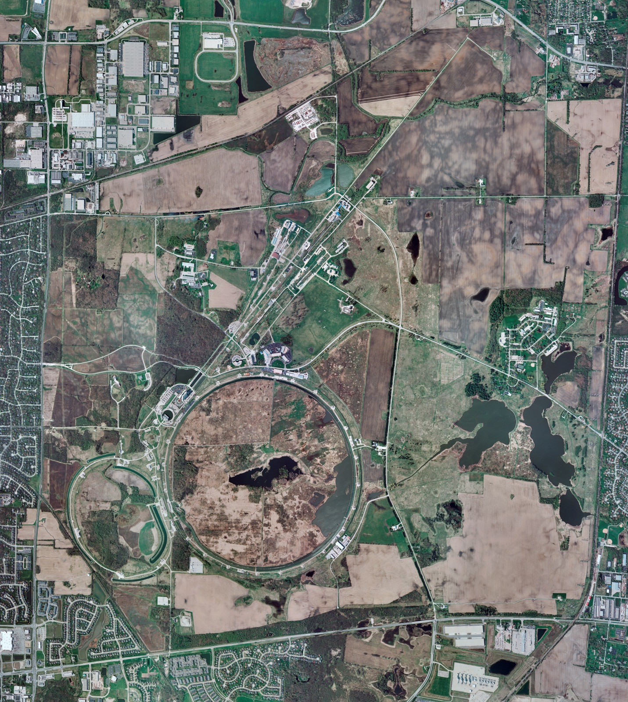
Helium Cryogenics
Status 11/03/2023 J.Makara
CMTF: SCP is cold and operating fine
CMTS: HECM28 installation in progress
PIP2IT: SSR1 pCM at 2 K for heat load testing
North CM stand empty
MCTF: cryo system cooled down with 3 comprs, 2 Fridges, and Purifier
MDB/HTS: at RT
MDB/STC: .at RT but SSR2 cavity cooldown shortly
MDB Magnet: at RT
NML/FAST: Cryo system is shut down and isolated for extended shutdown period
CC1: at RT
CC2: at RT
CM: at RT
IB1: cryo system cooldown in progress
Muon Campus: A0 comprs (3) online with MC-1 g-2 cryogenic system running fine at 5 K with g-2 magnet powering
Misc: ..

