Slide 1
Muon Campus Operation Report
Jim Morgan
Friday 09:00 Operation Meeting
November 3, 2023

Slide 2
Muon Campus status
ESS1 Electrostatic Septum at NWA
Slow but steady progress over the past week, now at 71.3 kV
At least a month before septum could be ready to be moved for installation in D30
LCW sub-header braided hoses were replaced
On hold last week waiting for rad coverage
Electrostatic Septum ESS2 remains isolated and under vacuum
Venting to reconnect to Delivery Ring vacuum depends on ESS1 progress
Working on plan for draining AP-0 RAW systems
Still waiting on RWP and personnel availability
Will keep Dump system filled and running for possible future Mu2e target test
Pre-Target exhaust blower EF1 VFD controller has been mounted to wall
Still needs to have wiring finished and to be programmed
AP-0 Air Conditioner Replacement work continues to be paused
Waiting on contractors to return and finish installation
Only a week or two of work needed before system can be tested
Study – M1-M3 Optics
Study – Alternative M5 optics
KPS5A PFL Repair
MC-1 Controlled Access
G-2 Trolley Run
Intentional Accelerator
Standby Period
<------------Week Days -------------------→

Slide 3
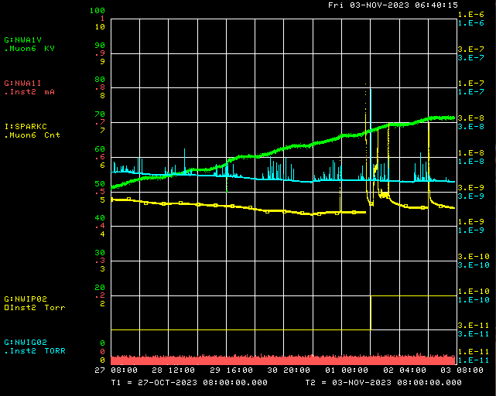
Mu2e Electrostatic Septa ESS1 conditioning
P.S. Voltage
Ion Gauge
Ion Pump
Spark Counter
P.S. Current

Slide 4
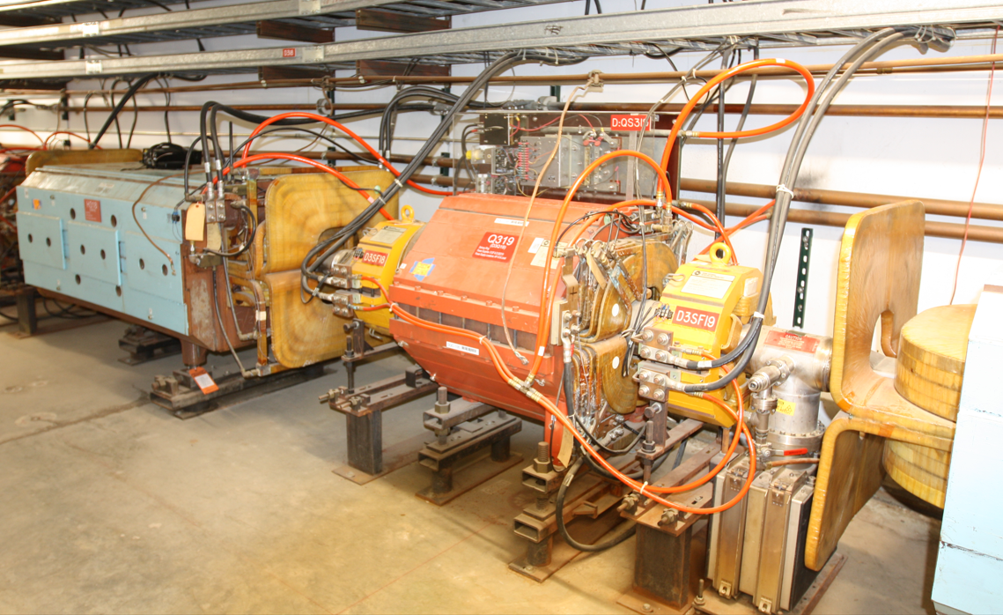
Example of NSA sextupoles in Delivery Ring
NSA sextupoles

Slide 5
Upcoming work
ESS1 high voltage conditioning continues at NWA
AP-10 120 Volt 20 Amp circuit breaker replacement
Remove M4 Extinction Collimator from tunnel for modification
Replace four leaking NSA Sextupoles in the Delivery Ring
Magnet selection and staging first, then hook up to LCW system to test for leaks
Survey and Alignment jobs, done for now
If ESS1 installed in Delivery Ring later this Fall, will need to be aligned
Vault access to finalize plans for draining AP-0 RAW systems
AP-0 A/C work on hold, awaiting return of contractor
Finish installing EF1 Pre-Target rad air exhaust VFD Controller
Try to fix old VFD Controller
Grey Zone proposed work
ESS1 installation, new compact ESS vacuum layout with new Q203 pipe
Rad hard Q205 magnet swap, new Q205 vacuum pipe that’s easier to service
Receive three rad hard quadrupoles from TD, then swap with three in D30

