Slide 1
Project Activities in MSD
Mayling Wong-Squires
AD Operations Friday 9am Meeting
3 November 2023

Slide 2
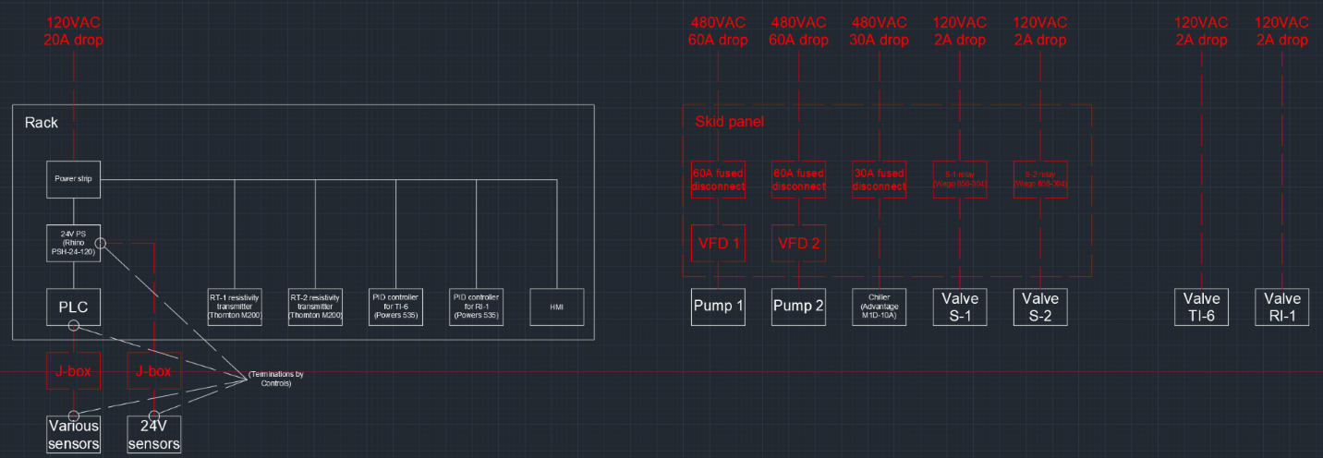
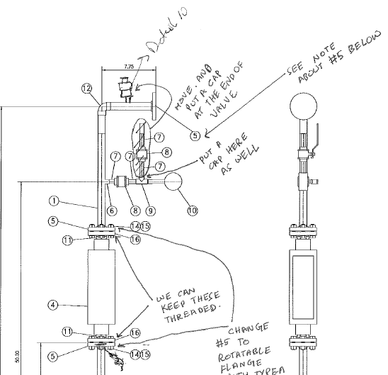
LBNF RAW Water Systems (incl Horn Test Stand)
Horn Test Skid PLC electrical components interface
Checking drawings and created equipment spec for the Horn Test Skid.
Working with electrical personnel to wire up diaphragm pumps for the gas system prototype. Facing some challenges here. Have had multiple discussions/walk throughs with Dave Mertz, Paul Neville, and Chris Jensen. Chris ordered new motor starters with overload protection for this.
One of the vessel engineering notes for gas system has got conditional approval (EN11388). Other note (EN11730) received some comments. Comments addressed and sent back to reviewer.
Controls engineer working on electrical infrastructure requirements for Horn Test Skid PLC and other components.
P&ID for the AH Argon gas system and AH RAW exchange system complete. Close to being approved.
Checking drawings: Horn Test Skid

Slide 3
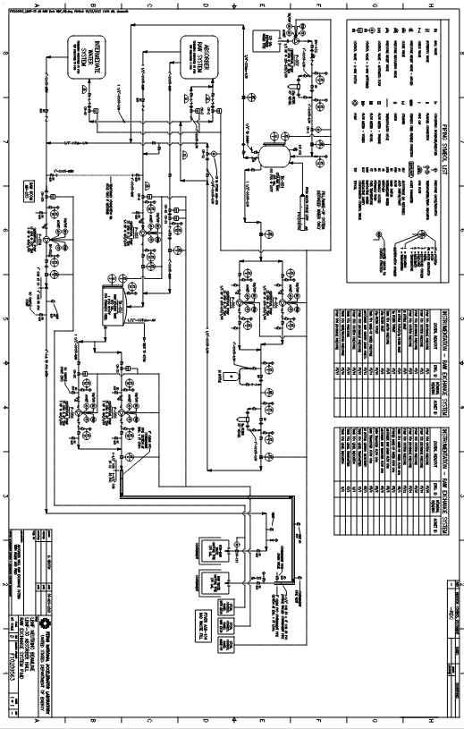
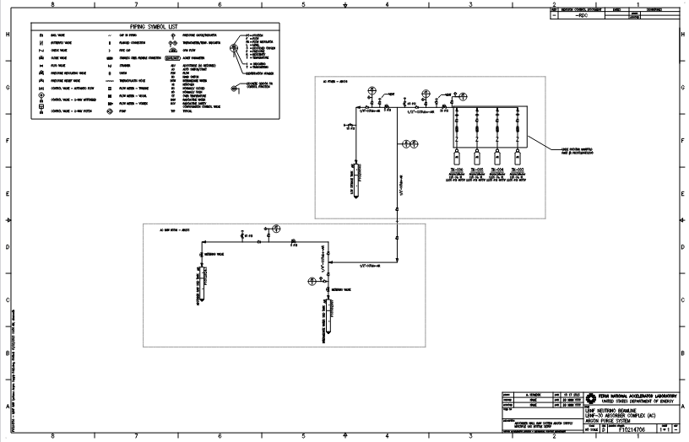
LBNF RAW Water Systems (incl Horn Test Stand)
AH RAW exchange system complete
AH Argon gas system and AH RAW exchange system complete

Slide 4
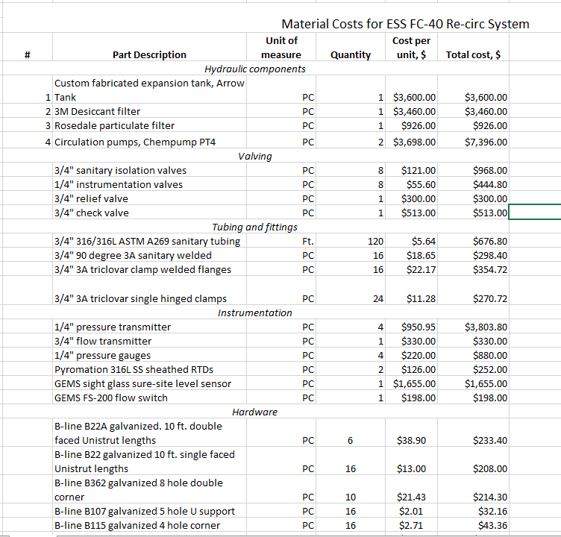
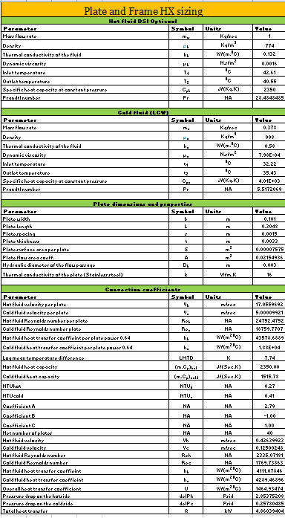
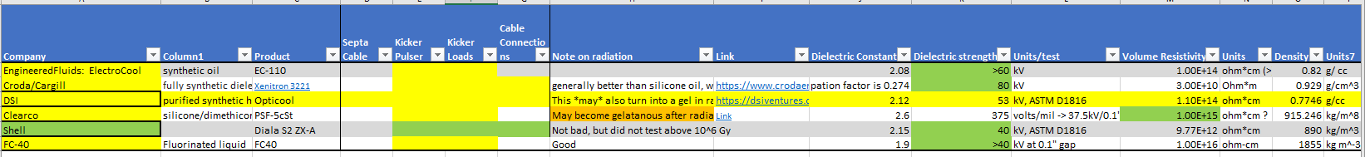
Mu2E HRS and ESS Septa work
Pressure test for HRS skid is scheduled for Friday, November 3, 2023.
Prepared a cost estimate for the ESS FC-40 recirculation system.
Recommended OptiCool as a preliminary test alternative for FC-40.

Slide 5
MSD Report
LBNF
Primary Beamline:
  sample coating of ceramic tiles by vendor in mid-November
  dipole tube installation demonstration at MI-60 is being planned for November 21
  PDR kicker magnet design review next week
  Checking drawings for quad stands and kicker magnet ceramic beam tubes
  Corrector magnet stand design and engineering note, multiwire stand, dipole stand design, and kicker magnet installation design in progress
  Vacuum system and magnet stand FDR in December and January
Target shield pile cooling skid design started
Instrumentation: BPM design, spool piece drawing review, support stand engineering note in review
Primary beam window: engineering review of final cartridge design drawings
PIP-II
RF cavities and PA’s: assembly of new Booster cavities & new MI cavity’s dual PA; design of new 53-MHz RR cavity
BTL collimator: drawings in progress; PRR scheduled for February 2024
Instrumentation: engineering, component procurement, and traveler documents in progress for instruments and and stands/girders
Vacuum: BTL and LPM design, drafting, and analysis; BTL evaluating dipole and septum vacuum chambers fabrication options as part of upcoming BTL Final Design Review; preparing for upcoming Integrated Vacuum Systems Final Design Review
Mu2e
Septa: await arrival of stand parts; septum voltage testing in progress; cleanroom activities resume next week; FC-40 skid cost estimate

