Slide 1
ES&H Radiation Physics Operations
Joel M Fulgham
Nov 3, 2023

Slide 2
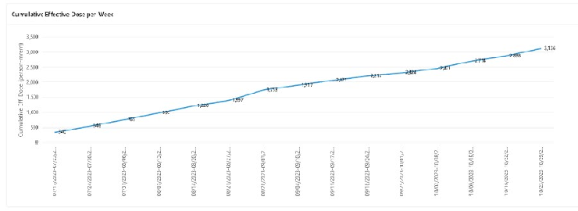
The pre-shut down estimate was 3161 person-mrem and we are at 3136. This number includes 3 people that entered their dose incorrectly and high. There were some high dose rates this week that are not included here so we are right on target. Thank you for making me look good on this estimate.
Notes:
From dye test in 2012 we know all the sump wells except 3 have a broken pipe somewhere. This is how tritiated water gets into sump well 4.

Slide 3
Updates
New High Rad Gates have been installed at MI-30, 230 and 305. They are accordion gates that do not close on their on so please close them after you pass through.
We are discussing ideas about the monthly briefings and when we have a complete plan from our side it will then be further discussed with AD and the machine departments.

