Slide 1
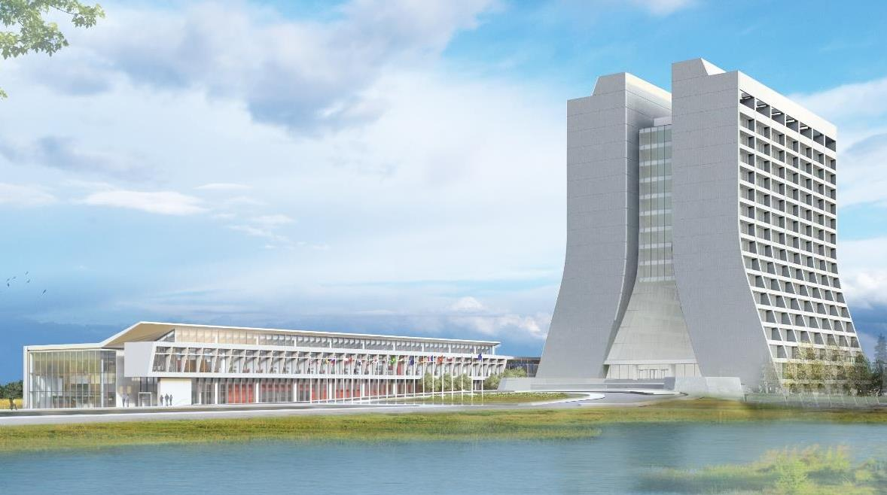
Infrastructure Services Division Updates
Roof Repairs in progress:
MI-20 (shifted to warranty work),
MDB, MS4, LINAC (walkdown on the 26th with Safety and DOE to look at safety concerns with all roof work) (BTW slide #6.) & (Mobile Rooftop Anchor slide #6)
NWA (full tear off) start date pending
Sustainability: C-0 is getting a facelift and represents our first effort to invite the Sustainability group to provide input, so the project scope aligns with the Lab Sustainability initiative.
In the queue:
HA’s pending for: XGW-105, XGE-113/118, TG window sealant, MI-8 electrical, MI-8 office
Quotes pending for: F0 Barn Stairs, XGC-129, XGE-124
Need to walk down for quotes: BGW exterior door push bar (trying to expedite the card reader), C0 Service Building, XGC-105 & 107, Rad Safety workspace build out.

Slide 2
Infrastructure Services Division Updates
RAD Safety – Working to get new signs to replace warn and dated signs off the buildings. Carpenters are involved and working on the signage.
NML Hi-Bay Lighting: Waiting on the Impact to get approved for the re-lamping. The LED initiative might be a combo effort with Sustainability.
EOL Equipment:
T091 - ERF and FDR in for approval to get a labor estimate to install FRA-Supplied package unit for TR091 offices. They currently have no heat. The FRA-Supplied unit is only weeks out for order at this time.
Fire Barn: The new units have been placed and electricians are in the process of hooking them up. slide #8.
BTW: New unit installed, and electricians are in process of hooking it up.
EOL Lighting: LED projects for BTW and AO have PO’s now, just waiting on materials and scheduling.
A-0 Cooling: Cleanroom – Waiting for pre-construction meeting phase, Prism is contractor
Main Building & 2nd flr – Work may start on the 8th.

Slide 3
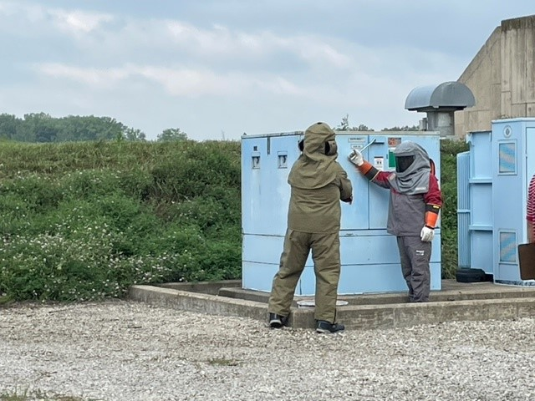
Utility Outages
Big Thank You! To the Power Outage Teams!!
“Make It HOT they said!”
“I’m already hot,
- in this suit.”

Slide 4
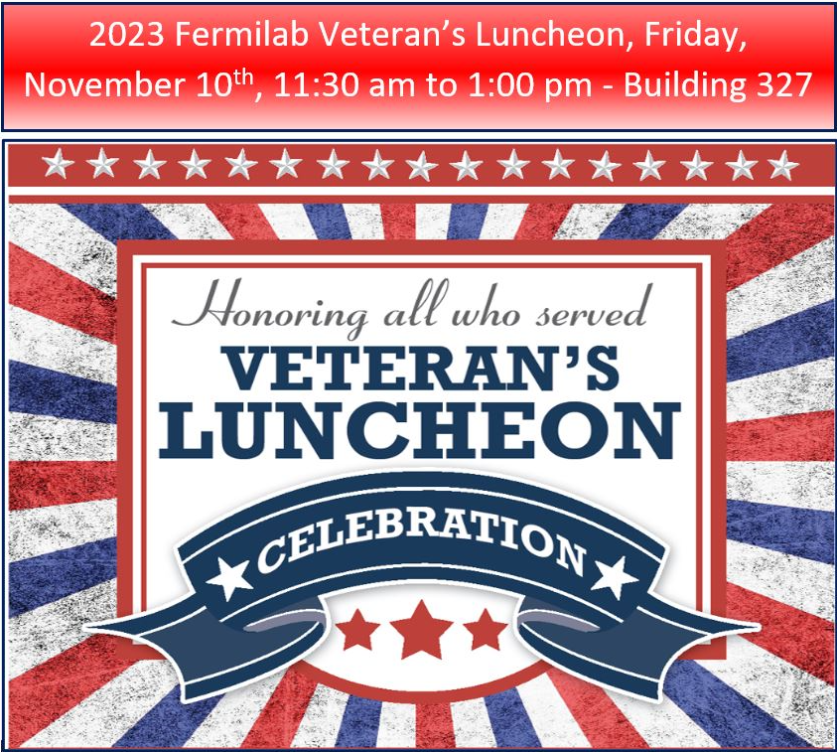
Veterans Day Luncheon
At BLDG 327

Slide 5
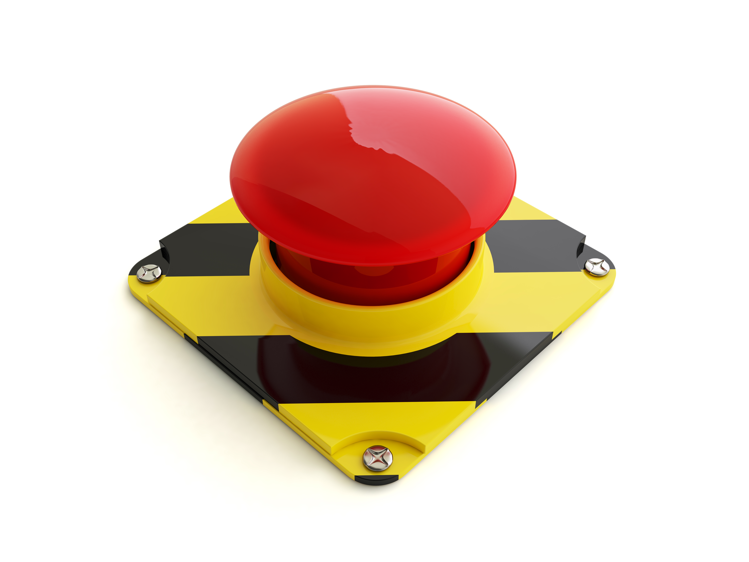
Current Happenings
The below slides are more detailed information on current happenings. Feel free to review. Keep scrolling…or hit the stop button.

Slide 6
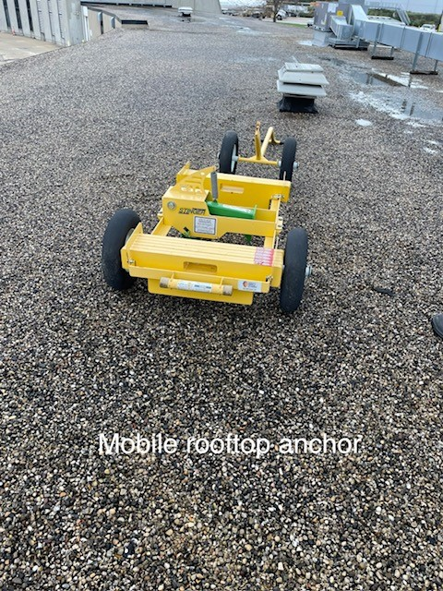
Current Happenings
BGE roof Leak Repair – HA has been approved and work started.

Slide 7
Current Happenings
Parking and traffic will be altered until the pad is complete and drivable.

Slide 8
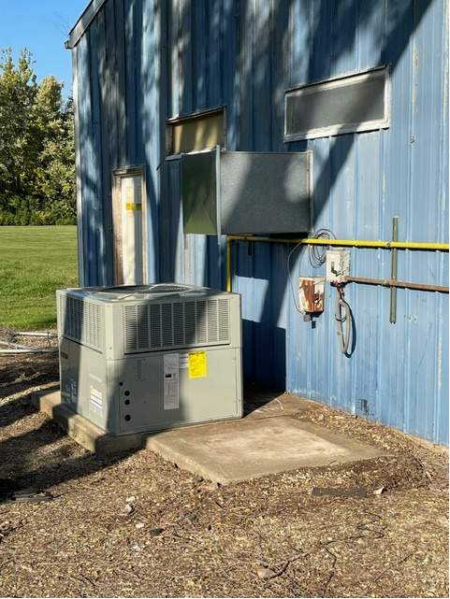
Current Happenings : Fire Barn
Old
New

Slide 9
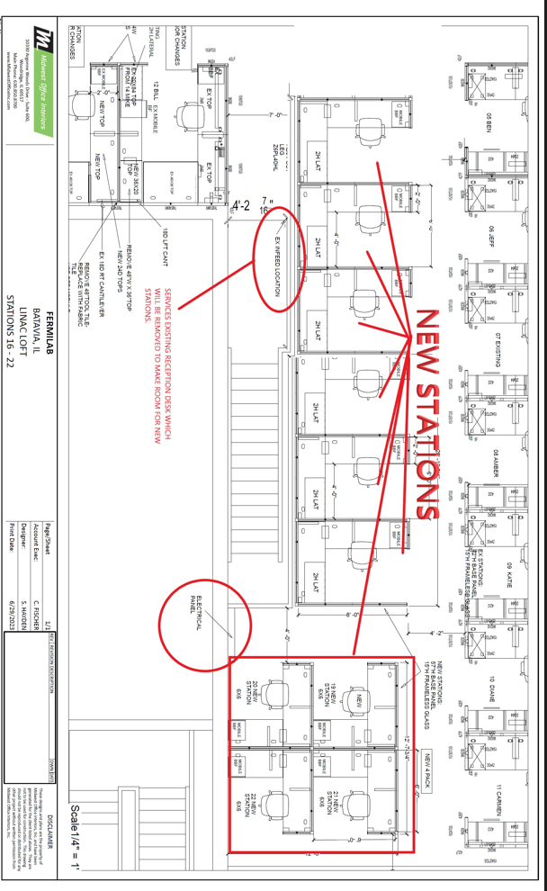
Current Happenings – LINAC RAD Safety Growth
Currently working on getting data drops and cubicle materials ordered and delivered.

