Slide 1
Fermilab testbeam data analysis
Calvision meeting Dec 21, 2023

Slide 2
Status
Compare the shape differences between the time spectrums of PbF2 and PWO/BGO (w/ filters) and compare PWO/BGO between channels with and without filters applied.
Though with filters applied, the PWO/BGO time spectrums are still different from the PbF2 ones.
PWO spectrums from channels with and without filters applied are similar to each other, which would be a challenge for a template fit.
Calvision meeting | Dec 21 2023

Slide 3
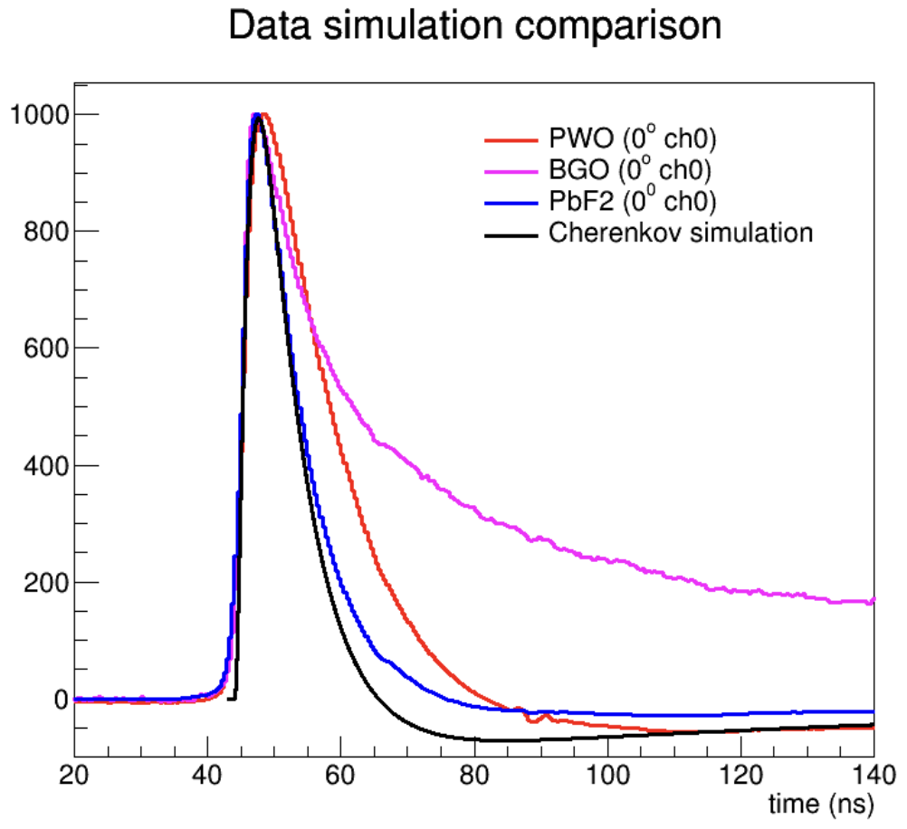
Pulse shapes of PbF2 and PWO/BGO (w/ filter)
The pulse shapes are taken from the average of events in the same run.
For PbF2 and PWO, no ADC cut is applied when taking the average; for BGO, a cut of amplitude>200 ADC is applied as the spectrums depend on the amplitude (see backup slides)
Simulation for 0 degree is provided by Sasha and takes into account the detector and electronics effects (SiPM recovery time, single photon amplifier response).
Rising time, limited by the impulse response from the SiPM, is similar among PbF2, PWO, and BGO: indicating the expected dominant contribution from Cerenkov photo detection (with sub-ns jitter).
The longer decay time for PWO than PbF2 suggests a non-negligible scintillation component (decay τ~6ns) remains.
Similarly, the long tail for BGO suggest non-negligible scintillation contributions even with the filter.

Slide 4
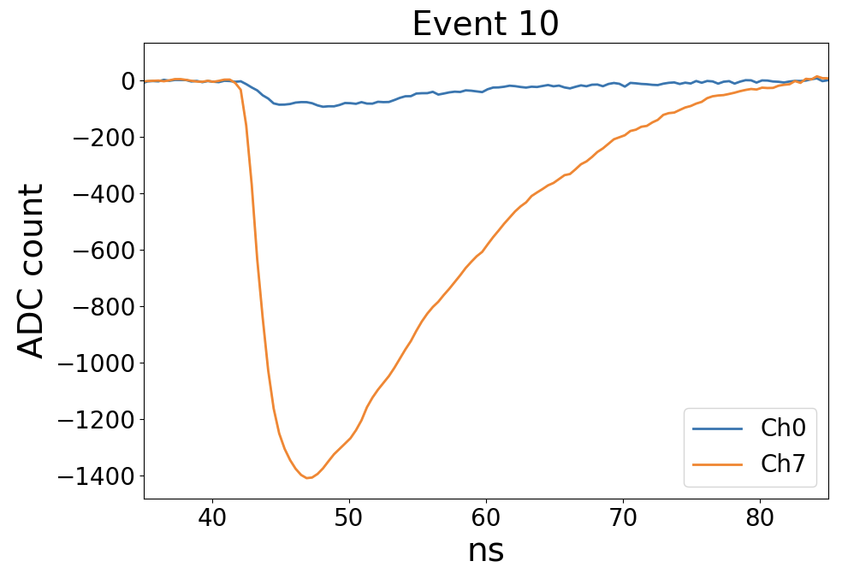
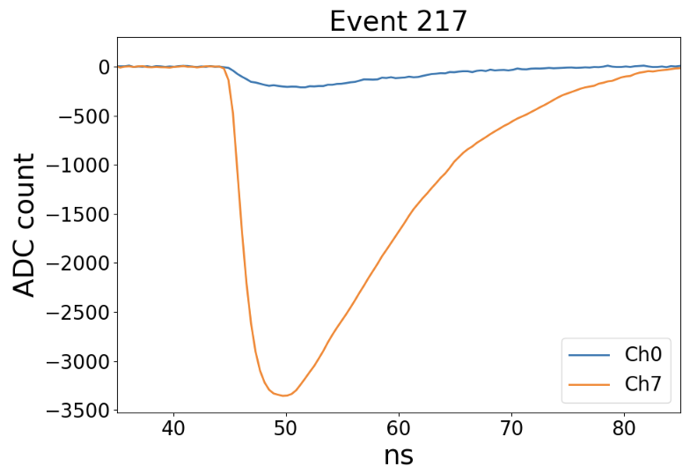
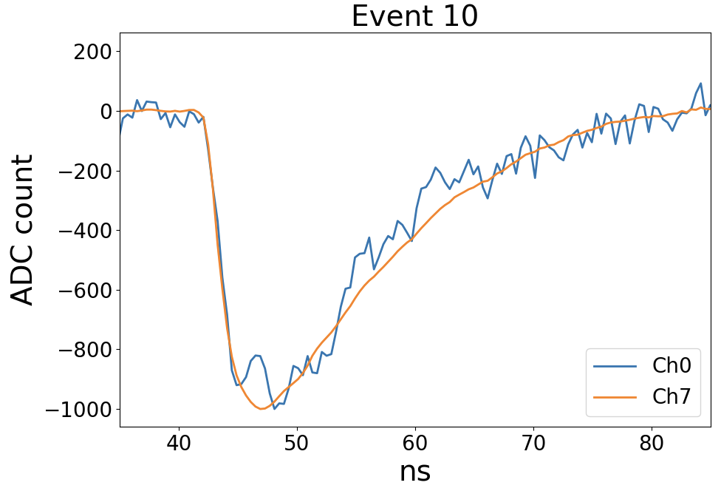
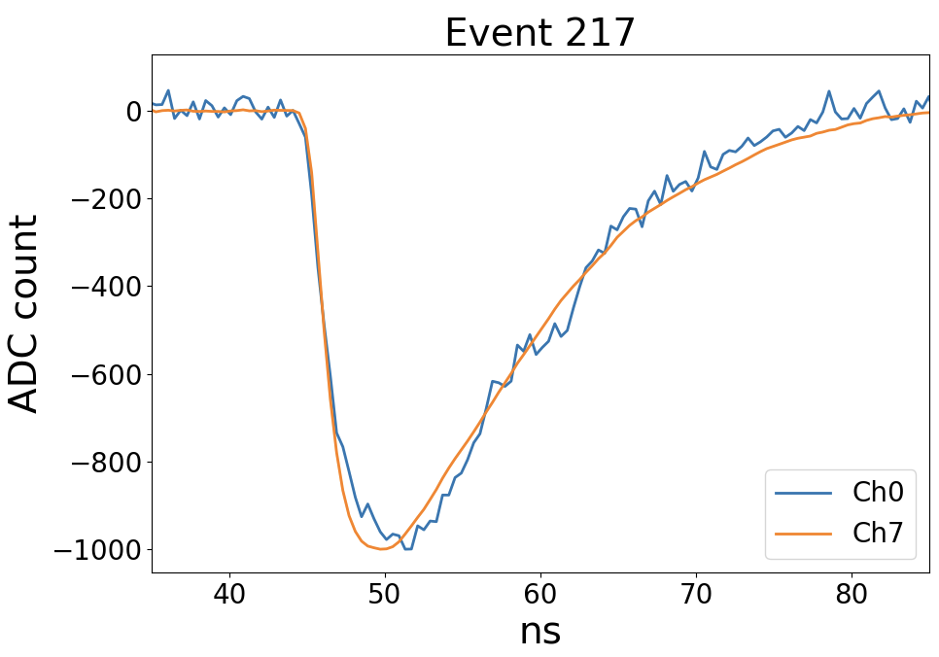
Pulse shapes from PWO (w/ vs. w/o filter)
Top: original pulses; bottom: normalize two sides w. or w/o filter to have the same pulse height.
The filters did reduce the amplitude of the signal. However, the shape is still similar between channels w/ and w/o filters. This suggests the scintillation component is still significant after filtering purported to cut out its contribution. Need future beam tests to examine whether we could extract the scintillation information from tails using different filters?
Calvision meeting | Dec 21 2023

Slide 5
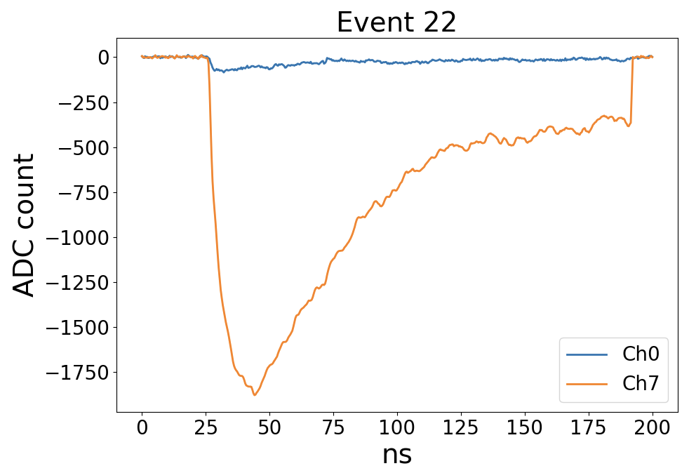
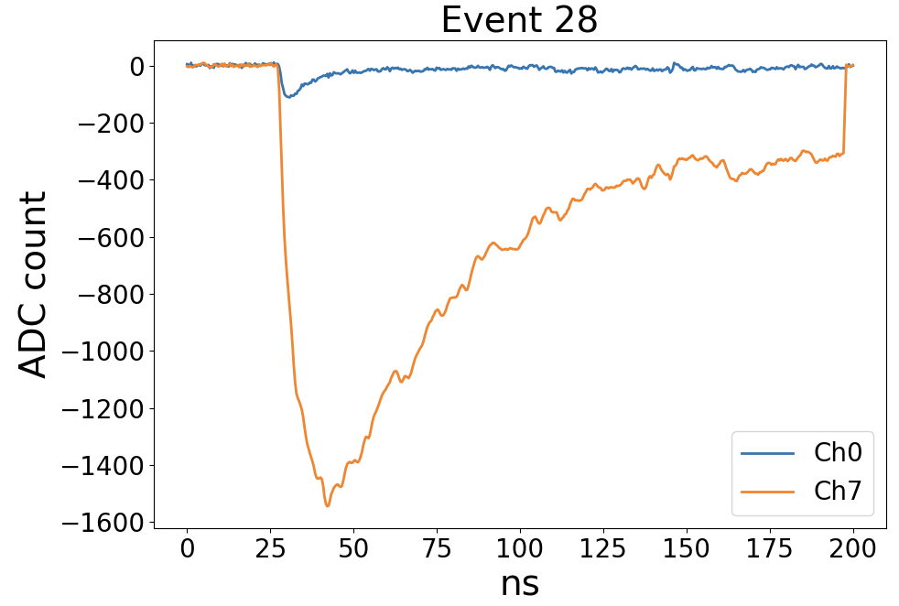
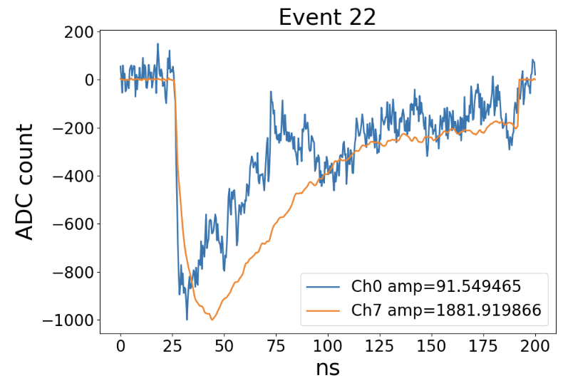
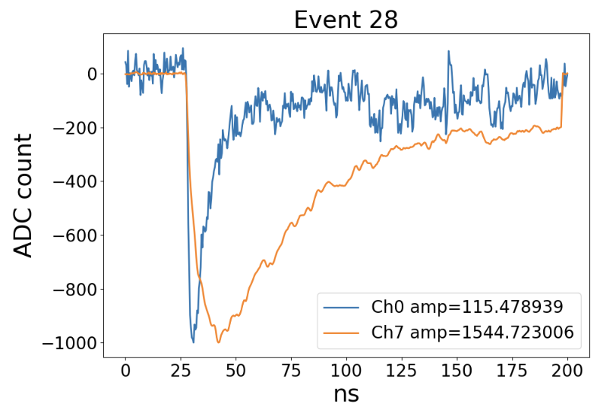
Pulse shapes from BGO (w/ vs. w/o filter)
Top: original size; bottom: normalize each spectrum to have the same height.
For BGO, the difference between channels w/ and w/o filters is larger. However, a portion of events the decay time is still much longer than the expected decay time for Cherenkov events.
Calvision meeting | Dec 21 2023

Slide 6
Conclusion
Time spectrums of PWO/BGO events with filters applied differ from PbF2 spectrums. Need to understand the impact from the scintillation contamination and electronics effects.
PWO spectrums are similar between channels with and without filters applied, which would be a challenge in the template fit.
For BGO, there’s significant difference between channels with and without filters applied, so it’s more possible to perform a template fit. Need to understand more about the BGO time spectrum, especially the fluctuating structures, before doing the fit.
To-do:
Check the relative contribution from Cherenkov and Scintillation for BGO events with different angles of incidence and amplitudes.
Calvision meeting | Dec 21 2023

Slide 7
Back up

Slide 8
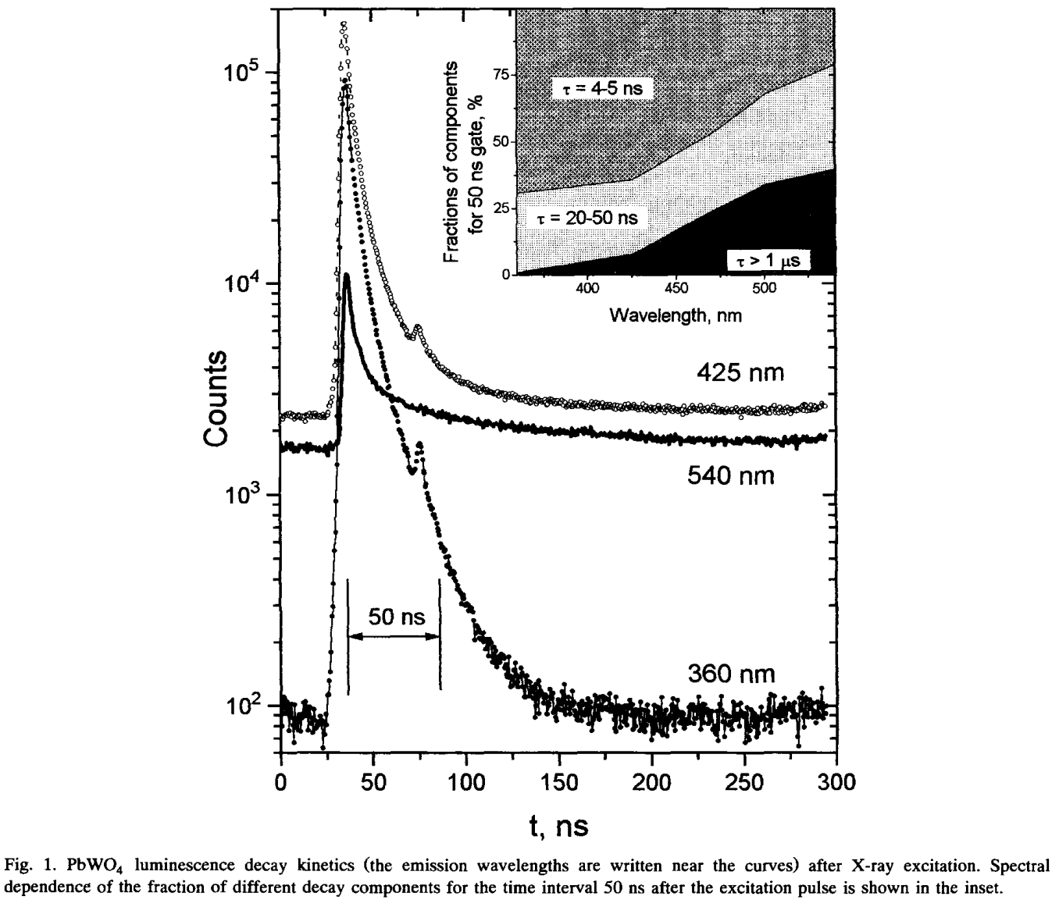
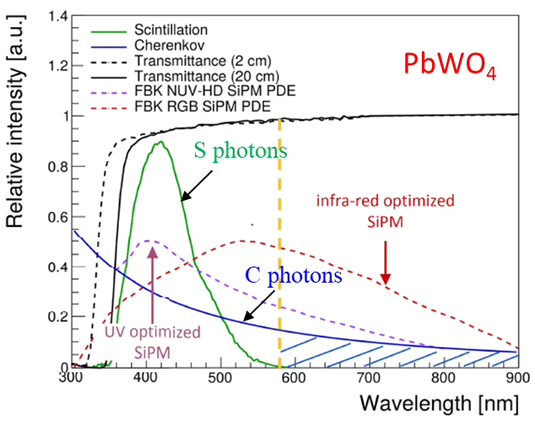
Understanding PWO Scintillation Component …
More prominent slow-component with high-bandpass filtering: ~75% with decay time > 20ns with a 580nm bandpass filter
Belsky, A. N., et al. "Fast luminescence of undoped PbWO4 crystal." Chemical physics letters 243.5-6 (1995): 552-558.
Calvision meeting | Dec 21 2023

Slide 9
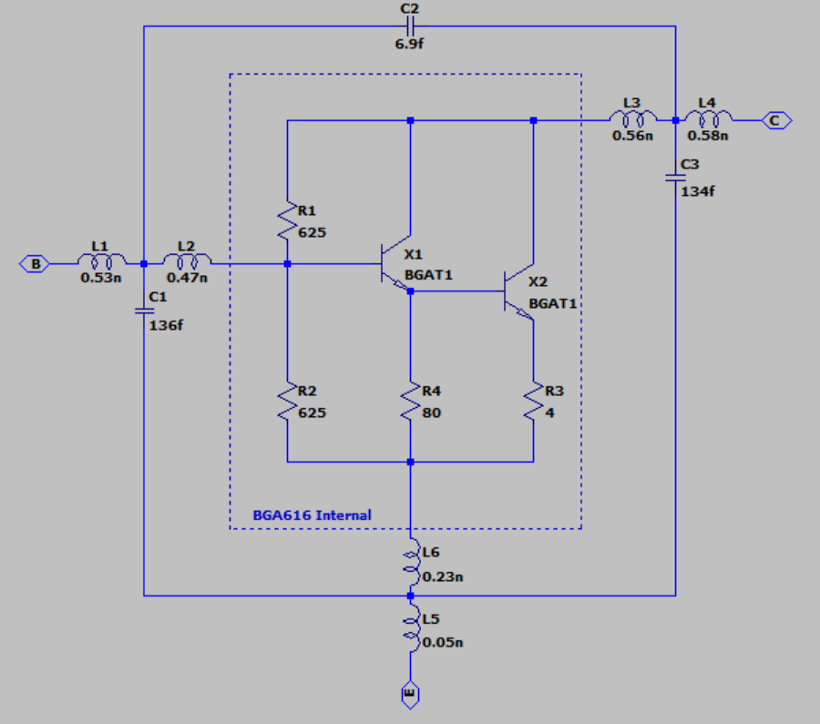
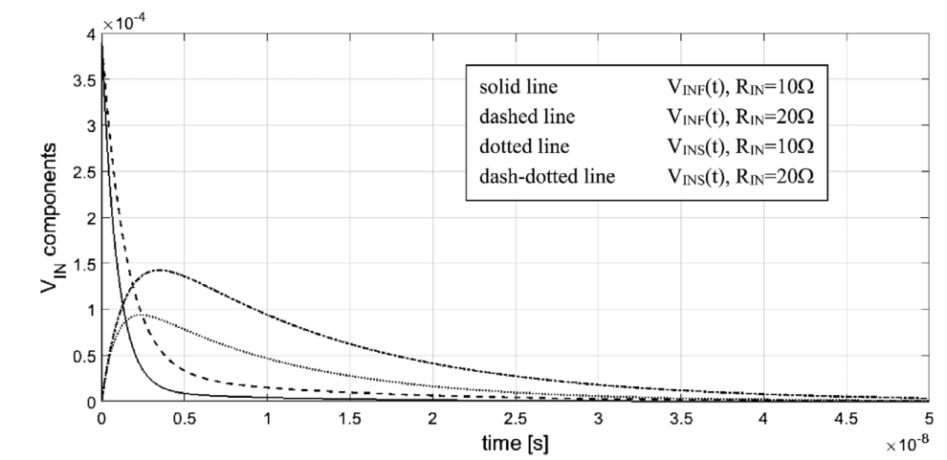
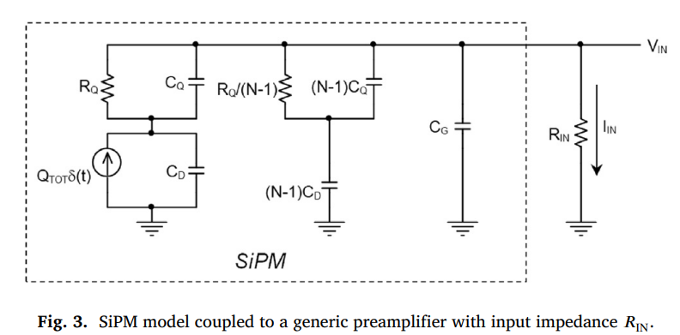
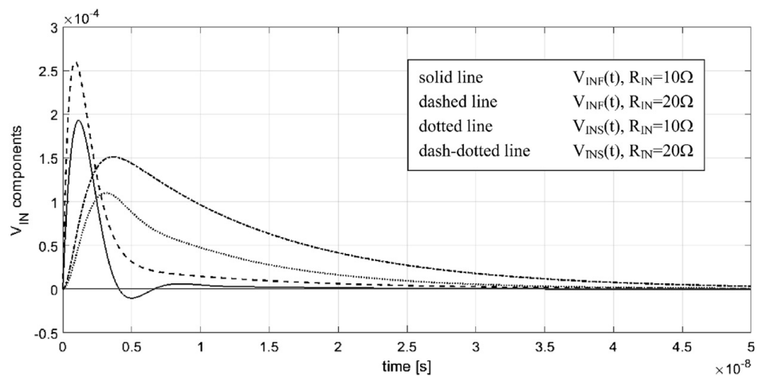
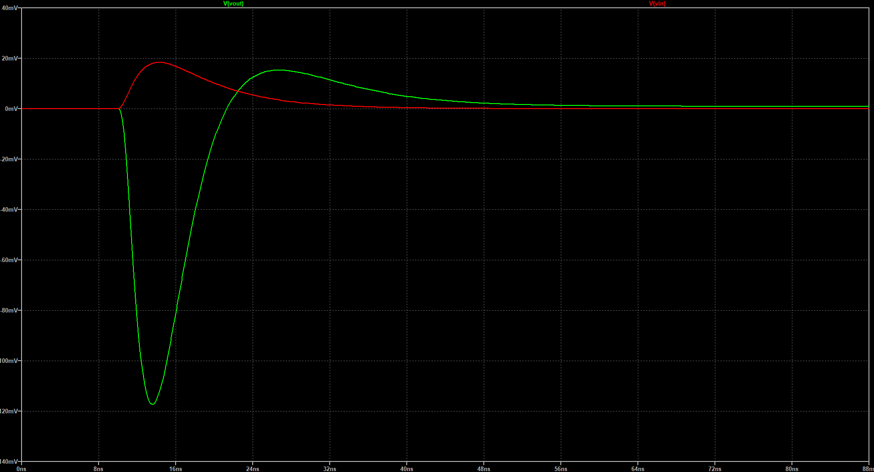
Understanding PWO Scintillation Component …
Better tail modeling/fit of the PWO pulses relies on a better understanding of the SiPM impulse response, Front-end single photon response and parasitics in the circuit.
The actual shape, especially the overshoot, undershoot will affected by the readout impedance, pole-zero compensation of the shaping circuit.
Simulation of fast and slow component response from SiPM coupled with an amplifier
BGA616 Amplifier
MPPC used for Fermilab Beam Test: Hamamatsu S14160-6050HS (50μm pixels). The decay/recovery time is expected be ~10 ns.
Undershoot should be more visible for short/prompt pulses: Generally consistent with PWO and BGO observations. But why not seen in PbF2 data?
Injected pulse (τ_{rise}=0.5ns, τ_{decay} =6ns)
Simulated amplifier response
8ns
BGA616 output (AC coupled)
Calò, Pietro P., et al. "SiPM readout electronics." NIM A926 (2019): 57-68.
Calvision meeting | Dec 21 2023

Slide 10
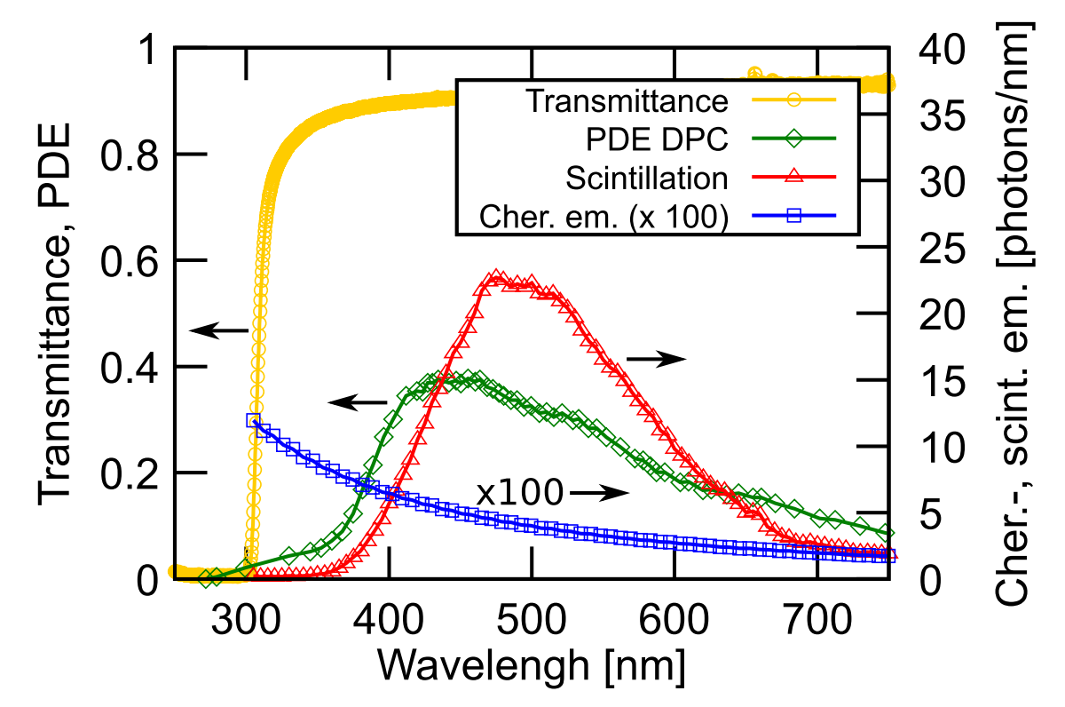
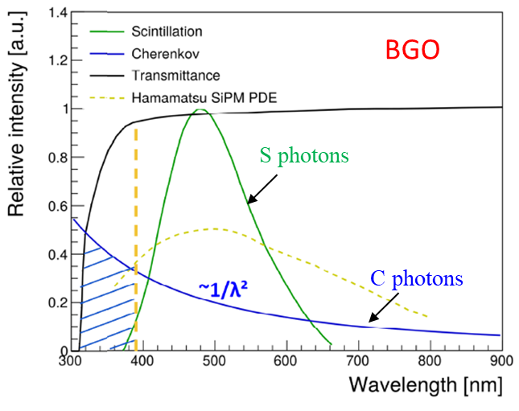
Understanding BGO Scintillation Component …
Discrepancies found between the published BGO photon emission spectra and those measured for Michigan BGO samples.
Still need to understand the fraction of scintillation photons compared with the total photons detected by the SiPM (taking into consideration of leakage at short wavelength using the U330 filter with a transmission cut-off @ 400-650nm)
Concerning the total number of photons from the BGO, how well could we trust the GEANT4 simulated number? (Given the difficulties to detect those photons at short wavelength in reality due to transmittance issues.)
S E Brunner and D R Schaart 2017 Phys. Med. Biol. 62 4421
Measurements of Michigan three BGO samples from CALTECH
Summary plot of BGO photon emission spectra and transmittance
Calvision meeting | Dec 21 2023

Slide 11
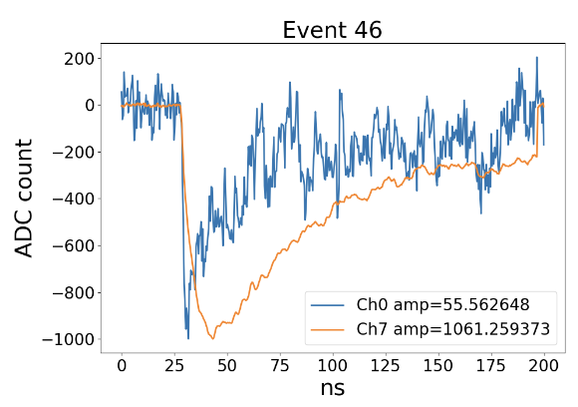
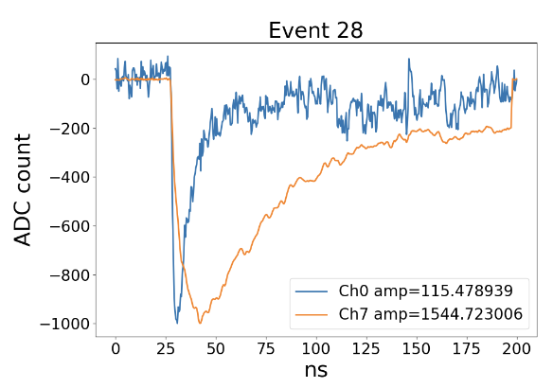
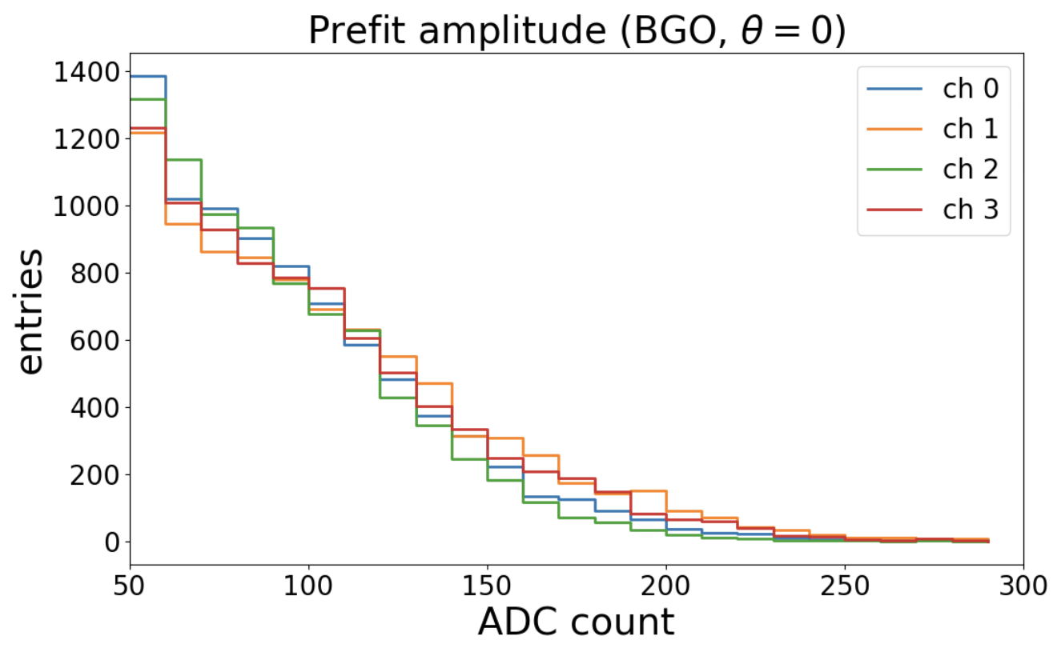
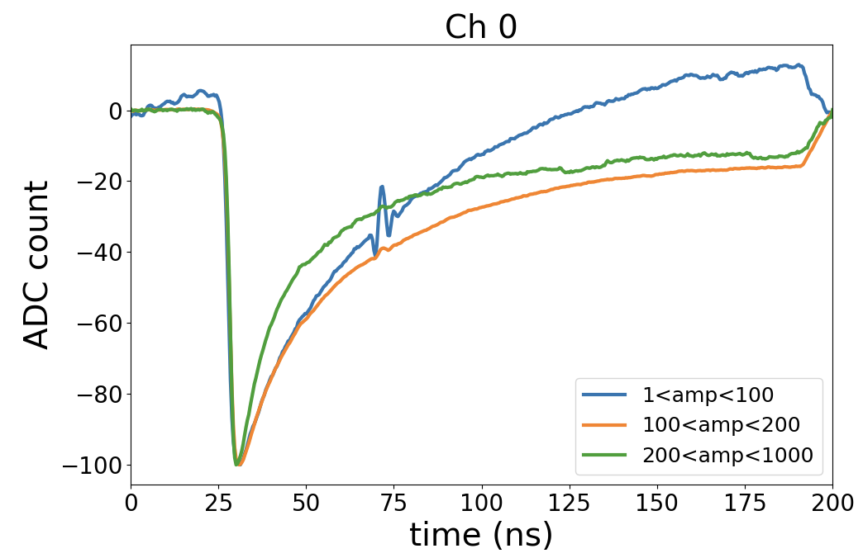
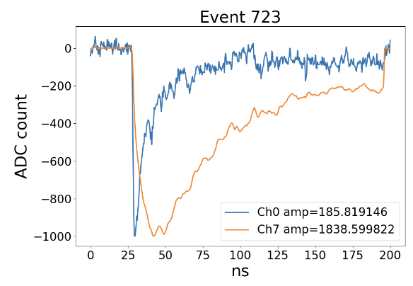
Amplitude dependence on BGO time spectrums
[backup]
BGO decay time is longer for events with smaller amplitude.
The ADC count can’t return to 0 after the pulse for events with larger amplitude.
Calvision meeting | Dec 21 2023

Slide 12
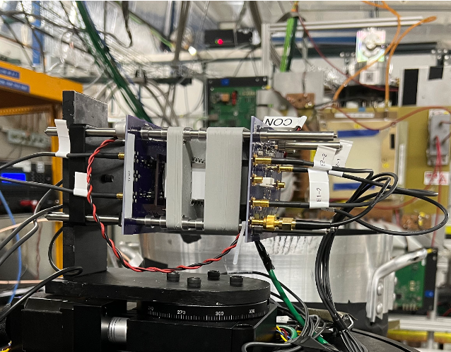
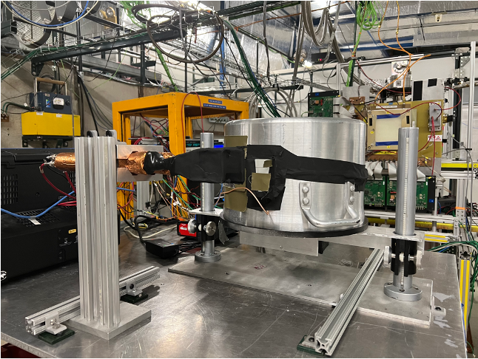
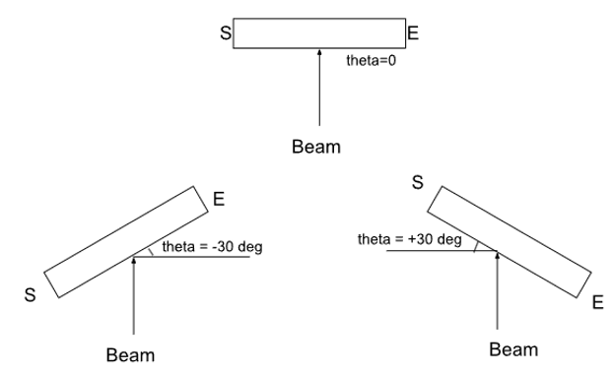
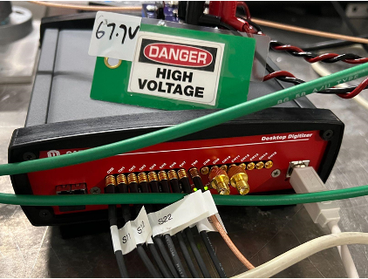
June 2023 Test Beam @Fermilab Setup
120 GeV protons, ~45k protons evenly distributed in 4 s
Only one spill per minute, 8 mm horizontally and 4 mm vertically
Only at most one proton expected in our readout window
Four 6mmx6mm SiPMs on each side
0-3 on the S side
4-7 on the E side
Calvision meeting | Dec 21 2023

Slide 13
June 2023 Test Beam @Fermilab Datasets
Crystal | Size | Filter (S side only) | Run # | Angle (°) | # of events | Satuarated-event rate (%)
PbF2 | 6x2.5x2.5 cm³ | No filter | 11-29 | 0 to ±90 (10° interval) | ~40k-70k | |θ|<30°: 2% 30°<|θ|<60°: 10% 60°<|θ|: 30%
PWO |  | R60 | 31-66 | 0 to ±90 (5° interval, except ±85°) | ~30k-70k | |θ|<30°: 2% 30°<|θ|<60°: 15% 60°<θ: 20% θ<-60°: 35%
 |  | No filter | 103-121 | 0 to -50 (5° interval), 0 to +25 (5° interval), ±90 | ~20k-40k | |θ|<30°: 5% 30°<|θ|<60°: 15% 60°<|θ|: 45%
BGO |  | U330 | 68-101 | 0 to -45 (5° interval), 0 to +50 (5° interval), -55, -65, -75, ±90 | ~50k-60k | |θ|<30°: 7% 30°<|θ|<60°: 20% 60°<|θ|: 40%
Calvision meeting | Dec 21 2023

Slide 14
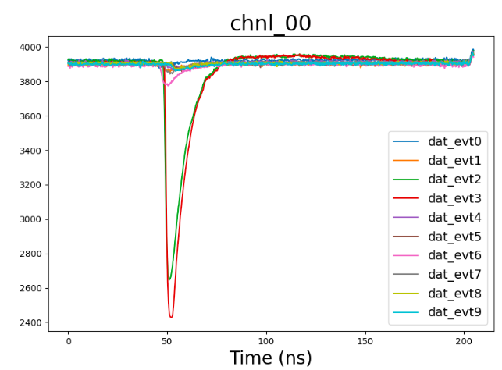
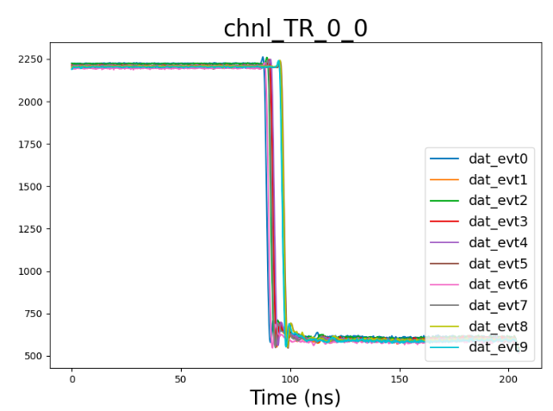
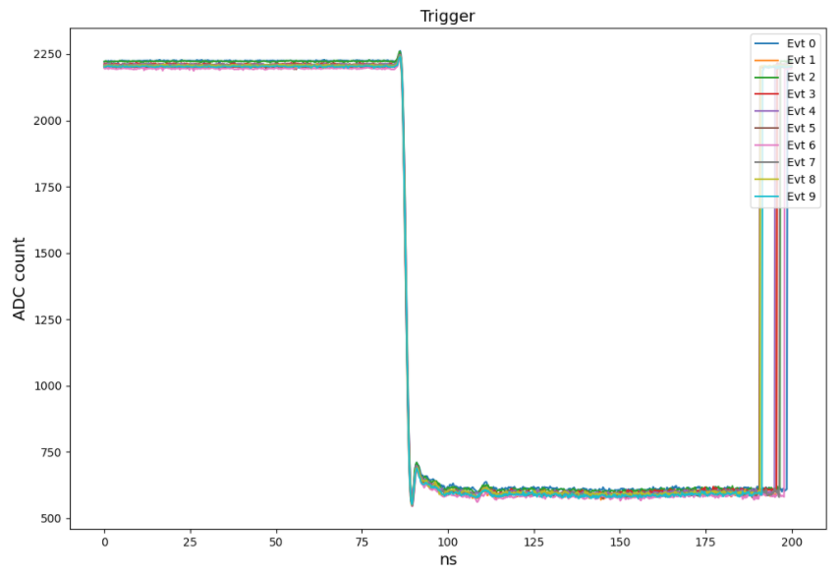
Data pre-processing
Events with at least one channel readout value saturated are thrown away
Pedestal correction: Average over the ADC counts in the time range (0, $t_{peak}−20$) ns as the base count. Subtract all points in the event by the base count.
Time correction.
Before time shifting
After time shifting
15 ns
ADC count
Calvision meeting | Dec 21 2023

Slide 15
Average Time Spectrum (θ=0°)
The spectrums shown are the average over all events (without the saturated ones) in the same run.
PbF2: no filter for all channels; PWO and BGO: w/ fiter for ch 0-3, w/o filter for ch 4-7
Calvision meeting | Dec 21 2023

