Slide 1
CalVision April Test Beam Analysis
Christopher Martin
UVA

Slide 2
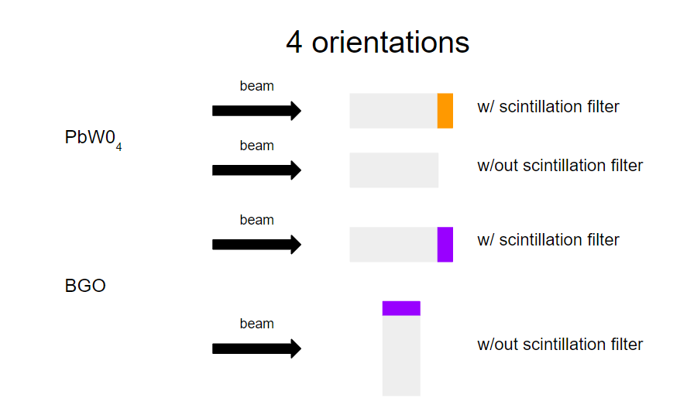
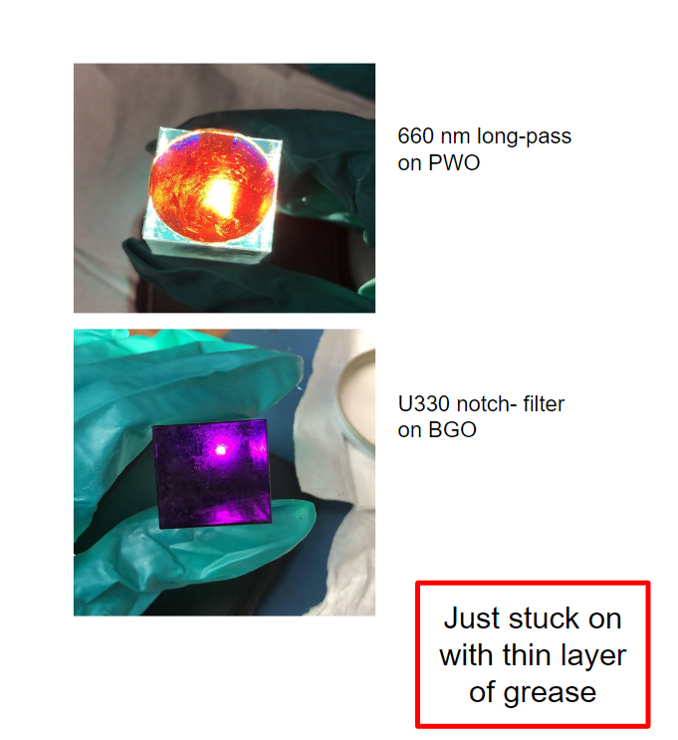
April Test Beam
Single Crystal test beam (PWO and BGO)
7 SiPMs, 1 MCP
120 GeV Protons
Front-End: (Upstream) Channels 4,5,6
Back-End: (Downstream) Channels 0-3 + MCP
Credit: Grace Cummings
*Filter Only Applied to the “Back-End” of the Crystal (Channels 0,1,2, & 3) While “Front-End” (Channels 4,5, & 6) experience no direct filtration
Credit: Grace Cummings

Slide 3
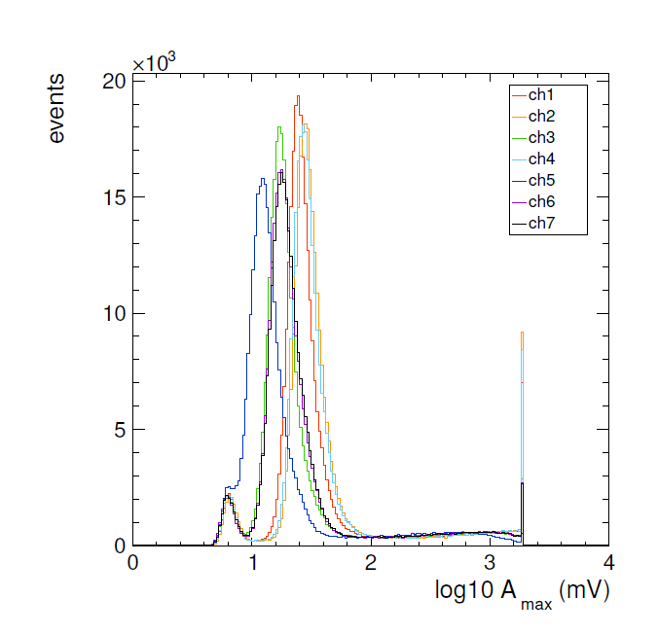
A study on MIPs
PWO (Parallel) Unfiltered
Credit: Alexander Ledovskoy
Focusing on events with amplitude < 80 mV
A timing analysis accompanied by an unexpected data structure
Found this data structure is correlated to the use of filters in data collection
The exact nature of the connection is yet to be fully understood
*A’_{max} proportional to Integrated waveform

Slide 4
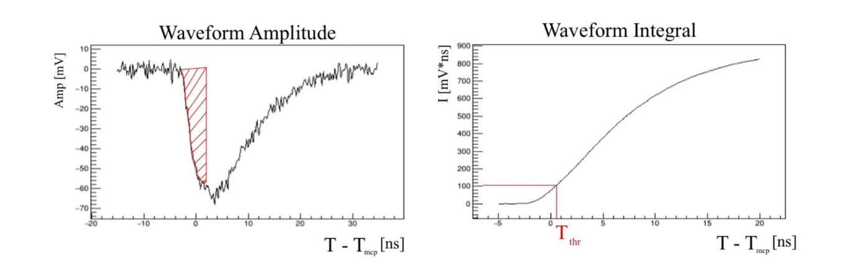
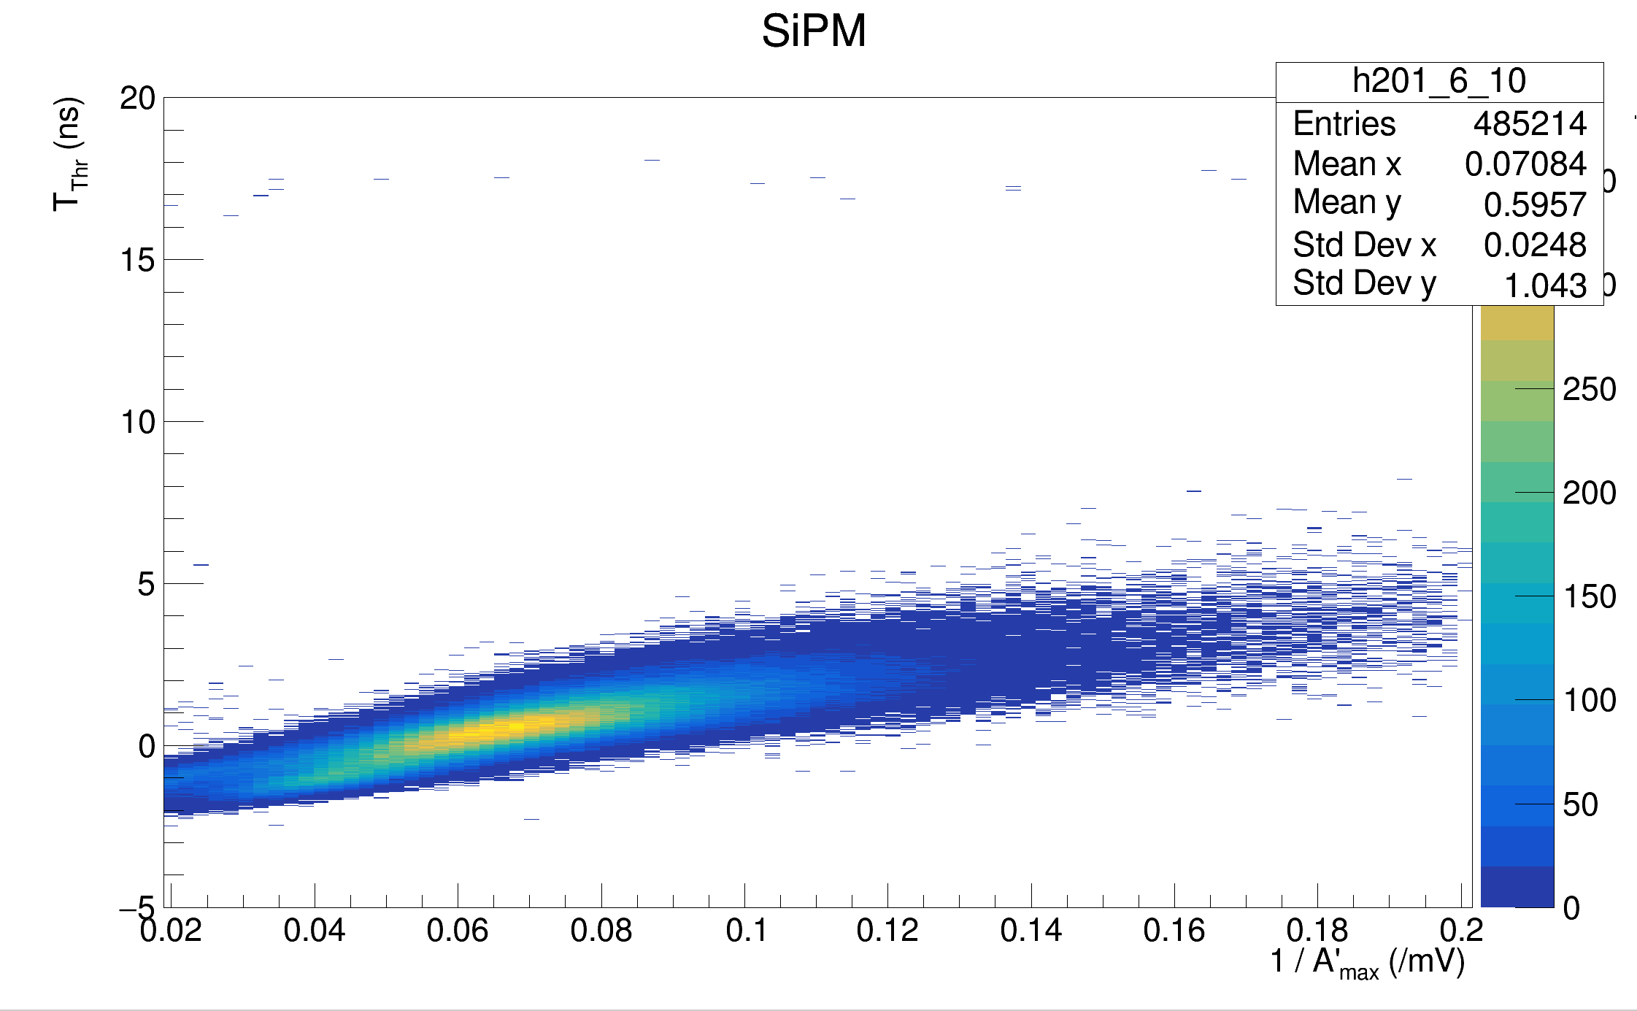
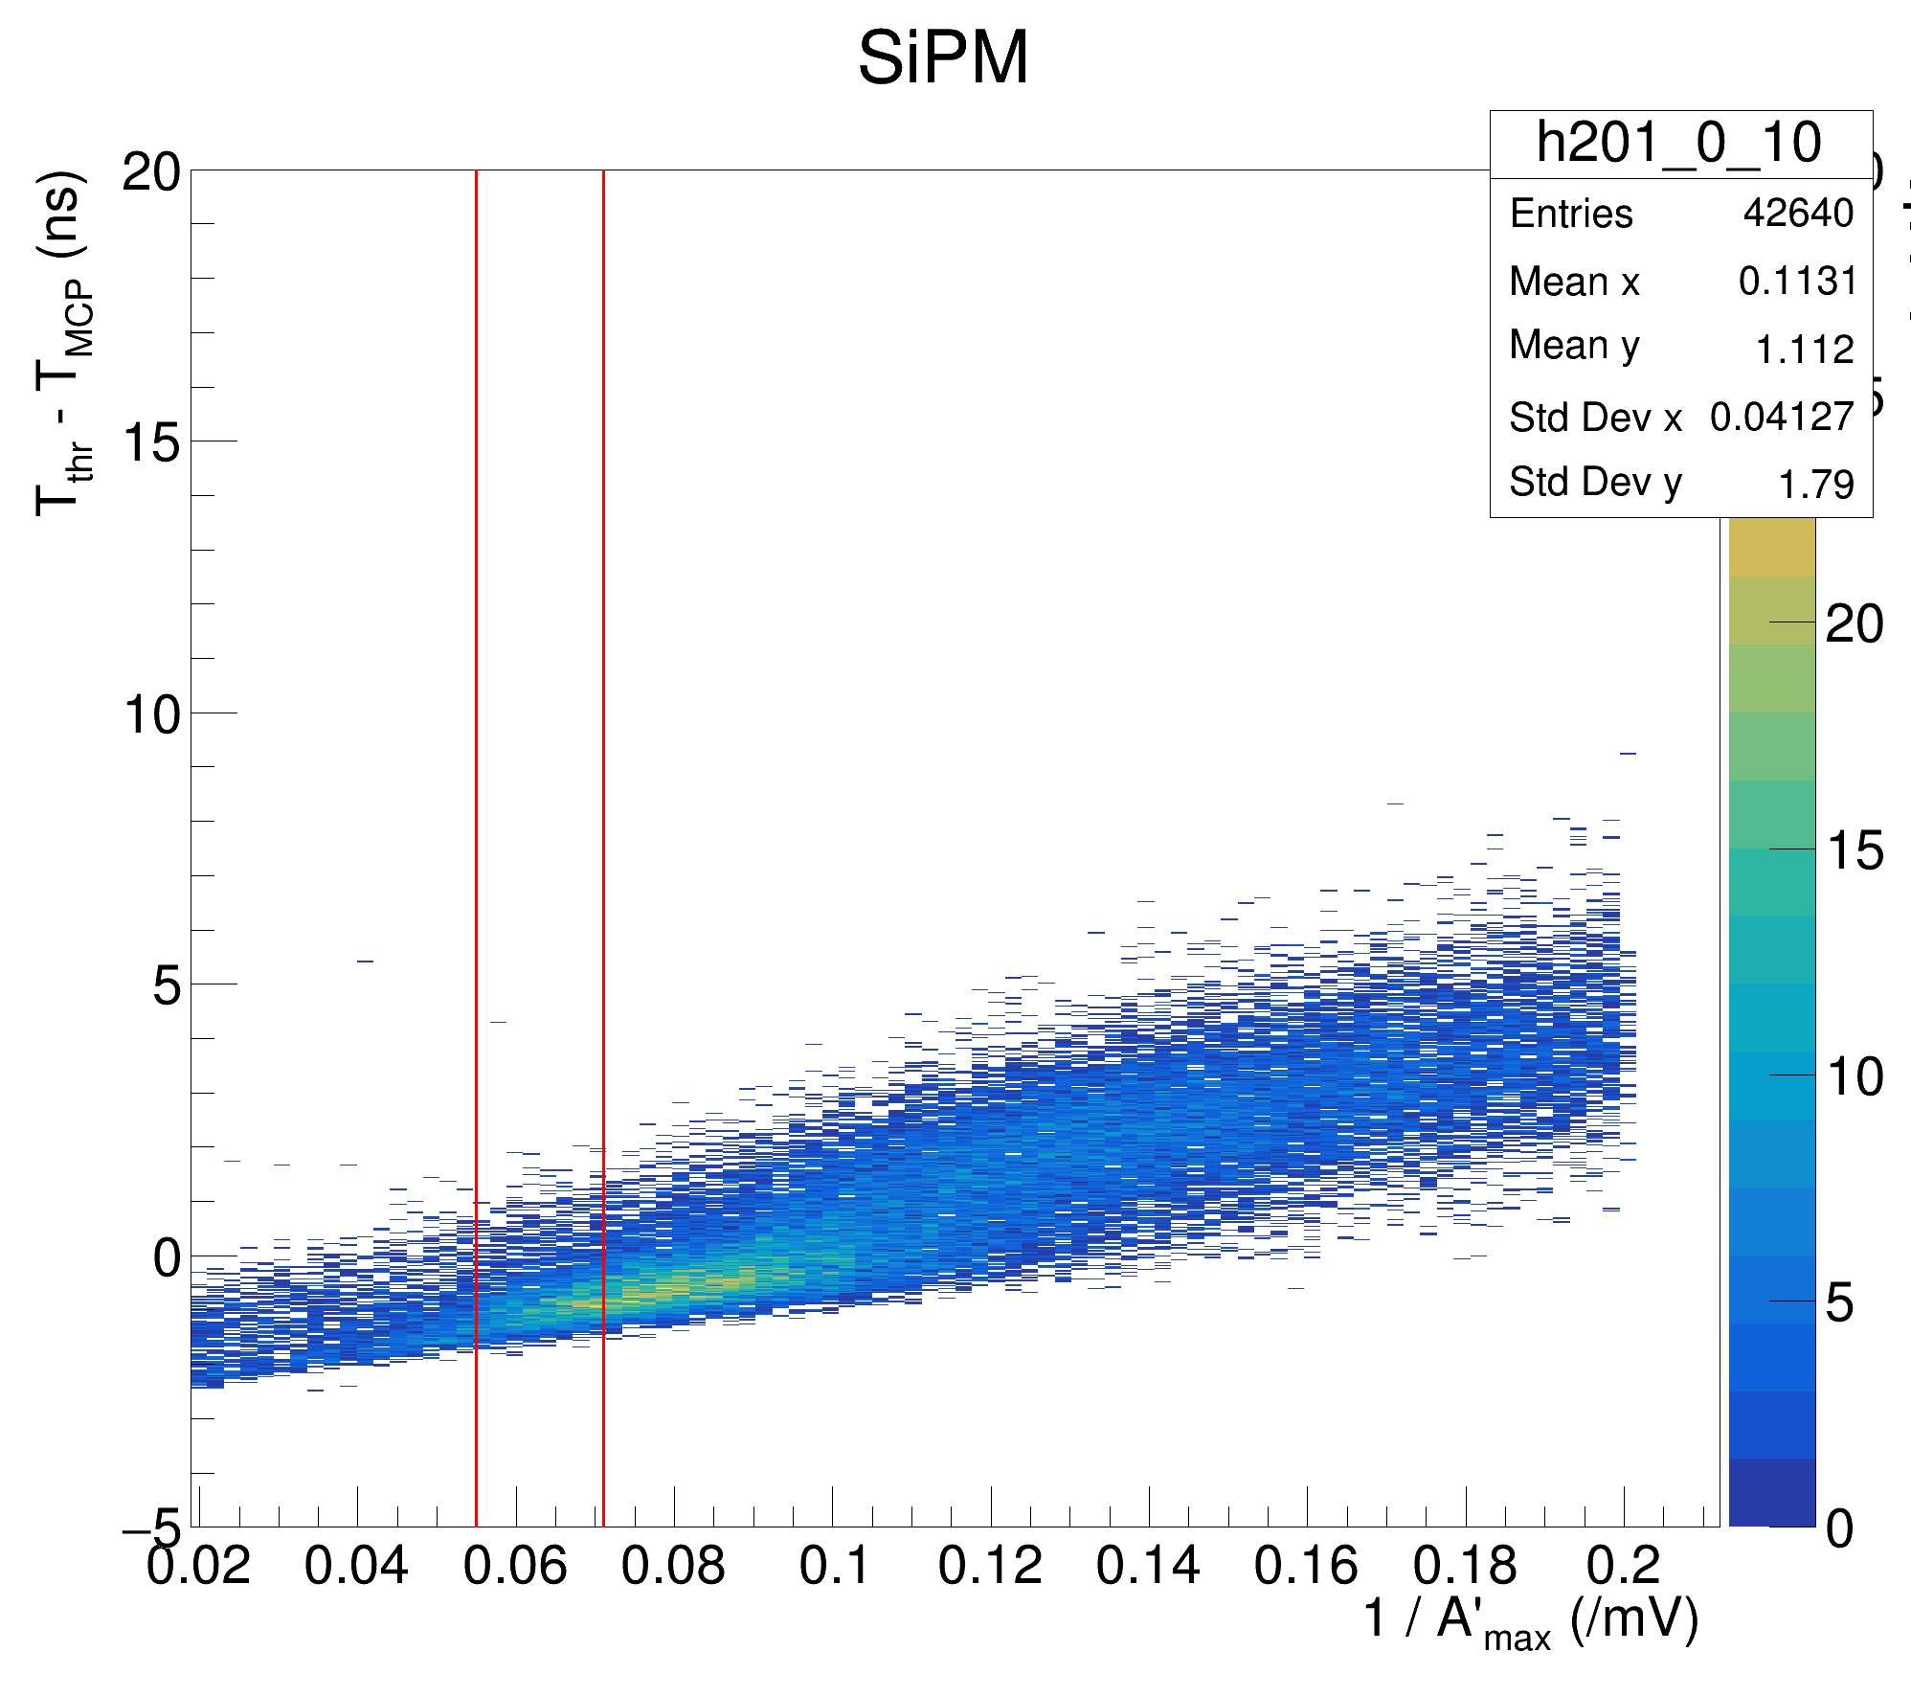
Credit: Max Dubnowski
Timing Analysis Method:
T_{MCP} is found as the time of the MCP signal peak for a particular event
The waveform is integrated
The time at which the integrated waveform achieves the given threshold voltage is found (T_{Thr})
Crafting a 2D distribution of T_{Thr} – T_{MCP} Vs. 1/A’_{max} of events, one can find the width of the distribution within narrow bins of amplitude
The threshold values evaluated are generated by an exponential function, the values used never may exceed 95% the maximum of a given integrated waveform’s maximum
PWO (par) Filtered, Channel 6: (Threshold Voltage 25.12 mV)
*Threshold Values used:
*A’_{max} proportional to Integrated waveform

Slide 5
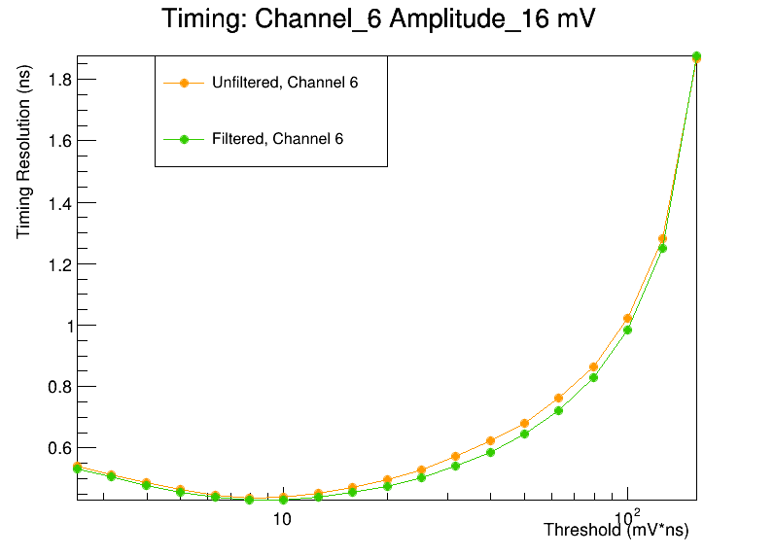
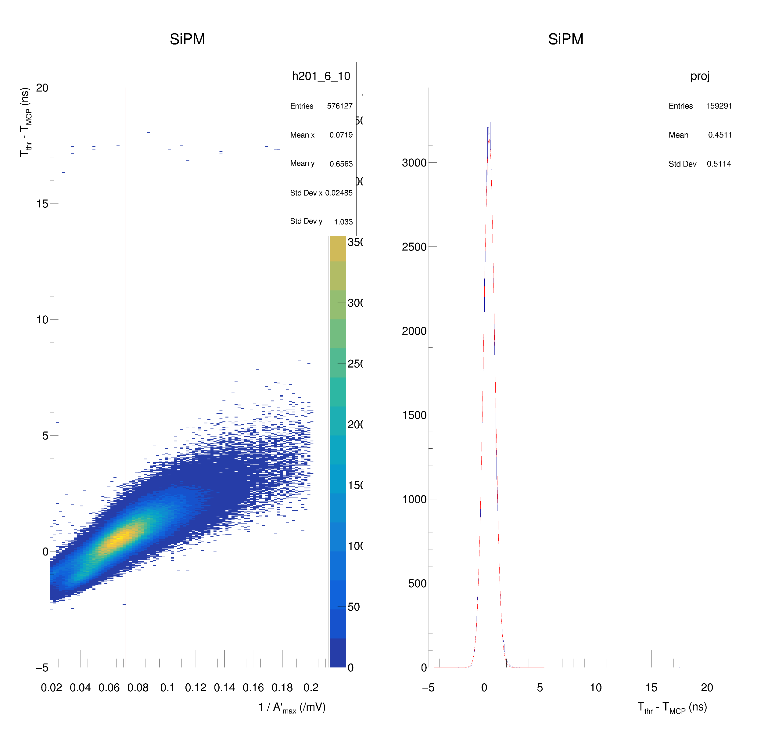
The Distribution is projected about the Y-axis within a “Nominal Amplitude” range (+/- 2 mV)
Then a gaussian fit is done at the peak of the 1D projection
The width of this peak represents the timing resolution for this particular channel, at the specified threshold voltage about the Nominal amplitude
PWO (par) Filtered, Channel 6, Nominal Amplitude: 16 mV (+/- 2 mV), Threshold Voltage: 25.12 mV*ns

Slide 6
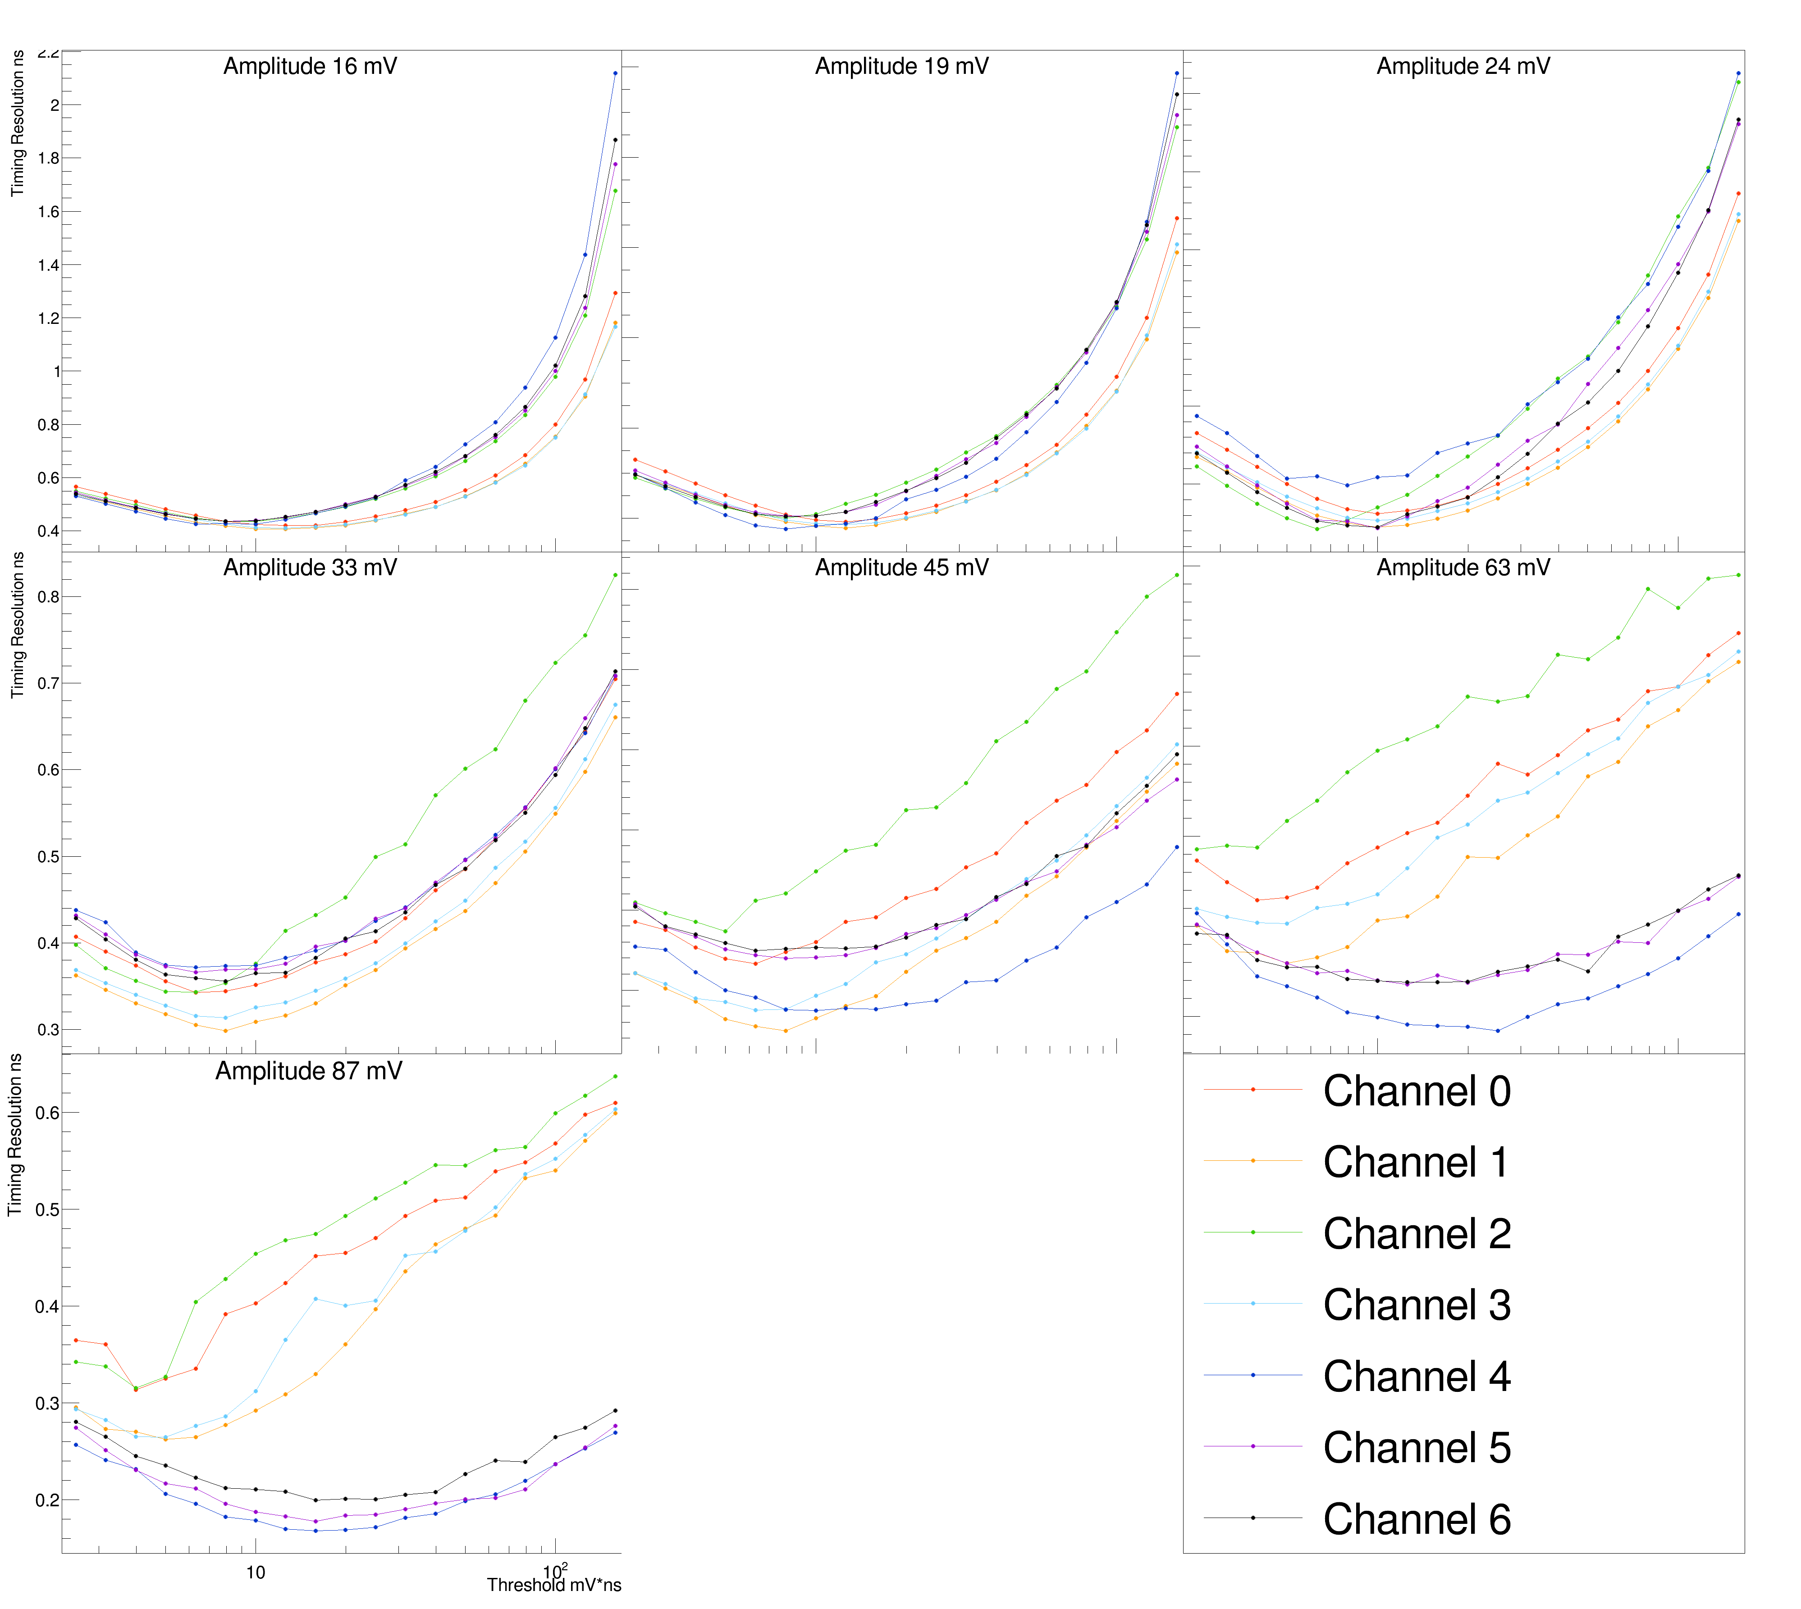
Timing Analysis:
PWO (Parallel Orientation) Unfiltered
Groupings of Front-end / Back-end Channels
Resolution improves as Nominal Amplitudes increase
Back-end Channels seem to have better resolution up until 45-63 mV

Slide 7
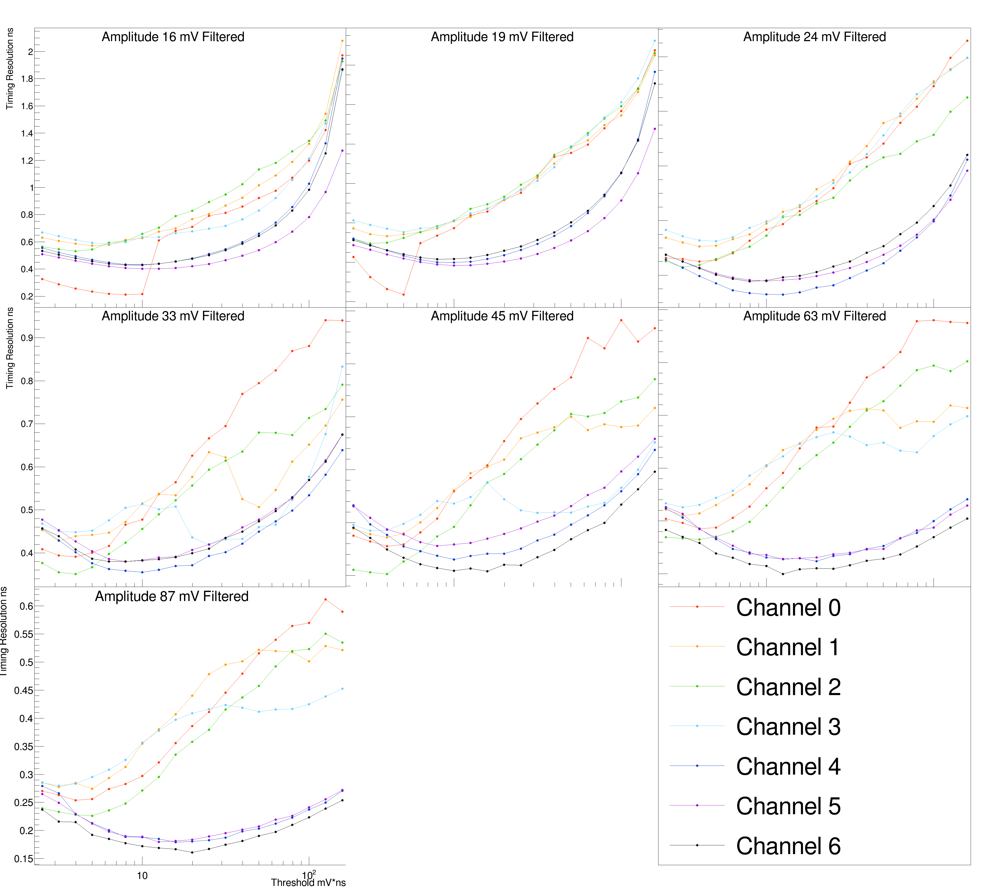
Timing Analysis:
PWO (Parallel Orientation) Filtered
Similar groupings of Front-end / Back-end Channels
Resolution improves on Front-end Channels at higher Nominal Amplitudes
Overall, resolution is better on Front-end Channels

Slide 8
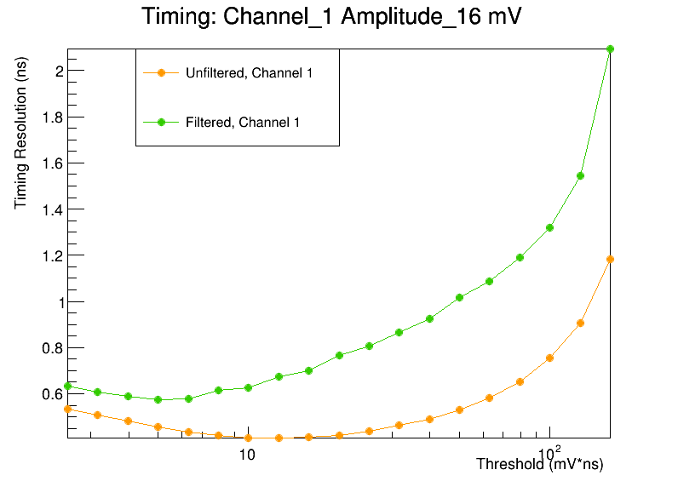
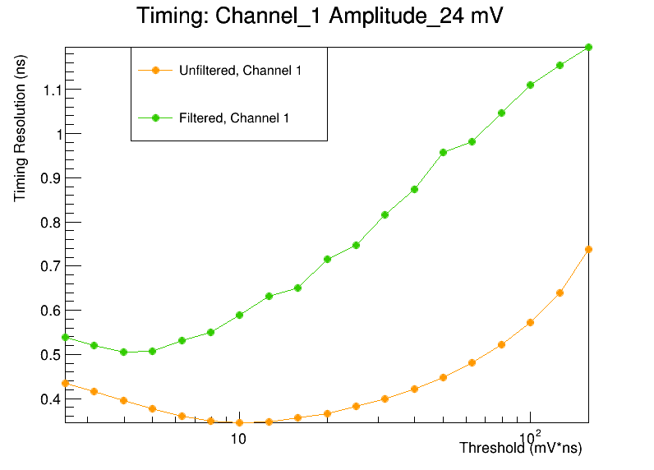
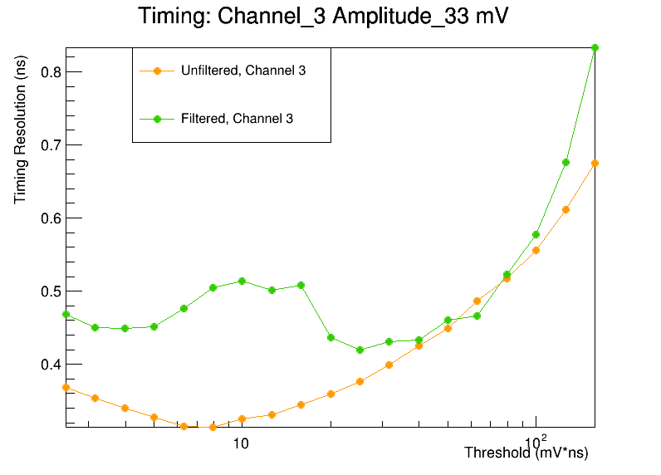
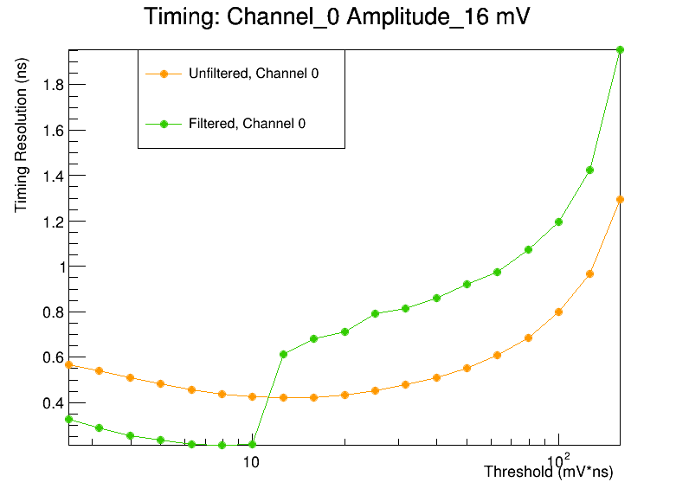
A Closer look at Trends:
*PWO (parallel Orientation)
Backend Channels (0-3) include large discrepancies
Filtered data seems to have a worse resolution for the most part.

Slide 9
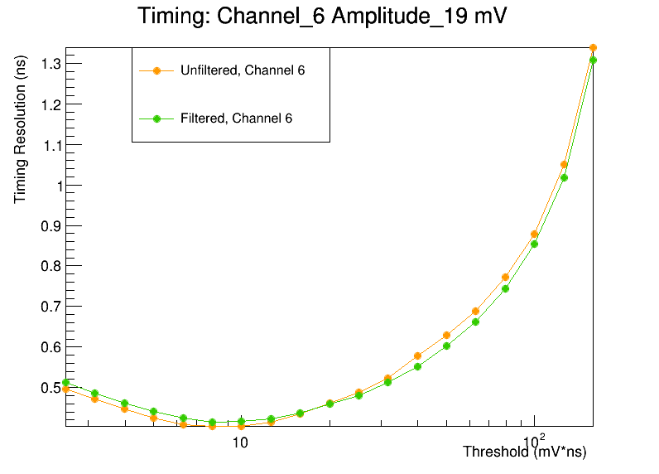
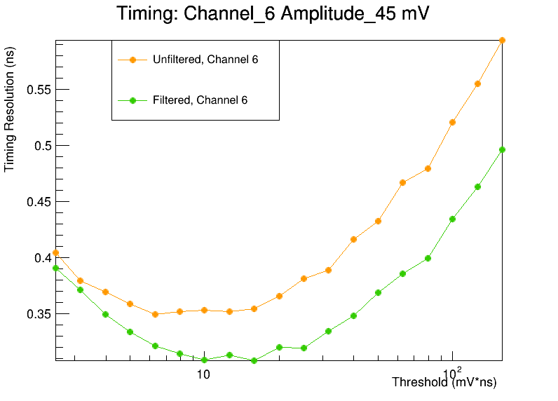
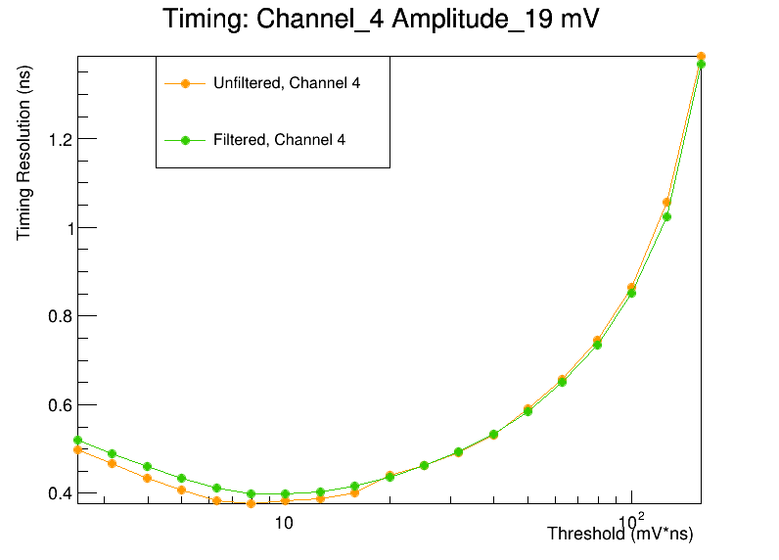
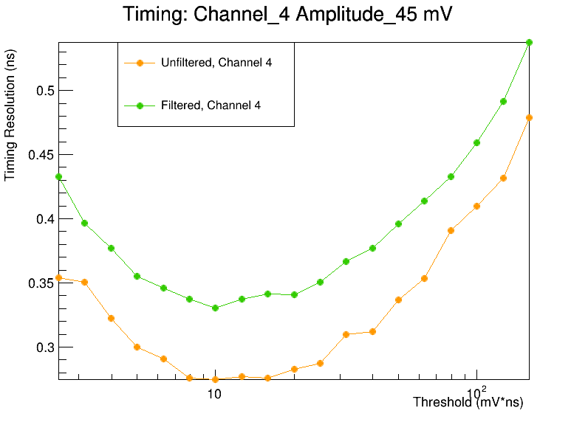
A Closer look at Trends:
*PWO (parallel Orientation)
Similarity Between Filtered/Unfiltered data sets at low Nominal Amplitudes for front-end Channels (4-6)
At higher Nominal amplitudes the trends are similar but diverge
Still Sensitive to the Filter on Front End Channels
*Filter Only Applied to the “Back-End” of the Crystal (Channels 0,1,2, & 3) While “Front-End” (Channels 4,5, & 6) experience no direct filtration
* Channel 5_45 mV: The Unfiltered data has better resolution

Slide 10
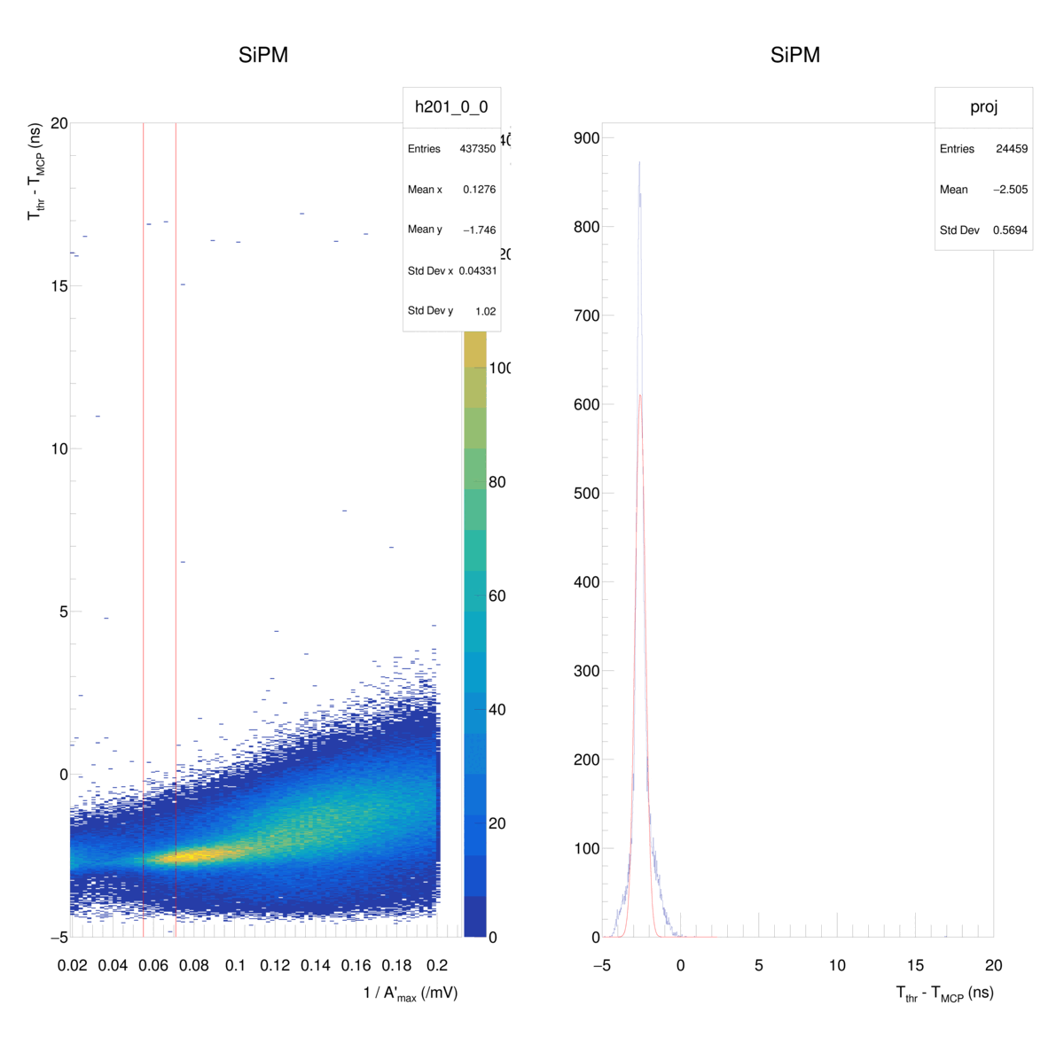
A Closer Look at Channel 0 from the
PWO (parallel) Filtered Data

Slide 11
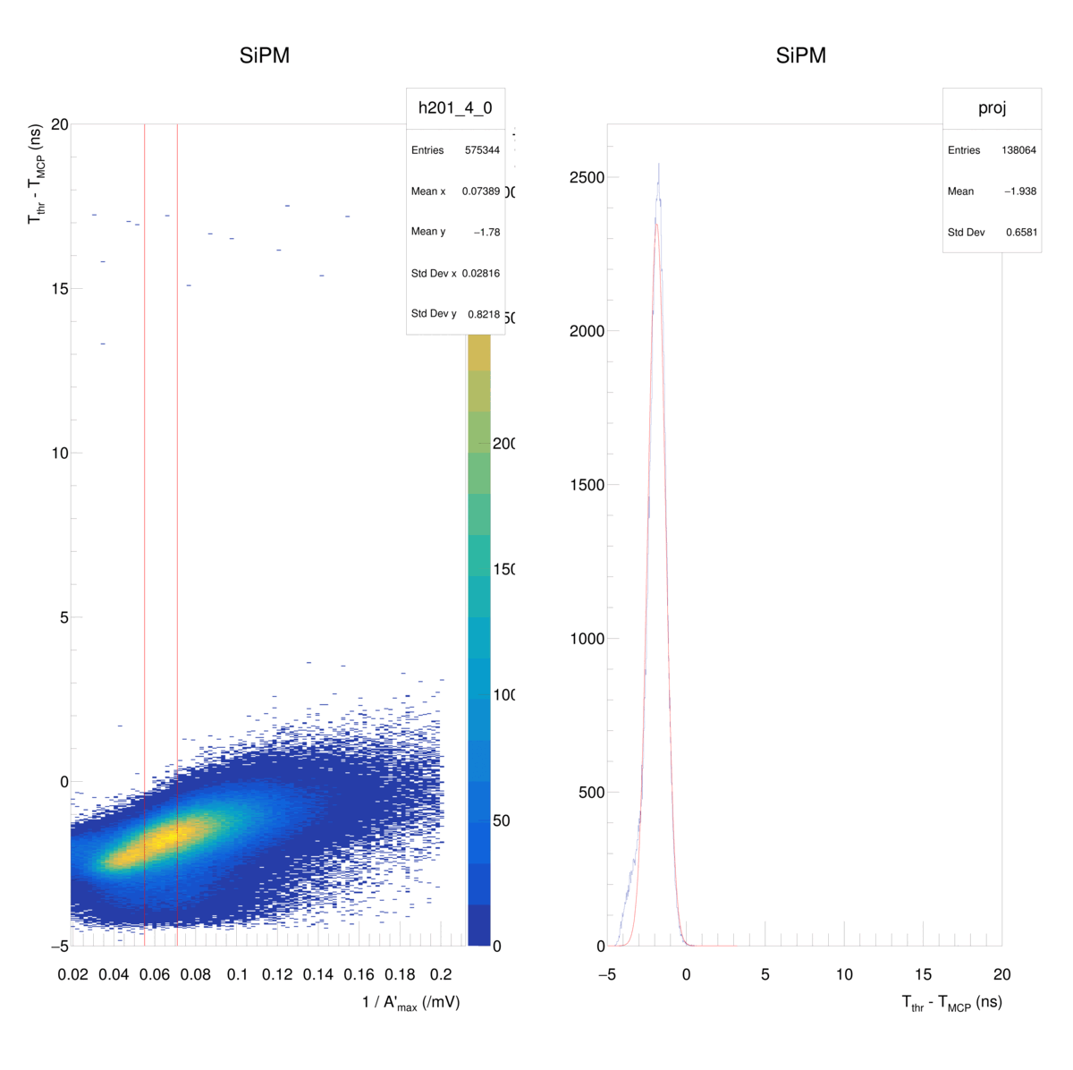
PWO (parallel) Filtered Data Set, Channel 4
*Filter Only Applied to the “Back-End” of the Crystal (Channels 0,1,2, & 3) While “Front-End” (Channels 4,5, & 6) experience no direct filtration

Slide 12
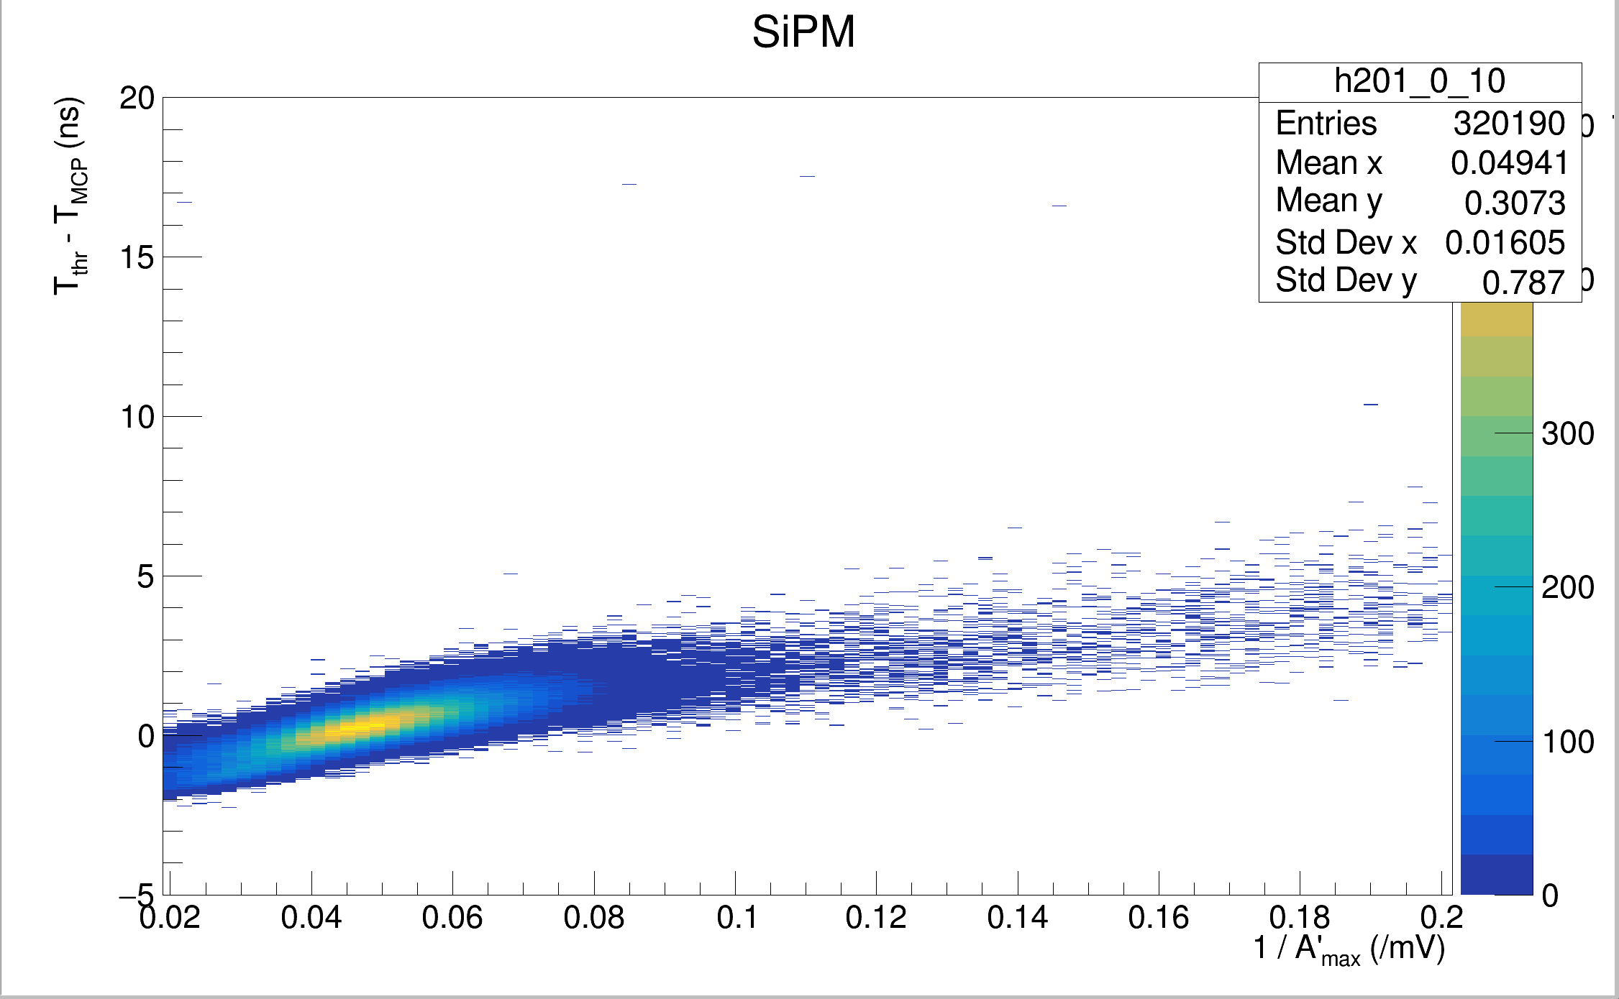
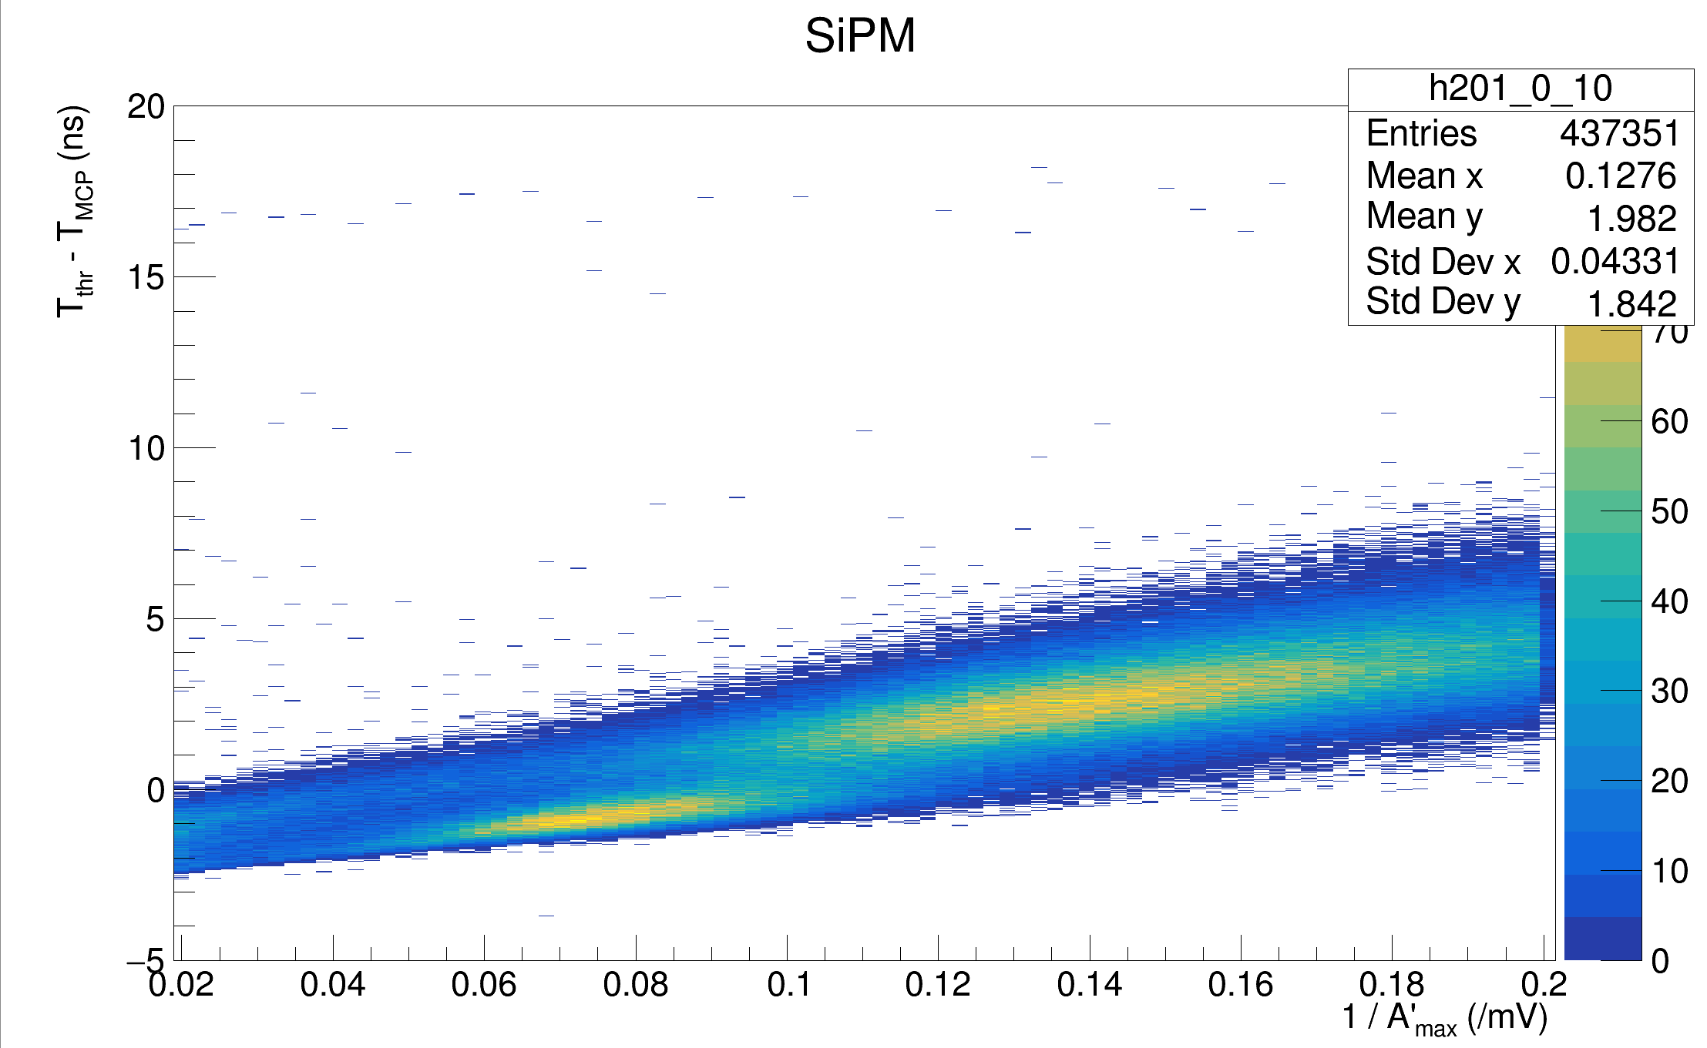
<- PWO (Parallel) Unfiltered, Channel 0
PWO (Parallel) Filtered, Channel 0 ->

Slide 13
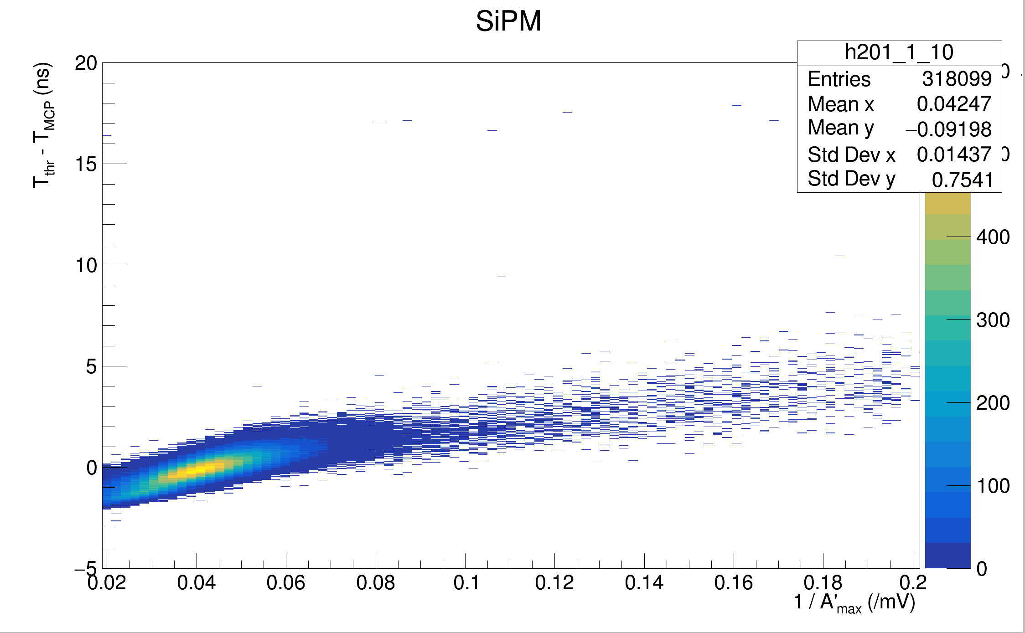
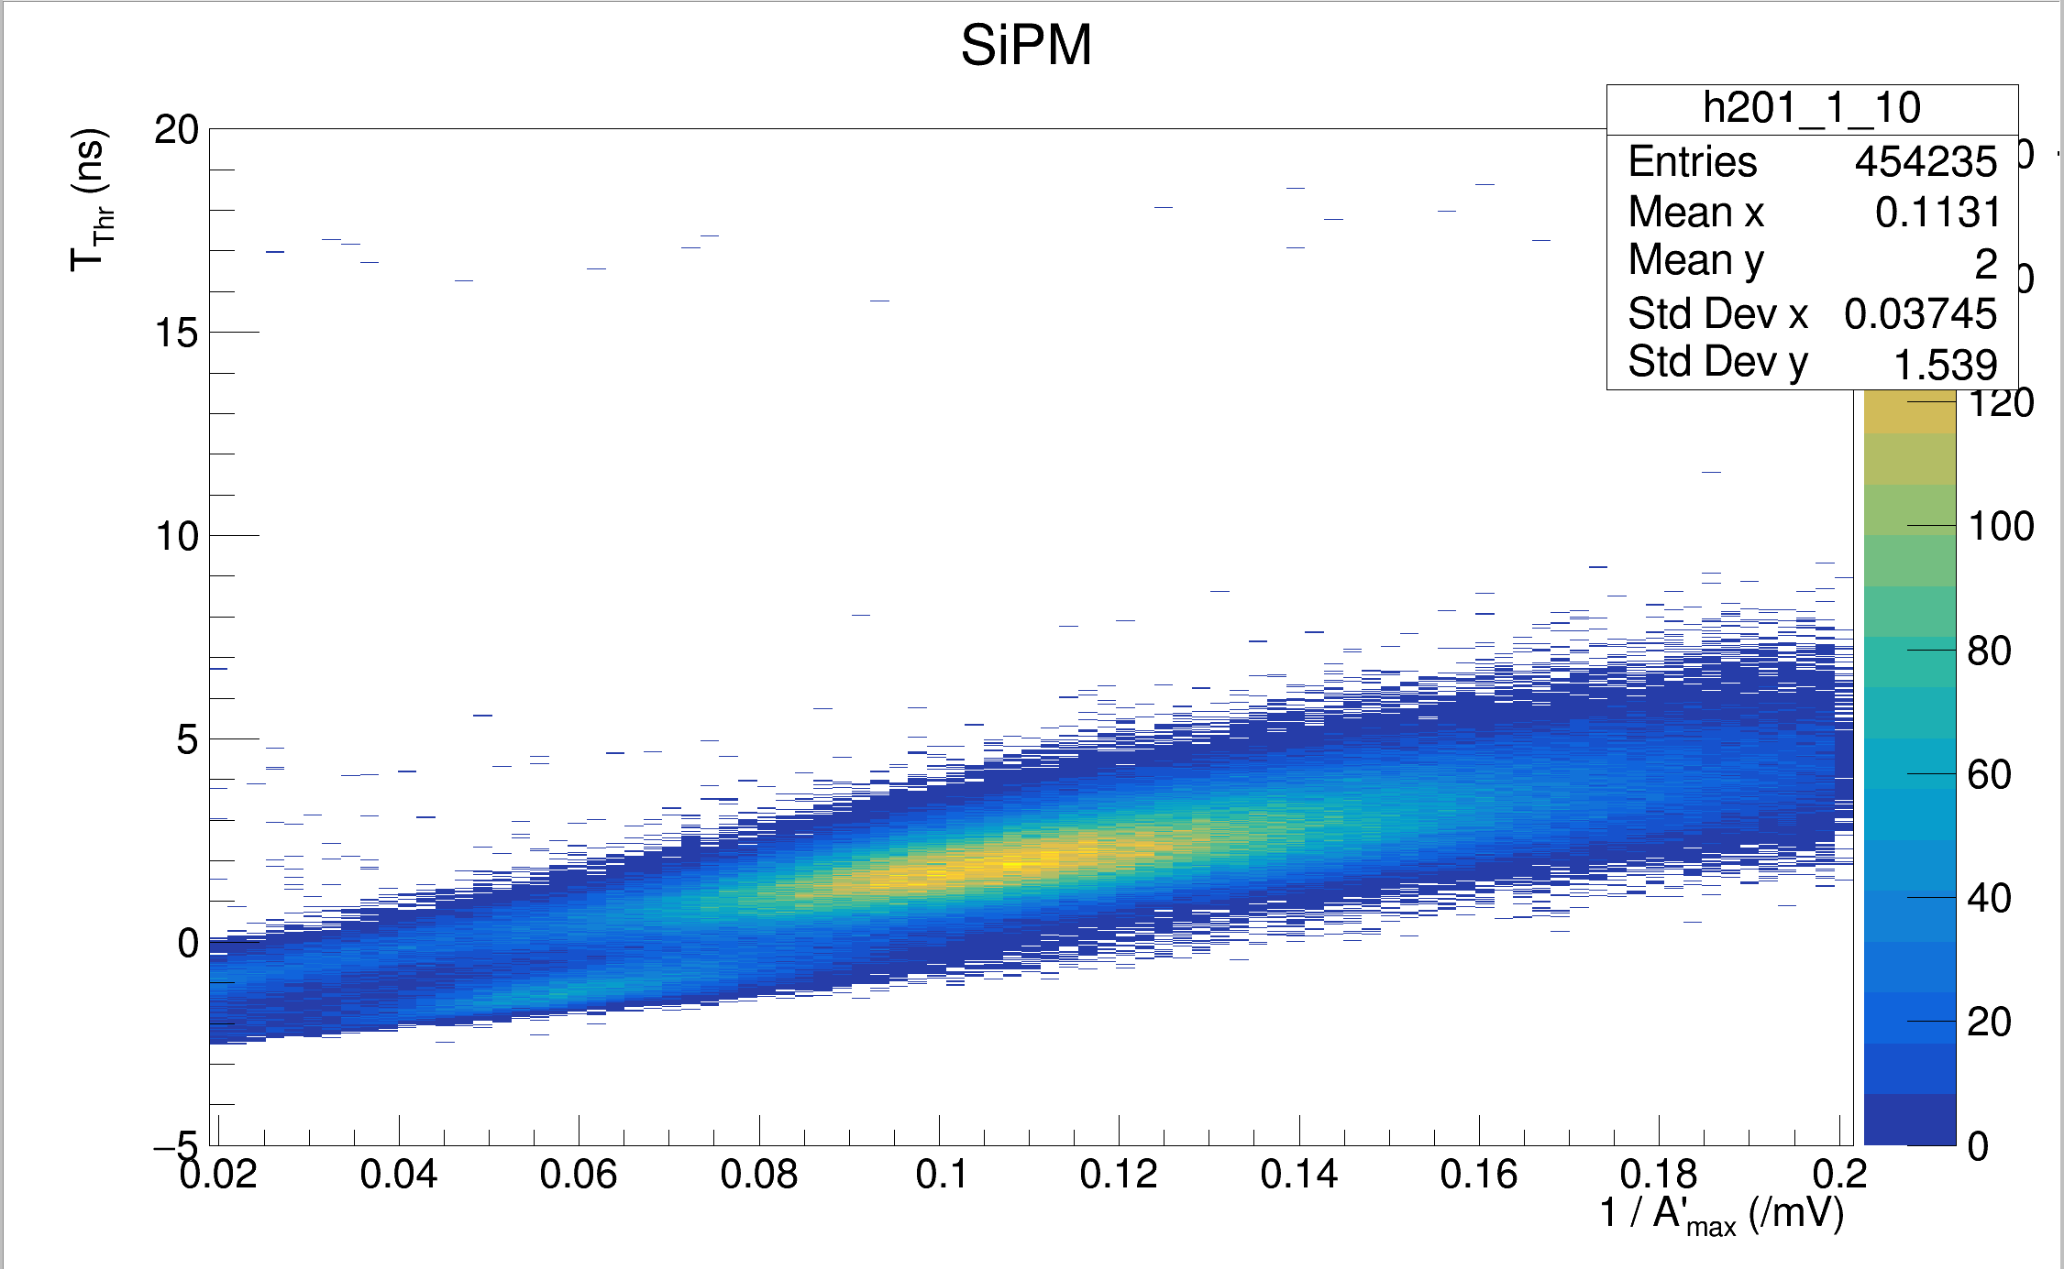
<- PWO (Parallel) Unfiltered, Channel 1
PWO (Parallel) Filtered, Channel 1 ->

Slide 14
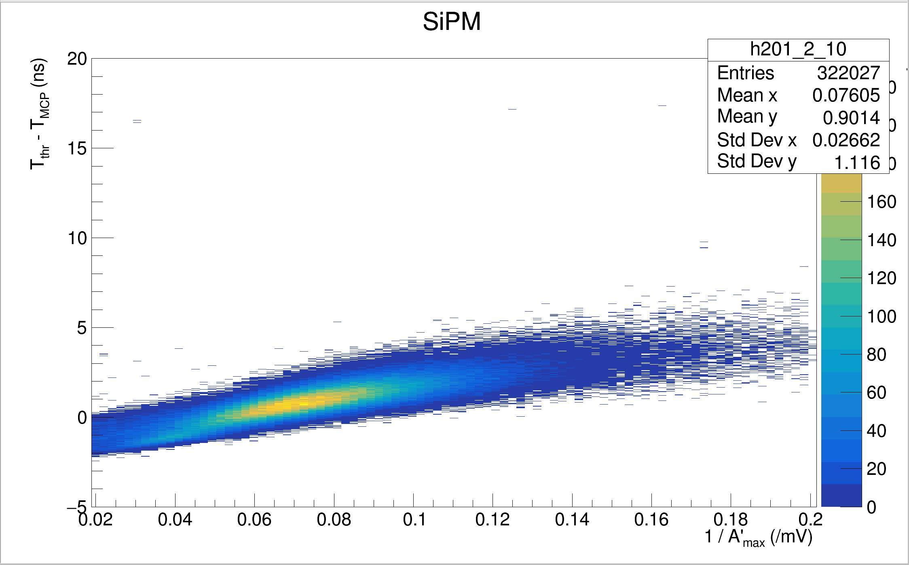
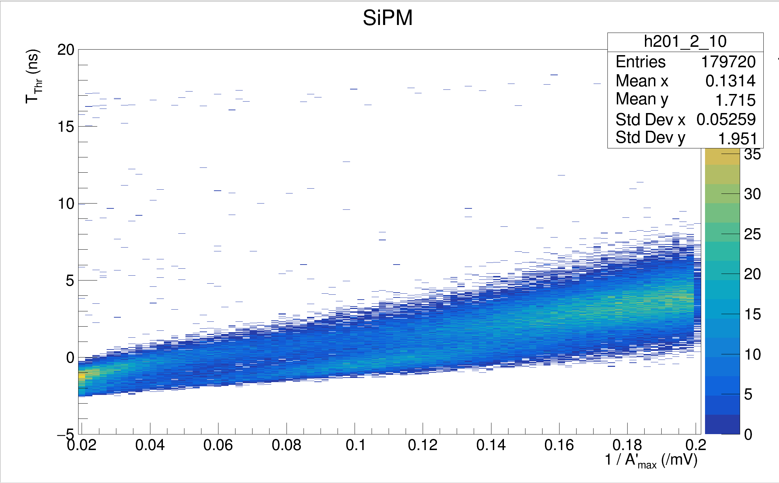
<- PWO (Parallel) Unfiltered, Channel 2
PWO (Parallel) Filtered, Channel 2 ->

Slide 15

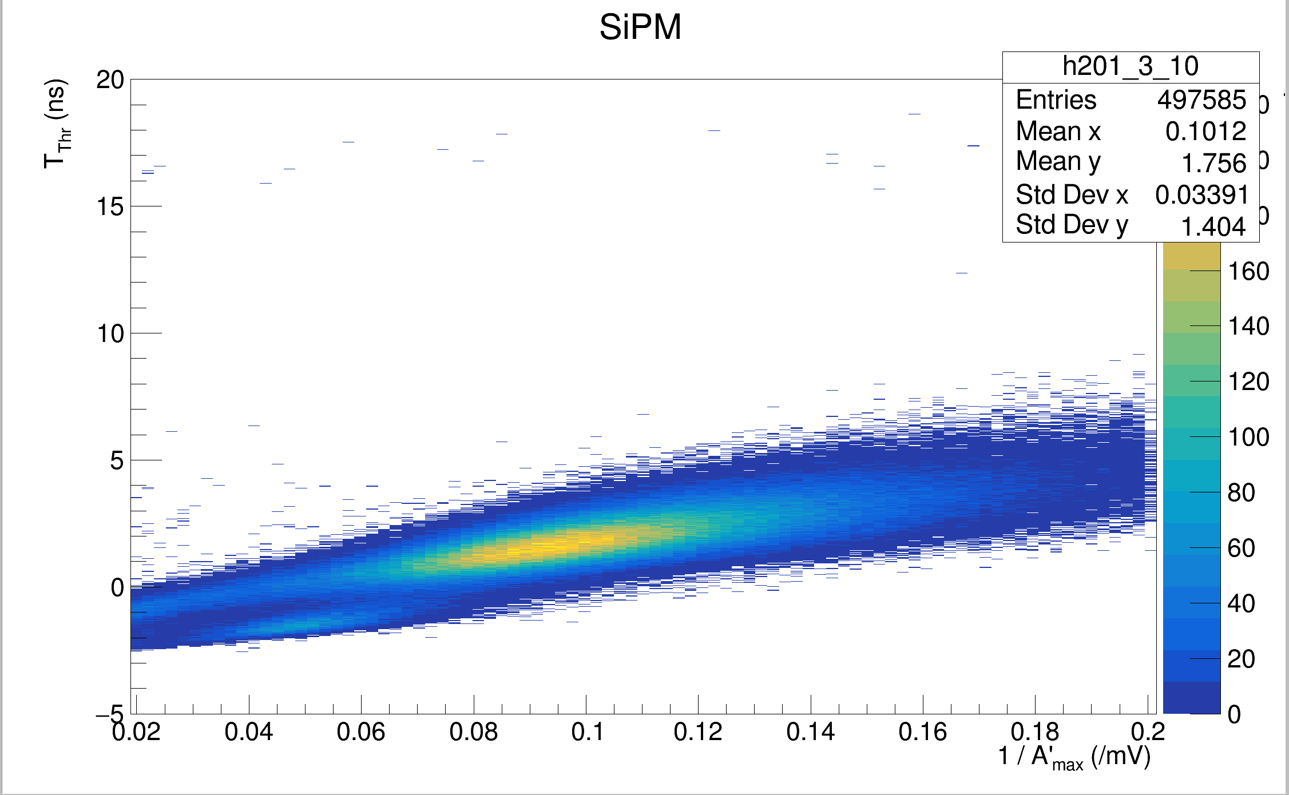
<- PWO (Parallel) Unfiltered, Channel 3
PWO (Parallel) Filtered, Channel 3 ->

Slide 16
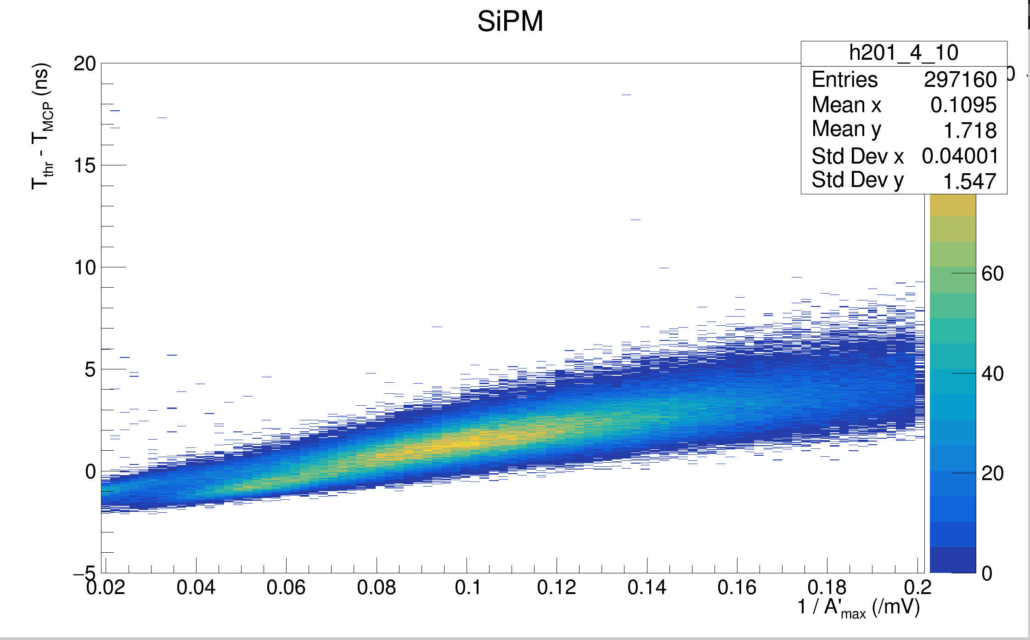
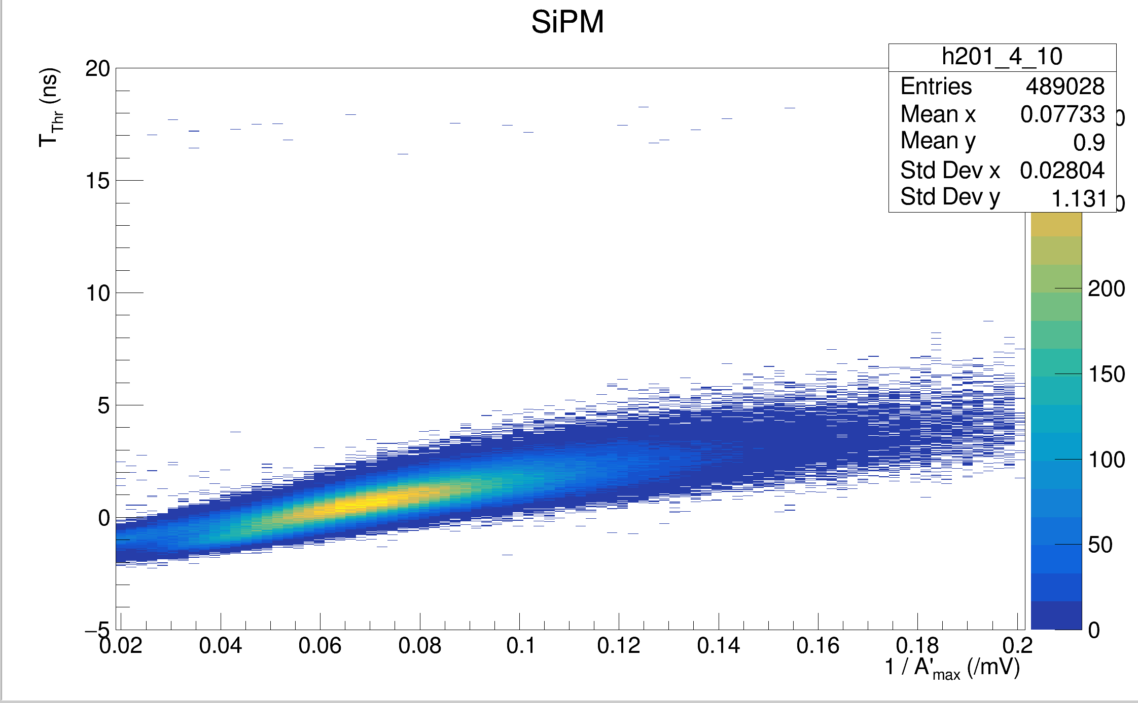
<- PWO (Parallel) Unfiltered, Channel 4
PWO (Parallel) Filtered, Channel 4 ->

Slide 17
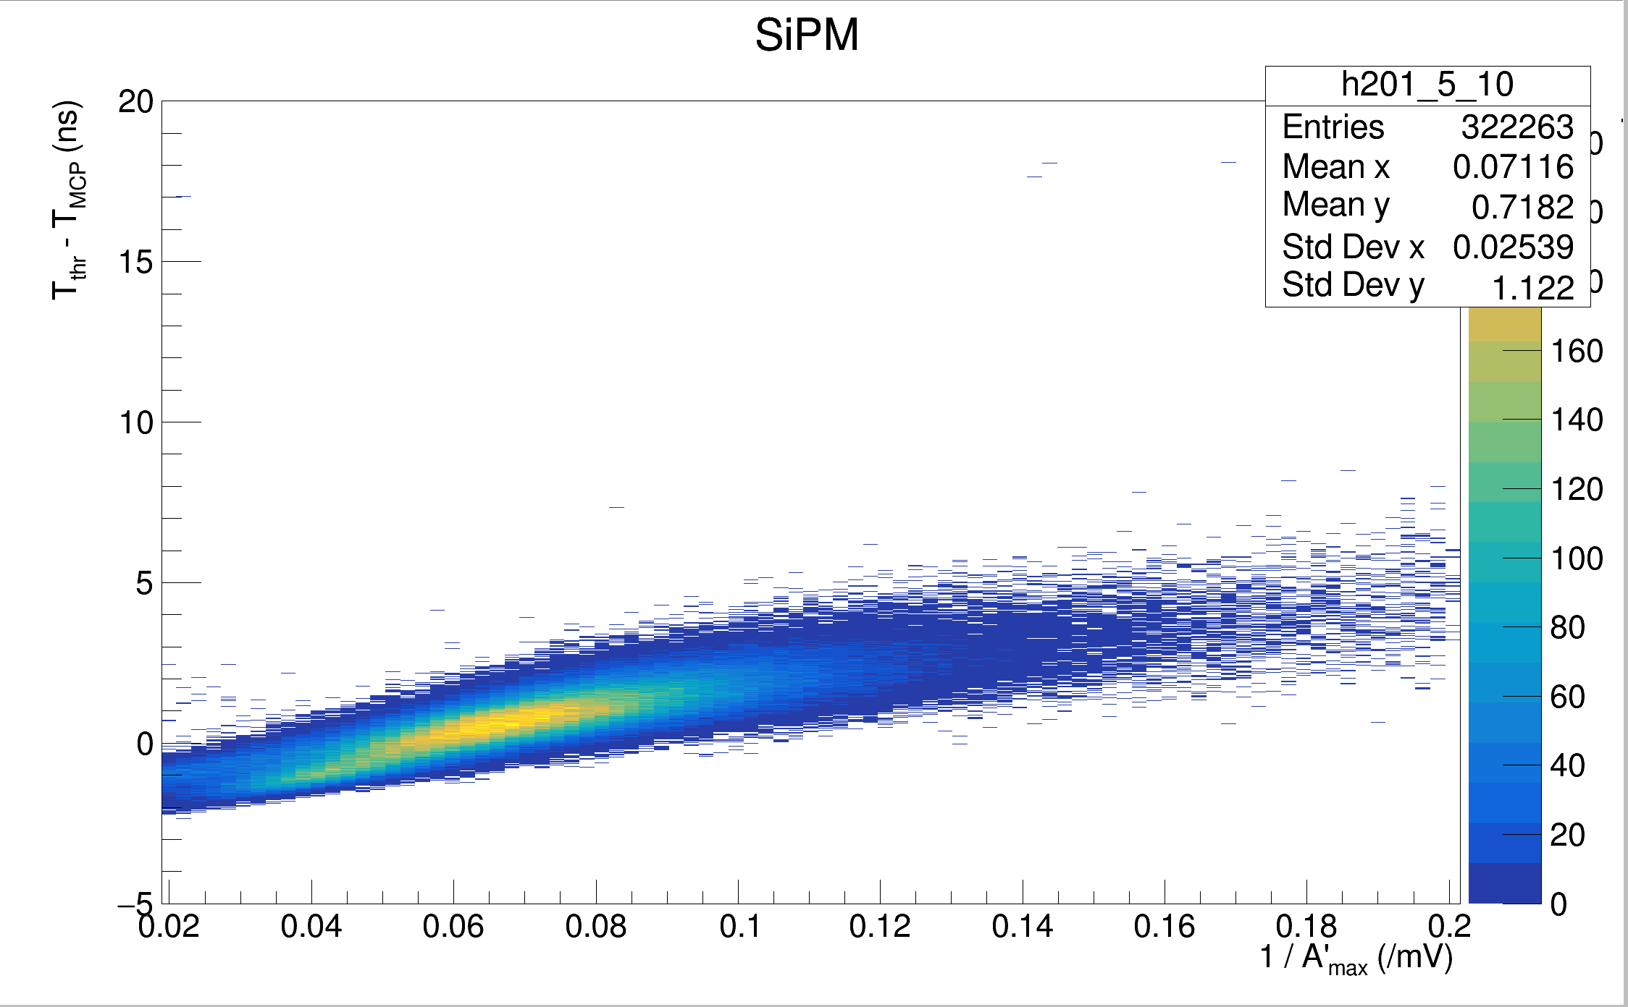
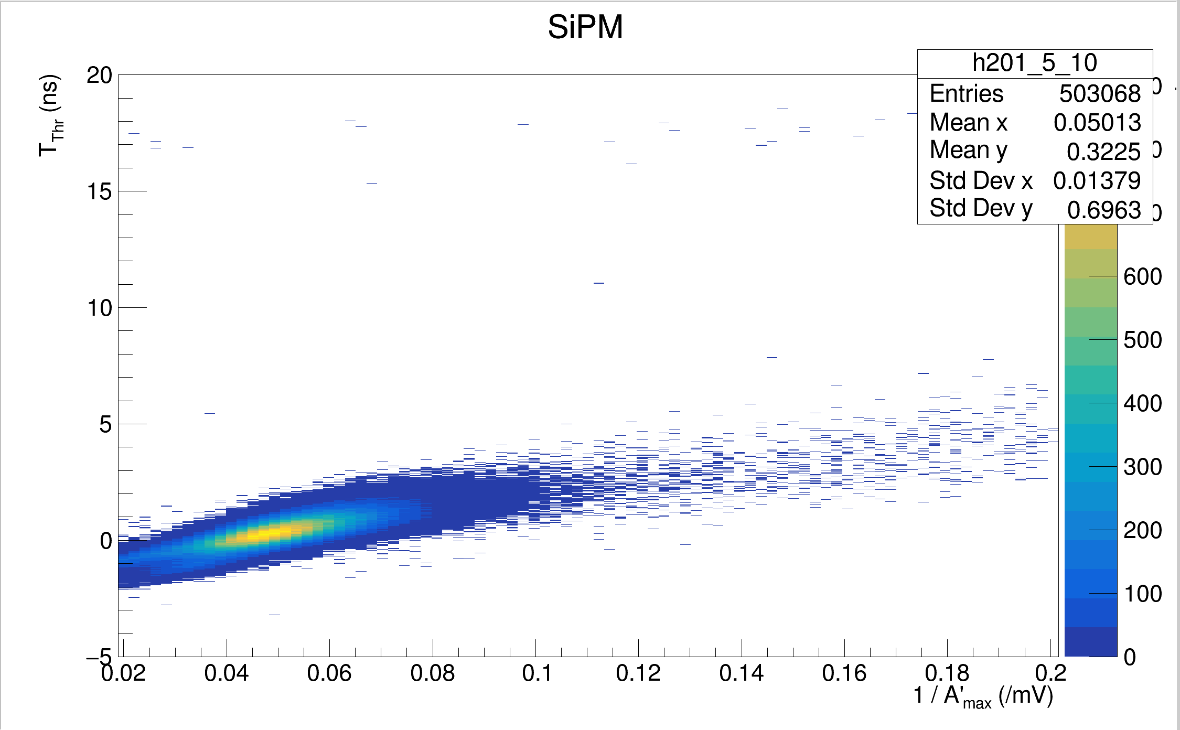
<- PWO (Parallel) Unfiltered, Channel 5
PWO (Parallel) Filtered, Channel 5 ->

Slide 18
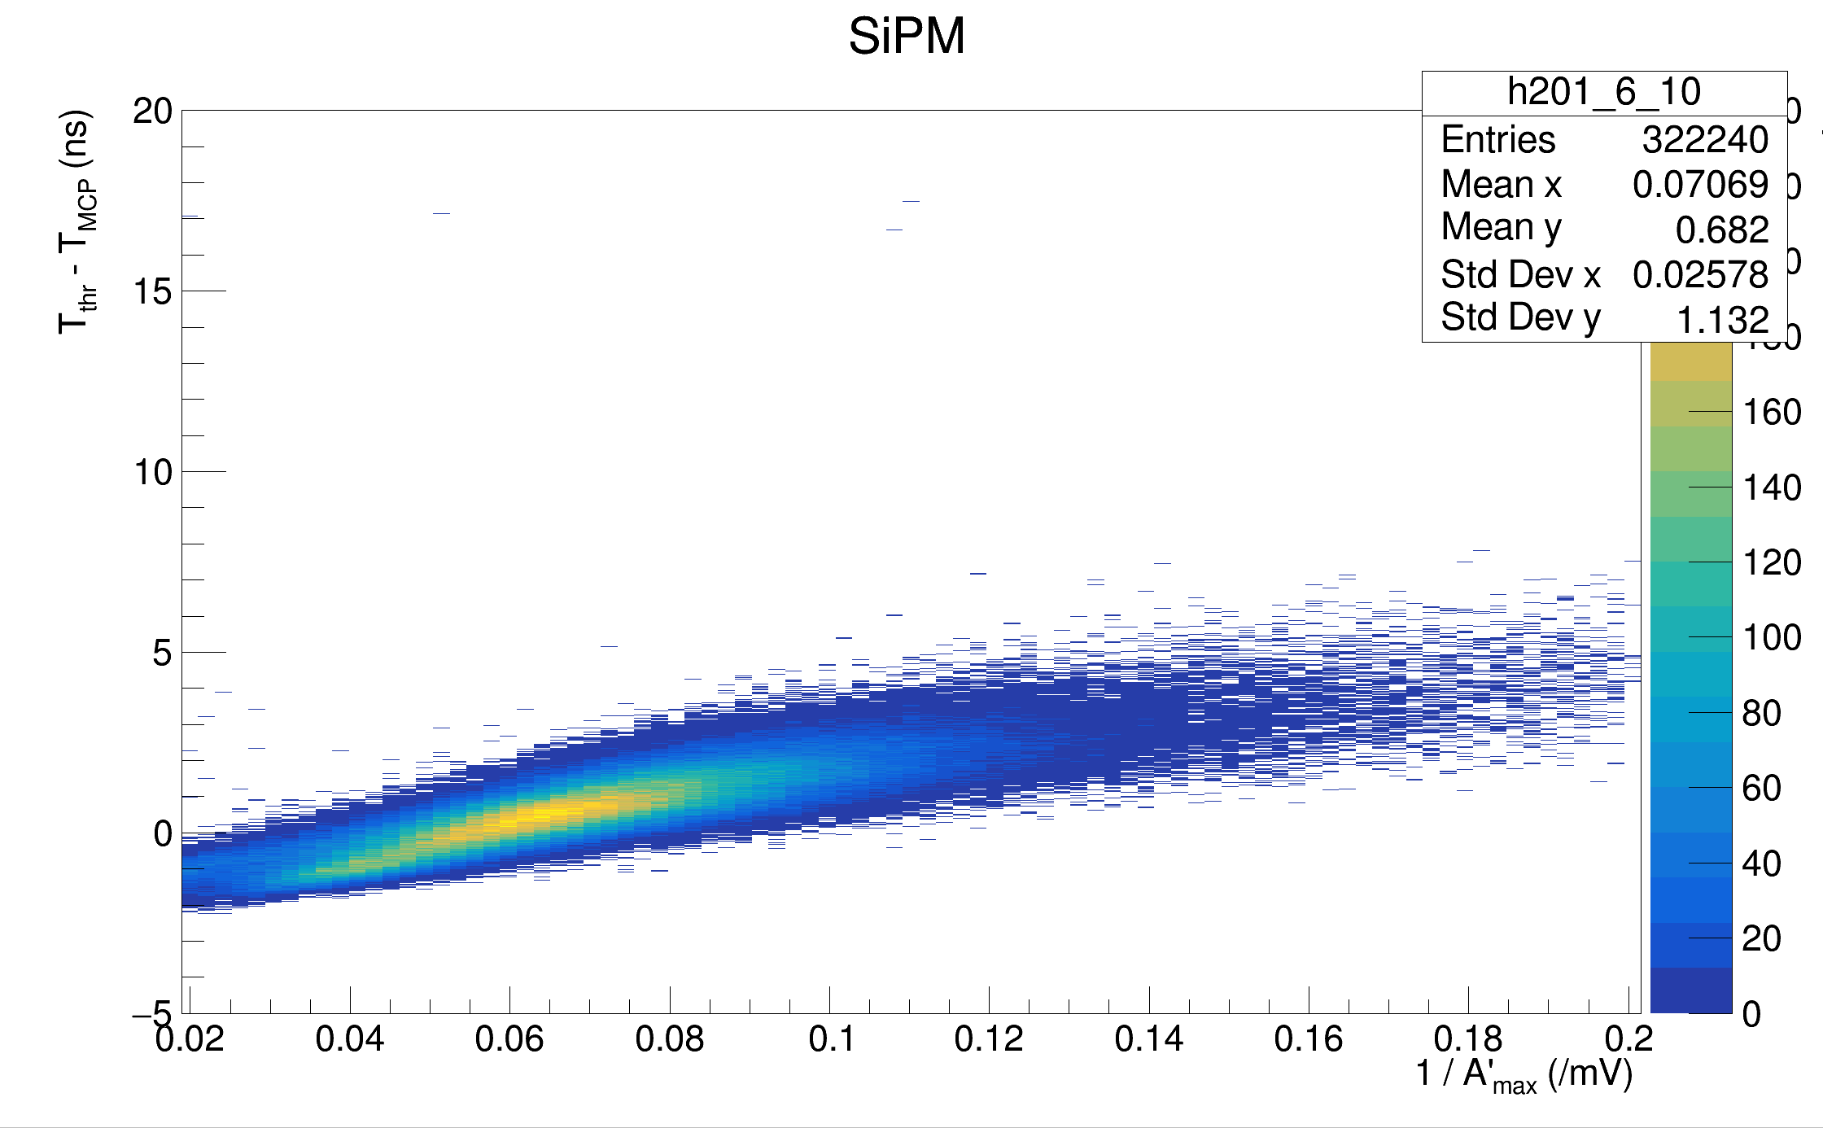
<- PWO (Parallel) Unfiltered, Channel 6
PWO (Parallel) Filtered, Channel 6 ->

Slide 19
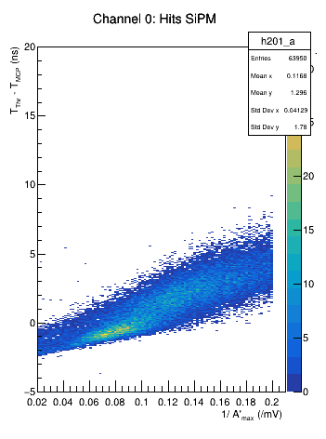
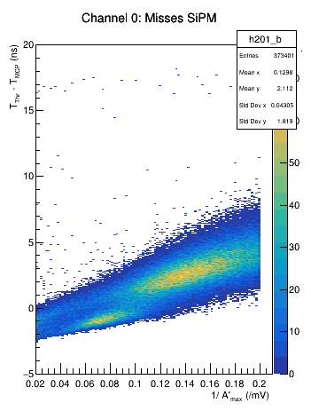
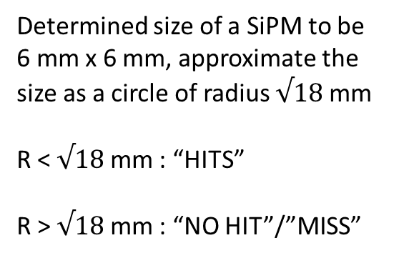
PWO (Parallel) Filtered, Channel 0: Cut on Location of Events wrt Channel 0 SiPM
Determined size of a SiPM to be 6 mm x 6 mm, approximate the size as a circle of radius $√18$ mm
R < $√18$ mm : “HITS”
R > $√18$ mm : “NO HIT”/”MISS”

Slide 20
More Radials cuts:
SiPM
12 mm
Radial Cuts are made on the distance an event occurs at wrt to the center of the SiPM
Cuts will occur in “Rings”:
  R < 2 mm
  2 mm < R < 4 mm
  4 mm < R < 8 mm
  8 mm < R < 12 mm
  R > 12 mm
4 mm
8 mm
2 mm

Slide 21
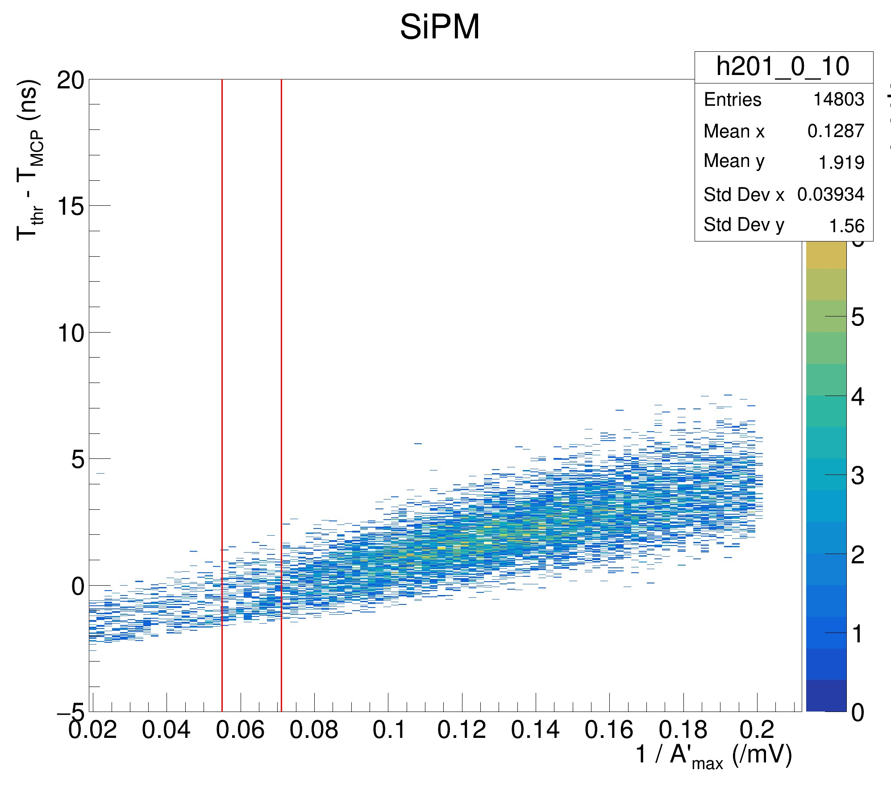
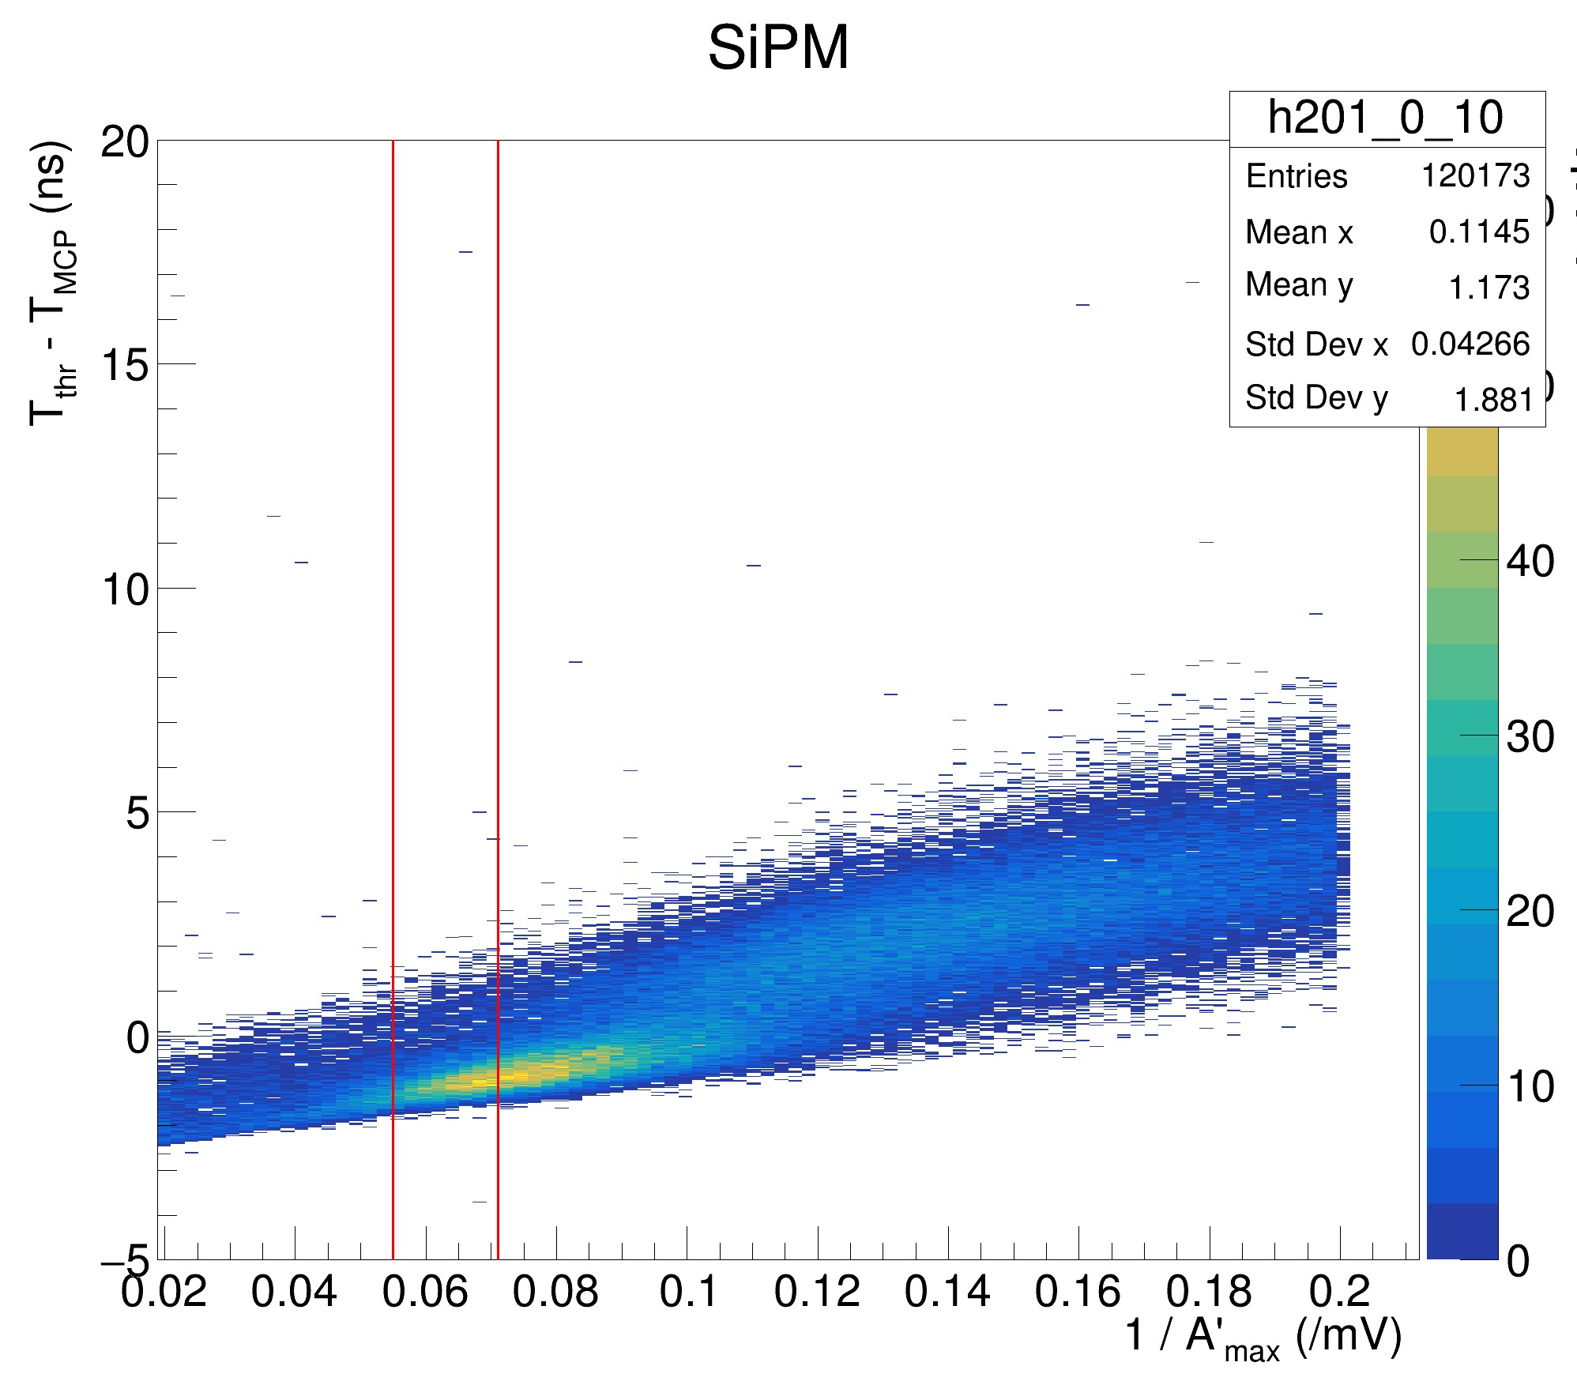
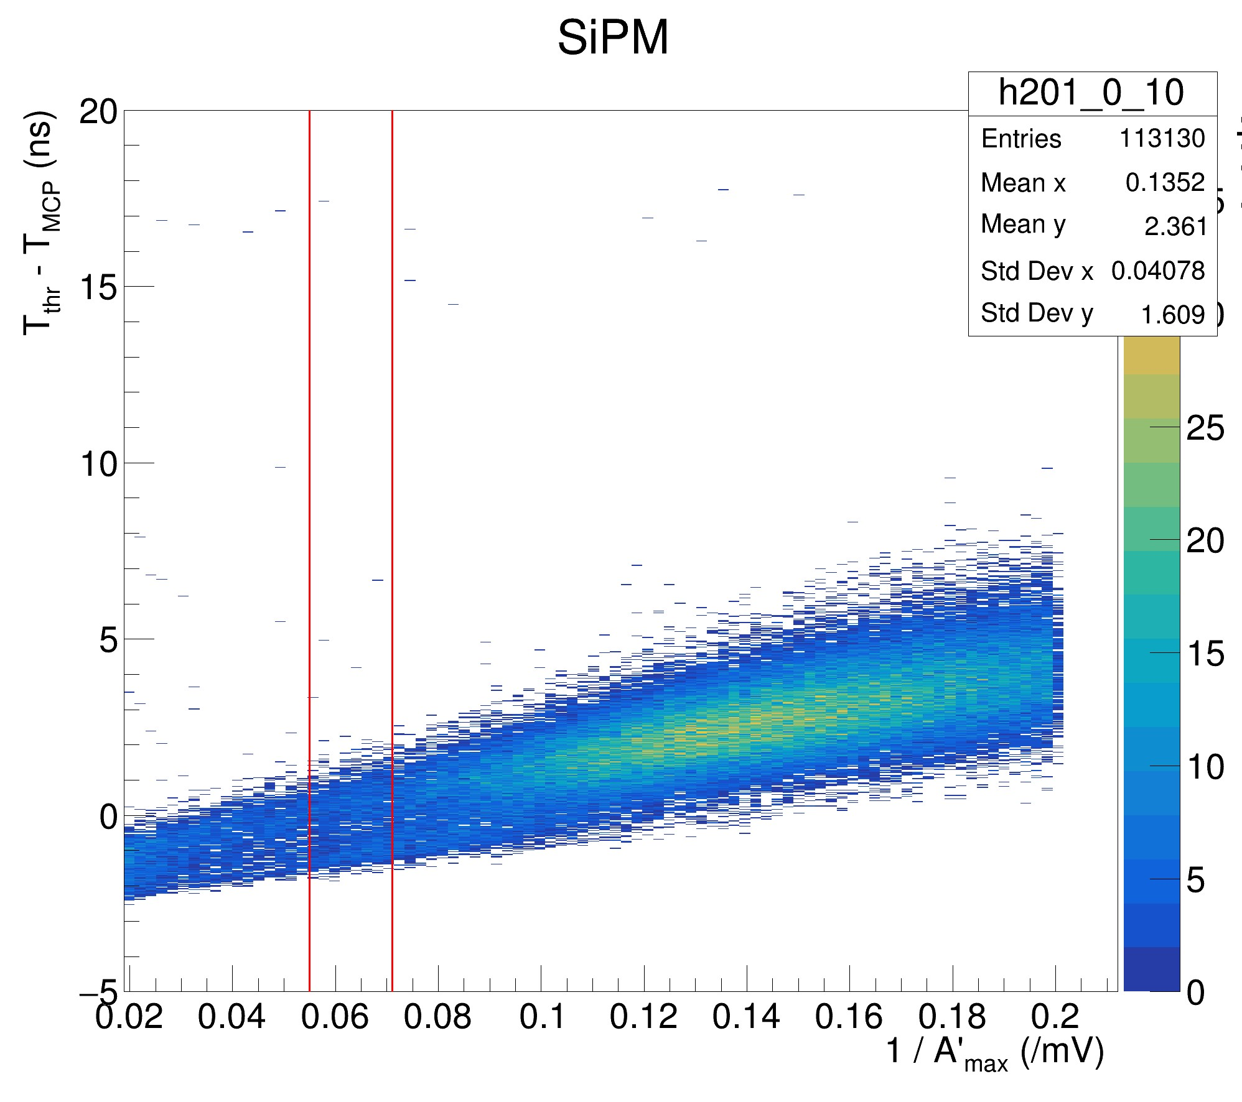
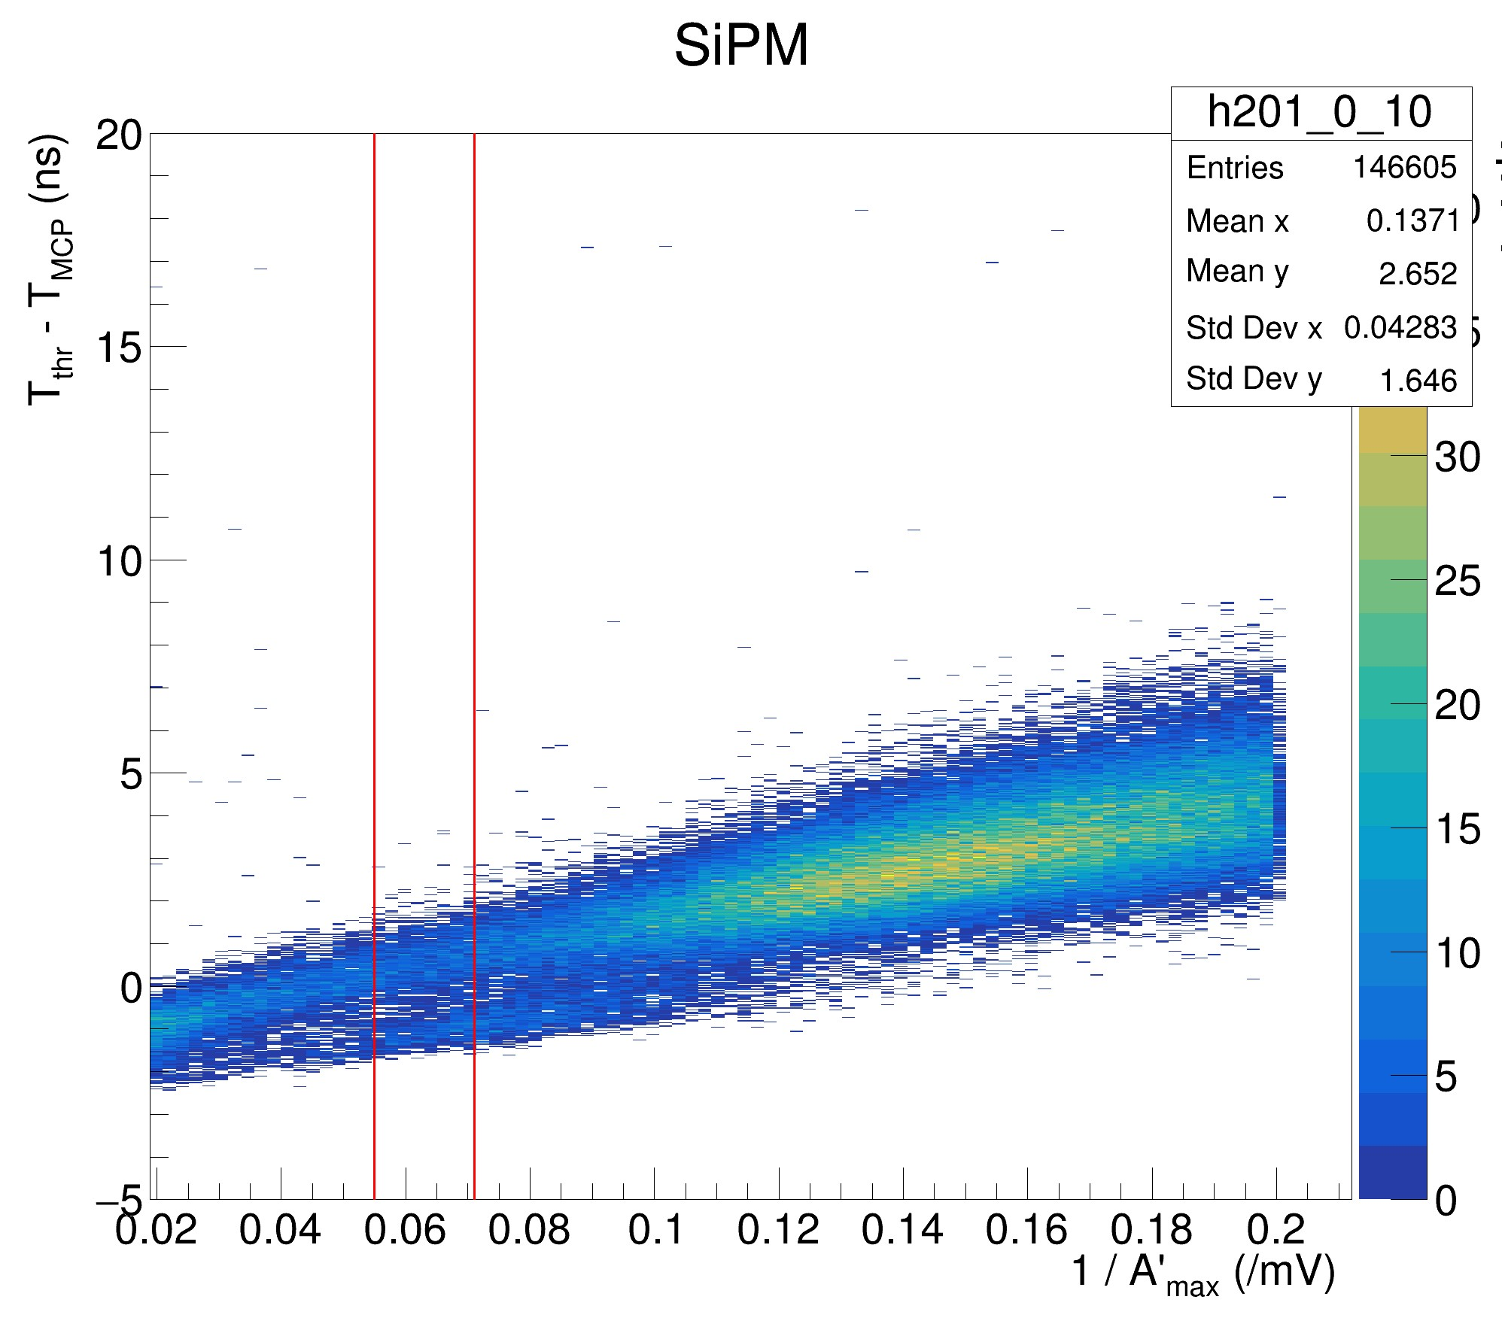
R < 2 mm 2 mm < R < 4 mm 4 mm < R < 8 mm
8 mm < R < 12 mm R > 12 mm
PWO (Parallel) Filtered, Channel 0: Cuts on Events occurring at Radii further from the center of the relevant SiPM

Slide 22
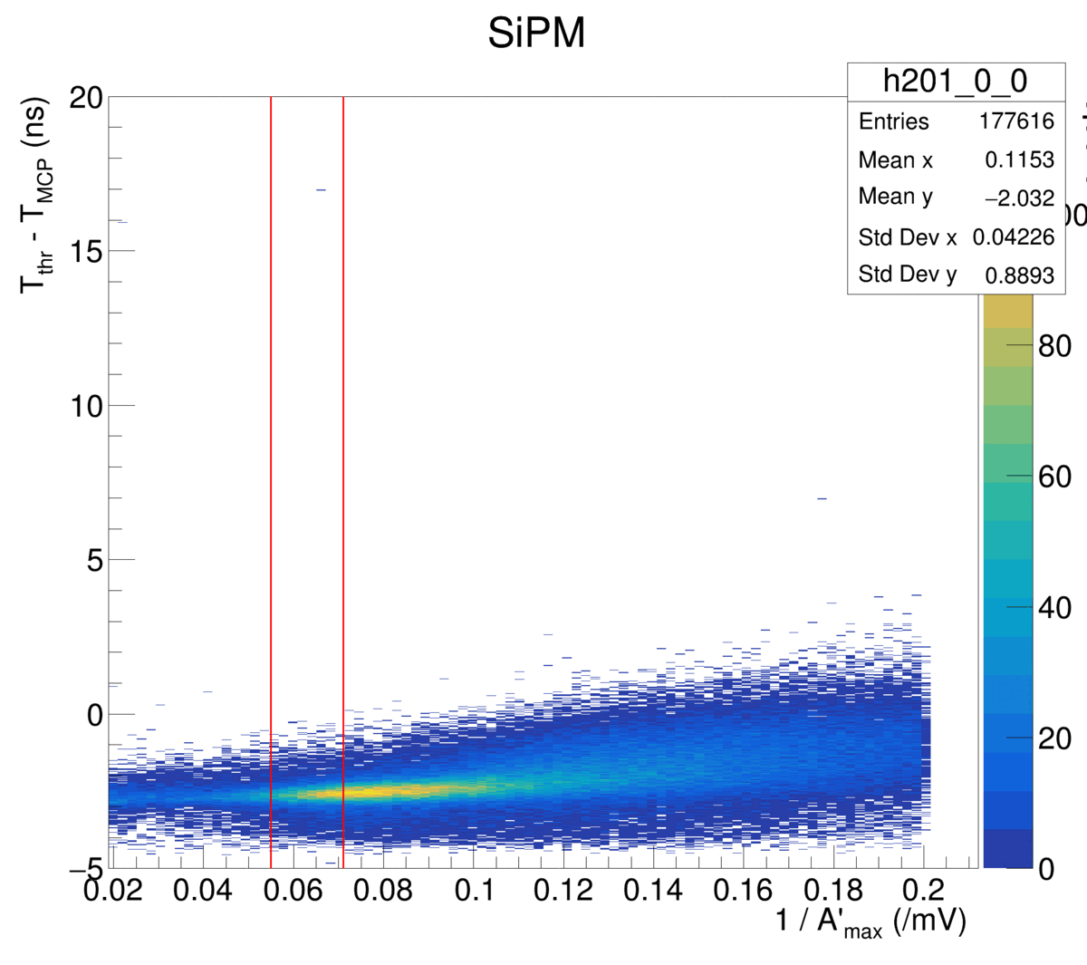
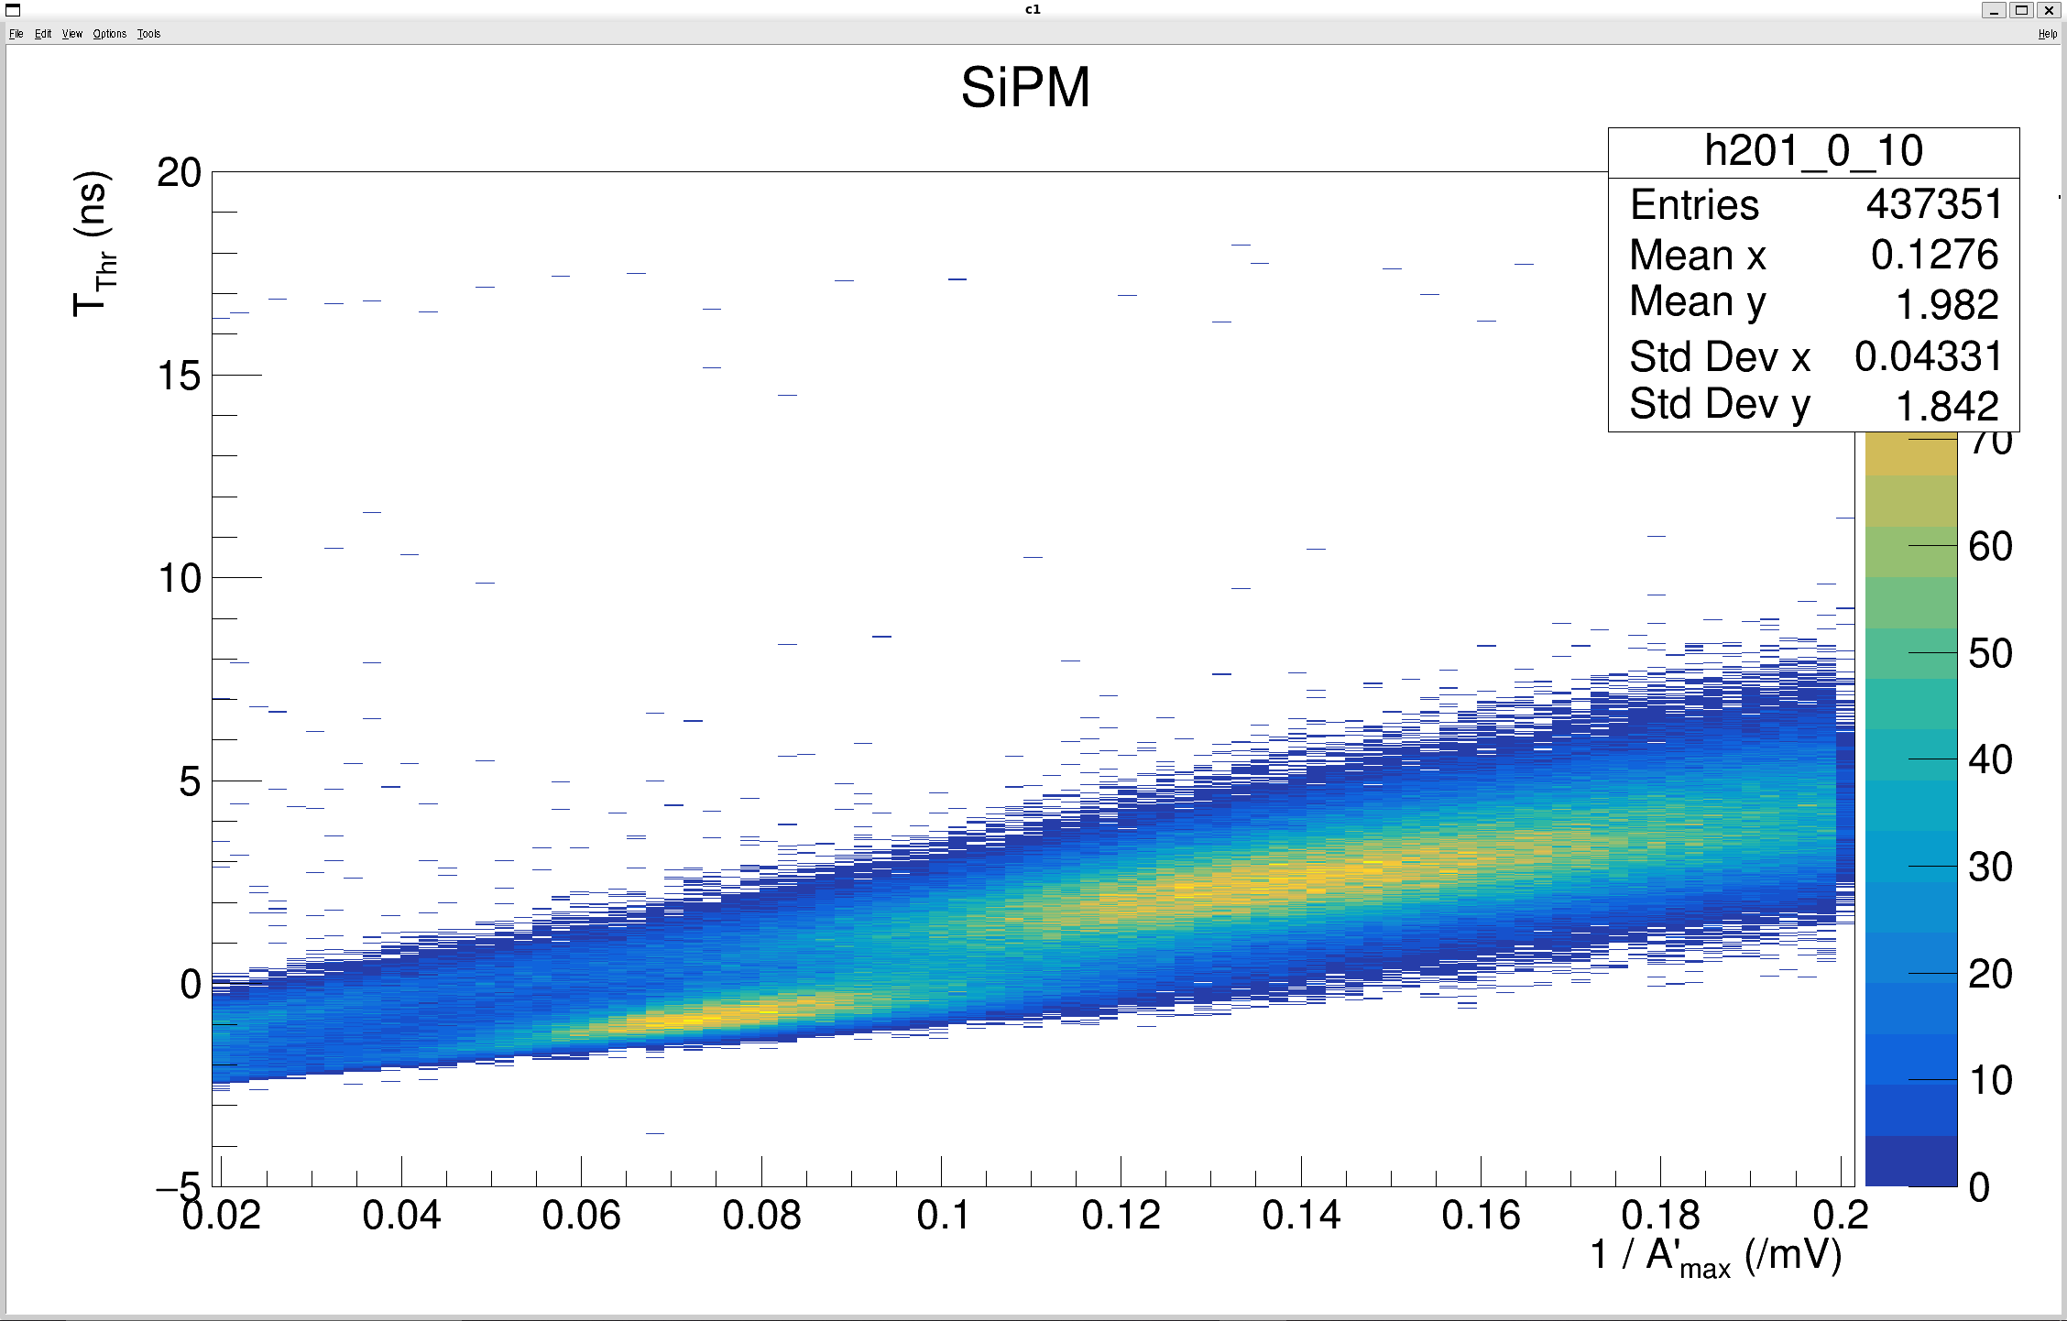
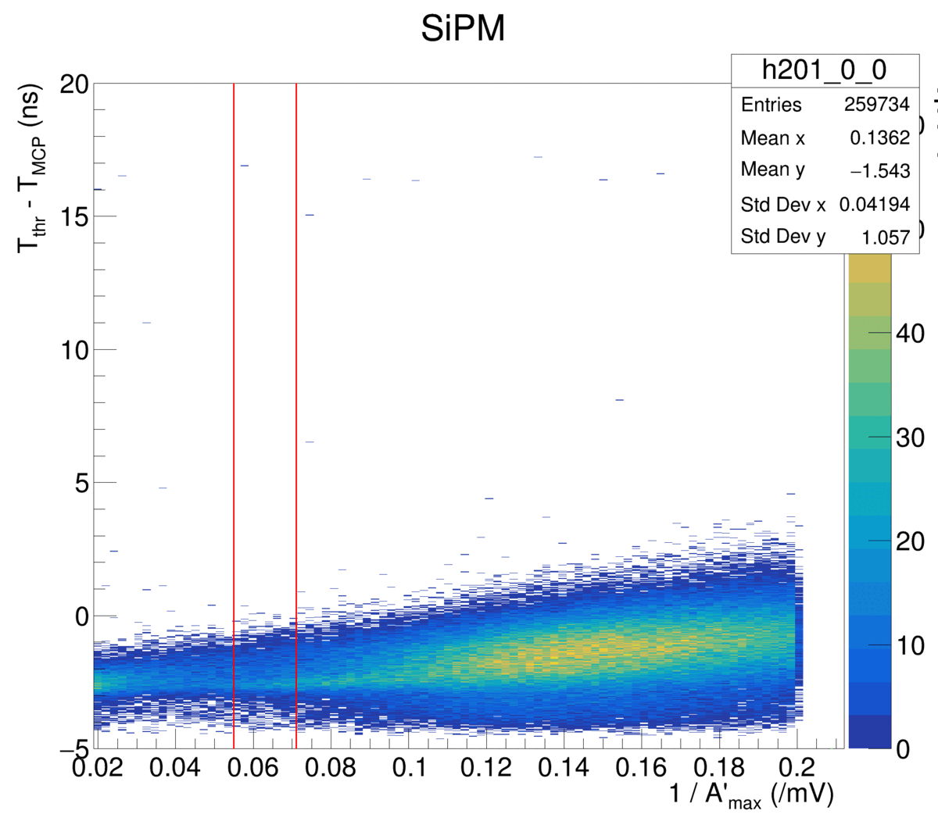
PWO (Parallel) Filtered, Channel 0: An informed cut on Radius
(R < 8 mm)
(R > 8 mm)

Slide 23
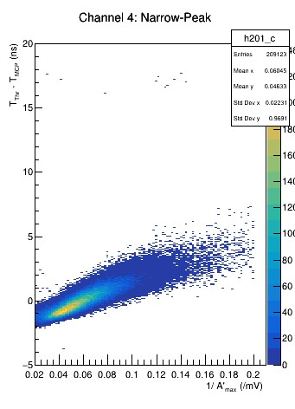
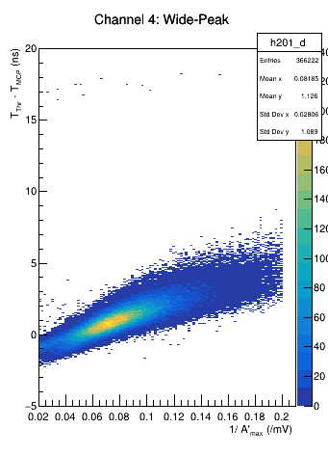
PWO (Parallel) Filtered, Channel 4: An informed cut on Radius
(R < 8 mm)
(R > 8 mm)

Slide 24
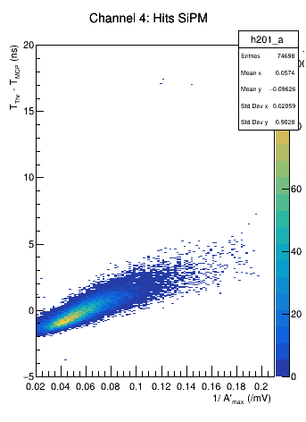

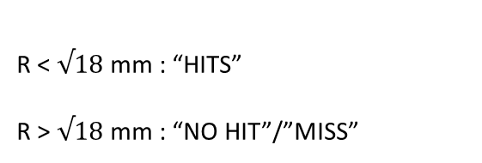
PWO (Parallel) Filtered, Channel 4: Radial Cut on Hit/Miss
R < $√18$ mm : “HITS”
R > $√18$ mm : “NO HIT”/”MISS”

Slide 25
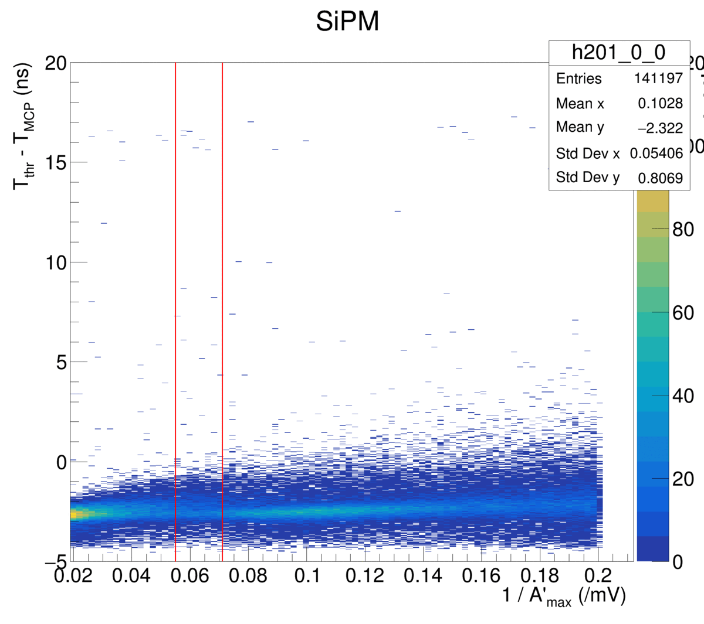
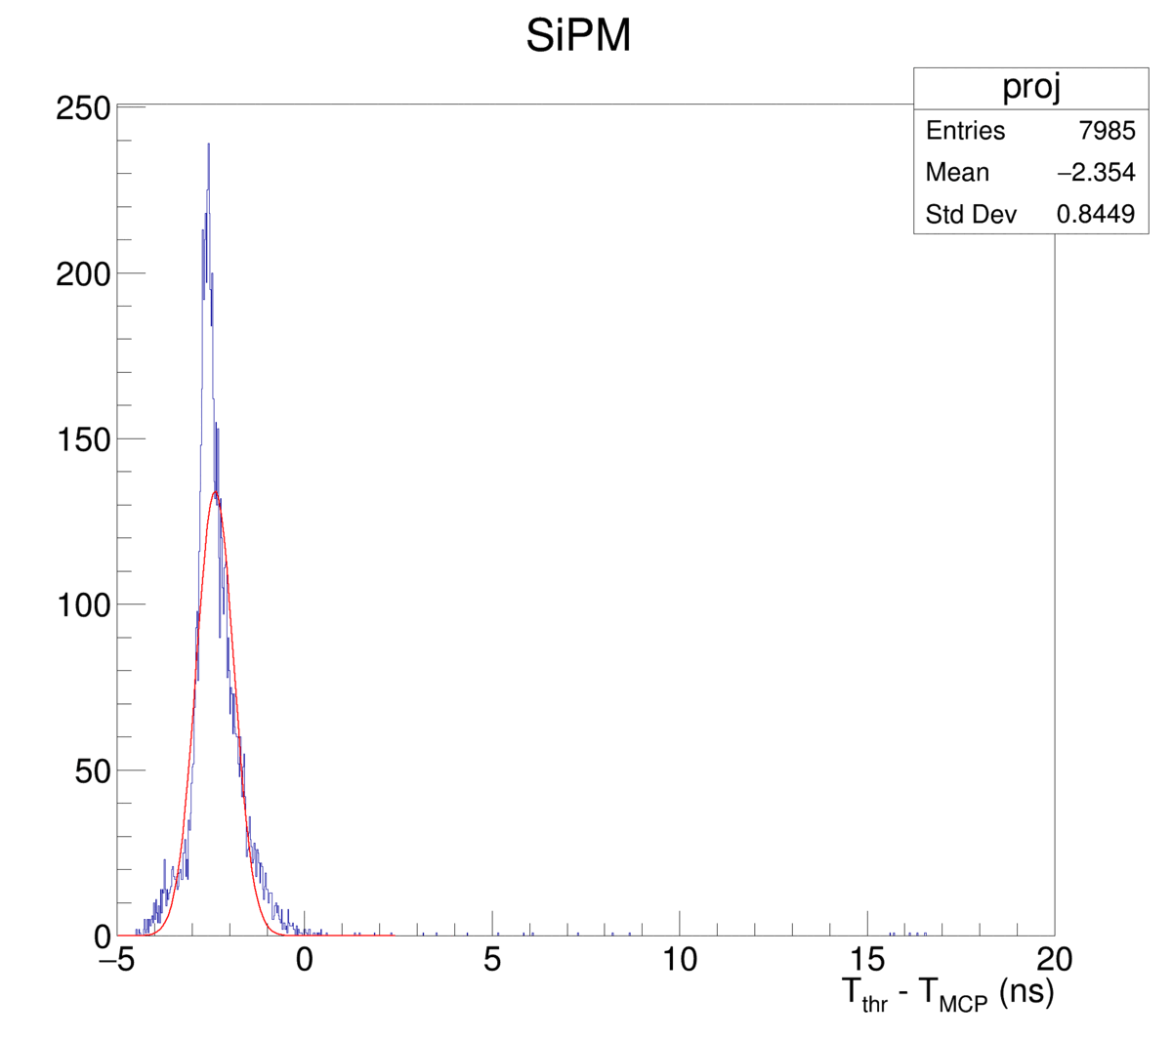
BGO (parallel) Filtered, Channel 0: Potentially Experiencing Similar “Double Peaks”

Slide 26
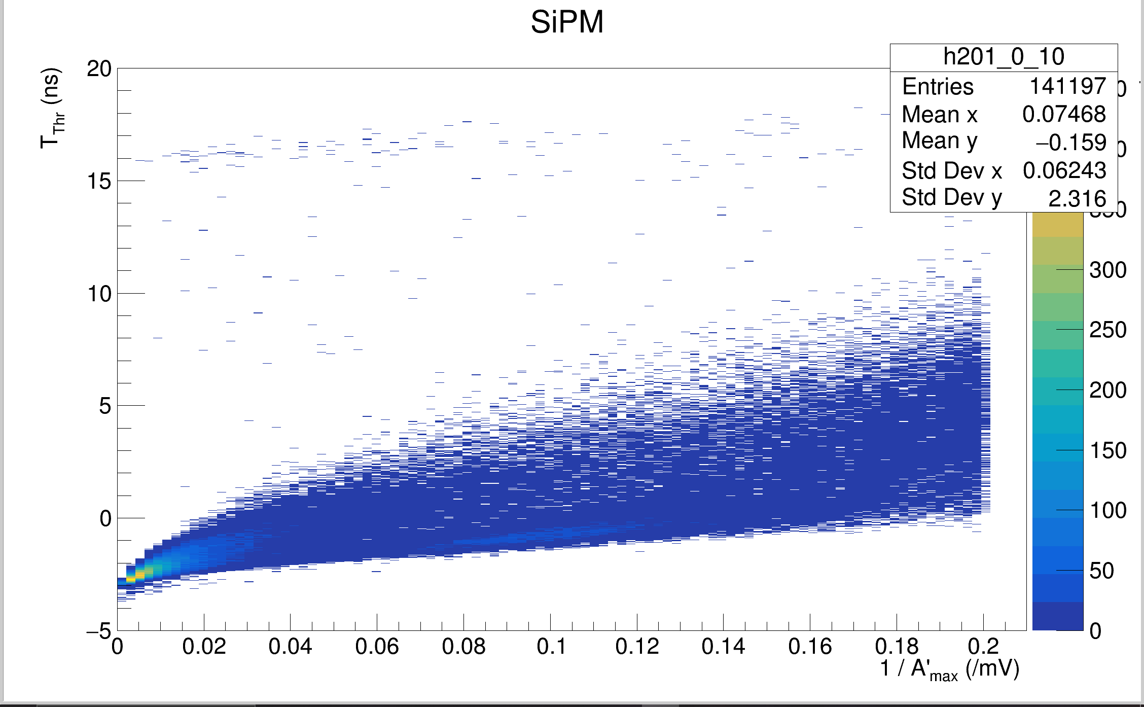
BGO (parallel) Filtered, Channel 0: Still of 2D Distribution at Threshold Voltage of 25.12 mV

Slide 27
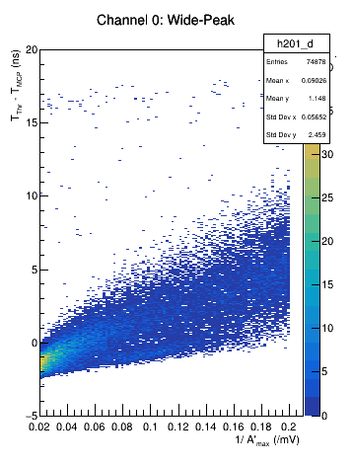

BGO (parallel) Filtered, Channel 0: Regime Split due to the same 8 mm radial cut
(R < 8 mm)
(R > 8 mm)

Slide 28



BGO (parallel) Filtered, Channel 0: Regime Split due to the Hit/Miss Cut
R < $√18$ mm : “HITS”
R > $√18$ mm : “NO HIT”/”MISS”

Slide 29

PWO (Parallel) Filtered, Channel 0 : Observing Single Event Waveforms In notable regimes
ntracks == 1
R < 8 mm
Threshold Voltage 25.12 mV
*
Left: A ~ 17.2 mV , ∆t ~ -1.2 ns
Center: A~ 13 mV , ∆t ~ -0.8 ns
Right: A~ 11 mV, ∆t ~ -0.8 ns

Slide 30



Single Pulses Closer to SiPM

Slide 31

PWO (Parallel) Filtered, Channel 0 : Observing Single Event Waveforms In notable regimes
ntracks == 1
R > 8 mm
Threshold Voltage 25.12 mV
*
Left: A ~ 9.4 mV , ∆t ~ 1.4 ns
Center: A~ 6.8 mV , ∆t ~ 2.6 ns
Right: A~ 5.1 mV, ∆t ~ 3.5 ns

Slide 32



Single Pulses Further from SiPM

Slide 33


Angular Distributions and Cuts
Angle (θ) is calculated wrt to the normal
Used the slopes of the track X(z) & Y(z)
Angular studies yielded a weak angular dependence
Distribution of angles is fairly narrow about direct strikes
Credit: Grace Cummings
PWO (par) Filtered, Channel 0 ->

Slide 34
Conclusion and Goals:
Overall, we’re experiencing this two peak structure due to the presence of the filter
There is large spatial dependence of this structure and little to no angular dependence
Next steps include:
  Exploring average waveforms at similar amplitudes for each unique regime
  Establishing an uncertainty about the timing resolution
  More in-Depth BGO studies

