Slide 1
Calvision 1-18-2024
Electronics Summary

Slide 2
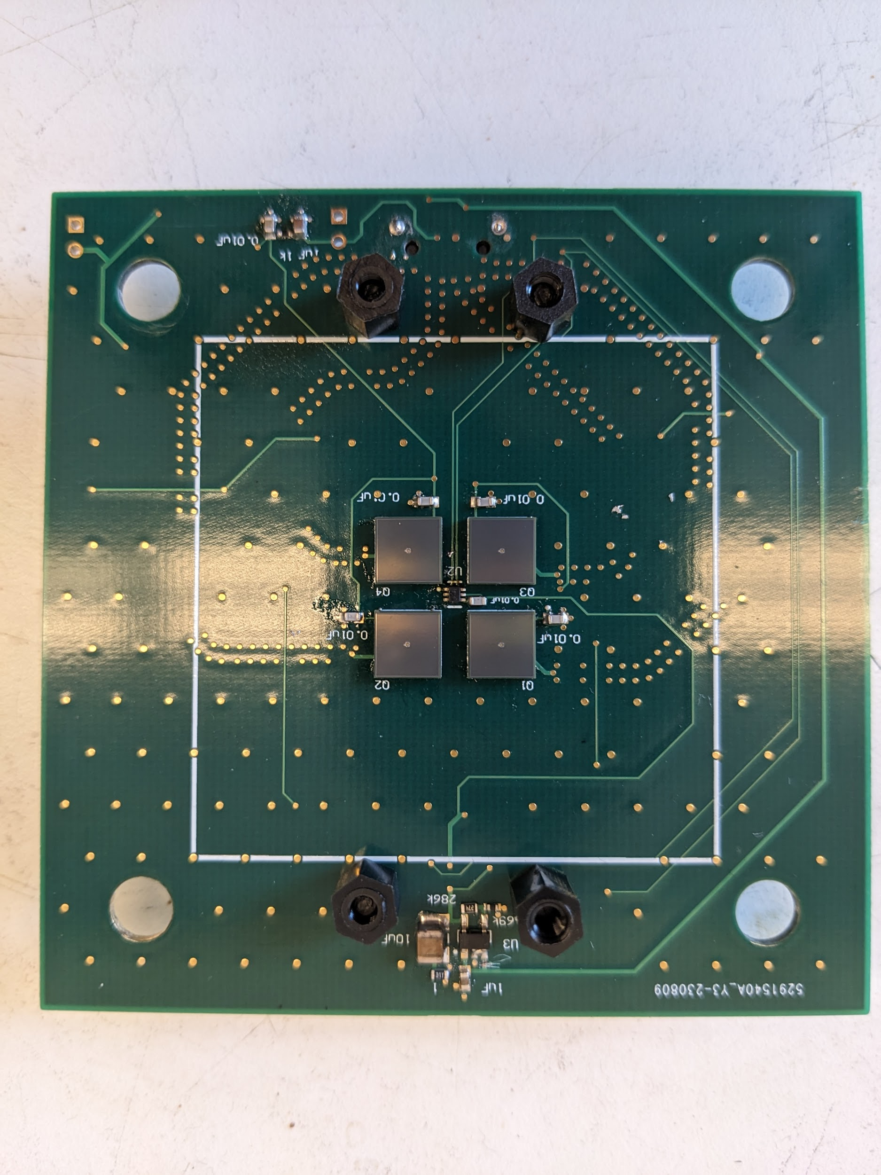
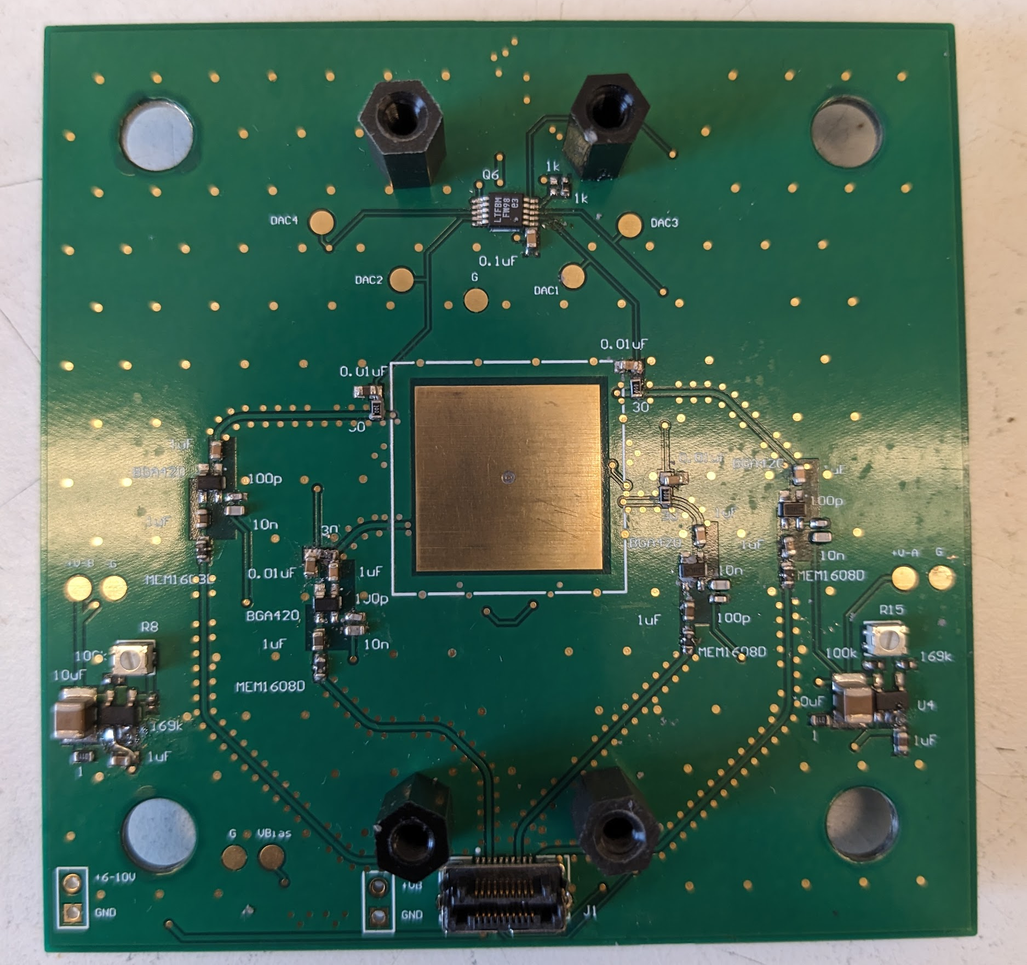
System Overview

Slide 3
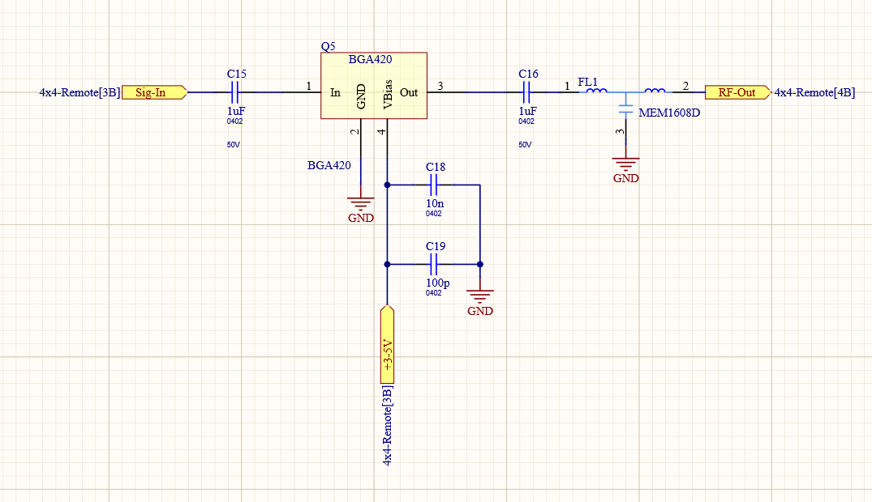
Amplifier Chain (Front End)
Samtec HLCD-10-12-TR
Backend

Slide 4
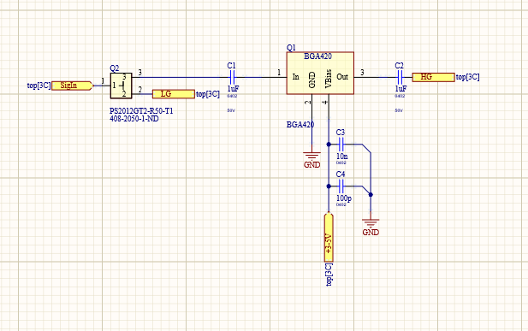
Amplifier Chain (Backend)
High Gain (MCX)
Low Gain (MCX)

Slide 5
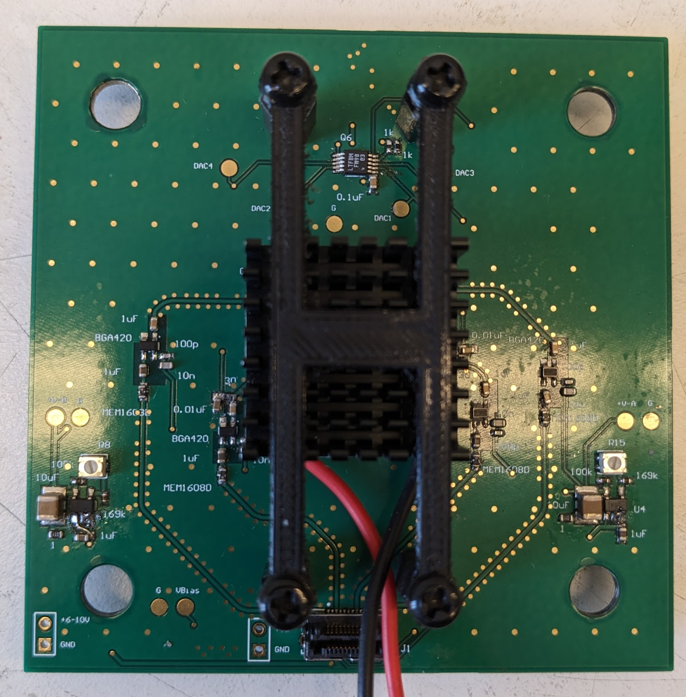
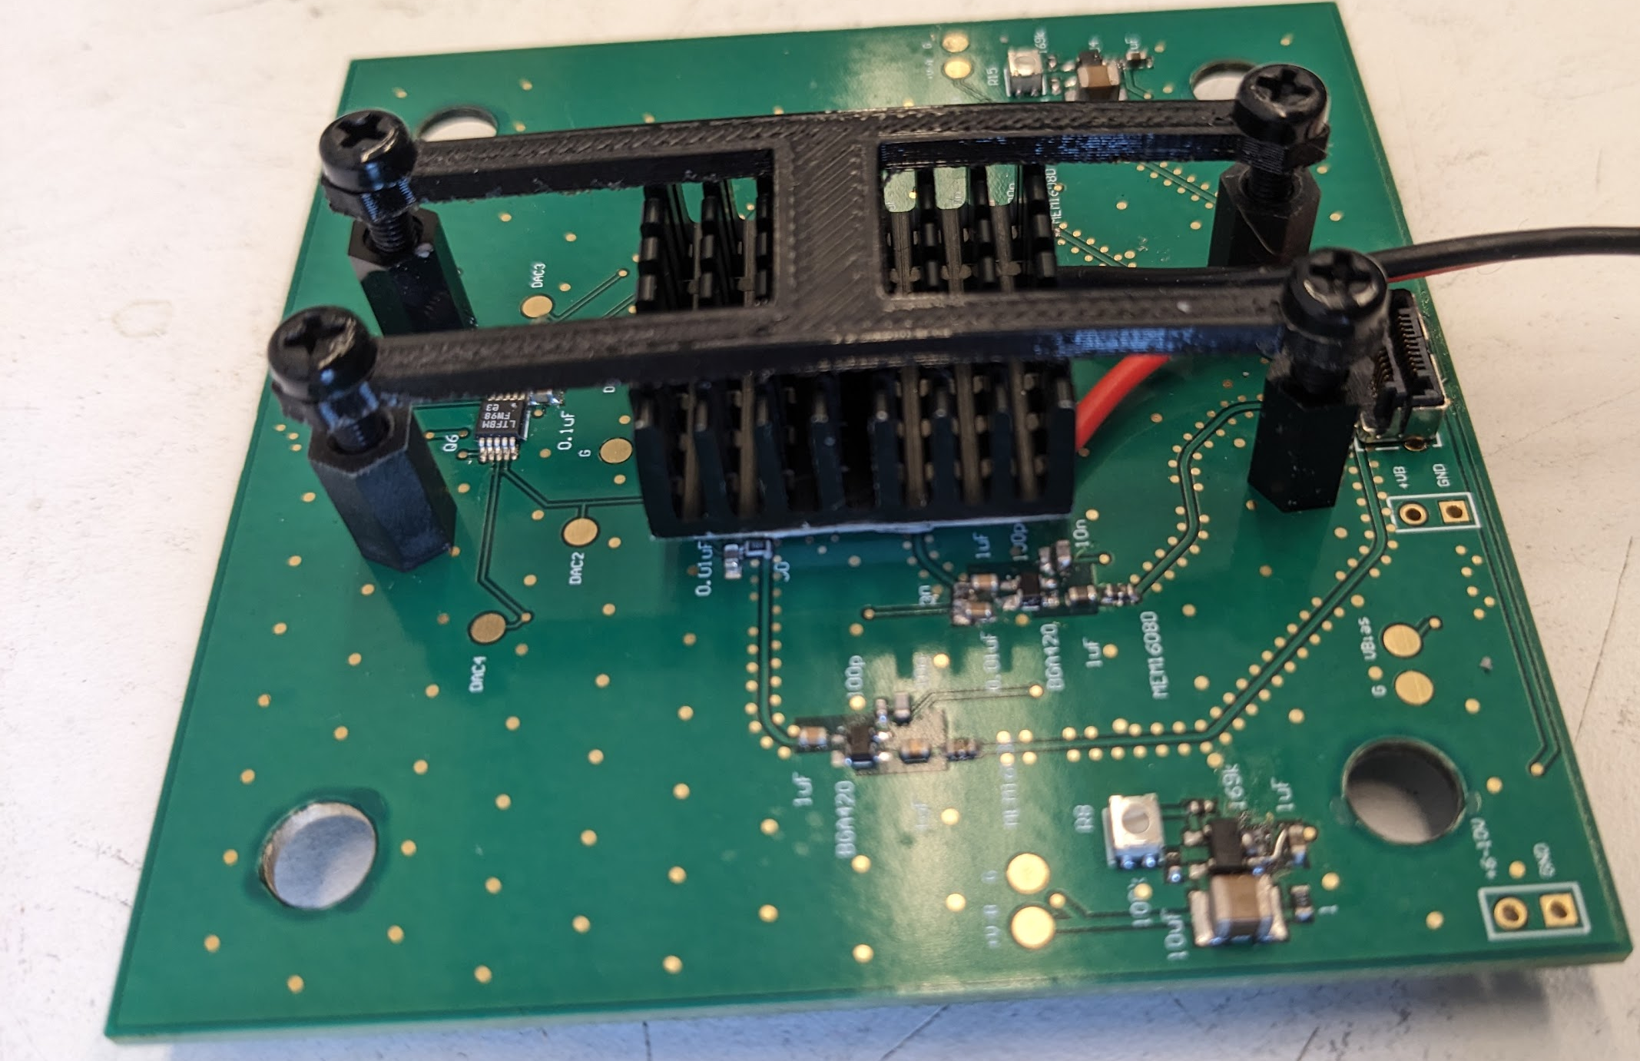
Cooling: Original Method, TEC w/Heatsink
Copper Pad located on the bottom of the PCB behind the SiPMs and Temperature Sensor.

Slide 6
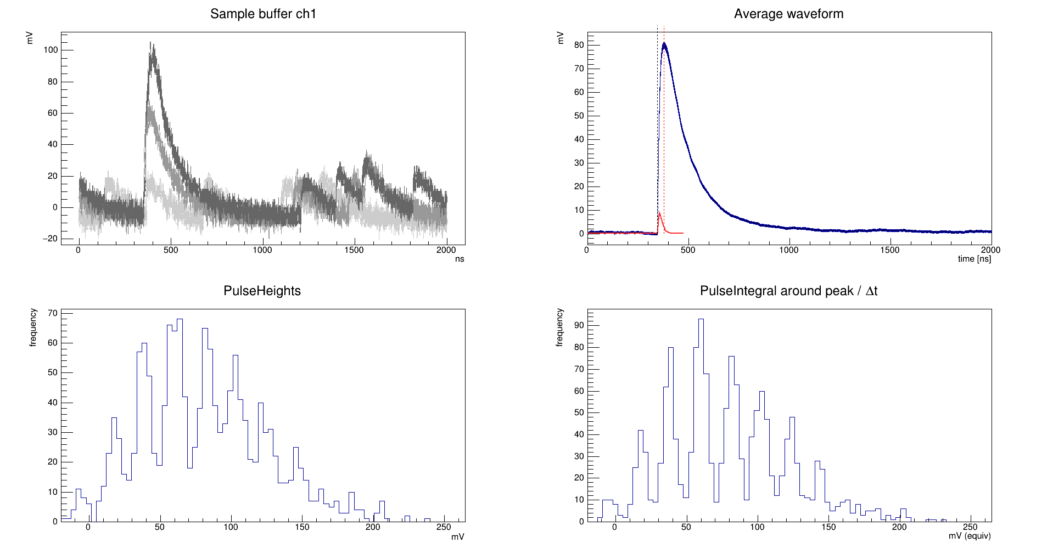
Cooling: Copper Manifold, TEC, external Chiller
39.8V, 4C, PQ 515 nm LASER

Slide 7
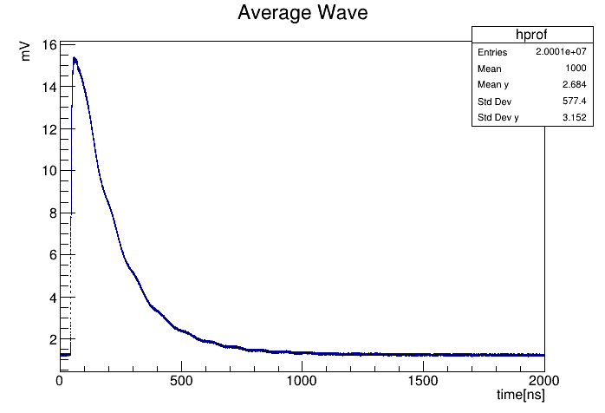
SiPM Response (No Amplifier) 40.5V, Hamamatsu 6mm^2

Slide 8
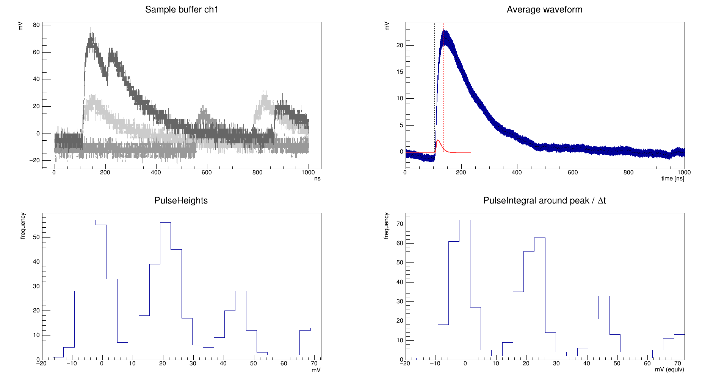
Single Pulses (Red LED ~9ns pulse, vBias: 40V) RTemp

Slide 9
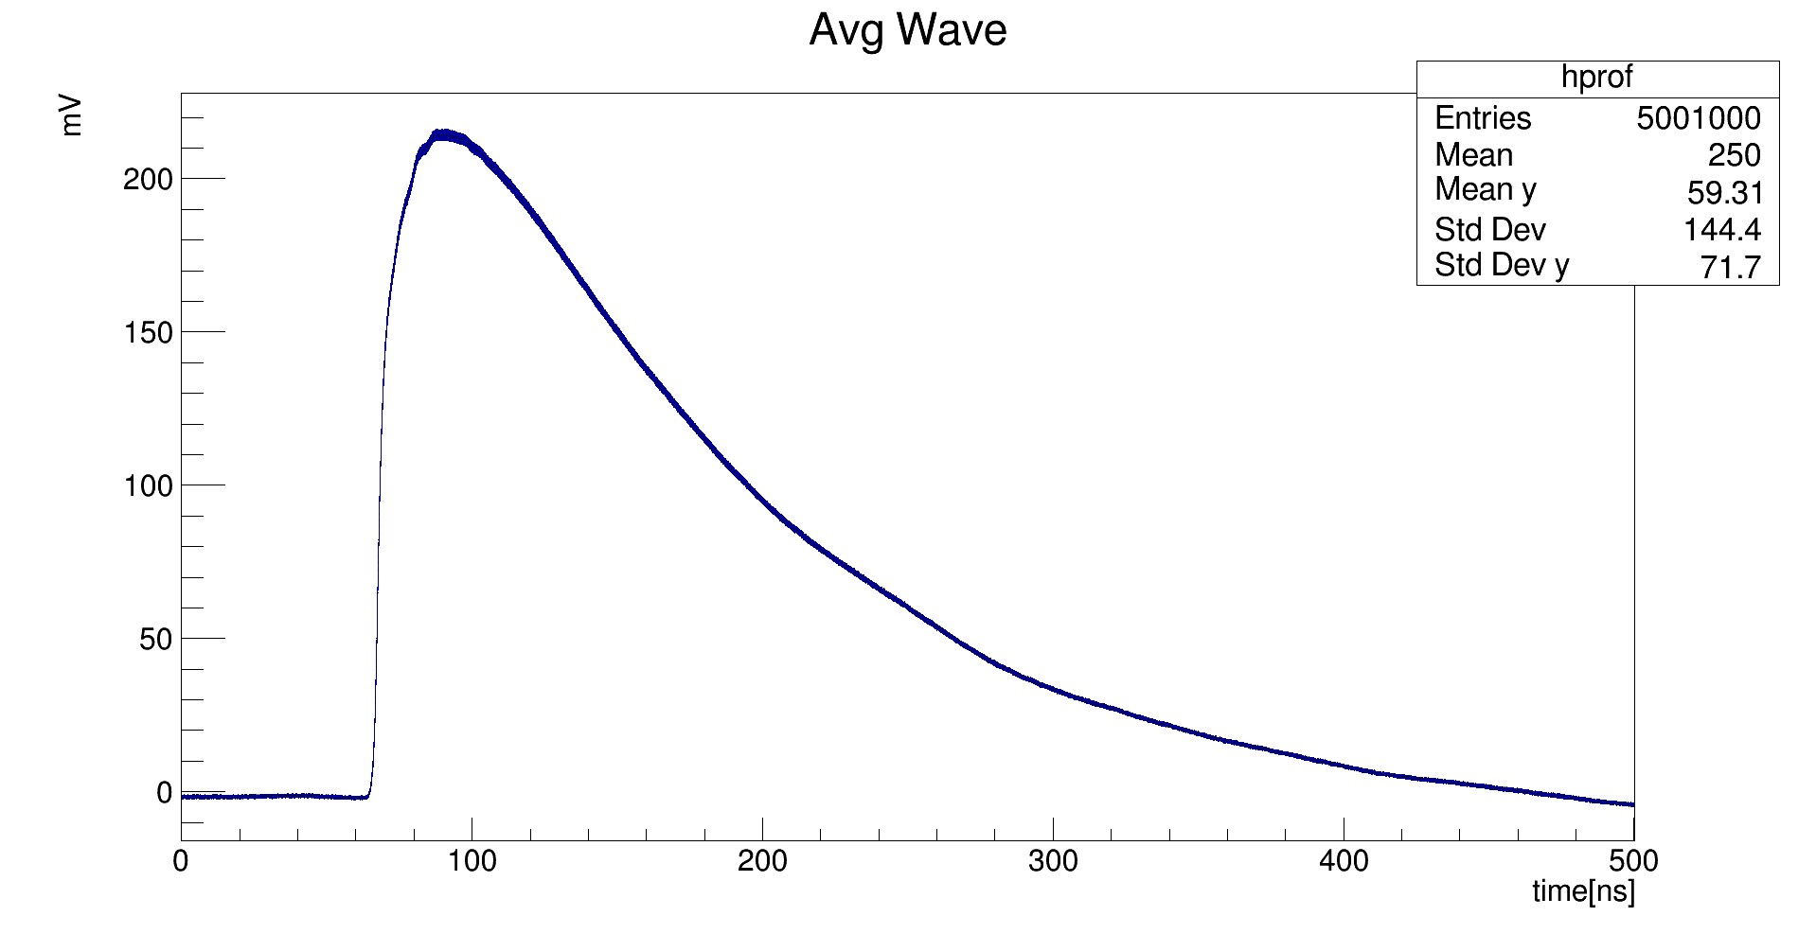
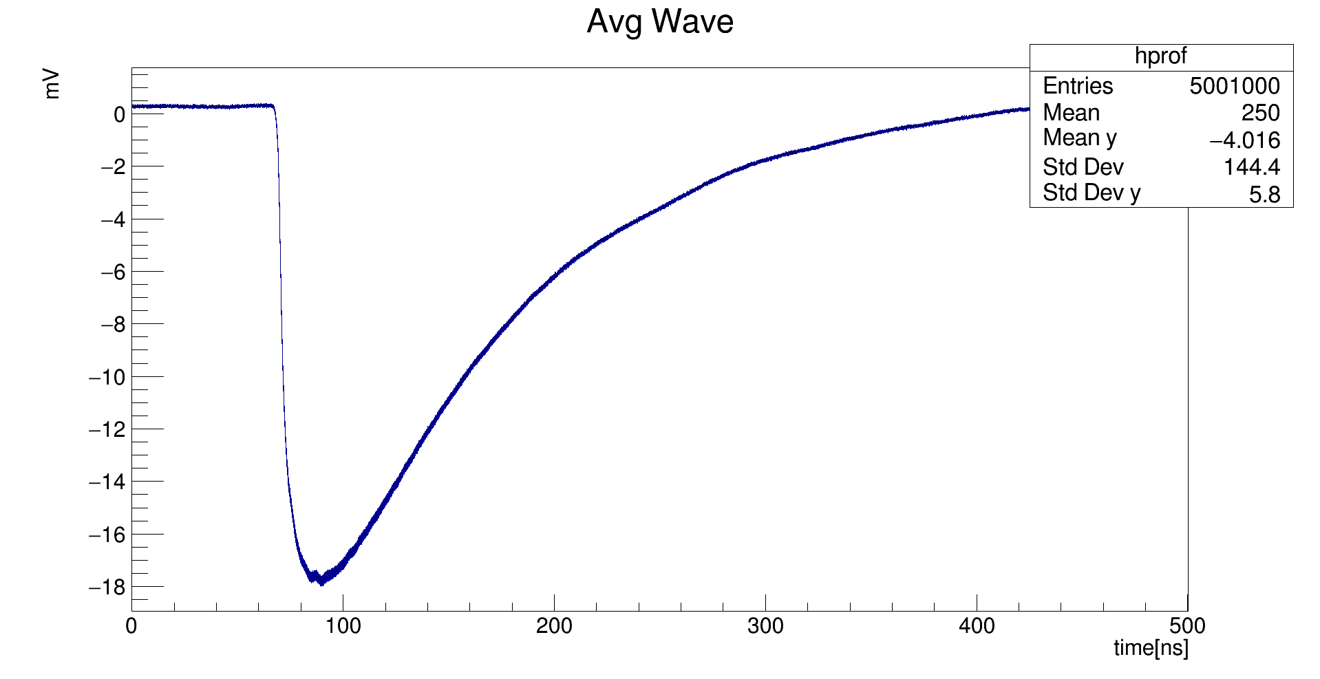
Fast Laser Pulse (514 nm, FWHM 120ps)
Low Gain
High Gain

Slide 10
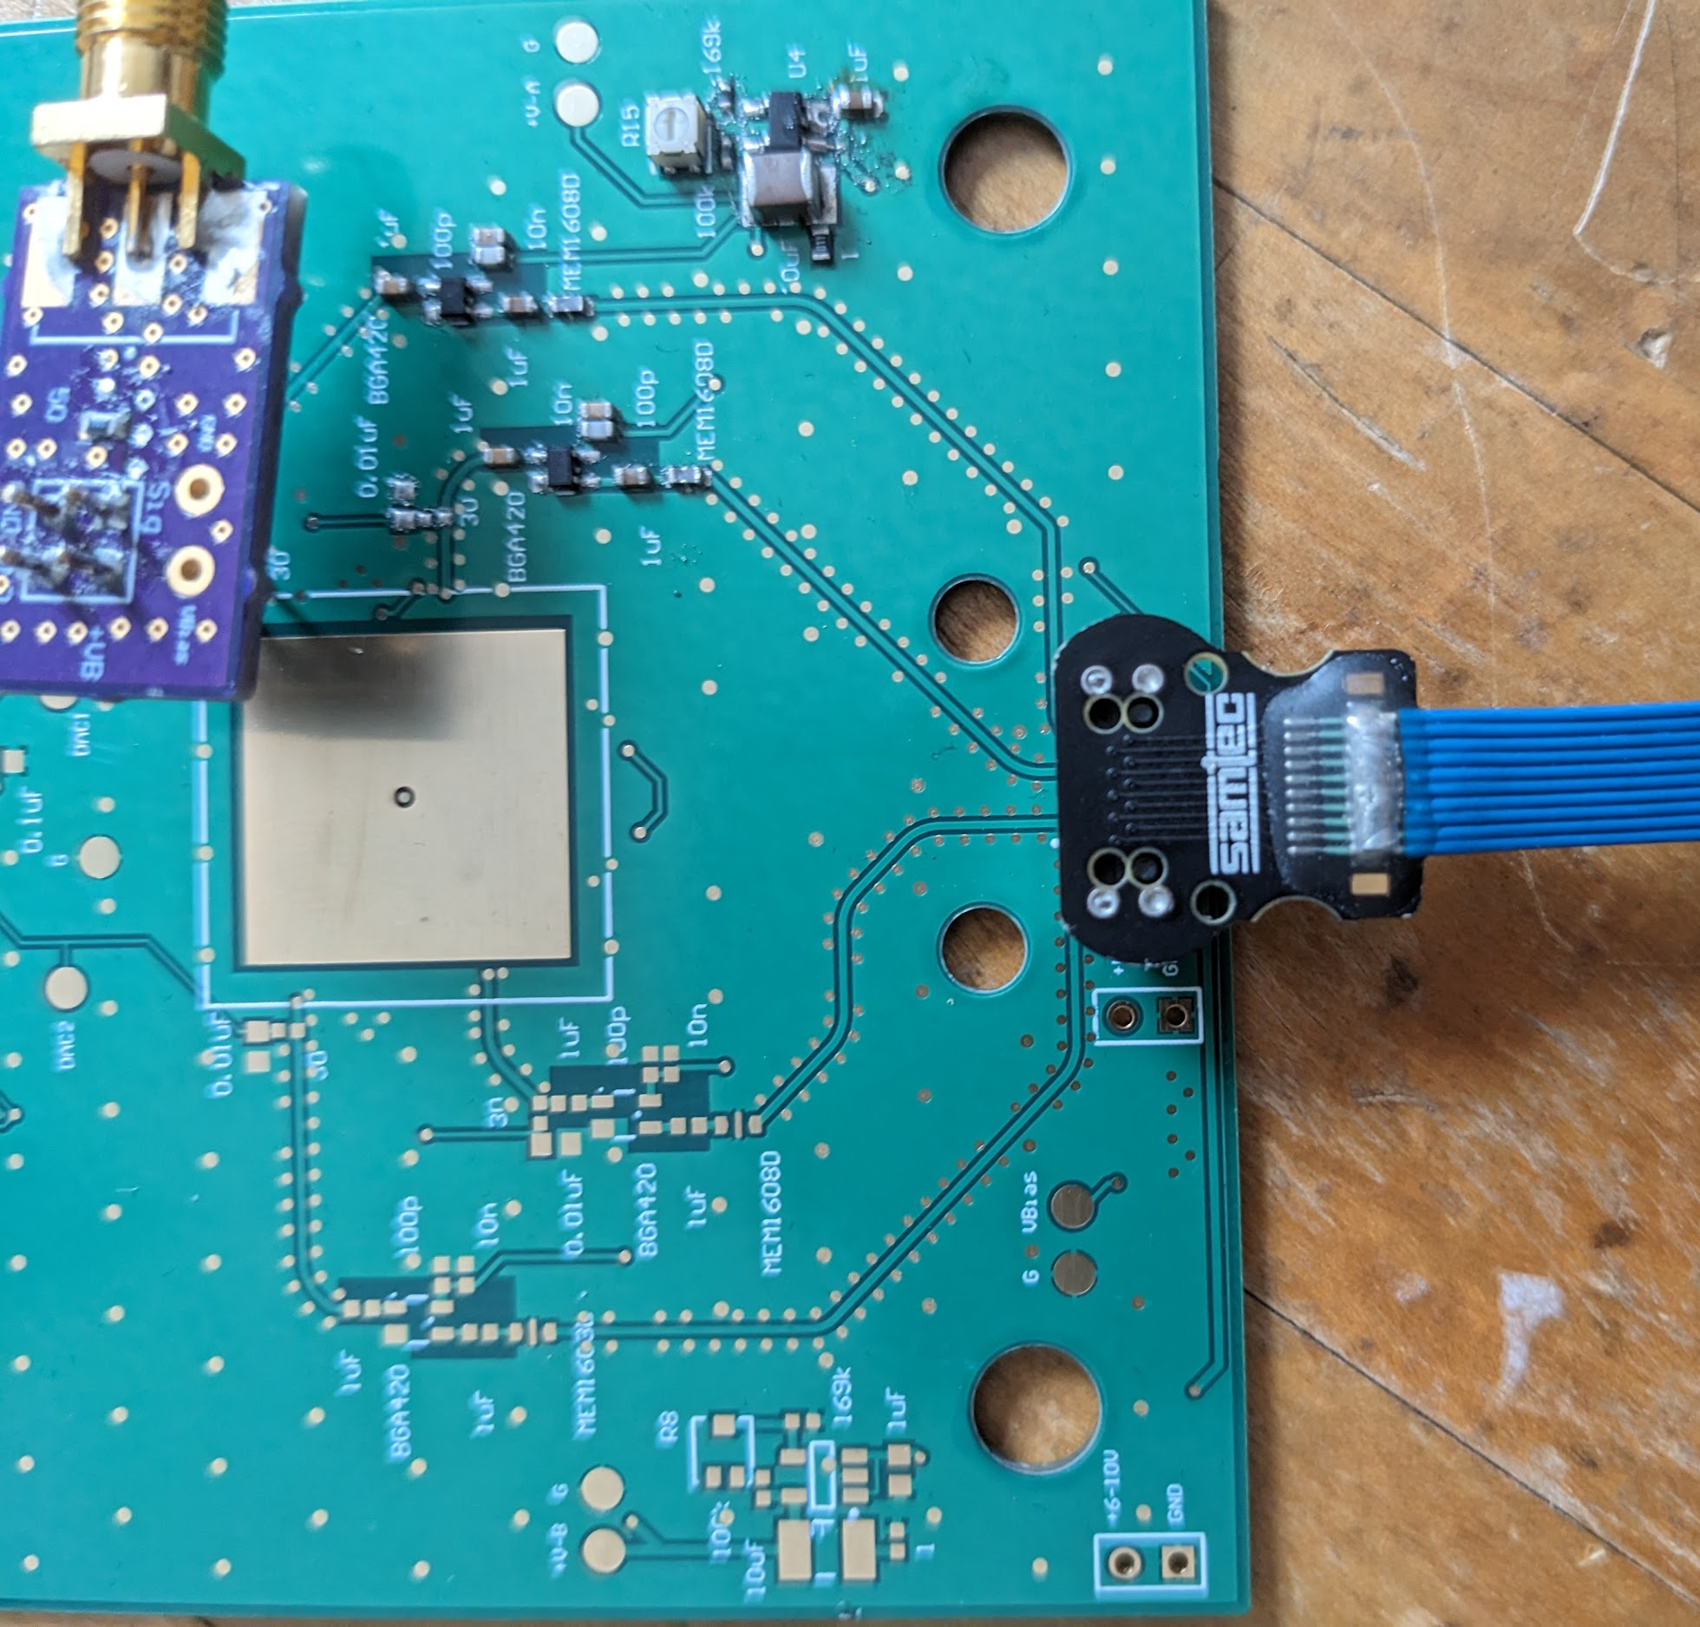
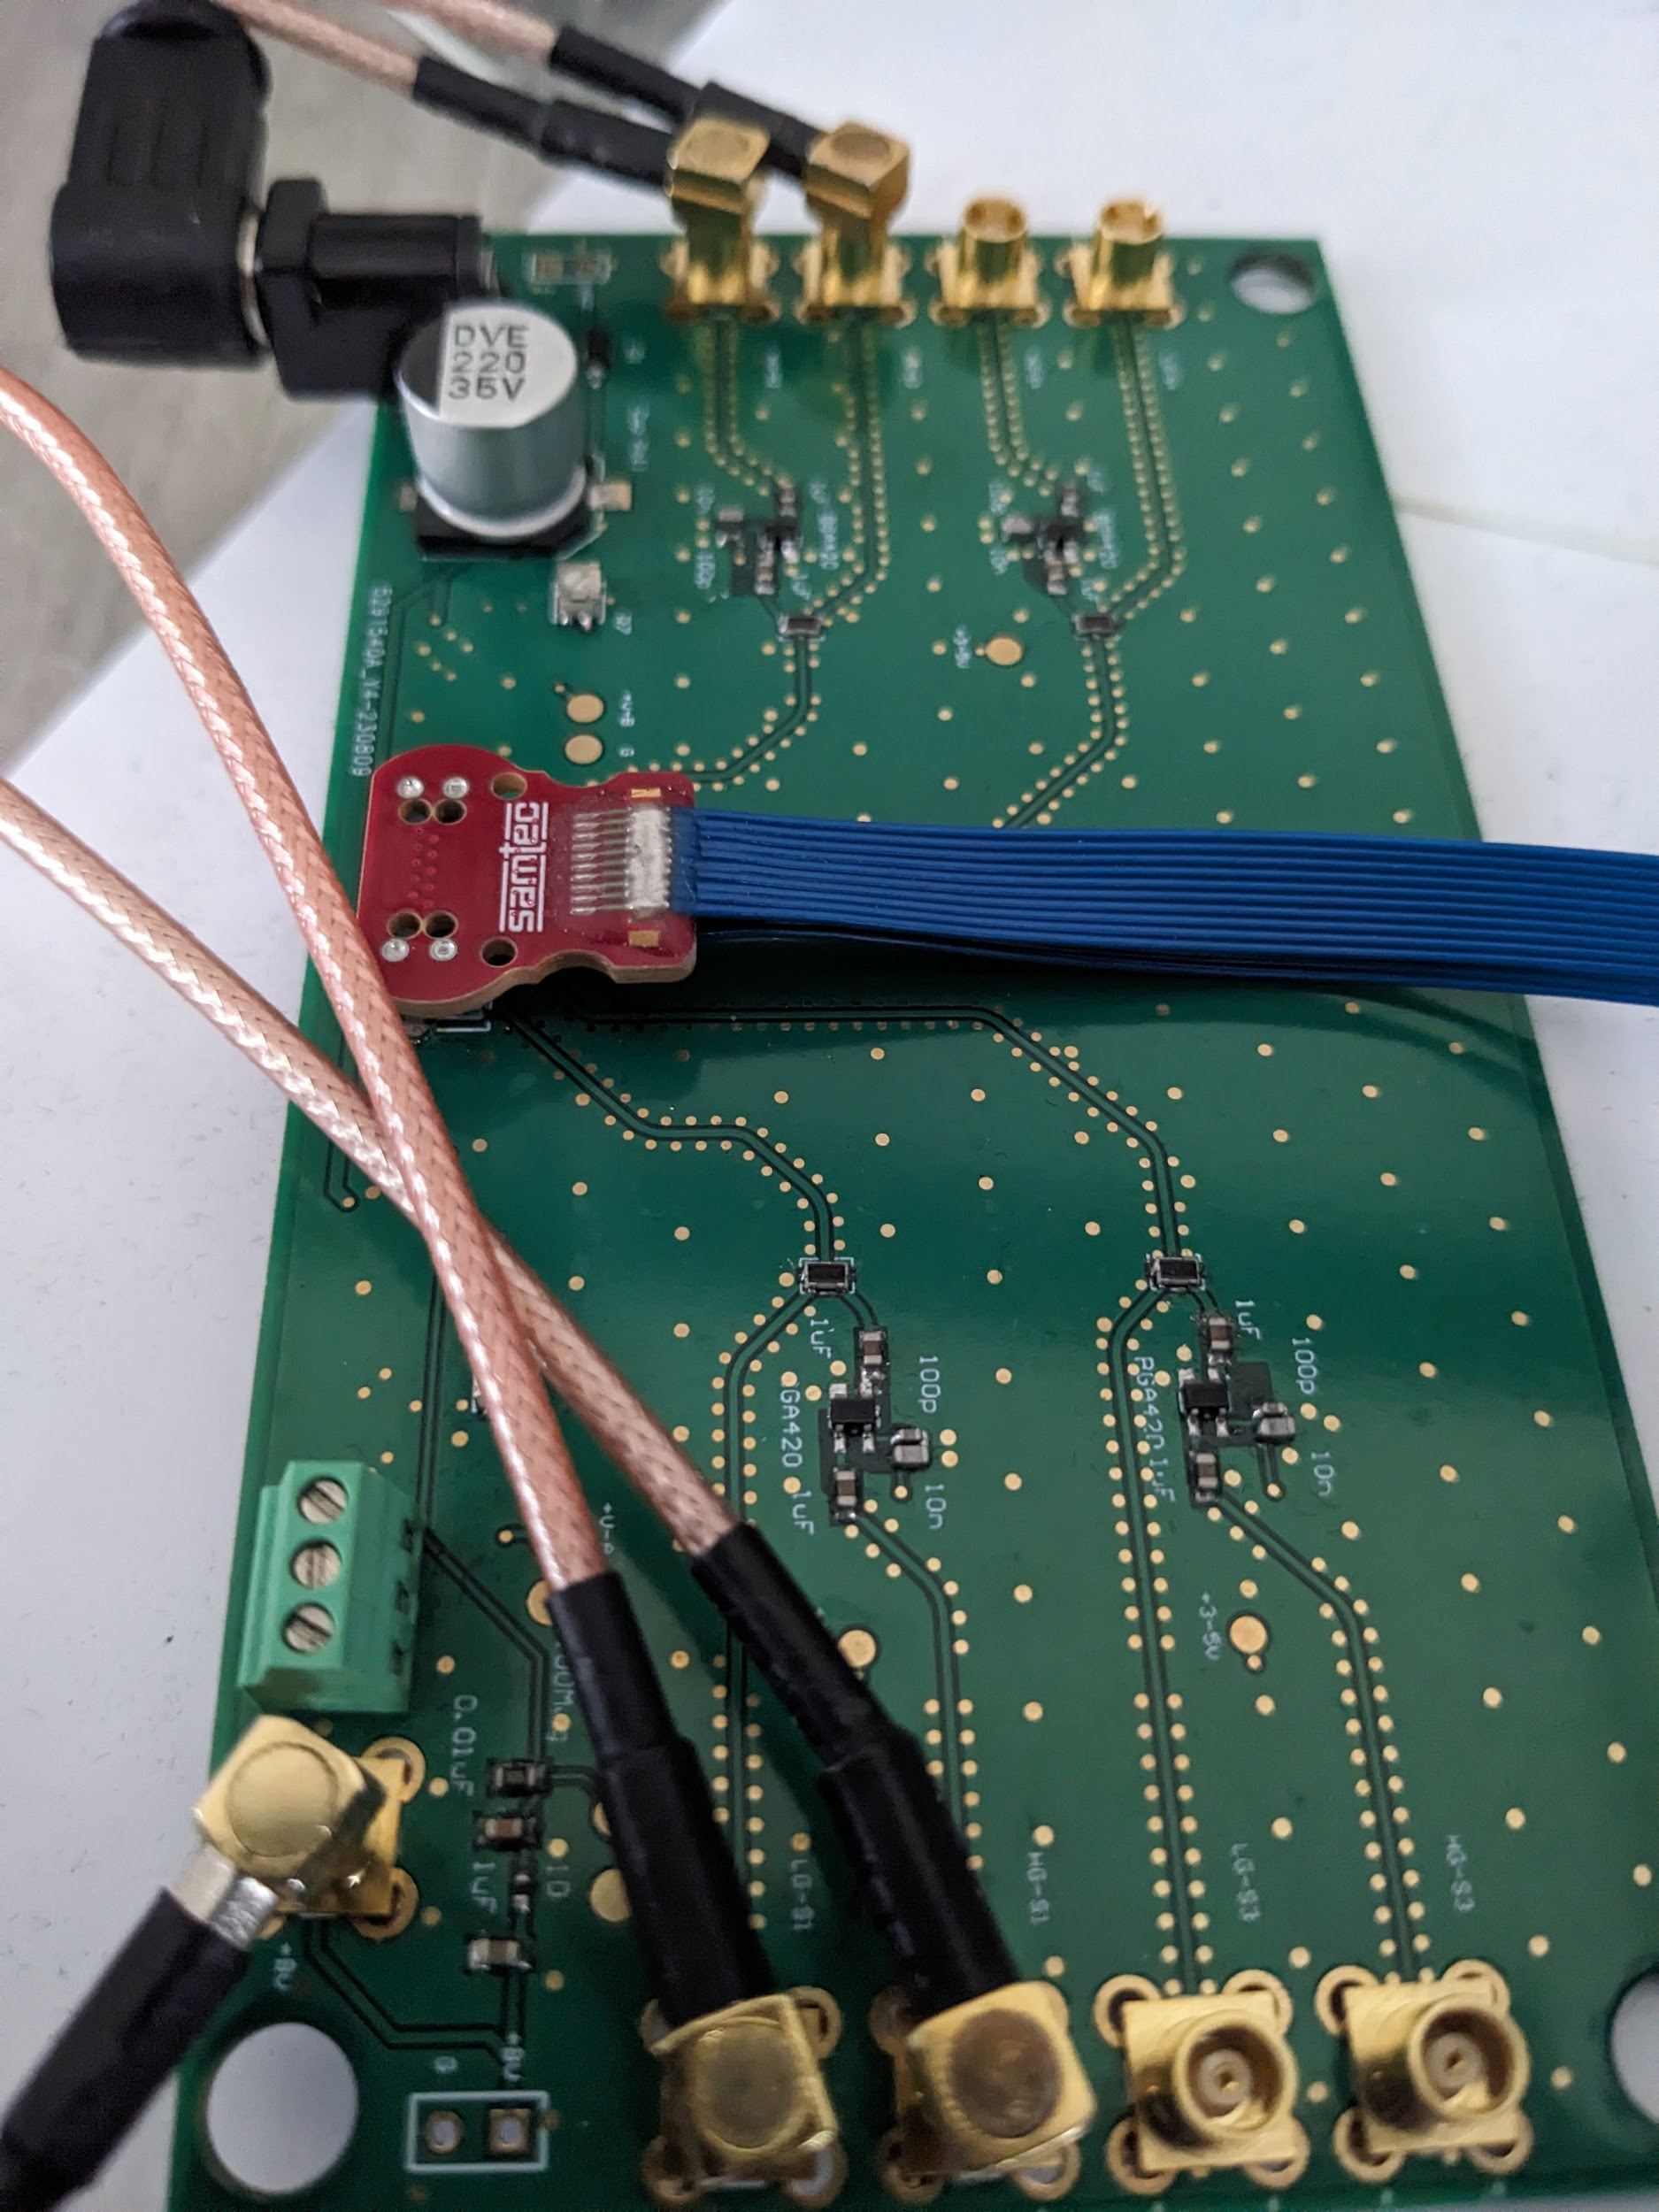
Amplifier Linearity: Still ongoing (Here’s the test setup)
Signal Injection
Two instrumented stages
Backend Card

Slide 11
To Do
Building Mechanical Mounting Setup for Electronics and MCP
Final Parts Order
Send PCBs out for assembly
Finish Linearity Study
Telescope and DT5495 Trigger Setup / Testing

