Slide 1
Residual dose studies in support of PIP-II Linac commissioning (stage at 32 MeV)
Igor Rakhno
Target Systems Department
November 16, 2023

Slide 2
Outline
Introduction
Major goal of this study
Current options for residual dose calculations in MARS code
Predicted dose distributions
Conclusions

Slide 3
Introduction
We get questions like “when does the residual dose exist?” and “what is the composition of the residual dose?) even in recent discussions with people who work with beamlines for a long time. That’s why this intro makes sense.
Residual dose is due mostly to γ generated by unstable nuclei in de-excitation processes.
In turn, the unstable nuclei are generated by primary beam – as well as by secondary particles – in interactions with surrounding matter (beam pipe, magnets, concrete walls, …. everything except vacuum).
The residual dose matters mostly when beam is OFF and people get access to areas with irradiated equipment. It starts to build up from the very 1st irradiation of the system, and during subsequent irradiations (beam ON) residual dose can be higher than prompt dose (from physics standpoint) if beam intensity is low enough. One can say that, at any time, residual dose is never = 0 (just very low or very low) – in contrast to prompt dose.
Residual dose reduction with cooling time takes place.
Every single residual nucleus is unique ($e^{−λtc}$).
For a collection of residual nuclei (usually 10s or 100s), one needs to solve Bateman equation using calculated nuclei production rates as an input.

Slide 4
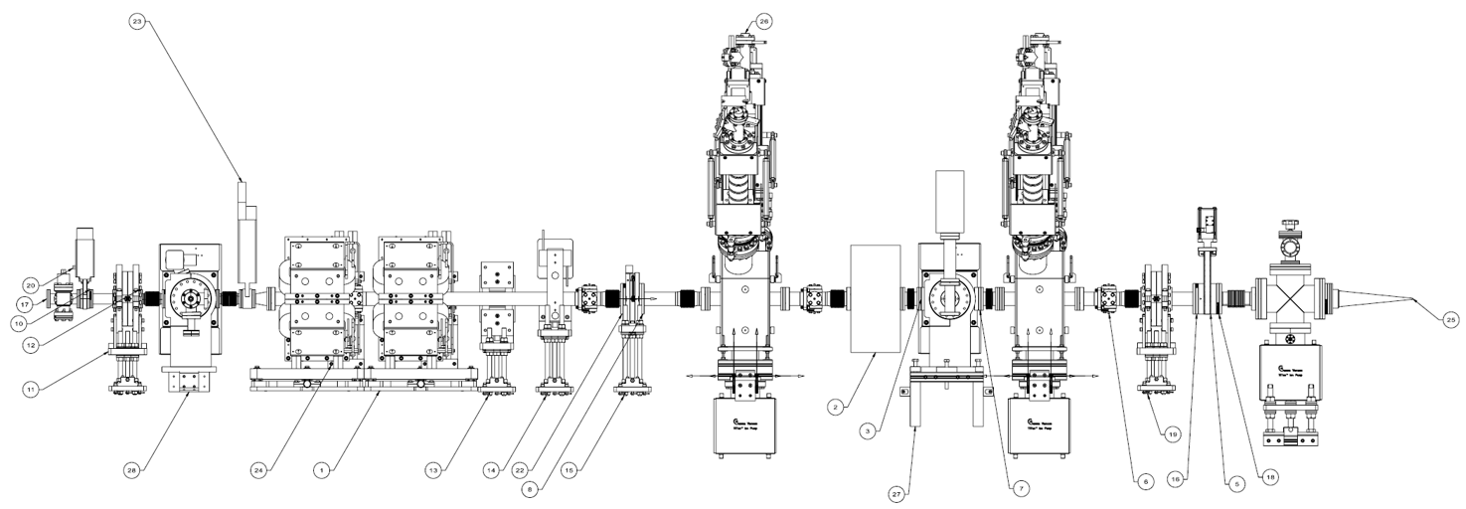
Major goal of this study
PIP-II Linac commissioning comprises several stages (5 families of SRF cavities) starting from warm front end. It will last for months.
Various measurements will be performed at 32 and 177 MeV using a removable instrumentation cart.
Distribution of predicted residual dose around the location with the cart is needed.

Slide 5
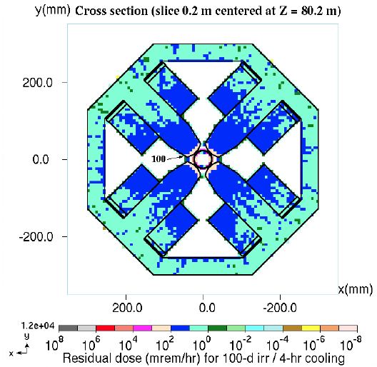
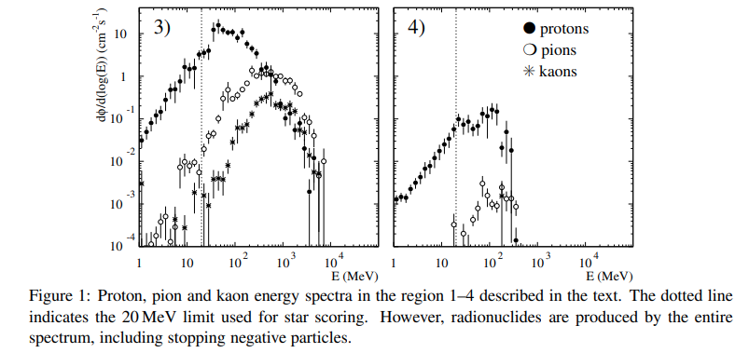
Current options for residual dose calculations in MARS code – long story short
One of initial options was using so-called omega-factors to calculate residual dose on contact (Mika Huhtinen et al., CERN/FLUKA, 2000s).
Residual dose is provided only in dense material, nothing in the air.
Data tables for various projectiles in various target materials at various energies.

Slide 6
Current options for residual dose calculations in MARS code – long story short (2)
A straightforward option can be used when processing decay γ as regular secondary particles. From physics standpoint, the only (numerical) difference is that time (of flight) of these gammas is usually well beyond the times corresponding to the primary and secondary particles that participate in nuclear cascades when the beam is ON.
A database is needed that allows us to simulate the decay γ production by each secondary unstable nucleus.
The most user friendly. A user needs to define irr/cool time profile, a region, beam intensity.
The calculation is done simultaneously with main modeling itself. No extra intermediate files.
A perfect approach for a beamline in a tunnel without very thick objects such as absorbers: just beamline itself, magnets, support structures, …
A “source file” option – looks preferable for systems with thick objects (in terms of λ_{in}) and when time to transport particles from source to regions of interest is high. The source file can be re-used multiple times. Various flavors of this are possible:
Generated unstable nuclei are calculated for regions (materials) of interest and used as an input for subsequent generation of decay γ. Usually, a dedicated material is needed for each region of interest. Uniform spatial distribution over the region is used.
A special spatial binning, e.g. FermiCORD implemented by V. Pronskikh – the only user of this option. A tricky 3D binning.
Nuclide distributions over arbitrary meshes (regular, rectilinear, unstructured) built using a CAD representation of original model (implemented by I. Tropin).
… other tricky binning … ?
Last but not least, a simple (X, Y, Z, DCX, DCY, DCZ, E, W, Zres, Ares, TOFF) distribution.

Slide 7
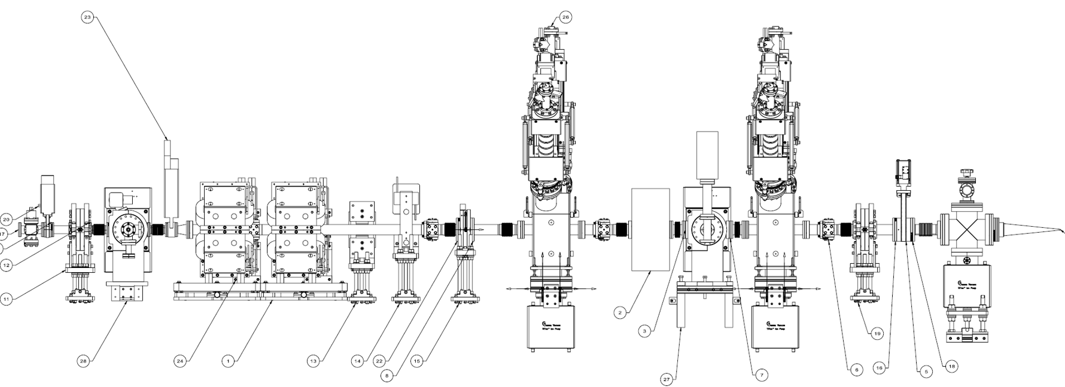
Predicted dose distributions (32 MeV / H⁻)
Irr/cool time profile: 16 hr/day, 4 days/week, 4 weeks followed by 24 (72) hr cooling.
The studies have been done for 2 scenarios – suggested by a PIP-II group:
The test beam is deposited uniform along the beam section on the instrumentation cart at 13.2 W rate;
The test beam is deposited in the Farady cup at 36.3 W rate.
The group already knows that prompt radiation even at such low energies can not be neglected – corresponding studies for a beam absorber have been done a few years ago. The major player is radiative capture in (p,γ) reactions. Now is the time for residual radiation.

Slide 8
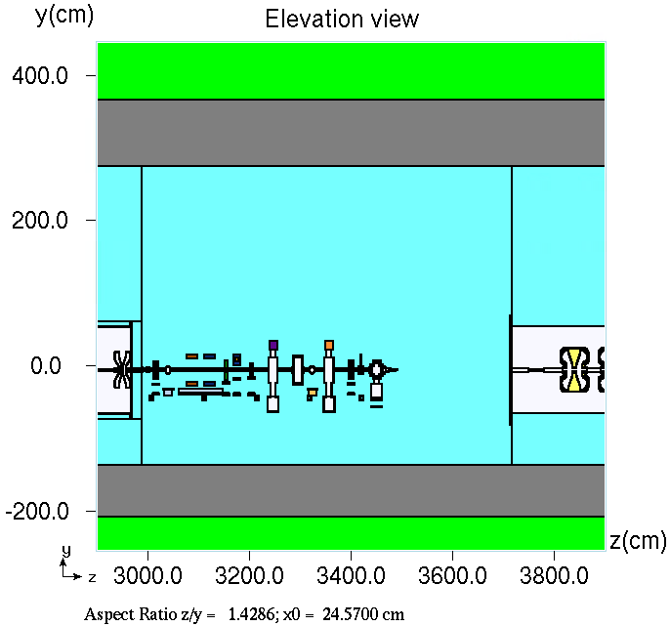
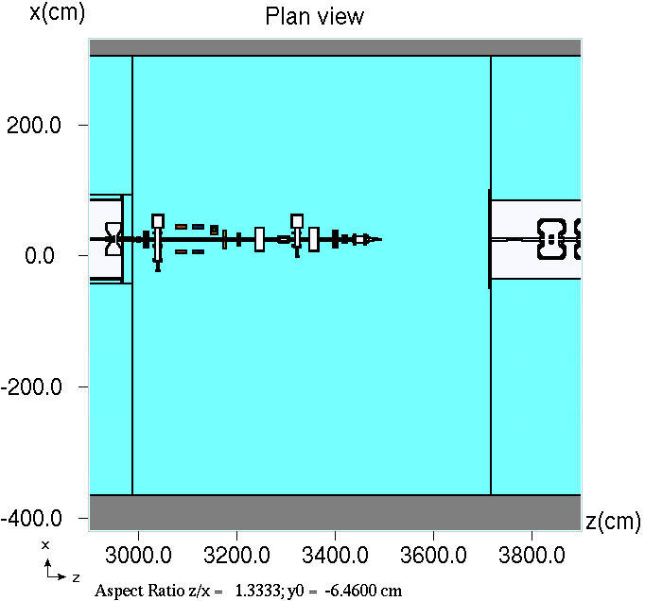
Predicted dose distributions (32 MeV / H⁻)

Slide 9
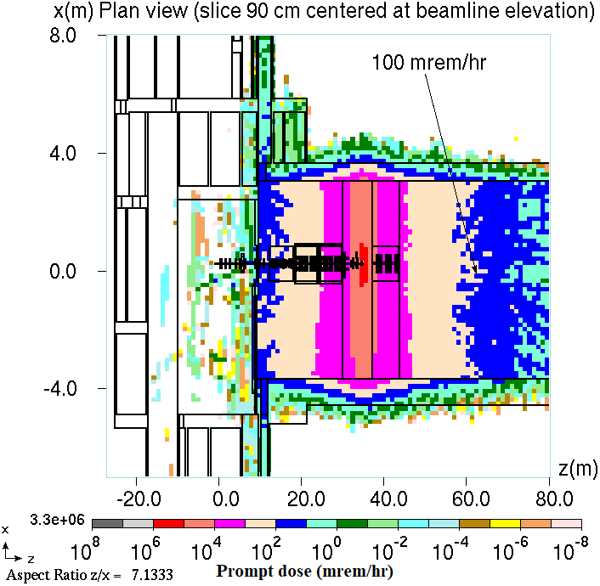
Predicted dose distributions (32 MeV / H⁻) 13.2 W along beam pipe 36.3 W in Faraday Cup

Slide 10
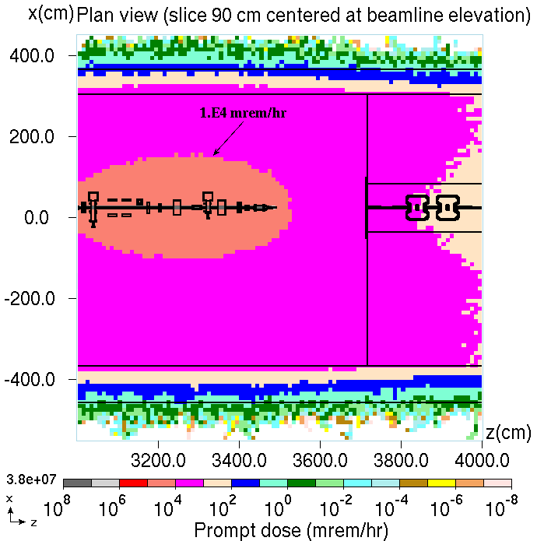
13.2 W along beam pipe 36.3 W in Faraday Cup

Slide 11
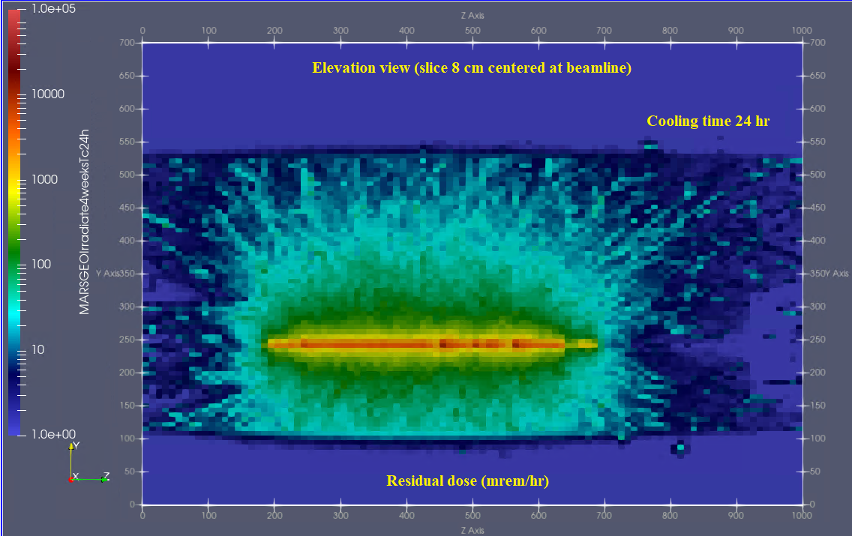
13.2 W lost along beam pipe – Elevation view

Slide 12
13.2 W lost along beam pipe Elevation view
100 mrem/hr at 4 ft from beam pipe
A simple estimate of γ flux at 4 ft from the beam pipe as well as
γ flux-to-dose (FTD) conversion factor (ICRP103) gives us exactly this number, 100 mrem/hr.

Slide 13
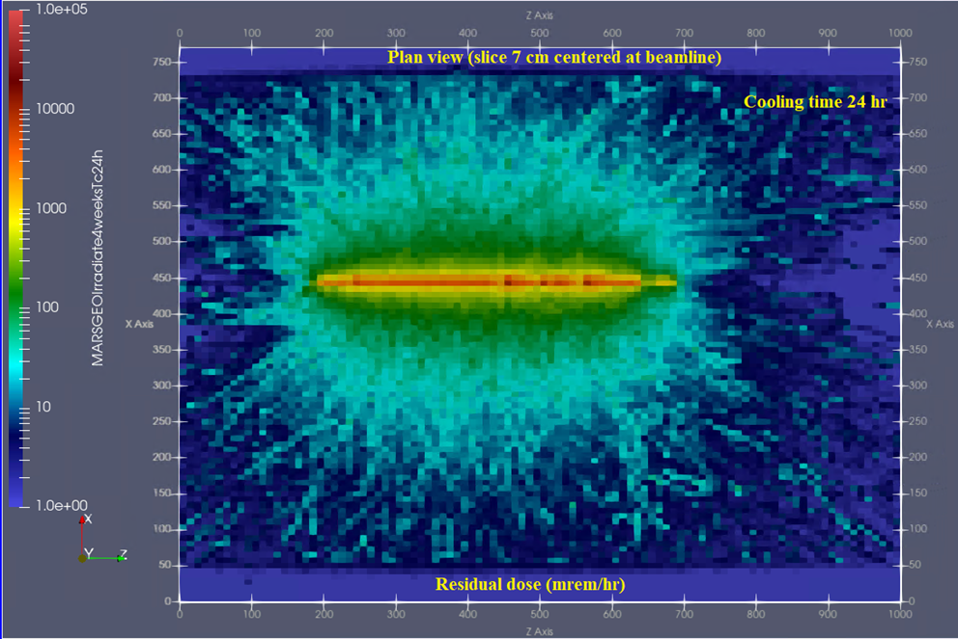
13.2 W lost along beam pipe Plan view

Slide 14
13.2 W lost along beam pipe Plan view Elevation view

Slide 15
13.2 W lost in along beam pipe Elevation view Cooling 24 hr Cooling 72 hr (~80% compared to 24 hr)

Slide 16
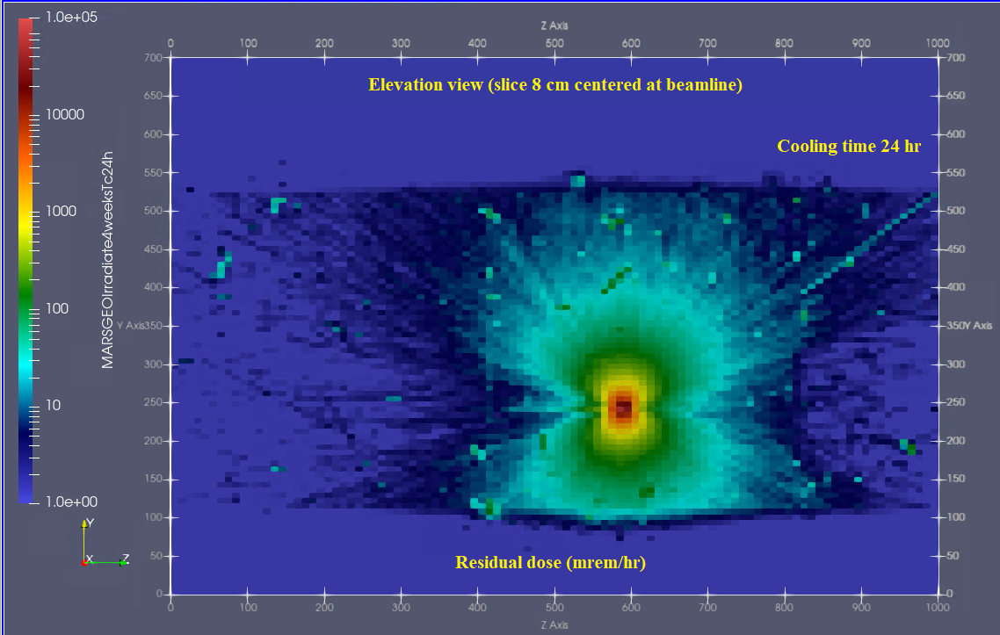
36.3 W lost in Faraday Cup Elevation view
100 mrem/hr at 5 ft from Faraday cup

Slide 17
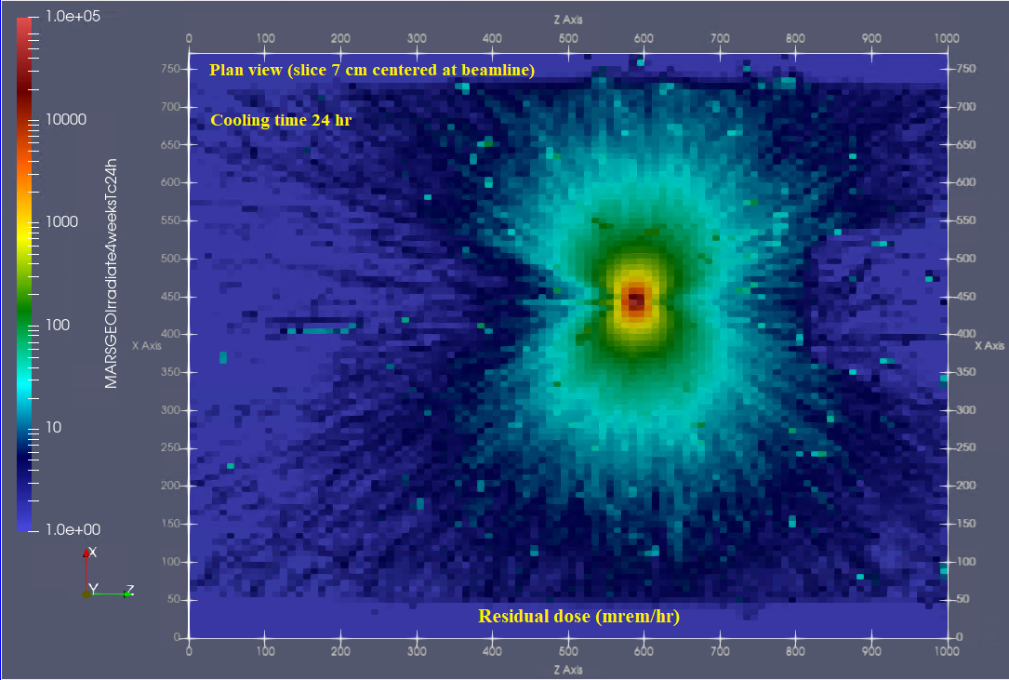
36.3 W lost in Faraday Cup Plan view

Slide 18
36.3 W lost in Faraday Cup Plan view Elevation view

Slide 19
36.3 W lost in Faraday Cup Elevation view Cooling 24 hr Cooling 72 hr (~50-60% compared to 24 hr)

Slide 20
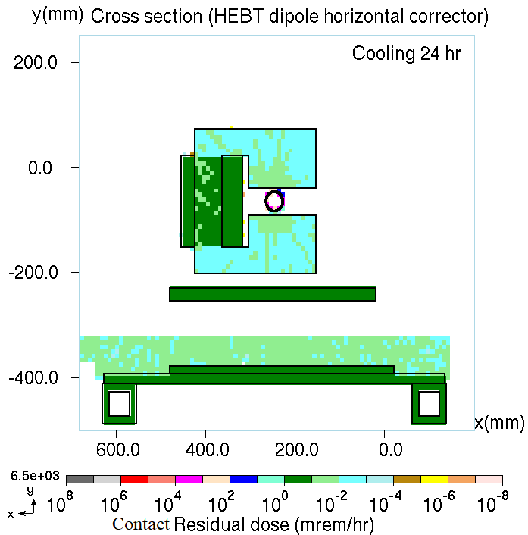
Comparison with “contact residual dose”

Slide 21
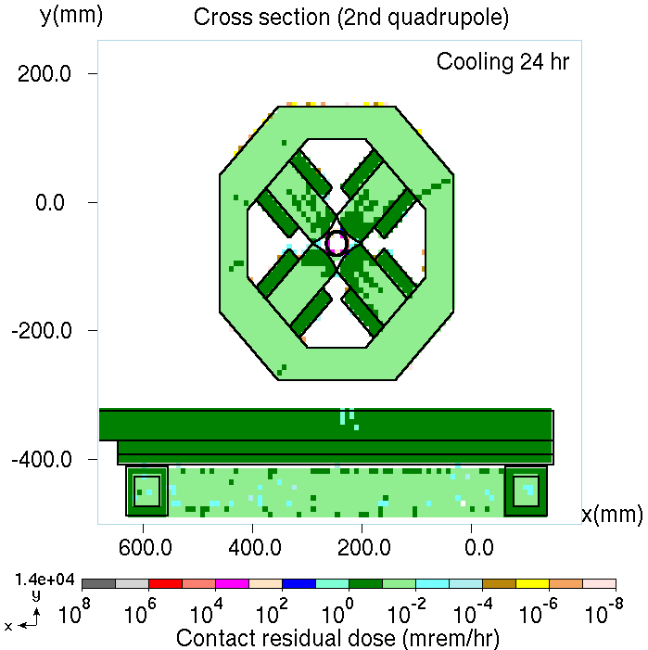
Comparison with “contact residual dose”

Slide 22
13.2 W along beam pipe 36.3 W in Faraday Cup Elevation view

Slide 23
13.2 W along beam pipe Elevation view Cross section at Z=32.6 m (MARS model)

Slide 24
Distribution of secondary nuclei generated in the tantalum Faraday Cup
The first and second columns of the table provide symbol of a chemical element and mass number of the generated isotope, respectively. The fourth and fifth columns provide production rate of the isotope (number of nuclei per projectile, H⁻) and statistical uncertainty (1σ) of that rate, respectively.

Slide 25
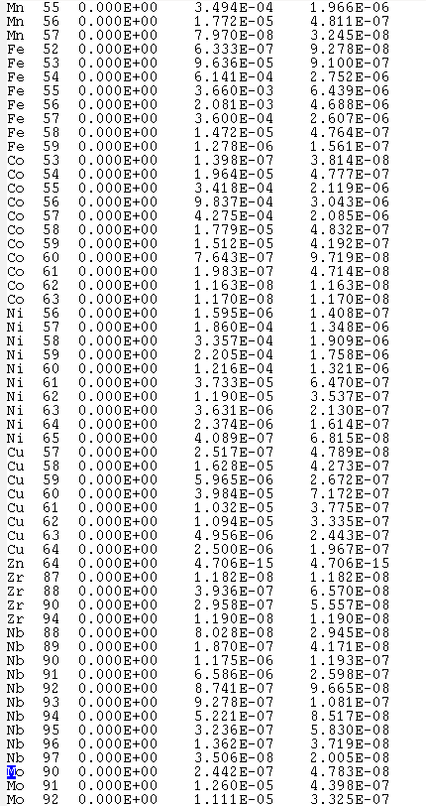
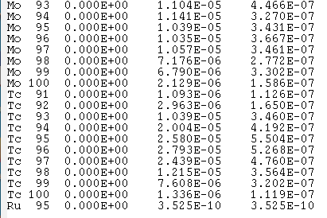
Distribution of secondary nuclei generated in the steel beam pipe
The first and second columns of the table provide symbol of a chemical element and mass number of the generated isotope, respectively. The fourth and fifth columns provide production rate of the isotope (number of nuclei per projectile, H⁻) and statistical uncertainty (1σ) of that rate, respectively.

Slide 26
Conclusions
These results will help the PIP-II commissioning team to plan their work well ahead of time.
The irradiation scenario studied: beam ON is 16 hr/day, 4 days/week, 4 weeks. Cooling time 24 hr minimum.
For the scenario of beam loss on the beam pipe (13.2 W):
Mostly beam pipe is activated.
Activation of other components on the cart – at 32 MeV – is significantly lower compared to the beam pipe. Radioactive nuclei are generated mostly inside the beam pipe.
Residual dose is ~100 mrem/hr at 4 ft (along radius) from the beam pipe. Cooling time 24-hr.
For the scenario of beam loss on Faraday cup (36.3 W):
Mostly Faraday cup is activated.
Other components show negligible residual dose.
Residual dose is ~100 mrem/hr at 5 ft from the Faraday cup. Cooling time 24-hr.
Increase in cooling time from 24 to 72 hr corresponds to ~50% reduction in residual dose.
Integral activation of Faraday cup is higher compared to the “beam loss on beam pipe” scenario: (i) 36.3 W vs 13.2 W; (ii) tantalum activation is higher compared to steel activation, other things being equal.
For the “Faraday cup” scenario, the residual dose reduction with distance is more significant (point-like source) compared to the “loss on beam pipe” scenario.
Having analyzed these data, the PIP-II group decided to reduce the amount of pulses needed for the tests/measurements significantly (by a factor of 10 or 100), so that every single pulse will count. Hardware improvements.

Slide 27
A simple estimate
N_{p} (p/s) * 0.032 (GeV) * 1.6×10⁻¹⁰ (J/GeV) = 13.2 J/s, so that N_{p} = 2.6×10¹² p/s
F_{γ} ~ 10⁻² (γ/p) * N_{p} (p/s) / 2πRL (cm²) = 10⁻² * N_{p} / 2π*100*400 = 10⁵ γ/(cm²s)
FTD_{γ} (ICRP103) ~ 10⁻² (μSv/h) / (γ/cm²s) = 10⁻³ (mrem/h) / (γ/cm²s)
F_{γ} * FTD_{γ} = 10² mrem/h

