Slide 1
Outlook for BEACH 2026
Nickolas Solomey, Chair BEACH Advisory Committee

Slide 2
Reflection on the past
Freddie Freeman founded the conference in 1995 with the goal to bring Theocratist and Experimentalist together and to have established speakers presenting with post-doc and graduate students.
BEACH 2022 - Krakow, Poland
BEACH 2020 - Pittsburgh, PA, USA (Covid)
BEACH 2018 – Peniche, Portugal
BEACH 2016 - Fairfax, VA USA
BEACH 2014 – Birmingham, UK
BEACH 2012 – Wichita, KS, USA
BEACH 2010 – Perugia, Italy
BEACH 2008 – Columbia, SC, USA
BEACH 2006 – Lancaster, UK
BEACH 2004 – Chicago, IL, USA
BEACH 2002 – Vancouver, Canada
BEACH 2000 – Valencia, Spain
BEACH 1998 – Genoa, Italy
BEACH 1996 – Montreal, Canada
BEACH 1995 – Strasbourg, France

Slide 3
BEACH 2024, Charleston, SC
Hosted by Univ. of South Carolina, Alexey Petrov
It is always a major effort to undertake hosting a conference and we appreciate the wonderful job that Alexey and his team did in making this conference a great success.
Thanks to all of them

Slide 4

Next Conference will be:

Slide 5
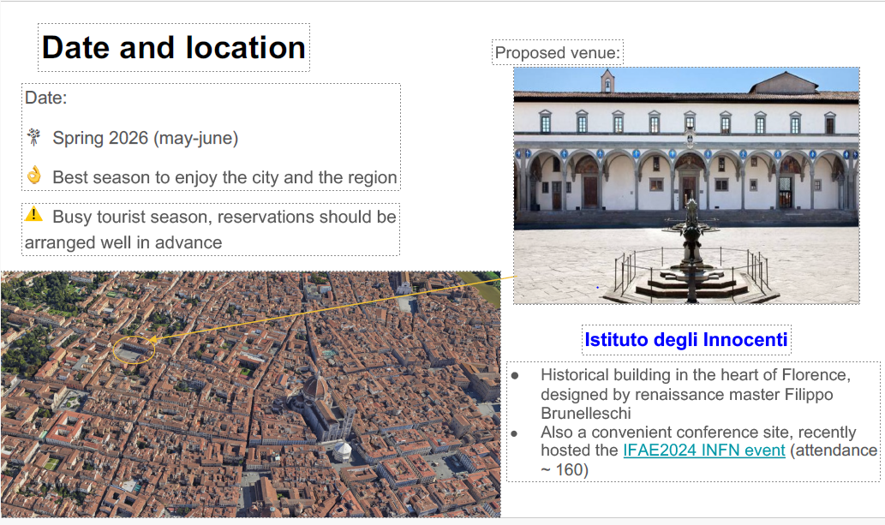

Slide 6
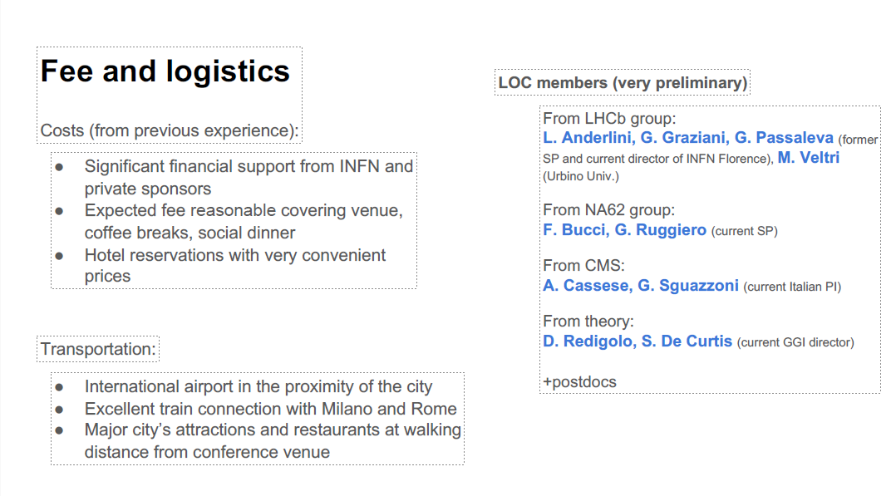

Slide 7
BEACH 2028
Those interested in hosting BEACH 2028, preferably in the USA, should contact the BEACH advisory committee:
Nick.Solomey@wichita.edu

Slide 8
Thank you for coming
We wish you good travel home, success in your work and time to enjoy life!
And we look forward to seeing you in BEACH 2026 in Florence Italy.

