Slide 1
The IOTA/FAST Facility: Status, Performance, Upgrades
Aleksandr Romanov on behalf of the IOTA/FAST team
IOTA/FAST Collaboration Meeting, 12 March 2024

Slide 2
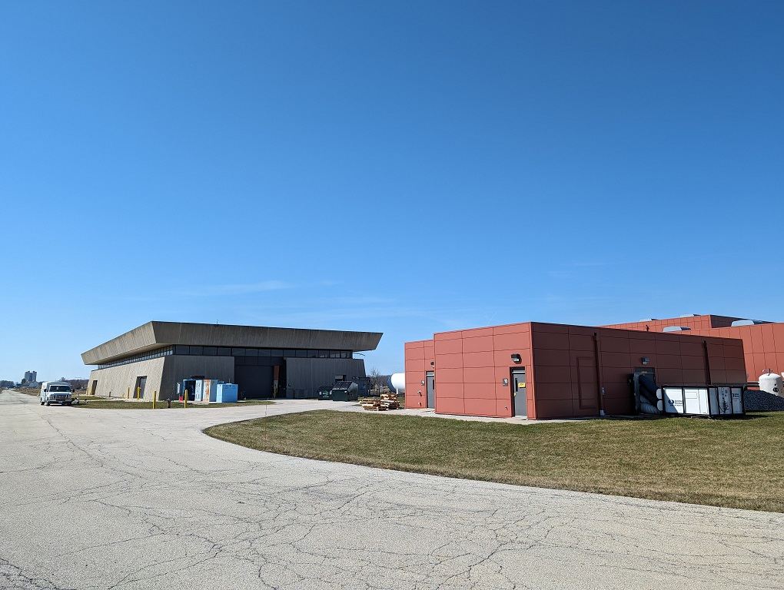
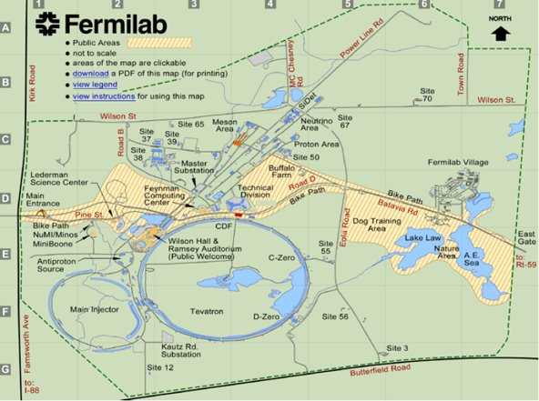
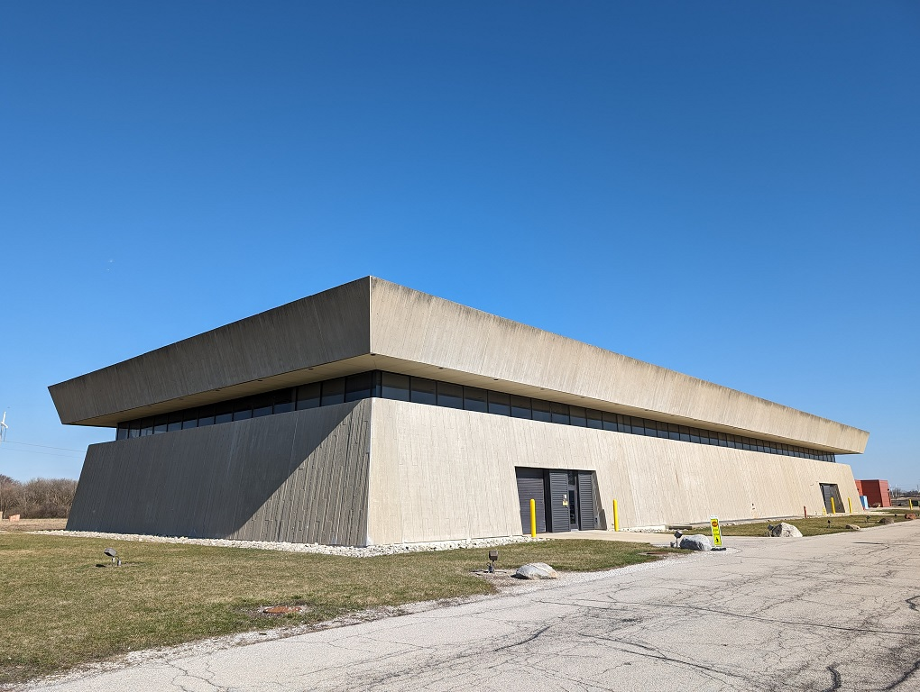
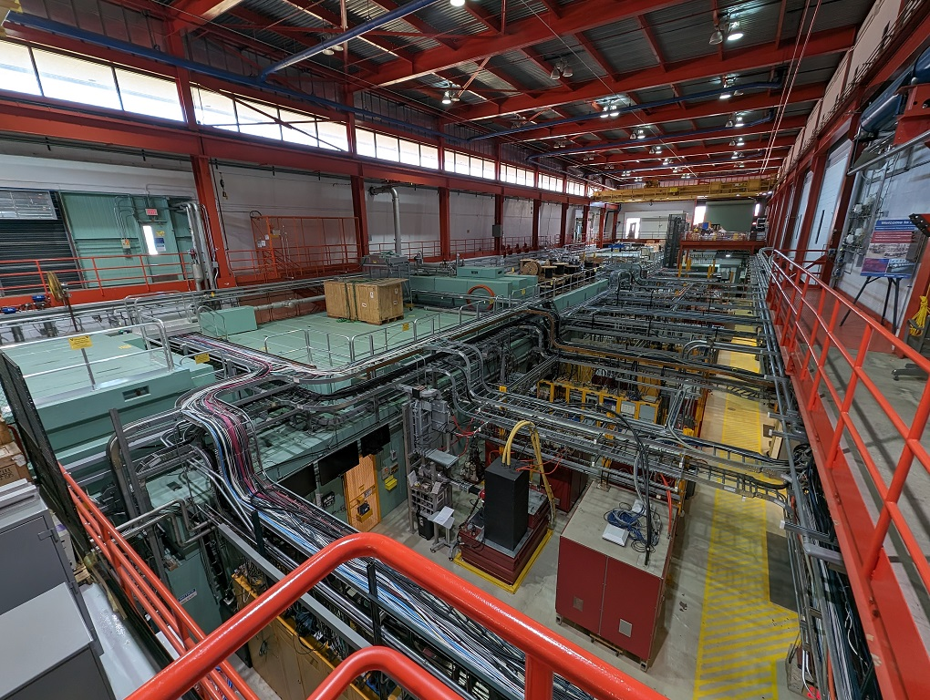
Locations
NML & ESB
NML
ESB
Lab 7
1 West
NML

Slide 3
IOTA/FAST accelerator complex
FAST is a superconducting linac with photoinjector
IOTA is a small storage ring
FAST can act as an injector of electrons for IOTA

Slide 4
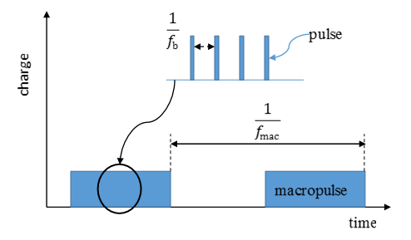
Electron Linac
The electron injector comprises a number of components, including a 5 MeV electron RF photoinjector, a 25-meter-long low energy (≤40 MeV) beamline and a ~100-meter-long high energy (≤300 MeV) beamline.
Parameter | Value
Beam Energy | 20 MeV – 300 MeV
Bunch Charge | < 10 fC – 3.2 nC per pulse
Bunch Train (Macropulse) | 0.5 – 9 MHz for up to 1 ms (3000 bunches, 3 MHz nominal)
Bunch Train Frequency | 1 – 5 Hz
Bunch Length | Range: 0.9 – 70 ps (Nominal: 5 ps)
Bunch Emittance 50 MeV, 50 pC/pulse | Horz: 1.6 ± 0.2 μm Vert: 3.4 ± 0.1 μm
JINST 12 T03002—2017, S. Antipov, D. Broemmelsiek, D. Bruhwiler, et al

Slide 5
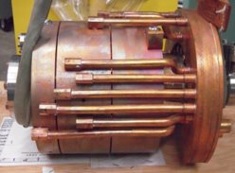
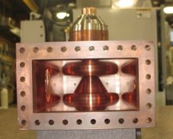
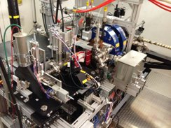
Electron Gun
1.3 GHz, normal conducting, 1.5 cell copper cavity (DESY/PITZ design)​
Up to 45 MV/m accelerating field at the cathode; requires 5 MW klystron; 20 KW average power at full ILC pulse length and repetition rate​
Cs2Te photocathode excited by 263 nm UV laser​
2 identical solenoids for emittance compensation​
Coaxial RF waveguide coupler ​
3 cavities have been fabricated​
1 by DESY – completed and shipped to Fermilab; 1st spare​
3 by Fermilab – 1 shipped to KEK; 1 completed and commissioned at NML; 1 as 2nd spare​

Slide 6
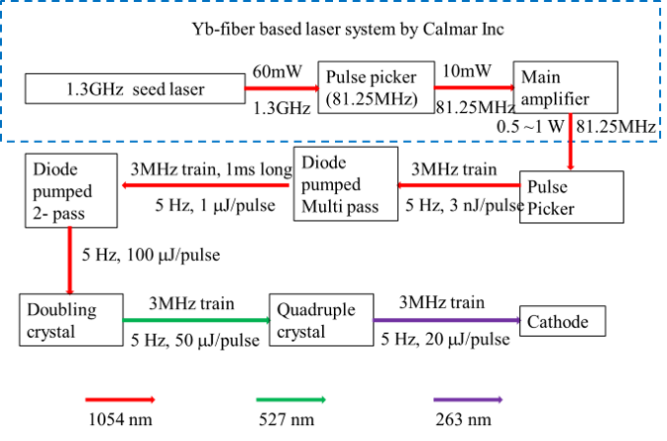
Laser

Slide 7
Laser Capabilities/Upgrades​
Nominal laser bunch train is at 3MHz. 9MHz is tested inside laser room.​
Higher frequency is also possible with the current laser configuration. However, the pulse energy is expected to drop linearly with the frequency change.​
Current laser is operated at 1Hz.​
5Hz operation is tested for the system as well.​
Seed laser is at 1.3GHz.​
In principle it is possible to pick 2 bunches separated at integer number of spacing(~720ps) to do pump probe measurement.​
Have demonstrated pulse shaping (IPAC2015 MOPMA043)​

Slide 8
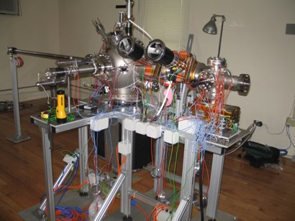
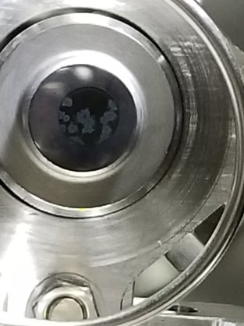
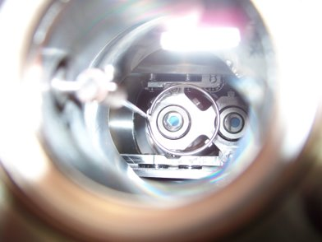
Cathode Preparation
Cathode chambers were fabricated at INFN Milano, Daniele Sertore​
Preparation chamber​
Transport chamber​
Transfer chamber​
Newborn
vs.
6 year old ​
Cathode preparation chamber at Lab 7​

Slide 9
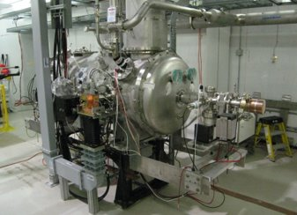
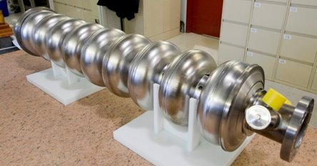
Capture Cavities
Two 1.3 GHz 9-cell SRF cavities​
CC1 at 17 MV/m​ (down from 27)
CC2 at 14 MV/m​ (down from 17)
Max beam energy of up to ~ 35 MeV​

Slide 10
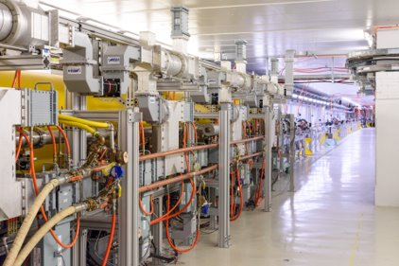
High Energy Beamline
CM commissioned. ILC goal reached. 250 plus MeV for beam.​
Currently we did 500 bunches at 3MHz maximum.​
Several beam line locations are available for R&D.
Possible space for more R&D.​
Undulator​
High energy chicane​

Slide 11
Linac Dimensions
B
A
A – 16m in 8 x 2m vacuum segments
B – 2.8m
– Instrumentation Crosses
– New Instrumentation Cross for ~32m spacing after cryomodule

Slide 12
FAST Linac Instrumentation
BPMs​
Capable of doing bunch by bunch monitoring at 3MHz ​
Can handle charge from 50pC to 3.2nC with different gain setting​
Transverse profile monitor​s
Live display ​
Longitudinal profile measurement​
Streak camera ​
Ceramic gap (non-interruptive)​
Charge measurement​
Faraday cup, Wall current monitor​
HOM detector with Capture cavity and CM​

Slide 13
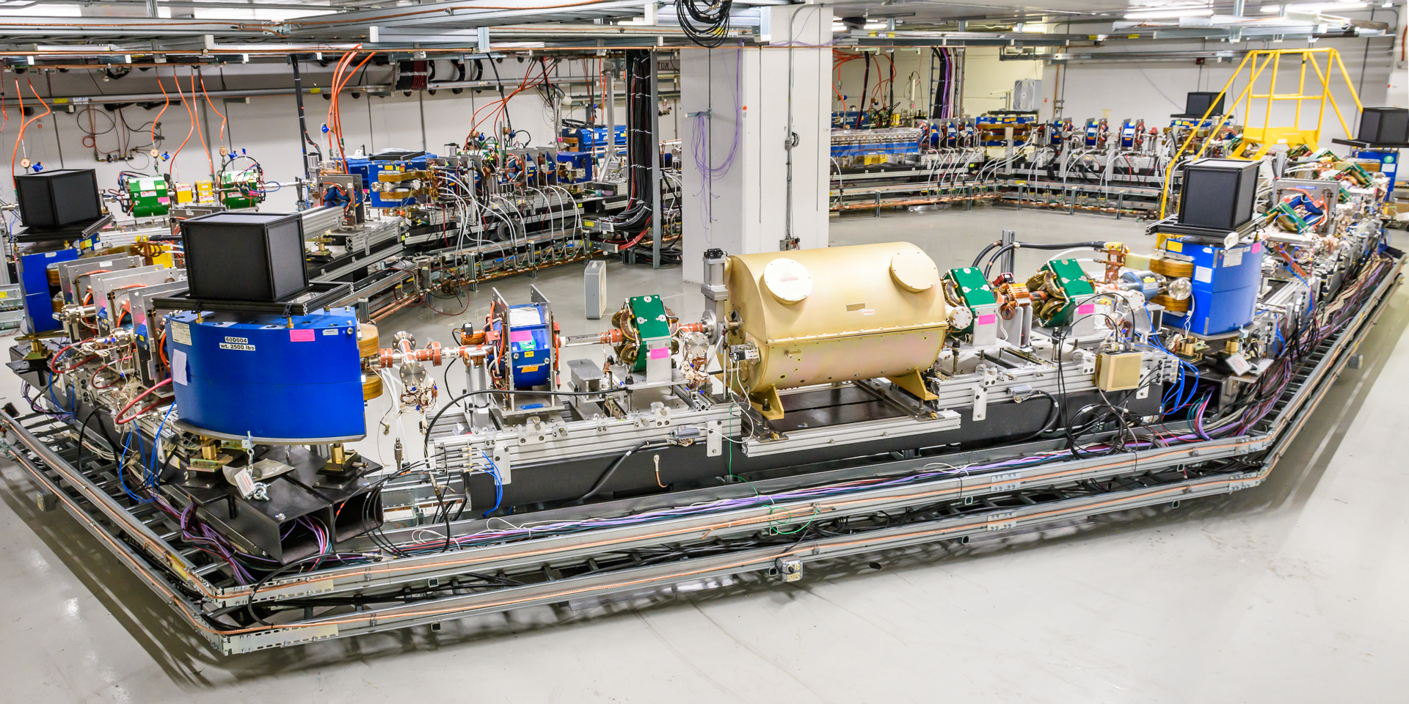
IOTA With Electrons
photo G.Stancari
Design momentum | 50-150 MeV
Perimeter | 40 m
RF voltage | 300 V
RF frequency | 30 MHz
3 Experimental sections | 2x180 cm, 1x150 cm
Main vacuum chamber aperture (R) | 25 mm
Lambertson and kickers aperture (R) | 20 mm

Slide 14
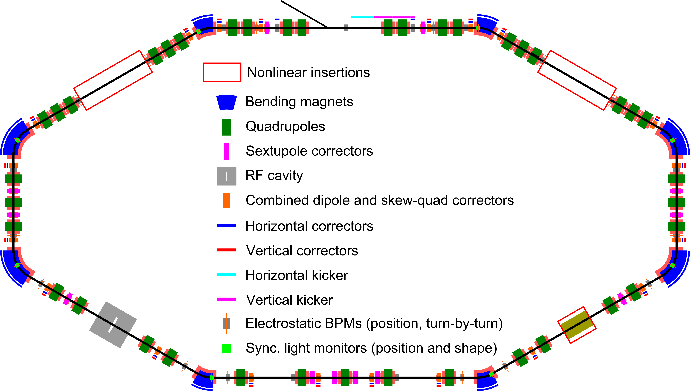
IOTA Layout

Slide 15
IOTA Main Components
Lambertson magnet |  | 1 | Horizontal, injection in vertical plane
Kickers |  | 1 hor. & 1 vert. | Horizontal for studies only
Main dipoles |  | 4x60 deg & 4x30 deg | Powered in series with Lambertson
Quads |  | 39 | Powered in pairs with individual shunts
Trims | Hor. | 8 | In main dipoles
 | Vert. | 2 | For injection bump
 | Hor. | 20 | Combined correctors
 | Vert. | 20
Skew-quads |  | 20
Pickups |  | 21 | Turn-by turn position
Sync. light monitors |  | 8 | Shape and position
RF |  | 1 | Dual frequency
Solenoid |  | 1 | For electron and McMillan lenses
Sextupoles |  | 12 | In six families
DCCT |  | 1 | Precision calibrated DC beam current
Wall current monitor |  | 1 | Bunch currents and longitudinal shape

Slide 16
IOTA Capabilities with Electrons
Commissioned momentum between 50 and 150 MeV/c
Wide range of beam currents: 1e⁻ to 4 mA
Versatile set of diagnostics tools
Individual control of all magnets
Developed set of software tools for new lattice commissioning
Takes 3-4 shifts to fully commission a new IOTA configuration
Injection matching, including FAST linac tuning
LOCO based lattice correction (beta beating 5% or better)
Beam based centering in various elements (50 um in the location of interest, 500um RMS around the ring)
Robust save/restore capabilities for quick switching between different experiments
Good vacuum conditions
Flexible access to the in-tunnel components

Slide 17
Beam Diagnostics
Optical diagnostics
Digital cameras
Up to 130 FPS (with ROI)
Single electron sensitivity (@ 500 ms exposure)
Software and hardware triggering
Streak camera
PMTs
SPADs
Convenient installation and commissioning of custom optical instruments
Electrostatic BPMs
DCCT
Wall-current monitor
Loss monitors

Slide 18
Lattice correction accuracy
NIO experiments are the most demanding in terms of lattice tuning precision:
Betas at the DN magnet | 1%
Overall beta beating | 3%
Dispersion | 1 cm
Closed orbit at insertion | 50 um
Phase advance errors | 0.001
Accuracy of the closed orbit responses must be 1 um at amplitude of 1mm as shown by modeling LOCO corrections of random lattice errors
Lattice was assumed to be linear, i.e. no sextupoles, fringe fields etc.

Slide 19
BPMs calibrations
A set of closed orbit samples was measured with the goal to map pickups current dependance around ideal closed orbit position.
2 trims for each plane were selected with ~Pi/2 phase shift to produce non-zero displacement in each BPM
ACNET glitches interfered significantly with data acquisition (stale readouts)
Partly recovered using logs
A total of 39 closed orbit in a current range of 0.1-0.5mA were recorded
Y
X

Slide 20
Sample of raw data
Y
X
Z_{fix,i}=C_{0i}+C_{1i} I+C_{2i} I²+C_{3i} I³
C_{k,i}= M_{k,i}+ N_{k,i}X+ K_{k,i}Y

Slide 21
Sample of raw data with and without correction
Current dependent calibration reduced RMS spread in the optimal current range:
from 2.75 um to 0.85 um on average

Slide 22
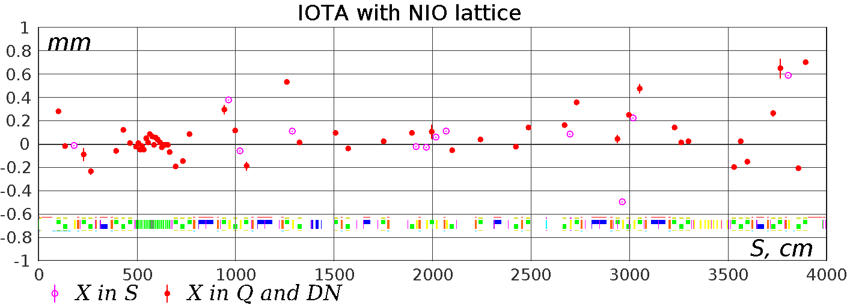
Example of closed orbit after correction
RMS orbit deviation in DN magnets with optimal orbit correction:
X: 41 um
Y: 30 um
RMS orbit deviation in quads and sextupoles:
X: 250 um
Y: 260 um
DN insert

Slide 23
Lattice correction accuracy
During Run-4 significant amount of time was dedicated to improving lattice correction accuracy.
The resulted lattice tuning accuracy as derived from independent measurements, turn-by-turn tracking of a kicked beam:
 | Goal | After correction
Betas at the DN magnet | 1% | 2% *
Overall beta beating | 3% | 2%
Dispersion | 1 cm | 0.5(2) cm
Closed orbit at insertion | 50 um | 40(5) um
Phase advance errors | 0.001 | 0.0010(5)
A set of knobs was developed for manual tuning of all main lattice parameters orthogonal with respect to each other
* Residual magnetization of the DN magnets have strong effect and can easily worthen lattice tuning if not degaussed properly

Slide 24
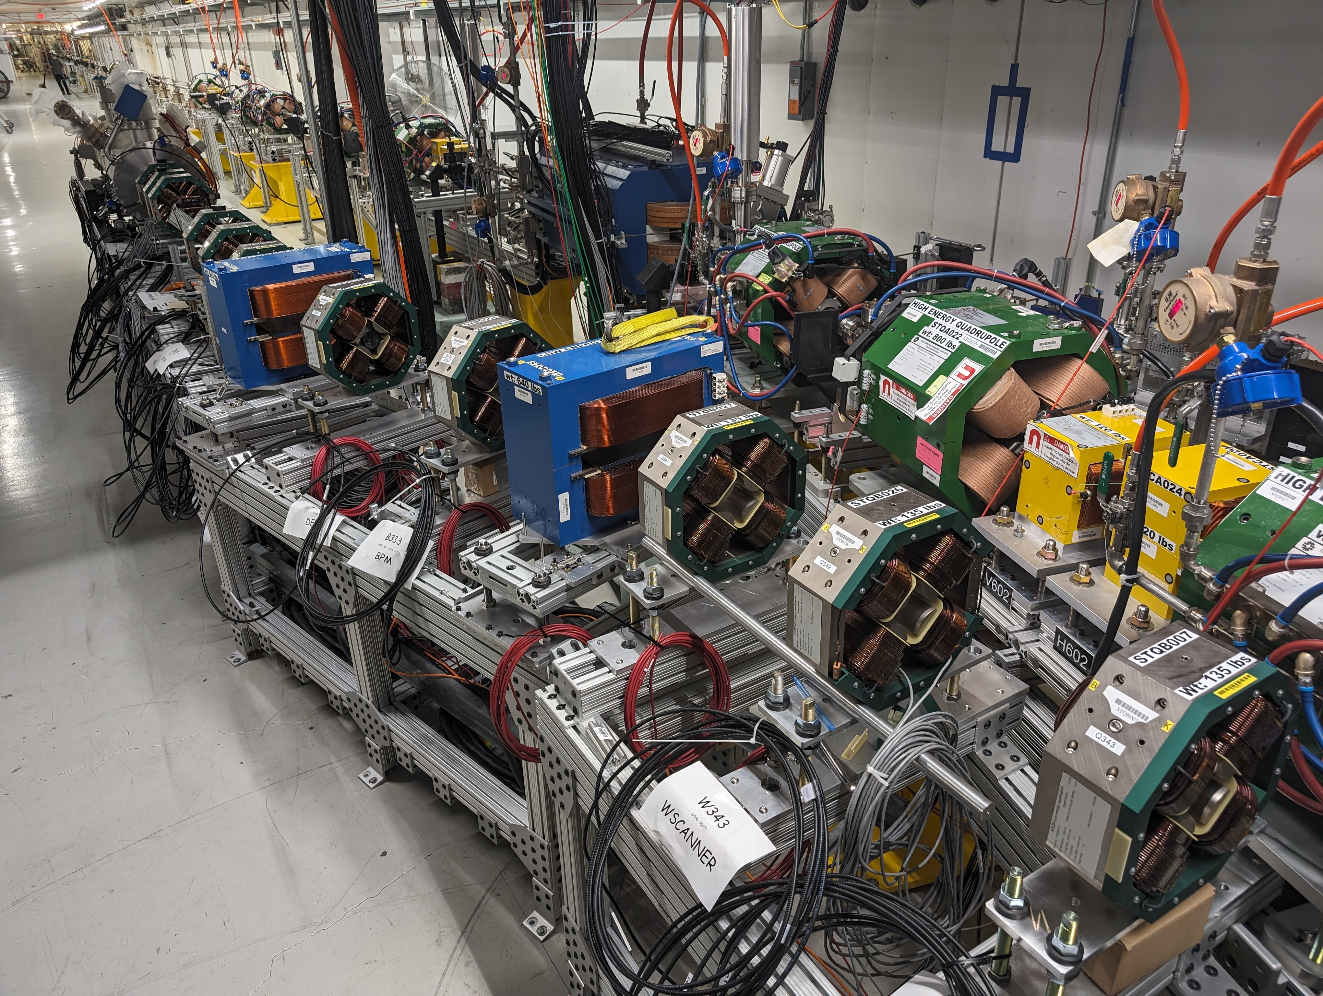
Proton injector construction
LEBT
Proton source tests will start during the next few weeks
RFQ and RF
RFQ is roughly aligned
RF distribution lines are nearing completion
High-level RF is being constructed
Work on low-level RF system is hindered by lack of available experts
MEBT
All main magnets are installed, ready for fine alignment
Vacuum system assembly is underway, with completion planned for early May
Cables are pulled and being distributed and terminated

Slide 25
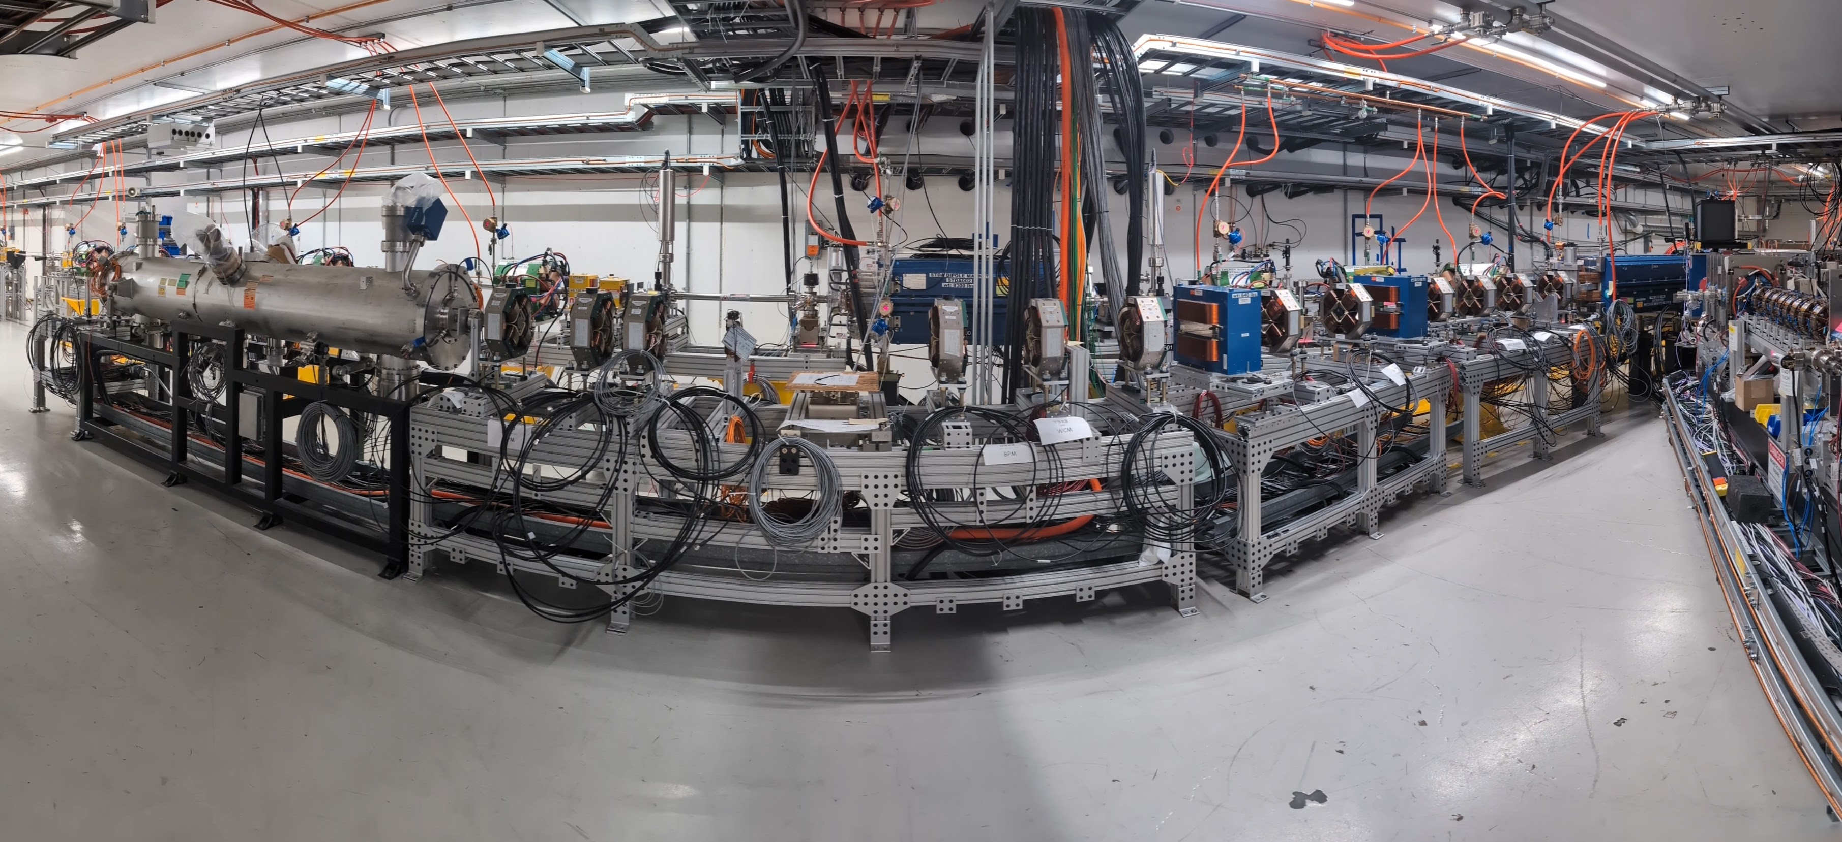
Proton injector construction

Slide 26
Next upgrades and experiments
The FAST team is understuffed, we need
Electronics specialist
Engineering physicist (hired, waiting for US visa)
Technician
Experiments
NIO with protons
Active OSC
GREENS
Electron lens
Facility
Laser lab at ESB
Refurbishing and/or replacing power supplies
Collaboration with ACORN project for testing improved controls

Slide 27
Summary
Recent improvements brought IOTA capabilities up and beyond the original expectations
Several issues found during the in-depth performance analysis and optimization will be addressed before and during the next runs
FAST linac, especially superconducting cavities and infrastructure, shows signs of degradation, but remain functional and suitable for wide range of experiments
Maintenance procedures are scheduled for the current shutdown to facilitate smooth operations during the following runs
Proton injector is actively constructed, commissioning of the first subsystems will begin shortly

