Slide 1
Quasi-Isochronous Lattices:
LADR & OSC Applications
Mike Wallbank, Jonathan Jarvis (Fermilab)
IOTA/FAST Collaboration Meeting, March 2024
3/12/2024

Slide 2
Overview
Quasi-isochronous lattices;
Motivation:
OSC program;
Alpha bucket operation;
OSX;
Low Alpha Demonstration Research (LADR) experimental program;
LADR experience;
Outlook.
More information on OSX tomorrow in the OSC talk!

Slide 3
Quasi-Isochronous Lattices
The momentum compaction factor describes the variation in orbit length wrt the reference for off-momentum particles.
Typically considered only as a linear term, but when the linear optics are set to reduce the leading term, higher-order terms will become relevant.
(There’s also an 𝛼0 term, independent of delta, which depends on betatron motion.)
The terms are analogous to the betatron case in the longitudinal plane: quadrupoles control 𝛼1 and lead to a ‘natural 𝛼2’, which can be corrected using sextupoles; 𝛼3 can be controlled using octupoles, etc.
Lattices which reduce the momentum compaction of the ring to lower than typical values are referred to as ‘quasi-isochronous’, or ‘low-alpha’, lattices.
The path length taken by particles as they orbit becomes less dependent on the momentum deviations.
Analogously, the slip factor is reduced, so the bunch stays temporally closer to the reference particle.

Slide 4
Low Alpha Motivations
New operational modes enabled by changes to the longitudinal dynamics at low momentum compaction.
e.g. The formation of alpha buckets results in larger areas of stable phase.
Issues injecting into the Passive-OSC lattice (low emittance) during the previous stage of the program are suspected to be related to uncompensated higher-order terms of momentum compaction.
Attaining a firmer understanding of low-alpha operations at IOTA will ensure these problems are not encountered again.
Has generally applicability across many lattices used at IOTA.
Could be a gateway to new areas of research or scientific programs at IOTA, if a low-alpha mode became a standard operational configuration.
e.g. Steady-state microbunching, discussed later.

Slide 5
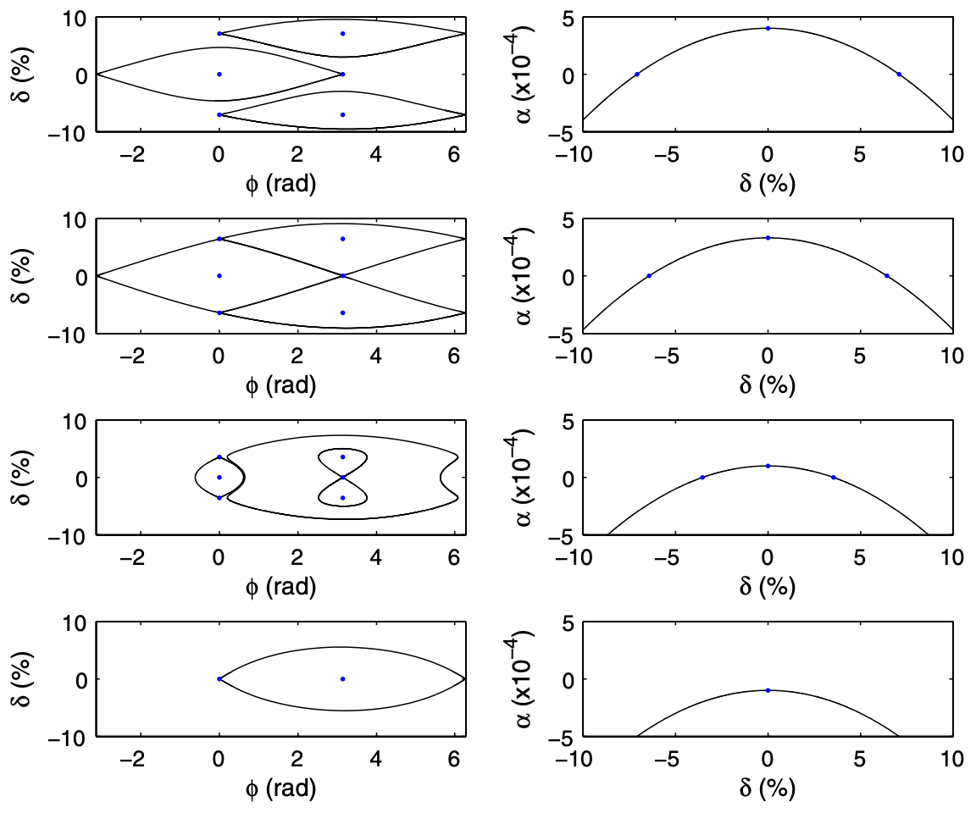
Alpha Buckets
Phys. Rev. ST Accel. Beams 14, 040705 (2011)
Effective control of higher-order compaction terms enables new stables areas of phase space, alpha buckets, by changing the shape and zero-crossings of 𝛼(δ).
Analogous to regular RF buckets but centered on a non-zero delta and shifted in phase by 𝜋.
Varying 𝛼2 (typically to ~0) and 𝛼3 allows manipulation of these stable regions of phase space.
Precise control over these higher-order terms can allow for larger regions of stable phase space for improved injection or storage.

Slide 6
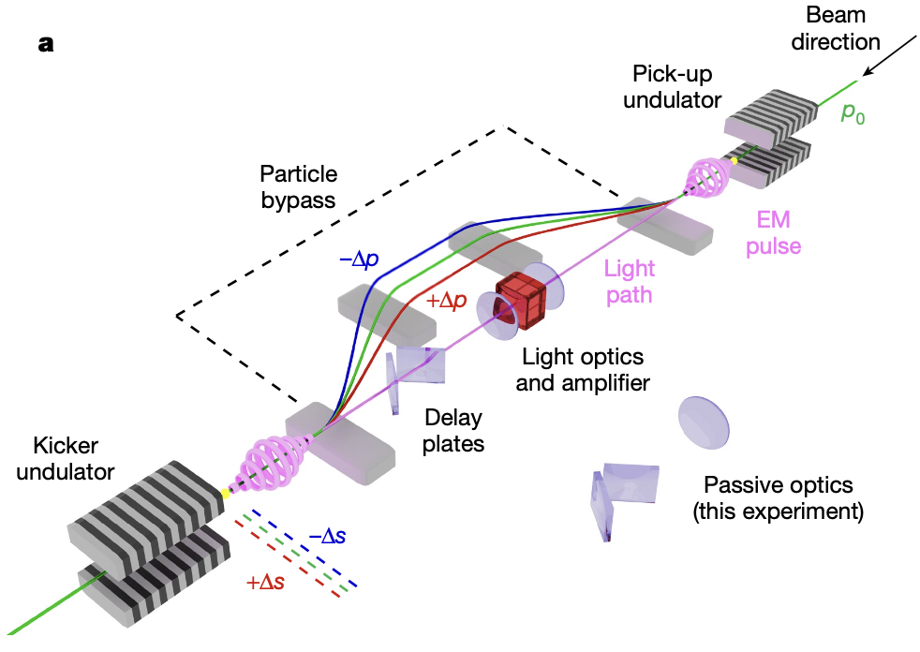
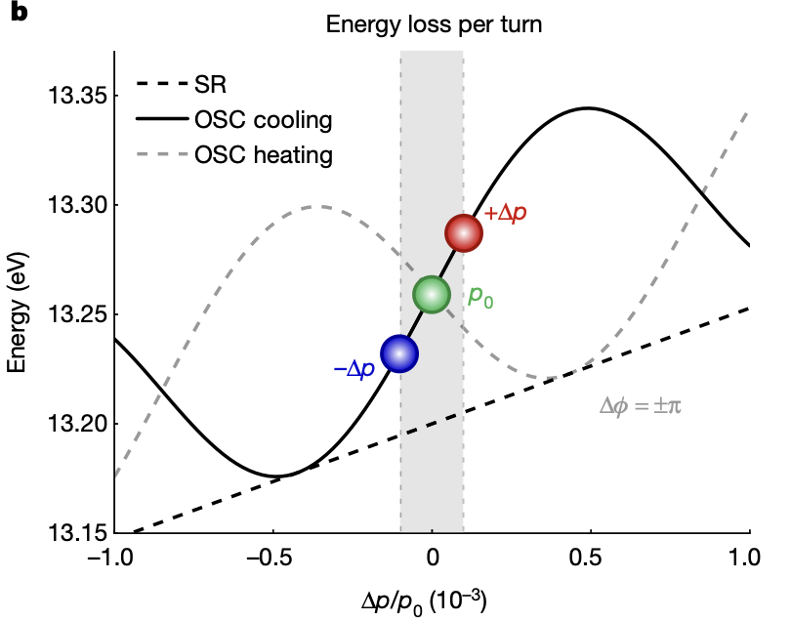
Optical Stochastic Cooling
Nature 608, 288 (2022)
First demonstrated at IOTA in 2021.
OSC uses the careful mapping of a particle’s radiation on itself following a bypass to apply corrective kicks to its momentum.
Each particle will additionally feel ‘noise’ kicks from each other particle within the bandwidth of the system.
Typically hinders cooling and so usually suppressed as much as possible.
Flexible system enabling cooling, heating and potentially more exotic phase space manipulations in all three dimensions.

Slide 7
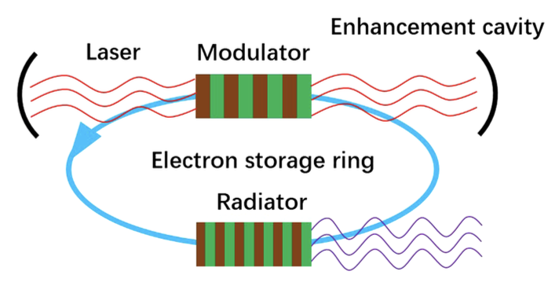
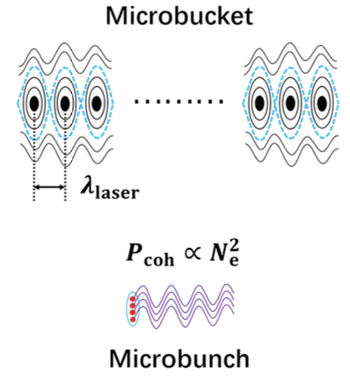
Steady-State Microbunching
PRAB 23, 044002 (2020)
The steady-state microbunching (SSMB) concept is a promising application of low-alpha lattices and a highly active area of research.
Light source combining high rep rate of storage rings with high brightness of FELs, with tunable frequencies potentially as high as the x-ray range.
Proposed in 2010 (PRL 105, 154801 (2010)) with a one-turn proof of principle demonstration at the Metrology Light Source published in 2021 (Nature 590, 576 (2021)).
‘Conventional’ SSMB utilizes MW stored laser power synchronized to the beam, which modulates bunch particles at the optical wavelength to produce microstructure.

Slide 8
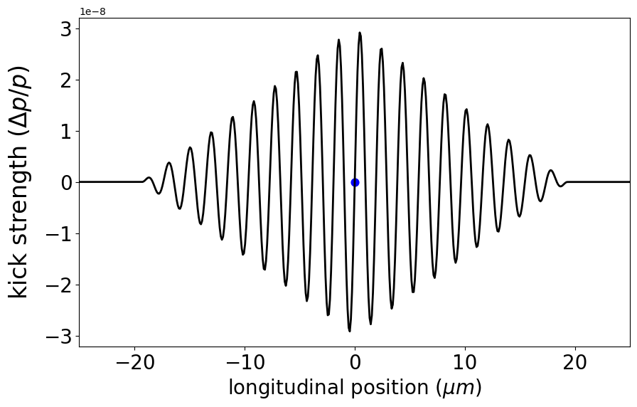
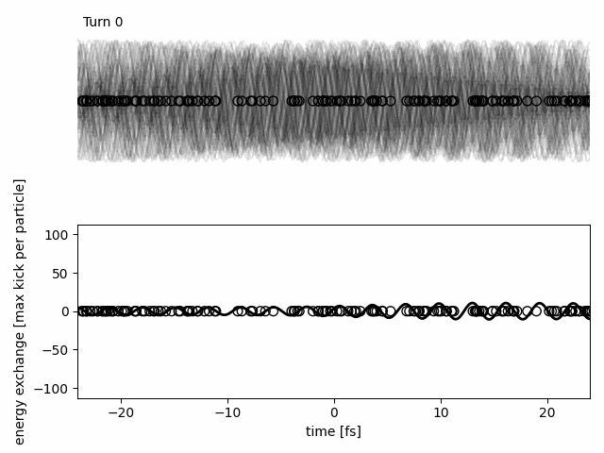
Optical Stochastic Crystallization
We have developed a mechanism which may enable SSMB using only the components of an OSC system, with careful control of the light and beam optics.
We refer to this as Optical Stochastic Crystallization (OSX).
Effectively comes ‘for free’ with OSC.
The inter-particle interactions within the optical bandwidth can provide, at sufficient gain, a self-reinforcing mechanism which locks the structure at the optical wavelength.
An OSX system is cool: combines the beam cooling of OSC with crystallization and advanced beam control.

Slide 9
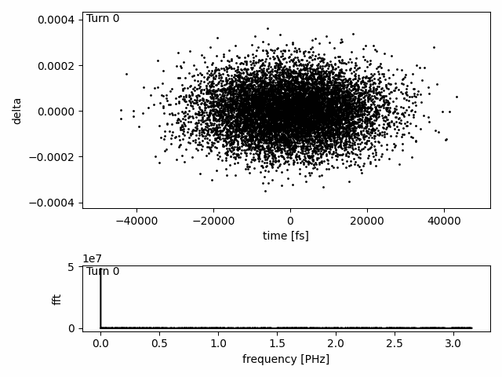
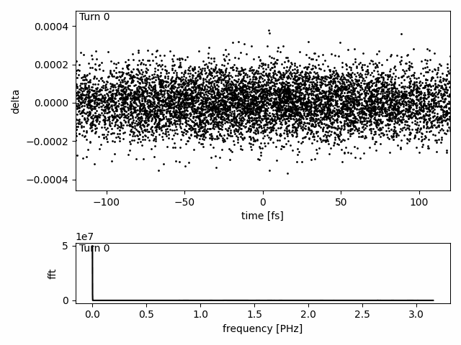
OSX Demonstrations
Currently at the level of exploring basic feasibility (similar to the original SSMB proposals).
A basic 1D toy model of OSC has been used to investigate OSX.
Requirements:
Low compactions (10⁻⁴ here);
Optical OSC amplification (40 dB here);
Matched signs of the slip factors between the OSC by-pass and the rest of the storage ring;
Low dispersion invariant ℋx at the undulators to reduce bunch lengthening from betatron motion.
Zoomed in

Slide 10
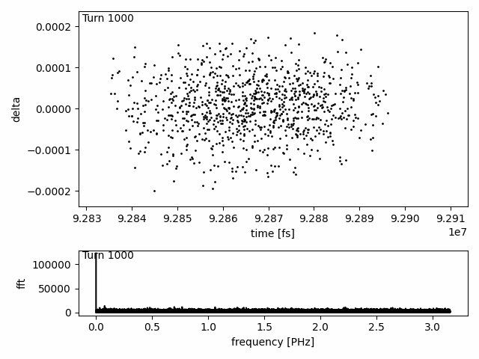
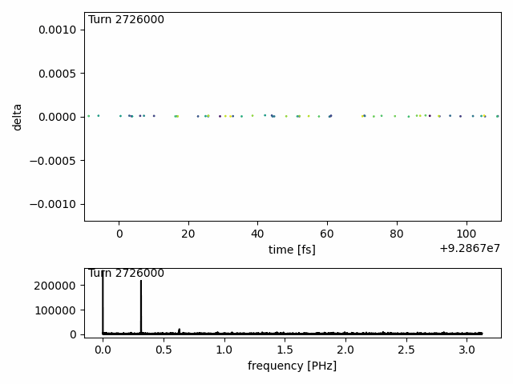
OSX Simulations
Fundamental mechanism has additionally been validated in ELEGANT using OSC model (PRAB 27, 012801 (2024)) — this slide.
‘Quick and dirty’ simulation using the Passive-OSC lattice with reduced compaction; same OSC parameters with increased gain.
Actively working on a new lattice as part of the amplified OSC program.
Lots of ongoing work to improve the quality of the simulations.
Basic incoherent radiation model with quantum excitation included.
Coherent synchrotron radiation and IBS not currently modeled.

Slide 11
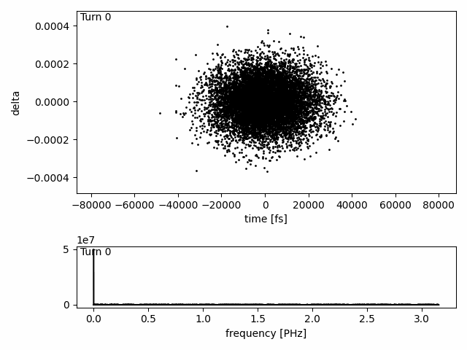
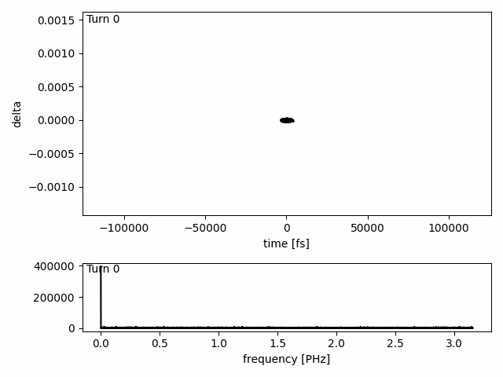
Bunch Manipulations
Various bunch manipulations have also been demonstrated.
Plan to incorporate this simulation into a reinforcement-learning model to produce a ‘beam-on-demand’ system.
In the basic model, crystallization occurs in almost all cases given sufficient cooling.
The models imply the required gain, lattice and bunch densities mean a demonstration may be feasible during the next phase of OSC at IOTA.
More from Jonathan in the OSC talk tomorrow!

Slide 12
Low Alpha Demonstration Research (LADR)
As a first step towards realizing these potential applications, Jonathan and I proposed the LADR program as a short R&D effort focused on demonstrating the feasibility of low-alpha operations of the IOTA ring.
Goals (taken from my proposal slides):
Demonstrate the reduction in the leading-order term, 𝛼1, with the linear optics. Aim to reduce to ~10⁻⁴ (~50 lower than previously used in IOTA).
Use online measurements of synchrotron frequency as a proxy for compaction (with an assumed constant synchrotron energy loss from the model).
Demonstrate correction of the second-order term, 𝛼2, using sextupoles. Aim to correct this to zero, and demonstrate zero-crossing. Critical for successful low-alpha operation.
Demonstrate control over the third-order term, 𝛼3, using octupoles. Show the expected effect on lifetime as this is knobbed through zero.
Demonstrate operation of IOTA with alpha buckets, likely by holding 𝛼3 constant and transitioning particles in a RF bucket as 𝛼1 is knobbed through zero.

Slide 13
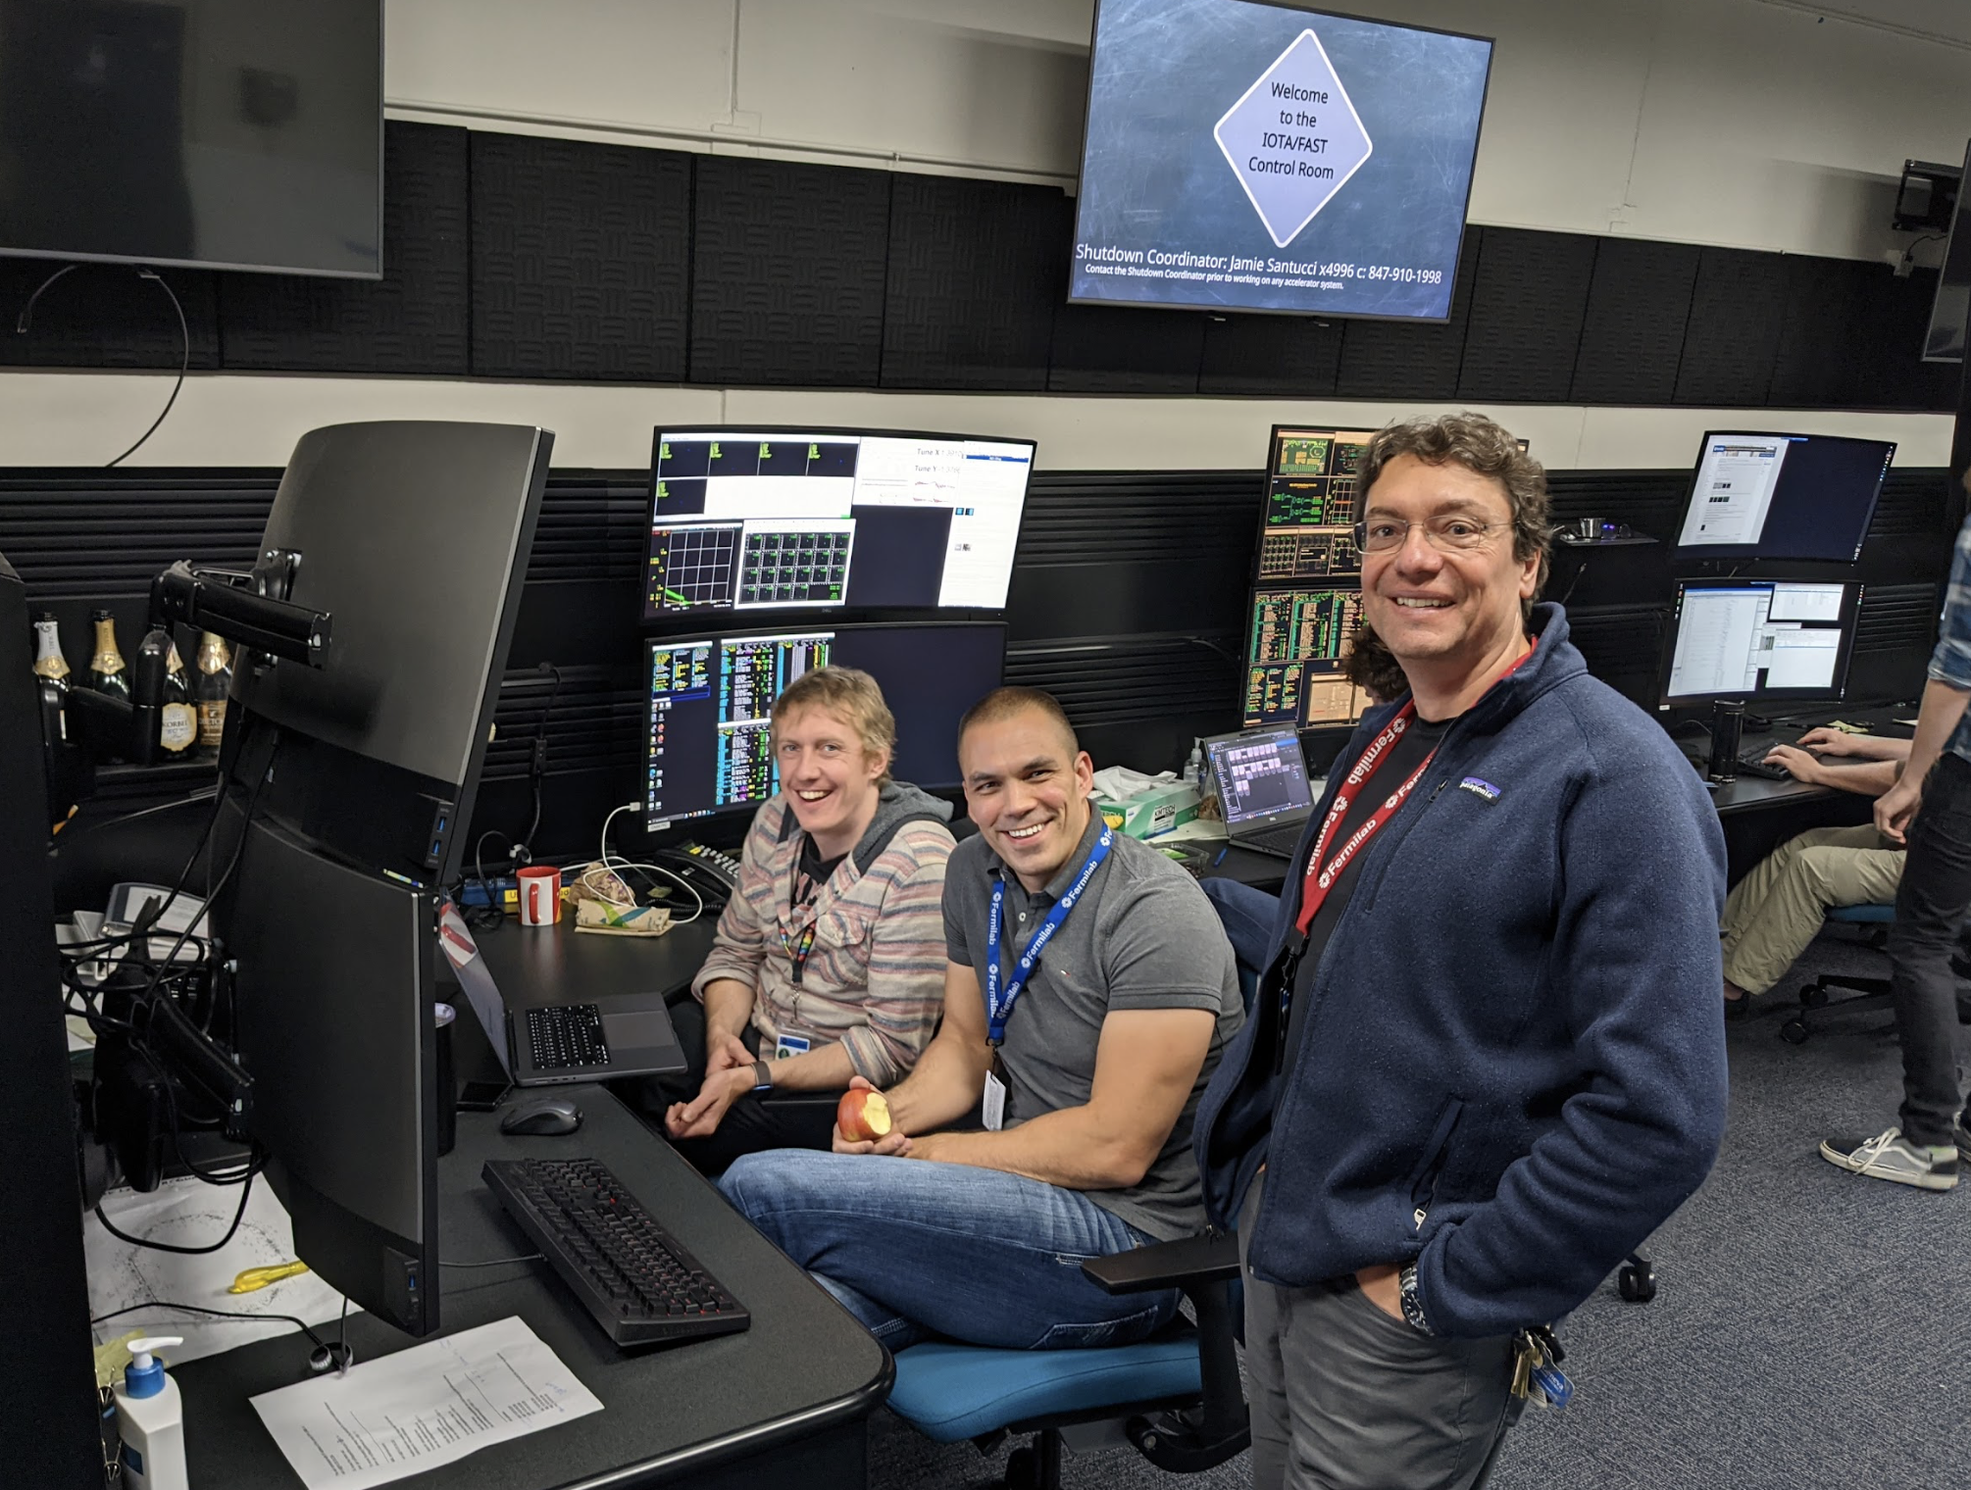
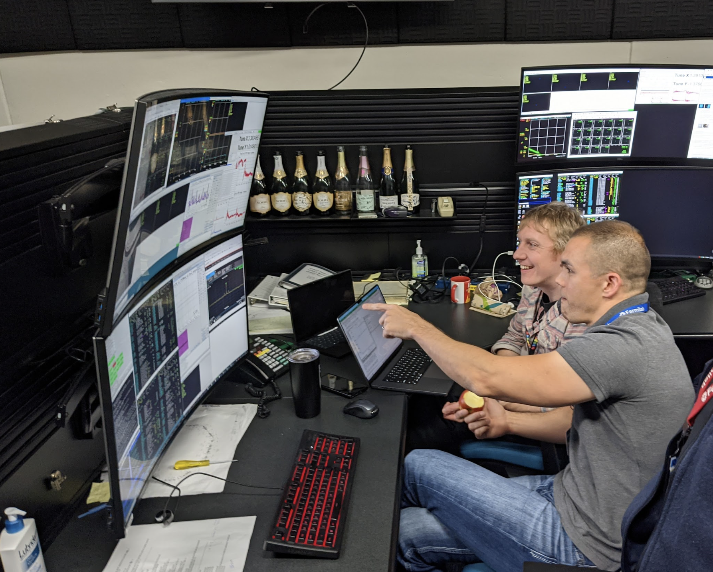
LADR Operations
Photo credit: Sasha Romanov
LADR took around 13 shifts in late September/early October, 2023.
Around half were used commissioning the lattice; the second half were used to work towards the goals of the program.
Successfully completed the main objectives: demonstrating control over the leading momentum compaction terms (𝛼1, 𝛼2, 𝛼3).
Achieved record-low IOTA ring compaction of ~3.4⨉10⁻⁴ (~15x lower than previously operated).
Unfortunately the run ended before we could reach the target of 1⨉10⁻⁴ or attempt to transition to alpha buckets, but nothing was found to suggest this should not be feasible in the future.

Slide 14
LADR Lattice
The LADR lattice was modified from the NIO version to ensure minimal disruption to the program.
Fully characterized in ELEGANT and MAD-X.
Developing knobs for varying the compaction.
Optimized lattice functions at sextupole and octupole locations for efficient control of higher-order terms.
Achieving stable injection into the lattice proved challenging.
Ultimately had to inject via the NIO lattice and transition with beam.
Typically injected >1 mA and worked with 300 µA and below for studies.
𝛼c ∼ 10⁻²
𝛼c ∼ 10⁻⁴

Slide 15
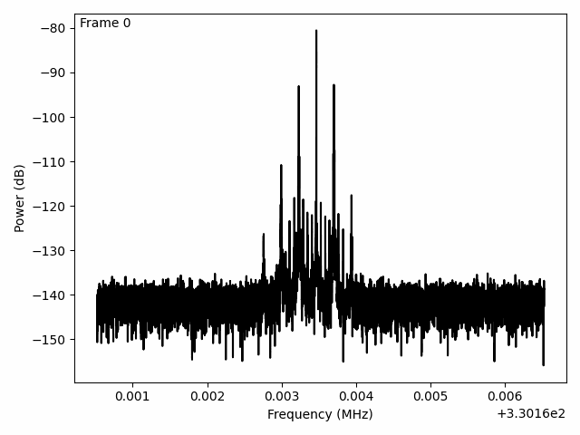
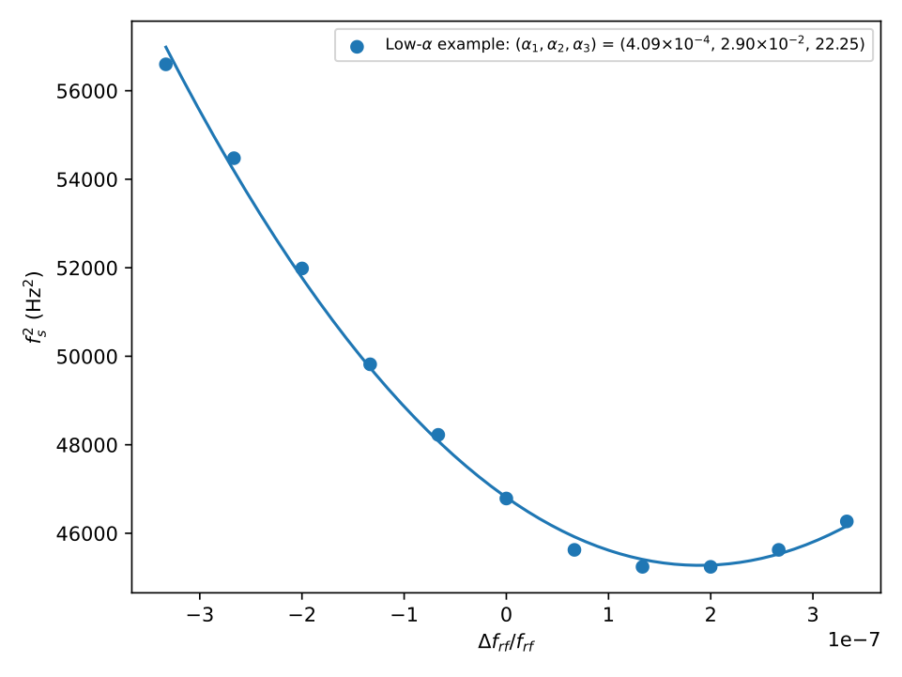
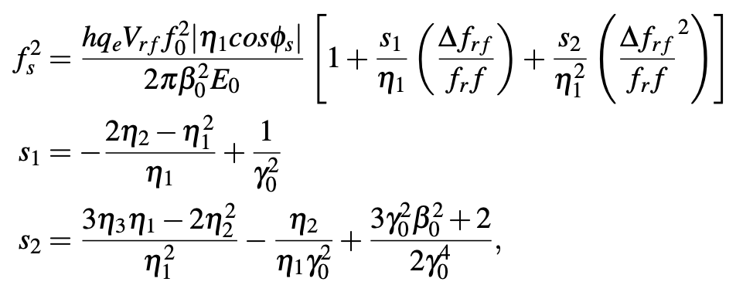
Momentum Compaction Measurements
Used spectrum analyzer attached to wall-current monitor.
Measure synchrotron frequency from the sidebands over an RF detuning scan; fit for 𝛼 terms.

Slide 16
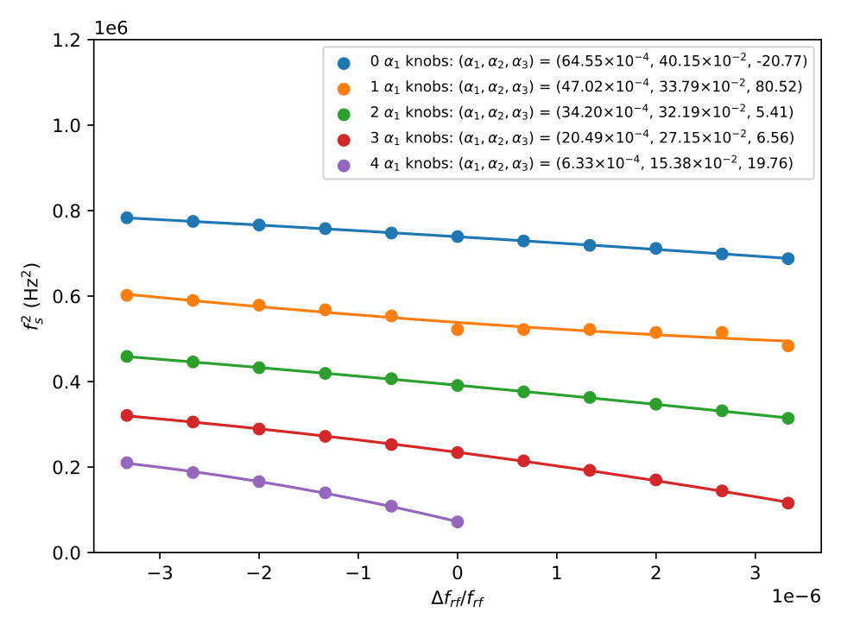
Reducing 𝛼1 using Linear Optics
Reducing the first-order compaction term using knobs built from the model.

Slide 17
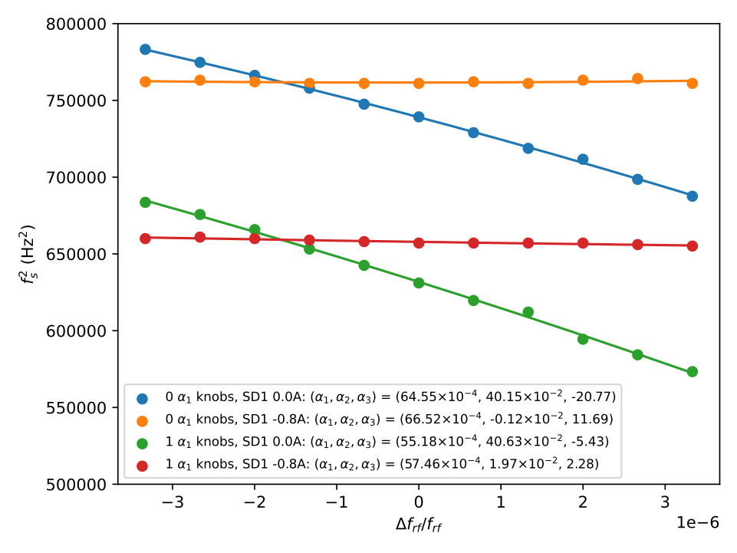
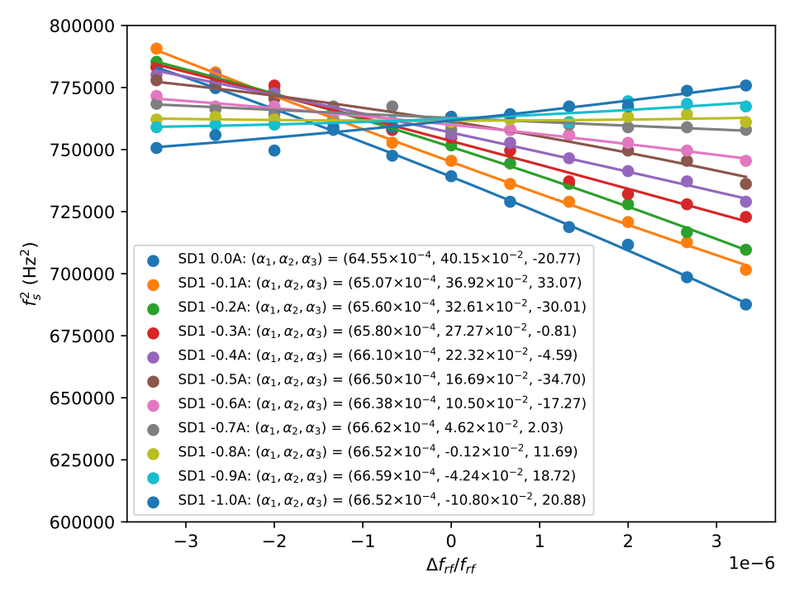
Controlling 𝛼2 using Sextupoles: High Compaction
The SD1 sextupole family were very effective at controlling and correcting 𝛼2 at relatively high momentum compaction.
Left: before and after correction at two values of 𝛼1; right: sweeping 𝛼2 through zero via a scan over sextupole excitations.

Slide 18
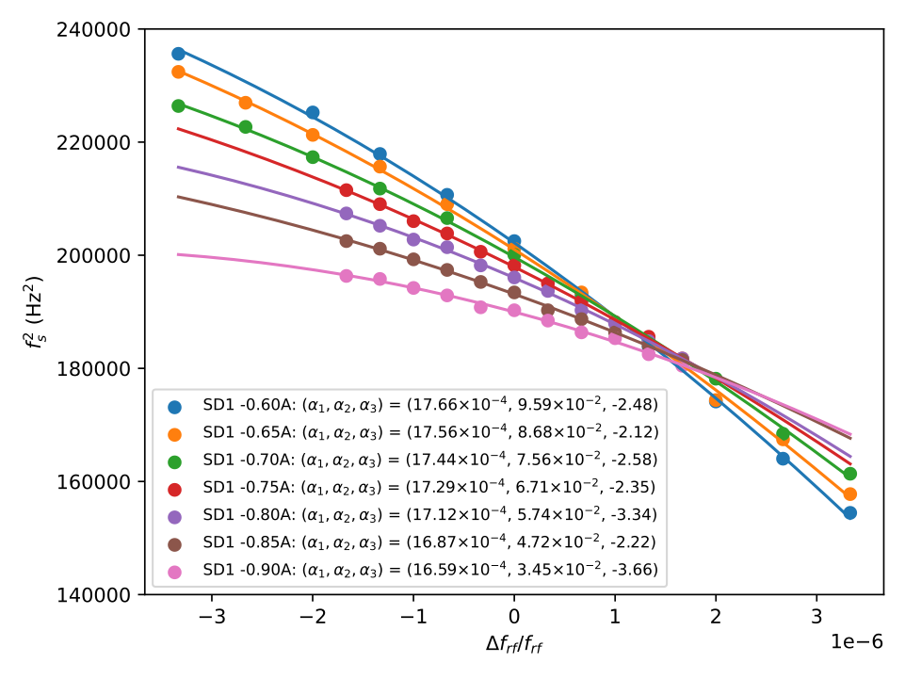
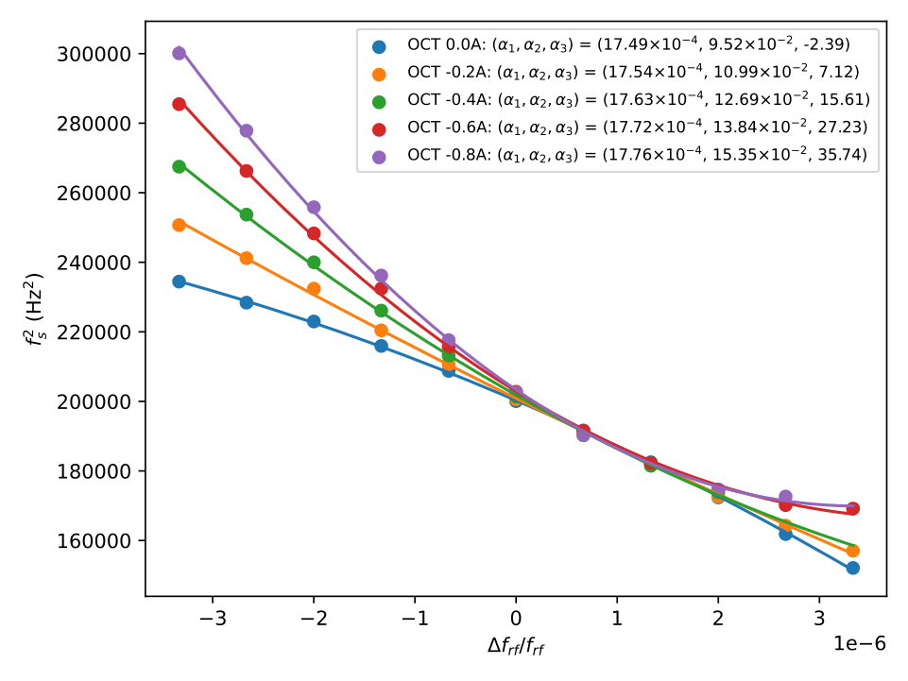
Controlling 𝛼2 and 𝛼3: Lower Compaction
Scan over sextupole excitations (no octupole)
Scan over octupole excitations in series (sextupoles: SC* injection values; SD1 at -0.6A).
Following four applications of the 𝛼1 knob to reach ~1.7⨉10⁻³.
It was not possible reduce 𝛼2 as much as before, or to knob through zero.
The ‘natural’ 𝛼3 is negative, which is the opposite to the sign of 𝛼1. It is understood that to improve lifetime and bunch stability, the signs should be the same; octupoles were therefore henceforth used to correct this.

Slide 19
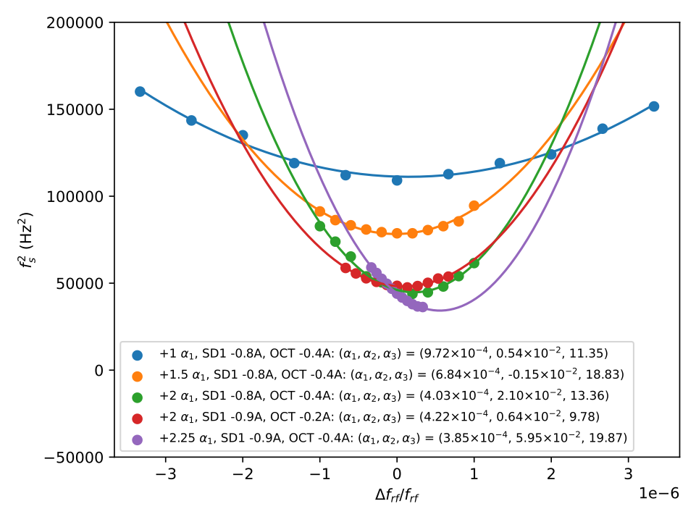
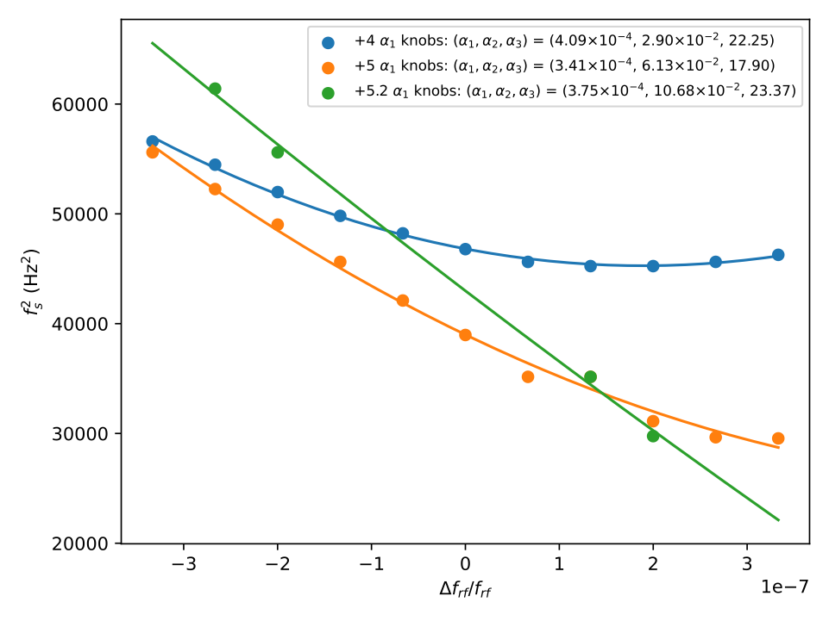
Achieving Low Compactions
(See backup)
Strategy is to move down slowly, taking sextupole and octupole scans, correcting as much as possible.
Should be possible to use a model to assist.
Record-low measurement (3.4⨉10⁻⁴) shown in the orange (lower plot).
As observed, a slight reduction causes immediate beam loss due to further uncompensated higher-order terms.
The path to zero and beyond was clear, we just didn’t quite have enough time.
No show-stoppers gives us confidence in achieving quasi-isochronous operations in IOTA!
𝛼1 = 3.4⨉10⁻⁴, 𝛼2 = 6.1⨉10⁻², 𝛼3 = 23

Slide 20
Summary
Understanding the beam dynamics in IOTA at lower compactions is generally important for a lot of use-cases.
Specifically will be very relevant for a lower emittance lattice such as OSC.
Additionally opens the possibility of new areas of research at IOTA, such as OSX.
Optical Stochastic Crystallization is a potentially very interesting application of OSC, which we are actively working on.
LADR successfully demonstrated the basic principles of controlling momentum compaction terms in low-alpha lattice at IOTA.

Slide 21
Backups

Slide 22
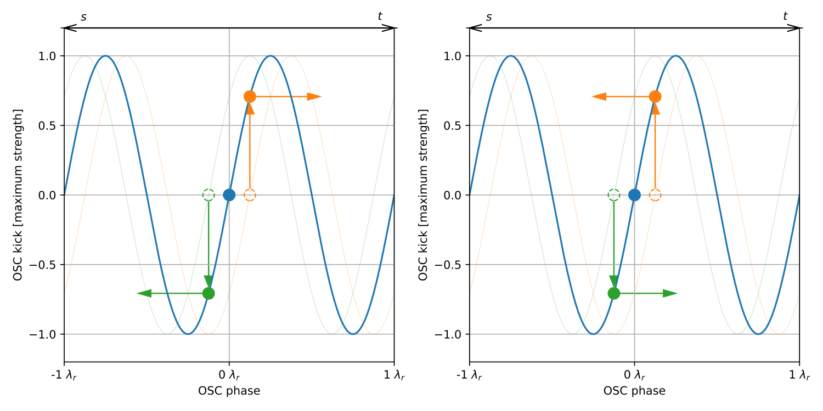
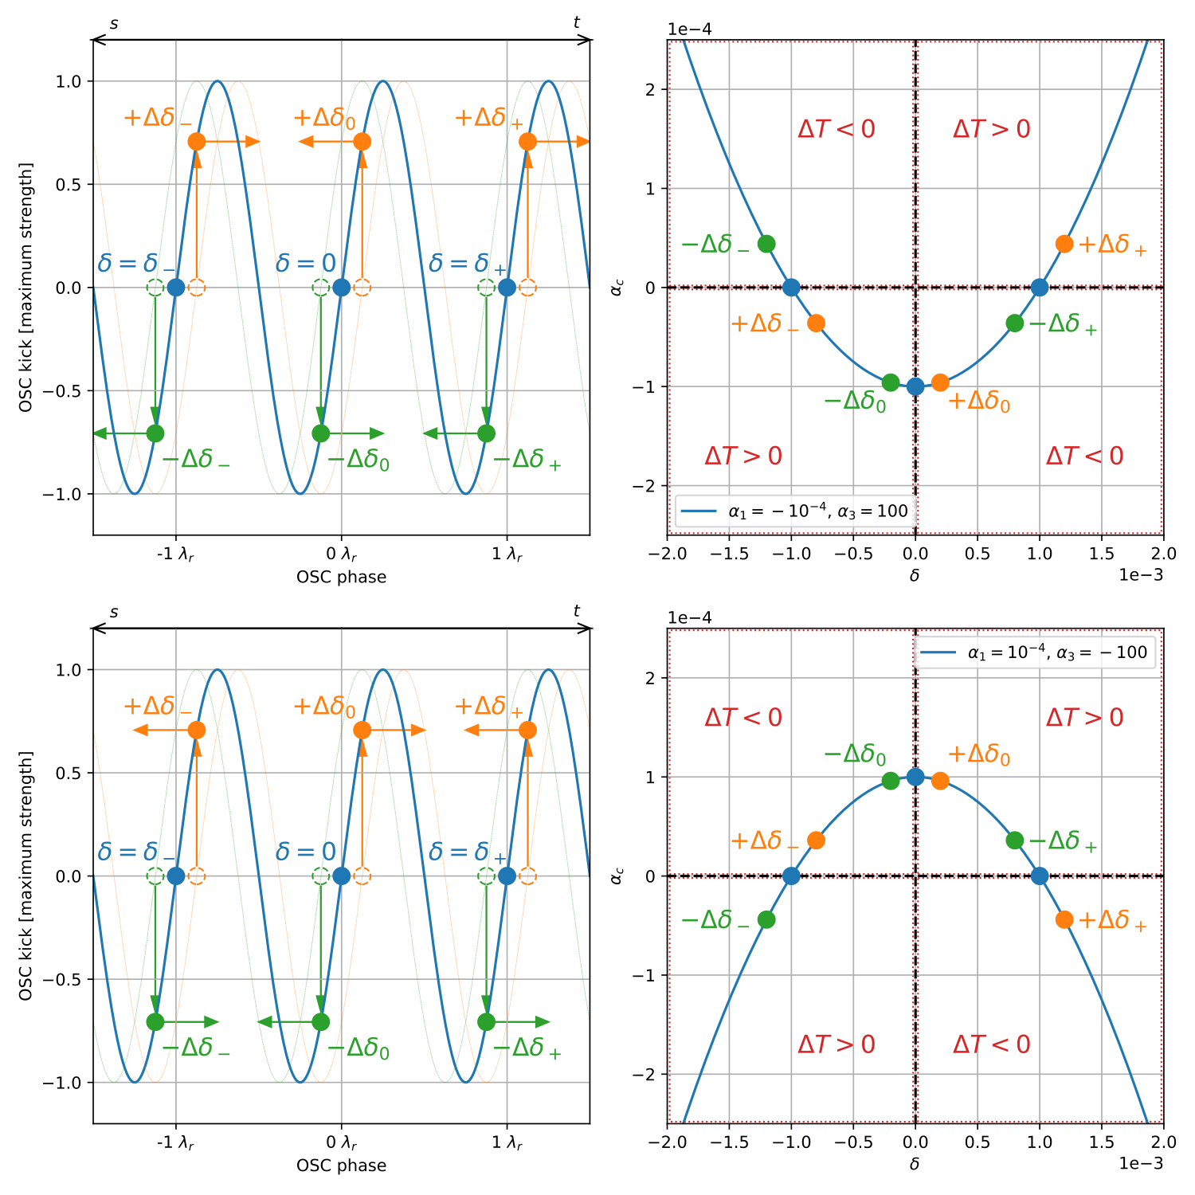
OSX Slip Factors
Demonstration of the required slip factors.
Top: RF bucket microbunching.
Left: 𝛼1 > 0;
Right: 𝛼1 < 0.
Bottom: alpha bucket microbunching.
Left: 𝛼1 < 0, 𝛼2 = 0, 𝛼3 > 0.
Right: 𝛼1 > 0, 𝛼2 = 0, 𝛼3 < 0.

Slide 23
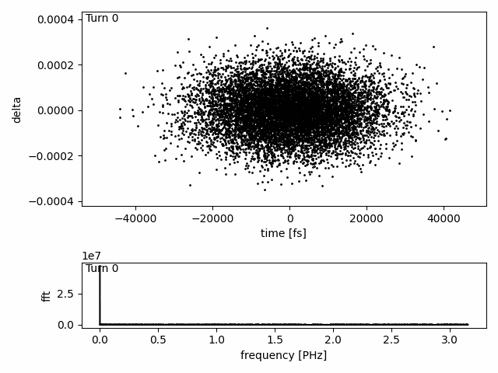
Squish and Bunch Manipulations
Turn on OSC with gain to cool, turn off the gain to let the bunch rotate in phase space, turn on again at an opportune time to bunch.

Slide 24
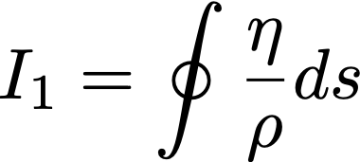
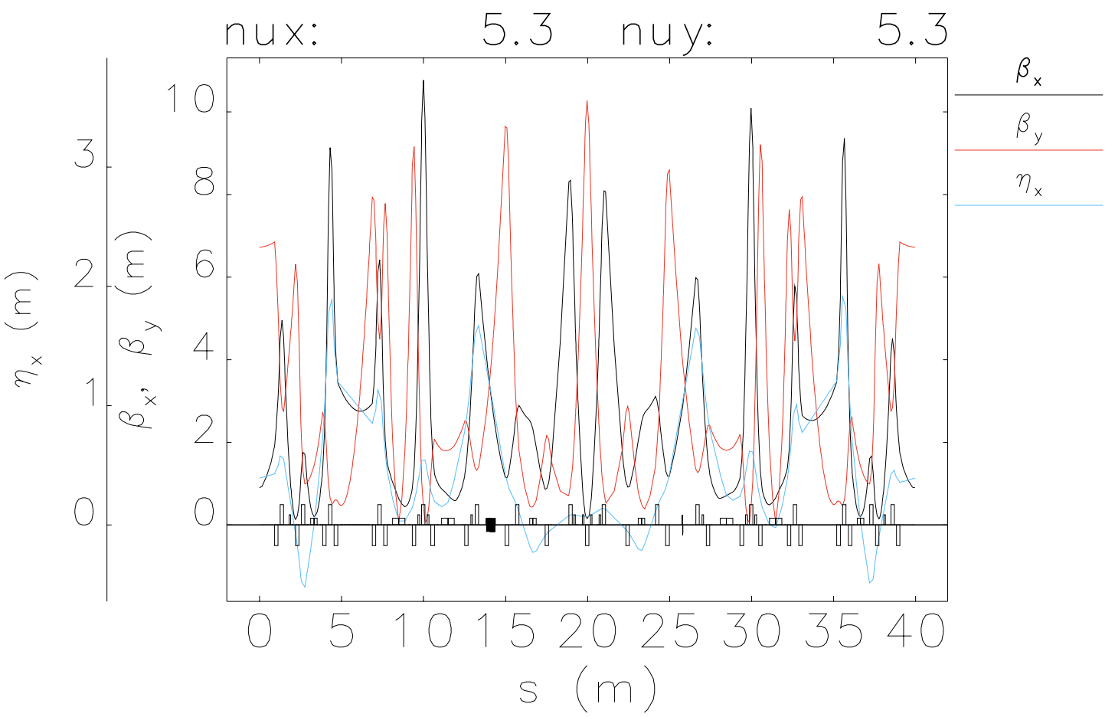
LADR Lattice & Knobs
The lattice was designed from the NIO lattice, with the compaction reduced.
Reducing compaction requires a net reduction in dispersion around the ring.
This is achieved either by balancing out positive and negative contributions in different straights or by enforcing zero-crossing in the bend dipoles.
The latter is preferred but was found to be unfeasible with the other constraints on LADR. It’s possible an improved low-alpha IOTA lattice could be designed without these self-imposed restrictions.
LADR lattice with ~10⁻² compaction.

Slide 25
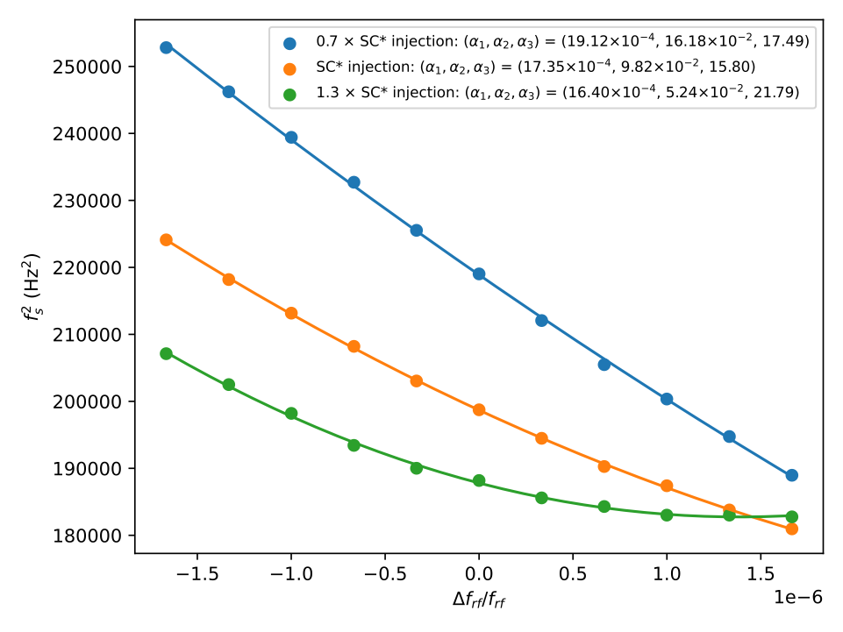
Importance of 𝛼3 at Low Compactions
Plot shows ‘nominal’ sextupole excitation and ±30%; octupole currents of −0.4 A to ensure a positive 𝛼3.
Positive parabolic shape observed when 𝛼2 is reduced sufficiently.
An uncompensated 𝛼3 will therefore come to dominate at lower compactions and will inhibit the ability to stably further reduce the compaction.

Slide 26
Impact of 𝛼2 at Low Compactions
Blue -> orange: reduce compaction.
Orange -> green: reduce compaction; second-order term becomes relevant.
Green -> red: correct second-order term with sextupoles.
Red -> purple: reduce compaction; second-order term again becomes relevant.

