Slide 1
Installation and Commissioning of the IOTA Proton Injector
Dean (Chip) Edstrom
IOTA/FAST Collaboration Meeting
13 March 2024

Slide 2
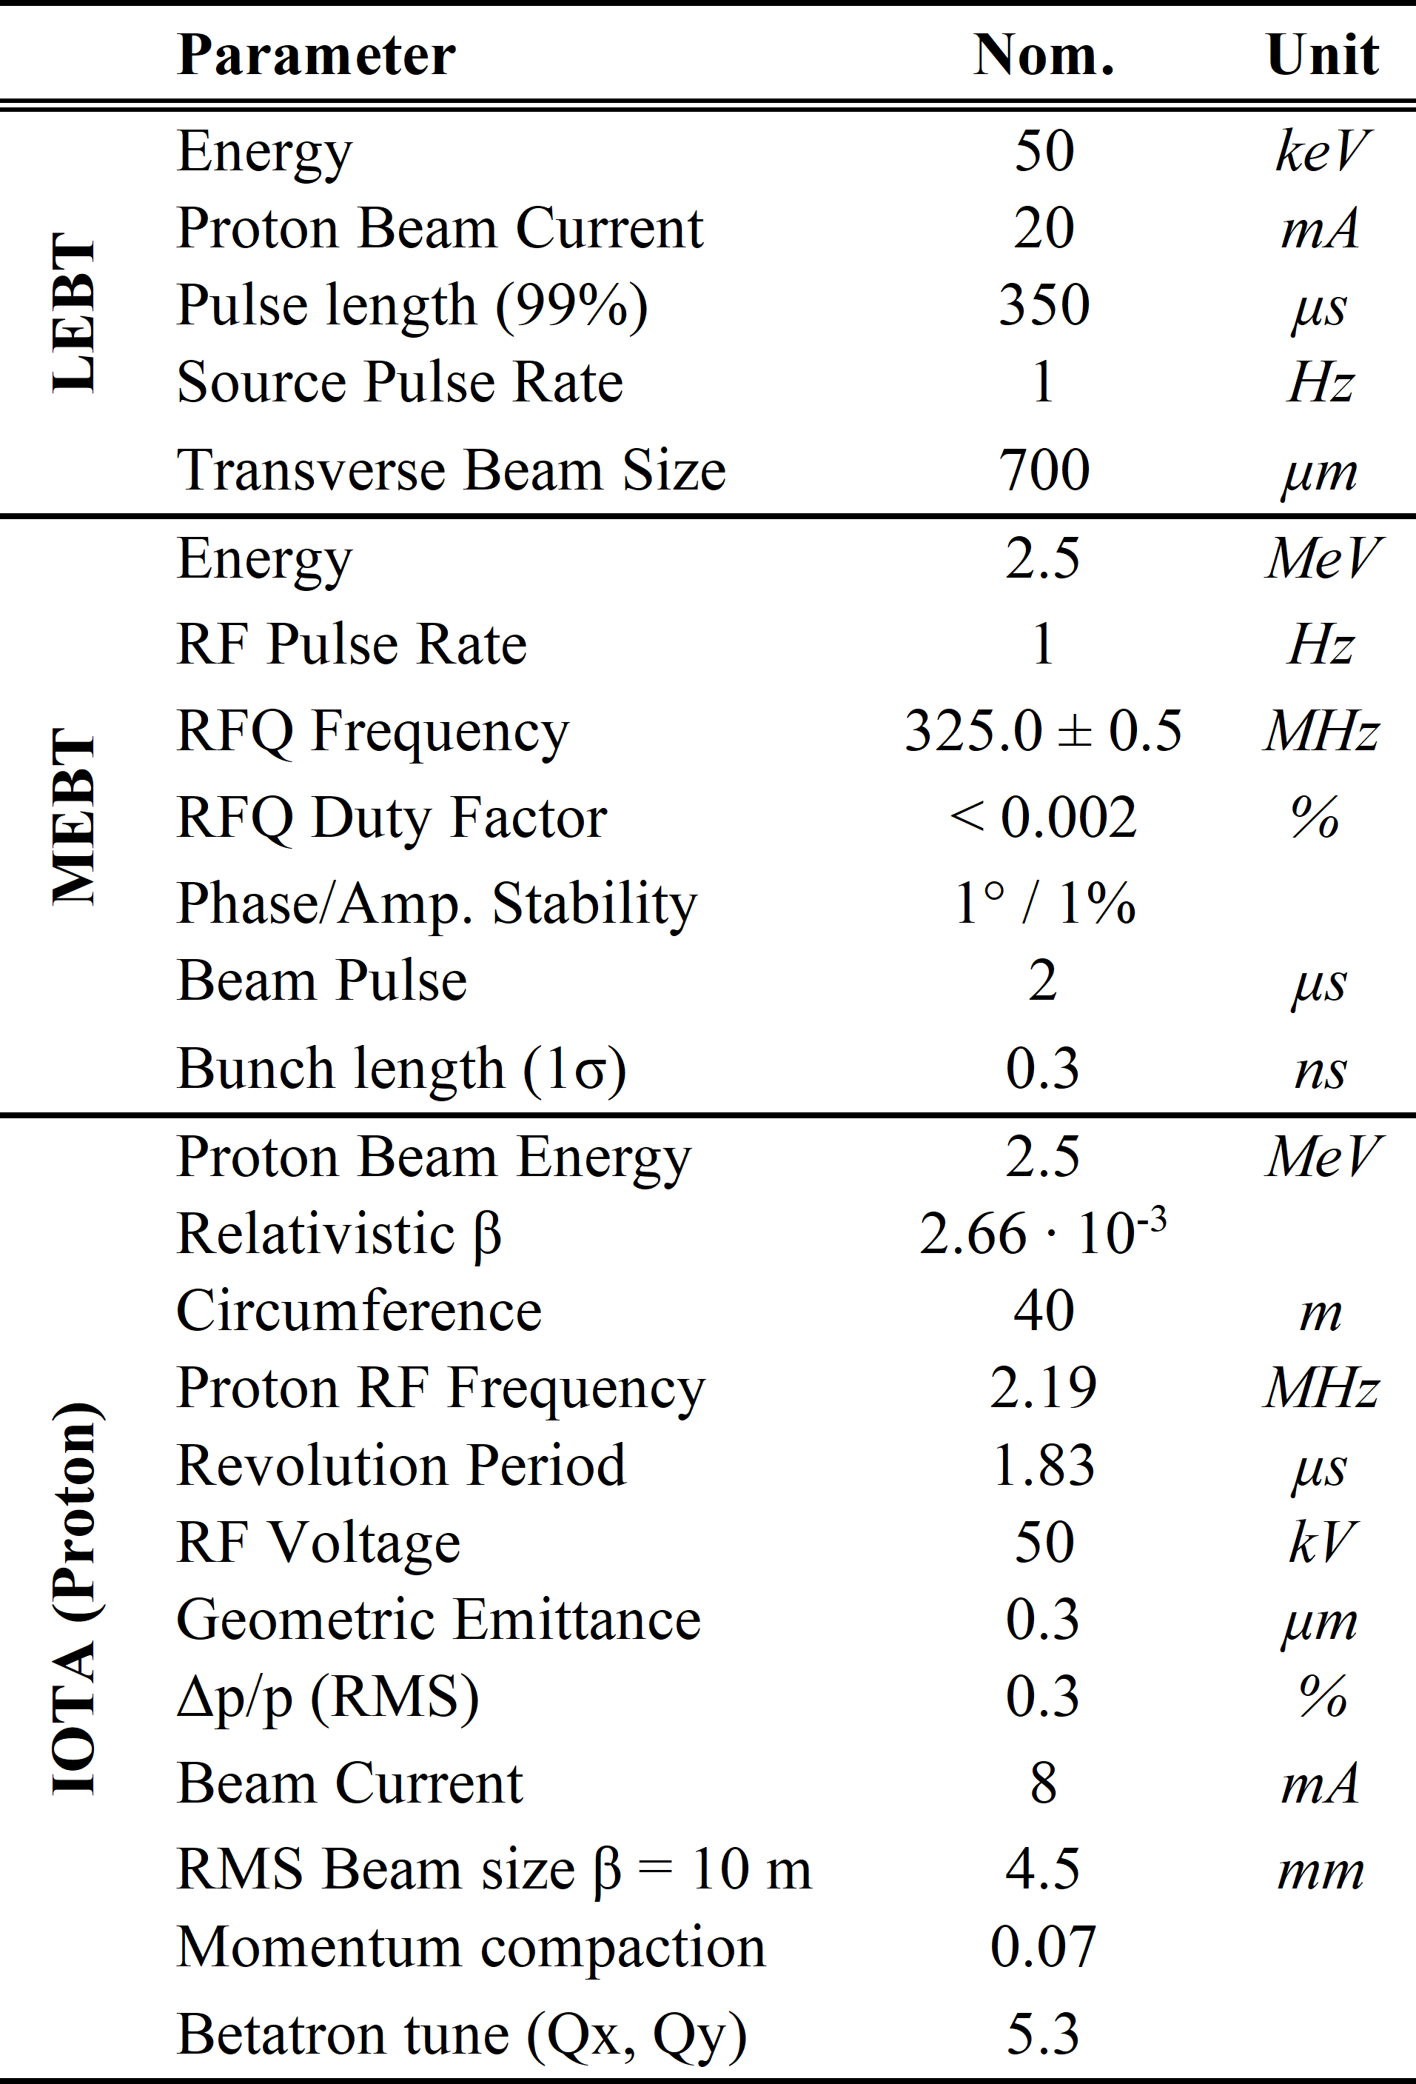
The IOTA Proton Injector (IPI)
Objective: Build a short proton linac for beam to IOTA
2.5 MeV Protons for use in the IOTA ring at the FAST Facility
Installation In Progress
50 keV extraction from the Duoplasmatron Source
Acceleration to 2.5 MeV through the RFQ
Primarily Reused / Borrowed Components
HINS: Duoplasmatron Ion Source, LEBT Solenoids, RFQ, Buncher, Toroids, Faraday Cup
PIP-II IT: LEBT/MEBT Allison Scanners, Scanning Wires, Bias Current Electronics
IOTA Electron Injector Beamline: LE Quadrupoles, LE Bend Dipoles, Wall Current Monitor
IOTA: Combined Function (H/V/SQ) magnets
Relatively few new systems
MEBT BPMs: Instrumentation Technologies / Bevatech
325 MHz LLRF: Euclid Techlabs, LLC

Slide 3
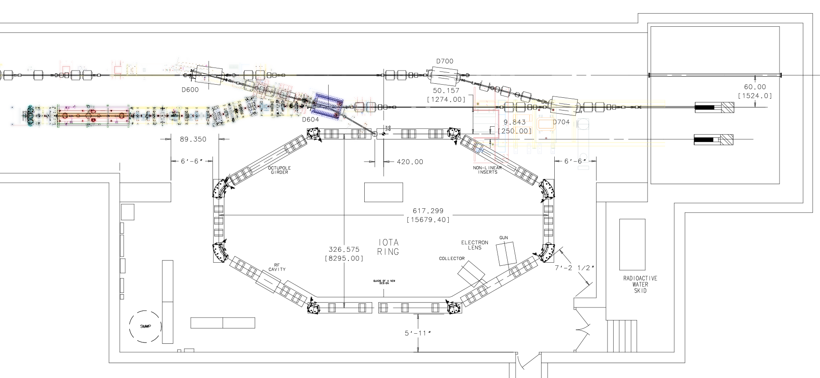
Beamline Overview
D600
Electron Beamline
IS LEBT RFQ MEBT
D604
IOTA

Slide 4
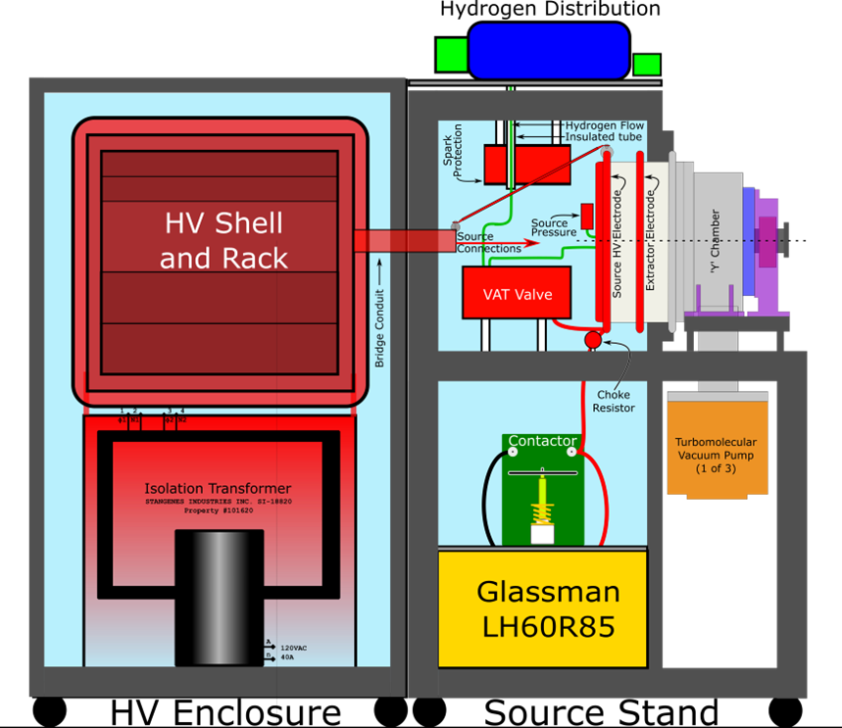
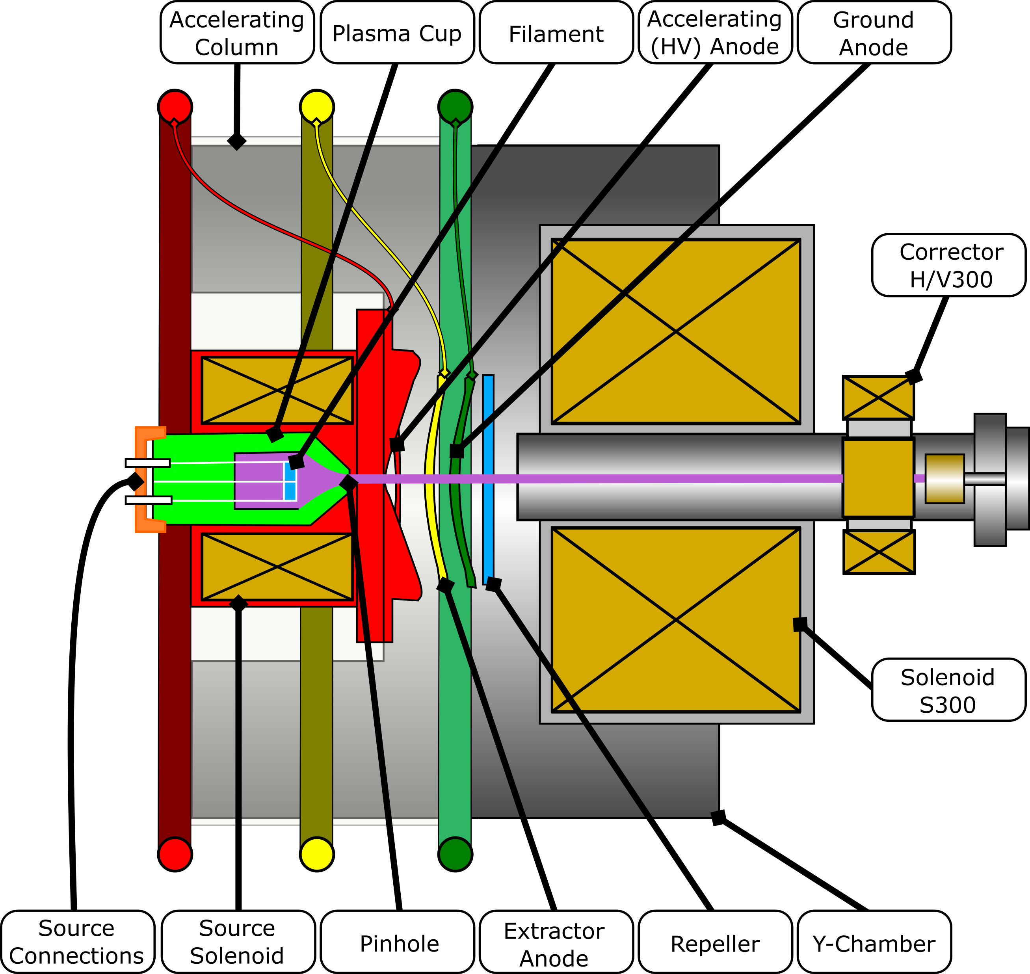
Duoplasmatron Source

Slide 5
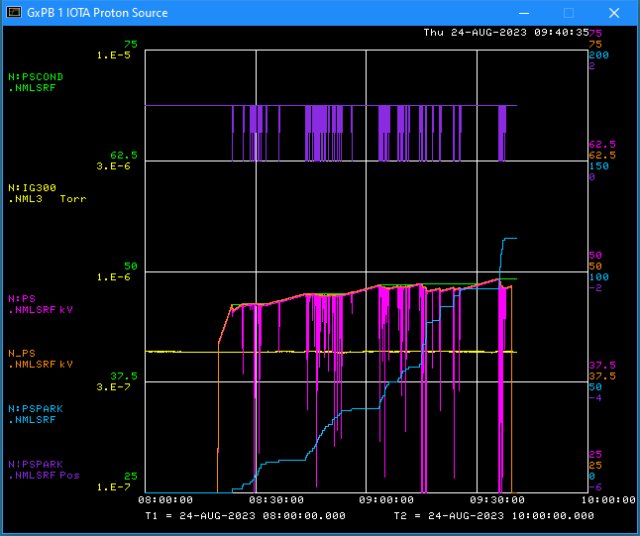
Source Commissioning
In Five Easy™ Steps:
Assemble the source
Insert good filament
Perform leak-check
Condition to ≥ 48 keV
(Ideally 50 kV, but…)
Establish beam to Faraday Cup

Slide 6
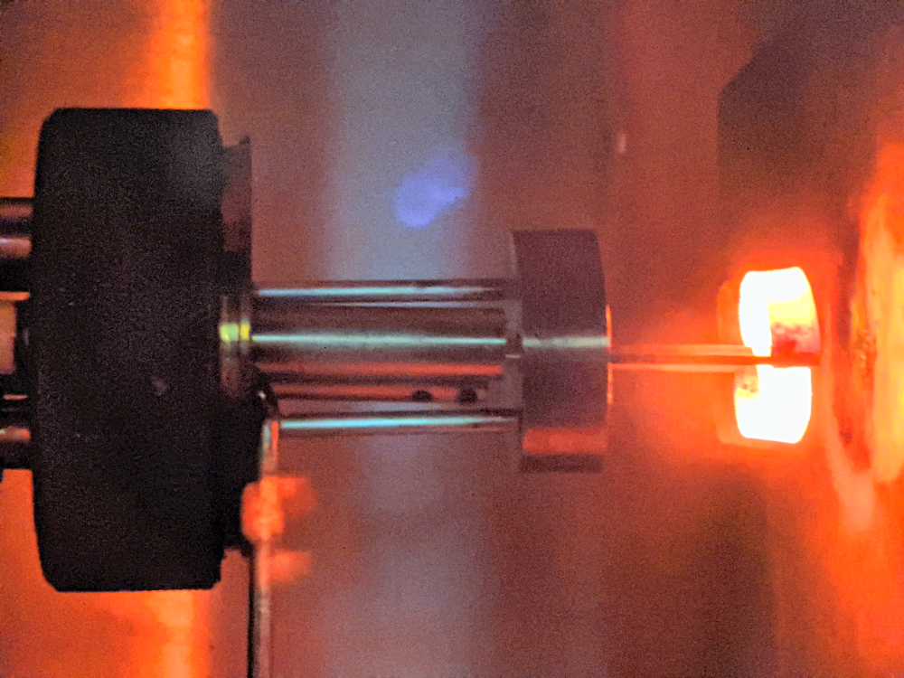
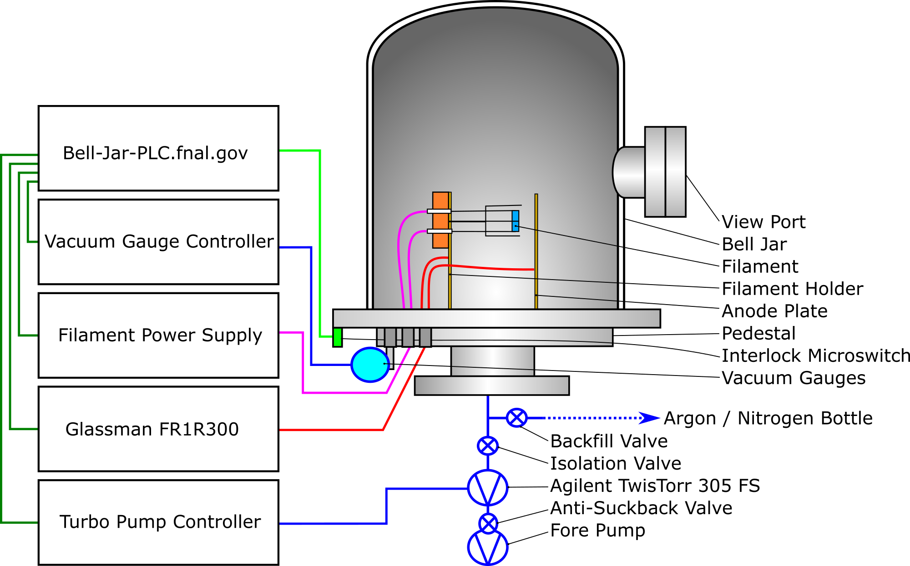
Filaments
Filament Prep
Coat w/ Carbonate Mixture
Install in Bell Jar
Heat to 900°C (White Heat)
Check activation w/ HV bias (~100VDC)

Slide 7
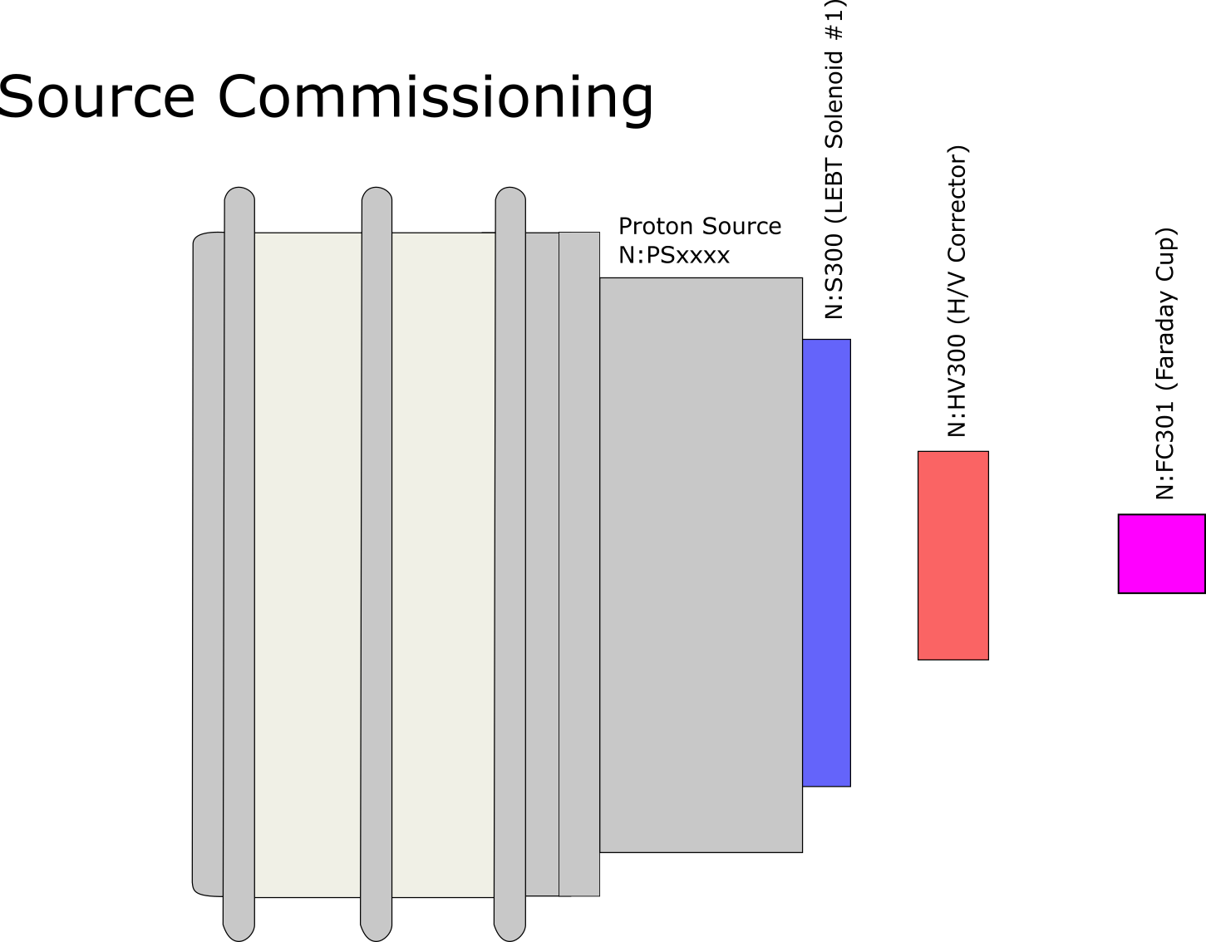
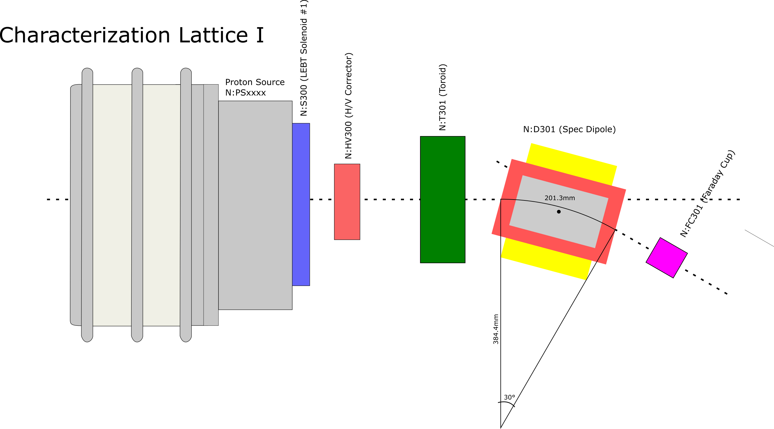
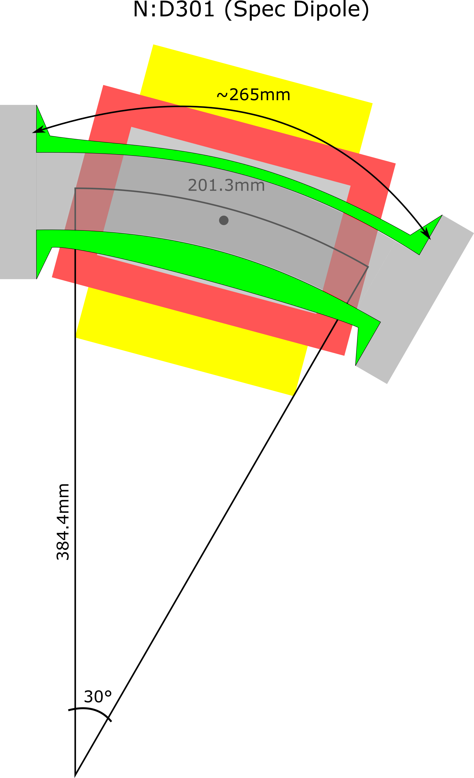
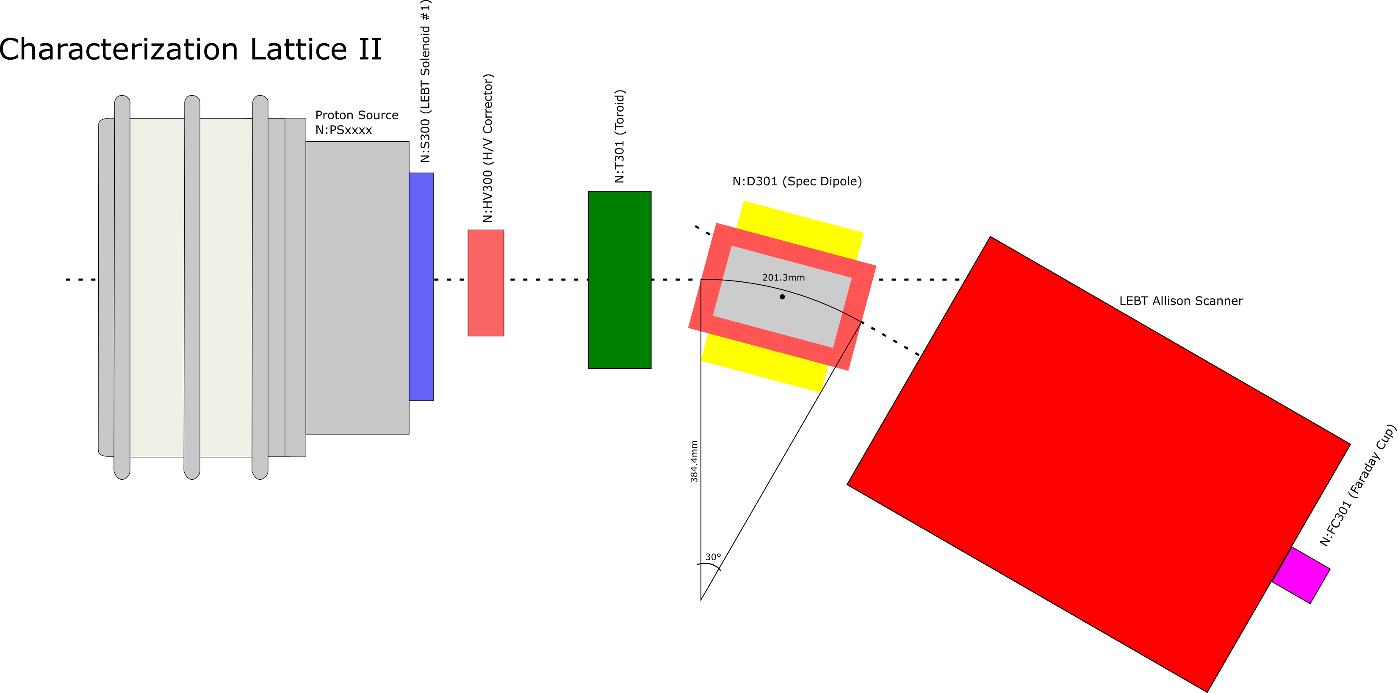
Duoplasmatron Source Commissioning / Characterization
A Plan in 3 Steps:
Bend Magnet
ORC 2011

Faraday Cup

Toroid
Faraday Cup
LEBT Allison
Scanner


Slide 8
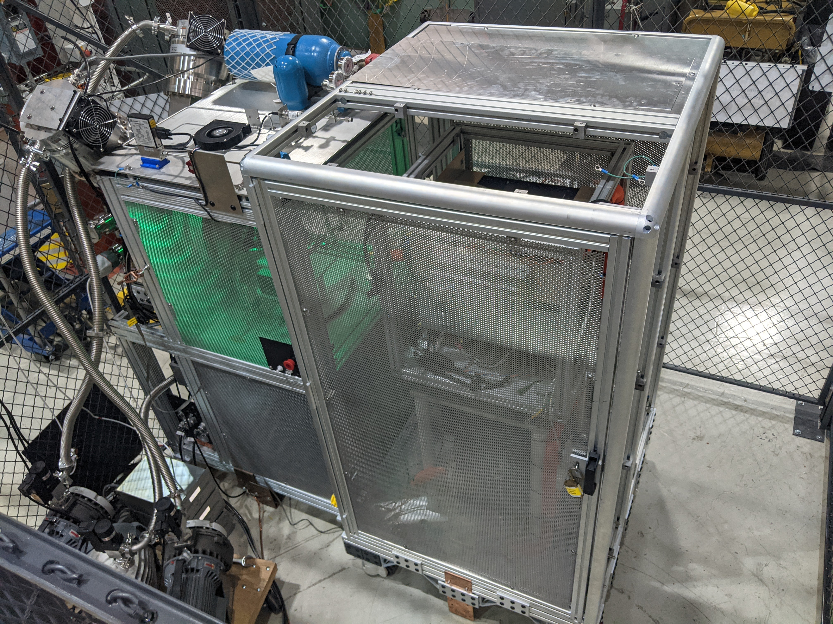
IPI Source – Radiation Generating Device (RGD) Registration
New Requirement
In compliance with DOE Order 420.2D
Registration is currently awaiting final approval from FSO
ES&H Training Course Available
IPI Source Operation [AD000190/CR/01]
Audience: All RGD Source Operators
ORC 2011 approved
Allows for Step #1 of Commissioning

Slide 9
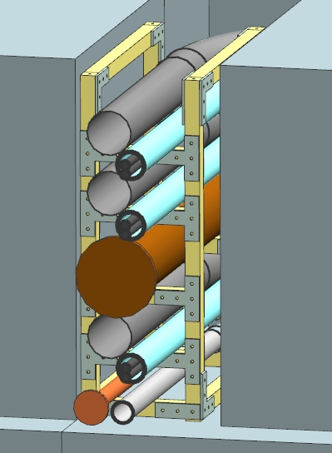
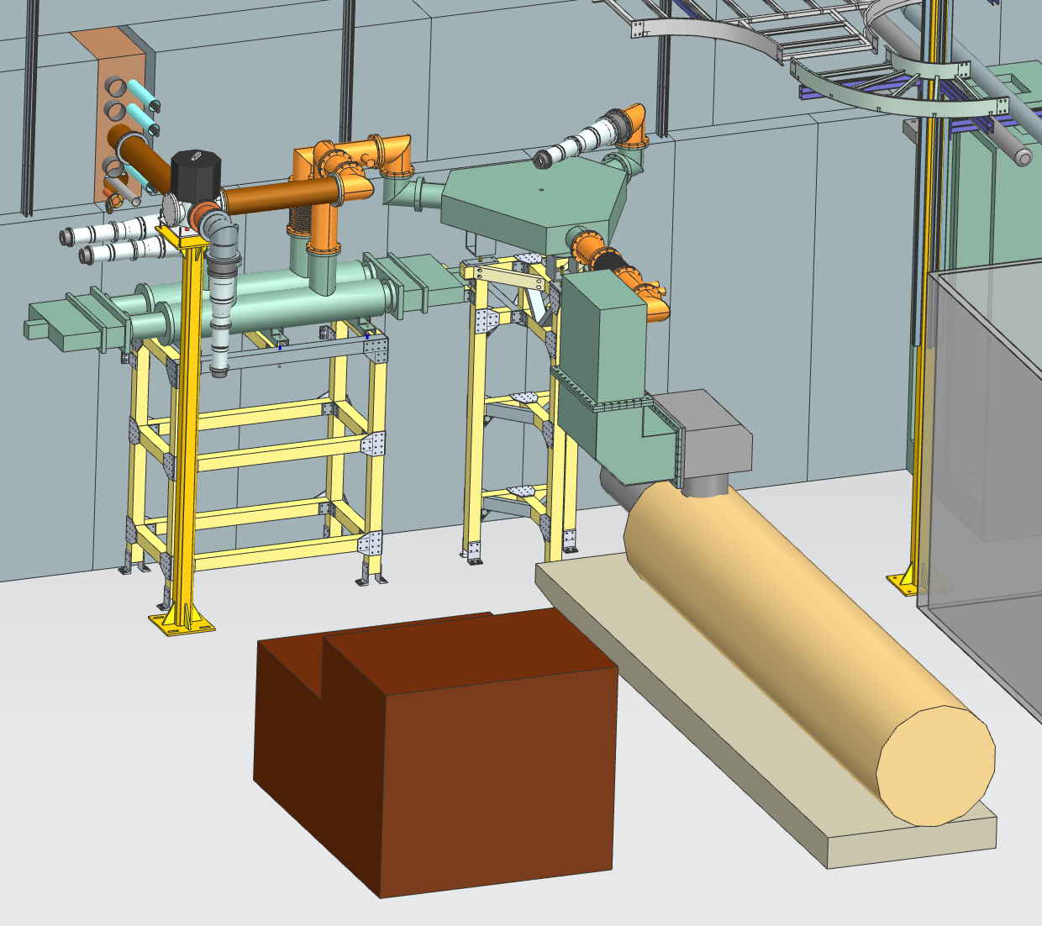
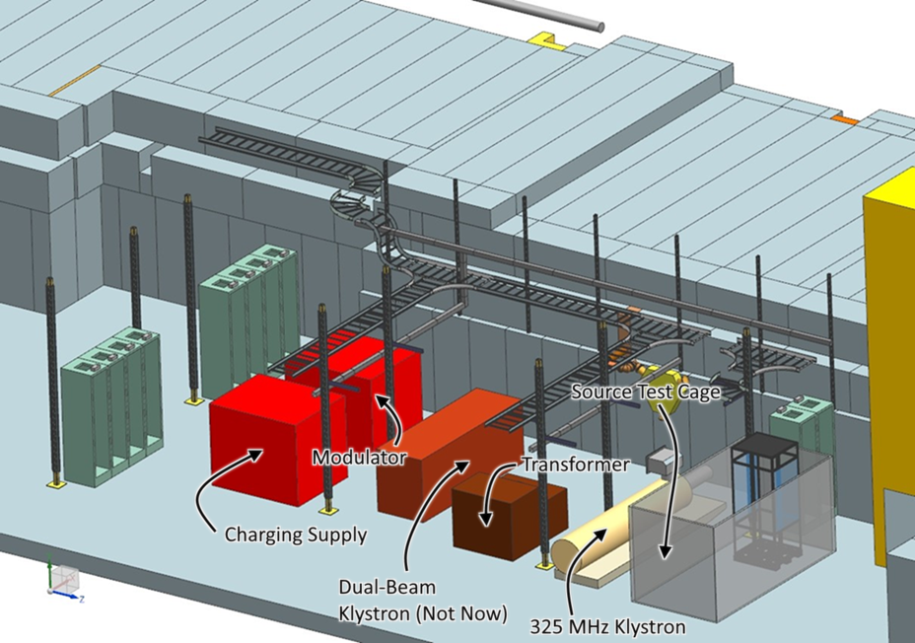
HLRF Distribution
Penetration
4” Conduits
2” Conduits
(500MCM)
RFQ WG
Buncher WG
1.5” Conduit
(Fiber)

Slide 10
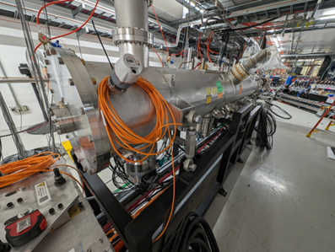
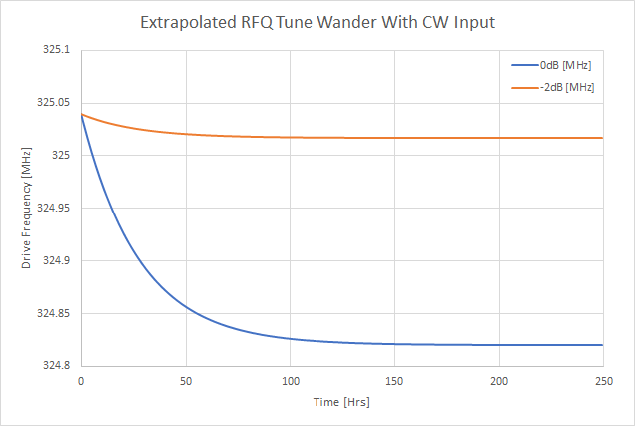
IOTA Overview: RFQ
Damaged cooling coil prohibited long-pulse operation…
Not (as big of) a problem for short pulse:
5.6 kHz / 8 Hr @ 100 W CW
Commissioning needed to assess

Slide 11
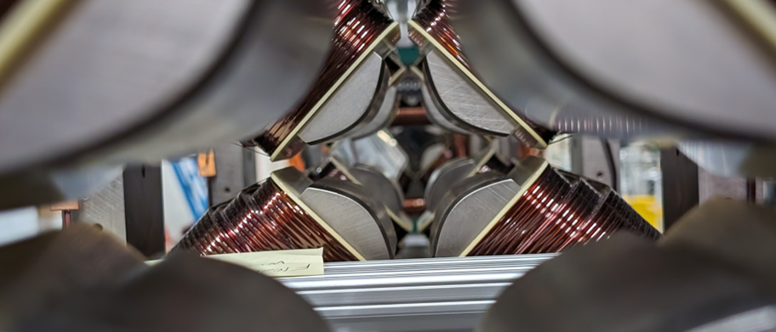
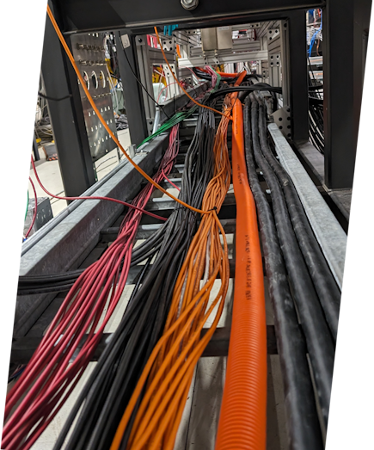
Installation In Progress
Cable Pulls Complete
Over 300 Cables / 17 Miles Pulled
Terminations In Progress
Beamline Element Installation in Progress
Installed: MEBT Magnets, RFQ

Slide 12
2023
2024

Slide 13
Instrumentation
W343
(Scanning Wire)
W315
(Scanning Wire)
T322
(WCM)
RFQ Probes (x12)
T344
(Toroid)
EID
MEBT Allison Scanner
X333
(Diamond Detector)
Scraper
T310
(Toroid)
Repeller
B312
B332
B345
Bias Current
Electronics
B310
B322
Beam Position Monitors

Slide 14
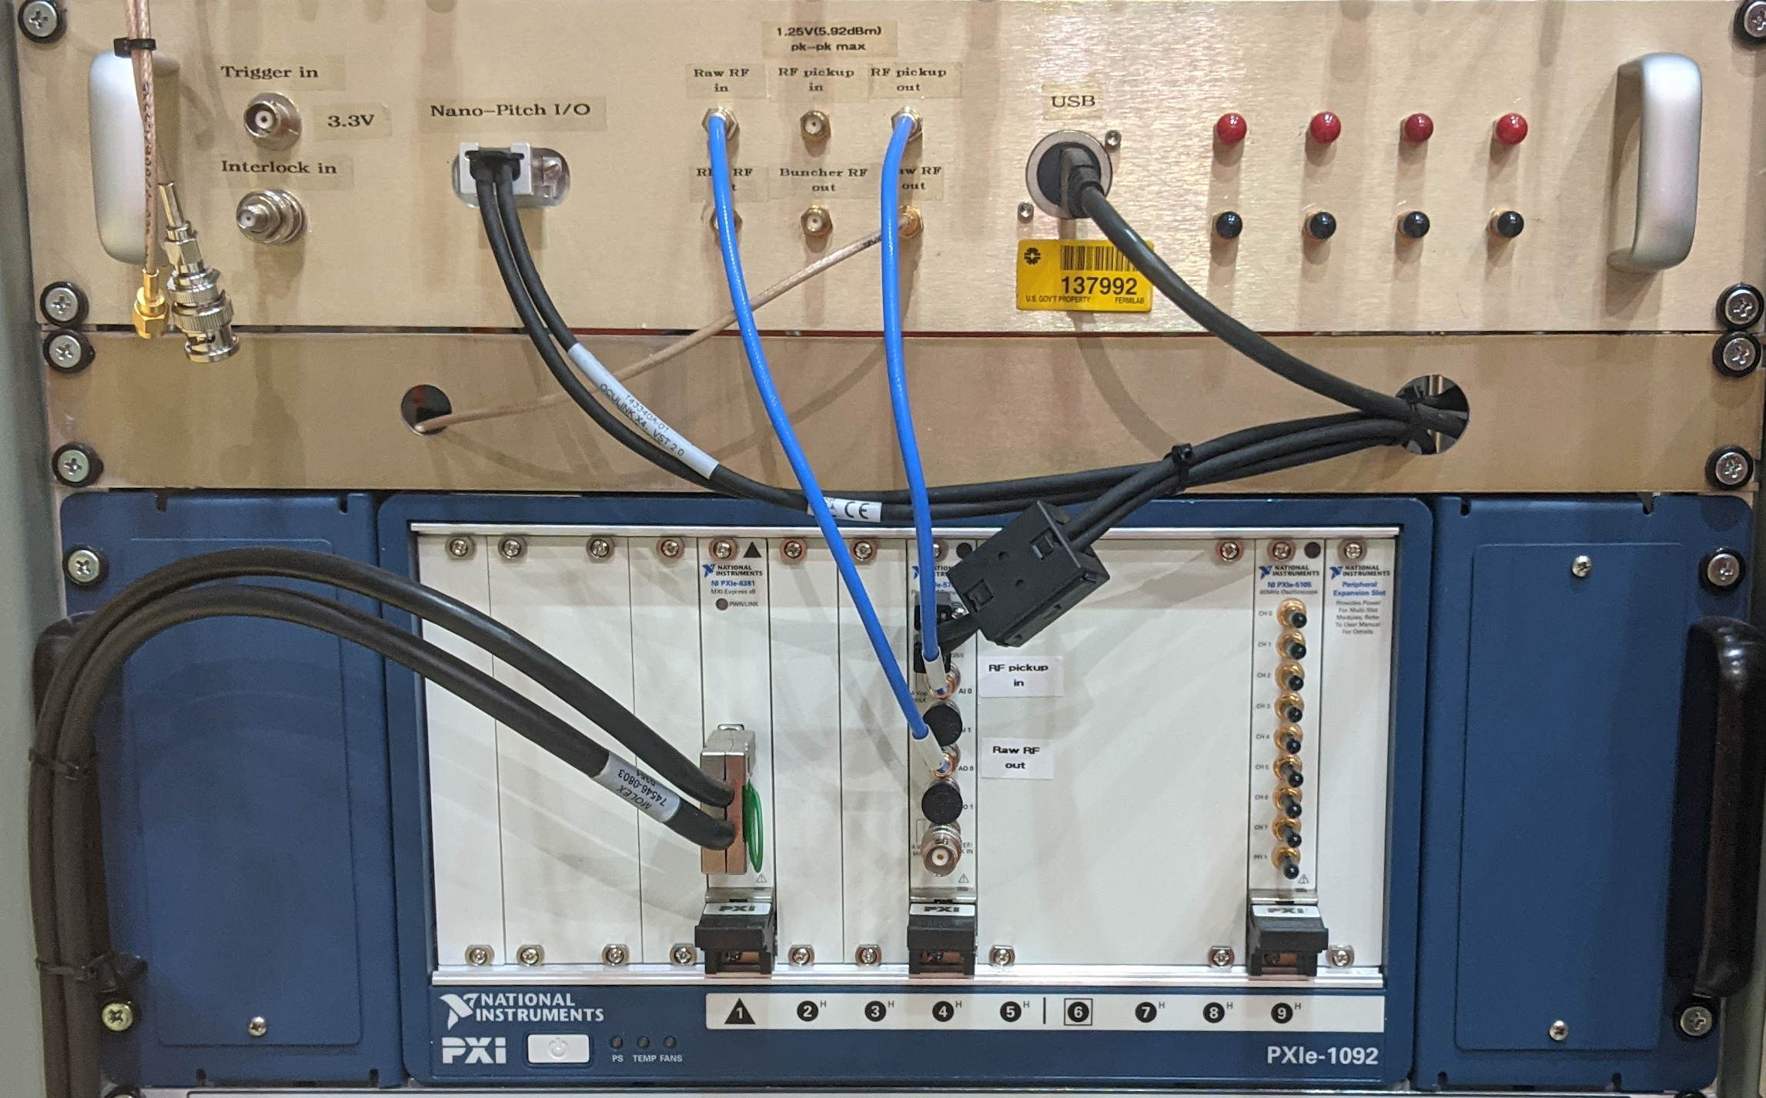
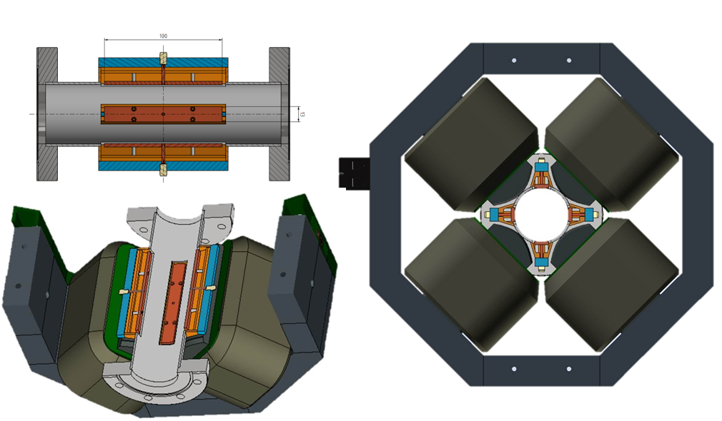
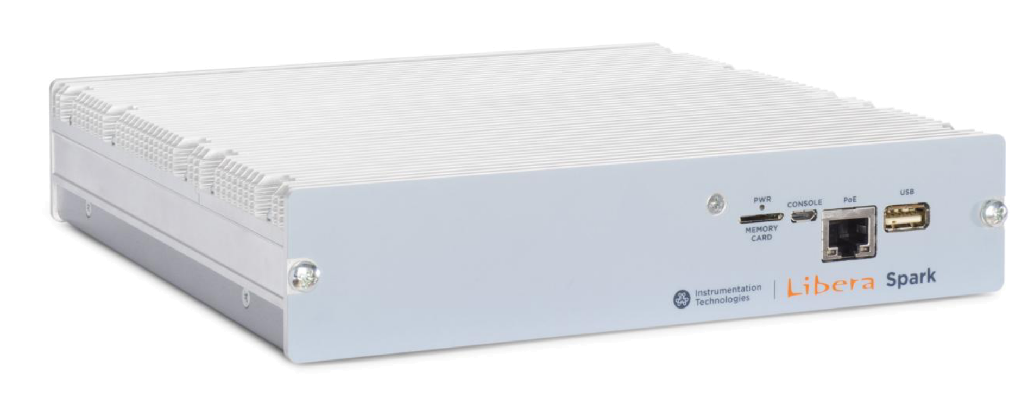
New Instrumentation – LLRF & BPMs
325 MHz LLRF by Euclid Techlabs
For RFQ & Buncher with Relative Phase Shift
Integrated EPICS IOC
BPMs by Instrumentation Technologies
Insert Fabrication by Bevatech
PreAmp Assemblies by AD/Inst
Integrated EPICS IOC

Slide 15
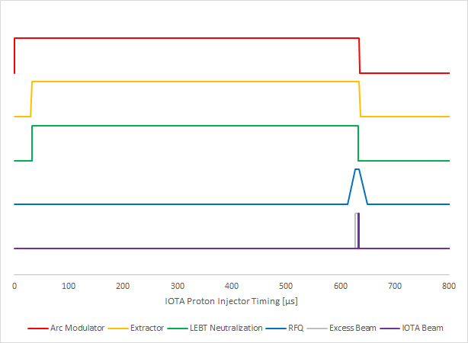
Timing
IPI Timing Assumes:
30 μs for Arc
600 μs to LEBT Neutralization
(Suppress Emittance Growth)
15 μs to RFQ Fill
5 μs to Stabilize
2 μs for Beam to IOTA

Slide 16
IOTA Proton Injector – Remaining
Source / Low Energy Beam Transport
Duoplasmatron Proton Source
50 keV Conditioning / Commissioning
Source Characterization
325 MHz RF (post-FPCs)
Installation of RF distribution
Controls/Instrumentation Electronics
Slow (PLC) RF protection system
Fast (VME) RF protection systems
Timing and Readback (HRM)
Klystron Hook-up / Commissioning ***
Critical Path Item (~ June 2024)
RFQ / Buncher commissioning
Fabrication / Installation
Vacuum / Instrumentation crosses
Bend dipole vacuum chambers
Alignment
RFQ / Beamline Element Alignment
Beamline Commissioning
Administrative: in progress ***
SAD Update / MCI Calc. / RGA Reg.
Critical Path Items (~ June 2024)
*** Note: Critical path item estimates are optimistic.

Slide 17
Thank you…
For your attention,
And to everyone working to make the IPI a reality!
Any Questions?

