Slide 1

Experiments with Electron Cooling and Space Charge
Nilanjan Banerjee, MaryKate Duncan, John Brandt, Young-Kee Kim, Sergei Kladov, Sergei Nagaitsev, Giulio Stancari

Slide 2
Overview
Motivation and Conceptual Design
Beam Experiments using Electron Cooling
Hardware Configuration and Status

Slide 3
Motivation and Conceptual Design

Slide 4
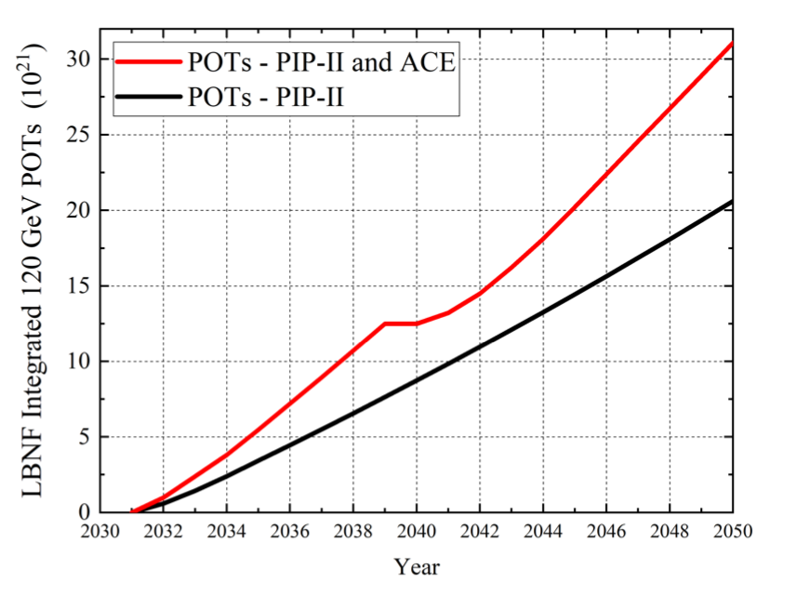
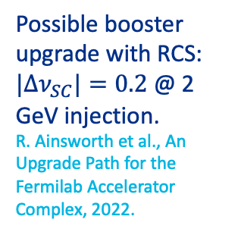
Maximizing Brightness and Intensity in ACE and Beyond
The proton program in IOTA was proposed for research into multi-megawatt hadron rings. Our research program addresses the four grand challenges of accelerator and beam physics facing the community:
Beam Quality: Space-charge, cooling
Beam Intensity: NIO, Landau damping
Beam Control
Beam Prediction
Possible booster upgrade with RCS: $|Δν_{SC}|=0.2$ @ 2 GeV injection.
R. Ainsworth et al., An Upgrade Path for the Fermilab Accelerator Complex, 2022.
R. Ainsworth et al., Report from the Fermilab
Proton Intensity Upgrade Central Design Group, 2023.
Derisk new booster design by finding methods to maximize beam intensity and quality for a range of beam storage times.
J. Blazey et al, Accelerator and Beam Physics Roadmap, DOE Accelerator Beam Physics Roadmap Workshop, 2022

Slide 5
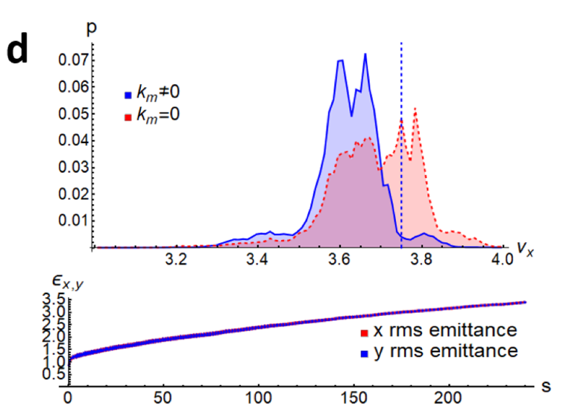
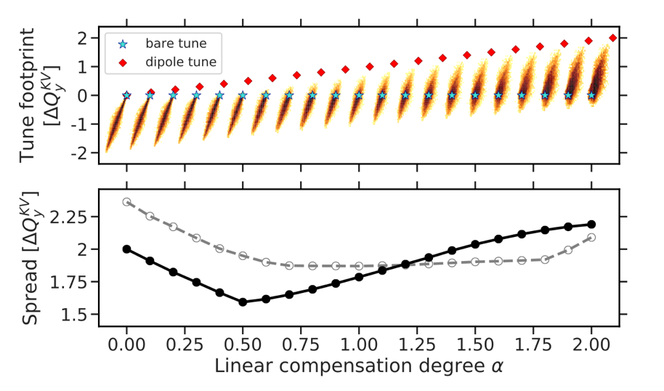
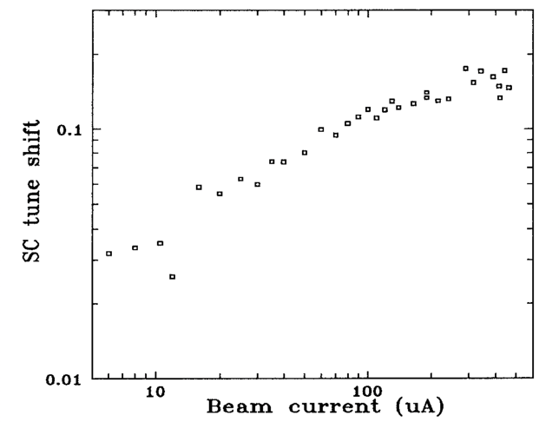

Enhancing Beam Quality
Pulsed e-lens with flat transverse profile.
McMillan e-lens
Realize a super-periodic lattice
Allocate more space for the tune footprint.
Compensate for space charge forces
Minimize tune footprint due to space charge. Tune-shift compensation per lens is limited. Gaussian or McMillan?
Electron cooling
Cool hadrons via thermal energy exchange with co-propagating electron beam. Constrained by space-charge.
How to maximize phase-space density of stored beam and minimize beam loss in a ring for given number of turns?
S. Nagaitsev et al., JINST 16 P03047, 2021.
A. Oeftiger and O. Boine-Frankenheim, arXiv:2310.02365, 2023.
$$Δν<0.1−0.2$$
S. Nagaitsev et al., Proceedings Particle Accelerator Conference, 1995, pp. 2937-2939
Beam density
Beam intensity

Slide 6
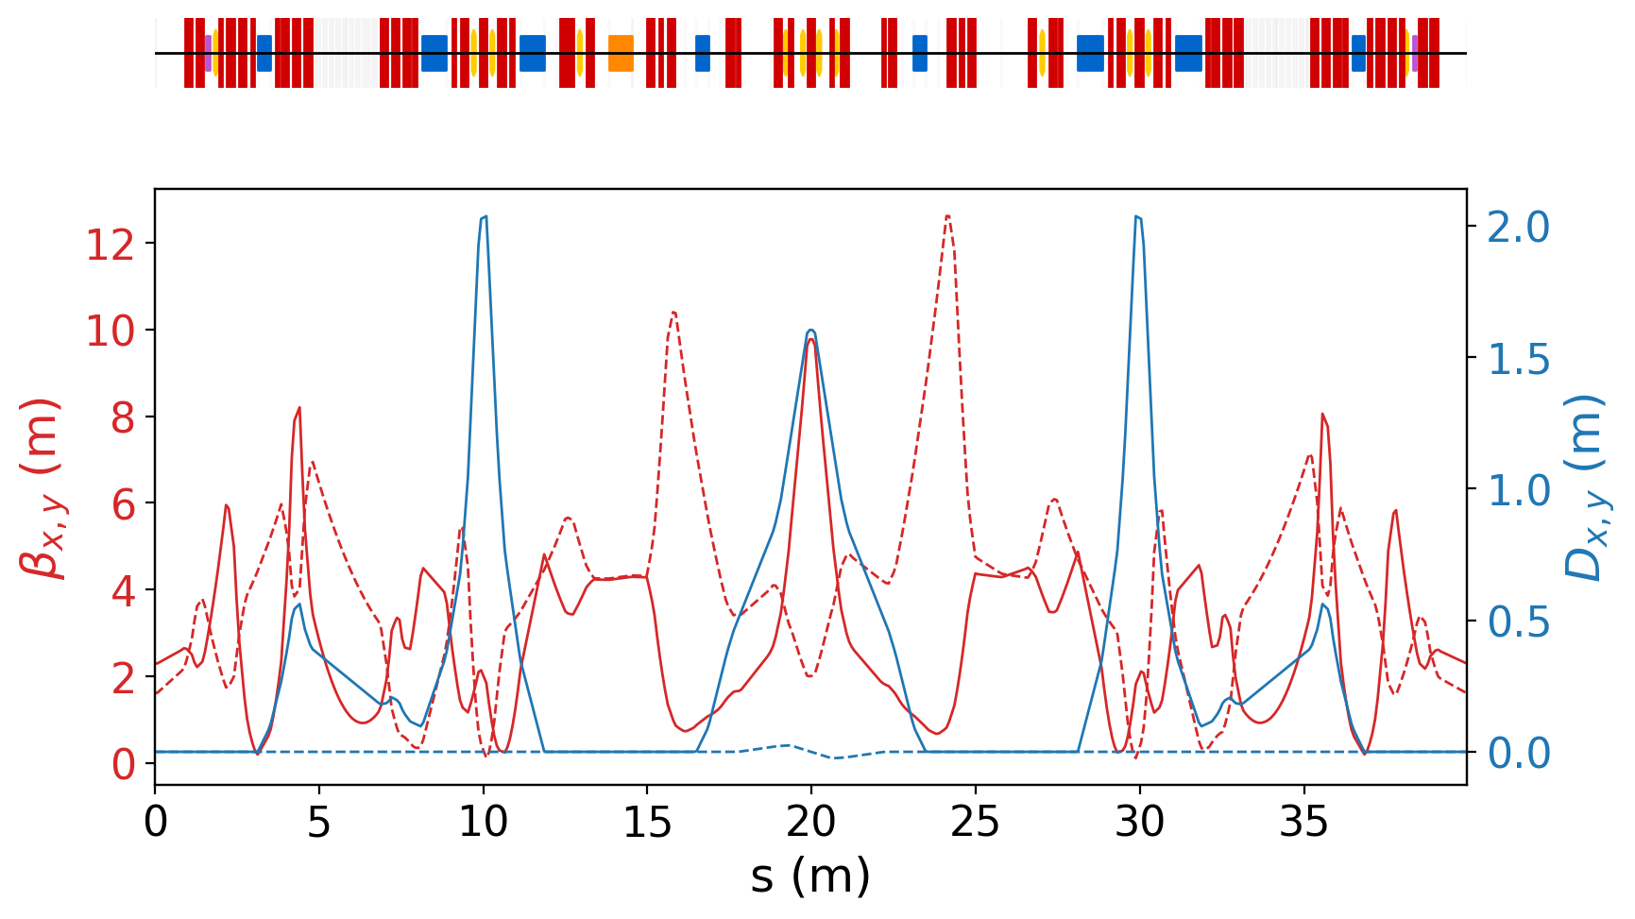

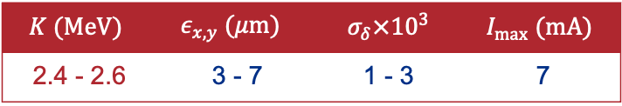
The Proton Program at IOTA
IOTA will be configured to recirculate 2.5 MeV protons up to $\left|Δν_{x,y}\right|\sim 0.5$.
Features:
All (skew) quadrupoles, correctors and sextupoles are independently controlled.
Rf cavity for adiabatic capture.
Single-turn injection.
Electron lens/cooler of length 0.7 m.
$$K (MeV)$$ | $$ε_{x,y} (μm)$$ | $σ_{δ}×{10}^{3}$ | $$I_{max} (mA)$$
2.4 - 2.6 | 3 - 7 | 1 - 3 | 7

Slide 7

Emittance Growth and Beam Loss
The primary sources of emittance growth and beam loss are:
Residual Gas Scattering
  Single scattering events lead to a finite lifetime. 10 mins @ 4.2 x 10⁻⁸ Torr measured in atomic hydrogen equivalents.
  Multiple scattering events lead to emittance growth independent of intensity.
  Baking can reduce residual pressure and increase lifetime.
Intra-Beam Scattering
Space-charge driven diffusion
  Functions of bare lattice and phase-space distribution.
Beam Lifetime
No aperture restrictions
$$\left|Δν_{y}\right|\sim 0.01$$
Emittance Growth
Electron cooling can allow us to compensate for emittance growth and enforce equilibrium.

Slide 8
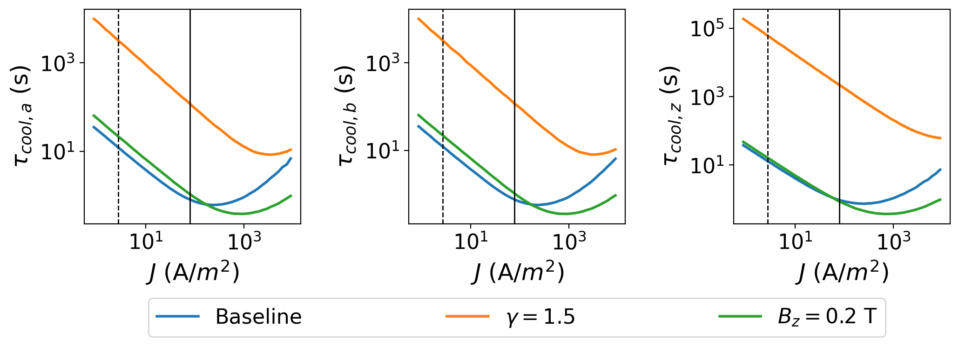
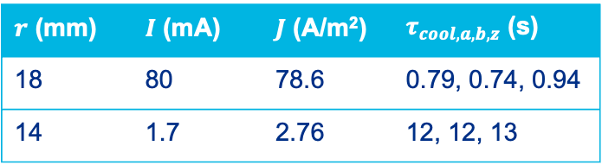
Electron Cooler Design Parameters
Electron beam parameters aim to provide a cooling time of ~ 1 - 10 seconds to control equilibrium emittance at different bunch charges.
We estimated the cooling time using the Parkhomchuk model assuming:
Flat transverse distribution of the electron beam.
Ideal solenoid field.
Matched proton beam.
For the baseline design we chose two electron coolers with an order of magnitude difference in cooling time.
$r$ (mm) | $I$ (mA) | $J$ (A/m²) | $τ_{cool,a,b,z}$ (s)
18 | 80 | 78.6 | 0.79, 0.74, 0.94
14 | 1.7 | 2.76 | 12, 12, 13

Slide 9
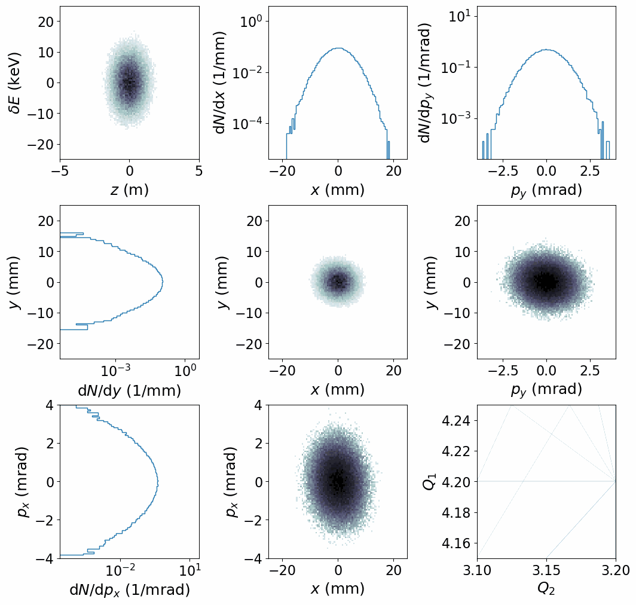
Simulations in PyORBIT with Space Charge and Cooling
We simulate our experiments using a transverse PIC space-charge model and the Parkhomchuk model of cooling.
Cool the core of the beam.
Can’t cool large amplitude particles.
More beam loss in bunched beam.

Slide 10
Beam Experiments using Electron Cooling

Slide 11
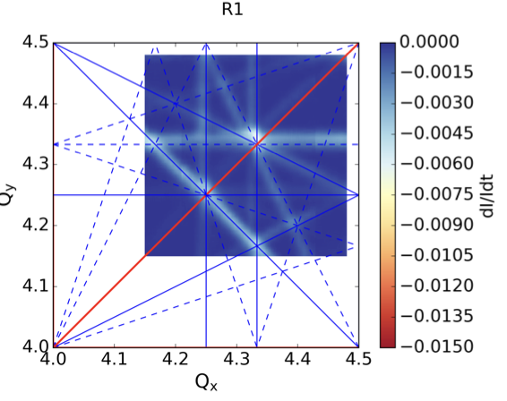
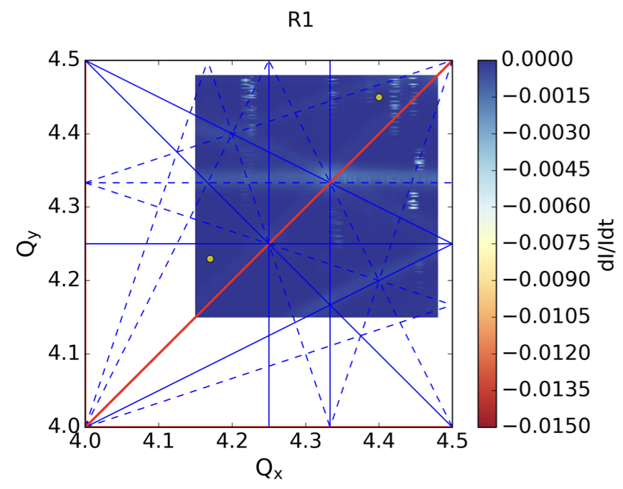
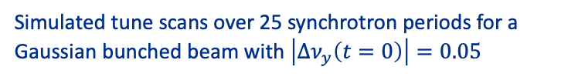
Optimization of Bare Lattice to Maximize Tune Shift
What is the maximum space-charge tune shift of stored beam we can achieve?
Optimizing the linear lattice configuration, including tunes and transverse coupling.
Increasing periodicity of the lattice.
Compensating for specific resonance driving terms using sextupoles and octupoles.
Simulated tune scans over 25 synchrotron periods for a Gaussian bunched beam with $\left|Δν_{y}\left(t=0\right)\right|=0.05$
F. Asvesta et al., in Proc. IPAC'22, pp. 2056-2059, 2022.

Slide 12
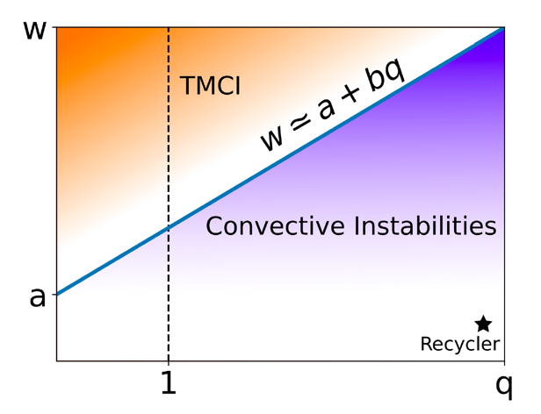
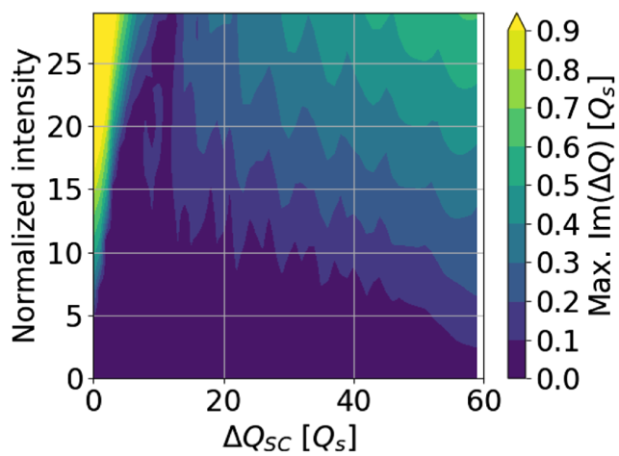
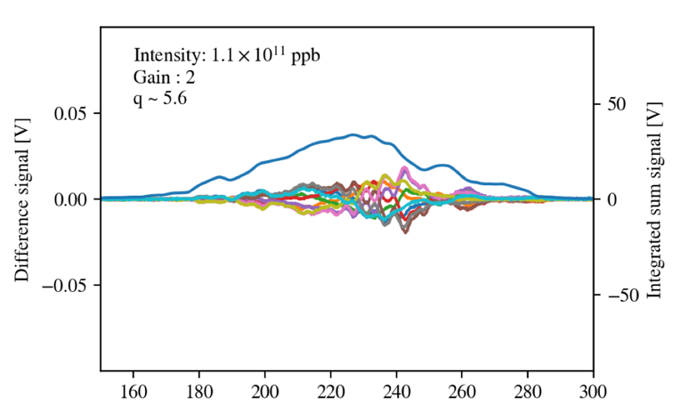
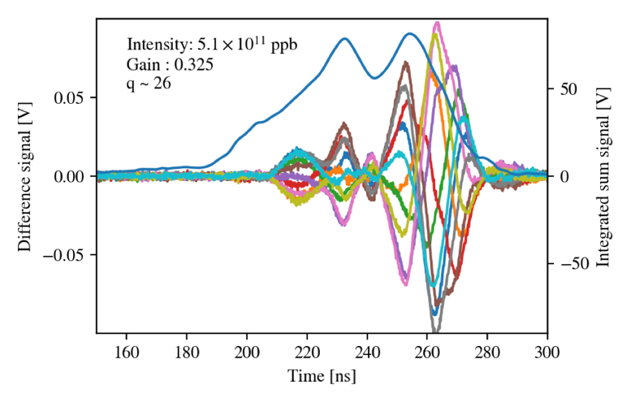
Interplay of Space Charge and Coherent Instabilities
The 2.5 MeV protons at IOTA provide strong space-charge but weak impedance.
Measure instability growth rate and head-tail amplification in the parameter space using:
Controlled wakefields generated using the wake-building feedback system.
Electron cooling to enforce an equilibrium phase-space distribution, independent of bunch charge.
Wakefield
Amplitude (Waker)
ABS
CMM Gaussian
SC Tune Shift (Electron Cooling)
ABS: A. Burov, Phys. Rev. Accel. Beams 22, 034202, 2019.
CMM: X. Buffat et al., Phys. Rev. Accel. Beams 24, 060101, 2021.
R. Ainsworth et al., in Proc. HB'21, pp. 135-139, 2021.
O. Mohsen et al., in Proc. NAPAC'22, pp. 124-127, 2022.
Fermilab Recycler
Time (ns)
Time (ns)

Slide 13
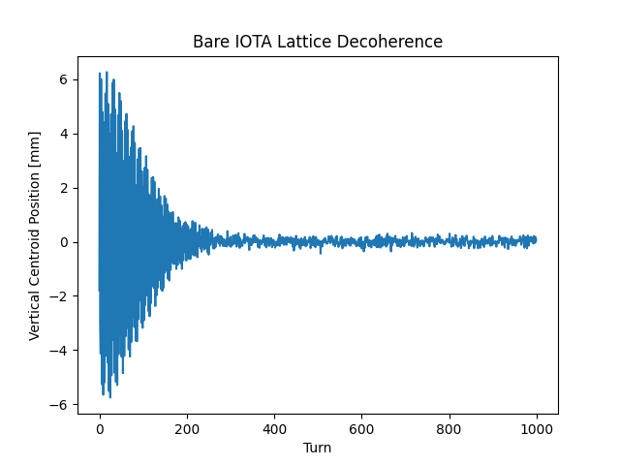
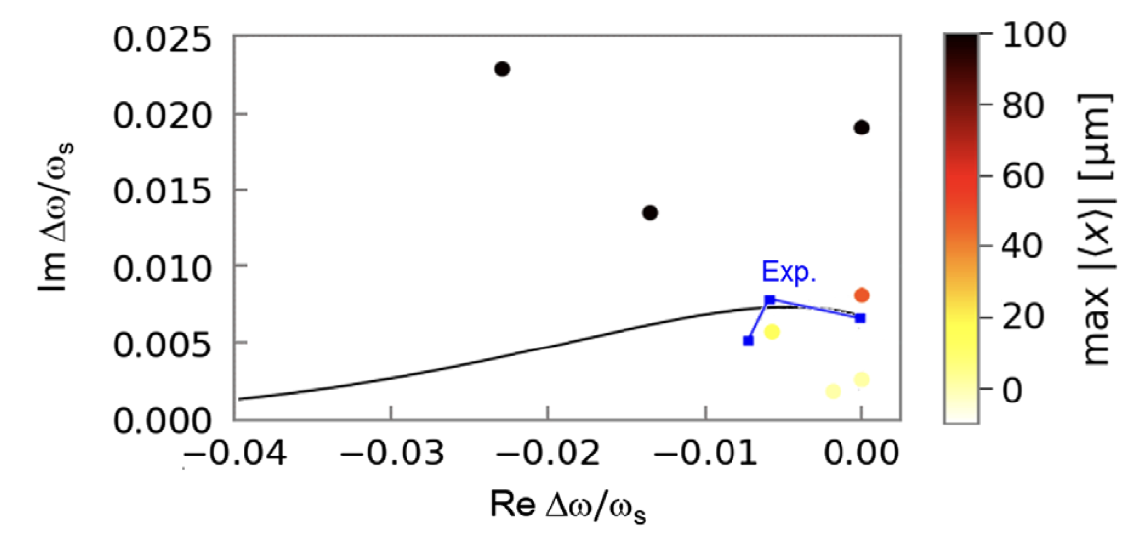
Tunable Landau Damping with Space Charge
Demonstrate integrable optics and Landau damping.
Danilov-Nagaitsev magnets
Octupole string
Electron cooling enables:
Single particle dynamics experiments with pencil beam and low energy spread.
Measurement of minimum tune spread required to mitigate coherent instabilities with space-charge.
J. Wieland, personal communication.
A. Valishev et al., in Proc. IPAC’21, pp. 19-24, 2021.
N. Kuklev et al., in Proc. IPAC'21, pp. 1964-1967, 2021.
V. Danilov and S. Nagaitsev, Phys. Rev. ST Accel. Beams 13, 084002, 2010.
Experimental data showing decoherence due to chromatic tune spread in electron bunches.
Instability Parameter Space
Stability Diagram: S. Antipov et. al., Phys. Rev. Lett. 126, 164801, 2021.

Slide 14
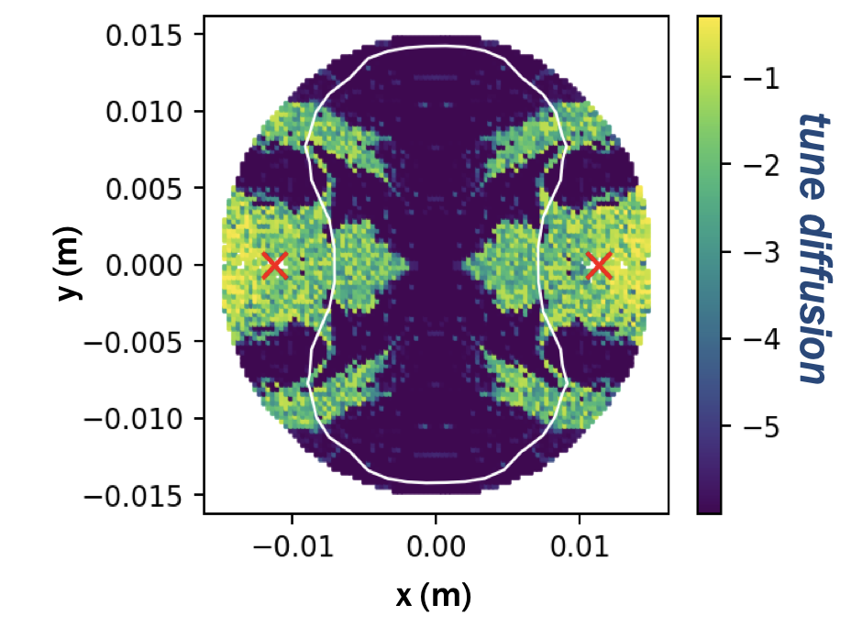
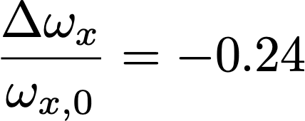
Other Experiments
Interplay of NIO, space-charge and electron cooling
  Integrability is broken in the presence of non-linear space-charge. Practical implications?
Electron lens which also works as a cooler.
  Electron lens provide favorable scaling of detuning compared to electromagnets. Can it also work as a cooler to increase brightness?
Semi-hollow distributions for electron cooling
  Should help in cooling protons with large betatron amplitude. Limited experimental data available.
Tune diffusion in DN focusing channel with intense SC
C. Mitchell et al., JINST 15 P07019, 2020.
Increasing magnetic field, increases optimal current density.
Cooling rate vs electron current density

Slide 15
Hardware Configuration and Status

Slide 16
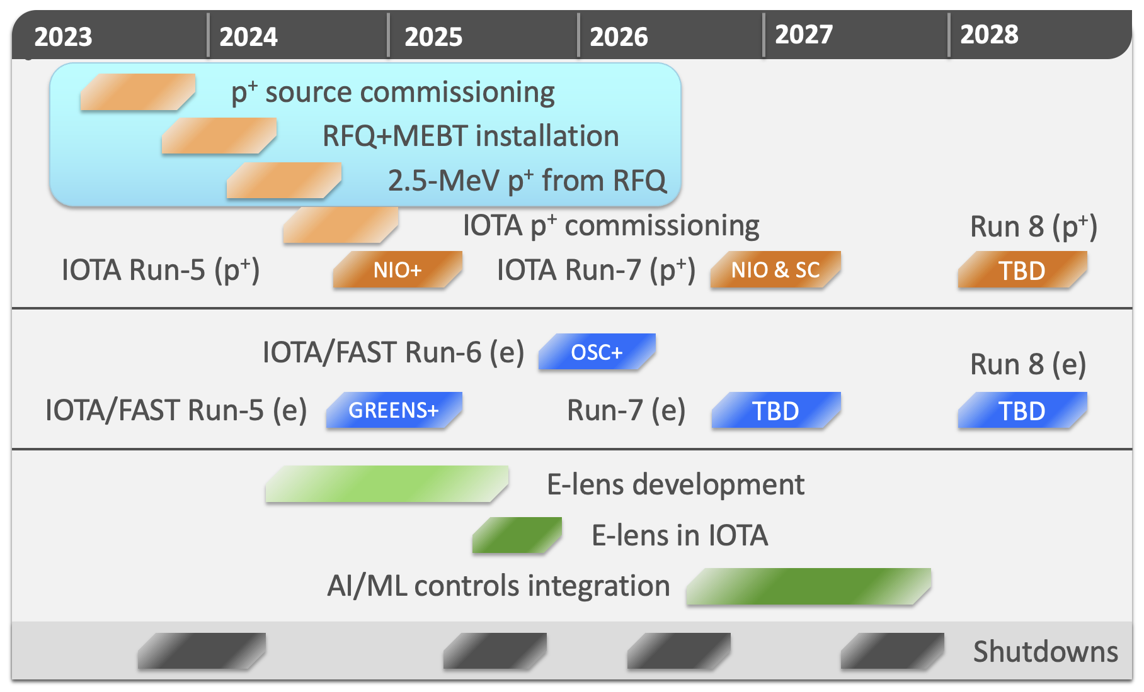
Electron Cooling in 2025

Slide 17
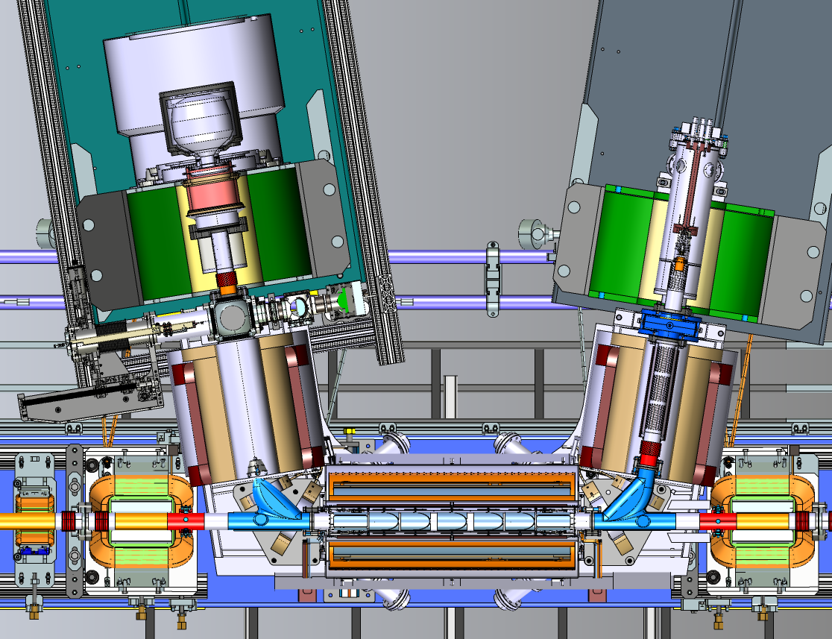
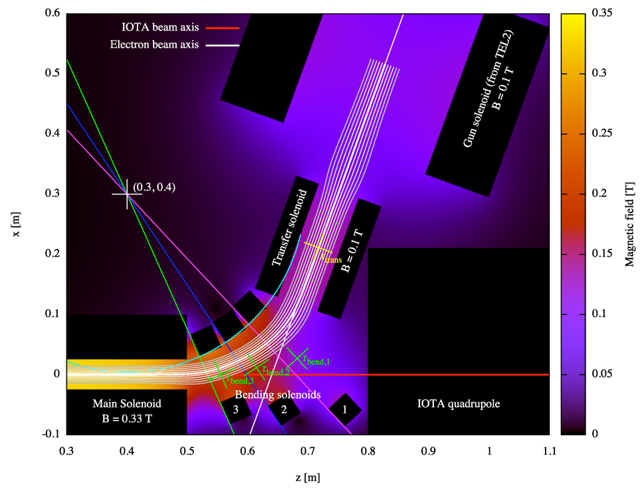
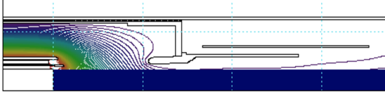
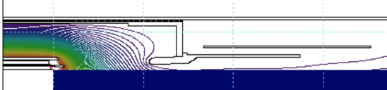
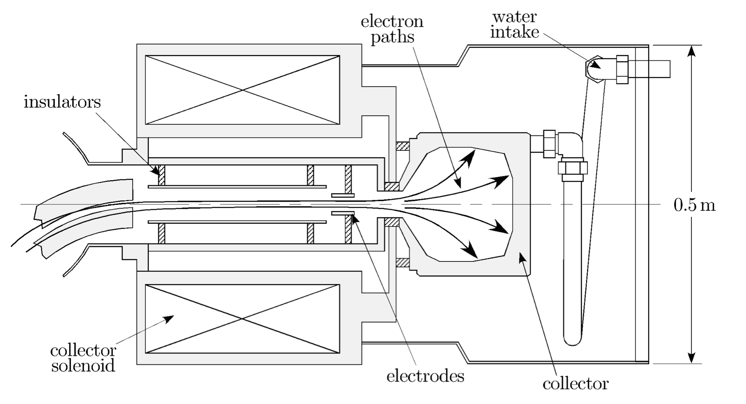
Electron Lens Setup
G. Stancari et al, JINST 16 P05002, 2021
Conceptual design of most parts exist but engineering design needs to be finalized.
e⁻ source
Anode
Profiler
Dispenser Cathode
e⁻ beam
Flat beam gun
M. Bossard et al., in Proc. IPAC'23, pp. 646-649, 2023.
Electron Tracking
D. Noll and G. Stancari, Technical Memo, Fermilab, 2015. FERMILAB-TM-2598-AD-APC.
TEL-2 Collector
V. Shiltsev et al., Phys. Rev. ST Accel. Beams 11, 103501 , 2008.

Slide 18
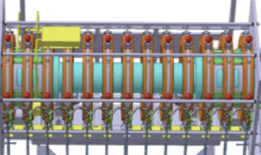
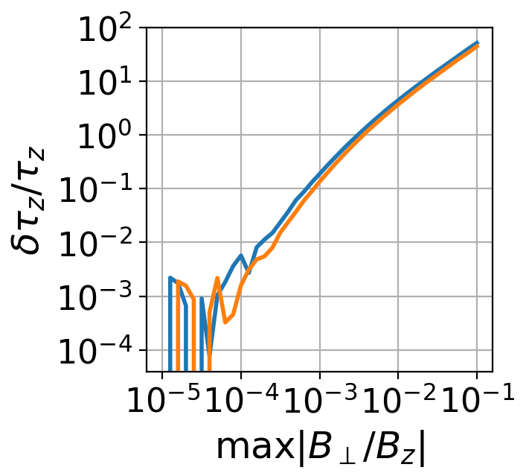
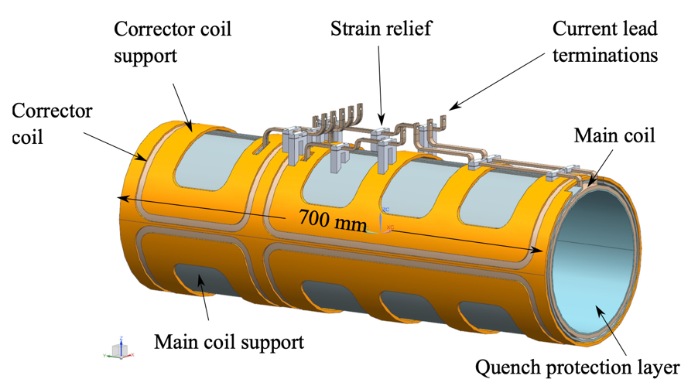
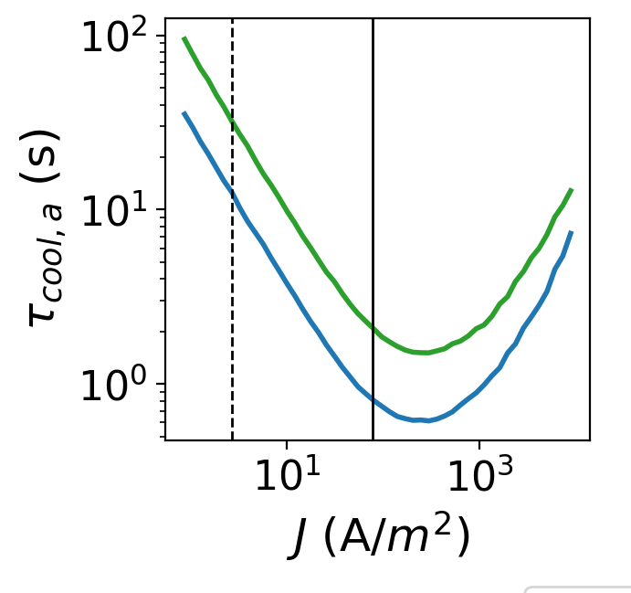

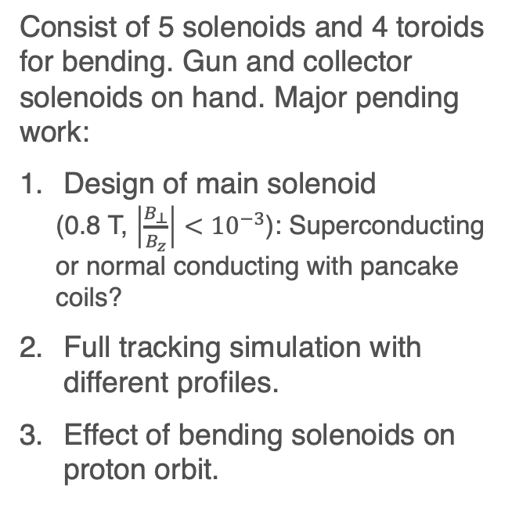
Magnetic Optics for Electron Beam
Consist of 5 solenoids and 4 toroids for bending. Gun and collector solenoids on hand. Major pending work:
Design of main solenoid
  (0.8 T, $\left|\frac{B_{⊥}}{B_{z}}\right|<{10}^{−3}$): Superconducting or normal conducting with pancake coils?
Full tracking simulation with different profiles.
Effect of bending solenoids on proton orbit.
Pancake coils in candidate design for new electron cooler in AD
A. Rossi et al., in Proc. COOL’23, Montreux, Switzerland, paper MOPPM1R3, 2023.
Conduction cooled SC solenoid
R.C. Dhuley et al 2021 JINST 16 T03009
~3 times increase in $τ_{cool}$!

Slide 19
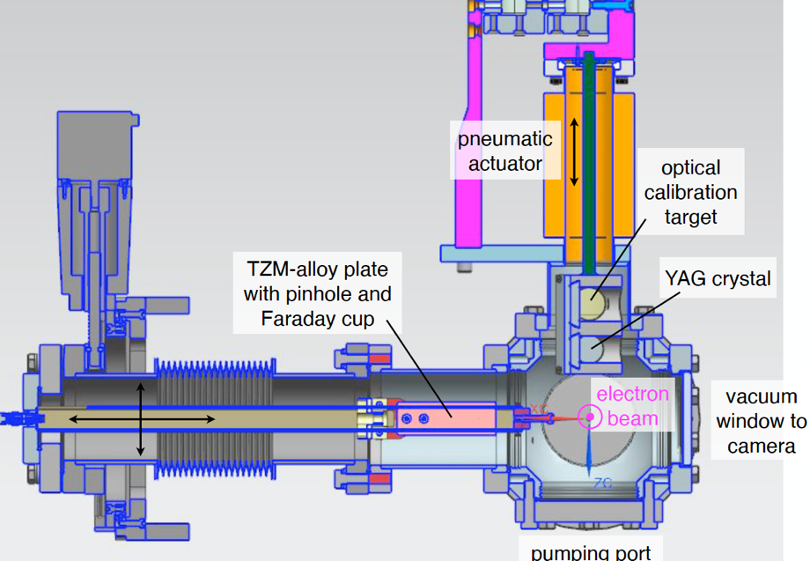
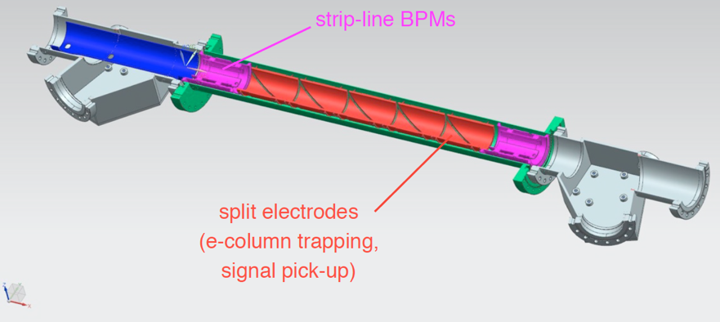
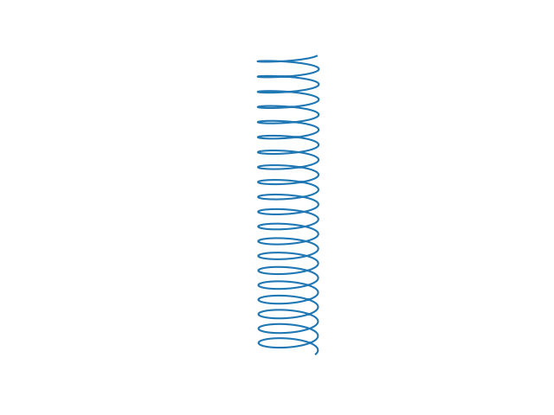
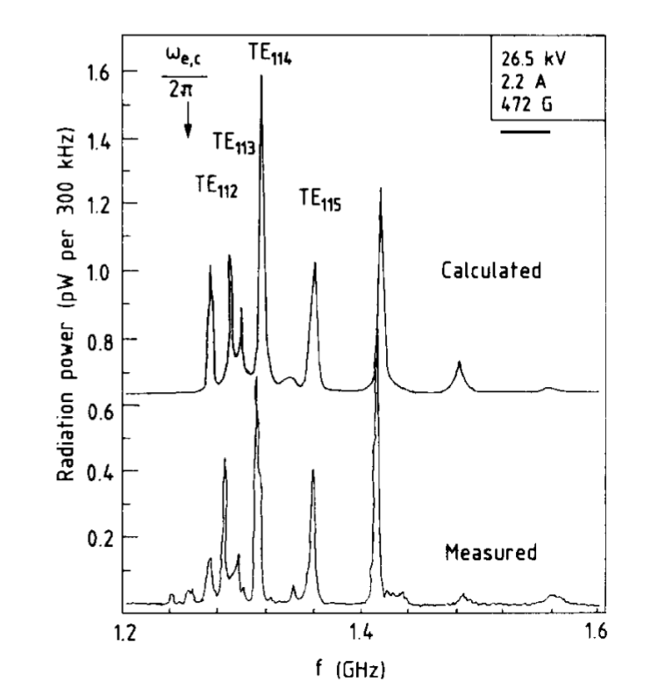
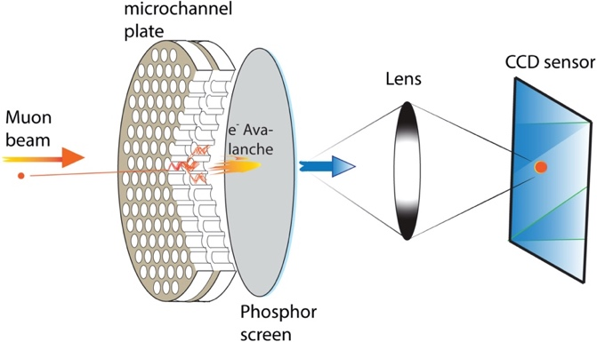

Electron Beam Diagnostics
Toroids: Measure beam current and losses.
Stripline BPMs: Align with the proton beam.
Profile measurement: Measure transverse profile.
Recombination Monitor: Optimize cooling performance.
Cyclotron Emission Monitor: Estimate electron density and temperature.
G. Stancari et al, JINST 16 P05002, 2021
Microwave photons
B_{z}
electrons
H⁰
C. Habfast, PhD thesis, Karlsruhe U., KFK-4188, 1987.
H⁰
Bongho Kim et al., NIM A, 899, 22-27, 2018.
$$f_{c}$$

Slide 20
Conclusion
The IOTA 2.5 MeV proton program will study extreme beam conditions in future hadron synchrotrons and storage rings.
  Space-charge tune shift approaching -0.5. – Electron cooling and space-charge compensation.
  Adjustable wakefields of arbitrary shapes and magnitudes. – Wake-building feedback system.
We have proposed a few experiments which use electron cooling:
  Optimize bare lattice to maximize tune shift with given emittance growth and loss budget.
  Measure instability growth rate and head-tail amplification as a function of space-charge tune shift and synthetic ring impedance.
  Characterize single-particle dynamics of Non-linear Integrable Optics systems with very low chromatic tune spread and demonstrate suppression of coherent instability.
  Study NIO with intense space-charge.
Electron lens and cooling in late 2025.

Slide 21
Appendix I: Lattices

Slide 22
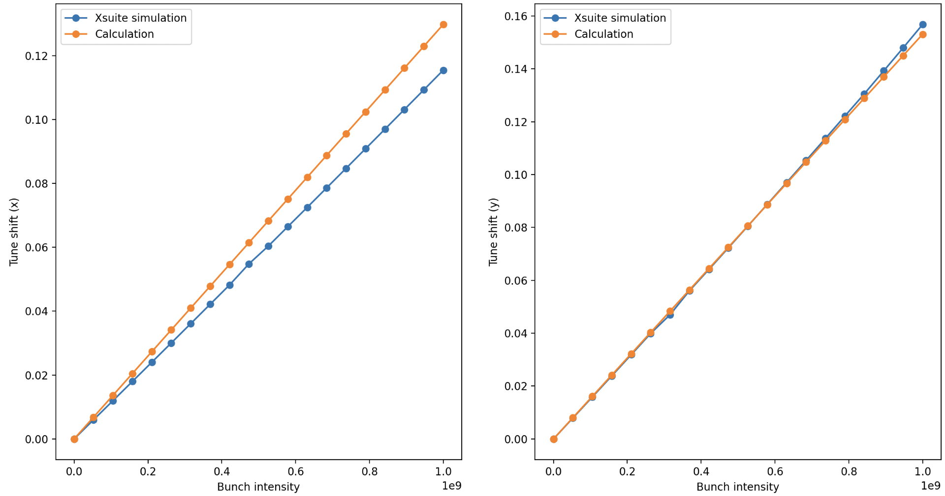
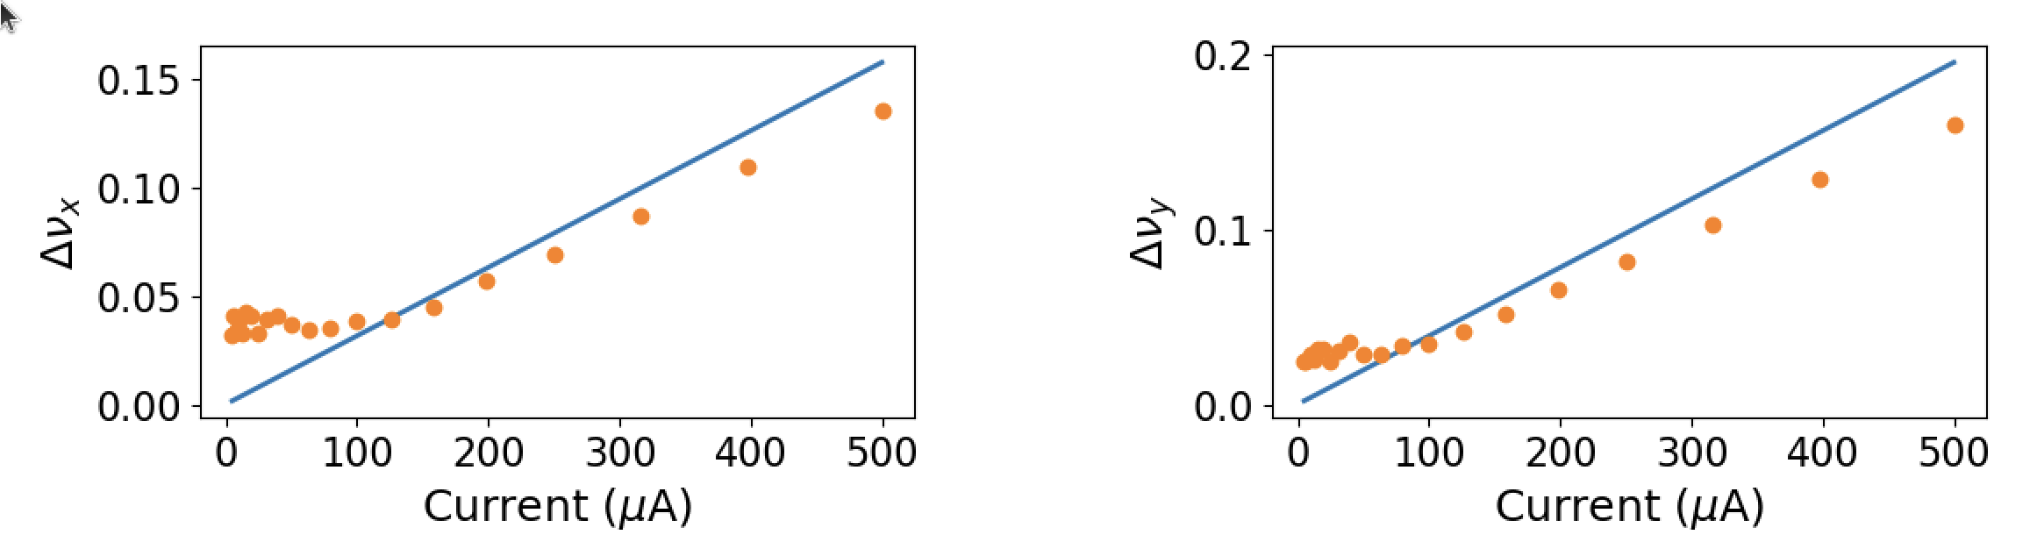
Appendix II: Space-charge simulations in multiple codes
XSuite
Also, IMPACT-X, MAD_X
PyORBIT

