Slide 1










The Role of Test Facilities in Beam Physics Research
Navid Vafaei-Najafabadi

Slide 2
Synthesis
Beam test facilities have a critical role in facilitating high-impact research
They provide unique training opportunities through direct instruction and research mentorship
Introducing BeamNetUS: a network of national-lab beam test facilities aiming to broaden the participation in beam-based research
The network aims to provide a centralized mechanism for access to the unique and distributed strengths of the beam test facilities

Slide 3

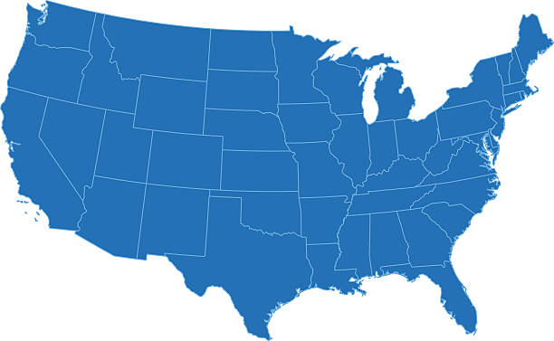









U.S. Advanced and Novel Accelerator Beam Test Facilities
Particle Beam
FAST/IOTA
FACET-II/NLCTA
AWA
BELLA
ELL
ATF/UED/
UTIF
UT³
Laser Beam
U.S. advanced and novel accelerator beam test facilities
[C. Clarke et al 2022 JINST 17 T05009, https://iopscience.iop.org/article/10.1088/1748-0221/17/05/T05009 ]
National Laboratories
Universities

Slide 4
R&D Ecosystem
Beam test facilities are engaged in the supporting layers of the pyramid
Enabling access to research
  – Provide state of the art facilities to enable high-impact research
Training ground for institutions
  – Facilitate research training for new researchers
  – USPAS and university courses, professional courses
  – DOE SULI, SCGSR, RENEW, FAIR
  – NSF REU
Research
Researchers
Institutions
Notes:
20230929_BTF_Facilities

Slide 5
Mission of Test Facilities
Providing experimental test beds to carry out basic research in advanced accelerators and beam physics
Developing the S&T needed to enable the next generation of science facilities and accelerator applications
Educating and training future scientists and engineers

Slide 6
Mission of Test Facilities
Providing experimental test beds to carry out basic research in advanced accelerators and beam physics
Developing the S&T needed to enable the next generation of science facilities and accelerator applications
Educating and training future scientists and engineers

Slide 7


FAST/IOTA
A network of National Lab facilities aiming to run a program specially targeting new collaborations for user-driven research
BELLA/HiRES
FACET-II/NCLTA
AWA
ATF/UED
United in a common mission
  Advance accelerator research and applications of accelerator technology
  Provide access to unique accelerator and accelerator component resources
  Foster collaboration to exchange ideas, skills and resources
UITF

Slide 8

Implementation Timeline
Facilities at 6 National Labs will form the initial network for the pilot year
  Argonne (AWA), Berkeley (BELLA, HiRes), Brookhaven (ATF, UED), Fermilab (FAST/IOTA), Jefferson Lab (UITF), SLAC (FACET-II, NLCTA)
Now
Website Launch
Gather LOIs
Proposal Call
Pilot run for facility time
FY24
FY25
Q1
Q2
Q3
Q4
Q1
Q2
Q3
Q4
Coordinate efforts at conferences, workshops and meetings to inspire new engagements
& work to streamline and document processes
Pilot year for competitive beam time awards
~ 3 weeks at each laboratory/facility by end 2025

Slide 9
A Unique Set of Distributed Capabilities
Electron, positron and proton sources
Electron energies ranging from a few MeV to 10 GeV
100 TW class laser sources
High power RF sources for testing
Advanced particle and radiation diagnostics
A mix of user facilities and mission-driven facilities

Slide 10
Overview of Individual Facilities

Slide 11
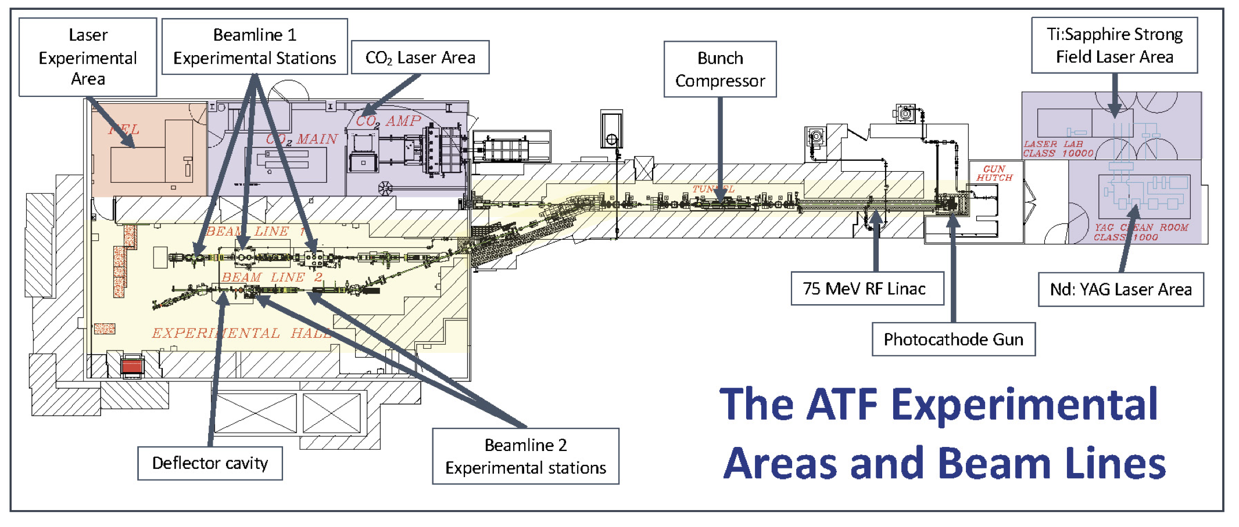
Accelerator Test Facility
Beams
5 TW, 2 ps, CO₂ laser
75 MeV, <1ps, nC linac beam (single bunch and multi-bunch)
TW NIR Sources
Research Focus
Particle and photon source development
Wakefield acceleration
Inverse Compton scattering
Laser-driven plasma ion acceleration
Mode of Operation
National User Facility
DOE Accelerator Stewardship

Slide 12

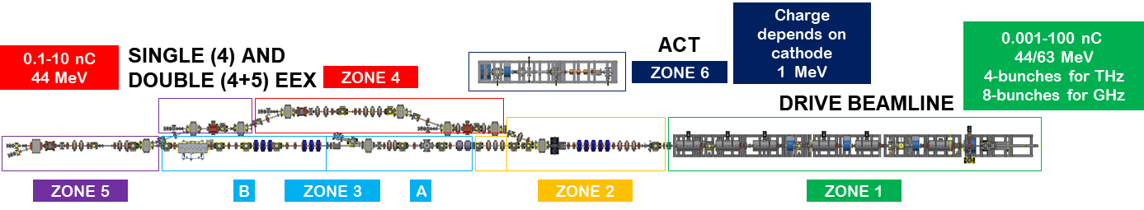
Argonne Wakefield Accelerator
ZONE 6 (ACT)
ZONE 4 & 5
ZONE 3b
ZONE 3a
ZONE 1 & 2
1 MeV flexible beamline
Mostly used for cathode tests
Main diagnostics:
YAG, ICT, or any other installed diagnostics
~1 m space is available for experiment.
Special beams such as longitudinally shaped beam can be provided.
Main diagnostics:
YAG, slit/quad scan, ICT, TDC, spectrometer
Flexible beamline, dedicated for re-build
Main diagnostics:
YAG, quad scan, ICT, or any other installed diagnostics
Fixed beamline with a device test area
Mostly used for SWFA exp
11.7 GHz 400 MW PETs available
Main diagnostics:
YAG, quad scan, ICT, spectrometer
Fixed beamline
Main diagnostics:
YAG, slit/quad scan, spectrometer, ICT
Suitable for small footprint experiment
Beams
Beamline #1: 1 pC-100 nC, 44/63 MeV
Beamline #2: 1 pC-50 nC, 15 MeV
Beamline #3: 1 MeV cathode R&D
1-16 bunch trains for GHz-THz
Tunable bunch length (<10 nC)
Tunable longitudinal profile (<10 nC)
Research Focus
High gradient acceleration (SWFA & PWFA)
Advanced beam manipulation & control
High-brightness electron source
Beam-based radiation sources
Mode of Operation
Mission based and Collaborative Experiments
Notes:
AWA research focuses on
underlying beam-dynamics challenges (e.g., production of bright- and high-charge-beams),
beam manipulation (e.g., beam-current shaping)
beam control (e.g., mitigation of the BBU instability),
advanced accelerating structures (e.g., dielectric waveguides, planar structures, metamaterials, rapid filling metallic structures, etc.) for efficient, high-peak-power RF generation
high-gradient acceleration.

Slide 13
Hundred Terawatt Thomson (HTT)
Beams
Drive beam - 2J, 40 fs
Multi-TW beam (0.5 J, 40 fs)
Fs laser probes (2 mJ 40 fs)
Research Focus
Colliding pulse for e-beam injection in a laser wakefield
Radiography of laser wakefield structures
Thomson scattering for noninvasive e-beam energy measurement
Mode of Operation
Mission based and Collaborative Experiments
Notes:
AWA research focuses on
underlying beam-dynamics challenges (e.g., production of bright- and high-charge-beams),
beam manipulation (e.g., beam-current shaping)
beam control (e.g., mitigation of the BBU instability),
advanced accelerating structures (e.g., dielectric waveguides, planar structures, metamaterials, rapid filling metallic structures, etc.) for efficient, high-peak-power RF generation
high-gradient acceleration.

Slide 14
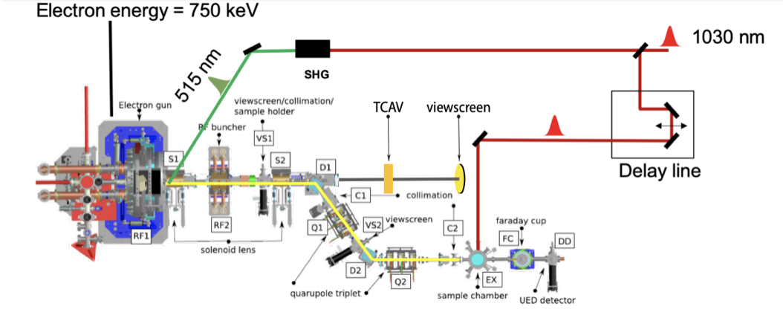
High Repetition-rate Electron Scattering apparatus (HiRES)
Beams
Electron beam (energy ~ 750 keV temporal resolution 300 fs, up to 1 MHz)
Pump laser
Research Focus
Photocathode development
Beam diagnostics, controls and instrumentation
Ultrafast electron diffraction experiment
Mode of Operation
Mission based and Collaborative Experiments

Slide 15
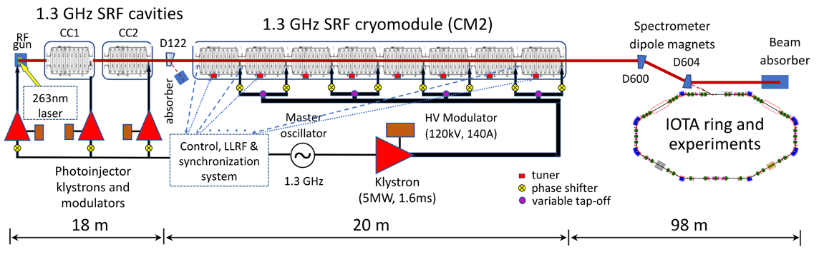
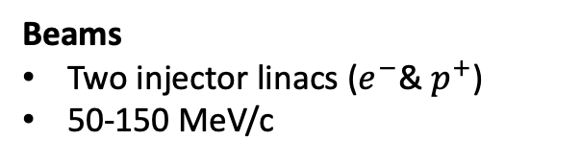
Fermilab Accelerator Science and Technology (FAST)
Beams
Two injector linacs ($e^{−}$& $p^{+}$)
50-150 MeV/c
Research Focus
Suppression of coherent beam instabilities
Mitigation of space charge effects
Advanced beam cooling
Mode of Operation
Mission based and Collaborative Experiments
1–3 concurrent experiments

Slide 16

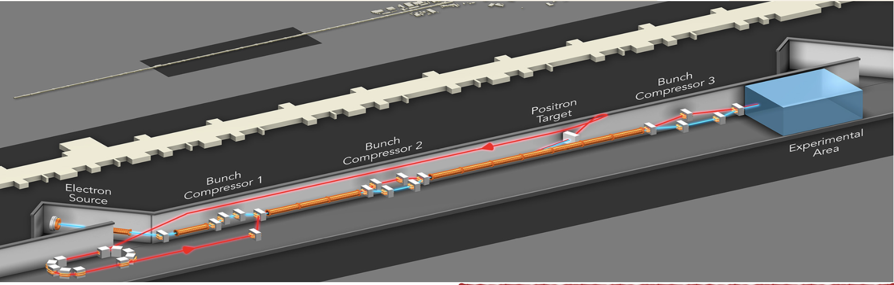
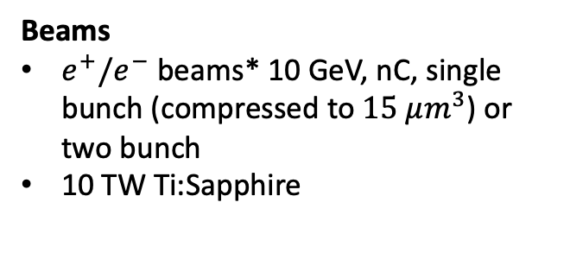

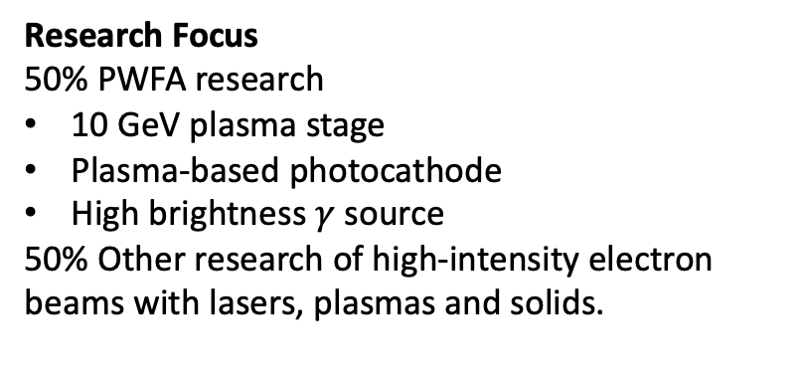
FACET II
Beams
$e^{+}/e^{−}$ beams* 10 GeV, nC, single bunch (compressed to $15 μm^{3}$) or two bunch
10 TW Ti:Sapphire
Research Focus
50% PWFA research
10 GeV plasma stage
Plasma-based photocathode
High brightness $γ$ source
50% Other research of high-intensity electron beams with lasers, plasmas and solids.
Mode of Operation
National User Facility
DOE HEP
* $e^{+}$ planned

Slide 17

Next Linear Collider Test Accelerator (NLCTA)
Five RF sources available to supply power to test areas
Beams
X-band Test Accelerator (XTA), a stand-alone high-power X-band beamline
Research Focus
Development of an X-band Linear Collider for future High Energy Physics Research
New accelerator designs
Compact accelerator applications in medicine, industry, and national security
Mode of Operation
User Facility
Multiple concurrent experiments

Slide 18
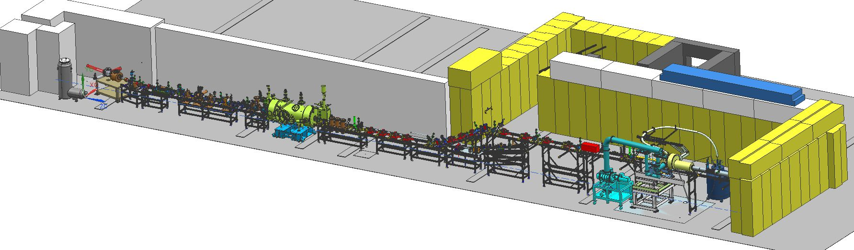
JLab – Upgraded Injector Test Facility
Beams
CW beam at 1497 MHz and subharmonics
Polarized or un-polarized electron beam
Milliampere beam at keV,
100 nA avg. current at MeV limited by available shielding,
10 uA at MeV energy with modest augmentation of shielding
100 uA with dedicated local shielding
Research Focus
Photocathode development
Beam diagnostics, controls and instrumentation
Polarized targets
Fast kicker studies for EIC
Waste-water irradiation for PFAS elimination
Mode of Operation
Mission based and Collaborative Experiments

Slide 19
Mission of Test Facilities
Providing experimental test beds to carry out basic research in advanced accelerators and beam physics.
Developing the S&T needed to enable the next generation of science facilities and accelerator applications.
Educating and training future scientists and engineers.

Slide 20
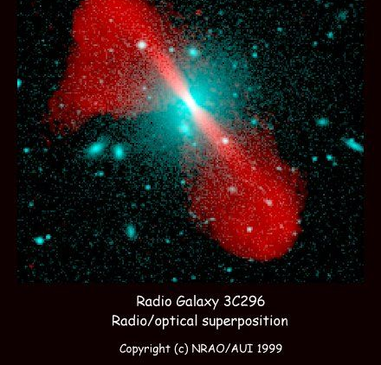
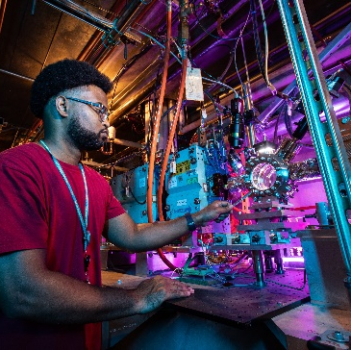
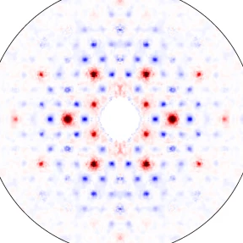
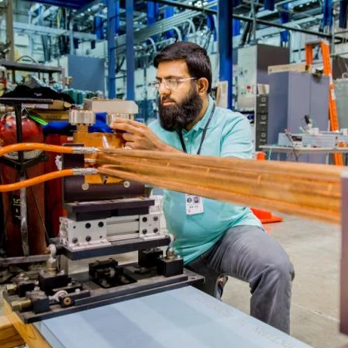
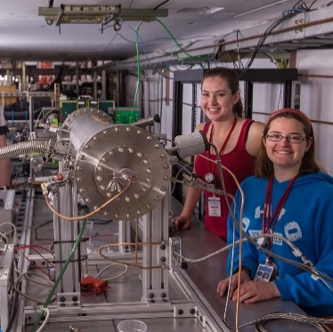
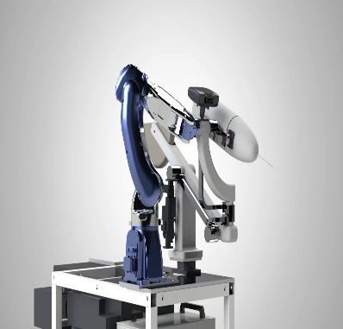
Enabling Next-Generation of Research
Plasma physics, astrophysics, particle acceleration, and
particle and light sources
Beam physics, controls
and diagnostics for
conventional and
advanced accelerators
Material science –
Ultra fast electron diffraction of materials, materials in extreme fields
Radiofrequency
Sources & structures:
normal, super-
conducting and novel
Nuclear physics,
polarized beams of low current, polarimetry, particle detectors
Radiation
enclosures and
electron beam irradiation
The facilities across the 6 participating laboratories provide complementary capabilities enabling research in multiple areas

Slide 21
Mission of Test Facilities
Providing experimental test beds to carry out basic research in advanced accelerators and beam physics.
Developing the S&T needed to enable the next generation of science facilities and accelerator applications.
Educating and training future scientists and engineers.

Slide 22


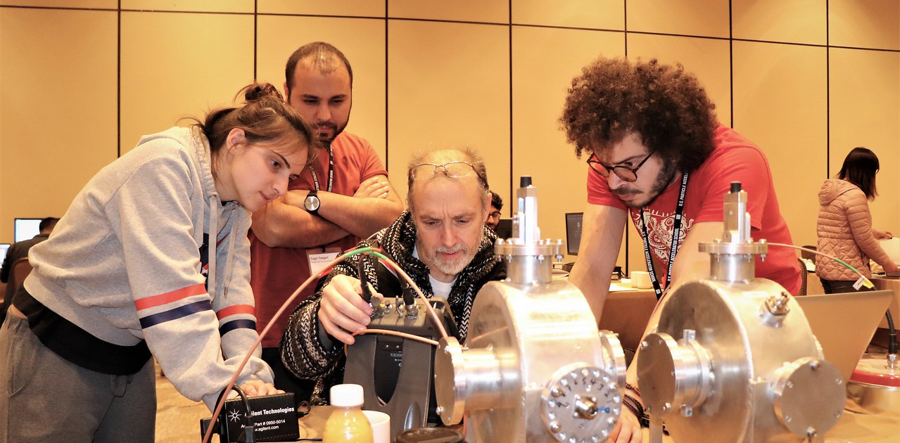
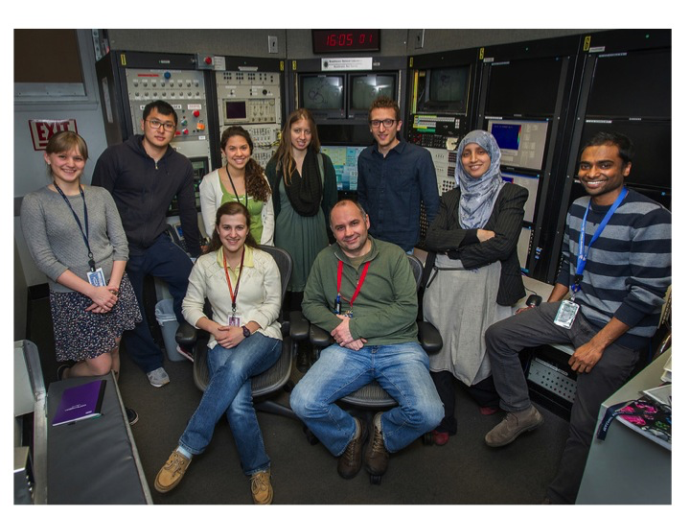
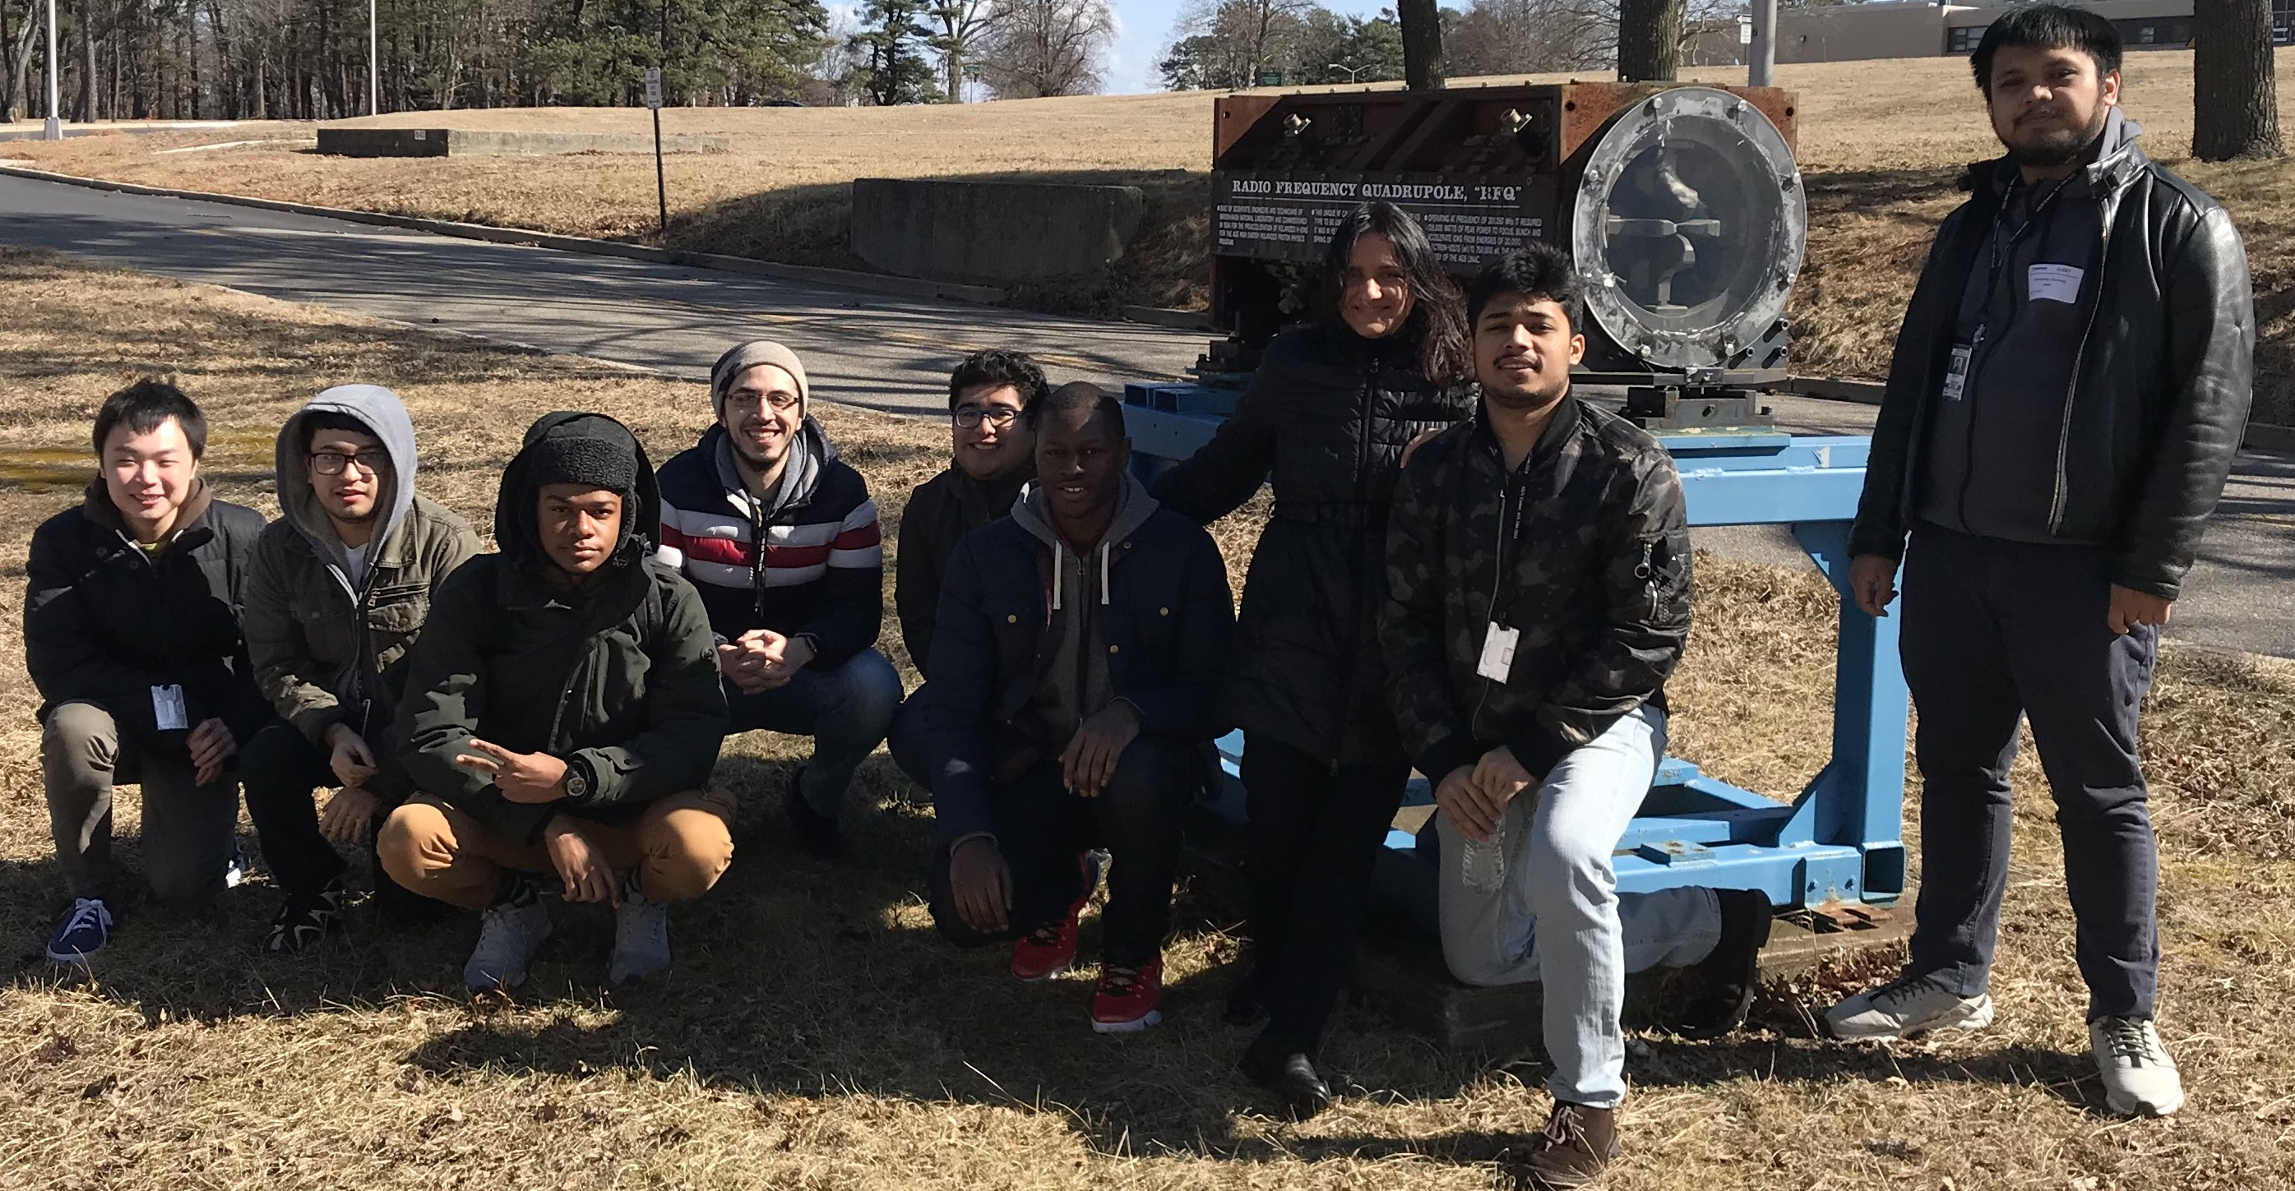
Graduate Education
Facilities participate directly in graduate education
ATF Advanced Accelerator Lab
ATF Advanced Accelerator Lab
Offered twice a year
A dozen courses a session
Several hundred students
Stony Brook graduate course
Hands-on experience with accelerator components
Advance Accelerator Laboratory course for City University of New York (CUNY) students
Notes:
Jan 2020 School

Slide 23
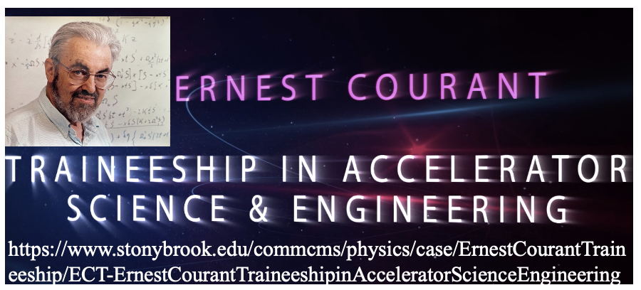







DOE Accelerator Traineeship Program
6-12 students per year per program
Certificate & special-degrees conferred
Graduate (and undergraduate) training
Virginia Innovative Traineeships in Accelerators (VITA)
Chicagoland Accelerator Science Traineeship Program
Accelerator Science and Engineering Traineeship (ASET)

Slide 24
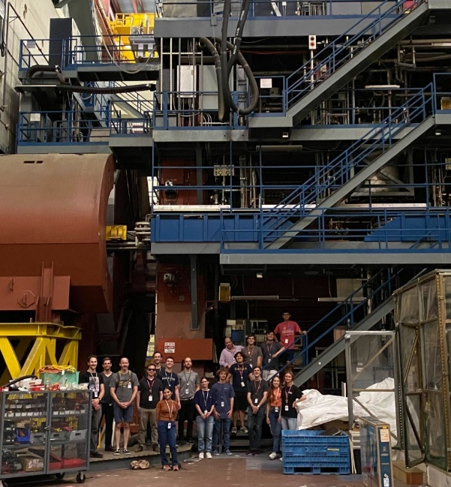
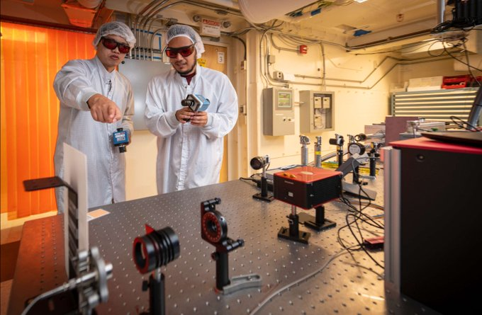
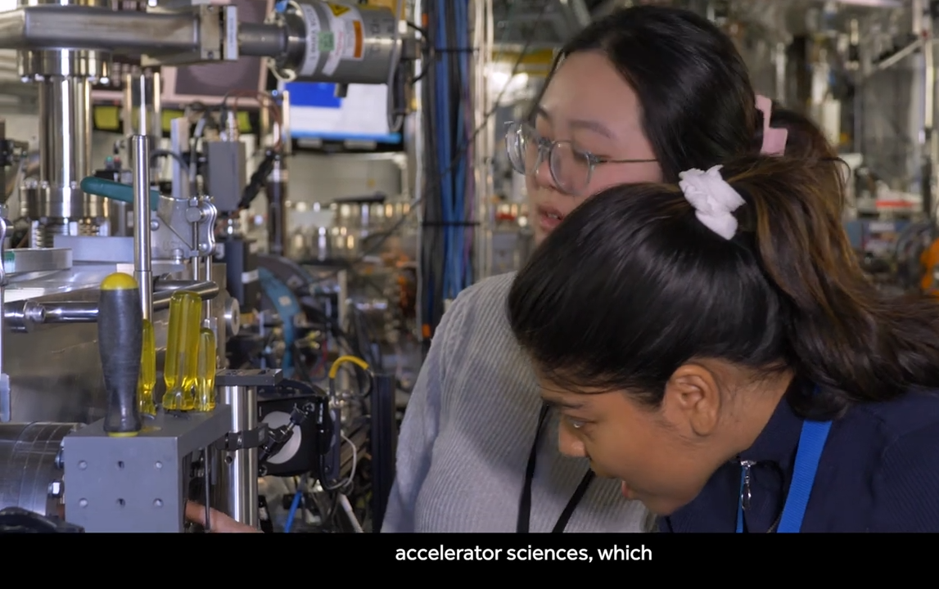
Training Ground for Next Generation Researchers
  Host SULI students and similar (NSF REU, RENEW, FAIR)
  Collaborate with academic institutions by mentoring SCGSR students and co-advising graduate thesis projects
FACET-II summer undergrads 2023
Bryan Alamillo (right) from California State University Channel Islands (CSUCI) under the NNSA MSIIP Internship Program (BELLA).
Stony Brook University graduate students co-advised by adjunct faculty at ATF

Slide 25
Summary
Beam test facilities have a critical role in facilitating high-impact research
They provide unique training opportunities through direct instruction and research mentorship
Introducing BeamNetUS: a network of national lab beam test facilities aiming to broaden the participation in beam-based research
The network aims to provide a centralized mechanism for access to the unique and distributed strengths of the beam test facilities

