Slide 1
FERMILAB-SLIDES-24-0050-SQMS-TD
Plasma processing for in situ performance improvement
Bianca Giaccone

Slide 2
Outline
Introduction on plasma processing
Plasma processing applied to LCLS-II-HE vCM
Plasma processing experience at other laboratories
Proposal to apply plasma processing to CM2

Slide 3
Outline
Introduction on plasma processing
Plasma processing applied to LCLS-II-HE vCM
Plasma processing experience at other laboratories
Proposal to apply plasma processing to CM2

Slide 4
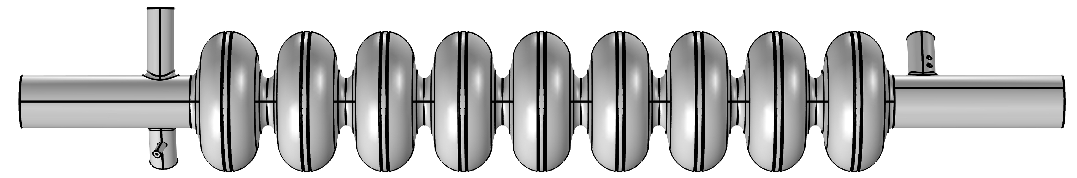
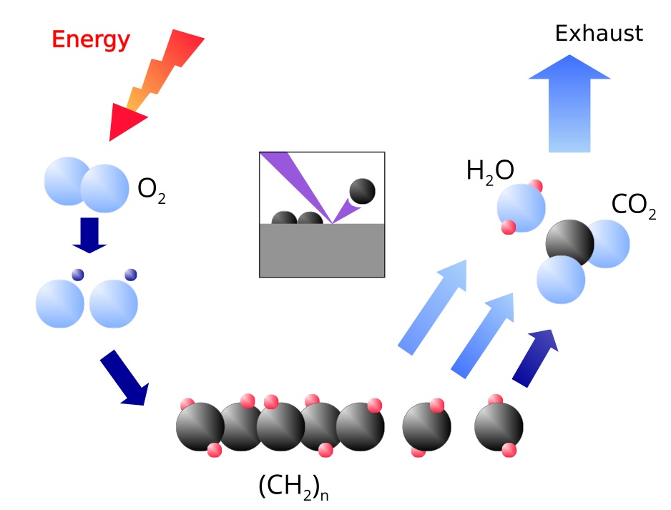
Plasma processing (PP) for field emission mitigation
Gas IN
Gas OUT
RF excitation
Gas flow of Ne-O₂ mixture (few % of O₂, mostly Ne) at p ~ 75-150mTorr;
Once plasma is ignited, oxygen reacts with hydrocarbons;
Reaction products (mostly CO, CO₂, H₂O) are pumped out;
Work function increases, reducing FE.
M. Doleans et al, NIMA 812 (2016)

Slide 5
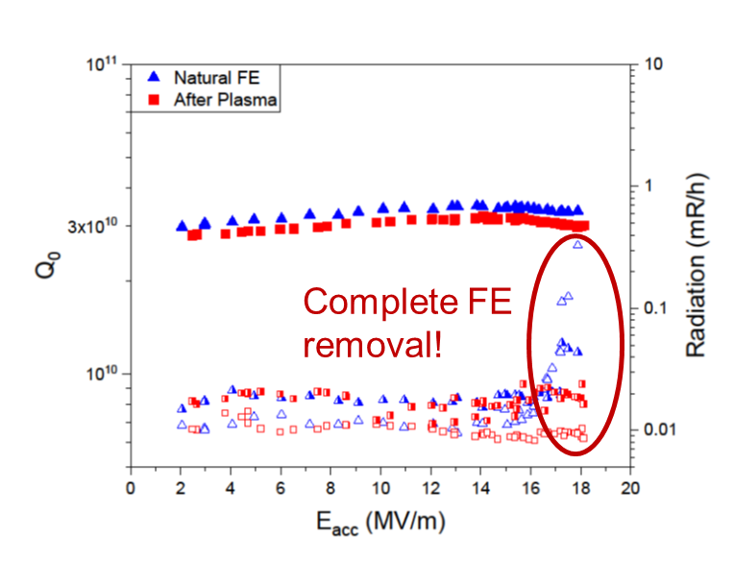
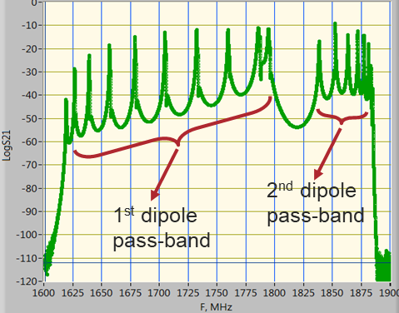
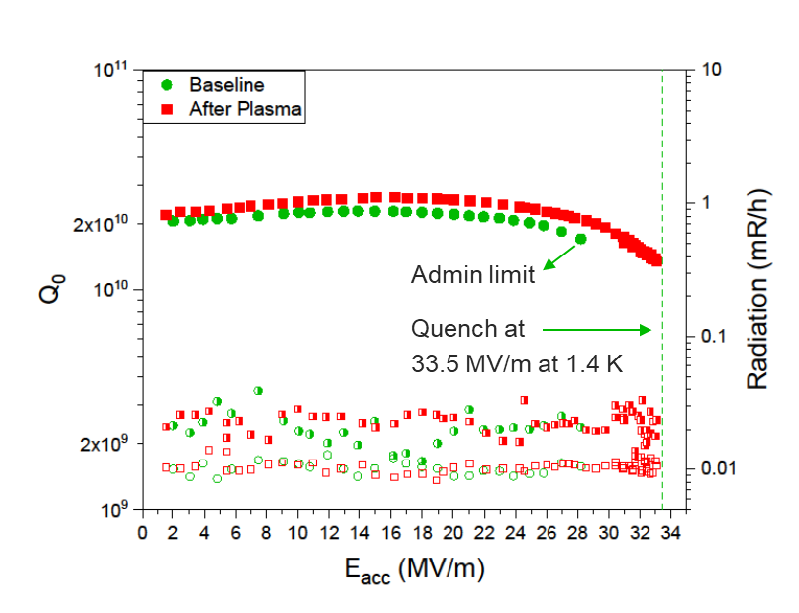
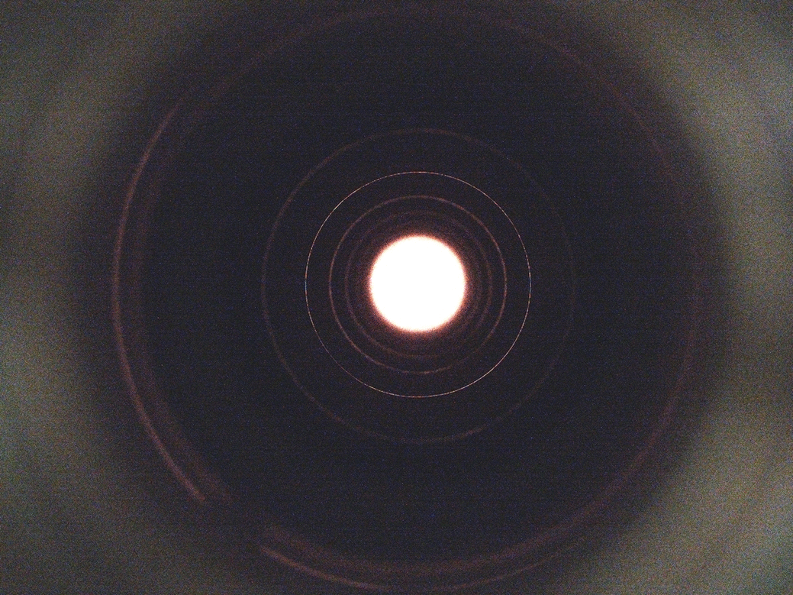
PP for LCLS-II(-HE): individual cavities
Plasma ignition sequentially cell-by-cell using HOM modes and antennas
Plasma is ignited in the central cell and moved to adjacent cells using a superposition of HOMs
We demonstrated removal of hydrocarbon induced FE
And no negative effect of plasma processing on N-doping: high Q₀ and quench field are preserved
P. Berrutti, et al., J. Appl. Phys. 126, 023302 (2019)
B. Giaccone et al., Phys. Rev. Accel. Beams 24, 022002

Slide 6
Outline
Introduction on plasma processing
Plasma processing applied to LCLS-II-HE vCM
Plasma processing experience at other laboratories
Proposal to apply plasma processing to CM2

Slide 7
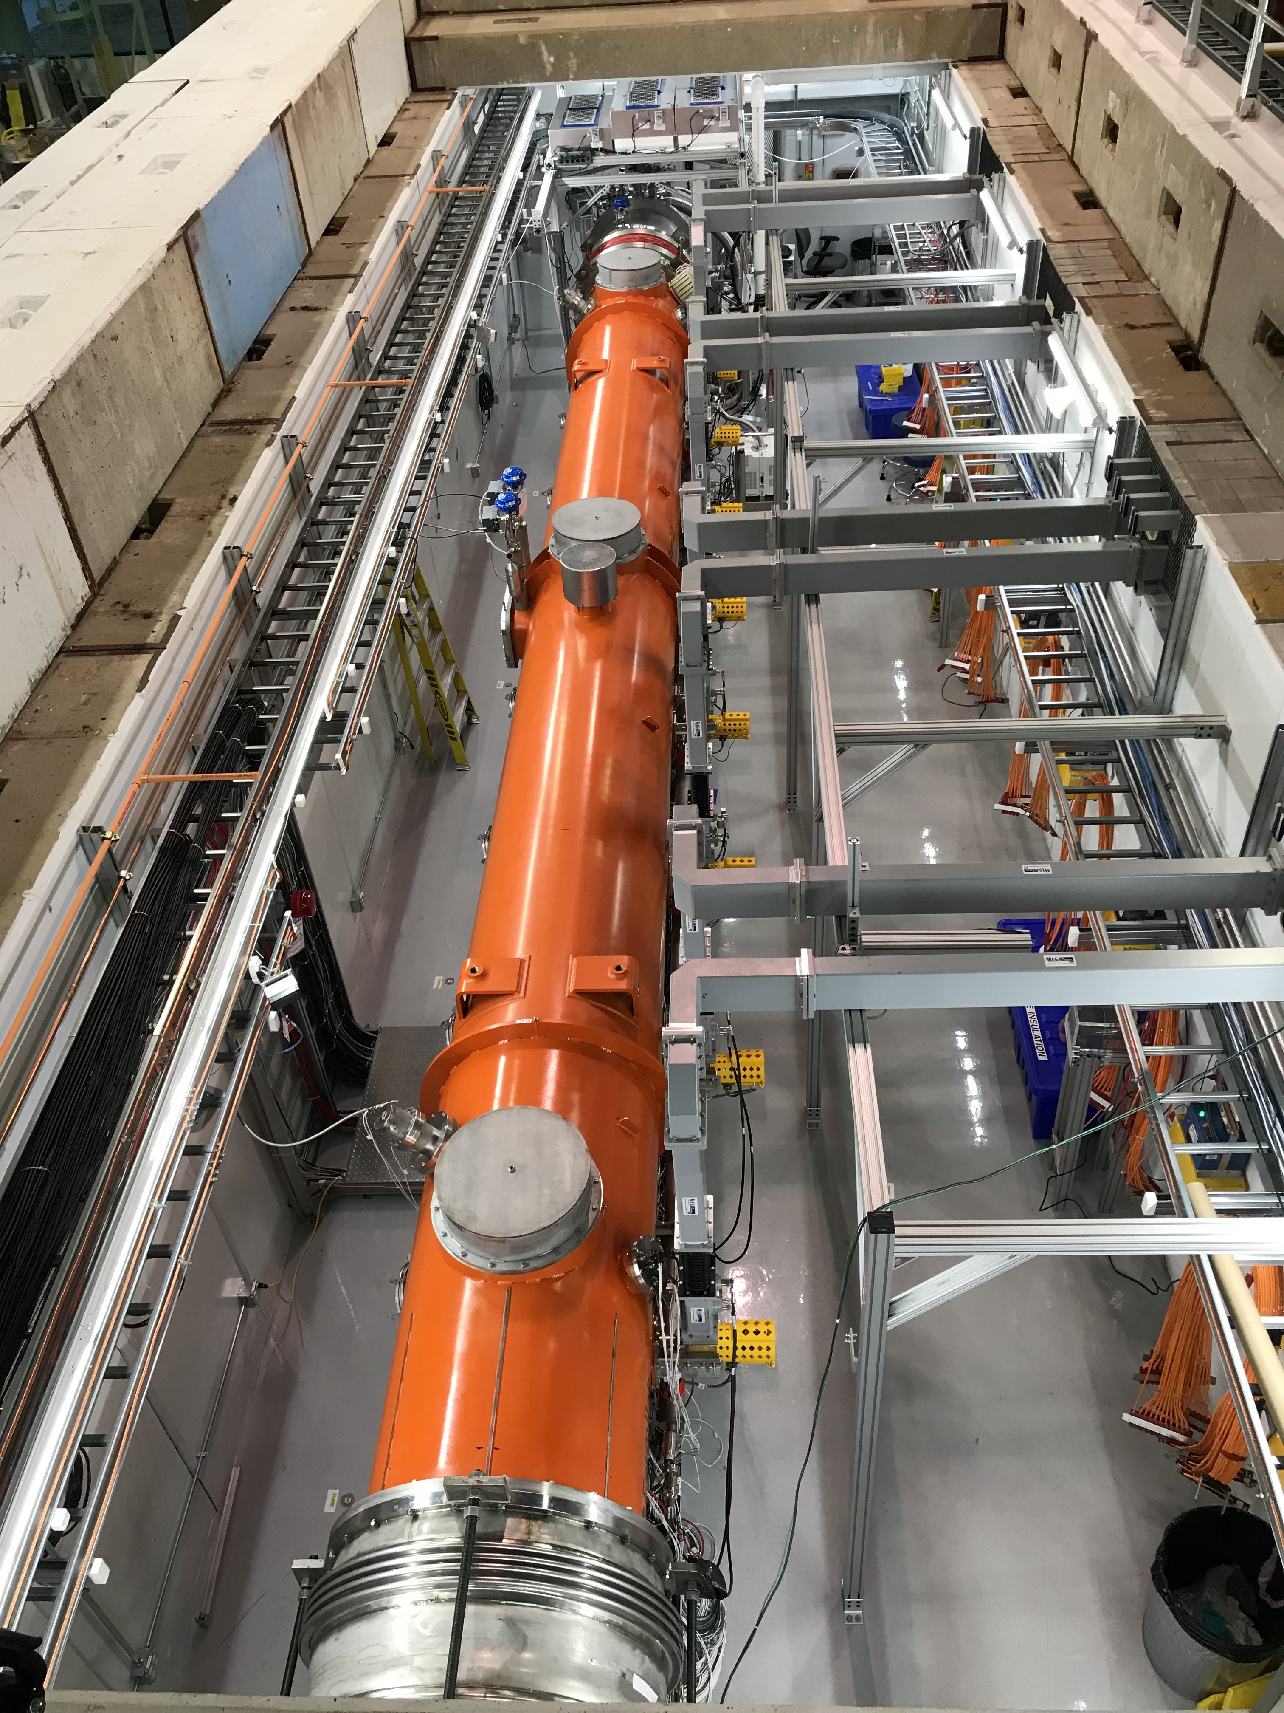
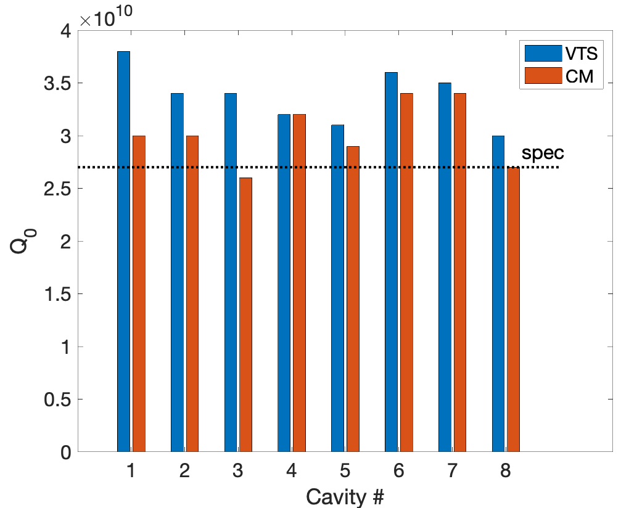
The LCLS-II-HE verification cryomodule (vCM)
Verification cryomodule → opportunity to: verify assembly and testing procedure at Fermilab and evaluate operations of 1.3GHz CMs at higher gradient
World record breaking performance, considerably above the ambitious specification!
S. Posen et al., Phys. Rev. Accel. Beams 25, 042001
Notes:
demonstrated total voltage of 200MV (vs required 173MV)
Average gradient >25MV/m (vs required 20.8MV/m)
Average Q₀ > $3×{10}^{10}$ (vs required $2.7×{10}^{10}$)

Slide 8
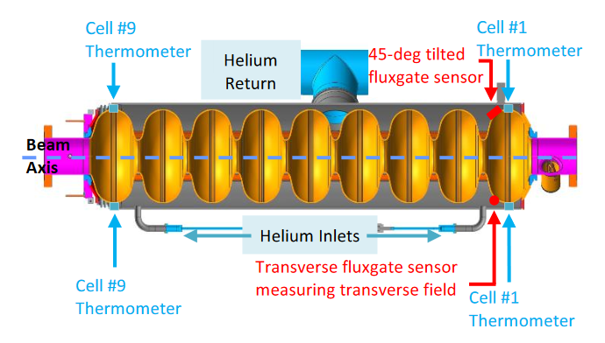
Preparation for PP on the vCM
Conducted risk & mitigation analysis for vCM
Parameters monitored during PP:
  Partial pressure of Ne, O₂, C, CO, CO₂, H₂O
  Pressure at the two ends of the cryomodule
  RF signals (forward & reflected power from HOM1, transmitted power from HOM2)
  Temperature of HOM1 cable connector, can and clamp
  Cavity temperature
We decided to process 4 cavities

Slide 9
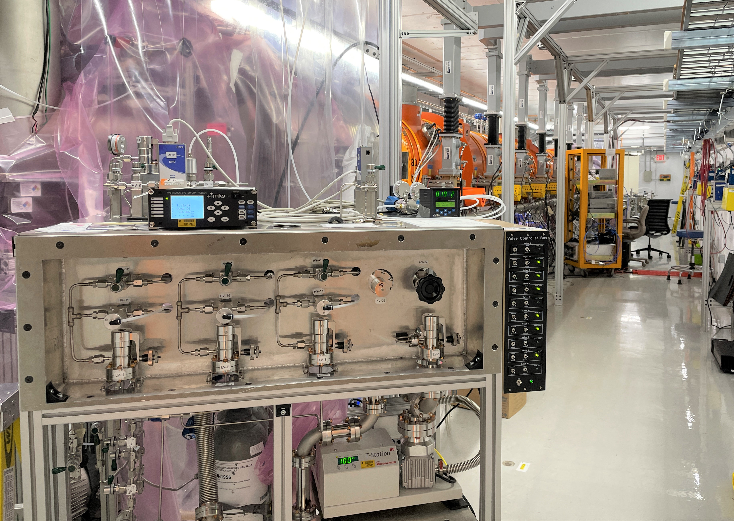
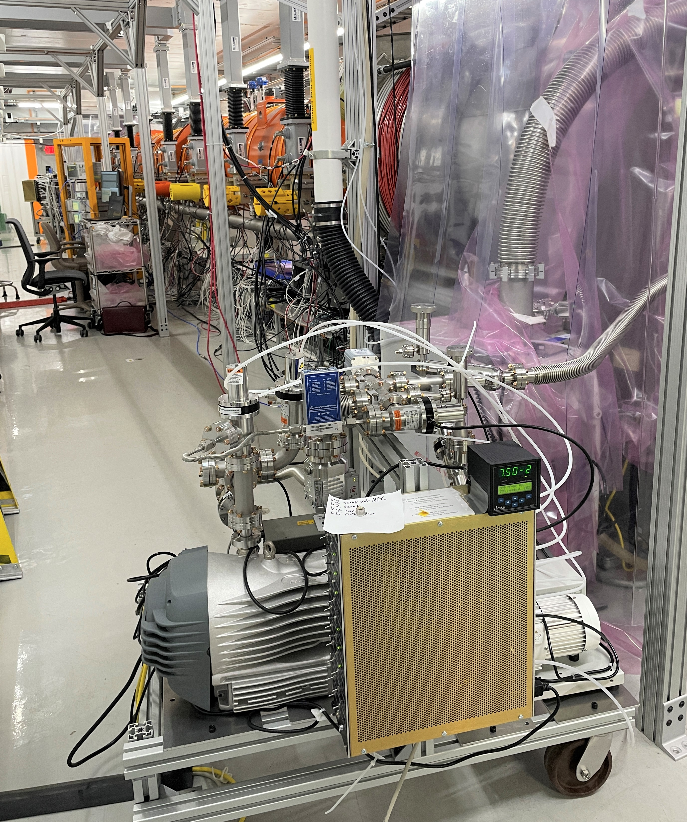
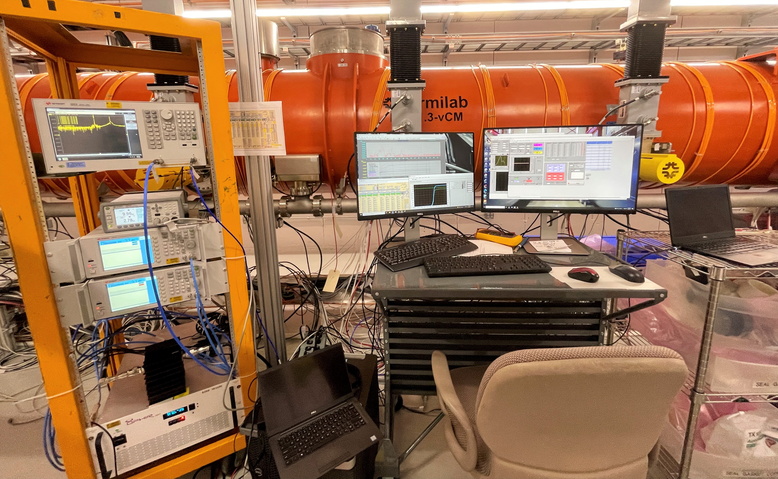
Experimental systems: gas injection, vacuum & RF
Vacuum cart – connected to Endcap side
RF system, computers
Gas cart – connected to Feedcap side

Slide 10
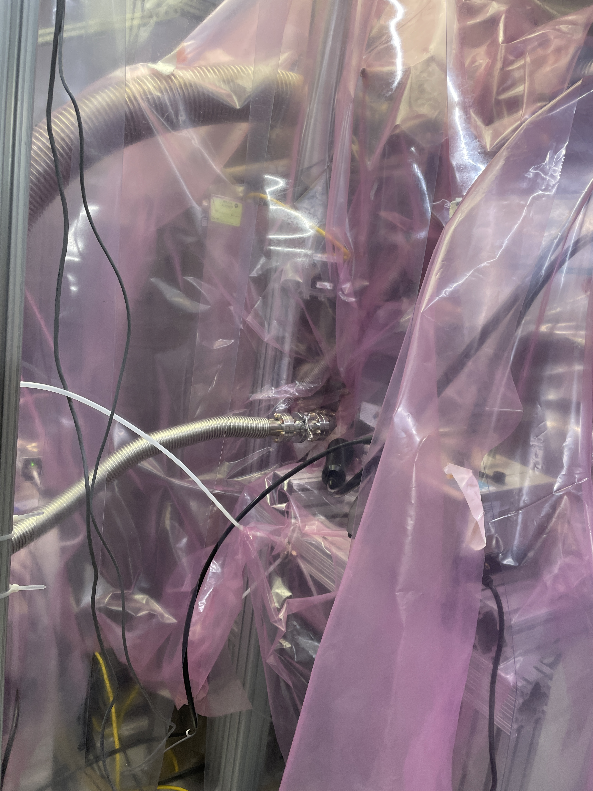
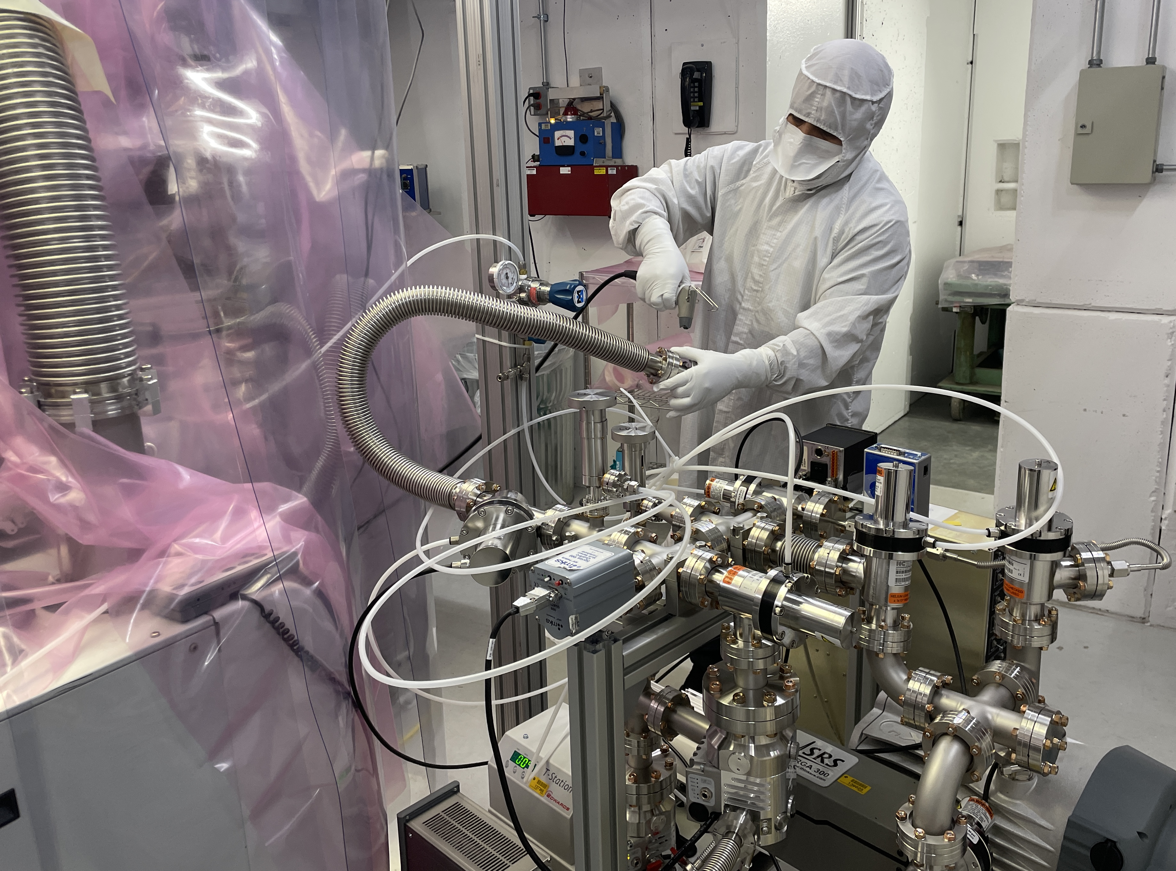
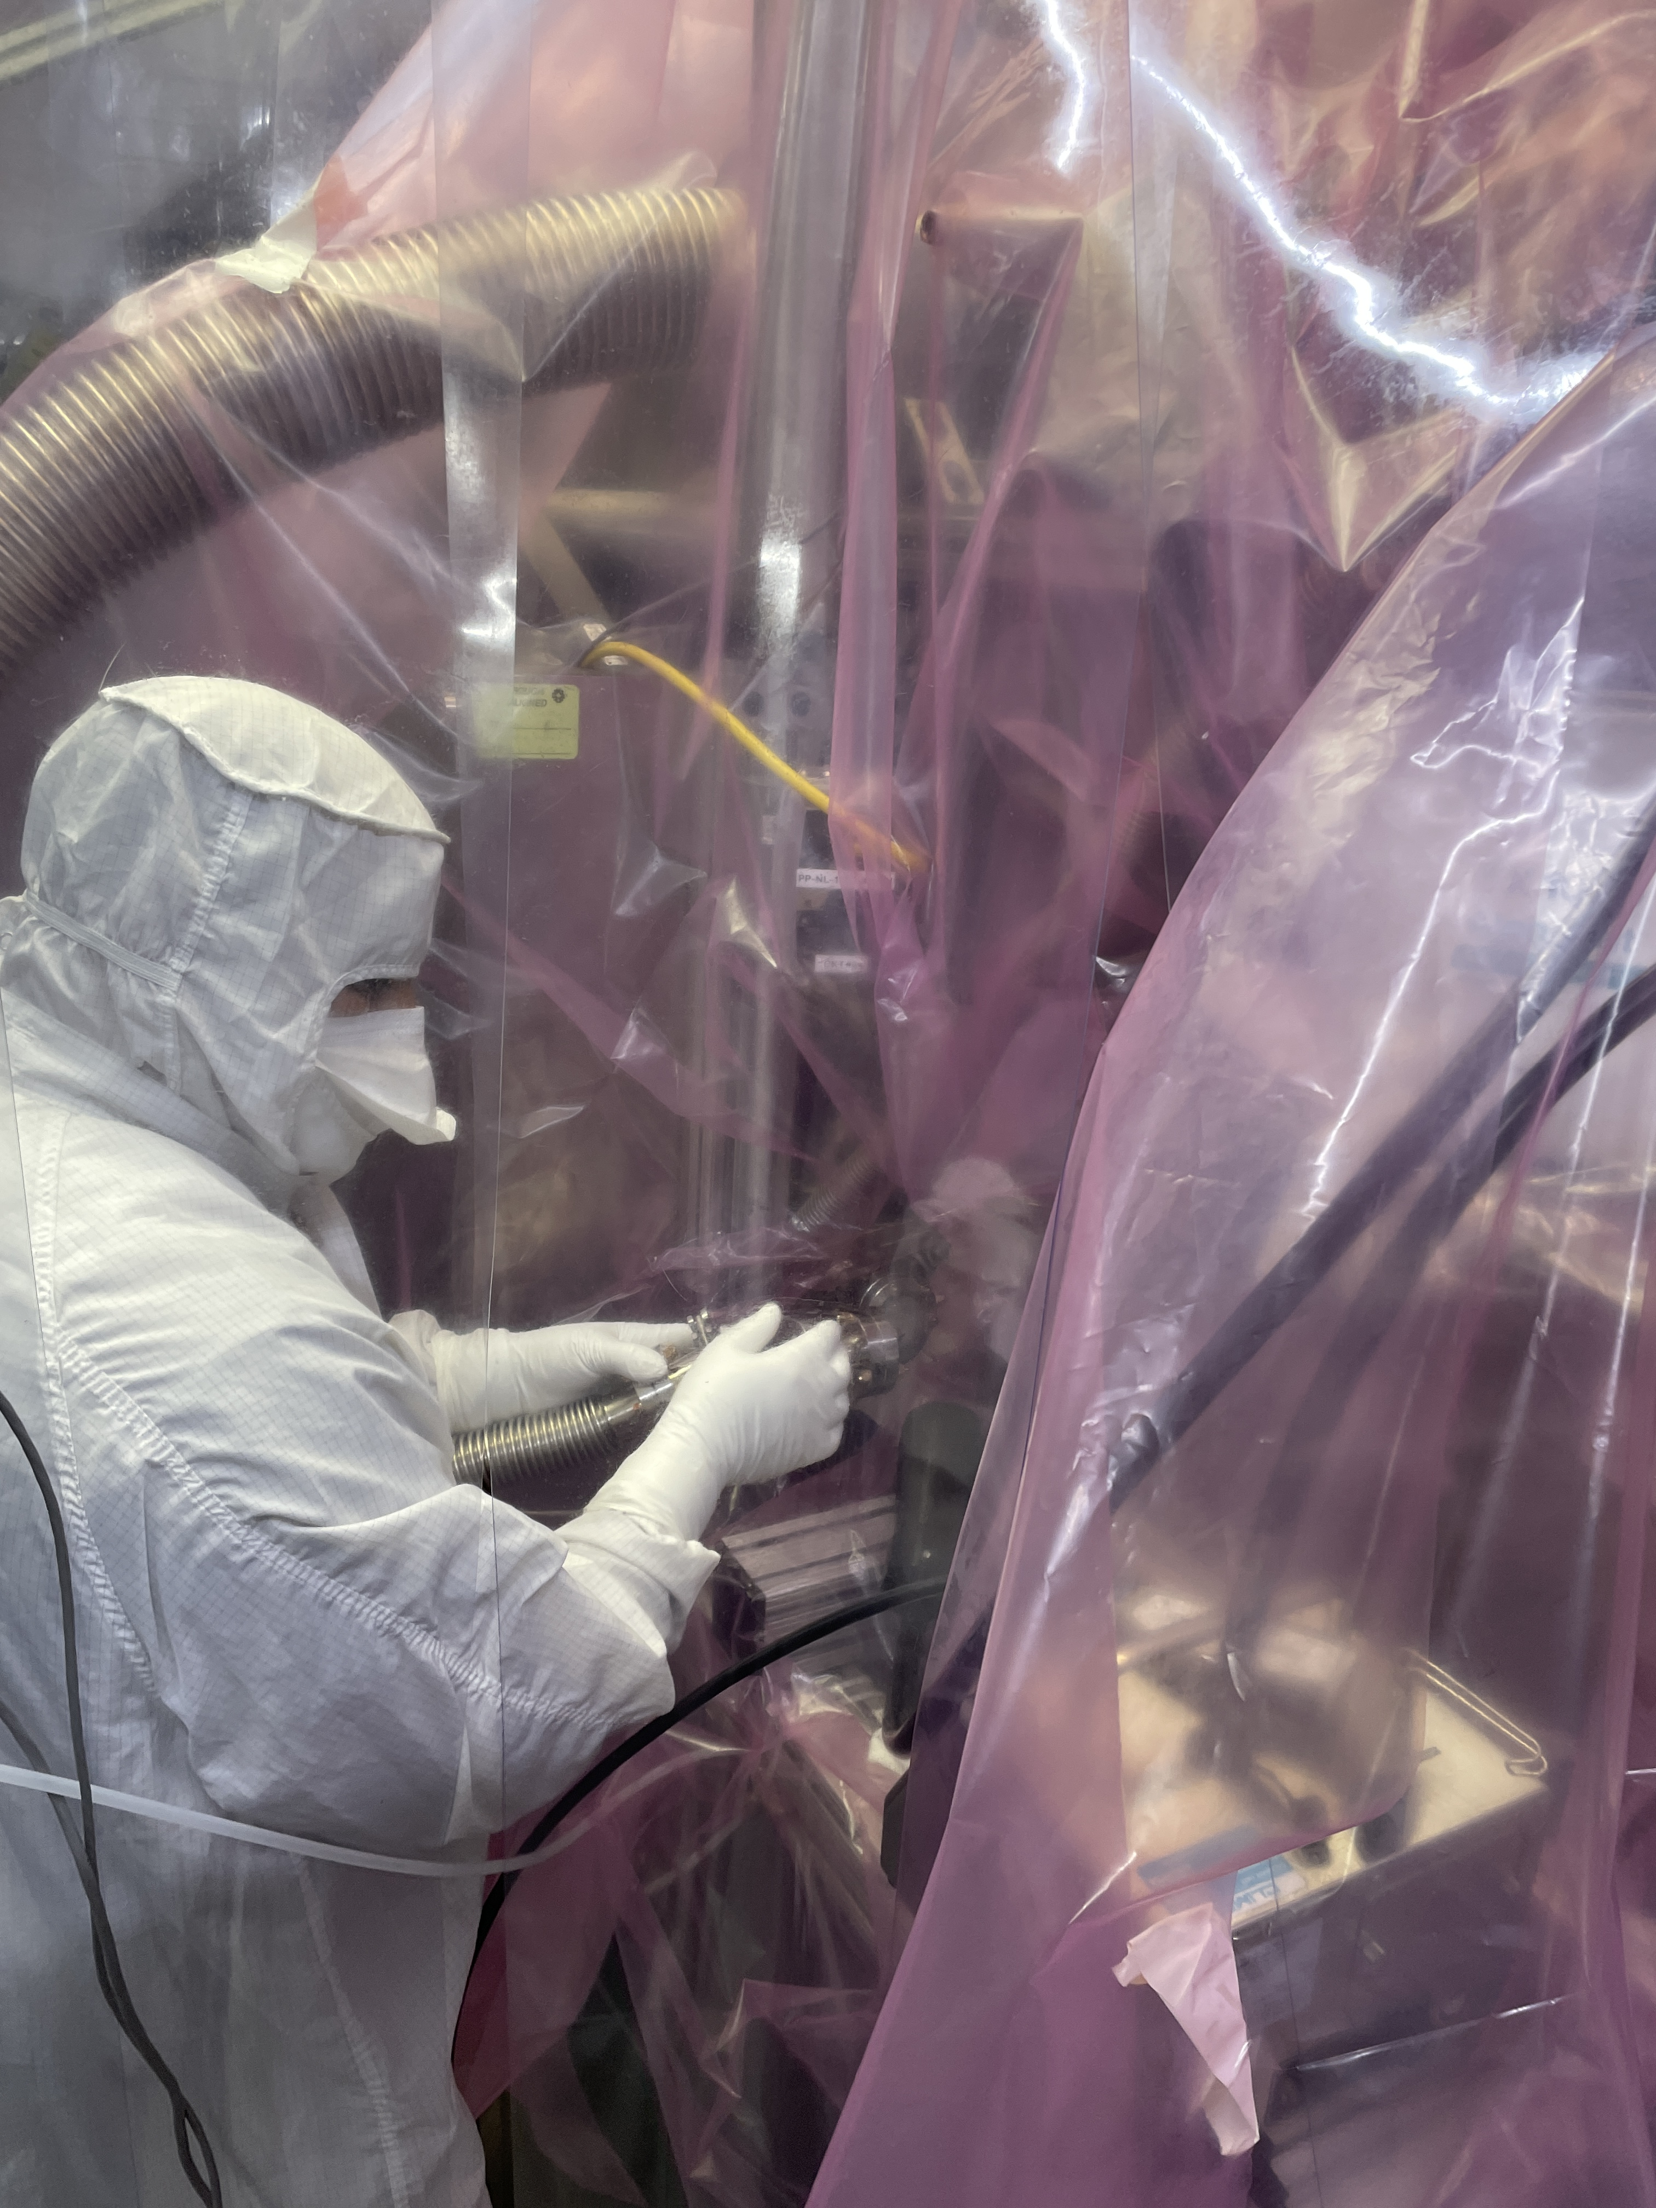
Connections between gas/vacuum systems and CM
Connections between vacuum/gas systems and vCM: conducted in cleanroom to minimize risk of particle contamination

Slide 11
PP applied to vCM (1)
Example of experimental data collected during plasma processing of CAV4. This includes a rare case of plasma ignition at the HOM coupler
Plasma transfer from cell 5 to desired cell
Plasma tuning/detuning
HOM coupler ignition
45 min of processing per cell
Plasma ignition in the cavity
B. Giaccone, et al., Phys. Rev. Accel. Beams 25, 102001 (2022)

Slide 12
PP applied to vCM (2)
Example of experimental data collected during plasma processing of CAV4. This includes a rare case of plasma ignition at the HOM coupler
Temperature increase on:
HOM1 cable < 2K
HOM2 cable < 0.5K
During coupler ignition: 1.4K increase on HOM1 cable
Temperature increase on:
Cell # 1 < 1.2K
Cell # 9 < 1.6K
During coupler ignition: 0.3K
B. Giaccone, et al., Phys. Rev. Accel. Beams 25, 102001 (2022)

Slide 13
Questions to address after PP
RF test after processing to monitor changes in performance:
Maximum gradient and usable gradient
X-ray & Dark current
Q-factor at 20.8 MV/m
Check that cavities can sustain stable operation at 20.8 MV/m
Time necessary to process multipacting
Did plasma processing deteriorate cavity performance in any way?
Did plasma processing have an impact on multipacting?
B. Giaccone, et al., Phys. Rev. Accel. Beams 25, 102001 (2022)

Slide 14
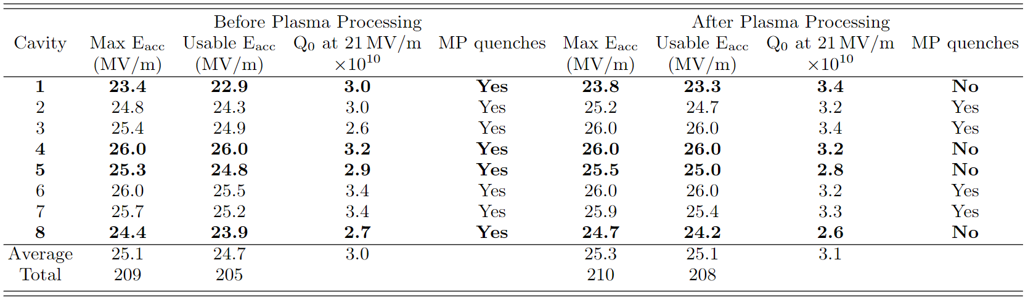
vCM performance before and after plasma processing
Plasma processing procedure is fully validated!
RF test after plasma processing demonstrated that:
vCM performance are preserved
Plasma processing did not introduce any contamination: vCM still FE-free
B. Giaccone, et al., Phys. Rev. Accel. Beams 25, 102001 (2022)

Slide 15
vCM performance before and after PP
B. Giaccone, et al., Phys. Rev. Accel. Beams 25, 102001 (2022)
Plasma processing can eliminate multipacting:
the 4 plasma processed cavities do no exhibit any MP quench, contrary to the other 4 cavities
We could address both FE and MP in situ at the same time!

Slide 16
Outline
Introduction on plasma processing
Plasma processing applied to LCLS-II-HE vCM
Plasma processing experience at other laboratories
Proposal to apply plasma processing to CM2

Slide 17

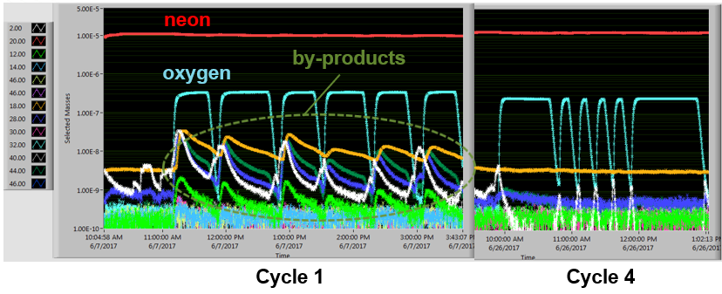
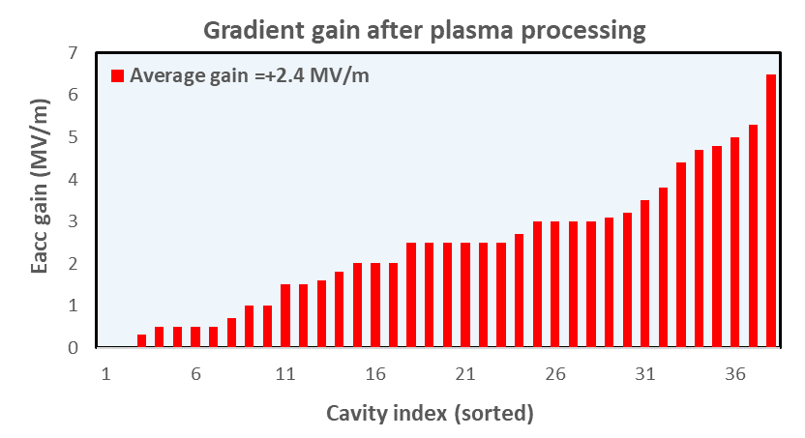
PP at ORNL-SNS
10+ cryomodules plasma processed at SNS either in offline facilities or directly in the linac tunnel
  8 High-beta CMs
  2 Medium-beta CMs
Cleaning of the cavity surfaces revealed by the significant reduction of by-products’ partial pressures over time
38 cavities plasma processed at SNS with an average E_{acc} increase of 2.4 MV/m
M. Doleans et al., NIMA 812 (2016)
M. Doleans J. Appl. Phys., 120, 243301 (2016)
P.V. Tyagi et al., Applied Surface Science 369 (2016)

Slide 18

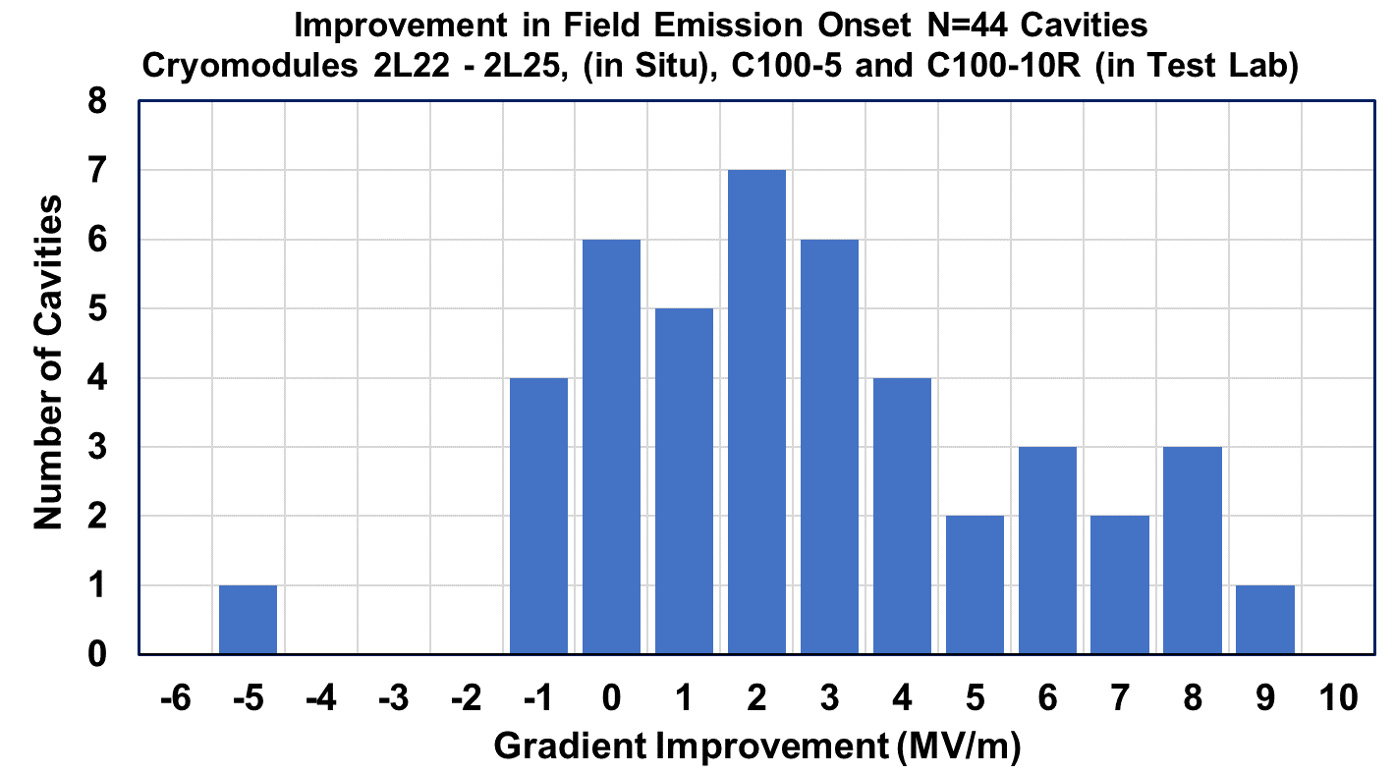
PP at JLab on C100 cavities and CMs
JLab uses Argon/Oxygen or Helium/Oxygen mixture for PP on C100 cavities using HOM and HOM couplers (Fermilab ignition method)
Processed several CMs in offline facility
Average improvement in field emission onset: 2.7 MV/m
The 4 cryomodules processed in-situ had a 59 MeV improvement in FE onset.
6 of the 44 cavities went from FE to FE-free after processing
Adapted from T. Powers, SRF 2023 (WEPWB054) and TTC 2023

Slide 19
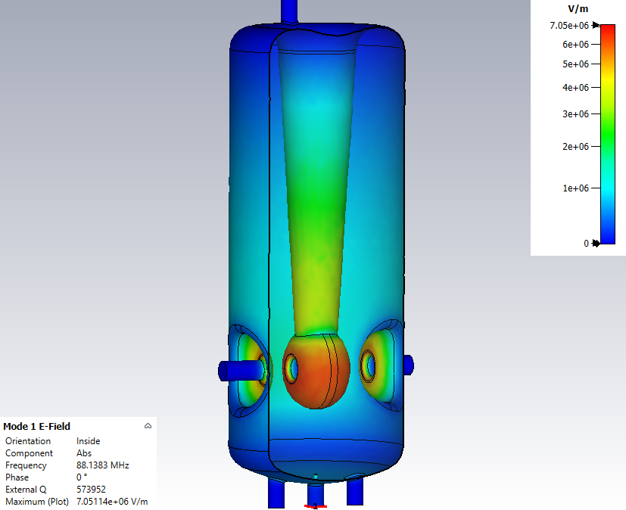



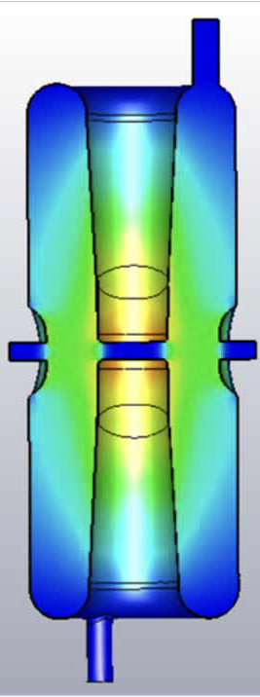
PP experience at other US and international laboratories
Studying PP for HWR and QWR: several promising tests on the two geometries. Recently processed spare QWR CM → waiting for results
Studying PP for SPIRAL2 QWR: Ar/O₂ mixture, investigating fundamental mode vs HOM for PP, deep study of coupler breakdown
C. Cheney, TTC 2023
Interested in PP for ATLAS HWR ad QWR: Ar/O₂ mixture, investigating fundamental mode vs HOM for PP on 172MHz HWR
W. Hartung, SRF 2023 (THIXA01) and P. Tutt, TTC 2023
M. McIntyre, SRF 2023 (MOPMB049)

Slide 20
Conclusions so far:
Starting from SNS successful experience, plasma processing has been developed for multiple types of SRF cavities
Fermilab developed a new ignition technique for 1.3GHz LCLS-II cavities and fully validated it on individual cavities and on the LCLS-II-HE vCM demonstrating that PP can reduce hydrocarbon-induced FE and MP in situ
Many laboratories are now developing PP for different geometries of SRF cavities
  ORNL-SNS and JLab-CEBAF both processed several cryomodules, showing positive results in FE mitigation and performance recovery

Slide 21
Outline
Introduction on plasma processing
Plasma processing applied to LCLS-II-HE vCM
Plasma processing experience at other laboratories
Proposal to apply plasma processing to CM2

Slide 22
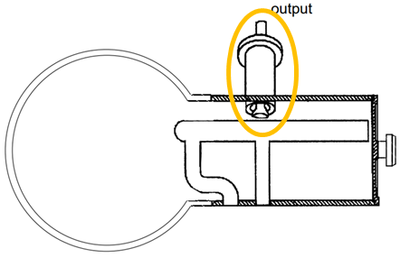
Proposal of PP for CM2: motivation
Demonstrated efficacy of in situ plasma processing for hydrocarbon-induced FE and MP mitigation
Additionally PP can achieve 5-10% increase of E_{acc}
For ILC style CMs: gradient requirement is extremely ambitious. In situ method for gradient recovery: crucial for high gradient operation projects
ILC cavity design is extremely similar to LCLS-II cavities: little effort, high reward

Slide 23
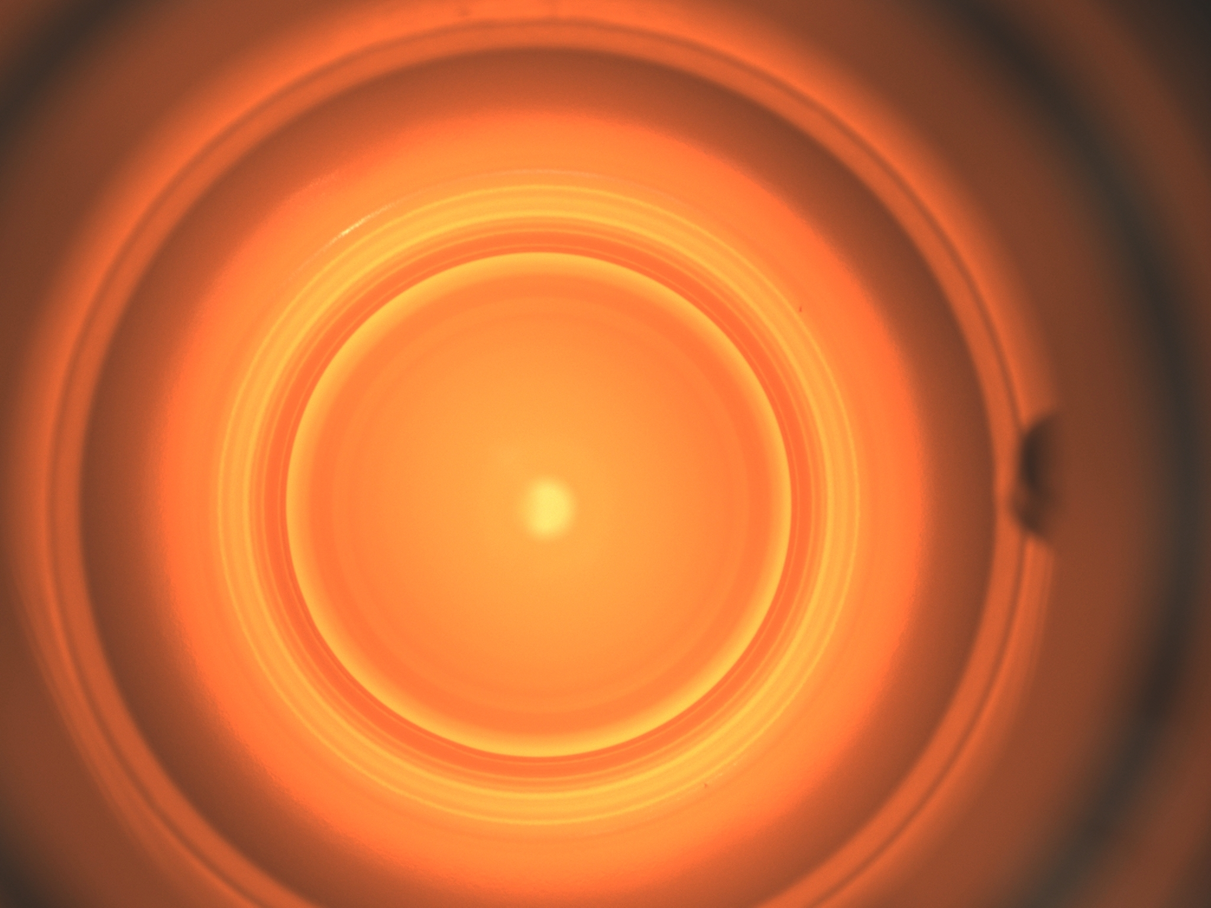
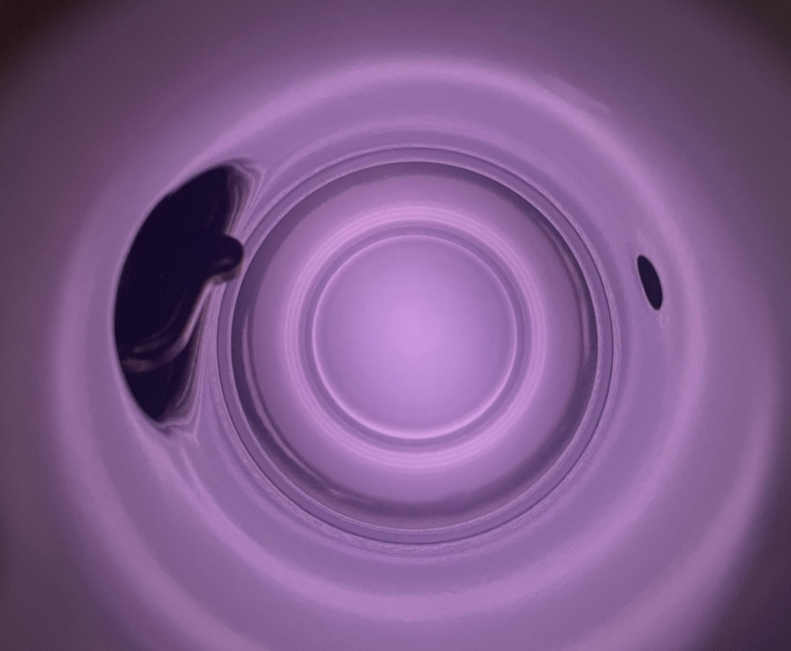
Plasma processing for ILC 1.3GHz cavities
Recipe optimization:
  Power decrease to respect HOM cables power specs (Neon → Argon, lower 1st ionization energy)
  Plasma parameter optimization with Argon to maximize PP efficacy (in progress) → on 1.3GHz single cell with RGA, once optimized it will be demonstrated on 9-cell through consecutive cold RF tests

Slide 24
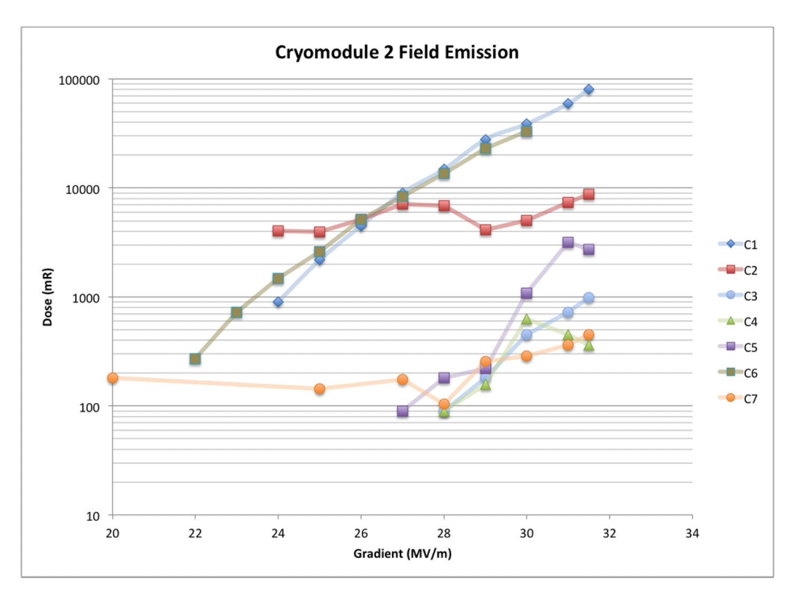
Proposal for PP on CM2
Motivation:
  CM2 cavities achieve high fields (> 30MV/m) but are affected by FE > 20MV/m
    Data as of 2014. More recent data, if available, would be useful for PP planning and comparison
  PP is a safe technique that can address FE, MP and gradient recovery in situ
    Only requires:
E. Harms, AWLC14 – Americas Workshop on Linear Colliders 2014
flow of gas through beamline and RF hardware present in CM. If possible, releasing the insulating vacuum should be considered.

Slide 25
Proposal for PP on CM2: Resources needed
RF and vacuum/gas hardware:
  RF cart: 1 is available at Fermilab, a 2nd system may be available as well and would allow to process 2 cavities at the same time.
  Vacuum and gas system: Gas injection system is available, vacuum system available as well. No modifications needed. Would need to order pure Argon and Oxygen/Argon gas cylinders for CM2 PP.
Manpower:
  1 Associate Scientist working (almost) full time on PP for the duration of CM2 processing
  1 RF engineer working (almost) full time on PP for the duration of CM2 processing
  1 technician for vacuum connections and vacuum operations of CM2 + transport, setup and disassembly of the hardware needed
RF cold tests:
  To determine PP efficacy: compare CM2 performance at operational temperature before and after PP. Measure Q vs E, FE onset (and MP-induced quenches).

Slide 26
Proposal for PP on CM2: Timeline
1 week to transport, connect and disconnect vacuum and gas systems
At the same time: connect RF system(s) and measure S21, S11 on all cavities
PP duration for 8 cavities:
  Use of 1 vs 2 RF systems will determine gas consumption
Procedure could be applied as early as summer 2024 shutdown if compatible with your activities
With 1 RF system:
    22-25 work days
With 2 RF systems:
  11-15 work days
What questions and requirements would you have for us to consider applying plasma processing on CM2?

Slide 27
In summary: plasma processing is a safe in situ technique with demonstrated efficacy on both hydrocarbon-induced FE and MP mitigation and it can be adapted to multiple purposes (different cavity geometries, SRF guns, …). Lots of potential!
PP on CM2 could increase FE onset and increase operational gradient.

Slide 28
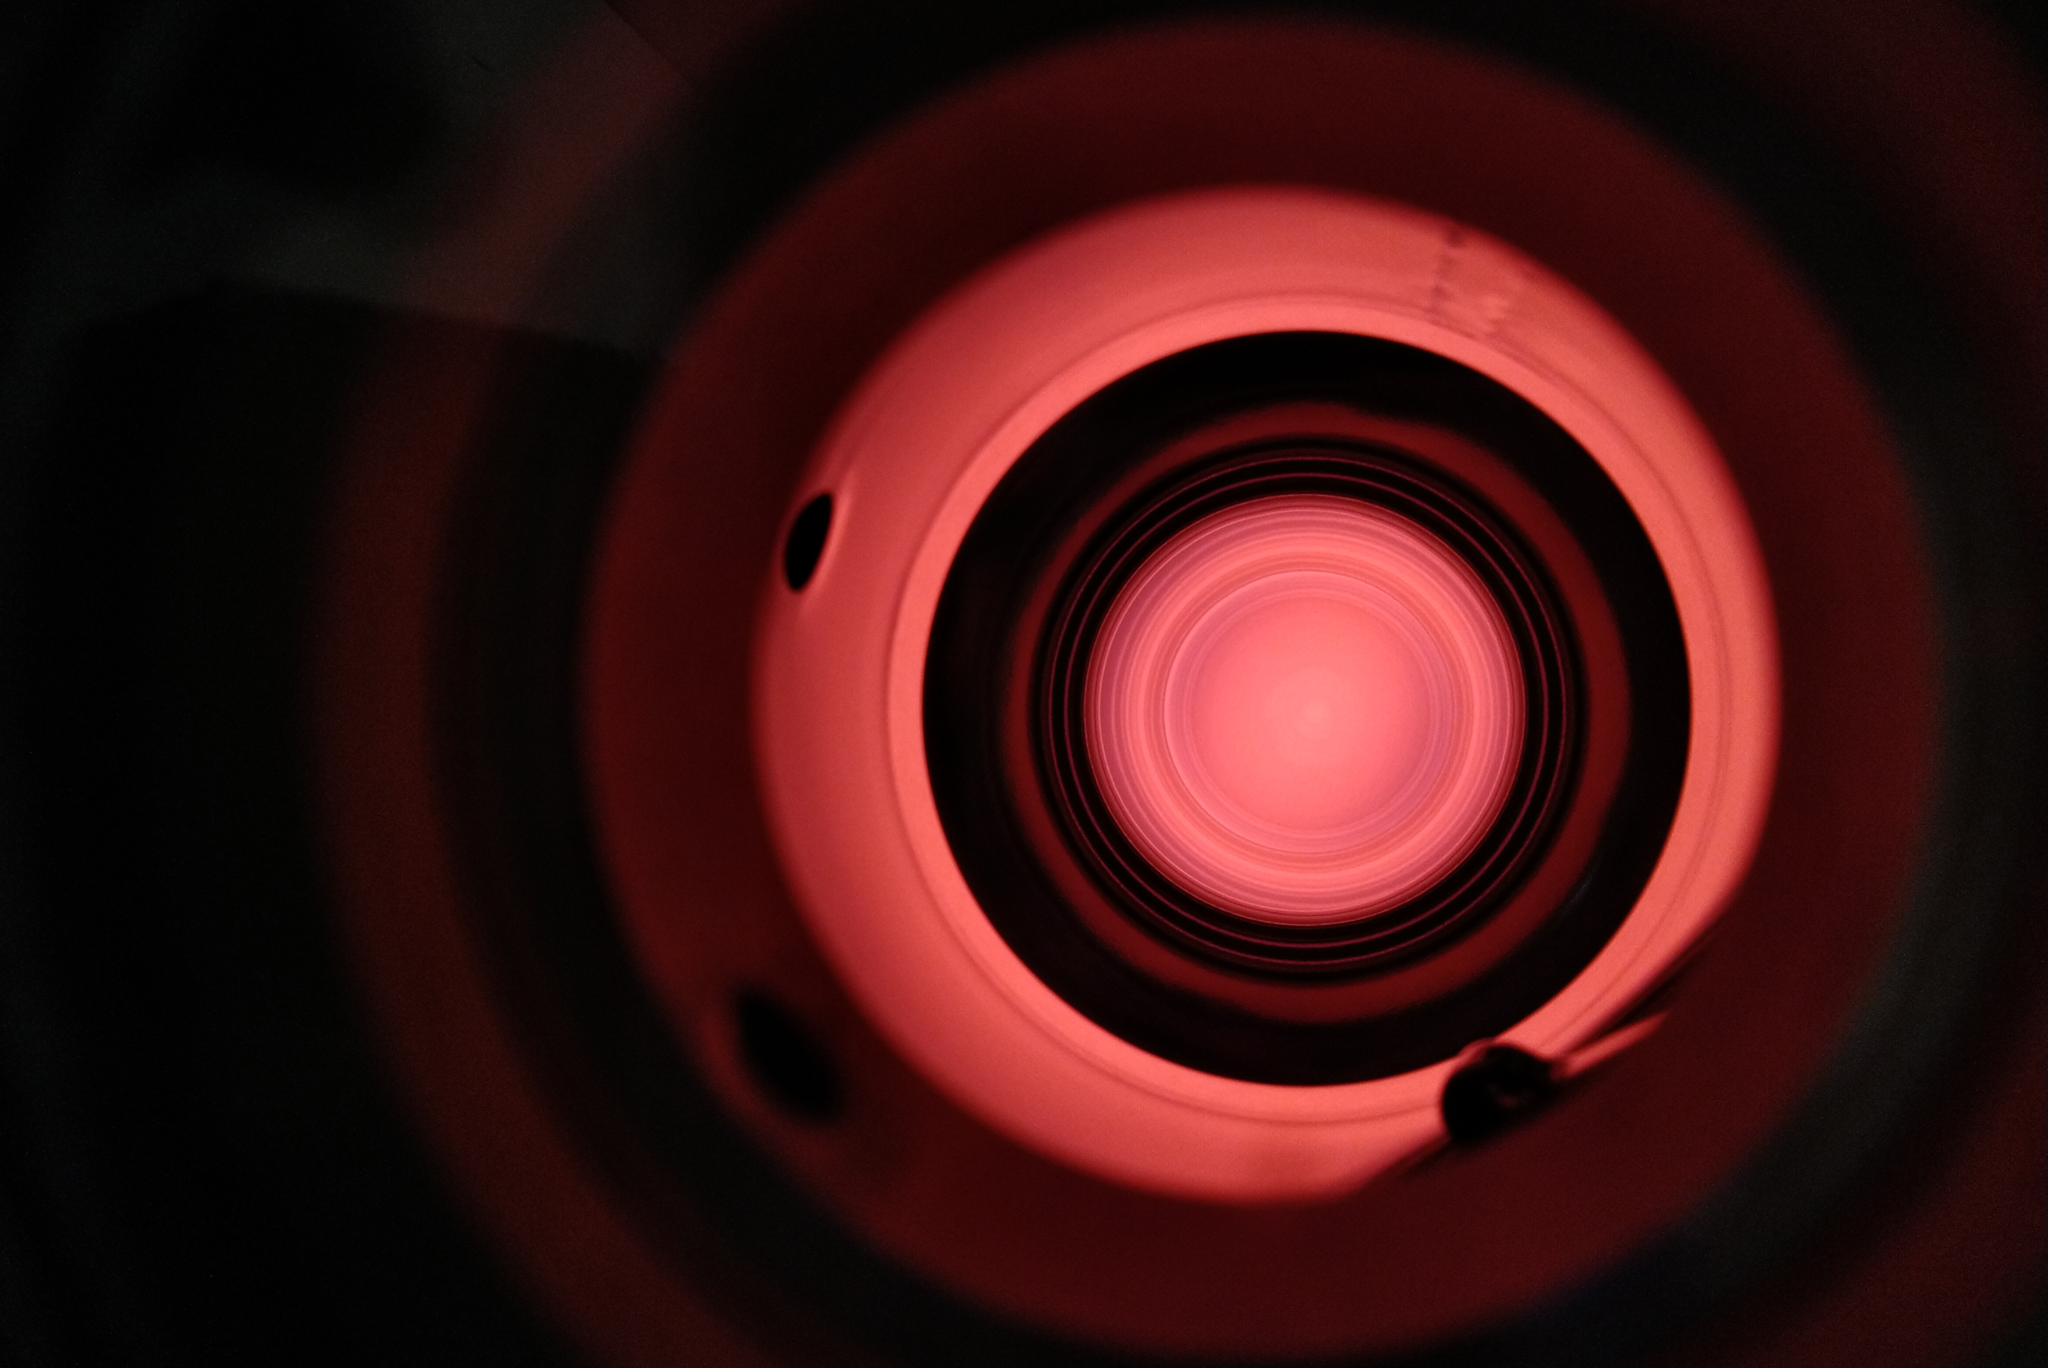
Thank you!
28

Slide 29
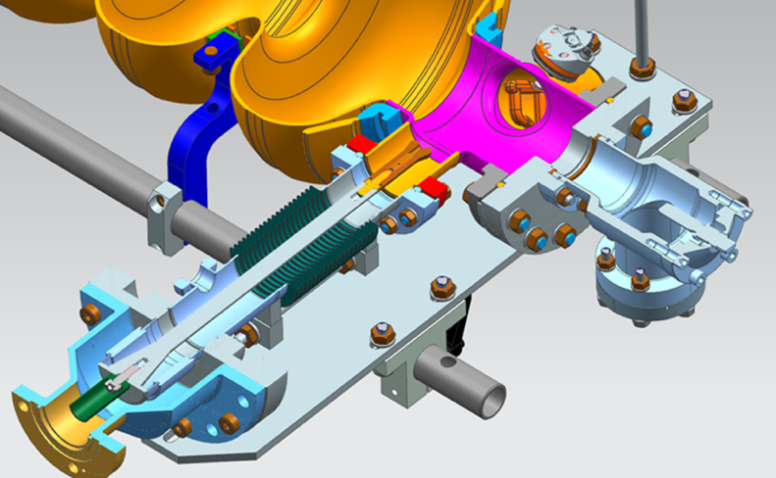
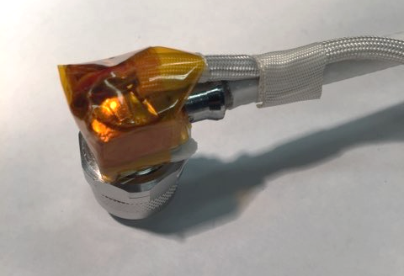
Risk & mitigation analysis for vCM
Major risks for applying the plasma processing in the vCM:
Unstable pressure in the cryomodule: new vacuum cart was assembled and tested on single cavity.
FPC ignition: ‘dummy’ variable FPC was installed on 9-cell cavity and subjected to plasma processing. It was verified that there was no ignition in the FPC during processing. Optical inspection of cavity and FPC after plasma processing showed no discoloration.
Heating of HOM cables: cables and cavity temperature were monitored during plasma processing on vCM (ΔT<3K). Previously verified that 100W for 30min do not degrade cables/connectors and do not cause excessive heating.
Heating of cavities: the vCM insulating vacuum was released.
B. Giaccone, et al. arXiv:2201.09776 (2022)

Slide 30
Timeline & Procedure
No cavity with FE in vCM → processed 4 instrumented cavities (CAV1, CAV4, CAV5, CAV8)
Processing order: started from CAV1 (closest to vCM end, gas injection side) and proceeded to CAV4, CAV5, CAV8 following the direction of gas flow.
Processing time: 1.5-2 hours/cell -> 13.5-18 hours/cavity
Plasma ignition procedure:
  Plasma is ignited in cell # 5 (requires ≈60-70W)
  Plasma is transferred to cell # 9 (going through cell # 6, 7, 8)
  Plasma density is maximized in cell # 9 and cell processed for 45 min
  Plasma density is detuned and plasma is transferred to cell #8
  Procedure is repeated for each cell

Slide 31
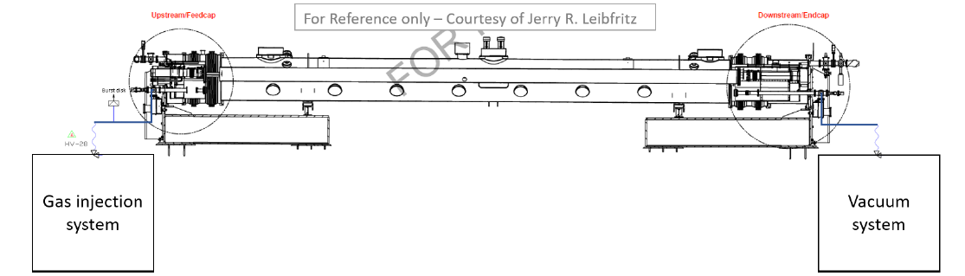
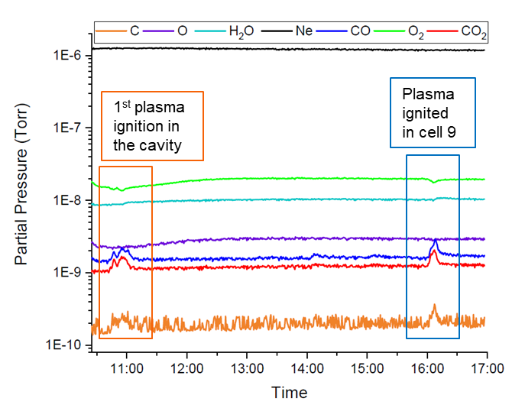
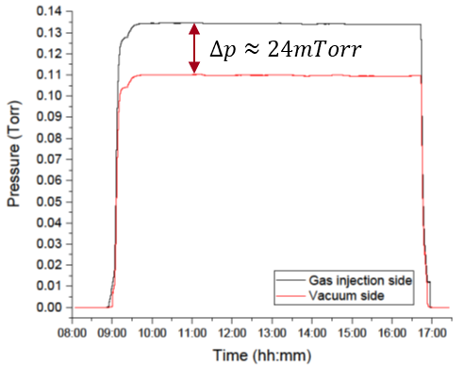
Plasma processing applied to vCM (1)
CAV1: 1st day of plasma processing
PI
Each morning the gas flow was established through the vCM
Increase in CO,CO₂, C signals is observed along with decrease in O₂ signal
Almost no by-products measured by RGA during 2nd day of plasma processing.

Slide 32
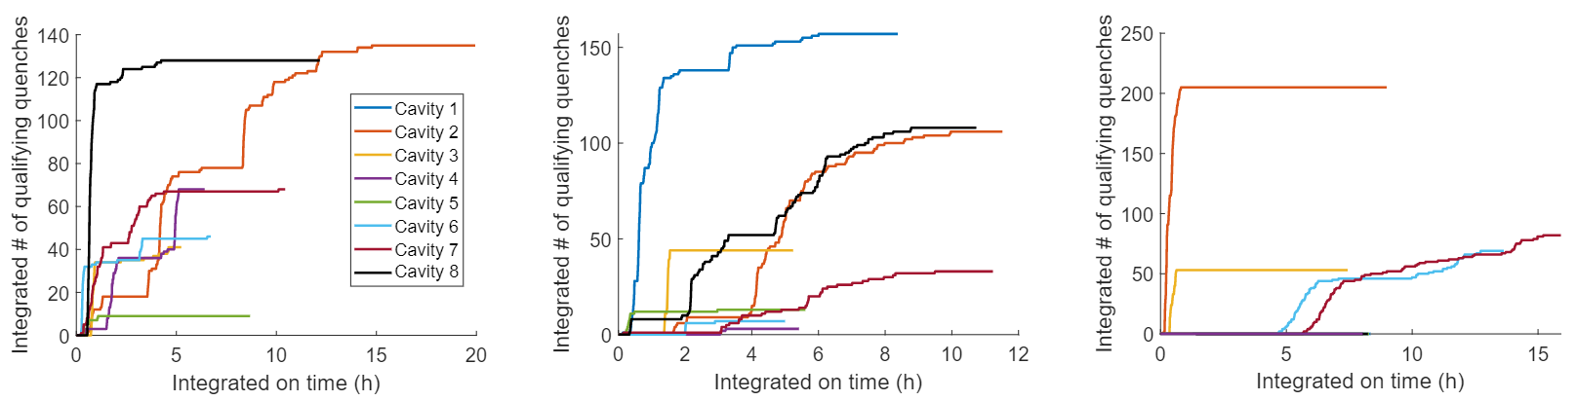
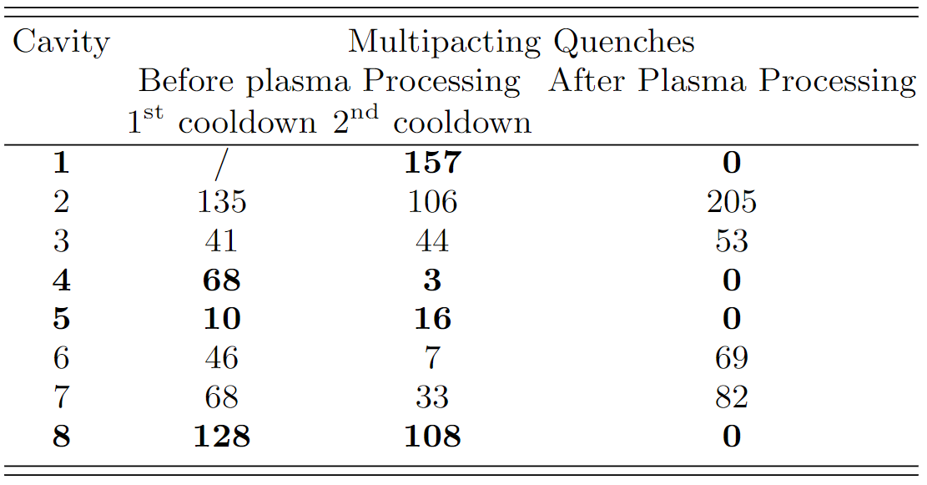
vCM performance before and after plasma processing
Before Plasma processing 1st cool down
Before Plasma processing 2nd cool down
After Plasma processing
Plasma processing can eliminate multipacting:
the 4 plasma processed cavities do no exhibit any MP quench, contrary to the other 4 cavities
We could address both FE and MP in situ at the same time
B. Giaccone, et al. arXiv:2201.09776 (2022)

Slide 33
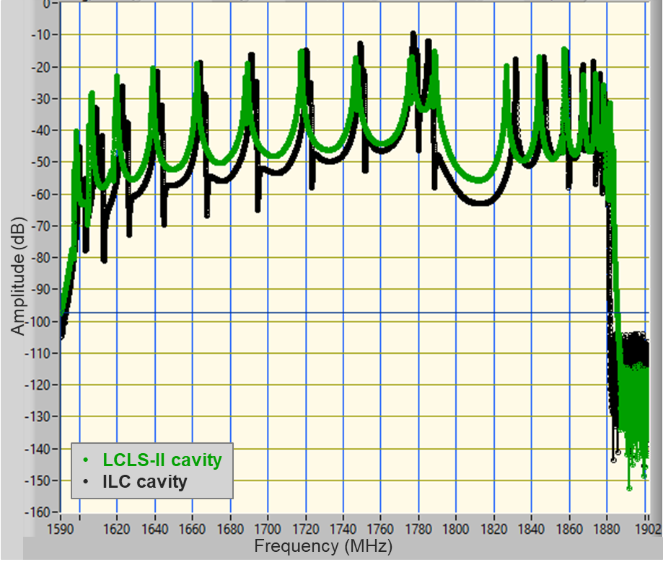
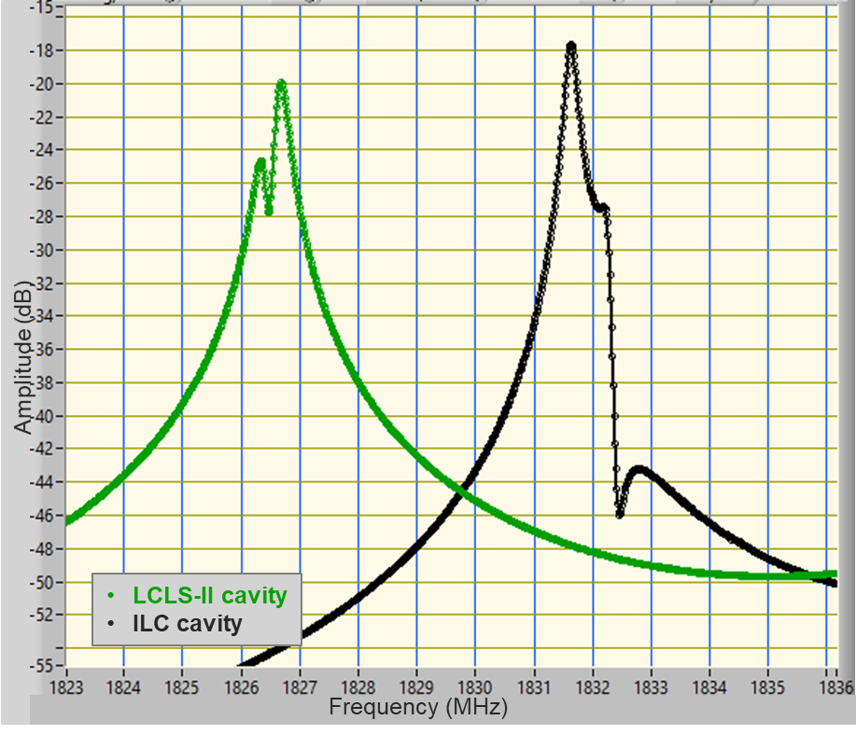
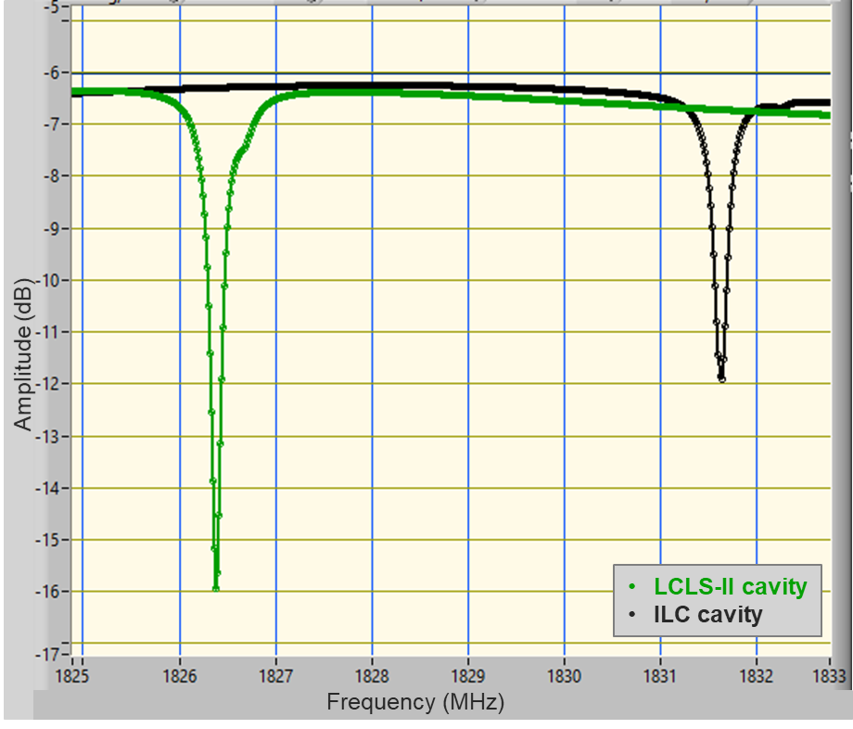
Plasma processing for ILC 1.3GHz cavities
Plasma ignition method developed at FNAL for LCLS-II(-HE): uses HOM and HOM couplers to ensure good coupling at RT
Antenna tip for LCLS-II and ILC HOM couplers is different → different coupling to 1D and 2D modes → can we still use same ignition method?
Comparison of RT S21, S11, S22 measurements on ILC style and LCLS-II cavities: no dramatic difference in coupling to dipole modes
Possible issue: CM HOM cables: for LCLS-II rated for 10W, for ILC rated for 1W!
S21 – 1D and 2D passbands
S21 – zoom on 2D-1
S11 – zoom on 2D-1

Slide 34
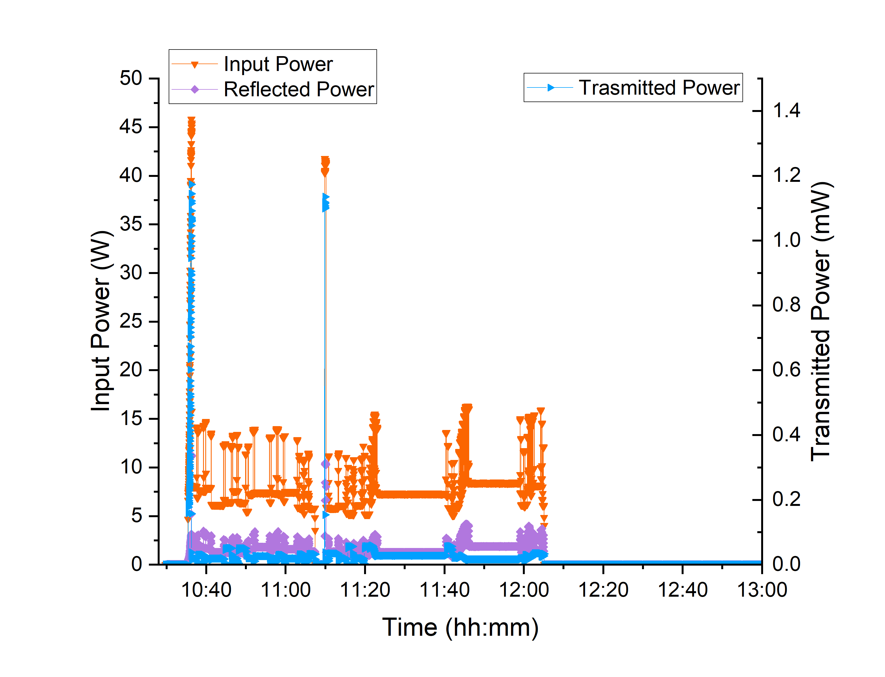
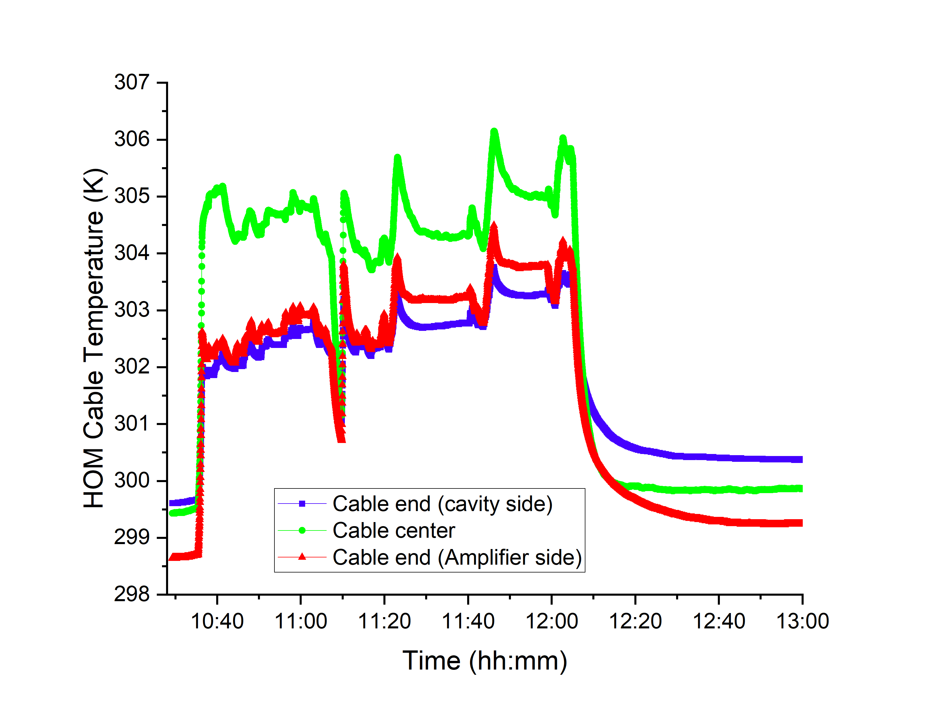

Potential recipe for ILC cavities
  Argon at $p≈50mTorr$, $P_{IN}^{Ignition}=45−55W$, max observed $∆T=7K$ on ILC HOM CM-style input cable
Power levels and corresponding cable heating recorded during plasma ignition, transfer to each cell and tuning tests for modes 1D-5, 1D-6, 1D-7

Slide 35
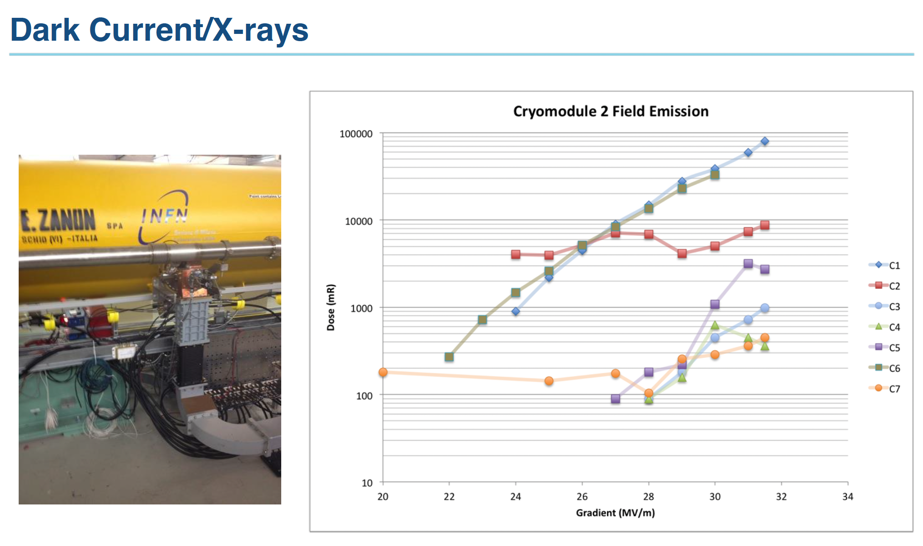
E. Harms, AWLC14 – Americas Workshop on Linear Colliders 2014

Slide 36
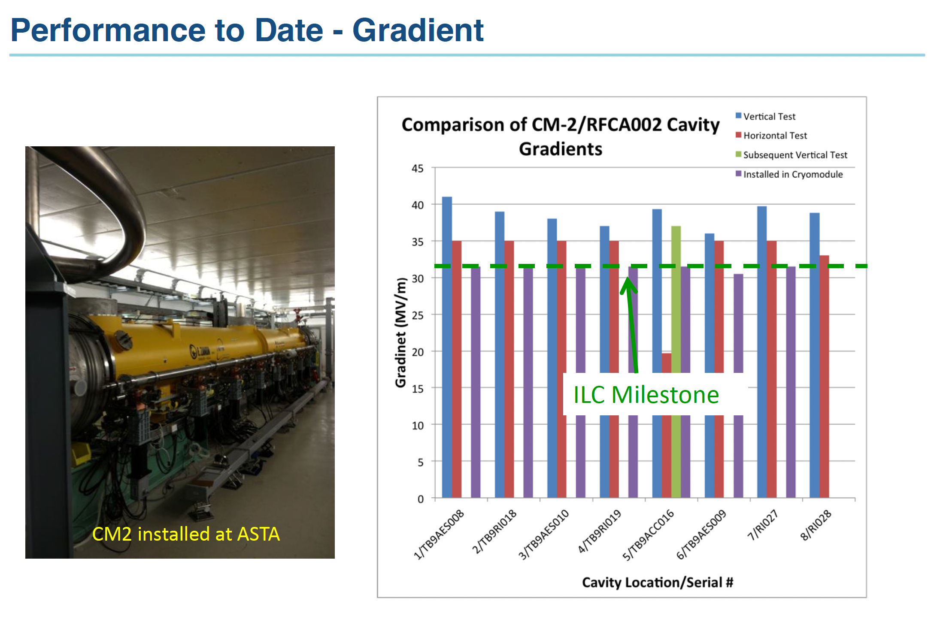
E. Harms, AWLC14 – Americas Workshop on Linear Colliders 2014

Slide 37
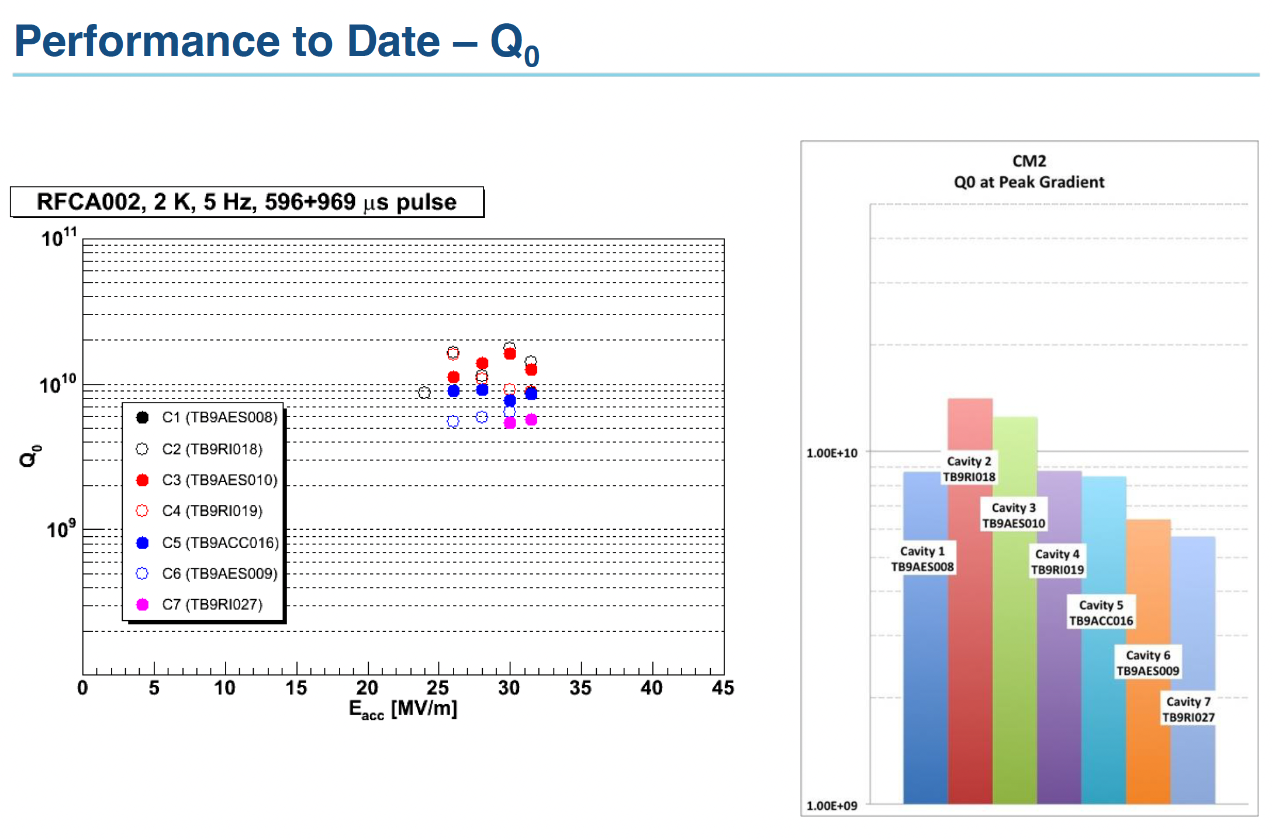
E. Harms, AWLC14 – Americas Workshop on Linear Colliders 2014

