Slide 1
Error Detection in Linacs with Machine Learning Techniques Jonathan Edelen, Kathryn Wolfinger, Matt Kilpatrick, Joshua Einstein-Curtis (RadiaSoft), Mike Wallbank, Dean Edstrom, Jonathan Jarvis (Fermilab)
March 14th 2024
FAST/IOTA Collaboration Meeting
Batavia IL, USA | radiasoft.net

Slide 2
Outline
Machine learning methods
Initial demonstration at Jlab
Transitioning to FAST
Initial results
Conclusions

Slide 3
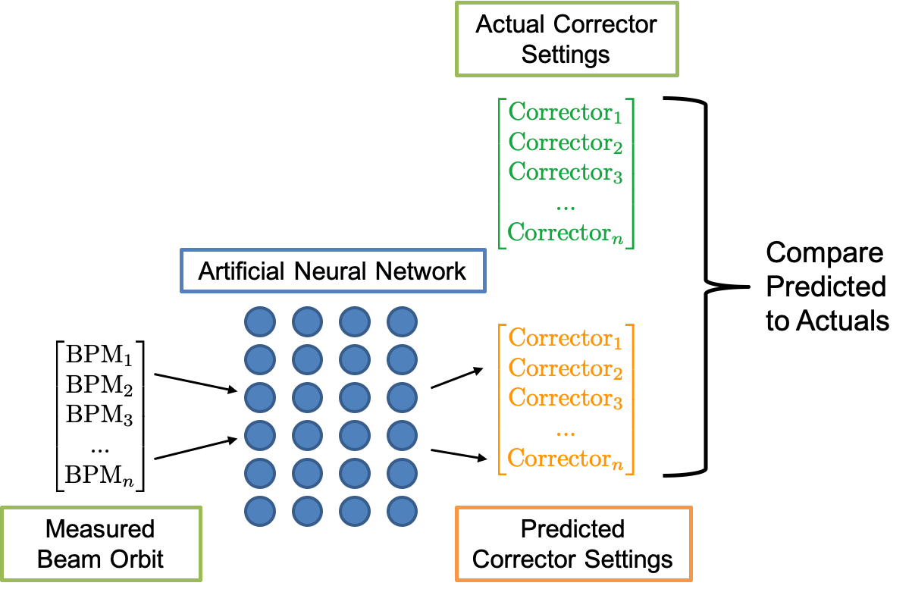
Inverse models as a diagnostic tool
Inverse models as a diagnostic in a supervised fashion
Direct comparison between predicted settings and actual settings informs operations of a potential anomaly
Inverse models as a diagnostic in an unsupervised fashion
Assumptions
model errors are caused by other beamline elements
each beam-line element will have a unique error signature
Inverse models for tuning
Minimize error between predicted settings and actual settings by varying quads
Right: model error as a function of quad strength error

Slide 4
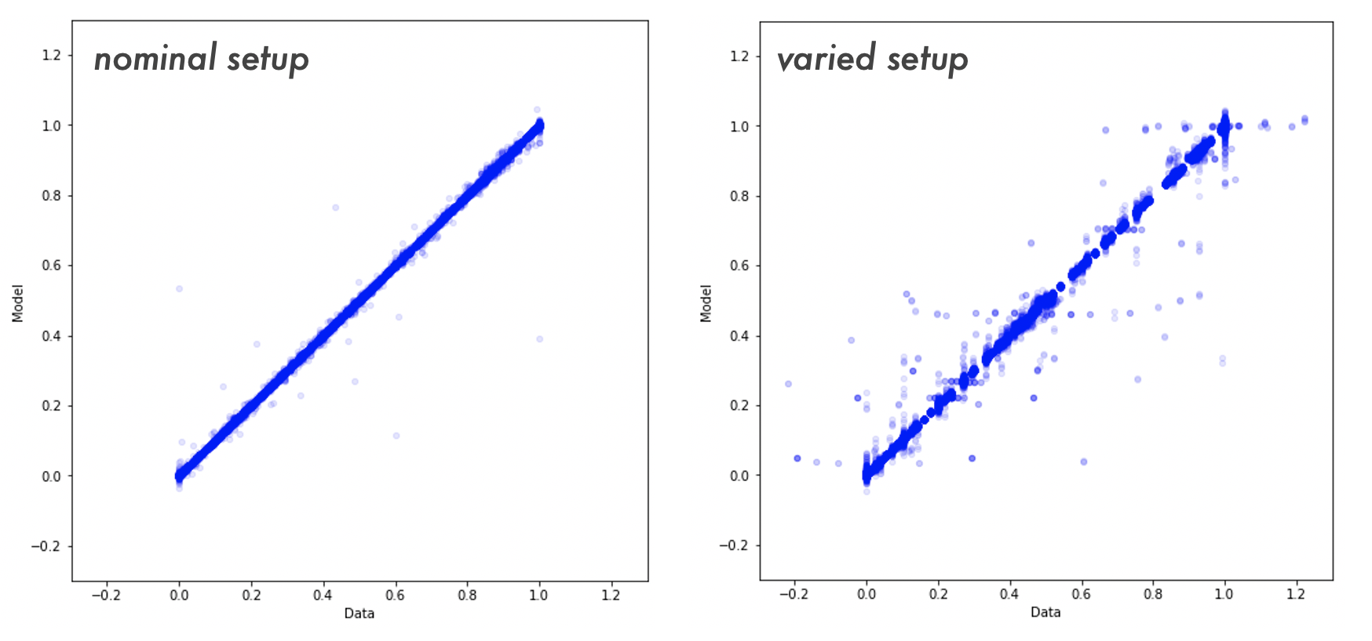
Inverse Model Anomaly Detection at CEBAF
Data collected during two different operational modes.
During normal operations
During a dedicated machine study
Inverse model trained to predict settings from readings
Left: Model prediction vs the ground truth for the validation data from the nominal setup
Right: Model prediction vs the ground truth for the test data

Slide 5
Establishing error thresholds
RMS error of the predicted settings by parameter for the machine study (left) and the nominal setup (right).

Slide 6
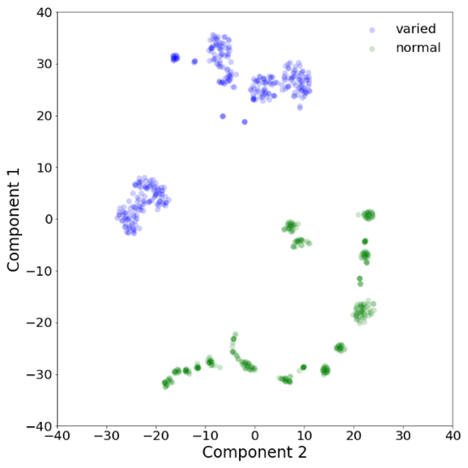
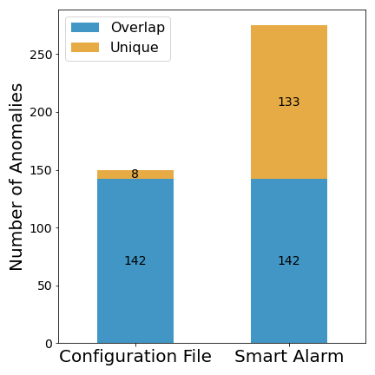
A Smart Alarm System for the CEBAF Injector
Left: T-SNE was used to reduce the dataset dimensionality
Operational data is shown in green and the study data in blue
The model correctly flagged the study data as anomalous
The T-SNE reduction of the data also provides a strong indication that these two datasets are distinct in nature
Right: Comparison with conventional threshold-based alarming.
Threshold misses numerous configurations that would be undesirable by the user program

Slide 7
Transition to the FAST LINAC
Objective(s):
Near term: Develop model that can effectively detect anomalies in an explainable fashion → 60% complete
Longer term: Utilize anomaly detection tools to assist in automatic tuning of the machine
Experimental plan:
Collect data during “normal” operational conditions
Train machine learning model on data archive
Test machine learning on study data where parameters are intentionally varied
Evaluate effectiveness at detecting anomalies
Develop uncertainty metrics for machine learning model
Deploy and test software during experimental run

Slide 8
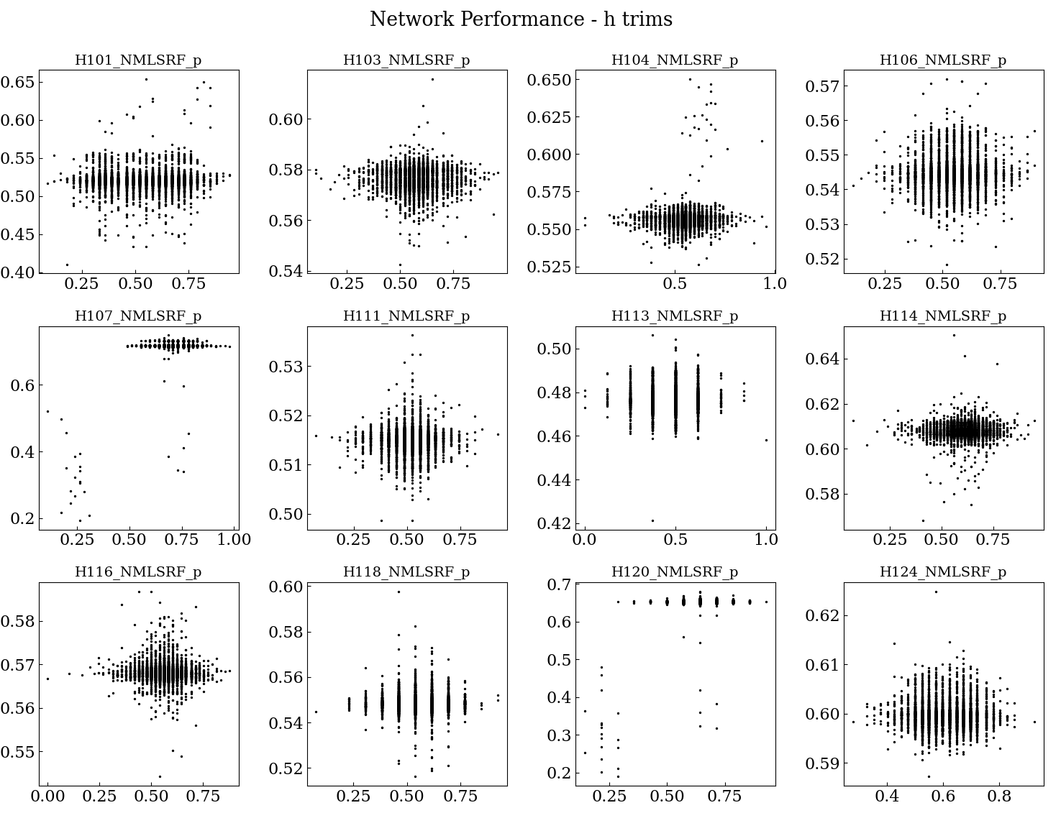
Transition to the FAST LINAC
Objective(s):
Near term: Develop model that can effectively detect anomalies in an explainable fashion → 60% complete
Longer term: Utilize anomaly detection tools to assist in automatic tuning of the machine
What actually happened:
Collect data during “normal” operational conditions
Train machine learning model on data archive
Model learning not adequate
Troubles with data alignment
Identified potential logger issues

Slide 9
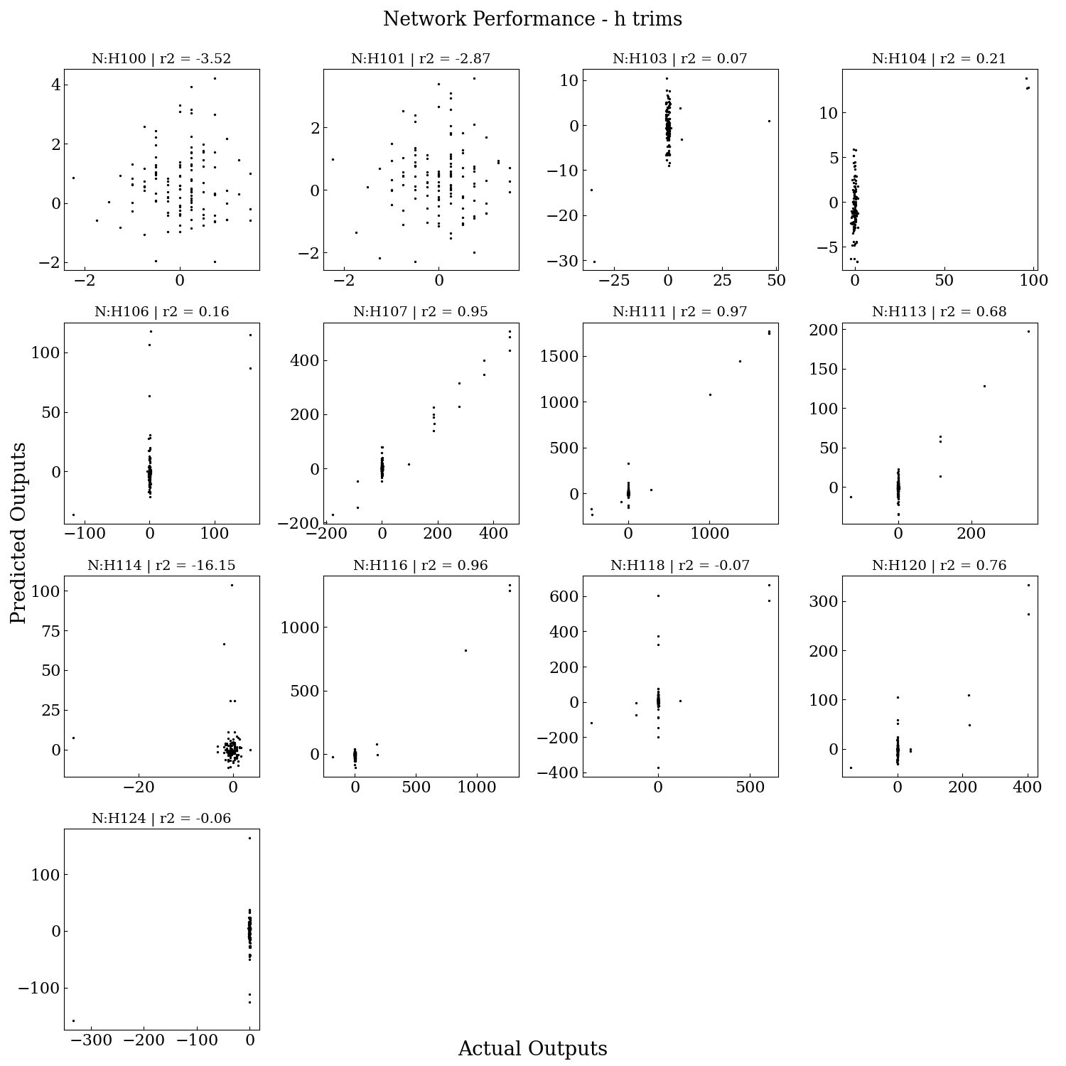
Transition to the FAST LINAC
Objective(s):
Near term: Develop model that can effectively detect anomalies in an explainable fashion → 60% complete
Longer term: Utilize anomaly detection tools to assist in automatic tuning of the machine
What actually happened:
Collect data during “normal” operational conditions
Train machine learning model on data archive
Model learning not adequate
Troubles with data alignment
Identified potential logger issues
Collected study data for training
Model learning not adequate

Slide 10
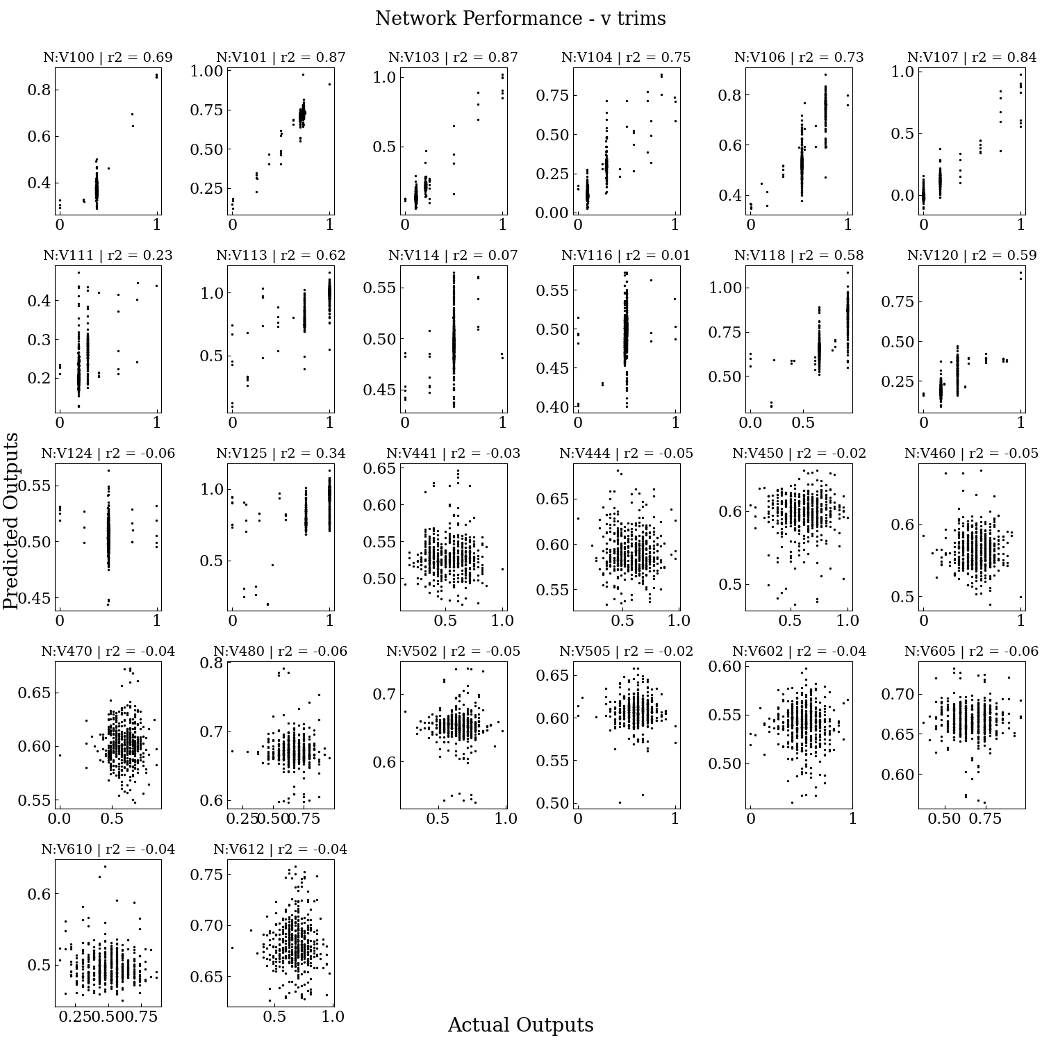
Transition to the FAST LINAC
Objective(s):
Near term: Develop model that can effectively detect anomalies in an explainable fashion → 60% complete
Longer term: Utilize anomaly detection tools to assist in automatic tuning of the machine
What actually happened:
Collect data during “normal” operational conditions
Train machine learning model on data archive
Model learning not adequate
Troubles with data alignment
Identified potential logger issues
Collected study data for training
Model learning not adequate
Collected new study data for more training
Model learning not adequate

Slide 11
Transition to the FAST LINAC
Objective(s):
Near term: Develop model that can effectively detect anomalies in an explainable fashion → 60% complete
Longer term: Utilize anomaly detection tools to assist in automatic tuning of the machine
What actually happened:
Collect data during “normal” operational conditions
Train machine learning model on data archive
Model learning not adequate
Troubles with data alignment
Identified potential logger issues
Collected study data for training
Model learning not adequate
Collected new study data for more training
Model learning not adequate
Contemplate giving up
Try to see if anomaly detection is possible even with a bad sub optimal model

Slide 12
Transition to the FAST LINAC
Objective(s):
Near term: Develop model that can effectively detect anomalies in an explainable fashion → 60% complete
Longer term: Utilize anomaly detection tools to assist in automatic tuning of the machine
What actually happened:
Collect data during “normal” operational conditions
Train machine learning model on data archive
Model learning not adequate
Troubles with data alignment
Identified potential logger issues
Collected study data for training
Model learning not adequate
Collected new study data for more training
Model learning not adequate
Contemplate giving up
Try to see if anomaly detection is possible even with a bad sub-optimal model
Success! … sort of

Slide 13
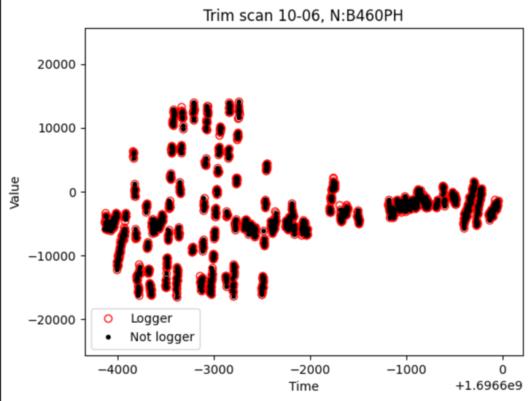
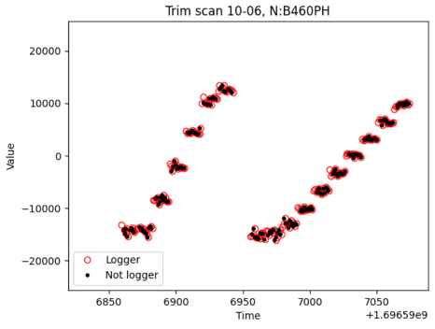
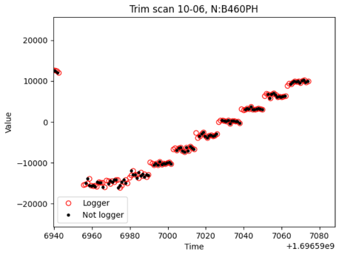
Identifying archiver issues
Time alignment efforts with archive data revealed inconsistencies
Comparison of scripted data logging with archiver
Study on 10-6 scanned trims and recorded BPMs for model development and testing

Slide 14
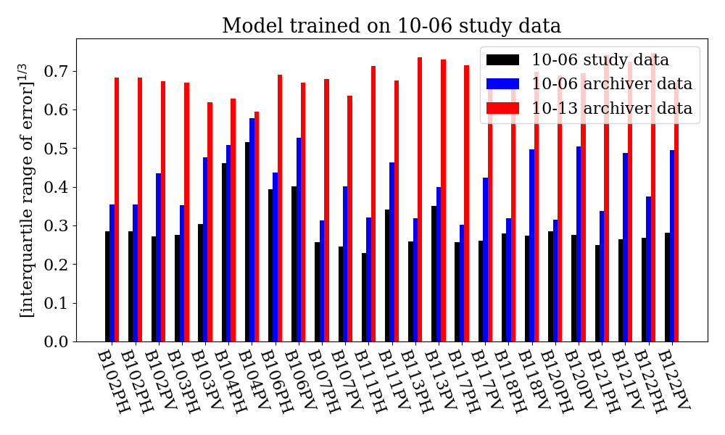
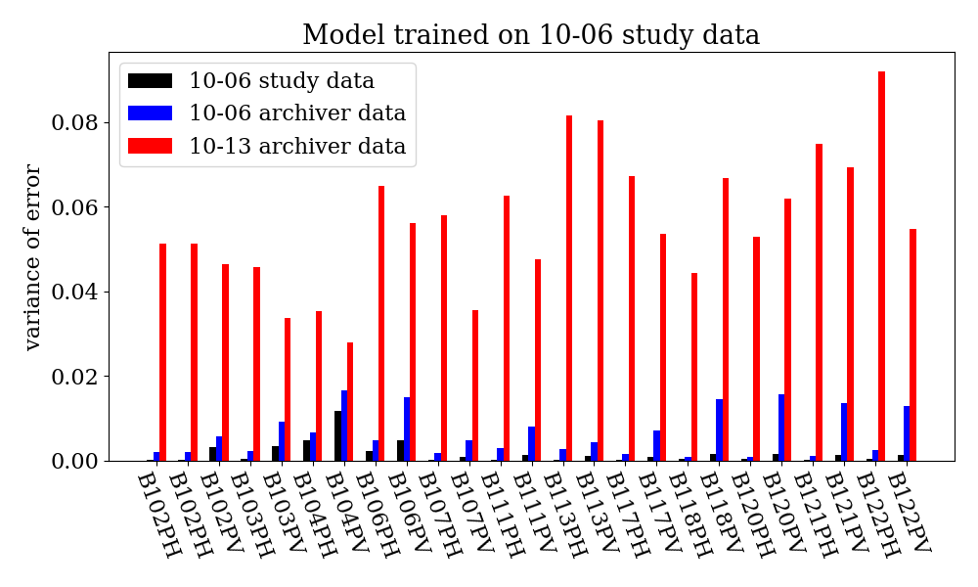
Initial model training results
We trained a model on only the 10-06 study data. Then, we applied that model to the archiver data and study data. The following plots show the error of the model predictions.
Note, we are considering an archiver timeframe on 10-06 when dedicated study data was collected and an archiver timeframe on 10-13 when no dedicated study was run.

Slide 15
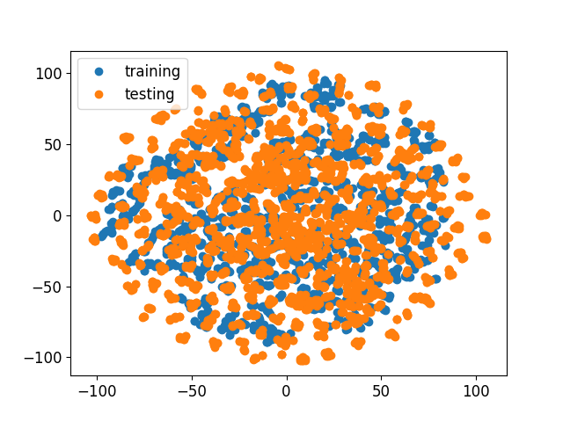
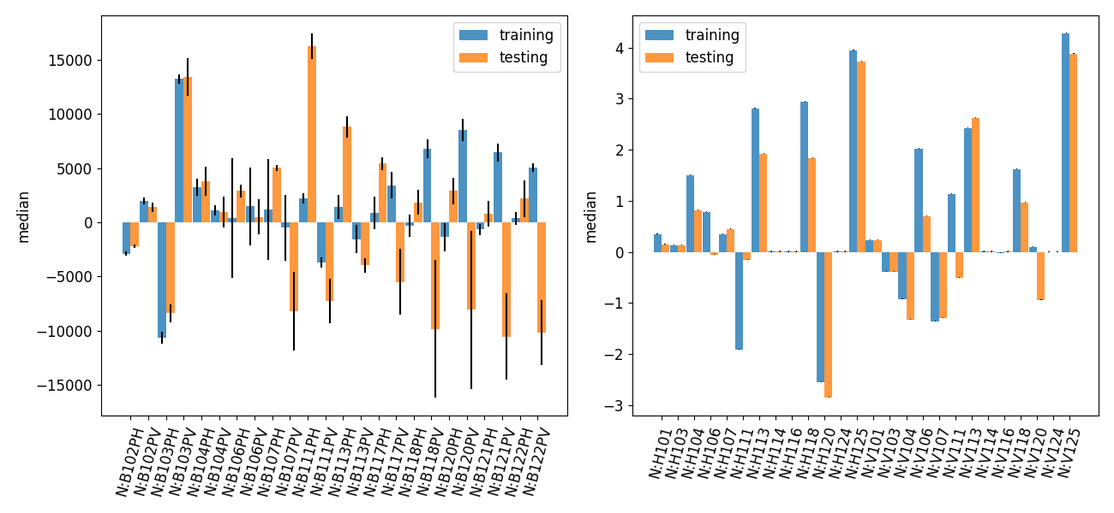
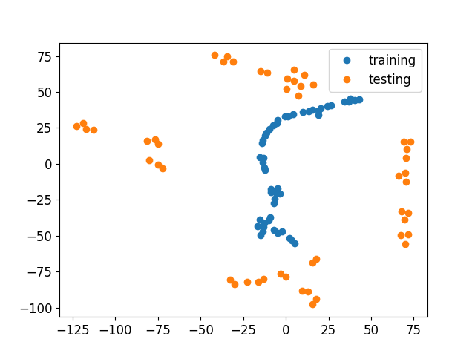
Understanding the training and testing data
Training data collected from the data logger between studies ~ Oct 13
Testing data collected from script during machine studies on Oct 6
Bar plots showing the median and interquartile range
BPMs (bottom left): Correctors (bottom right)
T-sne dimensionality reduction
Example-by-example (right top)
Model parameters (right bottom)

Slide 16
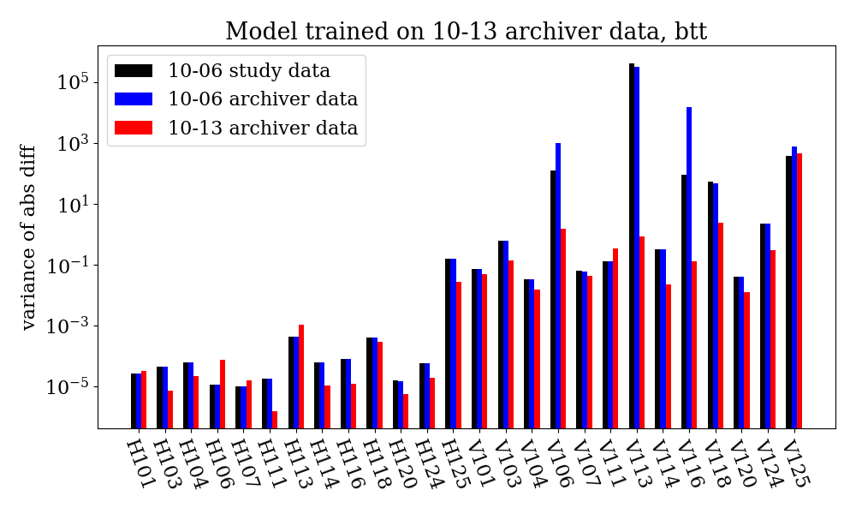
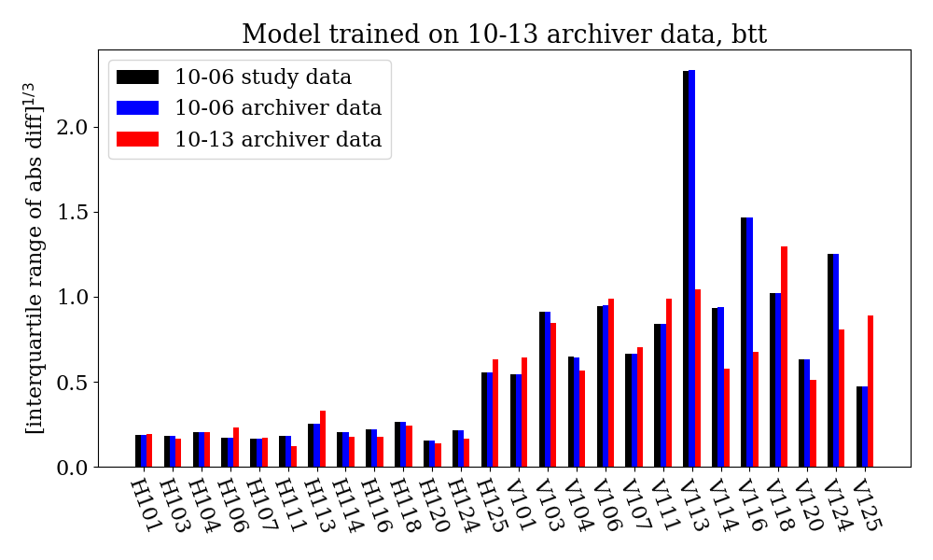
Initial machine learning studies
Model is trained on operations data and tested on study data
Study was conducted on 6 October: Both scripted data collection and data logger collection

Slide 17
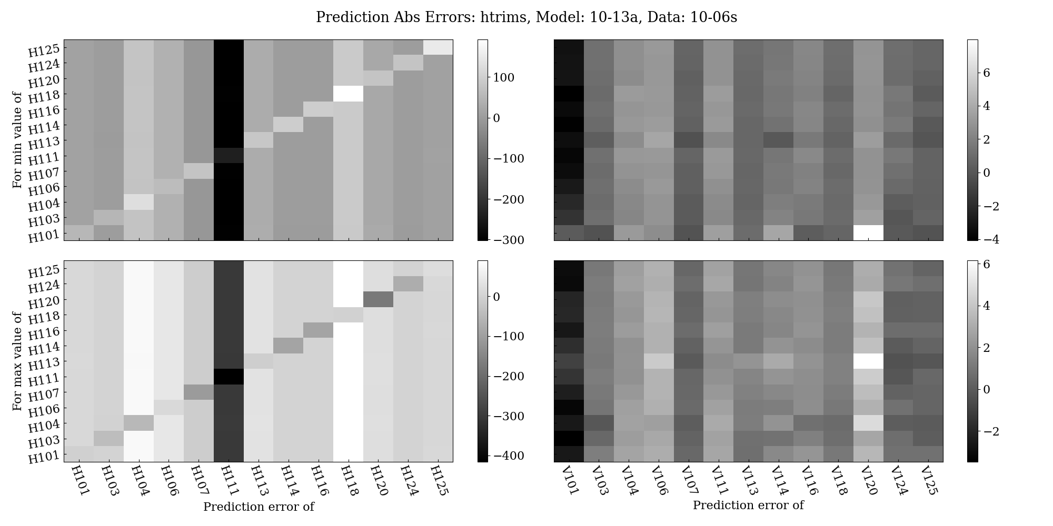
Predicting the trim settings from the BPMs
Prediction errors for the horizontal trims
For the min (left) and max (right) trim setting during the study

Slide 18
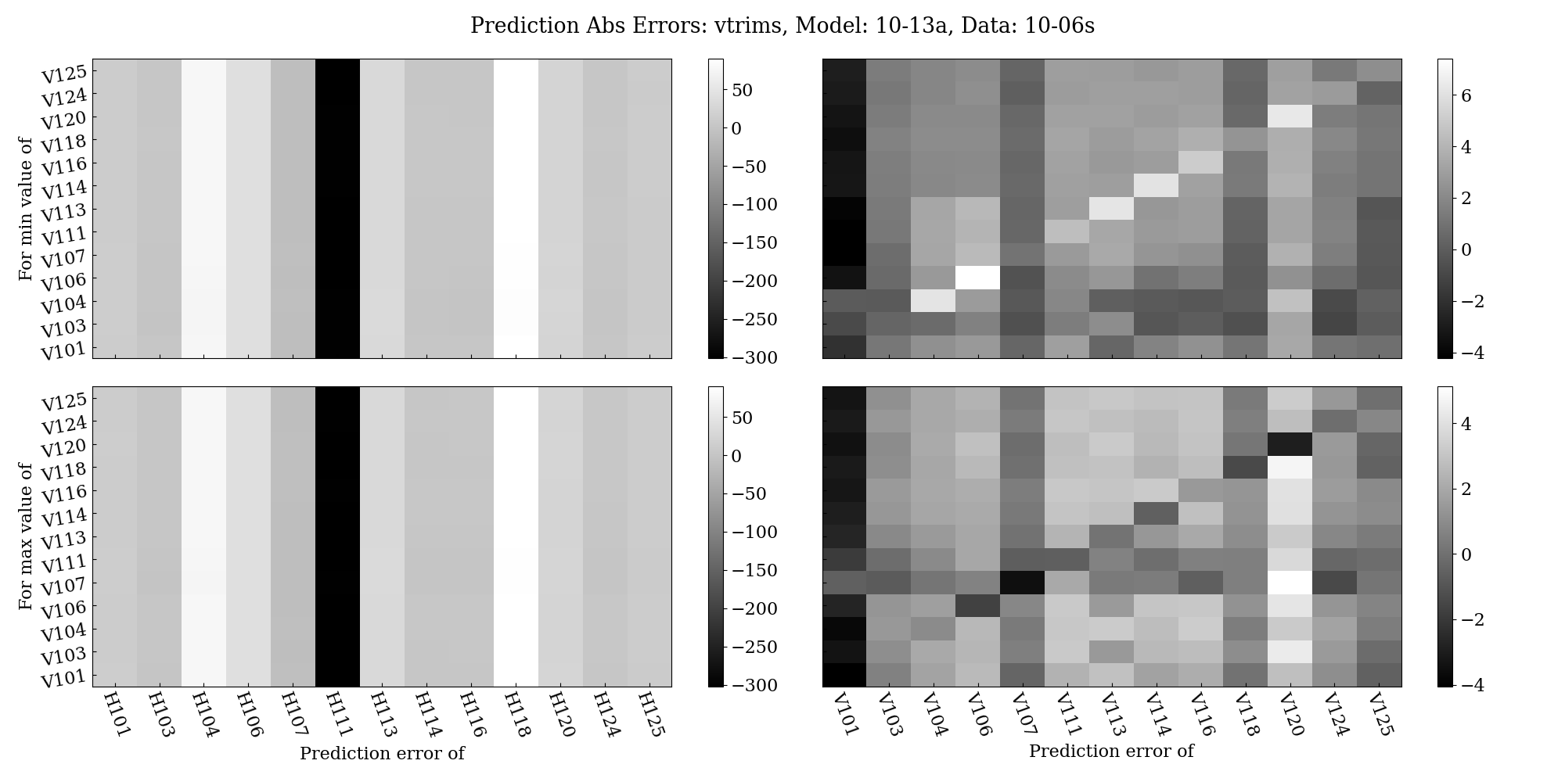
Predicting the trim settings from the BPMs
Prediction errors for the vertical trims
For the min (left) and max (right) trim setting during the study

Slide 19
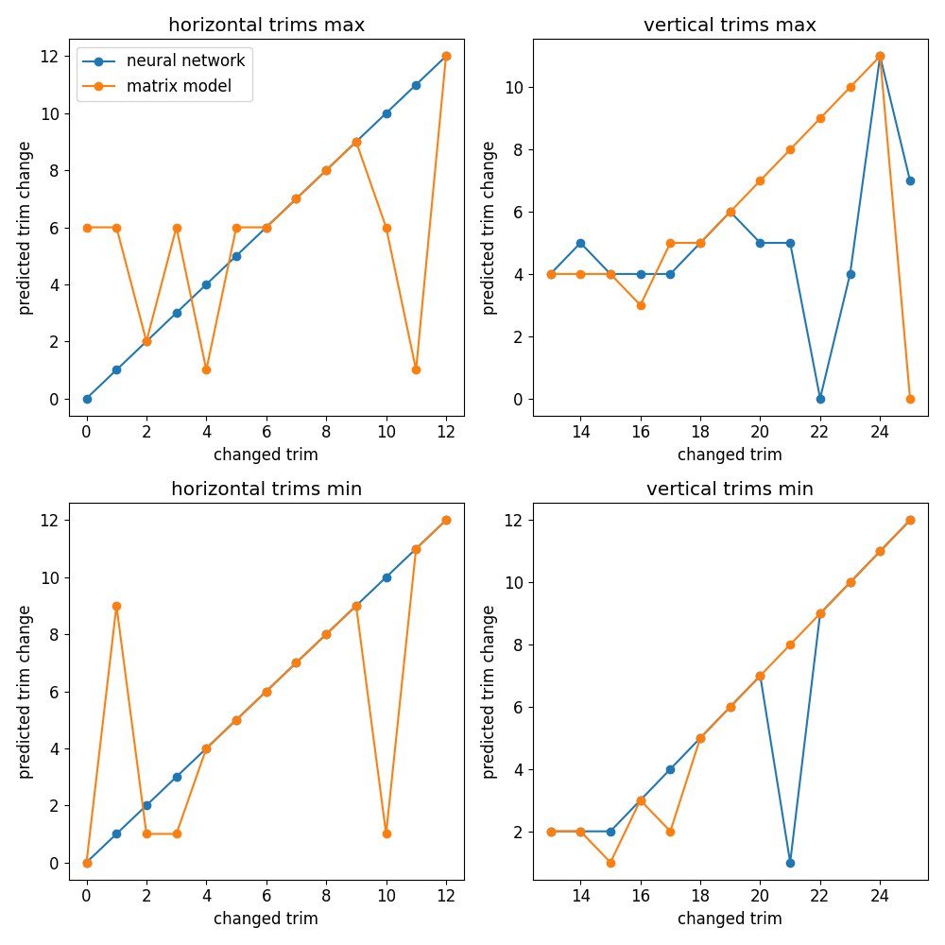
Identification of trim errors
Use algorithm to identify trim errors
Model trained to predict trim settings from BPM readings
Compute error between predicted trim setting and actual trim settings
Large model offsets make threshold determination challenging
The changed trim has a clear signature over non changed trims
Subtract the mean error and then find the location with the max residual
Compare with linear matrix model

Slide 20
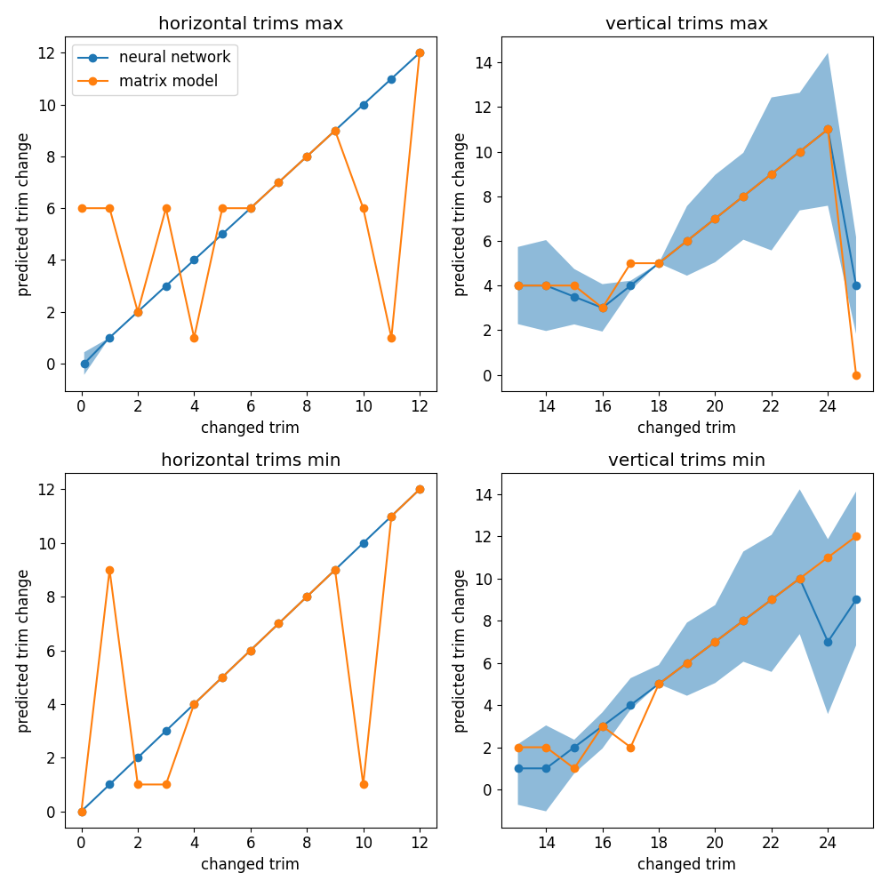
Identification of trim errors
Use algorithm to identify trim errors
Model trained to predict trim settings from BPM readings
Compute error between predicted trim setting and actual trim settings
Large model offsets make threshold determination challenging
The changed trim has a clear signature over non changed trims
Subtract the mean error and then find the location with the max residual
Compare with linear matrix model
Use model ensemble to improve prediction and provide error bars
Plots show median prediction with plus minus one standard deviation

Slide 21
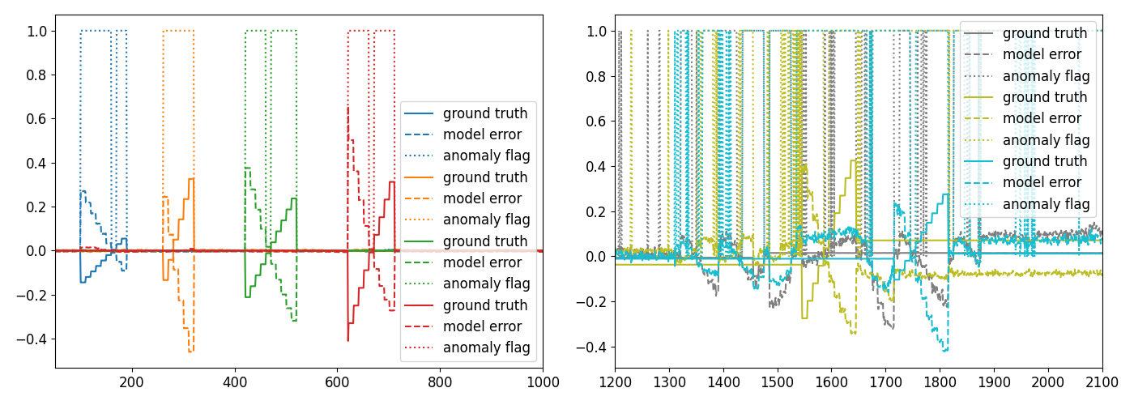
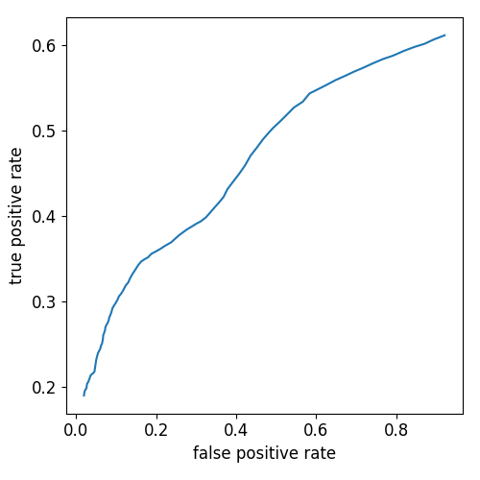
Detailed error detection analysis / threshold evaluation
Evaluate model performance on all test data
ROC curve (far right) shows true positive rate vs false positive rate for varying detection thresholds
Error detection for horizontal trim examples (left) and vertical trim examples (middle)
Color coded by which trim is changed
Model error in dashed line
Anomaly flag in solid line showing that the BPM is correctly identified

Slide 22
Next steps
Iterate on model learning
Try to improve the predictions for baseline model: planned
Improve detection algorithm
Extend to remaining BPMs on the LINAC: planned
Expand ensemble to include linear and other models: planned
Try Siamese networks for stronger error discrimination: in progress
Determine deployment path
Experiment on proton source?
Expand to include more diagnostics?

Slide 23
Conclusions
Neural network model was able to detect changes in the machine in different operational modes
Improvement over matrix model
Training data collected during normal operations (no dedicated study required to train the model)
Need to better understand the data logger issues
Understand why the method works even with a poor (in my opinion) model

Slide 24
Disclaimer
This report was prepared as an account of work sponsored by an agency of the United States Government. Neither the United States Government nor any agency thereof, nor any of their employees, makes any warranty, express or implied, or assumes any legal liability or responsibility for the accuracy, completeness, or usefulness of any information, apparatus, product, or process disclosed, or represents that its use would not infringe privately owned rights. Reference herein to any specific commercial product, process, or service by trade name, trademark, manufacturer, or otherwise does not necessarily constitute or imply its endorsement, recommendation, or favoring by the United States Government or any agency thereof. The views and opinions of authors expressed herein do not necessarily state or reflect those of the United States Government or any agency thereof.

