Slide 1
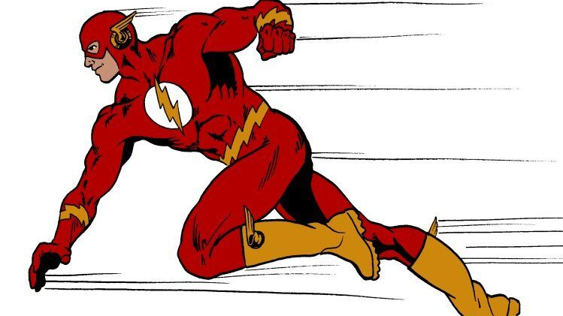
Very High Energy Electrons for Radiation Therapy including FLASH
C. Johnstone, R. Schulte,
March 14, 2024
IOTA Collaboration Meeting
Fermi National Accelerator Lab
Batavia, IL
Notes:
The title of this talk is … There is a new treatment for cancer call FLASH – as its name implies, it is a rapid application of radiation. First I will introduce you to present forms of radiotherapy and then cover the results from preclinical FLASH studies using different types of radiation. After preclinical, I will then move to a possible clinical implementation of FLASH including accelerator and beam delivery considerations. Examples will be presented using state of the art accelerators to fully realize FLASH capability followed by challenges in ultra-fast and large-field detector technology. Finally a summary of what we know about FLASH and open questions for further research.

Slide 2
https://www.mdpi.com/2076-3417/13/8/5021

Slide 3
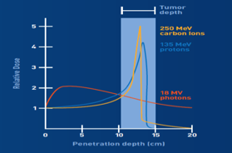
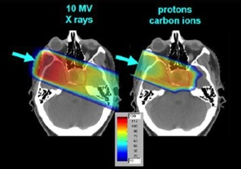
Conventional and FLASH Radiotherapy
Radiation therapy is driven by new accelerator technologies and innovation
~2/3 OF US CANCER PATIENTS UNDERGO RADIATION THERAPY; OFTEN THE PRIMARY COURSE OF TREATMENT
PHOTON AND ELECTRON BEAM THERAPY – used to treat the majority of cancer patients
Bremsstrahlung photons and ≤10 MeV low energy electrons
  Photons produced using a 10-20 MeV pulsed electron linac, from an e-beam on target
  Sophisticated, compact and inexpensive beam delivery systems (<0.1 Gy/sec on average)
High integral dose to normal tissue (dose limited by early & late toxicity)
PROTON AND ION BEAM THERAPY
Highly conformal dose distribution; biological advantage for high LET ions
  enhanced local tumor control; Bragg peak maximizes energy deposition at tumor site;
  Overall better sparing of normal tissue and organs at risk
Important for pediatric tumors, retreatment, organs at risk (brain, spinal cord)
  Delivered dose ~2 Gy/treatment < 3 Gy/min, typical is 20-40 treatment fractions
  Reduced early and late toxicity response
FLASH THERAPY NEW!
Acute dose of radiation delivered in a fraction of a second
  Many preclinical and clinical results indicate a dramatic reduction of toxicity response
  First patient treated (T-cell lymphoma, recurring), complete response, minimal toxicity¹
  Even after multiple non-FLASH skin irradiation and damage from photons and electrons!
    ¹ Bourhis J, et al. doi: 10.1016/j.radonc.2019.06.019
Tissue Tumor
Proton
Carbon
Radiation Dose
X-rays
Depth (cm)
X-rays:
Single Field
Proton
Carbon

Slide 4
The FLASH Effect:
Dose rates far exceed conventional therapies
STRIKING TOXICITY REDUCTION AT VERY HIGH DOSE RATES WHILE MAINTAINING TUMOR RESPONSE
EARLY EVIDENCE OF SPARING AT HIGH DOSE RATES (1969)
In vitro mammalian cells (noncancerous) irradiated with X-rays¹
  Cells irradiated with nanosecond pulses (7x10¹⁰ rad/sec or ~10⁸ Gy/sec instantaneous) remained viable; while lower rates decreased cell survival
RE-DISCOVERED IN RADIATION INDUCED LUNG FIBROSIS (2014)
Mice were irradiated with 4-6 MeV electron beams²
  Irradiation dose rate was ≥40 Gy/sec average in <500 ms for FLASH vs. 0.03 Gy/s Conventional
  A 15 Gy total dose with CONV RT induced lung fibrosis, no fibrosis for 20 Gy with FLASH (other sparing effects)
  HOWEVER, LUNG TUMORS SHOWED THE SAME RESPONSE TO THE TOTAL DOSE FOR FLASH AND CONVENTIONAL RT!
PRECLINICAL FLASH STUDIES
Electrons: Performed using 4-6 MeV electron beams from modified clinical linacs
  Provides the strongest, consistent evidence for FLASH
Photons: Synchrotron Radiation and keV X-rays (early study)
  Mixed results
Protons: CW or iso-cyclotrons (shoot-through beams, beam is not energy degraded)
  Mixed results – better tumor control in one study
  ¹ Berry RJ, et al. doi: 10.1259/0007-1285-42-494-102, ² Favaudon V, et al., doi: 10.1126/scitranslmed.3008973

Slide 5
Preclinical FLASH Studies with Electrons
LOW ENERGY (<10 MeV) ELECTRON BEAMS PRODUCED USING 100-200 Hz CLINICAL LINACS
FLASH EFFECT OBSERVED - highlights:
Study of pulmonary fibrosis from irradiation of the lung¹
  Severe to moderate for conventional average dose rate of 0.03 Gy/sec, 17 Gy total dose
  For an average dose rate of 40-60 Gy/sec, equivalent fibrosis occurred at 30 Gy total dose
Study of neurocognitive impairment from brain irradiation²
  Severe neurocognitive degeneration at an average dose rate of 0.1 Gy/sec, 10 Gy total dose
  Improvement starts at 30 Gy/sec with no neurocognitive decline at 100 Gy/sec average dose rate for10 Gy!
Skin irradiation (mini-pig)³
  Fibrosis and necrotic lesions observe at and average dose rate of 0.08 Gy/sec, (22-37 Gy total dose)
  Only mild depigmentation at an average dose rate of 300 Gy/sec, (22-37 total dose)!
  INITIAL PRECLINICAL ELECTRON STUDIES have established general beam conditions for FLASH
FLASH: ≥40Gy/sec, ≥10 Gy delivered in 0.1-1 sec, instantaneous dose rate 10⁵ - 10⁶ Gy/sec (during beam pulse)⁴
¹ Favaudon V, et al., doi: 10.1126/scitranslmed.3008973, ² Montay-Gruel, et al., doi: 10.1016/j.radonc.2017.05.003,
³ Harrington KJ. et al., doi: 10.1158/1078-0432.CCR-18-1796, ⁴ J. Wilson, et. al., doi: 10.3389/fonc.2019.01563,

Slide 6
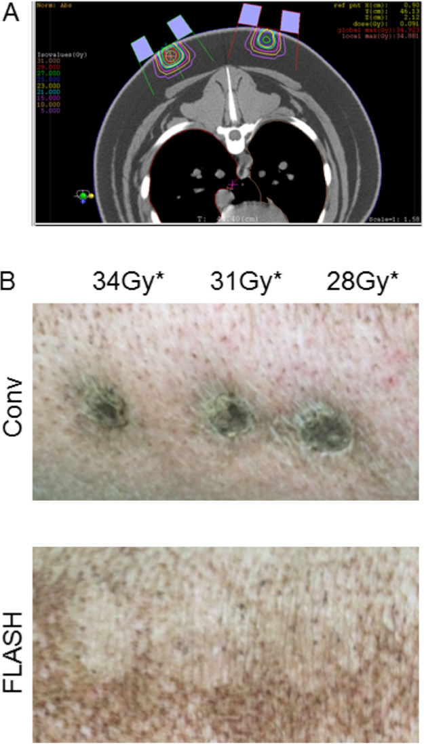

FLASH Effect in Skin Irradiation with electrons
Vozenin, et al, The advantage of Flash RT confirmed in mini-pig and cat-cancer patients.” Clinical Cancer Research. 2018;
 | CONV
Beam Type | Electron
Nominal Energy | 6 MeV
Beam Structure | Pulsed
Pulse Rep Rate | 10 Hz
Pulse Width | Few μs
Mean Dose Rate | 0.08 Gy/s
Dose
28 Gy
31 Gy
34 Gy
FLASH
Electron
6 MeV
Pulsed
200 Hz
1 μs
300 Gy/s
36 Weeks Post Irradiation
Notes:
Here is a study where different parts of the same pig were irradiated with conventional and FLASH dose rates to single-fraction doses of 28, 31, or 34 Gy.
(CLICK)
You can see the results here 36 weeks after radiation with 4.5-6 MeV electrons where spots irradiated with a conventional dose rate of 0.08 Gy/s showing necrotic lesions typical of late normal tissue damage. On the other hand, areas treated eiyh an ultra-high dose rate of 300 Gy/s showed no adverse affects of the radiation and appears to have spared the normal tissue.
The bottom line is that ultra-high dose rate radiation appears to have significant normal tissue sparing when compared to conventional treatments. However, the case is not so simple as to say that a FLASH dose rate will produce the desired effect. There have been other studies using FLASH dose rates that did not see the FLASH sparing.

Slide 7
Preclinical FLASH Studies with Photons
(photon dose rates from clinical electron linacs are too low)
CREATING HIGH DOSE RATES OF PHOTONS
PHOTONS FROM LIGHT-SOURCE SYNCHROTRONS
Synchrotron Broad-Beam Radiation therapy (SBBR)
  One study did not show FLASH effect ( 37 – 41 Gy/sec, 4-28 Gy )¹
  Another, mouse-brain irradiation (37 Gy/sec, 10 Gy), significant cognitive sparing; (vertical beam size x20 smaller)²
Microbeam Radiation therapy (MRT) – grid of “pencil” photon beams¹
  Parallel beam array, 25-100 μm (peak) spaced by 100-400 μm (valleys)
  Peak average dose rate ~300 Gy/sec; valley average dose rate lower factor of ~30 and strong indicator of toxicity
  The low dose rates, especially in valleys, conjectured to be the reason for no FLASH effect
PHOTONS FROM BREMSSTRALUNG³
FLASH dose rates produced by a high intensity 10-MeV SRF electron linac, tungsten target;
  Significant FLASH effect observed for lungs and tissues³
  Original 1969 study and a recent Monte Carlo Study suggests FLASH with X-ray tubes may be possible⁴
    ¹ Smyth LML, et al., doi: 10.1038/s41598-018-30543-1), ² Montay-Gruel, et al., doi: 10.1016/j.radonc.2018.08.016)
    ³ Gao F, et al., doi: https://doi.org/10.1101/2020.11.27.401869;, ⁴Bzalova-Carter M, et al., doi: 10.1002/mp.13858.2017.05.003

Slide 8
Preclinical FLASH Studies with Protons
(Pulsed FLASH has been proposed using large synchrotrons and fast single-turn extraction)
VERY HIGH PROTON DOSE RATES (CW) FROM ISO-CYCLOTRONS
230-250 MEV PROTON THERAPY CYCLOTRONS – very few studies
Requires shoot-through or non-degraded beam to achieve FLASH intensities
  MIXED RESULTS (high-energy beam placed Bragg peak beyond the targeted area)^{1,2}
Individual RF (MHz) proton bunch structure may be important for proton FLASH
  Proton RF “bunches’ are fractions of a microsecond; electron RF bunches are fractions of a nanosecond
  Proton beam is “quasi-continuous” ; 100-300 Hz electron linacs produce a microsecond “macro-pulse”
  For proton FLASH it can be hypothesized that the instantaneous dose rate of >10⁵ Gy/sec must be achieved within the RF bunch pulse
  For pulsed electron beams the instantaneous dose rate is integrated over microsecond macro-pulse
The <1 sec treatment time may not apply to quasi-continuous beams
  CW electron linacs , like proton cyclotrons, produce a quasi-continuous beam
    ¹ Rama N, Saha, et al., doi: 10.1016/j.ijrobp.2019.06.187, ² Beyreuther E, et al., doi: 10.1016/j.radonc.2019.06.024

Slide 9
COMPENDIUM: FLASH IN VIVO STUDIES IN NORMAL TISSUES: Irradiation parameters with outcomes for electrons (green), protons (blue) and X-rays (grey) J. Wilson, et. al., “Ultra-high Dose Rate (FLASH) Radiotherapy Silver Bullet or Fool’s Gold”, Frontiers in Oncology, Vol 9, Jan 2020.
Notes:
This intimidating table shows the large number of preclinical FLASH studies – and there are many more recent ones. The study circled gave the most systematic study, 10 Gy total dose with steps in instantaneous dose rate. This particular study helped define the beam conditions for electron FLASH.

Slide 10
COMPENDIUM: FLASH IN VIVO STUDIES IN TUMOR TISSUES: Irradiation parameters with outcomes for electrons (green), protons (blue) and X-rays (grey) J. Wilson, et. al., “Ultra-high Dose Rate (FLASH) Radiotherapy Silver Bullet or Fool’s Gold”, Frontiers in Oncology, Vol 9, Jan 2020.
Notes:
The FLASH tumor studies show no decreased response of tumors to FLASH vs conventional radiotherapy, However, one proton study showed significant increased reduction in tumor size for non small cell lung cancer for FLASH over conventional radiotherapy.

Slide 11
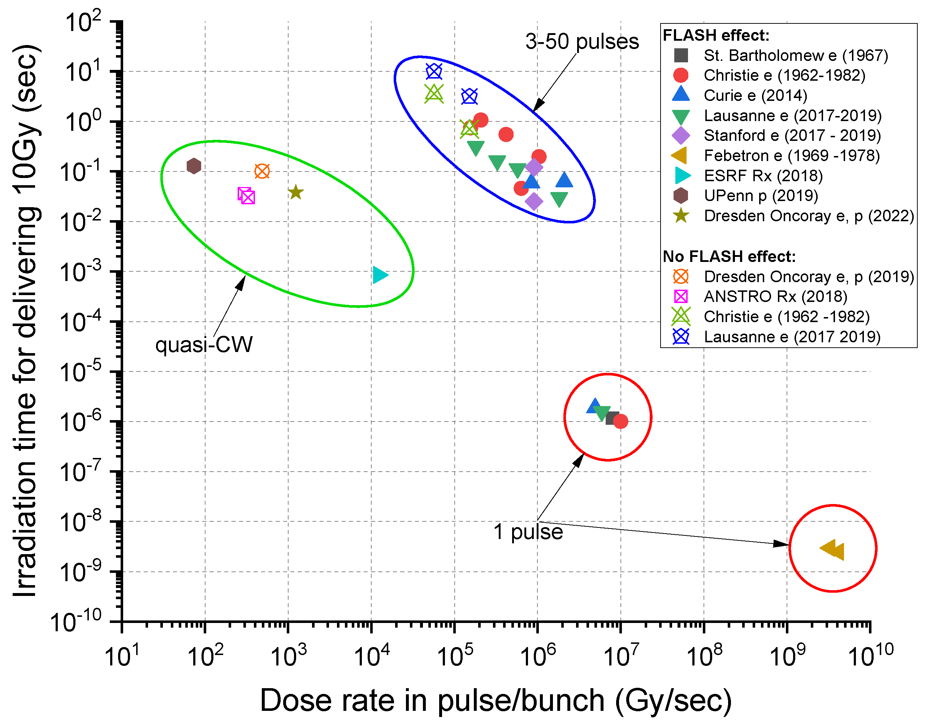
FLASH STUDIES AT ACCELERATOR FACILITIES
†R. Schulte and C. Johnstone, editors, “Transformative Technology for FLASH Radiation Therapy”, in Appl. Sci., 13(8), Apr, 2023, pp. 5021. https://doi.org/10.3390/app13085021
FLASH studies at accelerator facilities with different radiation types† (right panel).
The FLASH effect has been observed for a wide IDR range of repeated linac pulses and different types of quasi-CW bunch delivery with iso-cyclotrons and synchrotron radiation light sources.
FLASH effects were also seen with single electron pulses with IDR in the range of 10⁵–10⁷ Gy/s and single pulse 10⁹–10¹⁰ Gy/s, respectively.*
* Graph Modified from Montay-Gruel P et al. Clin Cancer Res. 2021 doi:10.1158/1078-0432.CCR-20-0894; data grouped according to delivery method with an added data point from Karsch et al, Radiother. Oncol. 2022, 173, 49–54.

Slide 12
Beam Conditions for FLASH
The FLASH effect has been observed for
A wide Instantaneous Dose Rate (IDR) range
  A train of electron linac pulses
  quasi-CW bunch delivery with iso-cyclotrons and synchrotron radiation light sources.
  Single electron pulses with IDR in the range of 10⁶–10⁷ Gy/s and 10⁹–10¹⁰ Gy/s, respectively.
Preclinical FLASH beam properties relevant to a clinical application of FLASH
(now ~70 Gy/sec)

Slide 13
Factors that Influence the FLASH effect mean and instantaneous dose rate, total dose, pulse structure, fractionation, and radiation type
ABSENCE OF SYSTEMATICS in MOST STUDIES:
INITIAL FLASH SYSTEMATICS (wide range of dose rates)
FLASH effects begin to appear at average dose rates >30 Gy/sec, apparent optimal at 100 Gy/sec¹
  FLASH effect likely tissue dependence
  Dependence on the micro-structure of beam delivery and the uniformity of dose deposition
Beam Delivery
  Maximum dose delivery time for a consistent (electron) FLASH effect is ≤0.1-1 second
  MOST positive FLASH studies used a pulsed clinical electron linac (beam pulse length of microseconds)
  Instantaneous (within the pulse) FLASH dose rate is 10⁶ Gy/sec (again, characteristic of clinical electron linacs)
Dosimetric issues
  Observed Volumetric dose deposition dependence
  Low dose-rate areas not tolerated during FLASH – toxicity reappears²
  Bragg peak and pencil beam scanning questions - distal edge and penumbra issues which create lower-dose rate beam “halos”?
  Can a Large Gross Tumor Volume be uniformly irradiated with FLASH?
  Instantaneous FLASH dose rate and delivery time for 10 Gy - is it consistent for all radiation types
  ¹ Montay-Gruel, et al., doi: 10.1016/j.radonc.2017.05.003, ² Smyth LML, et al., doi: 10.1038/s41598-018-30543-1

Slide 14
FLASH intensities translated into hadron accelerator currents
Dose translated to a clinical application of ion FLASH - Derived from electron FLASH conditions
R. Schulte, et. al. https://www.mdpi.com/2076-3417/13/8/5021
U. Titte, MDAnderson, private communication

Slide 15
Clinical FLASH with Pulsed Electron Accelerators
A pulsed electron accelerator is very effective for applying clinical FLASH
Example of a Electron Pulsed Beam Structure for FLASH¹
Schematic of pulse structure shown in Fig. 1
  Given ≥10 Gy total dose in 100 ms, 10⁶Gy/sec instantaneous
  Calculate dose per single pulse and pulse length
  Beam structure parameterization shown in Figure
Very High Energy Electrons (VHEE) Therapy²
Tumor depths of 30 cm require 200-250 MeV electrons
  Treatment models calculate that 10 Gy/sec ≅ 10¹¹ e/sec ^{(ref2 )}
  For 200-MeV electrons delivered with a Gaussian distribution, σ=1.5 mm ^{(ref 2)}
Example: 100 Hz LINAC FOR VHEE ^{1,2}
Using 10 Gy/sec ≅ 10¹¹ e/sec^{ref 2}
  Average 100 Gy/sec in 100 msec = 10 Gy dose, which is ten 1-Gy pulses @100 Hz
  10⁶ Gy/sec instantaneous dose rate requires a 1 μsec single pulse length for a 1 Gy pulse
  This is 10¹¹ electrons delivered in 100 ms, or 10¹⁰ e/μsec (# electrons scales with pulse length, # of pulses inversely)
How would you scan with a 100 Hz Linac,, 1 μsec pulse length?
  15 cm x 15 cm field – 10 pulses at each 1.5 mm position x (100 x 100 positions) or 100,000 pulses; 1000 sec or 17 min
  Scan rate – 15 cm/1000 pulses or 15 cm/10 sec or 1.5 cm/sec - isn’t technically challenging
  Granted clinical electron linacs are only 10-20 MeV – so here is where advanced accelerators can play a major role
  ¹ J. Wilson, et. al., doi: 10.3389/fonc.2019.01563, ² D. Bartkoski, private communication
Schematic view of pulsed beam delivery inducing the FLASH effect

Slide 16
Towards Understanding FLASH Radiobiology
What do we know about the radiobiology and radiation chemistry of FLASH?
Primary mechanism of DNA damage is radiation induction of free radicals into the DNA
Depletion of oxygen
  Oxygen depletion is one of the most frequent hypotheses to explain the FLASH effect
  In healthy tissues, oxygen can be depleted from a normal level by numerous radio-chemical reactions that take place during the physico-chemical and chemical stage of irradiation, cells might be transiently hypoxic and radioresistant
  In tumors, O2 concentration is generally lower, so tumors are not as impacted by the depletion of oxygen
Other Explanations
  Mitochondrial oxygen metabolism in tumor cells is mostly due to aerobic glycolysis (Warburg effect)
  Tumors consume large amounts of glucose a mechanism insensitive to hypoxia
  Hypoxic cells in tumors do not become more hypoxic by FLASH and remain resistant to low radiation doses
  Puzzling, is that they seem to be more sensitive at high radiation doses, possibly to immune-sensitization.
  The tumor’s microvasculature also appears more sensitive to high single doses than normal capillaries.
  Tissue oxygen levels return to normal (estimate is 10⁻³ sec)– pulse structure of beam may play an important role
    Race against oxygen replenishing – maintains hypoxia environment during a short radiation pulses
    Tumor vessels are known to be more transparent for oxygen (leaky) and replenishing could happen faster
    This would further explain the absence of a FLASH sparing in tumors

Slide 17

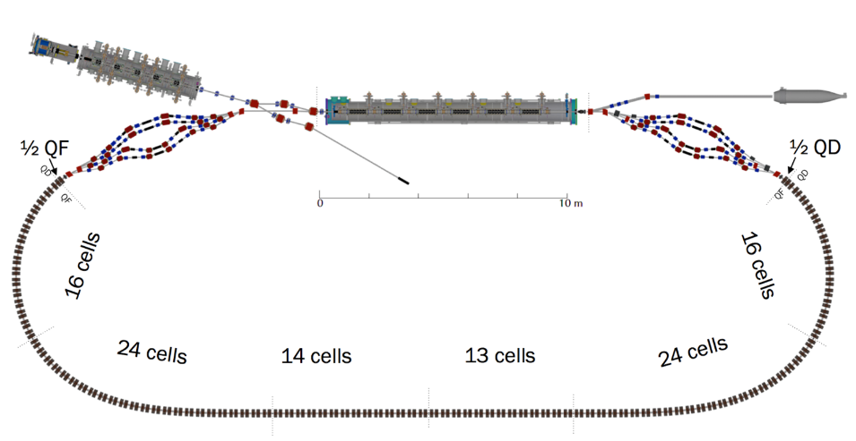




Broad Clinical Application of FLASH requires VHEE beams
Deeper cancers require penetration depths up to 30 cm – a 200-250 MeV electron beam
SRF Linac
Lower cycling time is relevant for FLASH Radiobiology (Fermilab FAST Linac)
  FAST SRF Linac produces 5, 50, 150, and 300 MeV electron beams
  FAST delivers 10¹⁴e/msec-pulse @5Hz;
  10 Gy/sec ~10¹¹ e/sec for a 1.5 mm (σ) Gaussian pencil beam (10¹¹e/10 Gy)
  The FAST Linac can delivers ≤ 10⁴ Gy/ms pulse @instantaneous dose rate of 10⁷ Gy/sec
  5 Hz represents a limitation for clinical scanning
Laser Accelerators (proton and electron)
Single intense, low-energy nanosecond pulses @1-10 Hz
  Platform for understanding radiobiology – being pursued at BELLA with protons
CBETA – Energy Recovery Linear Accelerator (ERL): 6-150 MeV electrons
CW 1.3 GHz linac, single FFA arc, 4 simultaneous acceleration turns
  CW VHEE beam in a recirculating format,
  CBETA can deliver ~10⁸ e/nsec-bunch @instantaneous dose rate of 10⁶ Gy/sec
  CBETA can SCAN: 10⁶ Gy/sec @ 200 cm/ms at peak intensity!
  Machine size can be dramatically reduced by replacing permanent magnets
Synchrotron Light Sources
Produces short pulse, high intensity broad-band X and gamma rays
  Photons are the most penetrating; ongoing preclinical studies
FAST LINAC at Fermilab
CBETA at Cornell

Slide 18
What about Dosimetry – Monitoring FLASH delivery
FLASH is ~1000 times faster
FLASH dose is delivered in < 100 ms. For proton-FLASH (@40 Gy/sec) the corresponding beam luminosity is ~6.25 x 10¹¹ protons/cm²-sec
Standard dosimetry methods do not work at the radiation intensity of FLASH delivery

Slide 19
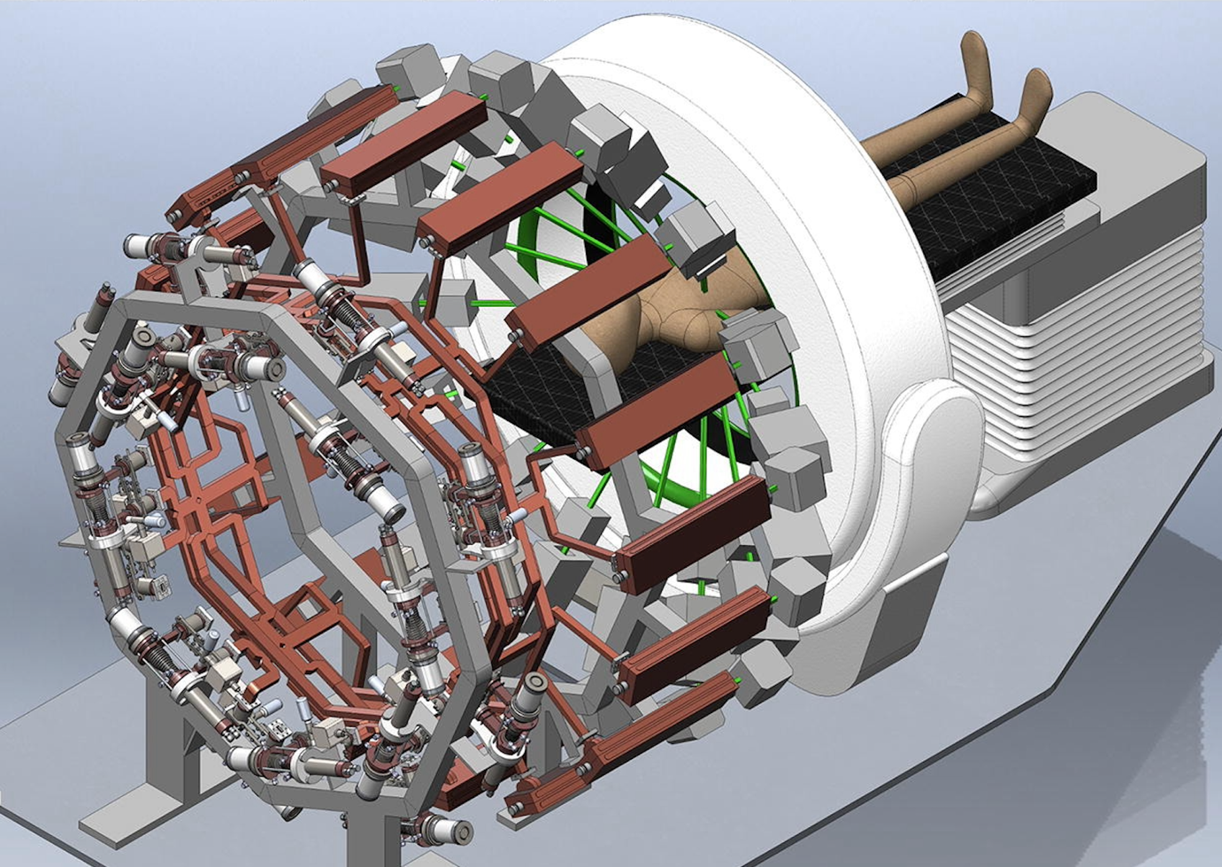
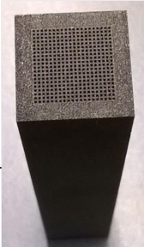
PHASER Project
A team from Stanford/SLAC has proposed the Pluridirectional High-energy Agile Scanning Electronic Radiotherapy (PHASER) concept
To deliver X-rays at FLASH dose rates, 16 linacs are arranged around the patient
  10 MeV, 300 mA peak, 1.5 mA average
Power from 16 klystrons are combined and transmitted to each linac in sequence with a special waveguide network
To achieve intensity modulation, the beam is quickly scanned over an X-ray converter/collimator array
Also considering adapting this approach for very high energy electrons (VHEE).
P.G. Maxim et al. / Radiotherapy and Oncology 139 (2019) 28–33

Slide 20
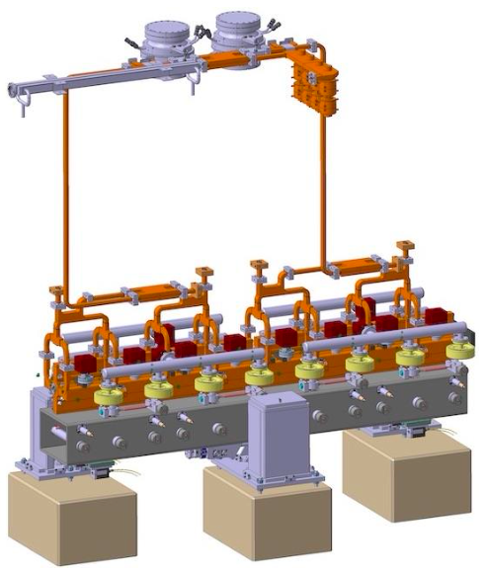
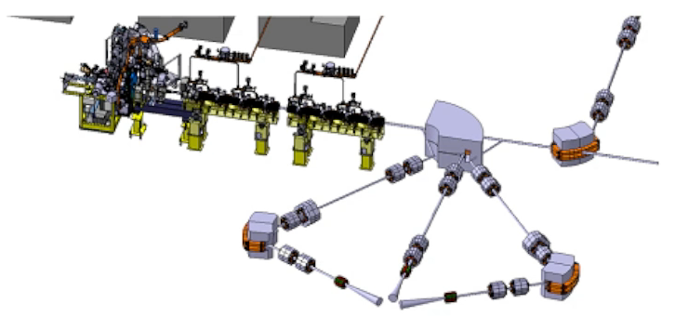
DEFT Project
CHUV (Lausanne) and CERN have begun to develop an approach to VHEE FLASH called Deep Electron FLASH Therapy (DEFT)
160 MeV using 2 m of high-gradient X-band linacs, leveraging CLIC technology
Multiple beam angles to patient provided by energy modulation + dipole magnets
W. Wuensch, KT Seminar, 26 April 2021. https://indico.cern.ch/event/975980/

Slide 21
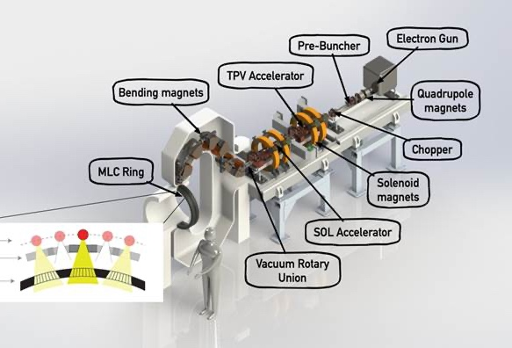
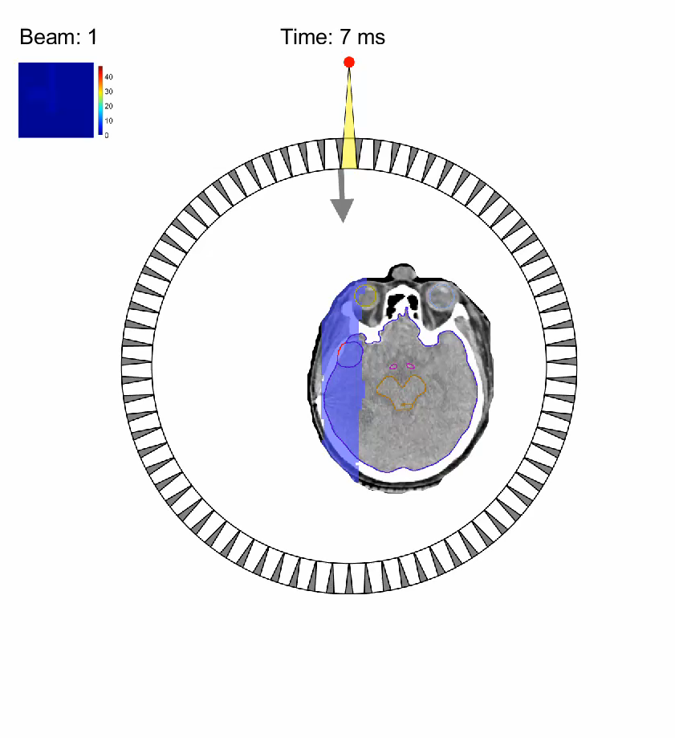
ROAD Project
RadiaBeam with UCLA are working to design and build a single linac solution based on a ROtational direct Aperture optimization with a Decoupled (ROAD) multi-leaf collimator (MLC) ring
The linac pulses are timed to align with a counter-rotating ring of 75 pre-shaped MLC apertures. As both the linac and MLC ring rotate in opposite directions at 60 rpm, 150 modulated beams are delivered in 1 s, with each delivering up to 0.67 Gy to the tumor*
*The goal of this project is to study the parameters for X-ray delivery that result in the best combination of FLASH effect
Lyu, Q. et al, Phys. Med. Biol. 66(3), 035020 (2021)
Notes:
At the same time RadiaBeam and UCLA are working on the design of a single linac solution based on a ROtational direct Aperture optimization with a Decoupled multi-leaf collimator) ring
In this project, called ROAD, the linac pulses are timed to align with a counter-rotating ring of 75 pre-shaped multi-leaf collimator apertures.
As both the linac and multi-leaf collimator ring rotate in opposite directions at 60 rpm, 150 modulated beams are delivered in 1 s, with each delivering up to 0.67 Gy to the tumor

Slide 22
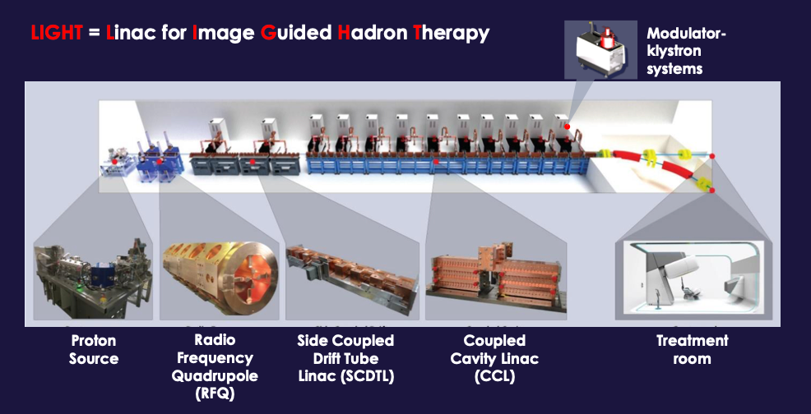
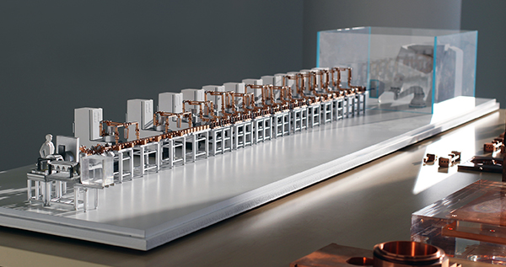
LIGHT Project
Advanced Oncotherapy and ADAM (CERN spinoff) have developed the LIGHT system for proton therapy
230 MeV in ~24 m of linac, 3 GHz RF power provided by common 7.5 MW klystrons
  230 MeV beam has been demonstrated
Also capable of FLASH delivery with spot scanning
A.M Kolano et al. Particle therapy co-operative group 58 (2019).
http://www.avoplc.com/Portals/0/adam/Newsroom/JT-G-yB62U6zzacNPeYGdg/Link/PTC58-0627.pdf
A. Degiovanni et al. NAPAC2016, https://cds.cern.ch/record/2314160/files/frb1io02.pdf

Slide 23
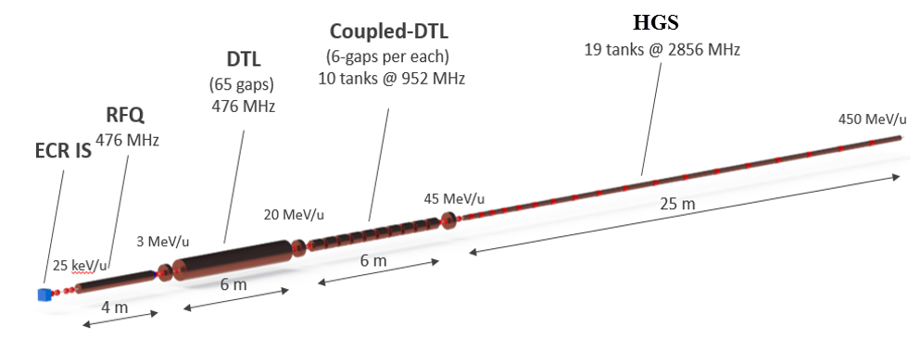
ACCIL Project
The Advanced Compact Carbon high gradient Ion Linac (ACCIL) is being developed by a collaboration of Argonne National Laboratory and RadiaBeam Systems
ACCIL must provide 1 GV accelerating voltage in a 45m footprint
To achieve this footprint, ~35 MV/m real-estate gradients and 50 MV/m accelerating gradients are required.
The project goal is to develop 50 MV/m structures for β=0.3-0.7
Capable of accelerating a variety of ion species, proton to neon, up to an energy of 450 MeV per nucleon
Pulse-to-pulse energy modulation
Intensity modulation at the source or by changing the pulse rep. rate
Fast ion beam switching possible from different ion sources in the front-end
Fast and effective variable energy intensity-modulated multi-ion beam therapy is possible with ACCIL
In addition to particle therapy, radiobiology research, imaging R&D and other applications are possible
P. Ostroumov et al., Compact Carbon Ion Linac, Proc. NAPAC-2016
Notes:
ACCIL, which stands for An Advanced Compact Carbon high gradient Ion Linac is being developed by collaboration of Argonne National Laboratory and RadiaBeam
ACCIL is designed to provide 1 GV accelerating voltage in a 45m footprint
To achieve this footprint, the real-estate gradients of ~35 MV/m and 50 MV/m accelerating gradients are required, which is about 5 to 10 times higher than the gradients achieved in the conventional drift-tube linac (DTL) or coupled DTL structures/
Therefore, one of the most critical project goals is to develop 50 MV/m structures for low energy ions.

Slide 24
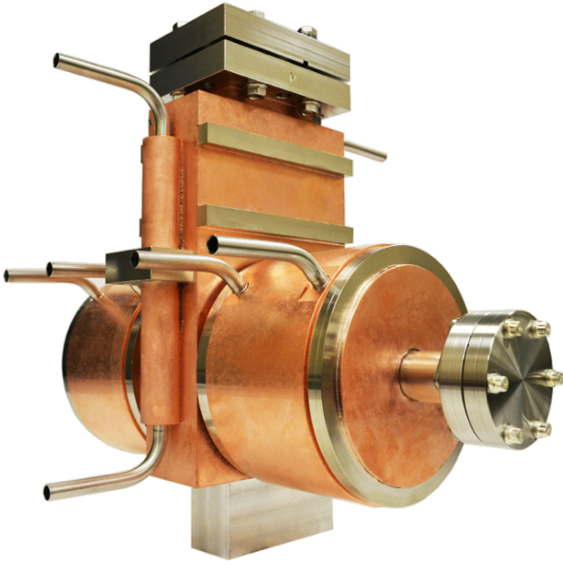
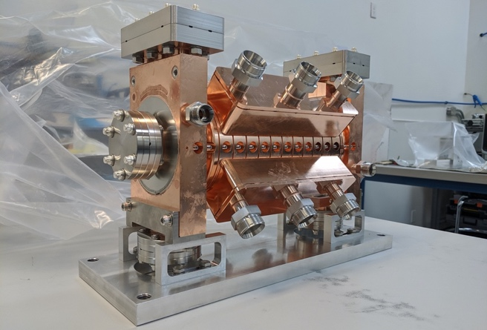
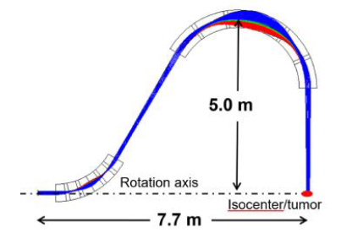
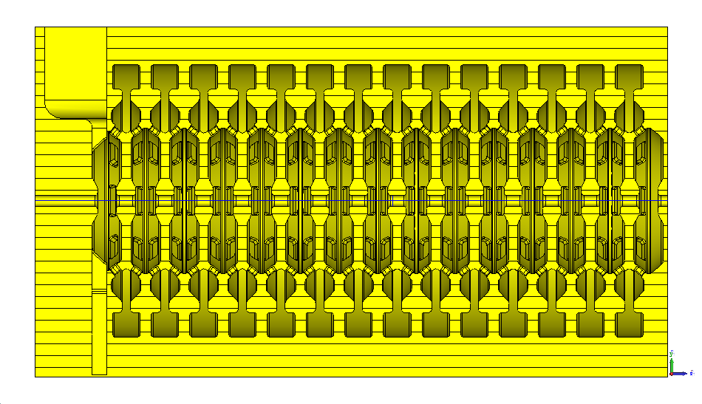
ACCIL R&D activities
Development of high-β 50 MV/m CCL structure
  Developed and built by RadiaBeam, tested at Argonne in 2016
Negative Harmonic Structure for β=0.3
  Developed and built by RadiaBeam, tested at Argonne in 2021
Negative Harmonic Structure for β=0.3 at 1000 Hz rep. rate
  Under development at RadiaBeam (due 2023)
Annular Coupled Structure for β=0.4
  Under development at Argonne
Compact Ion Beam Scanner & SC Gantry
  Under development at Argonne
L. Faillace at HG’2013 workshop
S. Kutsaev at HG’2016 workshop
S.V. Kutsaev et al, IEEE Trans. Microw. Wirel. Comp. Lett., 2021
B. Mustapha et al, NAPAC-19.
S. Ishmael et al, ASC-2016
Conference, Denver, Co
Notes:
Currently, this project is in R&D stage and consists of several smaller sub-projects, each solving its own critical problem.
For example, the high-gradient accelerating structure for fast particles with the energies of ~150 MeV and higher was developed by RadiaBeam and tested at Argonne 5 years ago
Low-beta negative harmonic structure for slow particles from 50 to 100 MeV has just been tested at Argonne this year.
The other developments include a structure for intermediate energies, compact beam scanners and gantries, which are also being developed at Argonne.

Slide 25

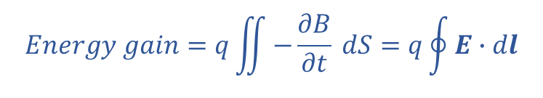
High current linear induction accelerators (LIAs) use magnetic induction to accelerate particles
$$Energy gain=q\iint{−\frac{∂B}{∂t} dS}=q\oint{E∙dl}$$
From Faraday’s Law:
E
D
Magnetic core
Accelerator “cell” boundary
Electric field develops here
B
A
B
C
Beam
Induction loop
Modulator
Modulator
Modulator
2-3 kA electron beam currents typical
Can accelerate multiple beams in the same structure for conformal therapy
Technique can be used to accelerate ions or electrons – LBNL demonstrated heavy ions for fusion
More free parameters are available to suppress wake field effects

Slide 26
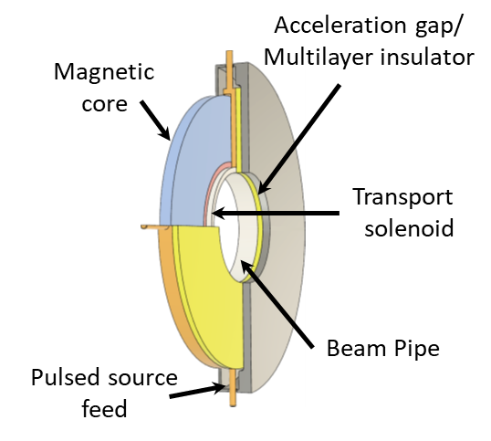
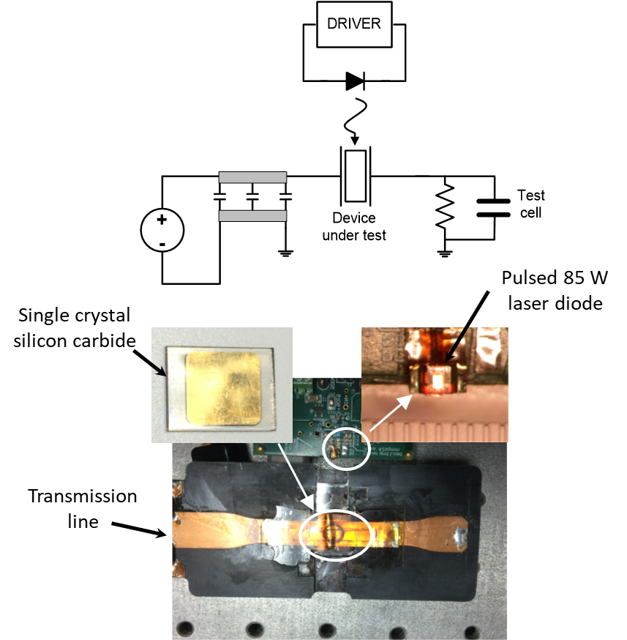

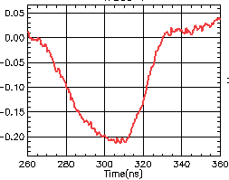
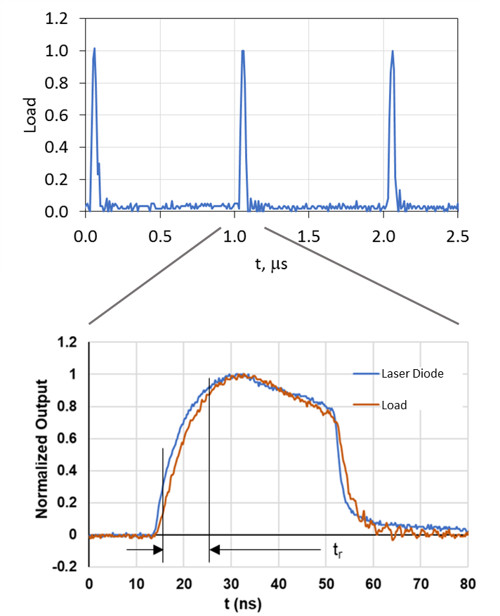
We are developing a compact induction linac for high current electron beams at 1 MHz pulse rate
Cell Development (LLNL) - Goal 5 MV/m for multi-kA electron beams
Modulator Development - Silicon carbide photoconductive high voltage switching demonstrated >1 MHz repetition rates⁺
MV
Accelerator voltage pulse
MHz, short pulse operation has been demonstrated using compact laser diodes
⁺Patent No. 9,748,859

Slide 27
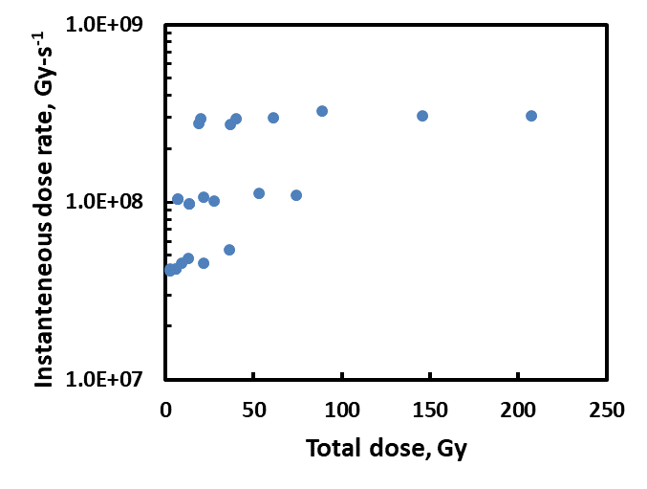

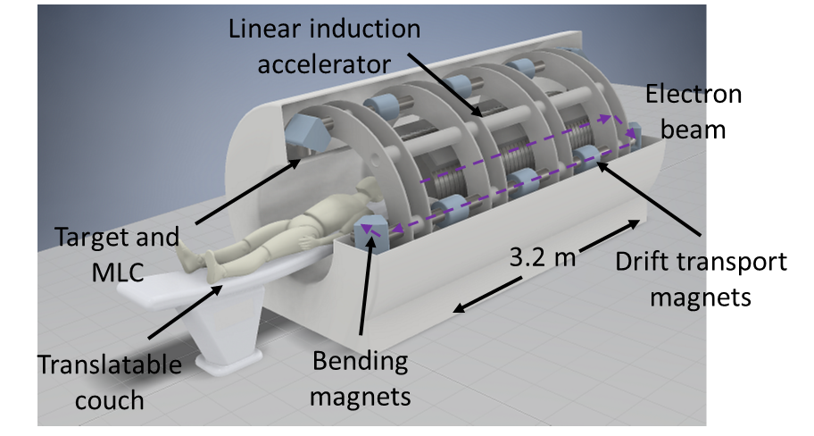
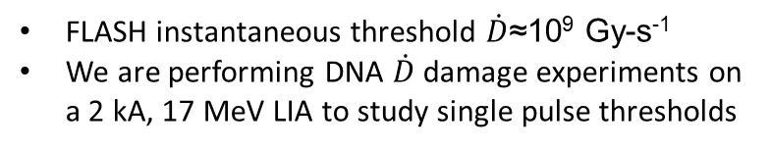
In vitro DNA FLASH tests define the accelerator design; a notional multi-beam LIA system design has been completed
DNA samples
Berry, 1966*- FLASH Threshold
Present parameter space @ 17 MeV, 2kA
FLASH instantaneous threshold $\dot{D}$≈10⁹ Gy-s⁻¹
We are performing DNA $\dot{D}$damage experiments on a 2 kA, 17 MeV LIA to study single pulse thresholds
*doi/10.1259/0007-1285-42-494-102
Notional multi-pulse system⁺
⁺Patent No. 11,697,032

Slide 28
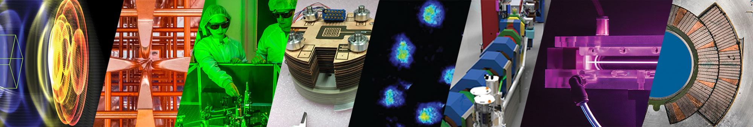



Laser-Driven Proton Sources for Preclinical Radiobiological Studies in the ultra-high dose rate regime
L. Obst-Huebl, Antoine Snijders, K. Nakamura, J. van Tilborg, C. B. Schroeder, C. G. R. Geddes, E. Esarey
09/11/2023
This work was supported by the Laboratory Directed Research and Development (LDRD) funding from LBNL provided by the
Director, the U.S. Department of Energy Office of Science Offices of High Energy Physics and Fusion
Energy Sciences, under Contract No. DE-AC02-05CH11231, and the LaserNetUS

Slide 29
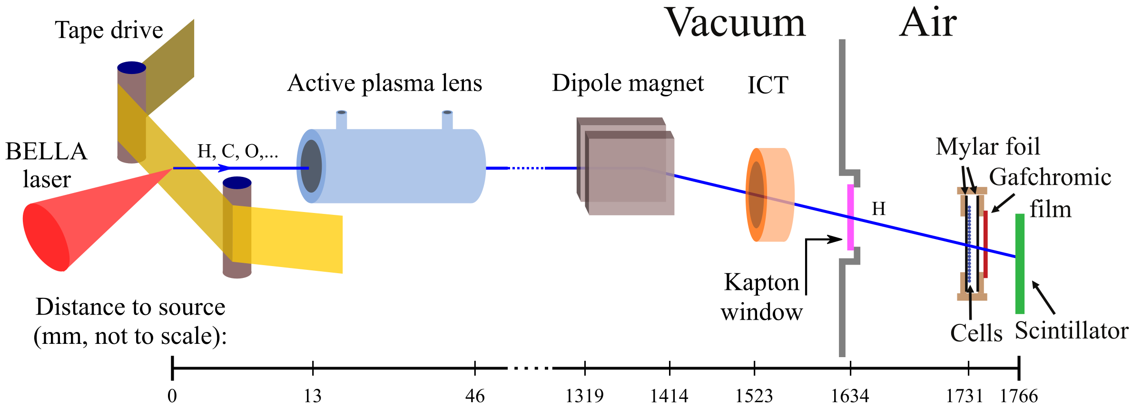
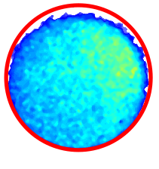
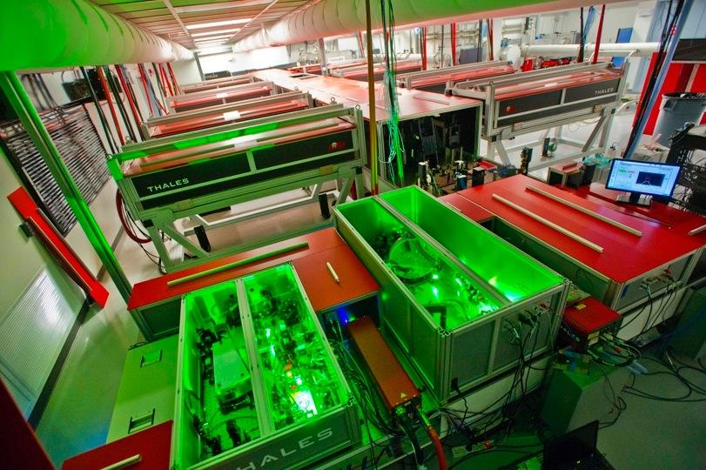
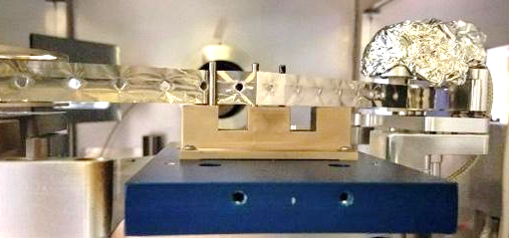
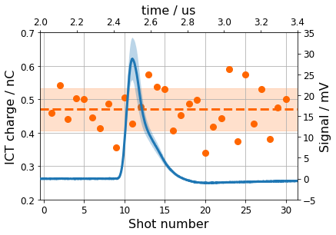
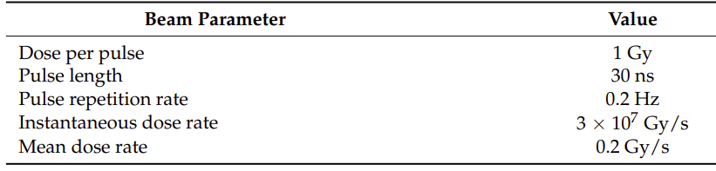
Cell samples were irradiated with laser-driven protons bunches of large energy spread and ultra-high instantaneous dose rate generated at the BELLA PW
BELLA PW laser
1 cm
Dose on cells:
1 Gy per shot
Protons, ions
35 J, 45 fs
Protons
Tape drive target
Online dosimetry
ICT charge / nC
Signal / mV
S. Steinke et al., PRAB 23, 021302 (2020).
J. H. Bin et al., Sci. Rep. 12, 1484 (2022)
L. Geulig et al., Rev. Sci. Instruments 93 (2022) 103301.

Slide 30
Commercial Accelerator Design Objectives
GOAL: To produce 150 – 250 MeV electrons in a compact accelerator format
Compact requirements
  An accelerator footprint compatible with conventional photon radiotherapy linac vaults
    Replace aging 10-20 MeV electron linacs without civil modifications to existing buildings and infrastructure systems
  Rapid pencil-beam scanning ?
    what level of conformality needed for FLASH
Operational and Beam specifications
  CW/pulsed beam for either conventional RT/FLASH
    Peak current as high as 50 mA;
    100-400 Hz pulsed or CW mode (injector accelerator)
    Potentially multiple linac stations: low-current/high current
  High, >90% machine reliability
    Turnkey or least low overhead operation
    Normal conducting for reliability, high currents
    Fixed magnet fields – as in a linac/ cyclotron
Shielding and Radiation Environment
  Reduction in shielding and radiation environment and beam intensity requirements (no secondary photon beam)
    3’ or more reduction in shield walls

Slide 31
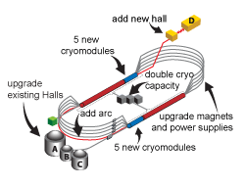
Evolution of Recirculating Electron AcceleratorsHybrid From microtron to a single-arc, fixed-field, CW recirculating Linear Accelerator – jump RF buckets
Electron Microtron: 10-75 MeV
  Single linac structure; multiple/integer # of RF wavelengths in return paths
  Single return arc: spectrometer magnet for precision pathlength control per energy
  Weak-focusing magnets; ultra-small beam emittances – no envelope control
CEBAF – Continuous Recirculating Linear Accelerator (RLA): multi-GeV
  Multiple return arcs – each energy has a separate return arc
    Strong-focusing, chromatically matched optics and independent integer RF pathlengths
CBETA – Energy Recovery Linear Accelerator (ERL): 6-150 MeV
  Single linac, single strong-focusing FFA arc, 4 acceleration turns
    SRF and Permanent magnet – long arcs, but small apetures quad gradients
Miniaturize CBETA: 10 MeV – 200 MeV
  Increase # linacs, for 15-20 acceleration turns (no SRF)
    Fixed-field Gradient electromagnets, 1T peak B fields
    Nonlinear field gradient
    Chromatic correction, matched optics, pathlength control
    Large beam emittances and high instantaneous currents
75 MeV microtron
CEBAF
10 m
Compact CBeta
CBETA

Slide 32
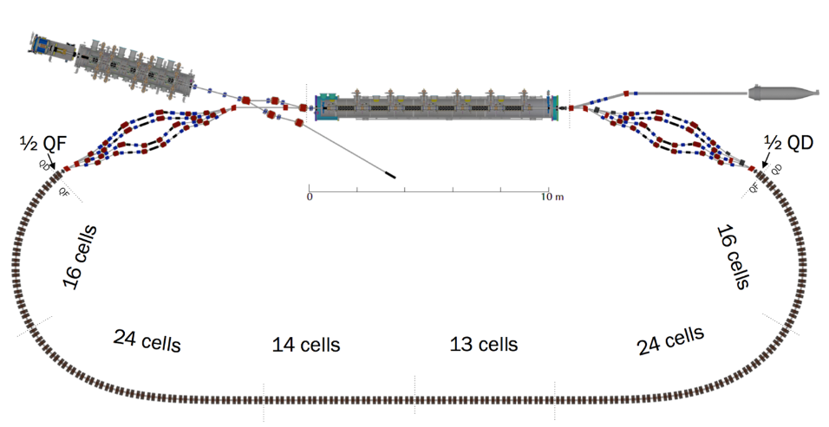
A High-Energy 10-200-MeV RLA
RLA racetrack – Miniaturizing 6-150 MeV, 4-acceleration turn electron CBETA eRLA
Opposing phased linacs and electromagnetic CF sector-magnet arcs:
  Replace permanent magnets with 1T (peak field) long electromagnets (~ sector magnets like a separated-sector cyclotron)
  Nonlinear gradient magnets, provide chromatic correction, match beam envelopes and adjust pathlengths
    Nonlinear radial gradients → 15-20 turns
Linac
2.5 m
Linac
6.5 m

Slide 33
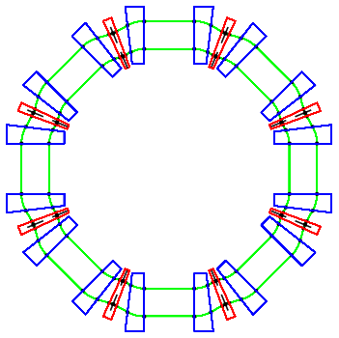
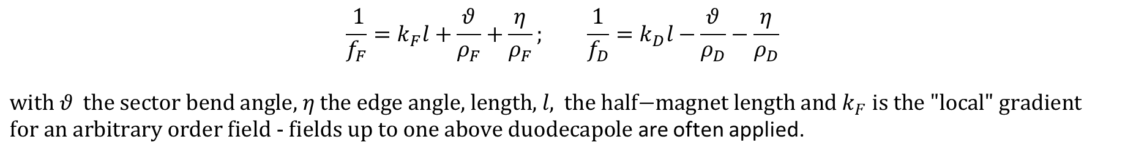
Fixed Field Compact Isochronous Accelerators
GOAL: To produce 150 – 250 MeV electrons in a compact accelerator format
synchrotron
cyclotron
$$\frac{ 1}{f_{F}}=k_{F}l+\frac{θ}{ρ_{F}}+\frac{η}{ρ_{F}}; \frac{1}{f_{D}}=k_{D}l−\frac{θ}{ρ_{D}}−\frac{η}{ρ_{D}}$$
$\text{with} θ \text{the} \text{sector} \text{bend} \text{angle}\text{, }η \text{the} \text{edge} \text{angle}\text{, }\text{length}\text{, }l\text{, }\text{the} \text{half}\text{−}\text{magnet} \text{length} \text{and} k_{F} \text{is} \text{the}\text{ "}\text{local}\text{" }\text{gradient} \text{for} \text{an} \text{arbitrary} \text{order} \text{field}\text{ - }\text{fields} \text{up} \text{to} \text{one} \text{above} \text{duodecapole}$ are often applied.
Compact requirements
  Min emittance lattice is the most compact lattice aperture-wise
    FODO cell with the dipole component combined/around with the D focusing quadrupole
    Produces the minimum dispersion (shortest F quad focal length) – there is an IPAC paper with this derivation
    A long drift is inserted at the centerline of the F quad which does not ~impact dispersion
  Nonscaling FFA lattices
    Linear gradient lattices are quasi -isochronous over a factor of 4 in dp/p without RF bucket jumping
    Nonlinear gradient lattices over much larger factors in dp/p - need RF bucket jumping
      Each individual energy orbit, however, maintains min dispersion with bucket jumping. for FLASH

Slide 34
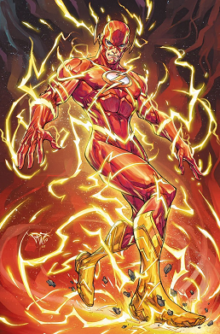
FLASH – a groundbreaking modality in cancer treatment
FLASH targets radiobiology of tumors not healthy tissue
Enhanced protection of normal tissue, reduced side effects
  Many beam delivery questions
FLASH requires state-of the art Accelerator Technologies
  Proton and Ion Synchrotrons cannot produce clinical FLASH beams
    Synchrotrons are not participating in FLASH preclinical trials
  Cyclotrons and clinical electron linacs highly limited for FLASH R&D
    Clinical linac electron beams cannot penetrate >few cm
    FLASH requires ultra-high, instantaneous intensity continuous beams
    Only (230-250 MeV shoot-through) CW proton beams achieve FLASH intensities (iso-cyclotrons, no energy degrader)
  FLASH IS IN THE PRE & CLINCAL TRIAL STAGE for specific cancers

Slide 35
Thank you!
A special thanks to my co-authors, especially Reinhard Schulte for his patience in listening to this talk repeatedly and all the impressive researchers and pioneers in understanding and bringing the FLASH effect to the clinical stage

Slide 36
4TeV Muon Collider Isochronous Storage Ring Lattice after all a muon is just a heavy electron
sextupoles
The variation of the momentum compaction factor versus , shown in Figure 8.9, is too large to preserve short bunches with a moderate rf voltage.
Arc module which cancels lowest order momentum compaction term
Over the desired momentum range of ±004, Δp/p, α exceeds 10⁻⁵ - α1 = 0, and α2 = 0.006 leading to an unacceptable longitudinal head-tail instability. Since α2 has a contribution from each sextupole of −2SD3; where S is the strength and D is the dispersion in the sextupole, it is possible to correct α2 with one or more sextupole families. Inserting a horiz. sextupole next to the central F quadrupoles in the arc, the α₂ term can be eliminated. Further, their sextupole contribution to α₃ is eliminated by pairing sextupoles ~π phase apart – controlling α₂ and α₃ to a precision of 10⁻⁷.

