Slide 1


302.3 RFD Dressed Crab Cavities
Leonardo Ristori – Fermilab
L2 Manager – RFD Dressed Crab Cavities Fabrication
PMG #56 – 21st November 2023

Slide 2
Outline
8 Months in Summary
Prototype Cold-Tests at Fermilab/JLab
Cavities & Helium Tanks Fabrication at Zanon
HOM Dampers Fabrication at JLab
Schedule & Delivery Dates

Slide 3
8 Months in Summary
Approval received for temporary import exemption of Niobium providing savings of ~$500k; material shipped to Zanon (April 2023).
Started fabrication of series cavities at Zanon (May 2023).
Prototype bare cavity + HOMs exceeded acceptance requirements at JLab after multiple issues were encountered and solved (August 2023).
Placed purchase order for series magnetic shields and helium tanks. This was the last contract with suppliers needed to cover the RFD scope (Oct 2023).
Completed fabrication of 2 Pre-Series bare cavities at Zanon. Shape accuracy improved compared to prototypes (Nov 2023).
Open issues/risks:
Failed qualifications of pre-series HOMs ceramics.
Although very likely due to pre-existing issues, the qualification of Zanon processing failed in cold-tests at Fermilab and JLab.
Jacketing activities and shipping of dressed cavity not yet validated.

Slide 4
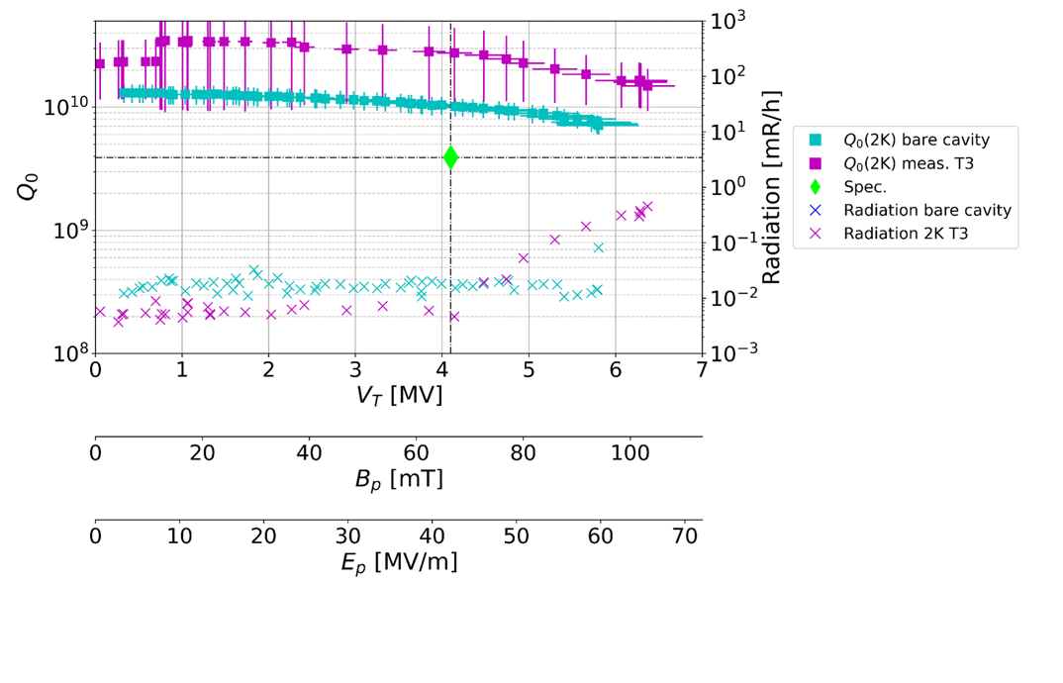
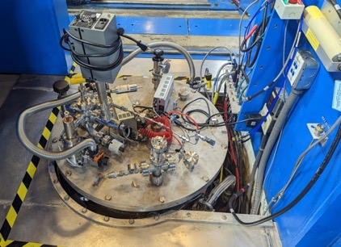
Proto Bare Cavity NRFDP002 + HOM Dampers
A. Castilla - JLab
Multiple tests at Jlab this year hindered by challenges with leaks and RF losses at the HOM interfaces.
Collaborative effort, progressive understanding and implementation of measures, culminated finally in a successful test in August.
Apparent increase in performance still to be explained, likely due to different calibration at the facilities. Important aspect to be understood in view of acceptance.

Slide 5
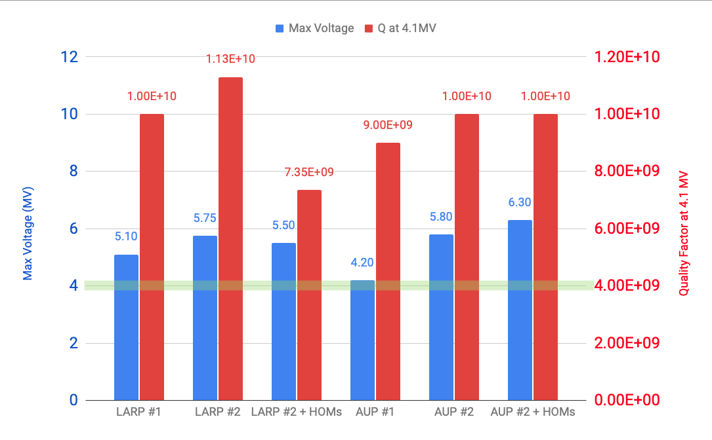
LARP + AUP Cold Test Summary
Acceptance
2017 - 2019
28 Nov 2018
21 Apr 2021
25 Aug 2021
17 Aug 2023

Slide 6
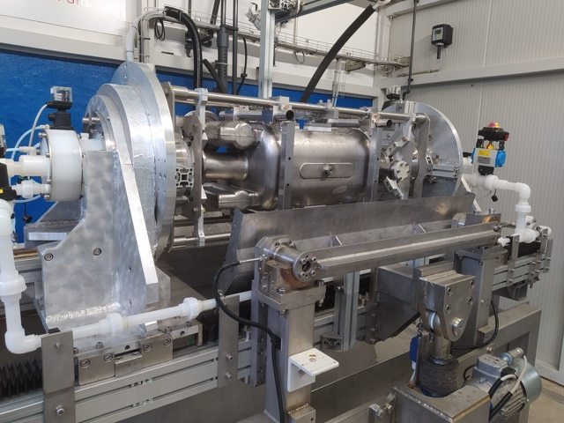
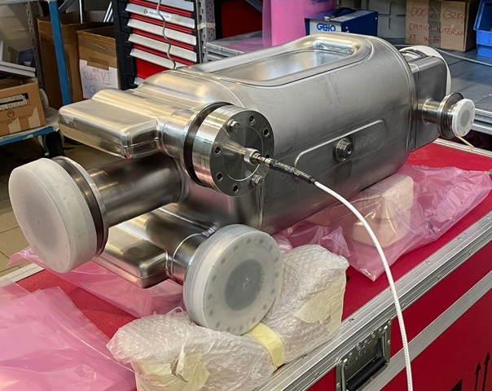
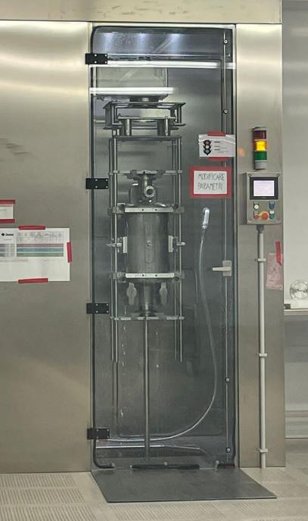
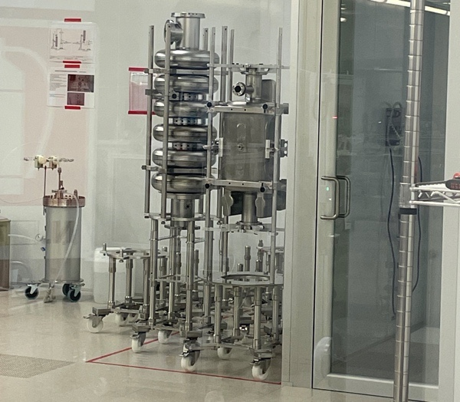
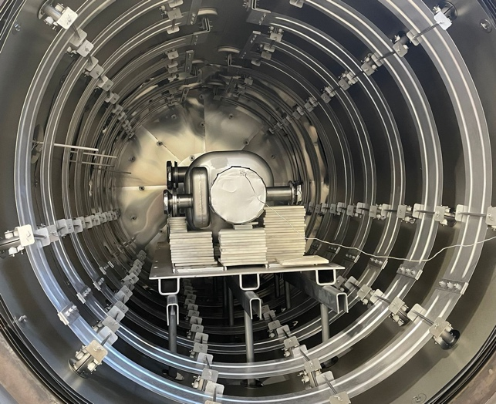
Prototypes Processing at Zanon
M. Narduzzi - FNAL
Prototype #1: Previously processed and prepared at ANL/FNAL, reached 4.2 MV with Q₀ 9E9, not stellar, possibly limited by surface defect or inclusion.
Went through full processing cycle at Zanon using rotating BCP, HPR, 600C, 120C
Courtesy of ZRI (confidential)
Notes:
Aggiungi dettagli processing

Slide 7
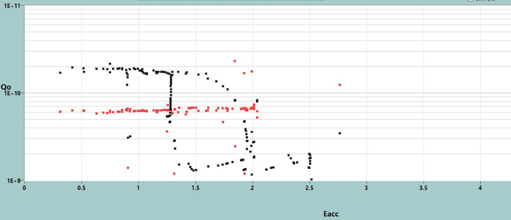
Proto Bare Cavity NRFDP001
Tested at FNAL. Low-field Q₀ was high, but unable to surpass ~50% of acceptance level (top right).
Moved to JLAB, evacuated again, 120C bake + RGA.
Tested at JLAB, essentially confirming results (bottom right).
Currently undergoing internal inspection at JLAB to develop a plan forward (HPR/BCP?).
NOTE: We had observed this type of degradation in LARP, and we were able to restore by repeating bulk processing a 3rd time.
Low-field Q₀ is excellent
9/13/23 - FNAL
E_{acc} ~ 50% of acceptance
A. Netepenko
10/31/23 - JLAB
A. Castilla

Slide 8
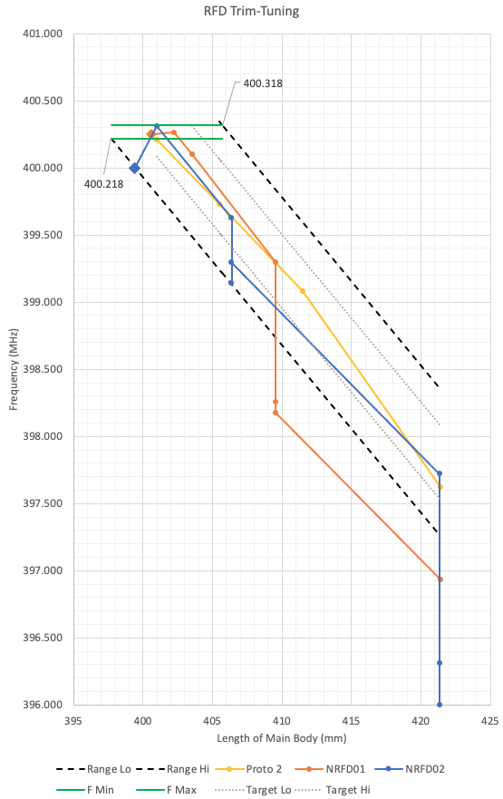
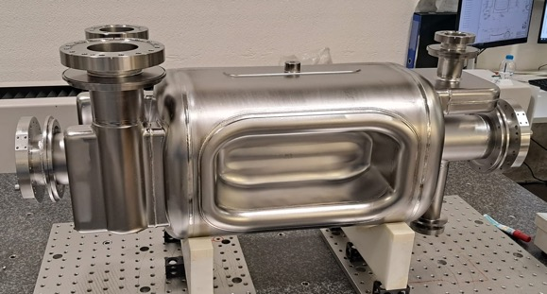
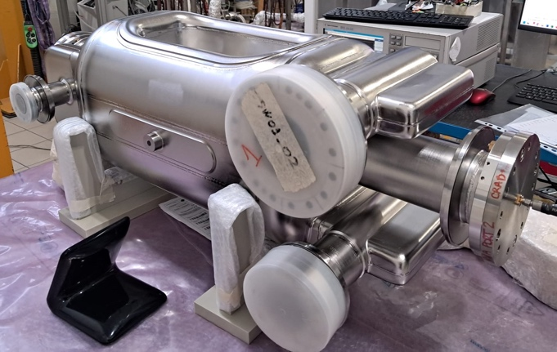

Pre-series Cavities at Zanon
Trim-Tuning + Welding Activities
Final Welds
Acceptable Frequency range
NRFD02
NRFD01
Both pre-series cavities completed at Zanon
NRFD02 (blue plot): Unexpected downward shift during final weld. Reshaping tool now ready, frequency adjustment imminent.
NRFD01 (orange plot): Knife-edge repairs successful. Fabrication completed last week; frequency achieved!
Cavities are expected to arrive at FNAL ready for testing in January-February.
L. Ristori - FNAL

Slide 9
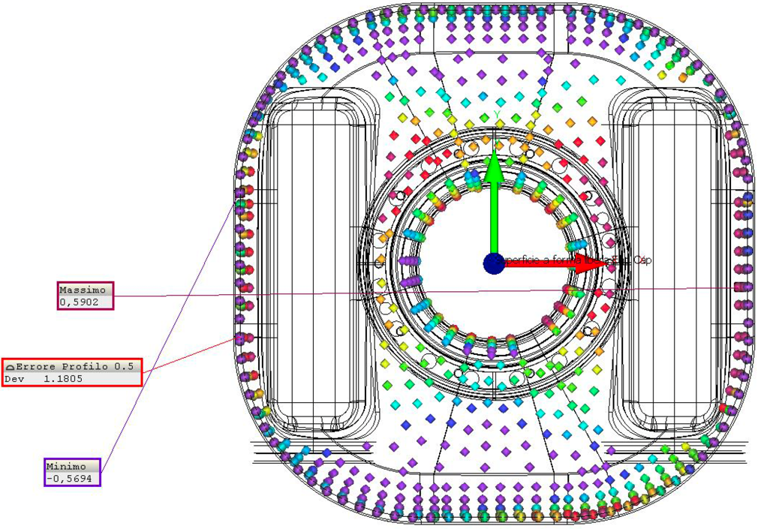
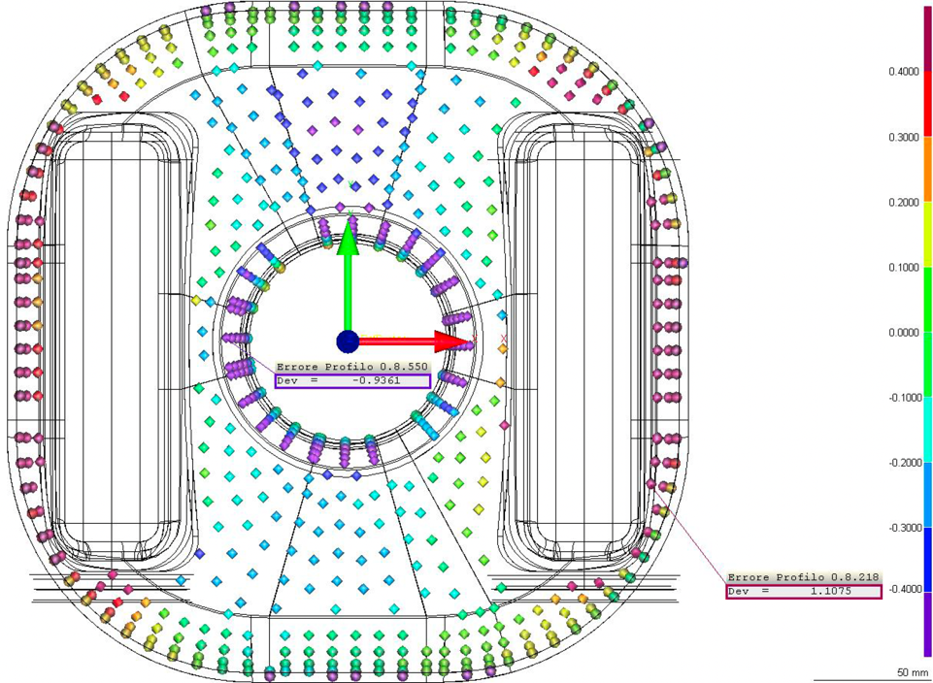
Pre-series vs Prototypes Metrology:
V-HOM End Group
M. Narduzzi - FNAL
Pre-series V-HOM End Group
{+/-0.25mm scale}
Prototype V-HOM End Group
{+/-0.4mm scale}
Several improvements in manufacturing have been implemented by ZRI:
  Forming tooling slightly reworked.
  EBW and CNC fixtures updated.
Significant improvement in shape accuracy from 2.22mm to +1.18mm.

Slide 10
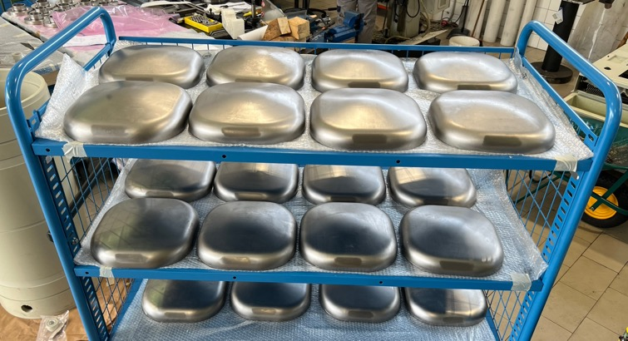
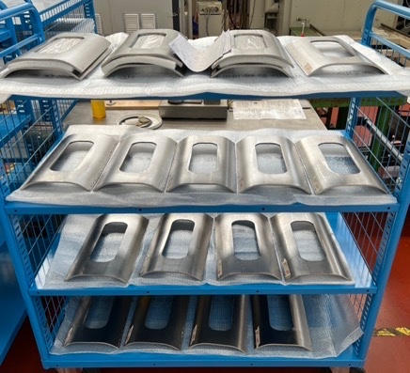
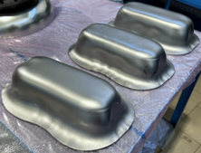
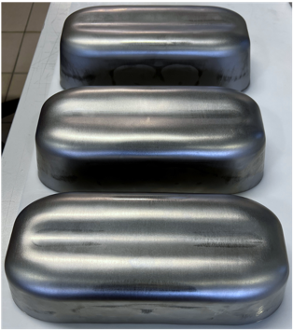
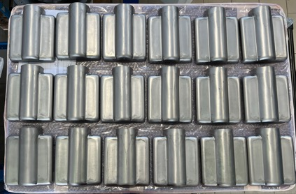
RFD Series manufacturing at ZRI
M. Narduzzi - FNAL
Series cavity fabrication in full swing, progressing not without surprises, with NCRs being managed successfully.
Raw materials yield within estimates despite having to discard 6 poles due to residual issues with forming.
Zanon will perform all processing and clean room assemblies to deliver cavities in test-ready conditions at Fermilab.
End-Caps
Pole Corners
Residual issues with pole-forming, discarded ~30% of parts.
Acceptable deflecting poles
Waveguide Boxes

Slide 11
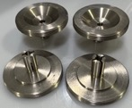
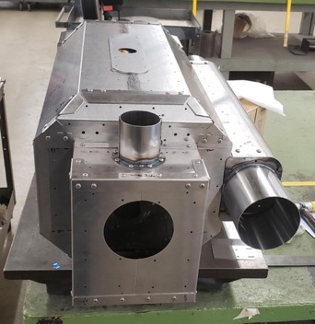
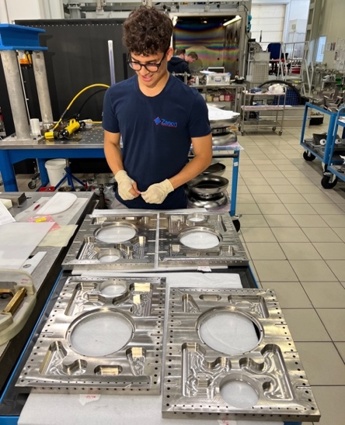

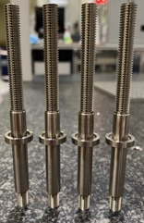
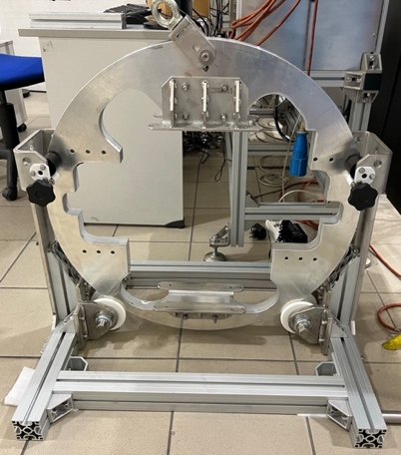
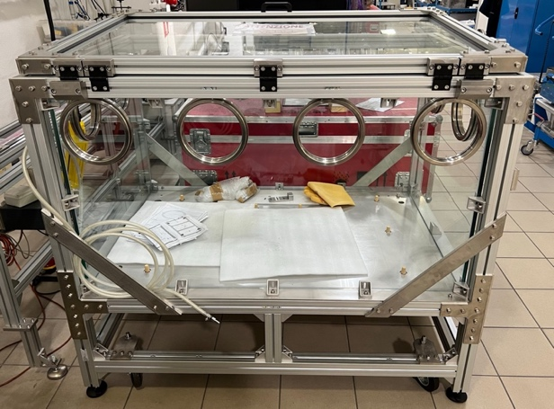
Jacketing (Magnetic Shields + Helium Tanks)
Purchase Orders for prototypes, pre-series, and series are all in place.
Integration activities started at Zanon on Proto #2. Currently machining interface adapter rings.
Glove box and rotational tool are completed. Welding staff is dedicated exclusively to AUP.
Jacketed cavities will be shipped to JLab for cold tests with HOM dampers.
JLab will perform final HPR, installation of HOMs and cold-tests.
Shipment to TRIUMF will be done using CERN shipping frames.
Helium Tank components at Zanon
Tooling and Glove-Box at Zanon

Slide 12
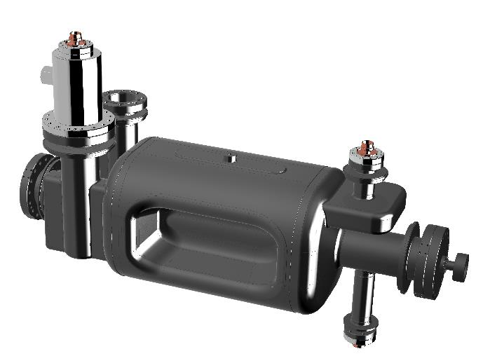
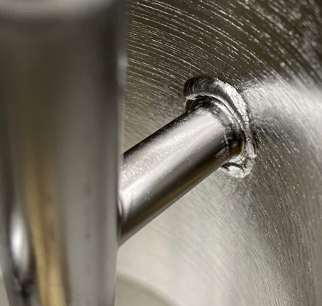
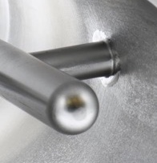
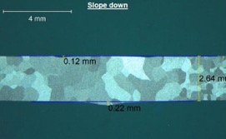
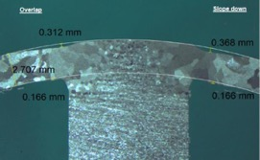
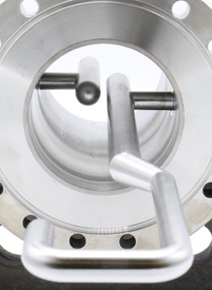
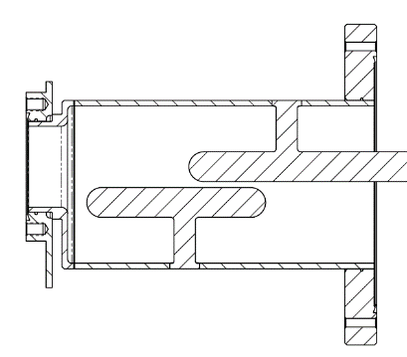

HOMs Fabrication at JLab
N. Huque - JLab
Prototypes
Pre-Series
PRR held in May 2022
Prototype: 3 sets (FY21/FY22) Complete (only 1 usable set)
Pre-Series: 3 sets (FY24)
Series: 8 sets (also FY24)
Tee
Visual Test
Penetrant Test
Radiographic Test
Metallographic Test
Bend Test
Tensile Test
Visual Test
Penetrant Test
Radiographic Test
Metallographic Test
Hook
Quality of Hook/Tee EBW are improved (top right).
The most critical dimensions are the gap and parallelism between the hook and tee (bottom right). Pre-Series deviations are smaller than prototypes, which passed simulations and RF check.

Slide 13
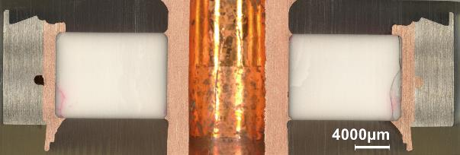
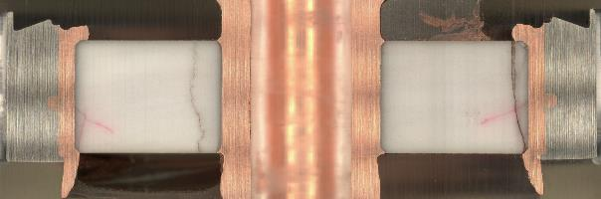
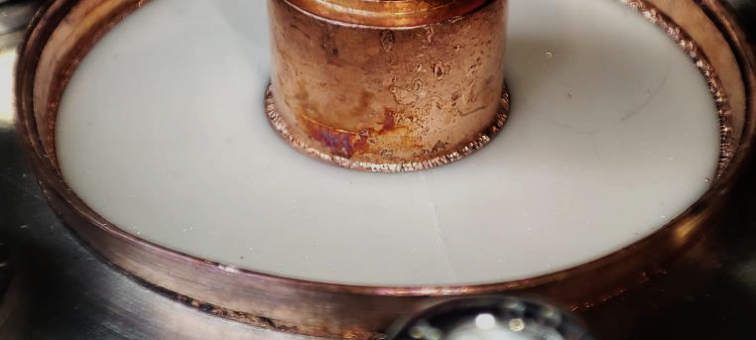
Failures of Ceramic Windows
N. Huque - JLab
First set of tests were carried out at CERN in February 2023. Parts held vacuum with no visible surface damage.
After sectioning, internal cracks were discovered. Observed both on JLab and CERN ceramics. Preexisting and caused by cutting.
Tests were repeated in August 2023. Worse results. Samples had radial cracks and this time during installation (bottom right).
JLab is fast-tracking one set based on integrity of prototypes, with additional measures implemented. Two additional sets will be made using CERN-provided ceramics.
ADDITIONALLY: CERN will provide 2 complete HOM sets + 4 ceramic sets as Parts Exchange items.
Liquid penetrant testing on sectioned ceramic windows
Surface fractures appearing during installation

Slide 14
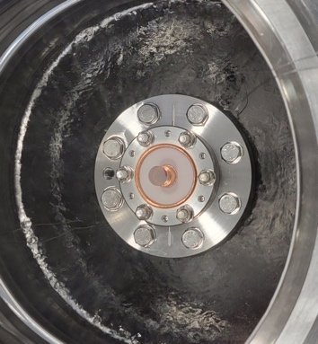
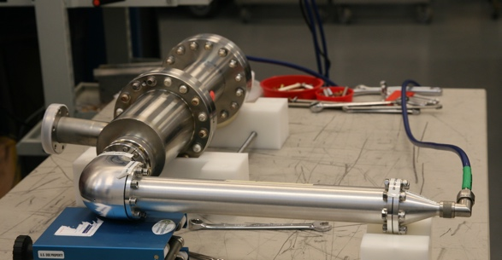
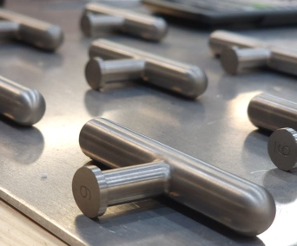
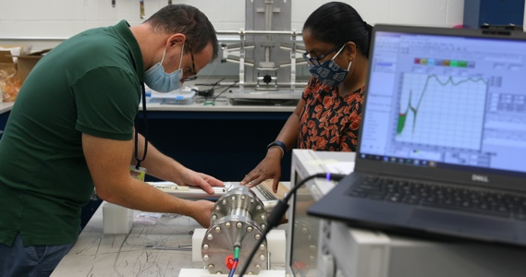
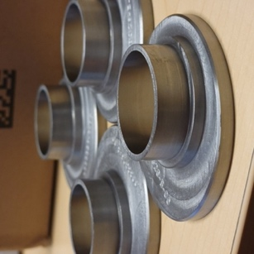
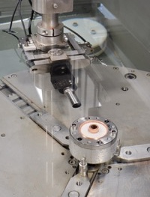
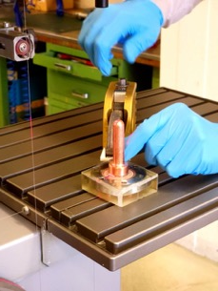
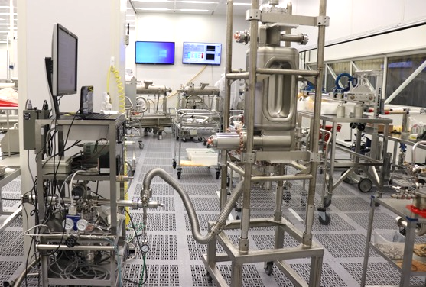
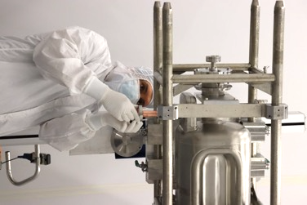
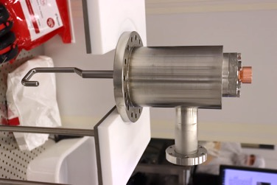
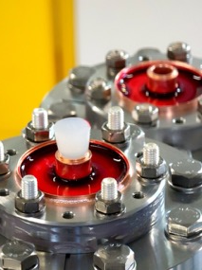
Activities at JLab
Thermal Shocks
RF Acceptance Measurements
Series Fabrication
Ultrasonic, Dimensional, Vacuum Inspections
Clean-Room Assembly

Slide 15
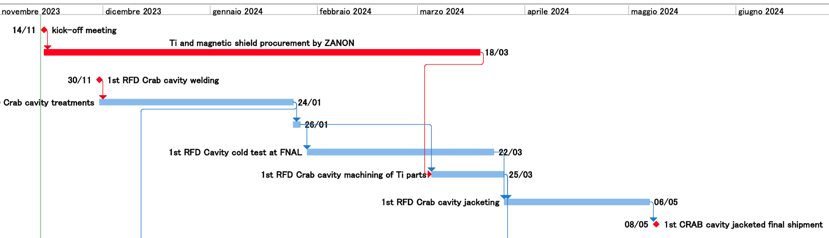
Integrated Schedule for 1st Cavity
PO placed, Kick-off meeting held, official schedule received.
Raw materials ordered by Zanon
2 months allotted for turnaround on cold-tests at Fermilab
Machining of interface Ti rings in parallel while cavity at Fermilab
1.5 months for jacketing at Zanon

Slide 16
Integrated Schedule for Cavities
Pre-Series
Feb 2025
Today
Series

Slide 17
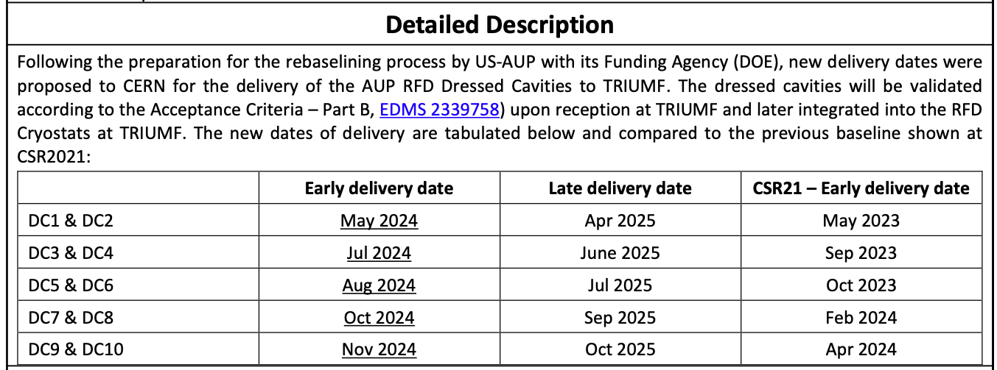
Rebaseline Delivery Dates
Dates in AUP Rebaseline were formally accepted by CERN (see EDMS 2781934)
Consistent with
AUP Rebaseline

Slide 18
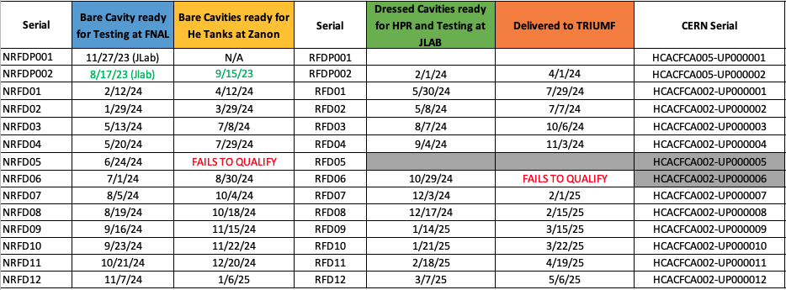
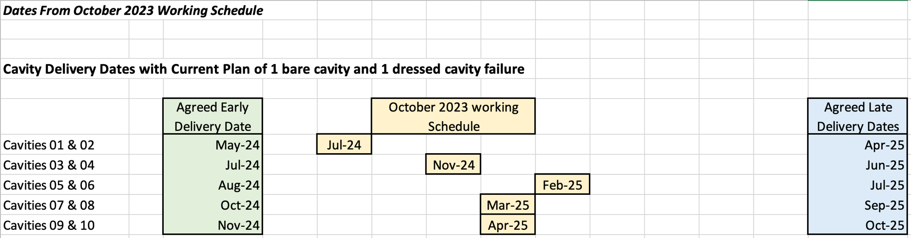
Delivery Dates
1 cell = 1 month

Slide 19
Summary
Successful cold test of prototype bare cavity with HOM dampers at JLab. Cavity is being jacketed.
HOM fabrication (pre-series + series) at JLab in full swing, with ceramic issues yet to be solved, and contingency plan launched.
Pre-Series cavities completed at Zanon with improved quality compared to prototypes. Cold tests ~ Jan-Feb 2024.
Series cavities reaching peak production without showstoppers.
PO placed for series helium tanks. Schedule officialized without surprises.
First jacketed prototype expected at JLab in ~ February 2024, and at TRIUMF ~ Spring 2024.
Deliveries of 10 cavities to TRIUMF: July 2024 - May 2025. With 5+ months of float.

