Slide 1
Computing Contributions Board
Preliminary Meeting
13 December 2023
CERN
Agenda: https://indico.fnal.gov/event/62210/
Pete Clarke & Mike Kirby / CCB / 13th Dec 2023 / CERN

Slide 2
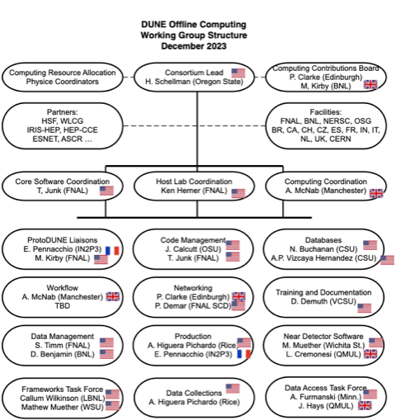
Computing Contributions Board

Slide 3
Computing Contributions Board
The CCB purpose
To receive reports and requests from DUNE computing management
To receive the annual DUNE computing capacity requirements
To satisfy capacity requirements through DUNE partners
To respond to any other requests in respect of computing resources from the computing management or DUNE management
To provide official expectation requests to national reps. where needed
To seek contributions of software engineering staff effort for the creation of the computing software infrastructure (NOT analysis);

Slide 4
Computing Contributions Board
The CCB composition:
Chair & Deputy
One national representative from each of the larger partner countries + FNAL + BNL+ CERN
Deemed to be able to report on and communicate with, all computing provision in their country
Have knowledge of, and connections to, the relevant national computing funding mechanisms
Observer status for all of the smaller partner countries
See notes below
Ex officio
DUNE Computing Management
Notes:
1. Larger partner countries are those with more than ~10 members in the DB, plus those who have a track record of large-scale computing and have indicated interest to contribute substantive resources.
Currently : USA, UK, FR, ES, CH, IT, NL, CZ, BR + FNAL, CERN then more recently CA, IN
2. Smaller partner countries are all other countries, generally those with <~10 members in DB (<1% of collabn.)
These are not expected to find computing resources yet, nor to staff CCB. They may choose to do so.
They will be kept informed. They can “upgrade” at any time. This is already the case for NL and CZ

Slide 5
Members ?
Please send me updates
Country | Rep | Alternate (not mandatory)
BR | Ernesto Kemp | Hélio da Motta
CA | Leslie Groer | Nikolina Ilic
CH | Michelle Webber
CZ | Petr Vokac
ES | Gonzalo Merino | Ines Gil Botella
FR | Elisabetta Pennacchio
IN | Nagaraj Panyam
IT | Marco Pallavicini | Sergio Bertolucci
NL | Jeff Templon | Paul De Jong
UK | Pete Clarke | Andrew McNab
USA | Steve Timm
FNAL | Ken Herner
BNL | Doug Benjamin | Mike Kirby
CERN | Xavier Espinal

Slide 6
CCB: Metrics and Practice
In long run DUNE needs a metric as proxy for the size of a partner nation
The most obvious would seem to be ~ M&O share
Based on PhD authors ?
In short term (next couple of years at least) this is not very useful or meaningful. Thus we will use:
Common sense
Soft expectation on countries (not formal MOU yet)
CCB will provide an official “expectation request” where country wants it
Ask for minimum sensible significant contributions from major proven data centres
In practice this will probably mean:
FNAL 25%
Other USA ~ 25%
CERN and other non-US LHC Tier1/2 sites each @ 5-20% level
[This will come to more than 100%]

Slide 7
Pragmatic suggestion for 2024
% are all in terms of official DUNE request as presented to CCB from time to time
FNAL
25% CPU, Disk
100% ? Tape (Custodial responsibility)
Non-USA partner Countries
Please provide a minimum of 5% of CPU and Disk (but no tape request at present)
If you are a large major LHC Tier-1 country please consider making this minimum of ~10%
All are free to provide more than this is they wish
CERN
CERN may choose to provide as it deems fit in the ProtoDUNE period
Some Tape
Other USA
25%
…discuss….

Slide 8
2023 outturn
 | Country |  | Total Pl. |  | Total Used |  | Ratio
 | BR |  | 200 |  | 36 |  | 0.18
 | CA |  | 360 |  | 23 |  | 0.06
 | CERN |  | 1500 |  | 134 |  | 0.09
 | CH |  | 200 |  | 3 |  | 0.02
 | CZ |  | 2400 |  | 92 |  | 0.04
 | ES |  | 512 |  | 44 |  | 0.09
 | FR |  | 320 |  | 58 |  | 0.18
 | IN |  | 450 |  | 41 |  | 0.09
 | IT |  |  |  | 3
 | NL |  | 514 |  | 228 |  | 0.44
 | UK |  | 1000 |  | 695 |  | 0.70
 | US |  | 1500 |  | 2793 |  | 1.86
 | Total |  | 8956 |  | 4150 |  | 0.46

