Slide 1
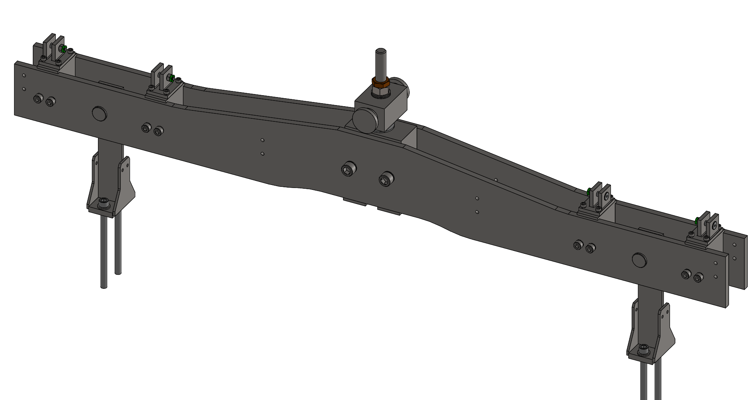
APA Yoke Engineering Change Requests
KDZ
December 4, 2023
APA TB

Slide 2
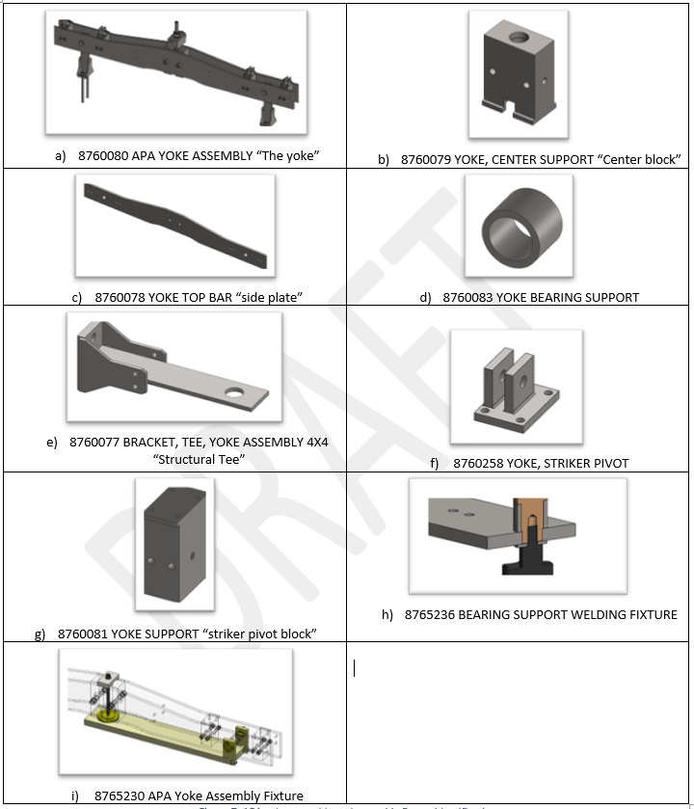
Introduction
As a reminder, we identified that the yoke assembly contributes to an unwanted increase in the APA Pair’s width envelope
Worst case “stackup” or “assembly shift”
The design and drawings are considered stable and mature with several assemblies having been produced and used for prototyping activities at Ash River and protoDUNEII
An assembly fixture used where APA yokes are produced is being designed which reduces the assembly shift
Places the yoke’s center block at a controlled distance from the pinholes.
Small improvements to the yoke assembly drawing and its component part drawings have been collected as the fixture has been developed.
Those things will be presented here

Slide 3
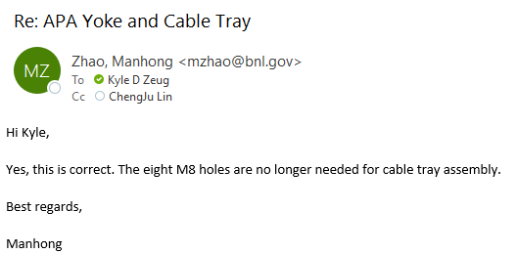
Remove M8 Tapped Holes from Side Plates
The yoke’s side plates used to accept brackets to support the CE cable tray. With the implementation of a cable tray that is supported by trolley wheels on the DSS the bracket mounting points can be removed.
Confirmation with the CE consortium engineering team is received which allows for the removal of the M8 tapped holes.
Parts affected: Side Plates (8760078)

Slide 4
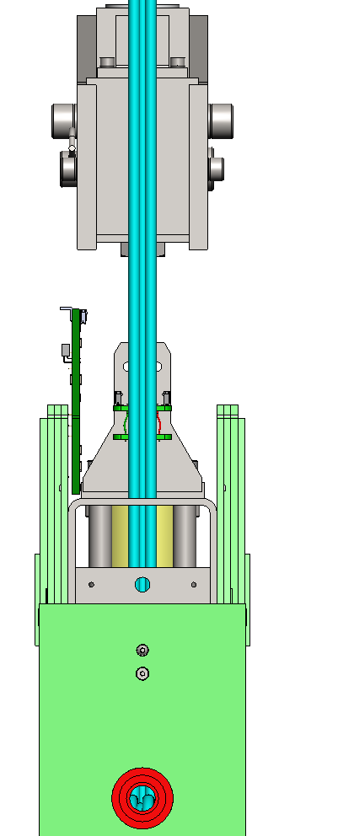
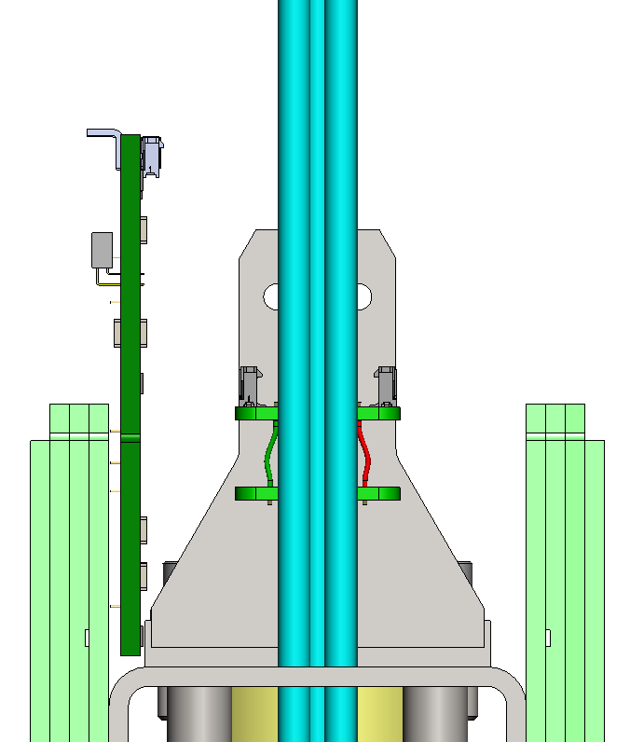
Reduce Baseplate Length of Structural Tees
Reduce the length of the base plate of the structural tees.
Base plate is the part of the weldment that touches the head tube. “Length” is measured left to right in the image
Note the limited space available to install a CR board. By reducing the length of the base plate (remove material shaded in red) an additional 1.5mm of clearance is made available.
While CR boards have been successfully installed for prototypes, not implementing the change puts components on the CR board (4 of 20) at risk of damage during installation.
H/T to Tom Wieber who once experienced challenges with installing CR boards and voiced his concern.
Parts affected: Structural Tees (8760077)
Head board stack
CR Board model fully populated with pins and capacitors
8760077 “Structural Tee”
Head Tube

Slide 5
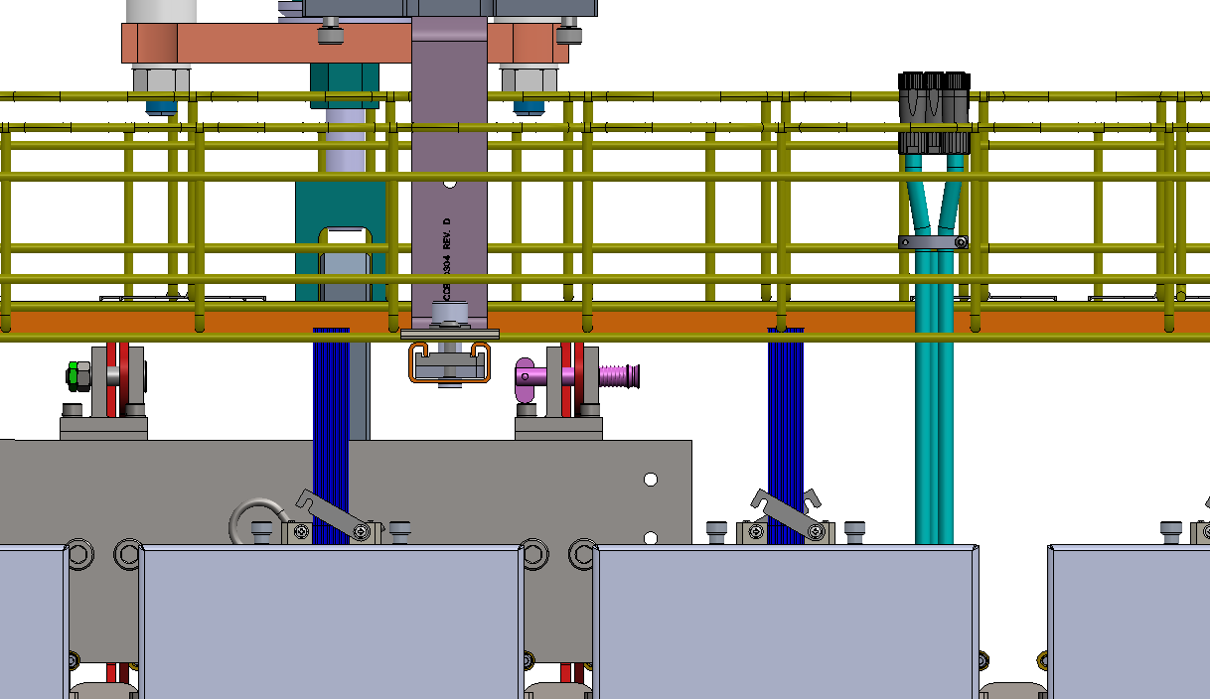
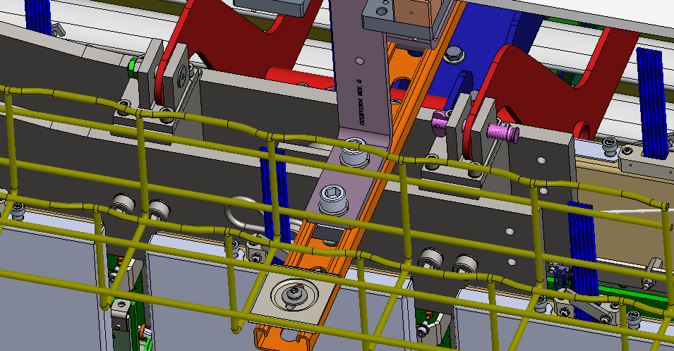
Improved Field Cage Latch Pivot
Top field cage latches pivot on members supported by the yoke assembly. The baseline pivot is a shoulder bolt with hex nut and jam nut.
To reduce the risk of dropping fasteners in the FD1 cleanroom a suggestion was made.
A suitable option has been identified.
Stainless steel, contains no trapped volumes and can be easily cleaned.
Early previews of this have been presented to and are supported by the HV and Installation Technical Leads.
Affected parts: Yoke assembly drawing and striker pivots (8760258)

Slide 6
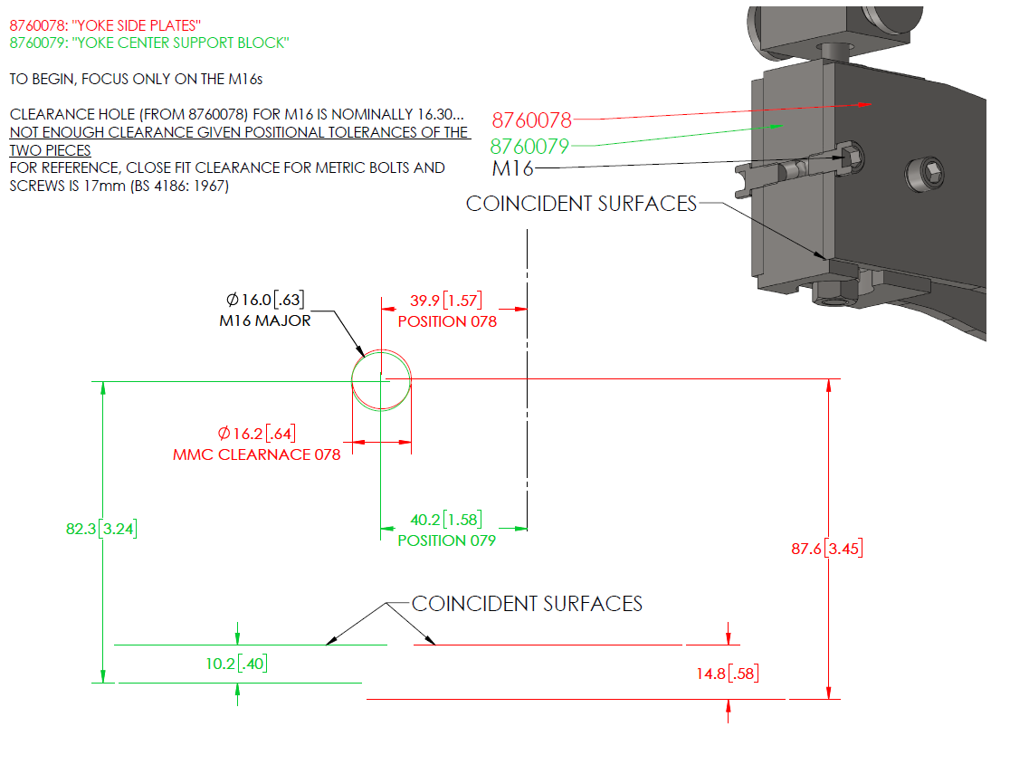
Drawing Changes for Compatibility with Assembly Fixture
A closer look at tolerance stack-up of mating parts reveals a few areas for improvement:
Screw clearance hole diameters (in side plates) are too small for the specified tolerances
Add a milling operation to water jet cut parts of the side plates
Water jet cutting produces a cut surface which is not perpendicular to the plate face (tapered shape kerf¹)
Zero ordinates on part drawings moved to more appropriate locations which reduce stack-up and aid inspection
Max radii are added to internal corners
¹ https://www.finepart.com/waterjet-cutter/waterjet-kerf-angle/

Slide 7
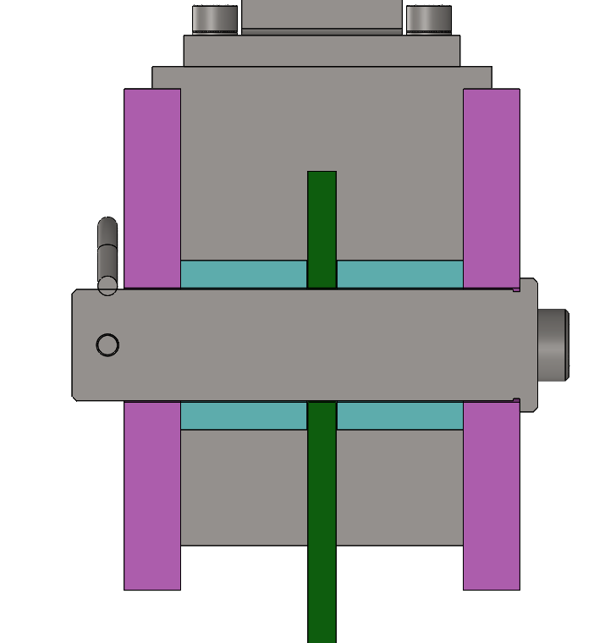
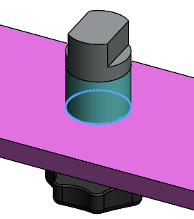
Drawing Changes for Compatibility with Assembly Fixture (2/2)
Bearing supports are welded to side plates and do not provide enough clearance if local distortion occurs (i.e. holes become non coaxial)
This can cause issues of installing the pin when mounting the yoke to the structural tees
Note: The name bearing support is a misnomer. It is not considered part of the structural integrity of the yoke assembly.
The baseline also requires the I.D. to be machined. By selecting a stock material with an I.D. slightly larger than the baseline the machining operation is eliminated.
A separate and smaller fixture is also being designed which aligns the axes of the bearing support to its side plate hole.

Slide 8
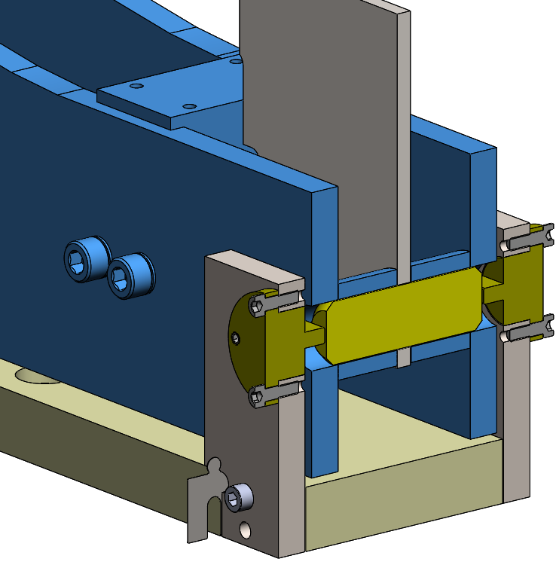
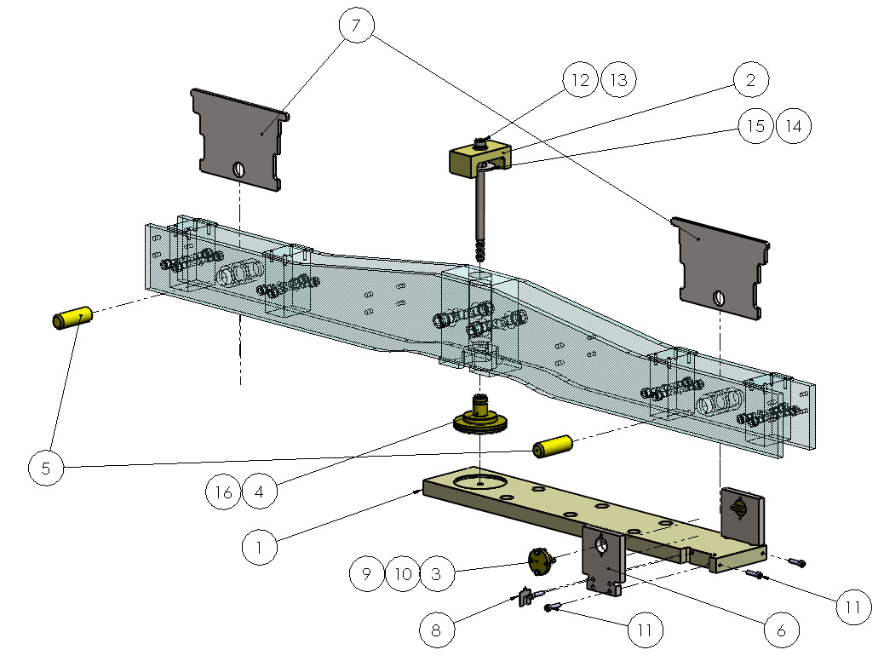
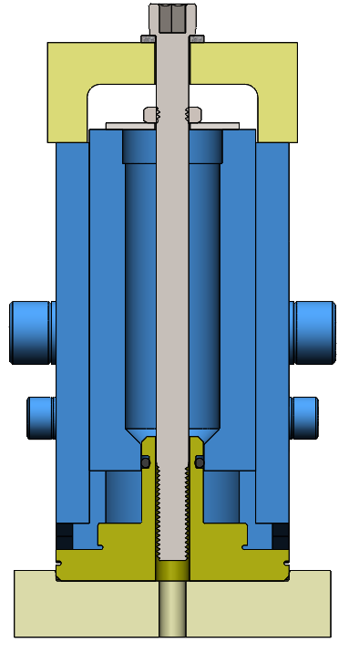
Main Assembly Fixture
Controls and aligns center block between pinholes
Controls position of striker pivot blocks
Forces side plates to fully seat against center block “step”

