Slide 1
TSD SharePoint for Quality Assurance Documentation
Eric Carson, Andrew Rauch, Adrian Orea, Yun He
TSD Topical Meeting
January 18, 2024

Slide 2
Outline
Introduction
Eric’s Story
Overview of NuMI Target TA-07 Site, by Andrew
SharePoint Basic Features, by Andrew
SharePoint for CNC Welding & Advanced Functions, by Adrian
Summary: Team Effort & a Sense of Ownership

Slide 3
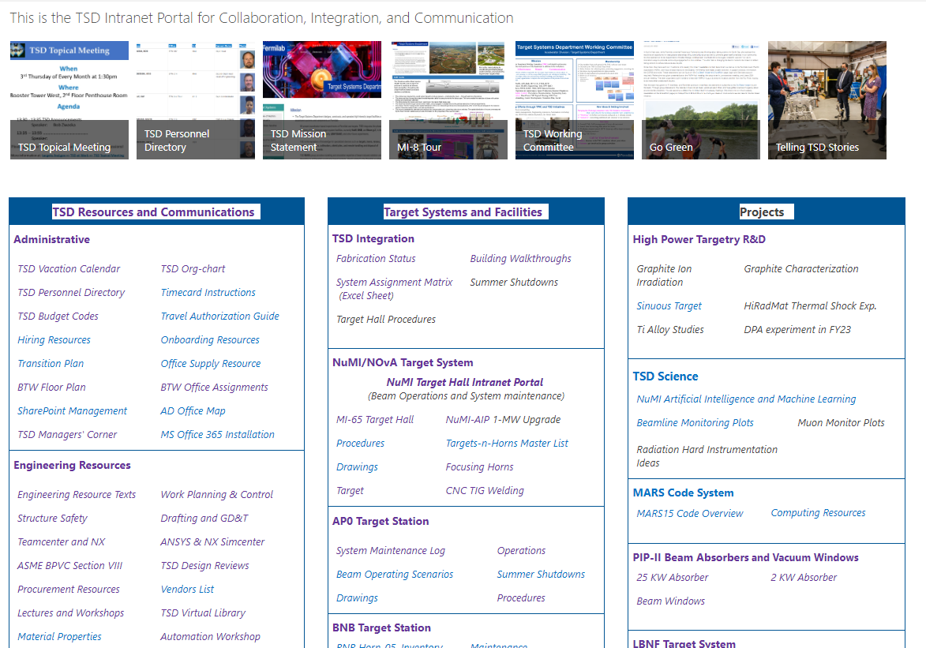
TSD SharePoint Home
We are going to present today
There is a wealth of information, and we are excited to have everyone working together to create a primary source of collaboration and connection.

Slide 4
Maintaining Quality Assurance Documentation on SharePoint
In addition to the QA documentation required for projects and operations (not our directive), here we present SharePoint for the fabrication team, enhancing communication and collaboration.
Purpose :
Preserve and share knowledge >> efficiency
Learn from past experiences >> onboarding new team members
Consistent quality standards >> reliability, traceability and accountability
Future reference >> operations & troubleshooting
Fabrication status, inventory, continuous improvement
Basis for audits, groundwork for future projects
Documents need to be shared within the fabrication team
Drawings (controlled version are in Teamcenter, not everyone has access to it)
Requirements, specifications, fabrication steps, and procedures
Reports of inspection & quality control (measurements, survey, leak check, pressure testing, weld quality, etc.)

Slide 5
Benefit of Using SharePoint for Team Collaboration
Web-based, accessible for all levels of team
Developed by Microsoft, familiar user interface, easy to use
Centralized with logically or visually linked documents, easy to find
Enterprise-level reliability, Microsoft, trusted platform, dedicated FNAL team
File recovery, backup tapes from lab’s SharePoint management team
Permission control, site level, group based, documents folder, individual file
Additional features as of Jan. 17, 2020, from Kimerly Myles:
Hybrid environment- both on premise SharePoint hosted with our own server farm plus a SharePoint environment in the cloud (with the advantage that you can share files with external stakeholders.
Enterprise search capability displaying results from Indico (in progress) , Docdb private and public (available now), Service Now (in progress) Team Center (investigating as potential project); Inspire (available now).
Ability to share documents with external stakeholders as long as they have a personal email tied to a Microsoft account via our online Office 365 instance of SharePoint.
Ability to use 3rd part tool “Nintex” forms and workflows to create customizable forms with instructional content and workflow such as approval workflow, workflow that moves files between lists or libraries pending approval etc.
The ability to use managed meta data to make filtering easier, and to create columns that can be used with this data across multiple lists and/or libraries to provide a standard way to tag content.
We are grateful to those who have started their SharePoint journey.
Let’s share Eric’s story

Slide 6
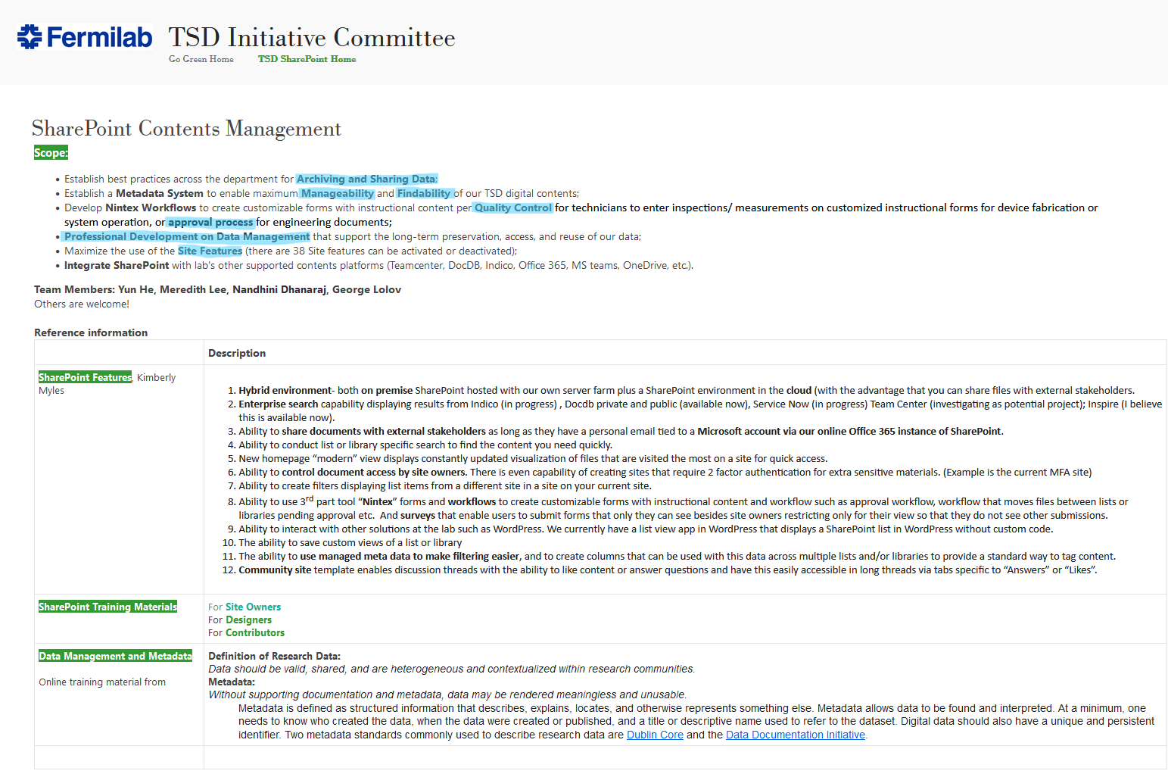
ERIC'S STORY

Slide 7
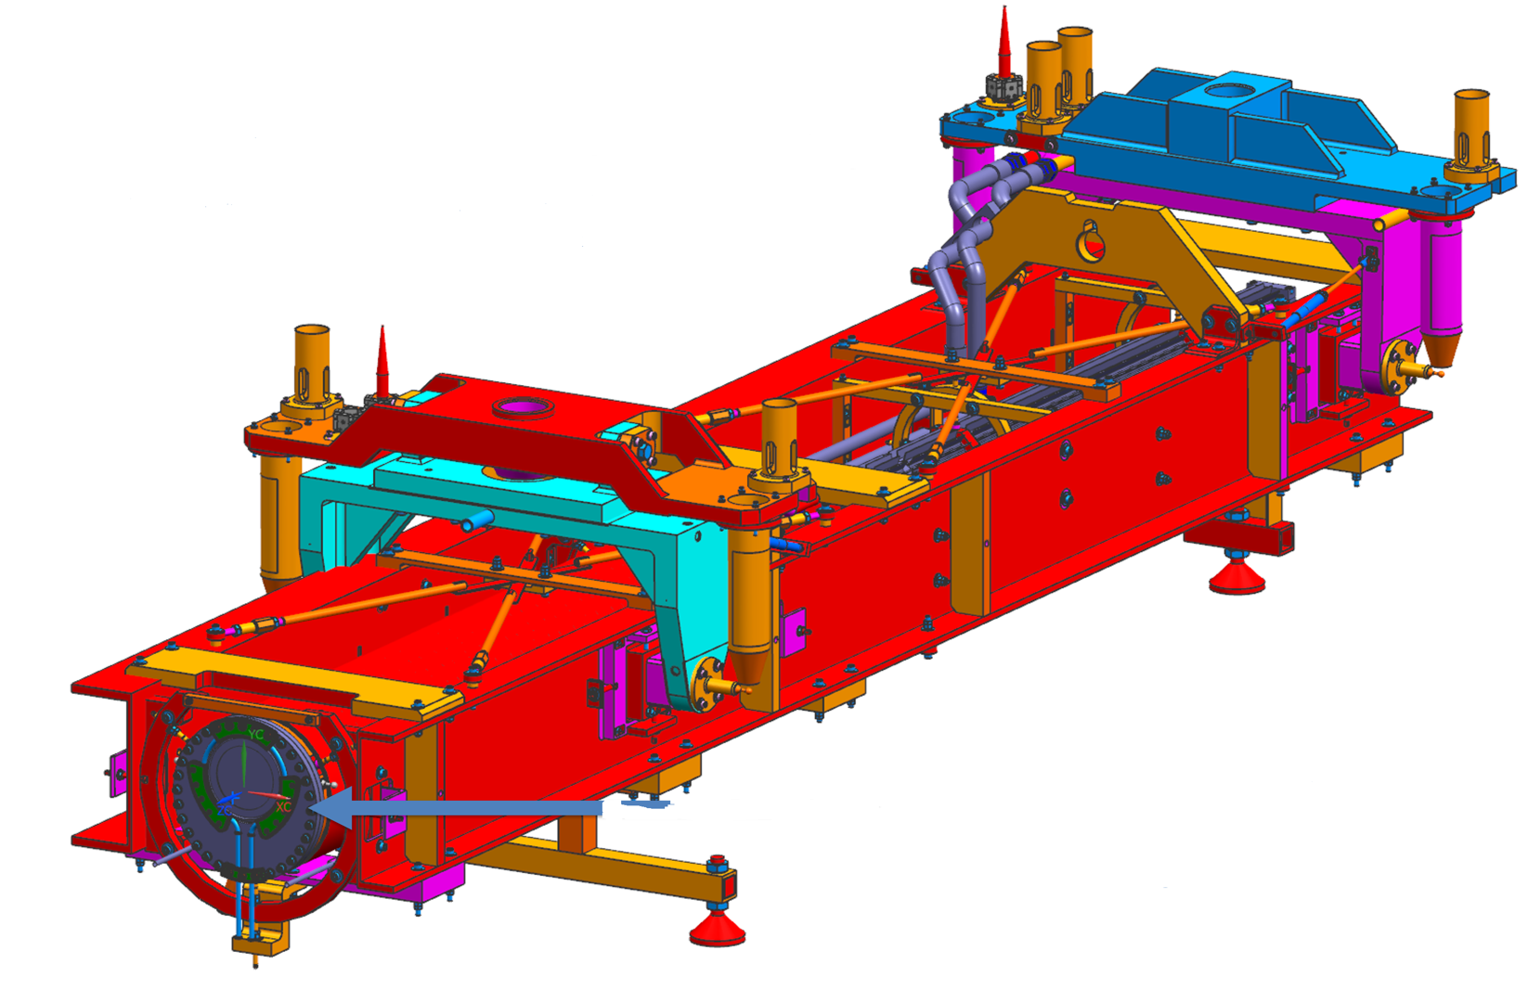
The Beginning
My new assignment
NuMI Target TA-07 & TA-08 spare production.
It’s such a fascinating engineering art…
Necessity…
The Mother of invention
For me, it was getting up to speed as quickly as I could.
My experience…
In the early days... NAVIGATION! IT’S HIDING! FRUSTRATION!

Slide 8
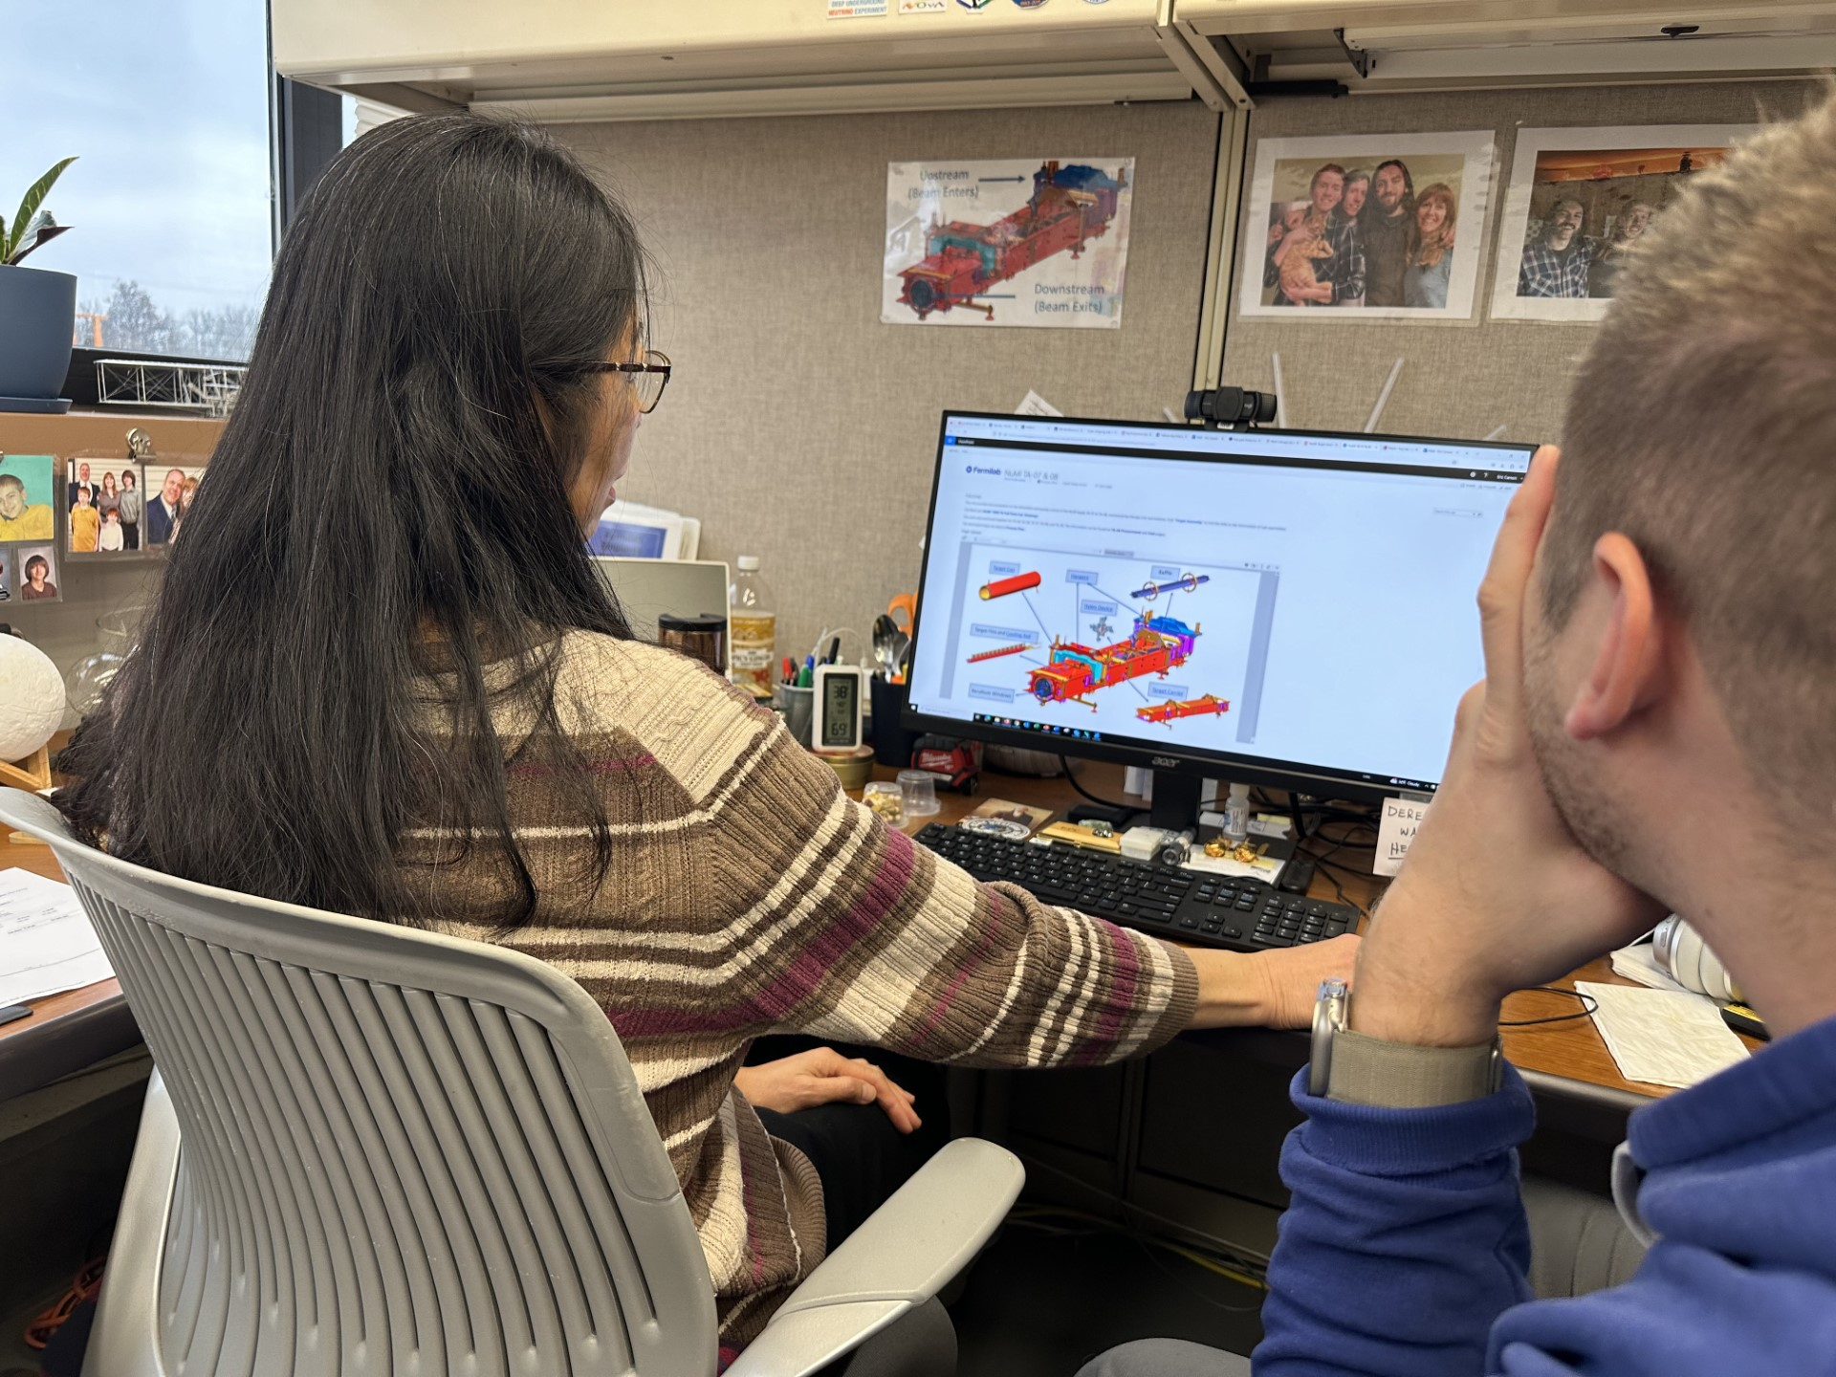
Journey with SharePoint
SharePoint beginner
I’m a user of this tool, and in the beginning, it overwhelmed me
SharePoint Team
Yun’s passion, stepped up to set the site structure and provided tutorials
Andrew, my work partner, worked along my side
Georgi, lead engineer, uploaded the files
Adrian, used advanced feature to fulfill my ideas
Possibilities & Connection!
I love all the possibilities with collaboration that also brings connection!

Slide 9
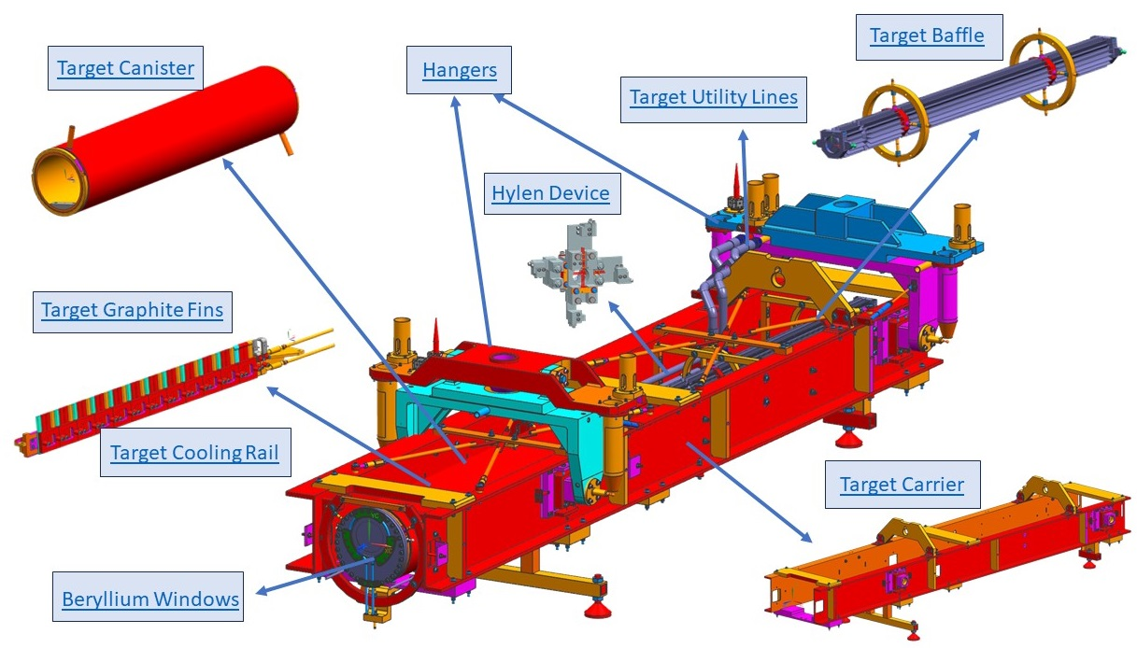
Creative Idea
My Visually Wired Grey Matter
My grey matter is wired to work visually
My early exploration of SharePoint my wiring was short circuiting
I started asking questions, a personal mantra of mine...“Smile and Be Curious”
Satisfying My Brain!
I am impressed that SharePoint has the functionalities for my brain’s wiring.
Just simply click the link in the picture
It will lead me to the information that I’m looking for!

Slide 10
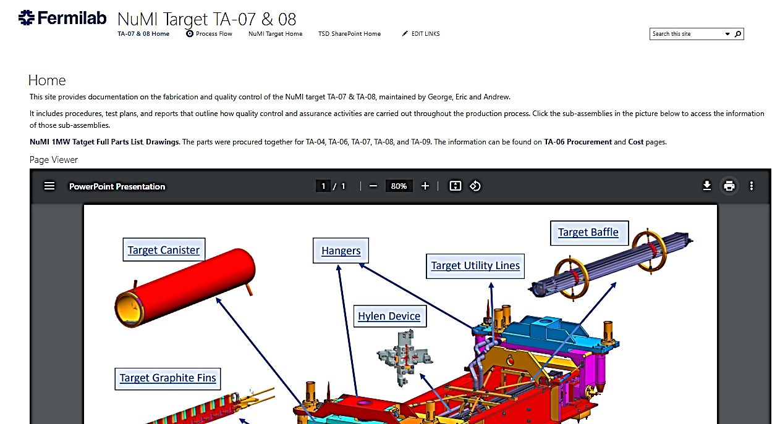
Taking the Plunge
Deep Dive
Andrew supplied me the LIFELINE to do this as he has a more extensive experience with this tool I do not yet have.
Owning NuMI TA-07 & 08 Site
That’s our platform for QA Documentation, which is important…for the team, for future operations…

Slide 11
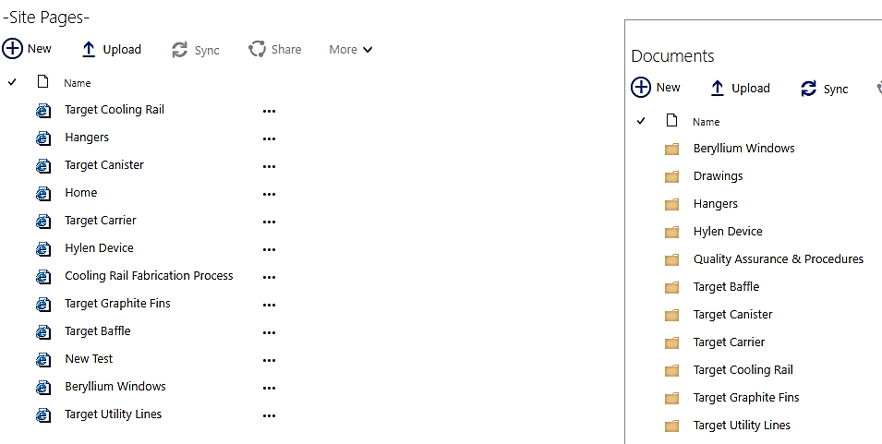
"Becoming" Fearless
Being a Co-owner of Target TA-07 & 08 Site
I can develop this site in the best interest of my team
The operative word is “becoming” as I will make mistakes which I view simply as lessons.
Yun & Andrew's support with SharePoint, gives me great comfort. I encourage you to find your support
Pages and Documents of Sub-assemblies
This is where the QA documents reside

Slide 12
My Goal
Let’s Get Together…and “Share” the Point
The future... having SharePoint as common a tool as a wrench for a technician and comfortable enough that it is second nature.
I look forward to making contributions on “Share” Point.

Slide 13
Overview of NuMI Target TA-07 Site SharePoint Basic Features Andrew

Slide 14
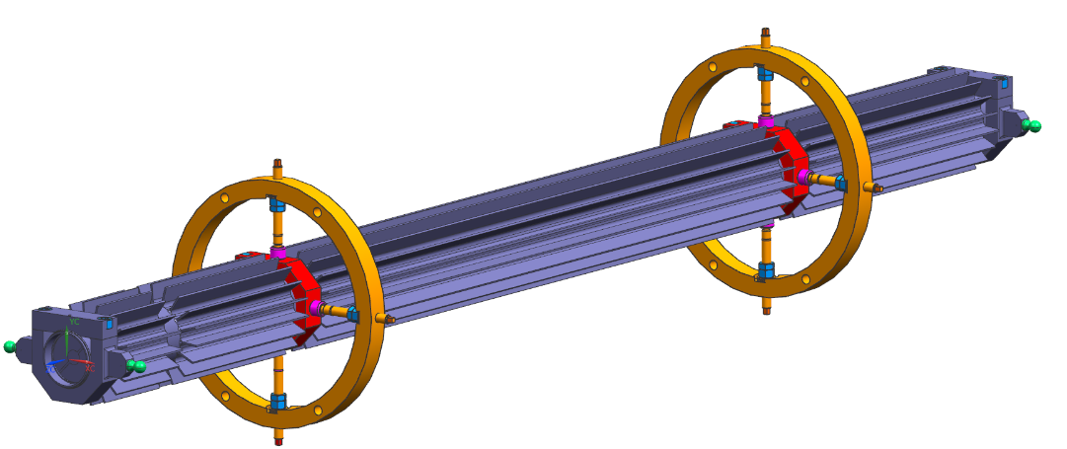
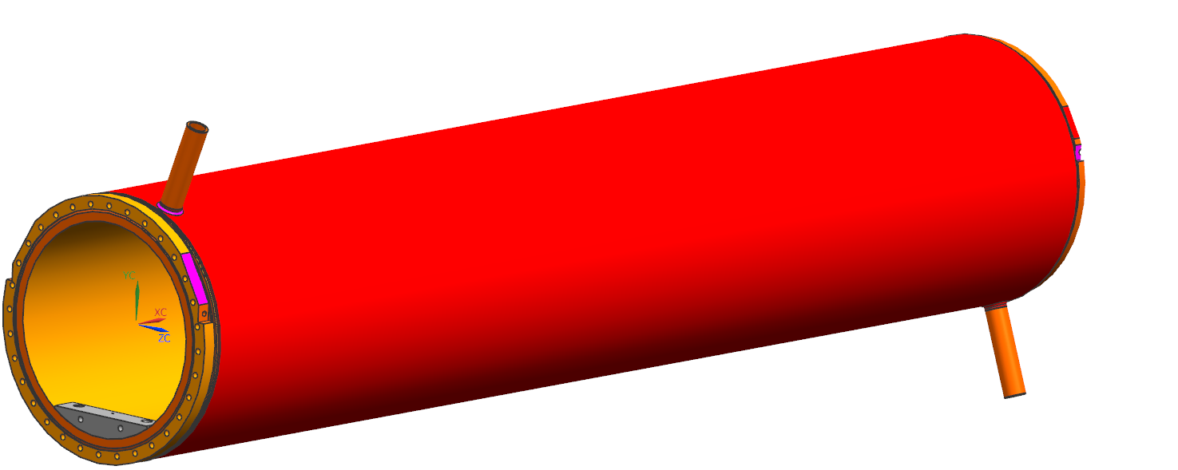
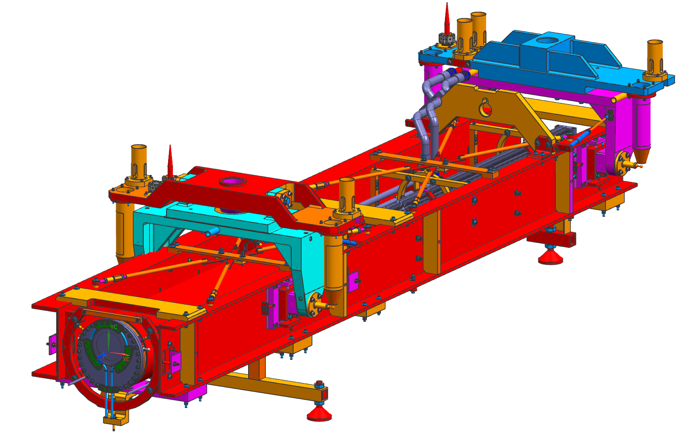
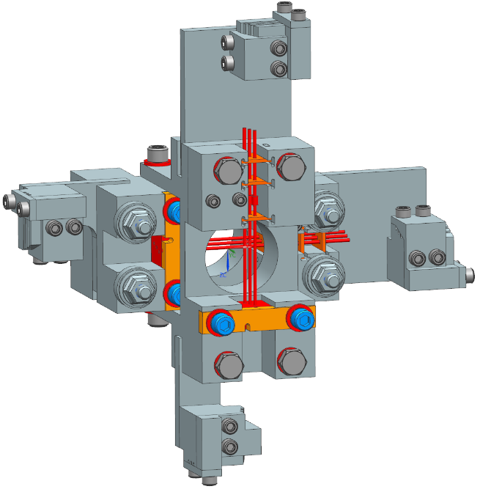
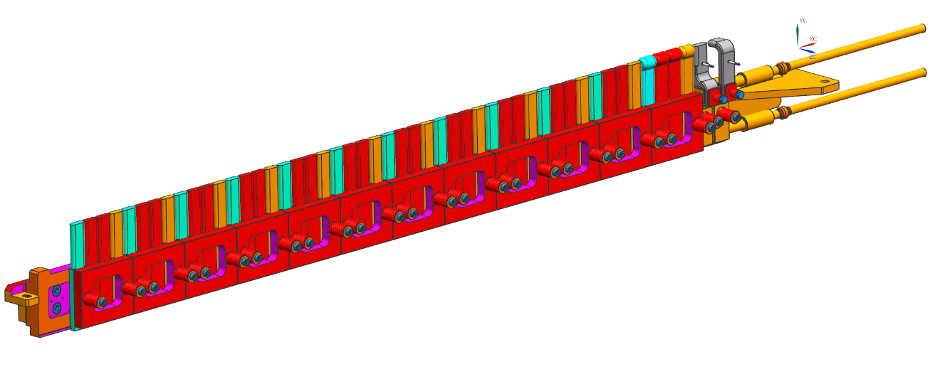
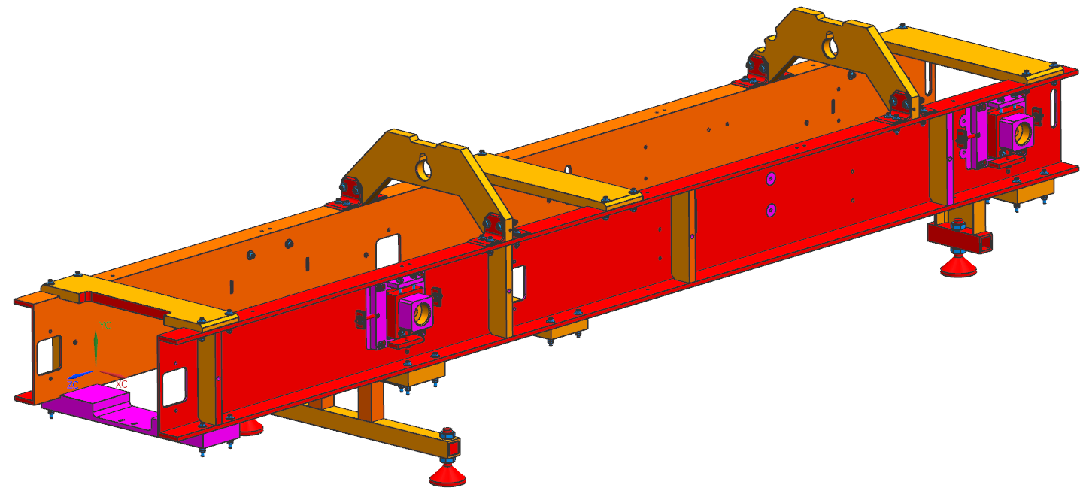
NuMI Target Sub-assemblies
The links on the sub-assemblies in the picture provide easy, web-based access to their information
Accessible to everyone in the team
Target Baffle
Target Canister
Hangers
Target Utility Lines
Hylen Device
Target Graphite Fins
Target Cooling Rail
Target Carrier
Beryllium Windows

Slide 15
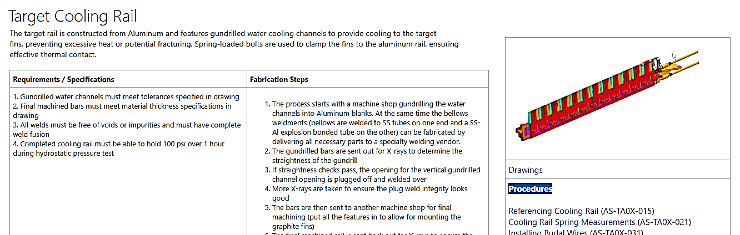
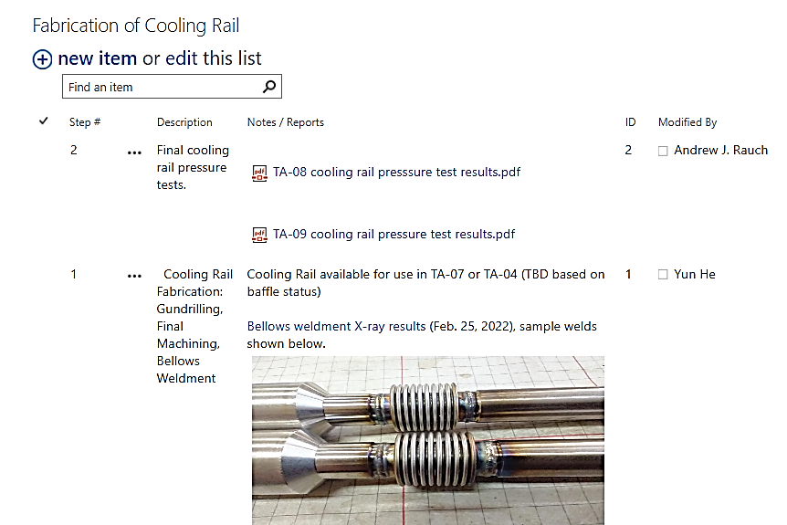
Target TA-07 Site Overview, by Andrew
One of nine sub-assemblies of NuMI Target
Log entries by technicians or lead engineer
Test reports

Slide 16
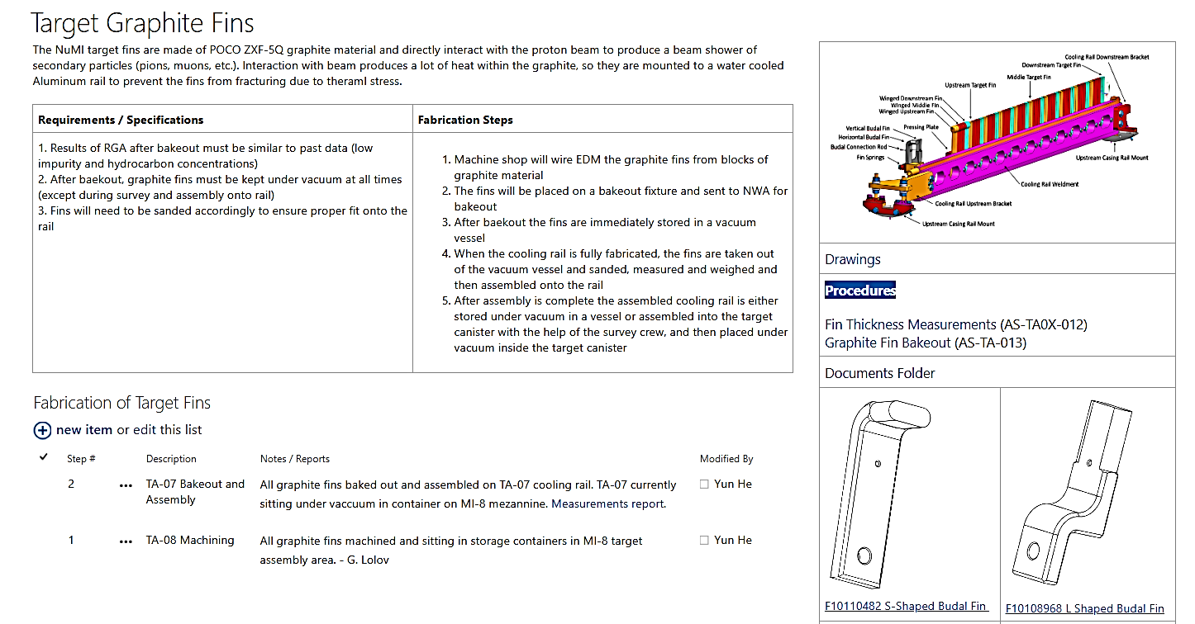
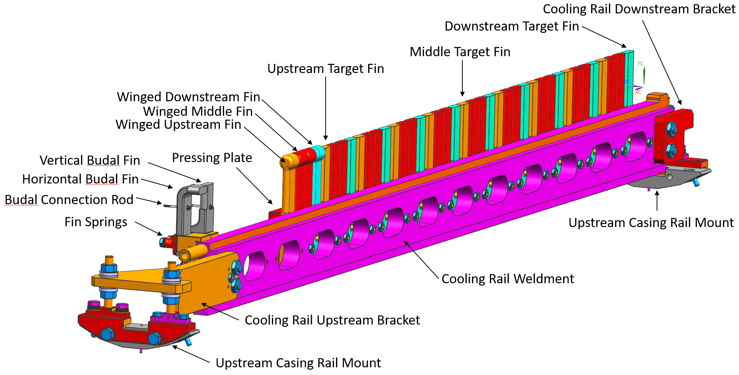
Navigating Information
clicking the image enlarges it for more details

Slide 17
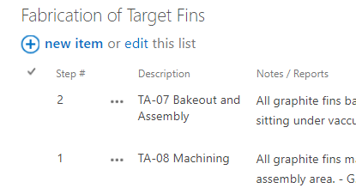
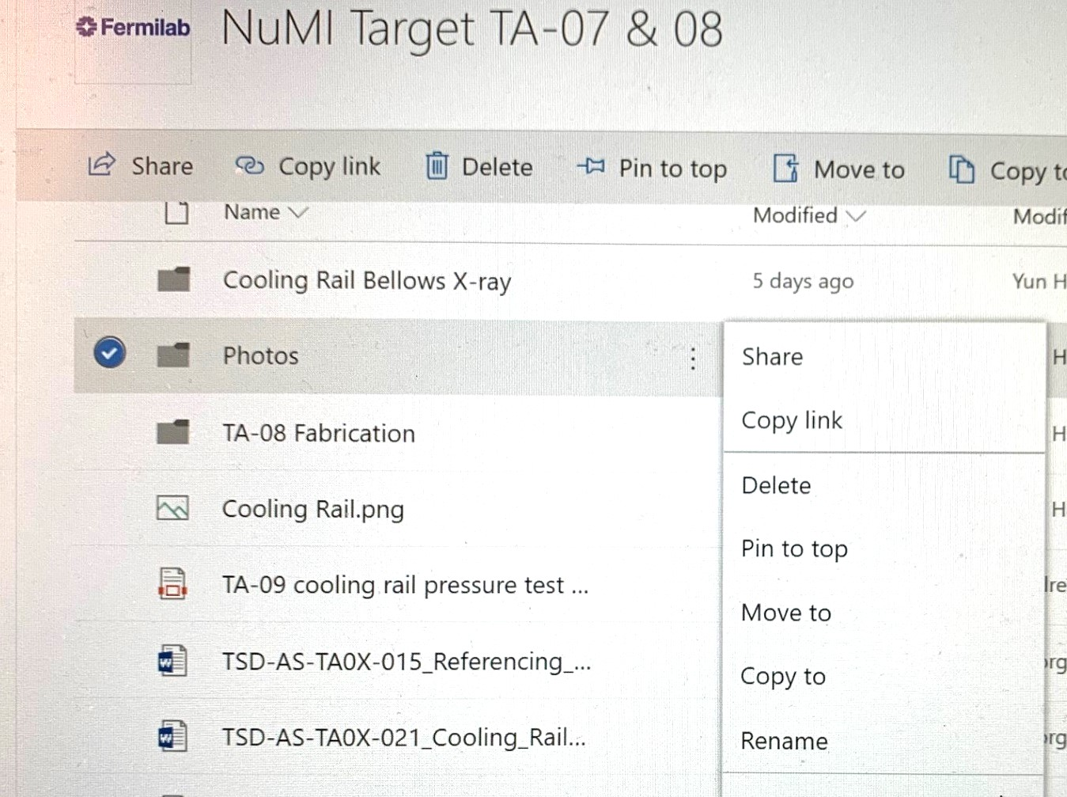
Making Contributions Is Easy
Two steps (TA-07 Home)
Upload files to Documents folder
Link the file on Page
Make a Log entry (Target Cooling Rail page)
Flexible in re-organizing files

Slide 18
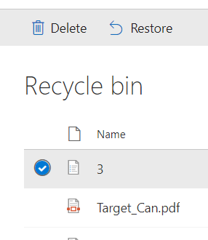
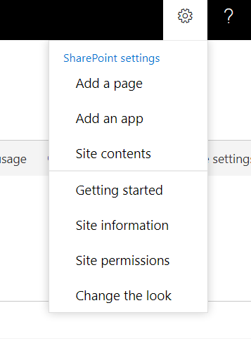
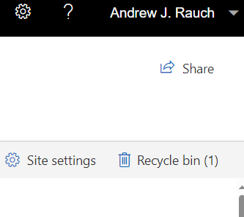
“Eliminate the fear”
Common SharePoint Operations
Become familiar with SharePoint operations
Cloud storage
Most mistakes are reversable
Recycling bin holds all deleted files and sites for 93days

Slide 19
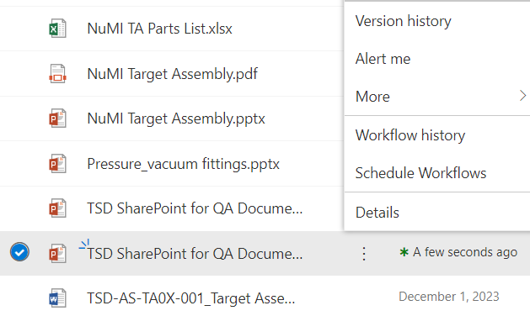
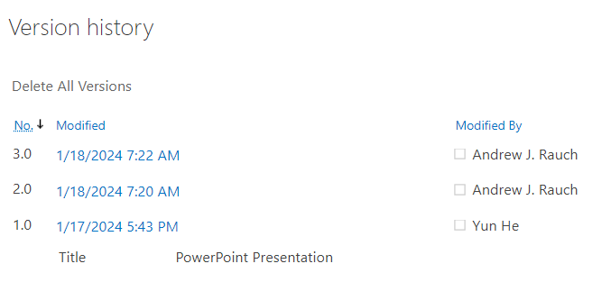
Common SharePoint Operations
Version History
When done correctly each edit of a document has a new version created and saved behind the scenes.

Slide 20
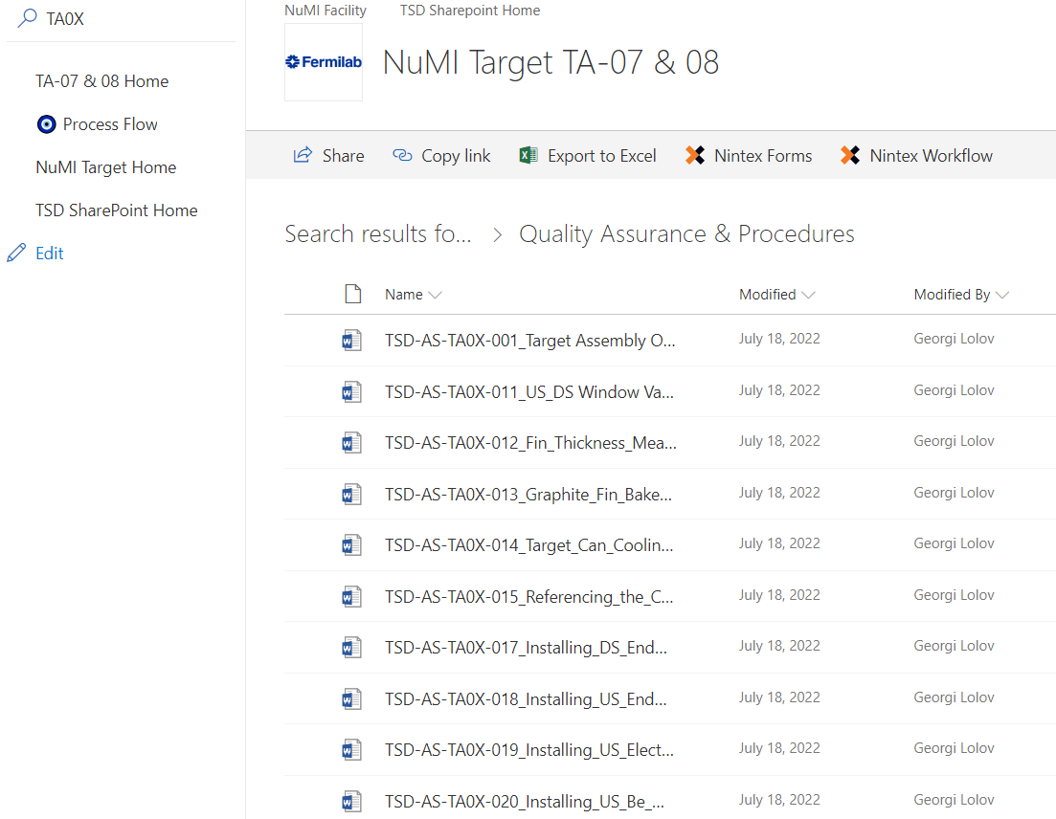
Name files consistently for easy retrieval
Common vocabulary
Part/drawing numbers
Tags
Use a tag to start or end a
file name. Ex. TA0X

Slide 21
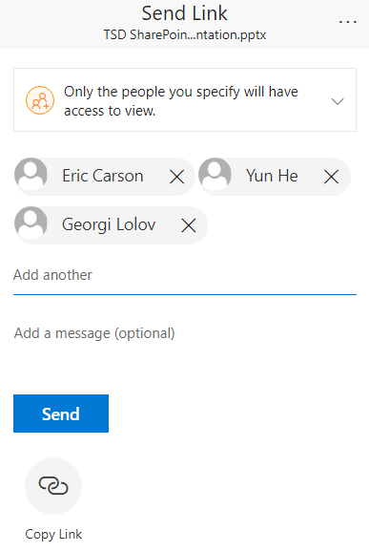
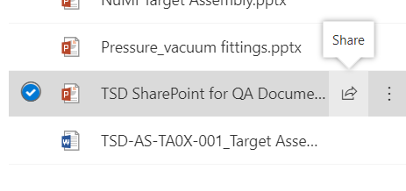
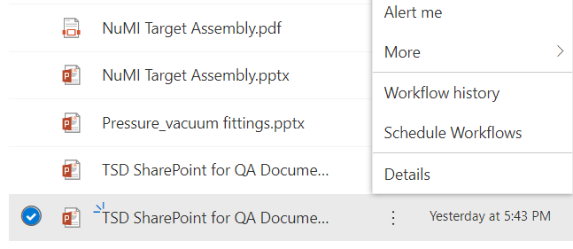
Common SharePoint Operations
Control sharing
input who can see and edit documents
Create alerts
Get notified as soon
as a change is made.

Slide 22
SharePoint QA Site Horn CNC Welding SharePoint Advanced Functions by Adrian

Slide 23
SharePoint QA Sites for Other Projects, by Adrian
Horn CNC TIG Welding
Knowledge has been passed down from Kris to Yun >> Cory >> Meredith
Well documented on SharePoint: welding setup, routines, best practices & lessons learned, how to guide
Enabled Adrian to learn the critical skills efficiently & effectively
Horn CNC TIG Welding 2023 Effort: updated/newly developed welding routines, status of PH1-07, 08, 09
LBNF Stripline Friction Stir Welding
A page under LBNF Target System >> Horn A Prototype Fabrication

Slide 24
Welding Routine Documentation
Used to be a table format
Fine, but becomes harder to search
Can't be sorted
Can't be filtered
Changed over to a list which fixes the issues from above
Working with Nintex Forms further simplifies documentation

Slide 25
Table Routine Format

Slide 26
List Routine Format

Slide 27
Nintex Forms
Faster entry of data
Allows for documentation to be seamless

Slide 28
LBNF Stripline Documentation
Meant to keep track of POs, comments, and status
Easy to access for any role transitions
Makes it more efficient to catch up on a project that is being handed off
Goal is to make a similar page for each horn
Especially for part inspections
Pricing for spares production budgets

Slide 29
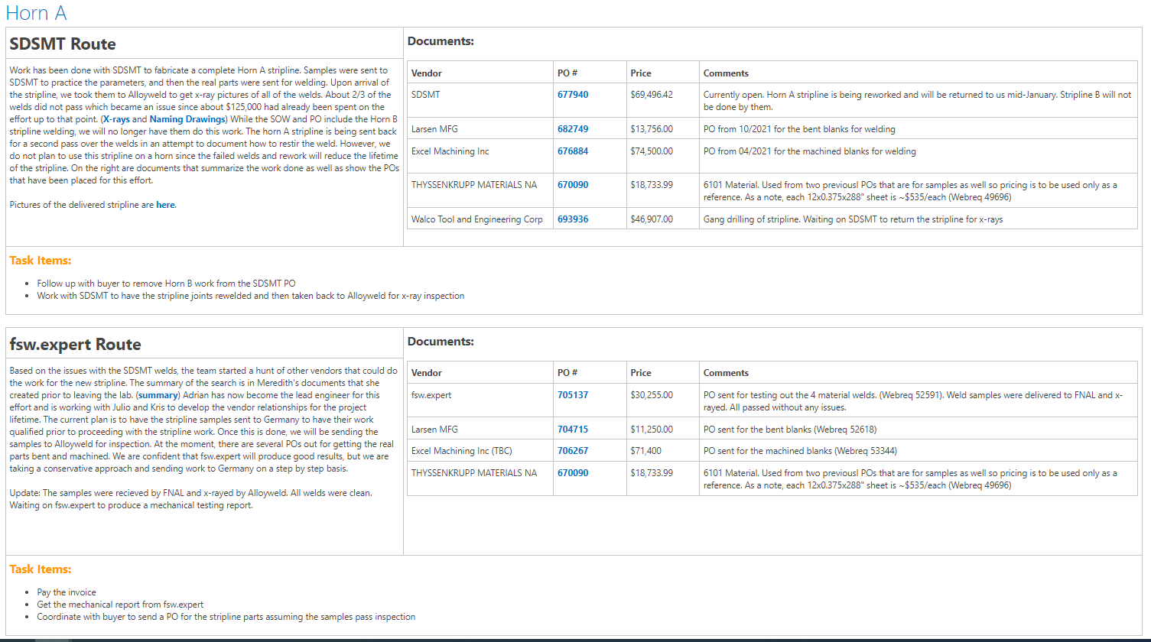
LBNF Stripline Documentation

Slide 30
Summary
In the coming years, the TSD team will dedicate significant effort to the production of LBNF target system devices.
Team effort for SharePoint:
Technicians may spend 2 hours a week:
scan handwritten inspection sheets for the parts critical or not meet the specs
make log entries
upload photos
Lead engineer may spend 2 hours a week
set up the site
upload files
re-organize documents.
Please contact Yun and Adrian if you’d like to have SharePoint sites set up for your project
Join Andrew’s effort to explore advanced features that have potential to enhance efficiency

