Slide 1
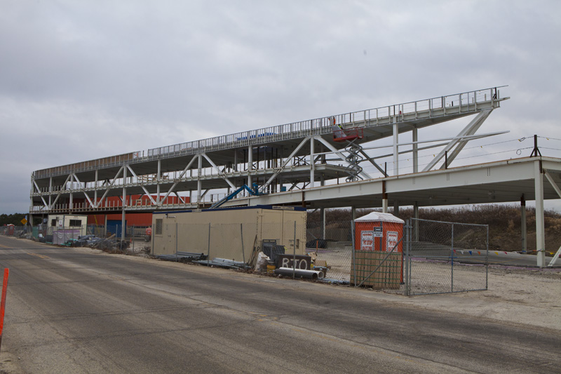
OTE Building PMG Report January 7, 2013 Rhonda Merchut

Slide 2
Agenda
Coordination
OTE Building Project State Activities
Schedule & Fiscal
Summary Action Items

Slide 3
IASU Update (IGPP)
Phase 2 scope approximately 85% complete.
CDF Coordination
OTE work inside CDF complete and returned to CDF use.
West ramp is open for Lab use (w/ prior arrangements with contractor).

Slide 4
CDF Refurbishment
Project schedule has been accelerated.
Project manager is Steve Dixon, FESS-Eng.
$3.2M GPP project initiated in FY13 for fire and life safety.
Scope Study for multi-year project underway.

Slide 5
OTE Outfitting GPP
Project Plan draft in final review.
There are three main components to the OTE Outfitting Project: Equipment, Furnishings, and Contingency.
* No indirect costs budgeted for $ 1M OTE contingency work which is capped exempt construction.

Slide 6
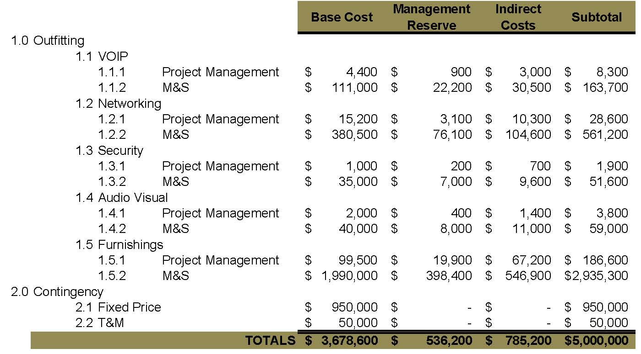
OTE Outfitting GPP

Slide 7
OTE Project Status:
Shop drawing review well underway. Approx 70% through anticipated 800+ submittals.
More than 200 RFI’s rec’d from contractor have been responded to.
Subcontractor’s BIM model completed for coordination.
Schedule analysis, reporting, and cost curve continues.
Safety procedures continue to be expanded as more subs come onto the project.

Slide 8
OTE Project Status:
LEED procedures & Action Plan implemented.
Contractor reporting 99% construction waste has been recycled.
On track to meet goal of 20% (by cost) of regionally manufactured materials.
On track to meet goal of 20% (by cost) of recycled content in materials used.

Slide 9
OTE Building Construction Status:
Superstructure complete
Roof and floor decks poured
Slabs on grade poured
Interior CDF roof reinforcement & Bridge complete
Structural steel studs for exterior enclosure underway
Elevator steel underway
Stairway installation underway

Slide 10
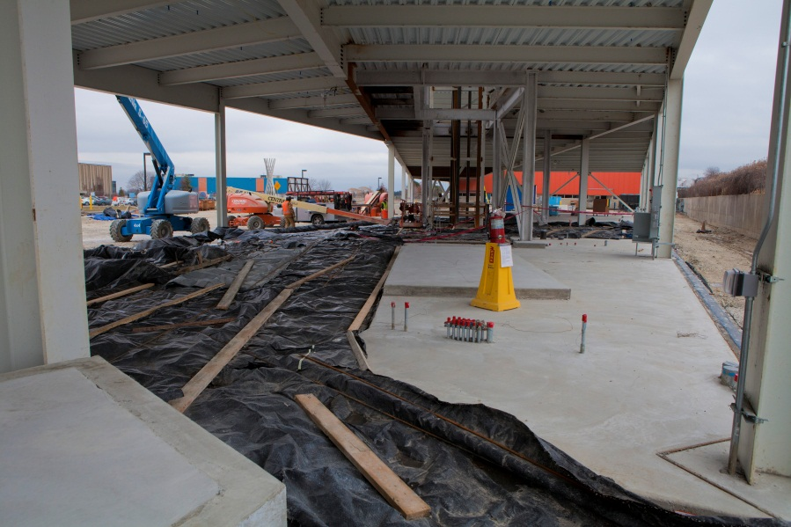
Lecture Hall
Lobby

Slide 11
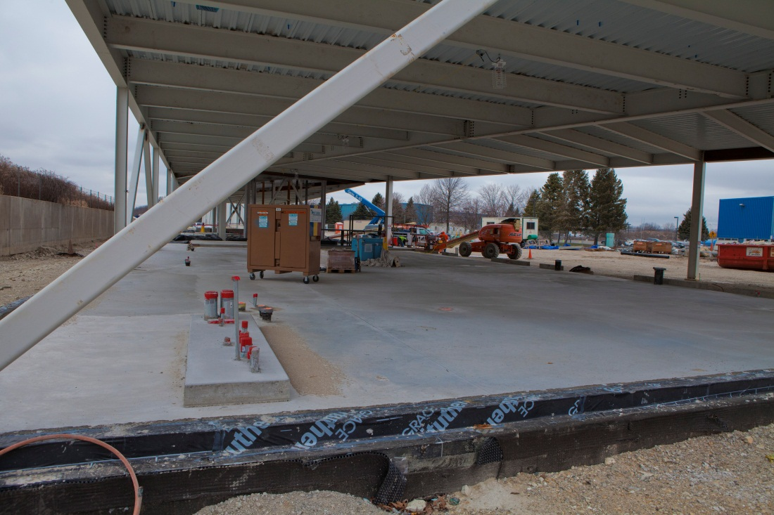
Tech Area

Slide 12
East Ground Floor

Slide 13
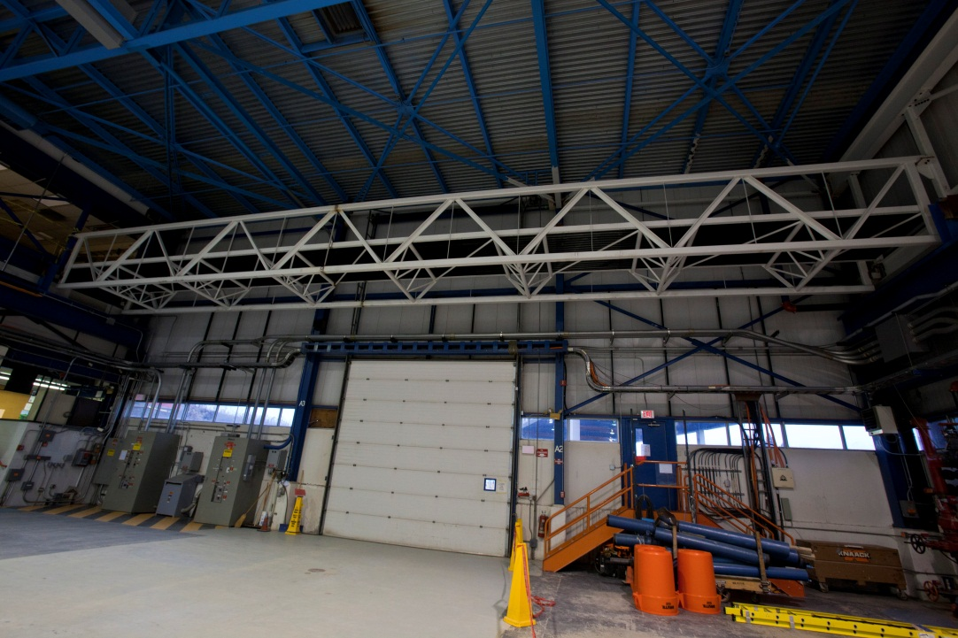
CDF Bridge
Polished Concrete mockups

Slide 14
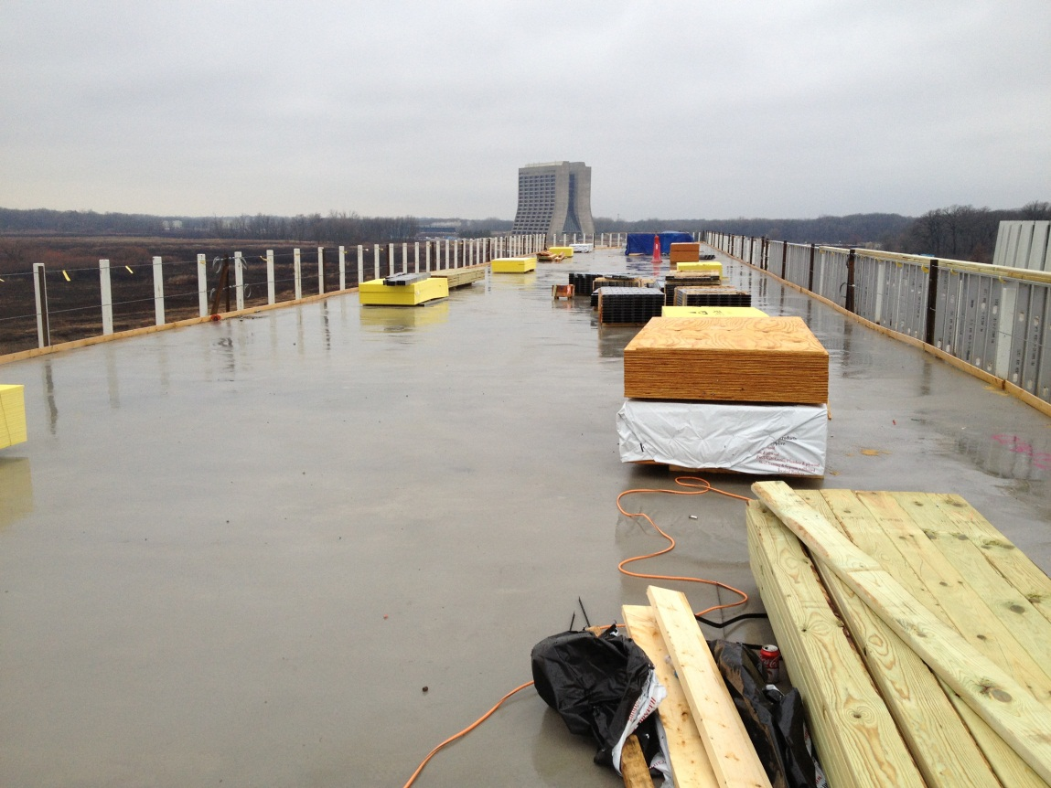
Polished Concrete mockup
Roof Deck

Slide 15
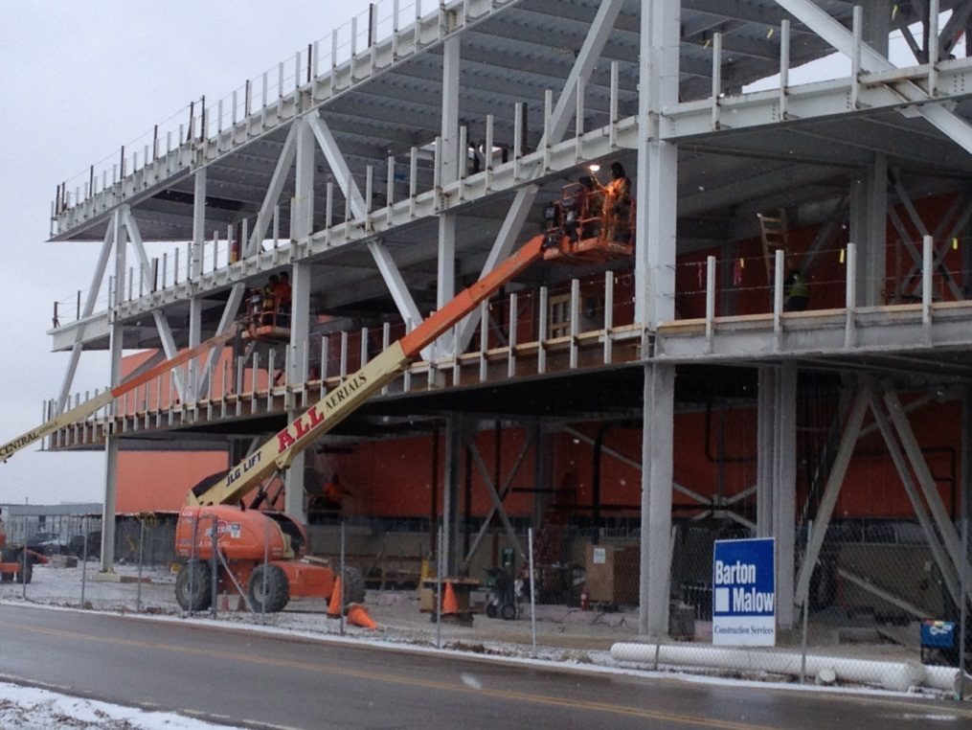
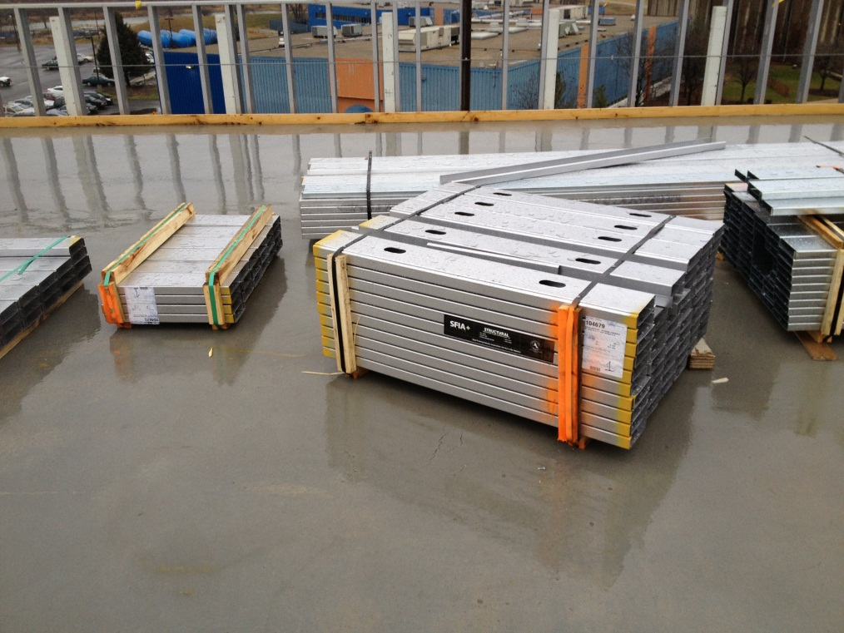
Ext. Structural Tubes
Structural Stud infill

Slide 16
Two Week Look Ahead
Roof parapet & 2nd 3rd floor structural studs continue
Elevator steel, over run
Above ceiling piping, racks, electrical
Storm lines
Temporary enclosure
Polished concrete

Slide 17
State DCEO Activities
DCEO quarterly report to State 12/26/12 for quarter ending 11/30/12
33% facility construction activity task complete
Total Grant Expense to Date:
$4,942,528/$17M
$1,501,894/$3M

Slide 18
Schedule Adjustments
24 additional days for underground work (SA05 & SA07)
Anticipated revised MS 3, Project Complete: 12/17/13

Slide 19
Schedule

Slide 20
BCWS & ACWP Cost Curve
33% costed
33% time

Slide 21
Financial – Grant & GPP Budget (Does not include IGPP)
2010
*
* + $1M VoIP, networking, security, etc.

Slide 22
Financial – Grant & GPP Budget (Does not include IGPP)

Slide 23
Financial – OTE BMC PO a/o 12/20/12

Slide 24
Contingency Management
Sources available to fund change orders:
IGPP;
De-scope from anticipated T&M work;
De-scope from A/E support work;
DOE backstop (GPP Outfitting project);
De-scope from main construction work (will not recover all funds);
Value engineering main construction work

Slide 25
Summary Action Items
Continue contingency opportunities identification.
Continue cost loaded schedule evaluation & cost curve analysis with Subcontractor.
Continue shop drawing & change order review, RFI responses
Continue construction coordination & oversight.
Engineering design for Outfitting GPP including VoIP, networking, furnishings

