Slide 1
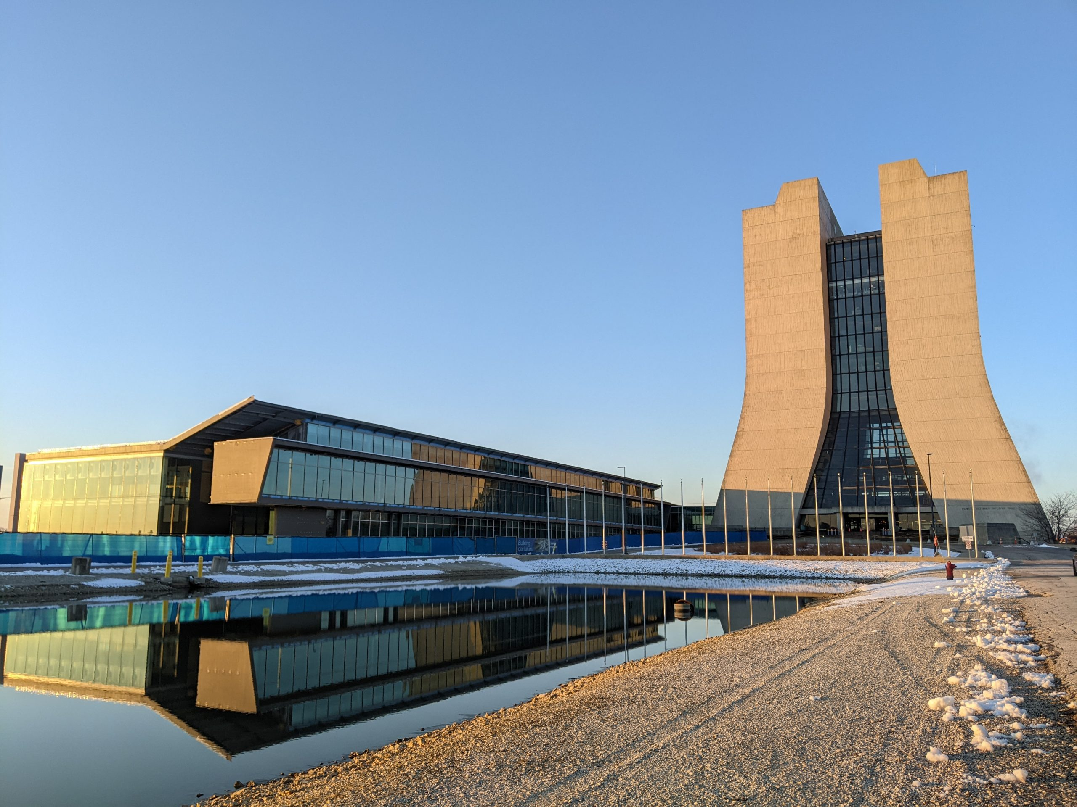

Fermilab to Argonne Entanglement Swapping
Andrew Cameron
December 13th, 2023

Slide 2
Geographical Locations
Argonne
0.58km
IERC
59km
2km
2.08km

Slide 3
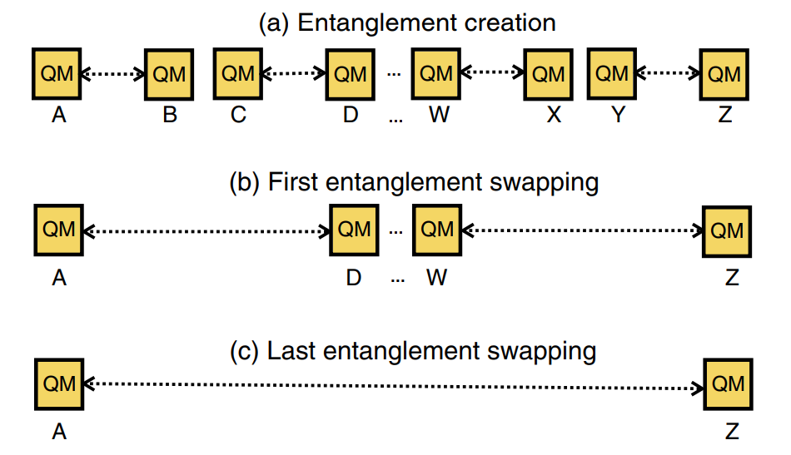
Motivating ES – Repeaters!
Nicolas Sangouard, Christoph Simon, Hugues de Riedmatten, and Nicolas Gisin. Rev. Mod. Phys. 83, 33 (2011).

Slide 4

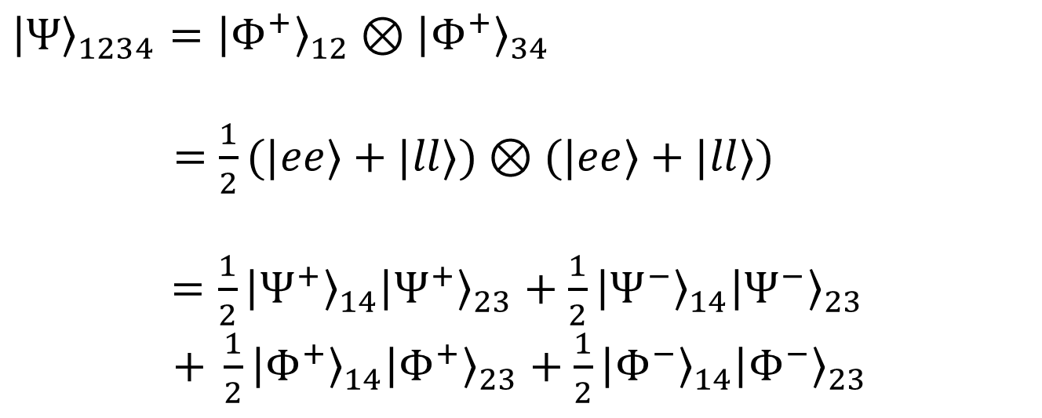

Entanglement Swapping Theory
$${\left|Φ^{+}\right\rangle }_{12}$$
$${\left|Φ^{+}\right\rangle }_{34}$$
$${\left|Ψ\right\rangle }_{1234}={\left|Φ^{+}\right\rangle }_{12}⊗{\left|Φ^{+}\right\rangle }_{34}$$
$=\frac{1}{2}(|ee⟩+|ll⟩)⊗(|ee⟩+|ll⟩)$
$=\frac{1}{2}{\left|Ψ^{+}\right\rangle }_{14}{\left|Ψ^{+}\right\rangle }_{23}$ + $\frac{1}{2}{\left|Ψ^{−}\right\rangle }_{14}{\left|Ψ^{−}\right\rangle }_{23}$
$+ \frac{1}{2}{\left|Φ^{+}\right\rangle }_{14}{\left|Φ^{+}\right\rangle }_{23}$ + $\frac{1}{2}{\left|Φ^{−}\right\rangle }_{14}{\left|Φ^{−}\right\rangle }_{23}$
1
2
3
4
EPR Source 1
EPR Source 2
A projective measurement of photons 2 and 3 in the Bell basis entangles photons 1 and 4

Slide 5
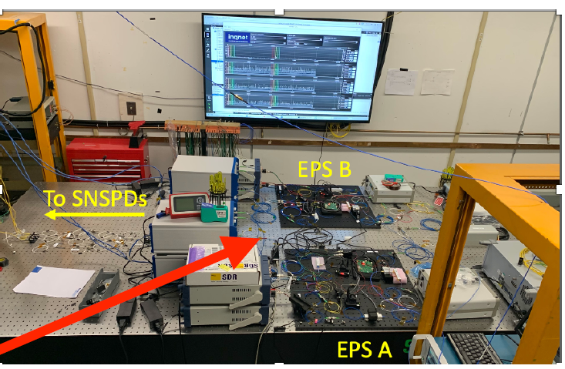
D0 Node
0.58km
IERC
2km
2.08km
Entanglement Swapping Testbed

Slide 6
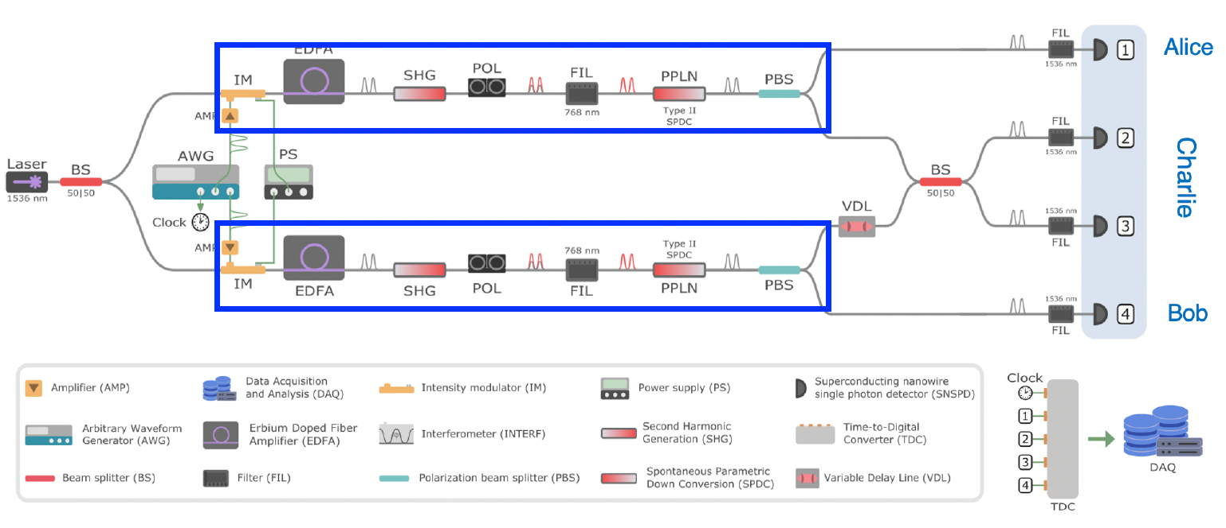


Experimental Setup – D0 Swapping
$${\left|Φ^{+}\right\rangle }_{12}$$
$${\left|Φ^{+}\right\rangle }_{34}$$

Slide 7
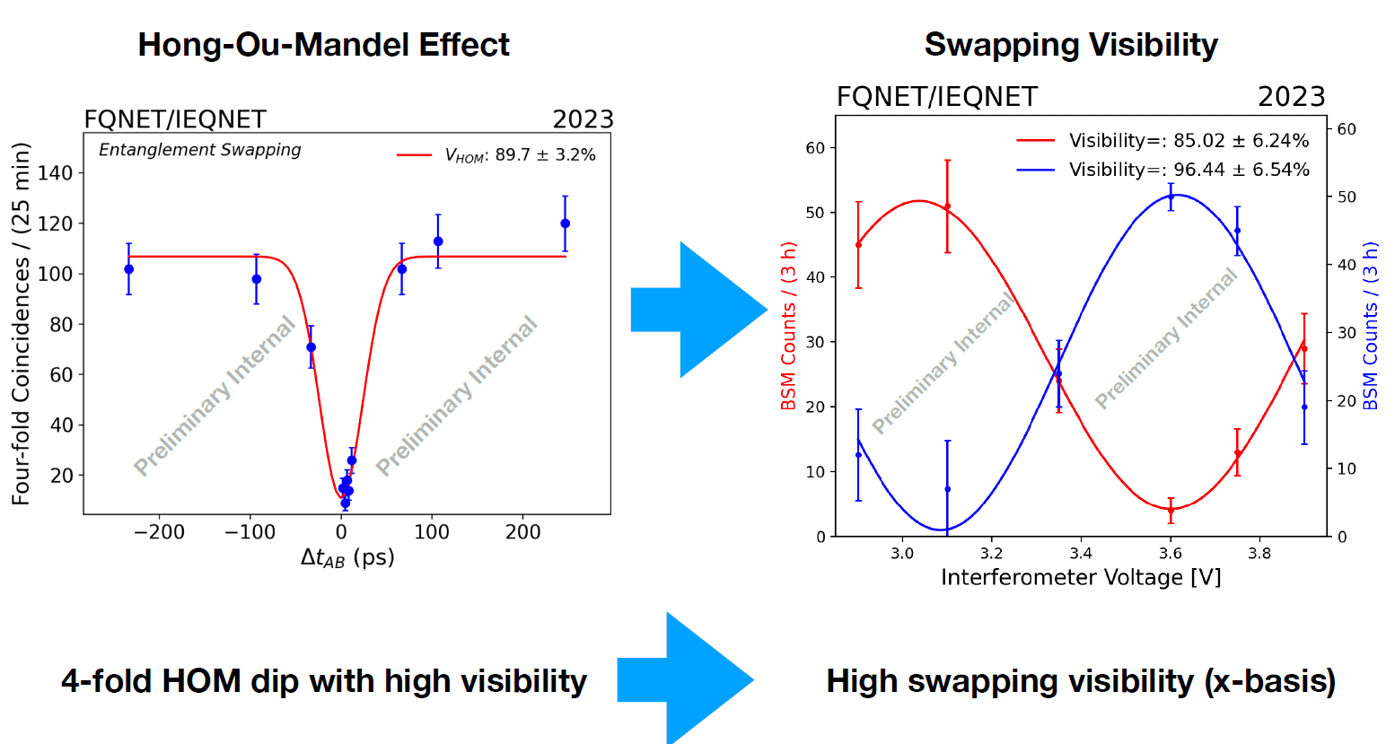
D0 – Preliminary Results

Slide 8
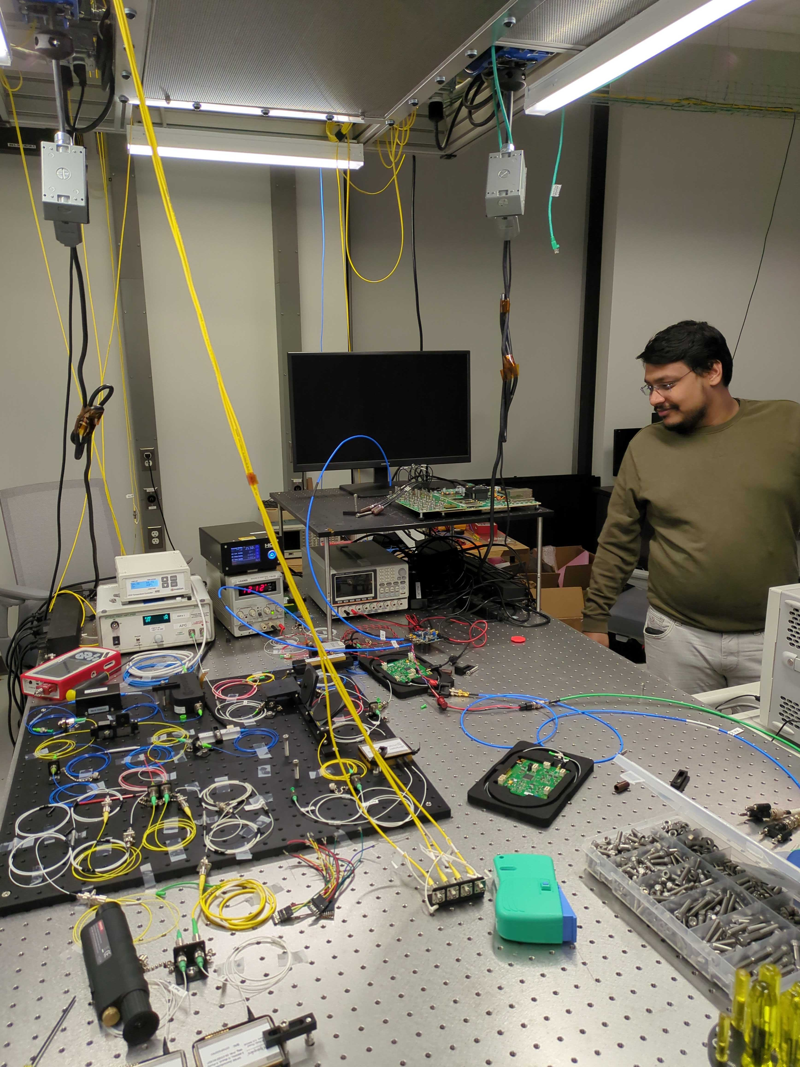
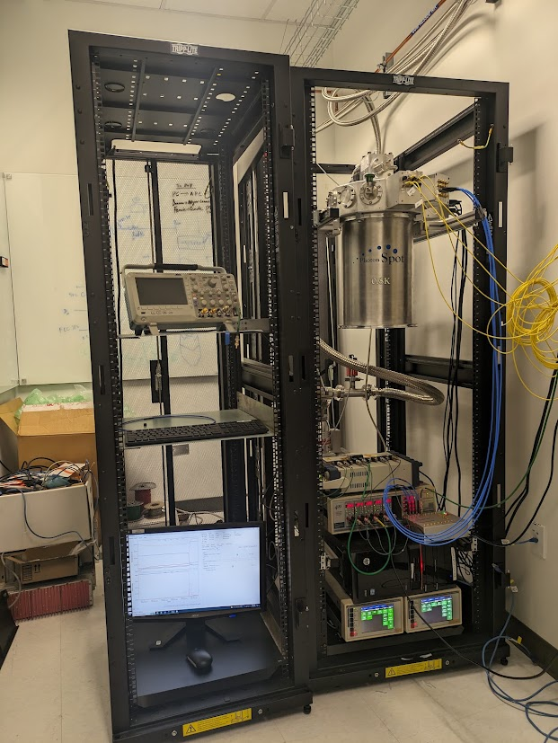
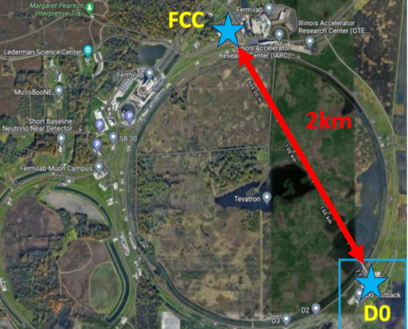
Fermilab Campus Network
Swapping between two D0 sources
Manuscript in preparation
Swapping between two FCC sources
One source built
Swapping between FCC – D0
2024

Slide 9
FCC Node
0.58km
IERC
2km
2.08km

Slide 10
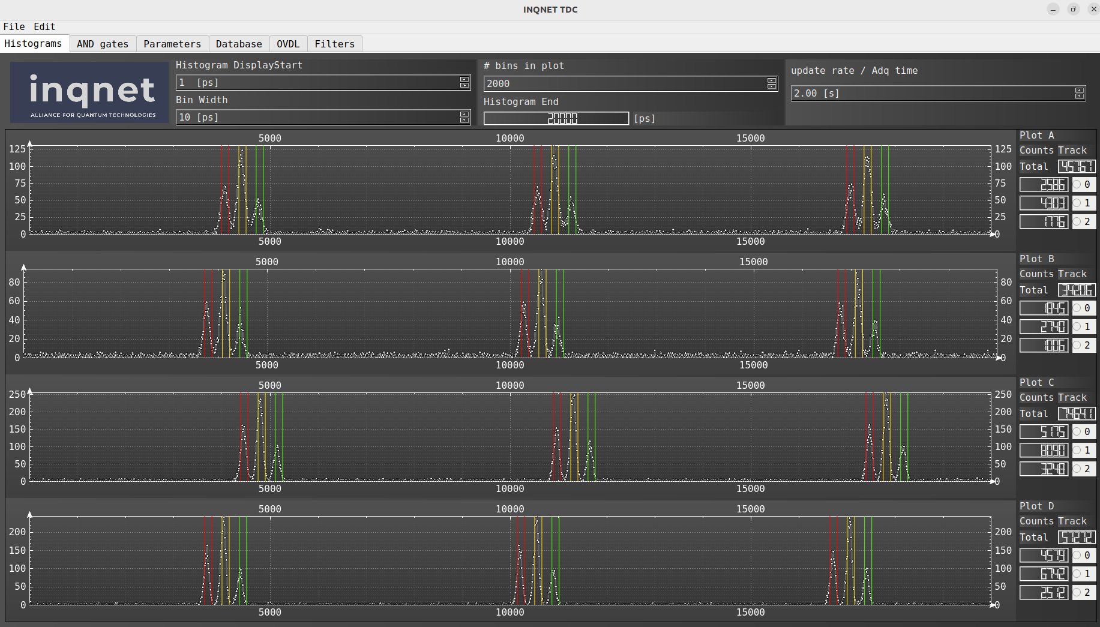
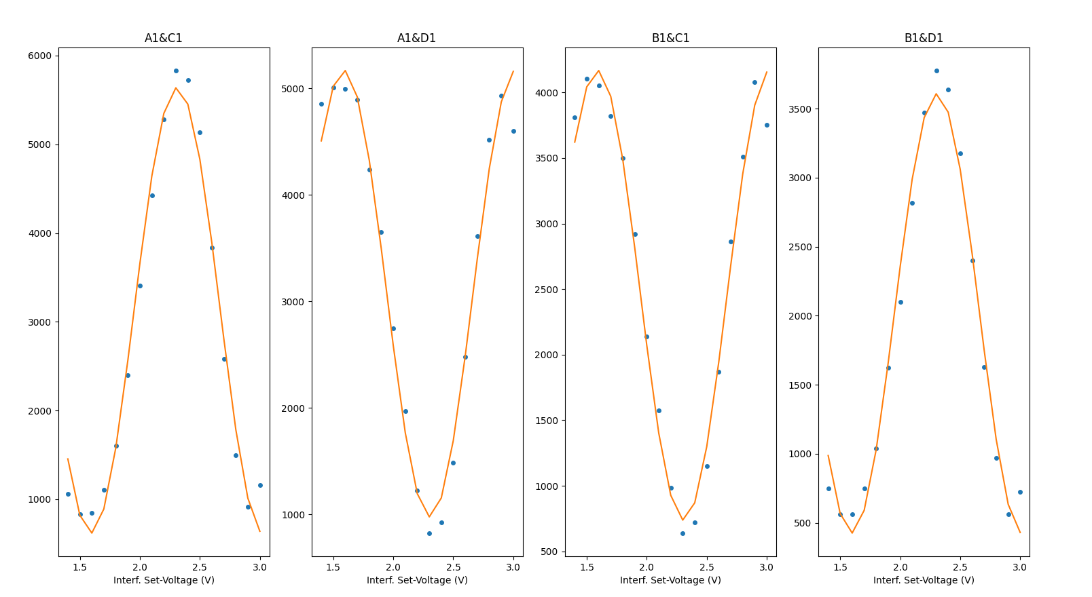
FCC Node (1 source)
Z Basis Visibility ~100%
X Basis Visibility ~80%
6.5ns (153MHz)
360ps (2.88GHz)

Slide 11

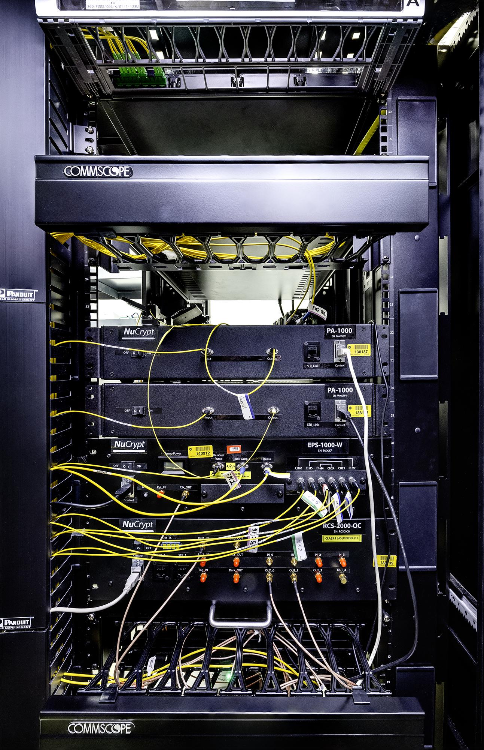
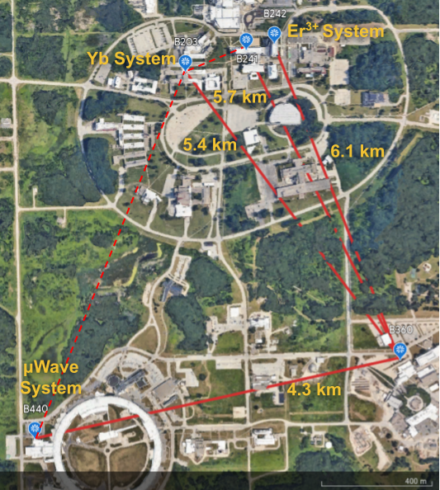
Argonne Quantum Network (ARQNET) Testbed
Connects 5 buildings in the Argonne campus on a star topology using deployed fiber
Long distance connections to Fermilab and StarLight using dark fiber
NuCrypt EPS – cascaded SHG-SPDC
  |HH> + |VV> Bell state generated in Sagnac Loop
  3-wavelength channels
  Pump @ 1550.1 nm (ITU Ch. 34)
Polatis 16x16 SDN Switch
  16 input and output channels
  Controlled via REST and NETCONF APIs
Quantum Opus SNSPD
  2 detectors
  85% efficiency at 1550 nm

Slide 12
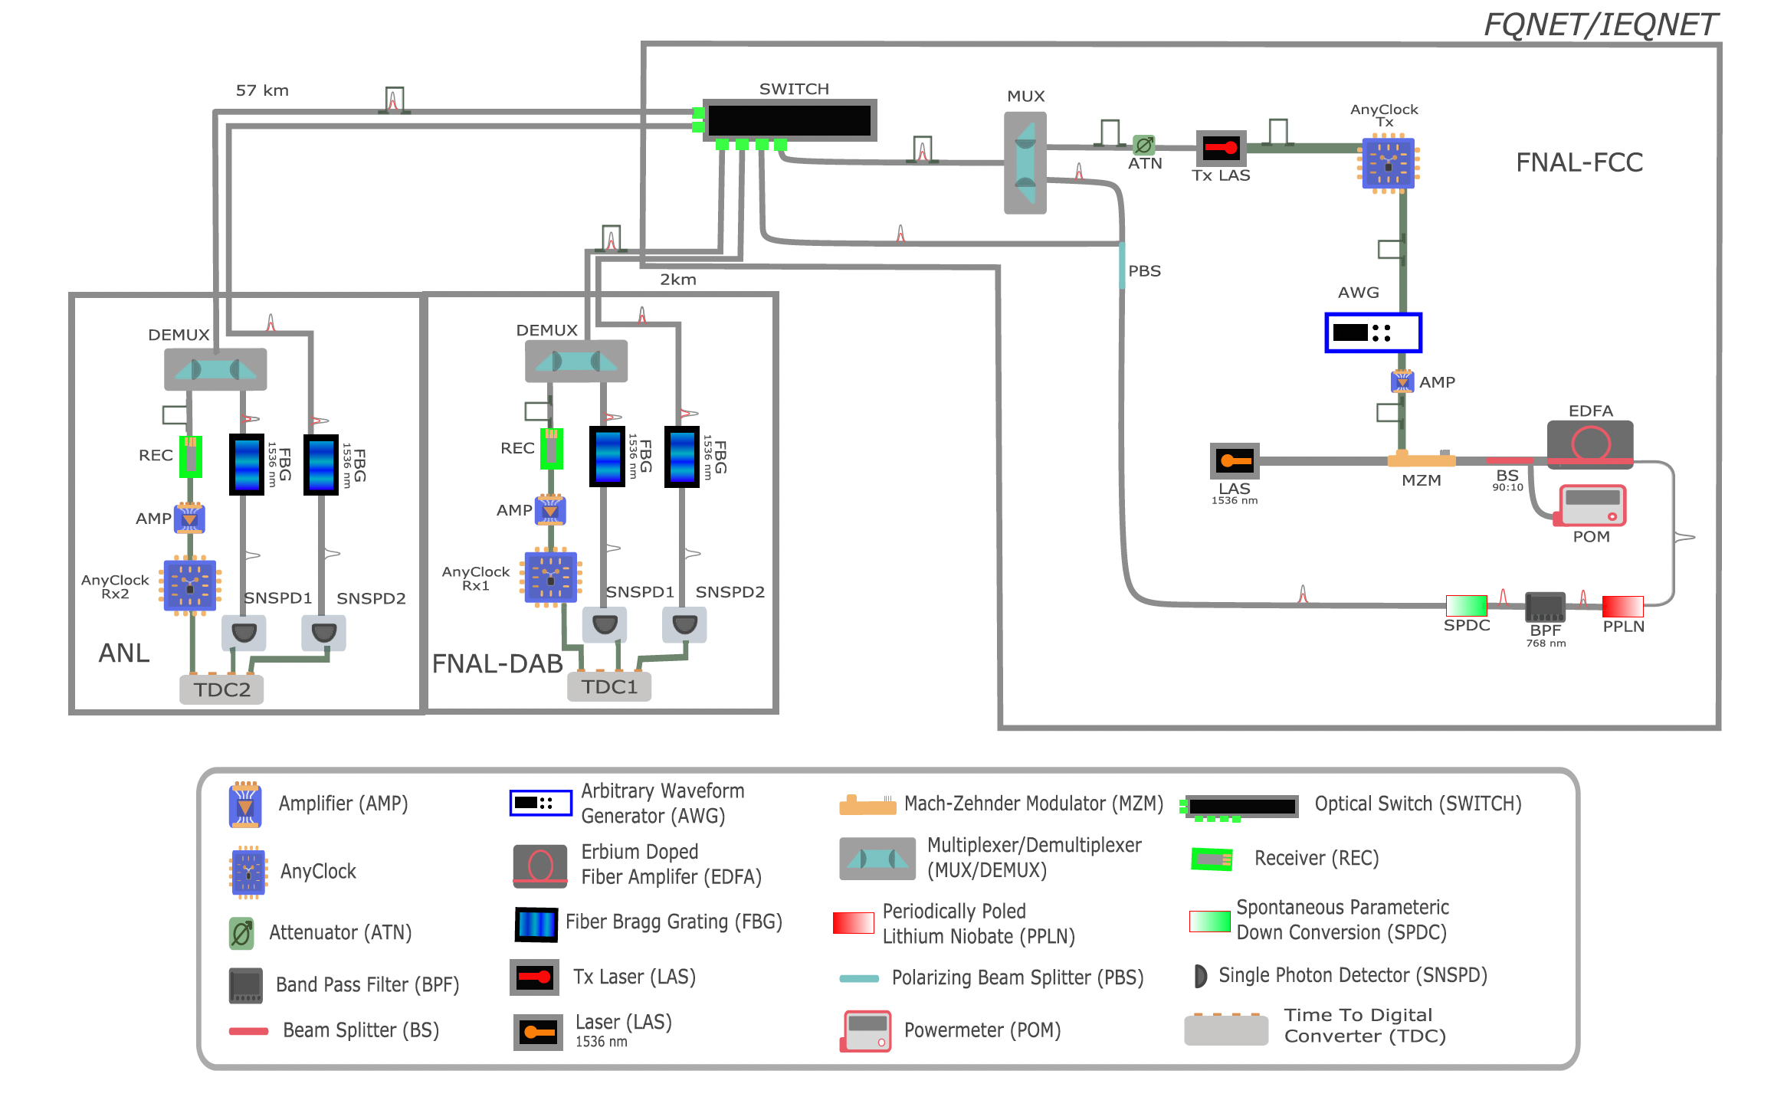
Timing and Synchronization Network
Timing circuit between Fermi and Argonne for Entanglement Distribution.
square pulses → clock signal grey Gaussian Pulse → quantum light
Red Gaussian Pulse → second harmonic (768 nm),
The photon pairs are produced at FNAL-FCC and routed either 2 km away to FNAL-DAB
or 57 km away to ANL through software provided with the optical switch
Ref: K. Kapoor et al., "Picosecond Synchronization System for the Distribution of Photon Pairs Through a Fiber Link Between Fermilab and Argonne National Laboratories," in IEEE Journal of Quantum Electronics, vol. 59, no. 4, pp. 1-7, Aug. 2023, Art no. 9300107, doi: 10.1109/JQE.2023.3240756.

Slide 13
Where we’re headed
Prepare Argonne for the the Bob node
Modifying the timing synchronization circuit (if needed)
Participate in setting up the low jitter SNSPDs

Slide 14
Where we’re headed
Working on coexistence of Classical and Quantum signals
Adding high-rate sources to the network
  Upgrading existing SNSPDs to lower jitter.
Swapping between Fermilab and Argonne

