Slide 1


Higher-dimensional quantum communication using photons
Eric Chitambar
A-QNET Kickoff meeting
December 13, 2023
University of Illinois
Urbana-Champaign

Slide 2
Outline
Introduce quantum multiplexing
Describe some applications (prior work and future A-QNET directions)
Introduce hyper-entanglement
Describe some applications (prior work and future A-QNET directions)

Slide 3
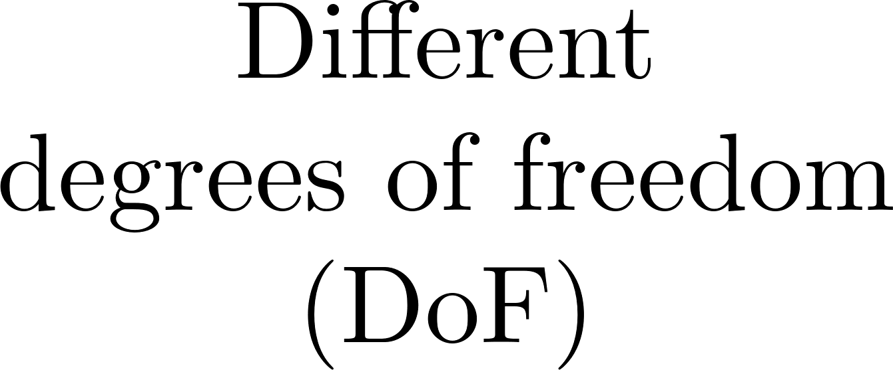
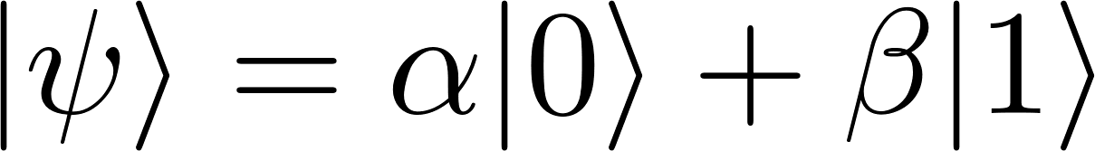

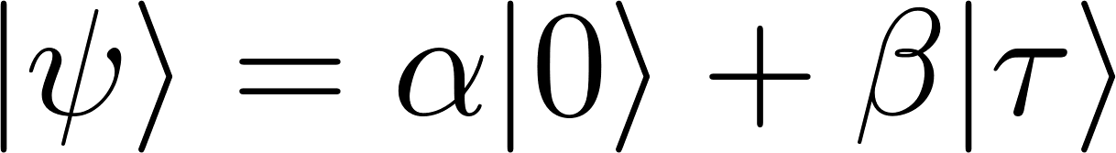

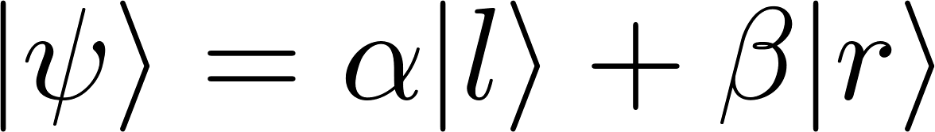
Conventional qubit encoding in quantum comm.
one qubit logical state
one photon physical state
…

Slide 4
Quantum multiplexing
Lo Piparo, Munro, and Nemoto PRA, 99, 022337 (2019).
three qubit logical state
one photon physical state
Pilnyak et al. PRA 100, 043826 (2019).

Slide 5
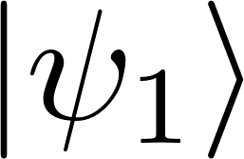
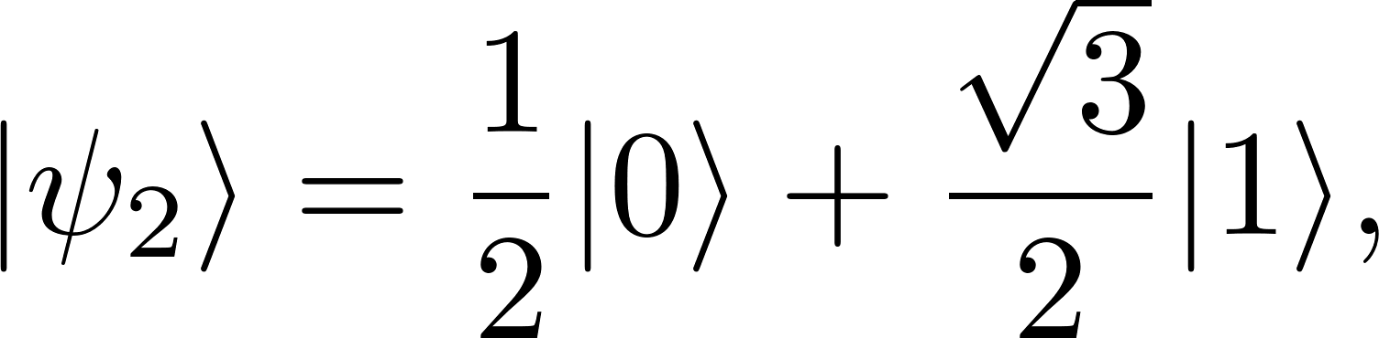
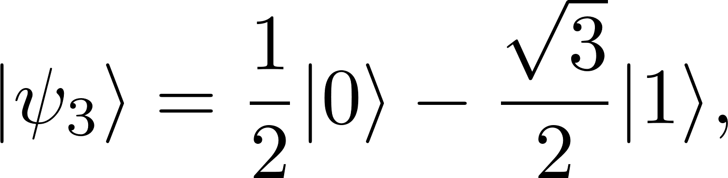
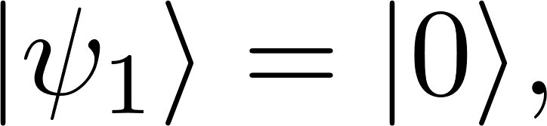
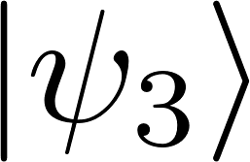
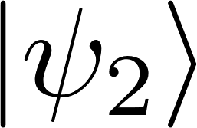
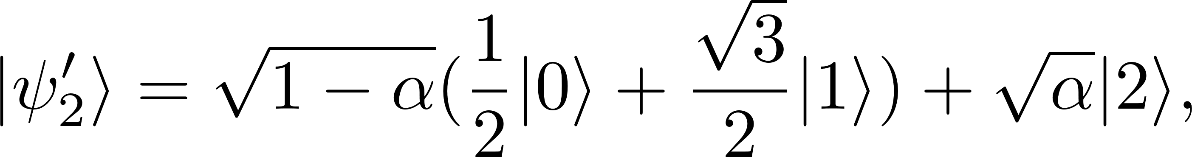
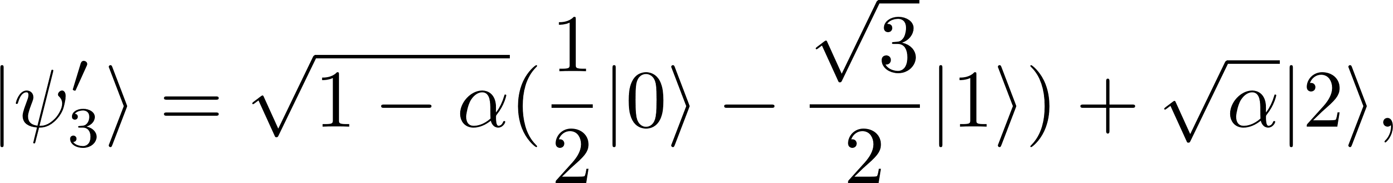


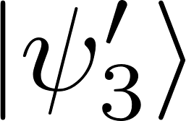

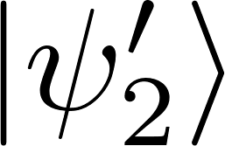
Quantum multiplexing

Slide 6
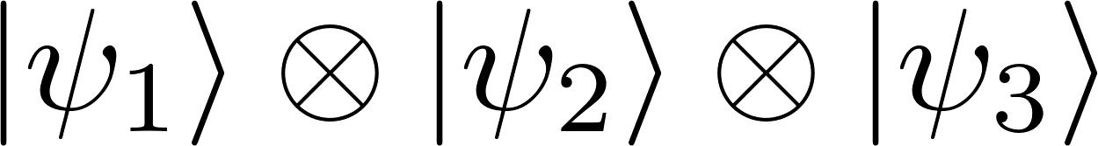
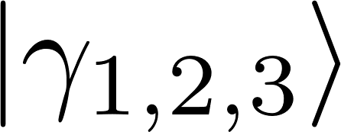





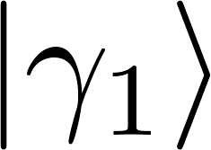

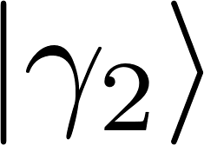
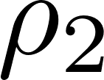
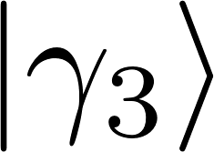

Using multiple DOFs for good!
three qubits
one photon
With
multiplexing:
three photons
Without multiplexing:
three qubits

Slide 7
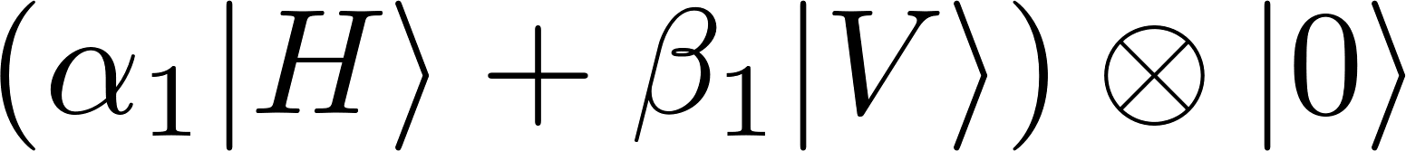
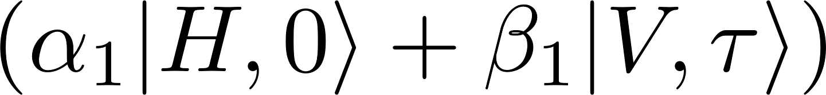
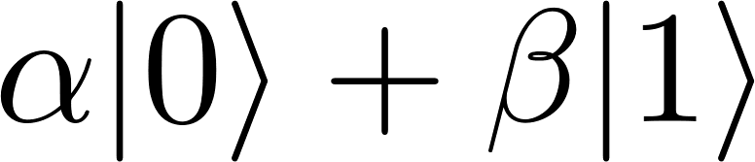
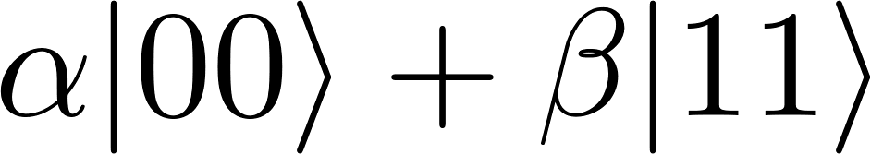



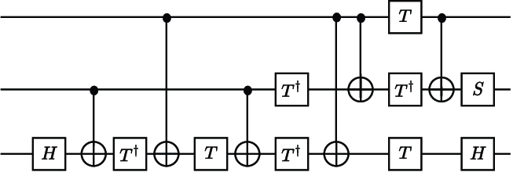

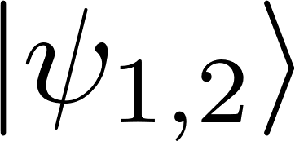


Using multiple DOFs for good!
Toffoli
Without multiplexing:
With multiplexing:
OS
OS
Ralph et al. PRA, 75 022313 (2007)
Kwiat and Weinfurter PRA, 58 R2623 (1998).

Slide 8




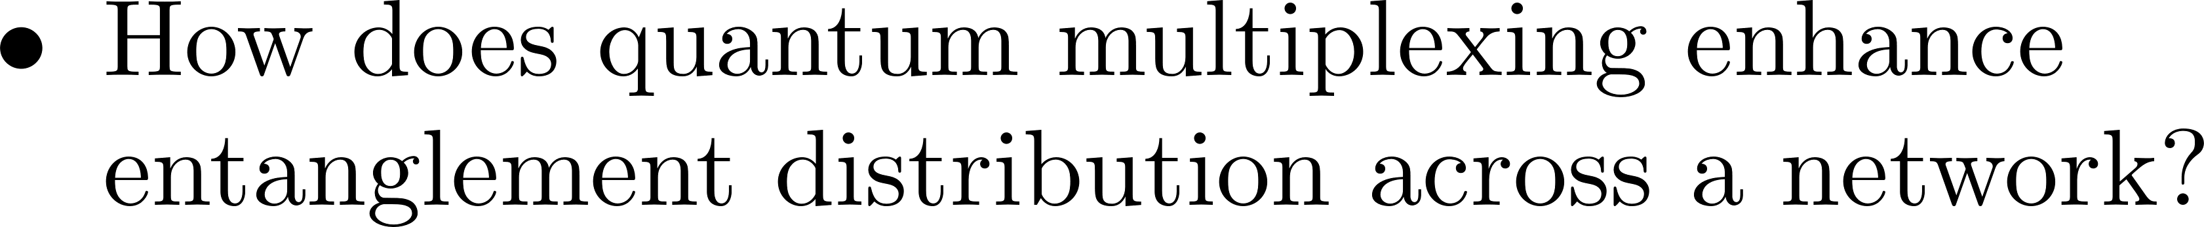
Applications of quantum multiplexing
Lo Piparo, Munro, and Nemoto PRA, 99, 022337 (2019).

Slide 9




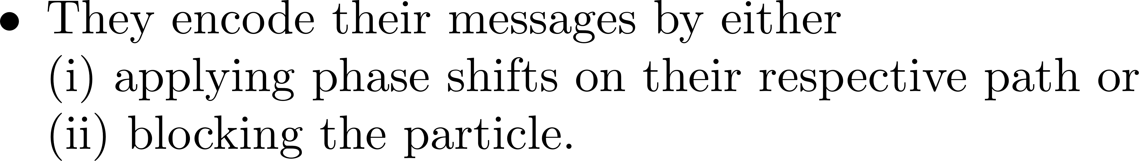







Applications of quantum multiplexing
1
1
Particle
Source
2
2
Receiver
…
…
…
…
N
N

Slide 10
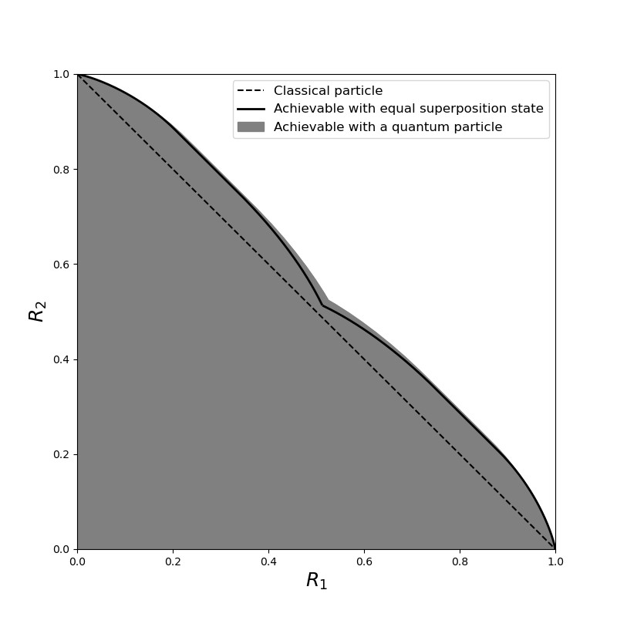
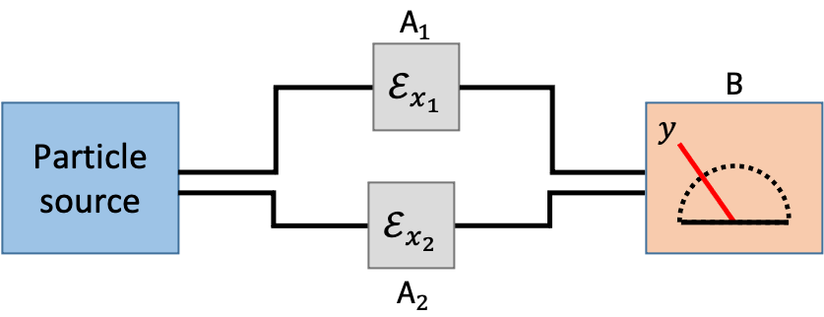


Applications of quantum multiplexing
Chen, Zhang, Lorenz, Winter, E.C. arXiv:2301.02513

Slide 11
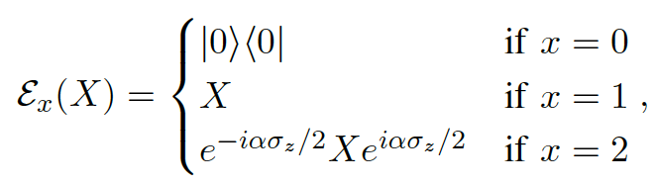
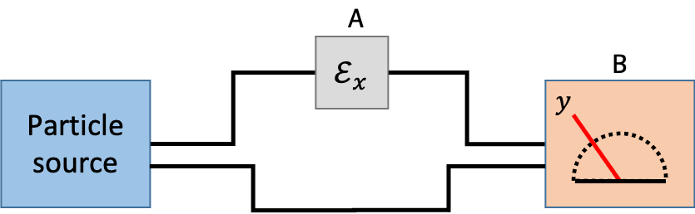
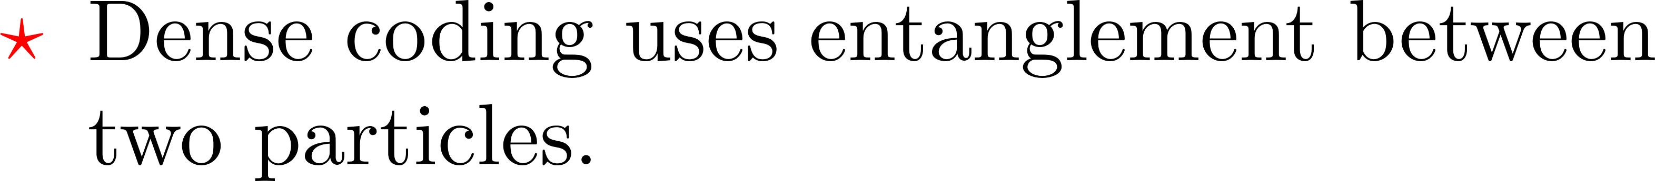



Applications of quantum multiplexing
(blocking)
(identity)
($α$ phase)
$${R ≤χ}^{∗}=\max_{q,θ}{qh_{2}\left(\cos^{2}{θ}\right)+\cos^{2}{θ}h_{2}\left(q\right)}≈1.2339$$
Chen, Zhang, Lorenz, Winter, E.C. arXiv:2301.02513

Slide 12
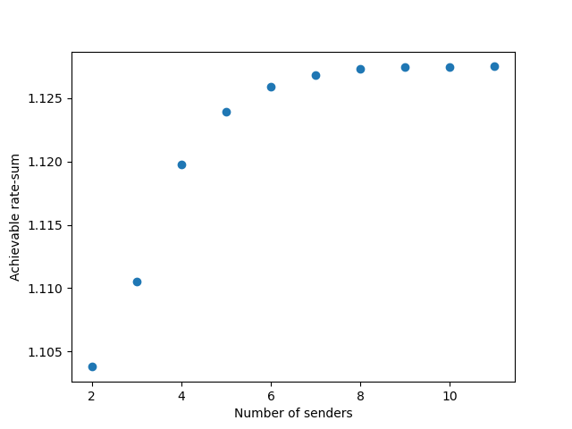
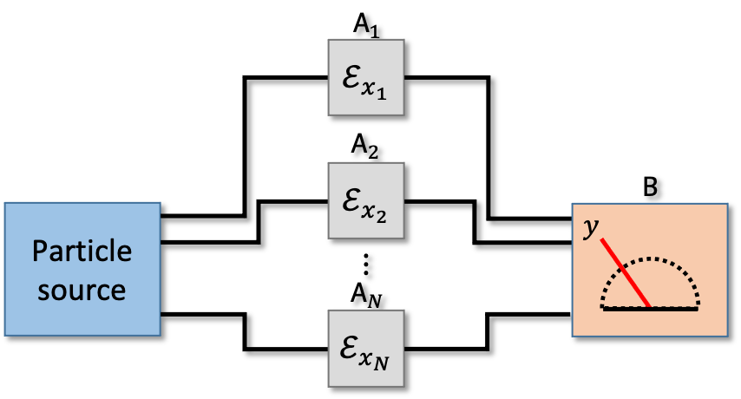
Applications of quantum multiplexing
Chen, Zhang, Lorenz, Winter, E.C. arXiv:2301.02513

Slide 13


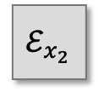
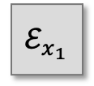



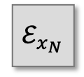

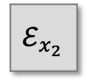
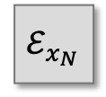

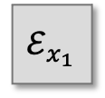


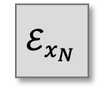

Applications of quantum multiplexing
$$A_{1}$$
$$ℰ_{x_{1}}$$
$$ℰ_{x_{1}}$$
$$ℰ_{x_{1}}$$
$$A_{2}$$
$$ℰ_{x_{2}}$$
$$B$$
$$ℰ_{x_{2}}$$
Particle source
$$ℰ_{x_{2}}$$
$$y$$
Particle source
Particle source
$$⋮$$
$$A_{N}$$
$$ℰ_{x_{N}}$$
$$ℰ_{x_{N}}$$
$$ℰ_{x_{N}}$$
Chen, Zhang, Lorenz, Winter, E.C. arXiv:2301.02513

Slide 14
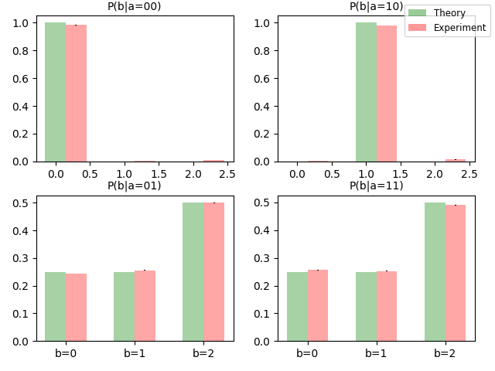
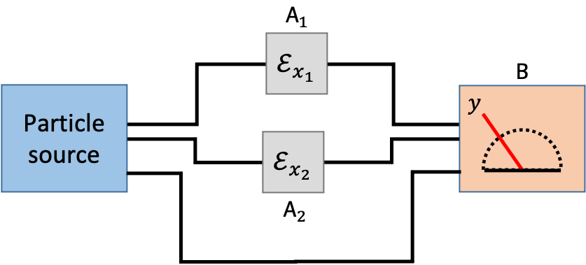
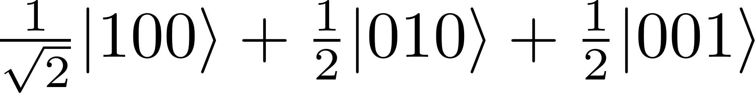
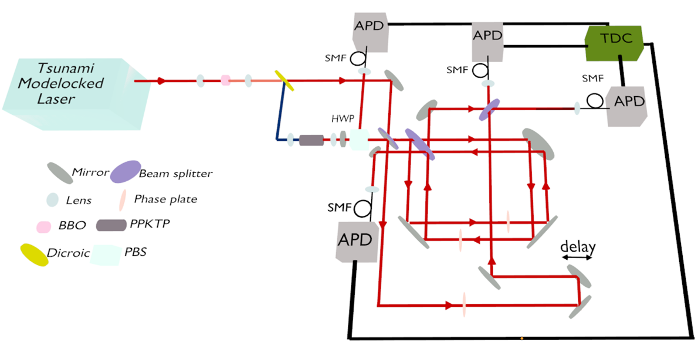

Applications of quantum multiplexing
$$ℰ_{x}\left(X\right)={\left(σ_{z}\right)}^{x}X{\left(σ_{z}\right)}^{x}$$
p(y|x₁x₂=00)
p(y|x₁x₂=01)
p(y|x₁x₂=10)
p(y|x₁x₂=11)
y=0
y=1
y=2
y=0
y=1
y=2
Predicted rate sum: 1.0875
Calculated experimental rate sum: 1.015 ± 0.003
Chen, Zhang, Lorenz, Winter, E.C. arXiv:2301.02513

Slide 15
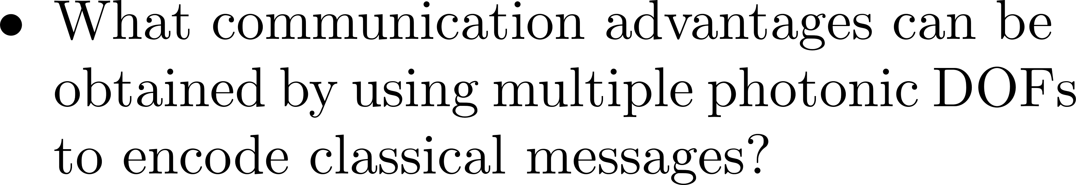
Applications of quantum multiplexing
1
1
Particle
Source
2
2
Receiver
…
…
…
…
N
N

Slide 16
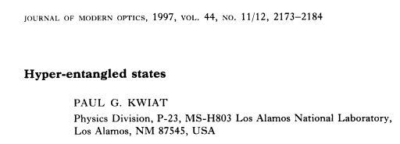
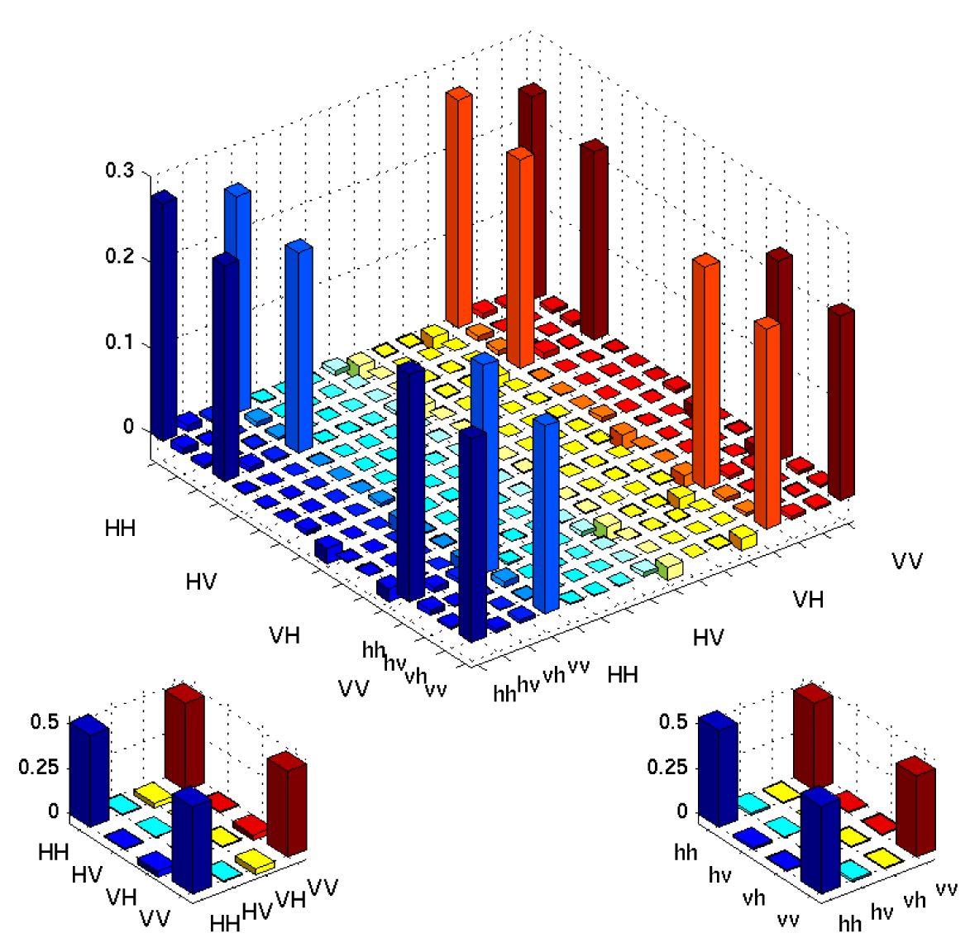
Hyper-entanglement

Slide 17

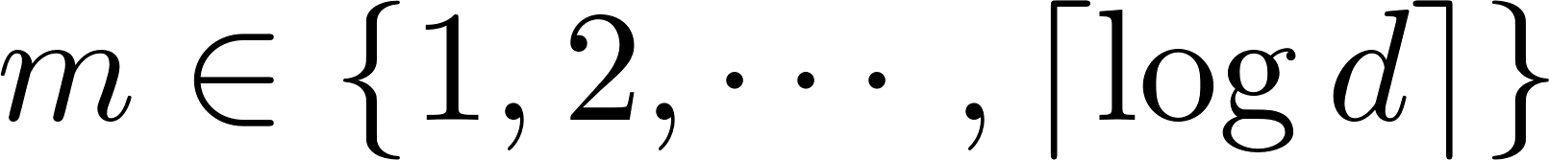



Applications of hyper-entanglement
Graham et al. Nat Comm, 6 718 (2015).
Ecker et al. PRL, 127 040506 (2021).
Without hyper-entanglement:
With hyper-entanglement:
Chen and EC (2023)

Slide 18















Applications of hyper-entanglement
Shared Classical Randomness
Black Box
Black Box

Slide 19




Applications of hyper-entanglement
Shared Classical Randomness
Black Box
Black Box
J.F. Clauser; M.A. Horne; A. Shimony; R.A. Holt, PRL 23, 880 (1969)

Slide 20


Applications of hyper-entanglement
Shared Classical Randomness
Black Box
Black Box

Slide 21



Applications of hyper-entanglement
Zeitler et al. PR Applied, 18 054025 (2022).

Slide 22



















Applications of hyper-entanglement
Kim et al. IEEE Comm Lett, 2886016 (2018)
Buhrman et al. PRL, 87 167902 (2001)

Slide 23

Thank You!

