Slide 1
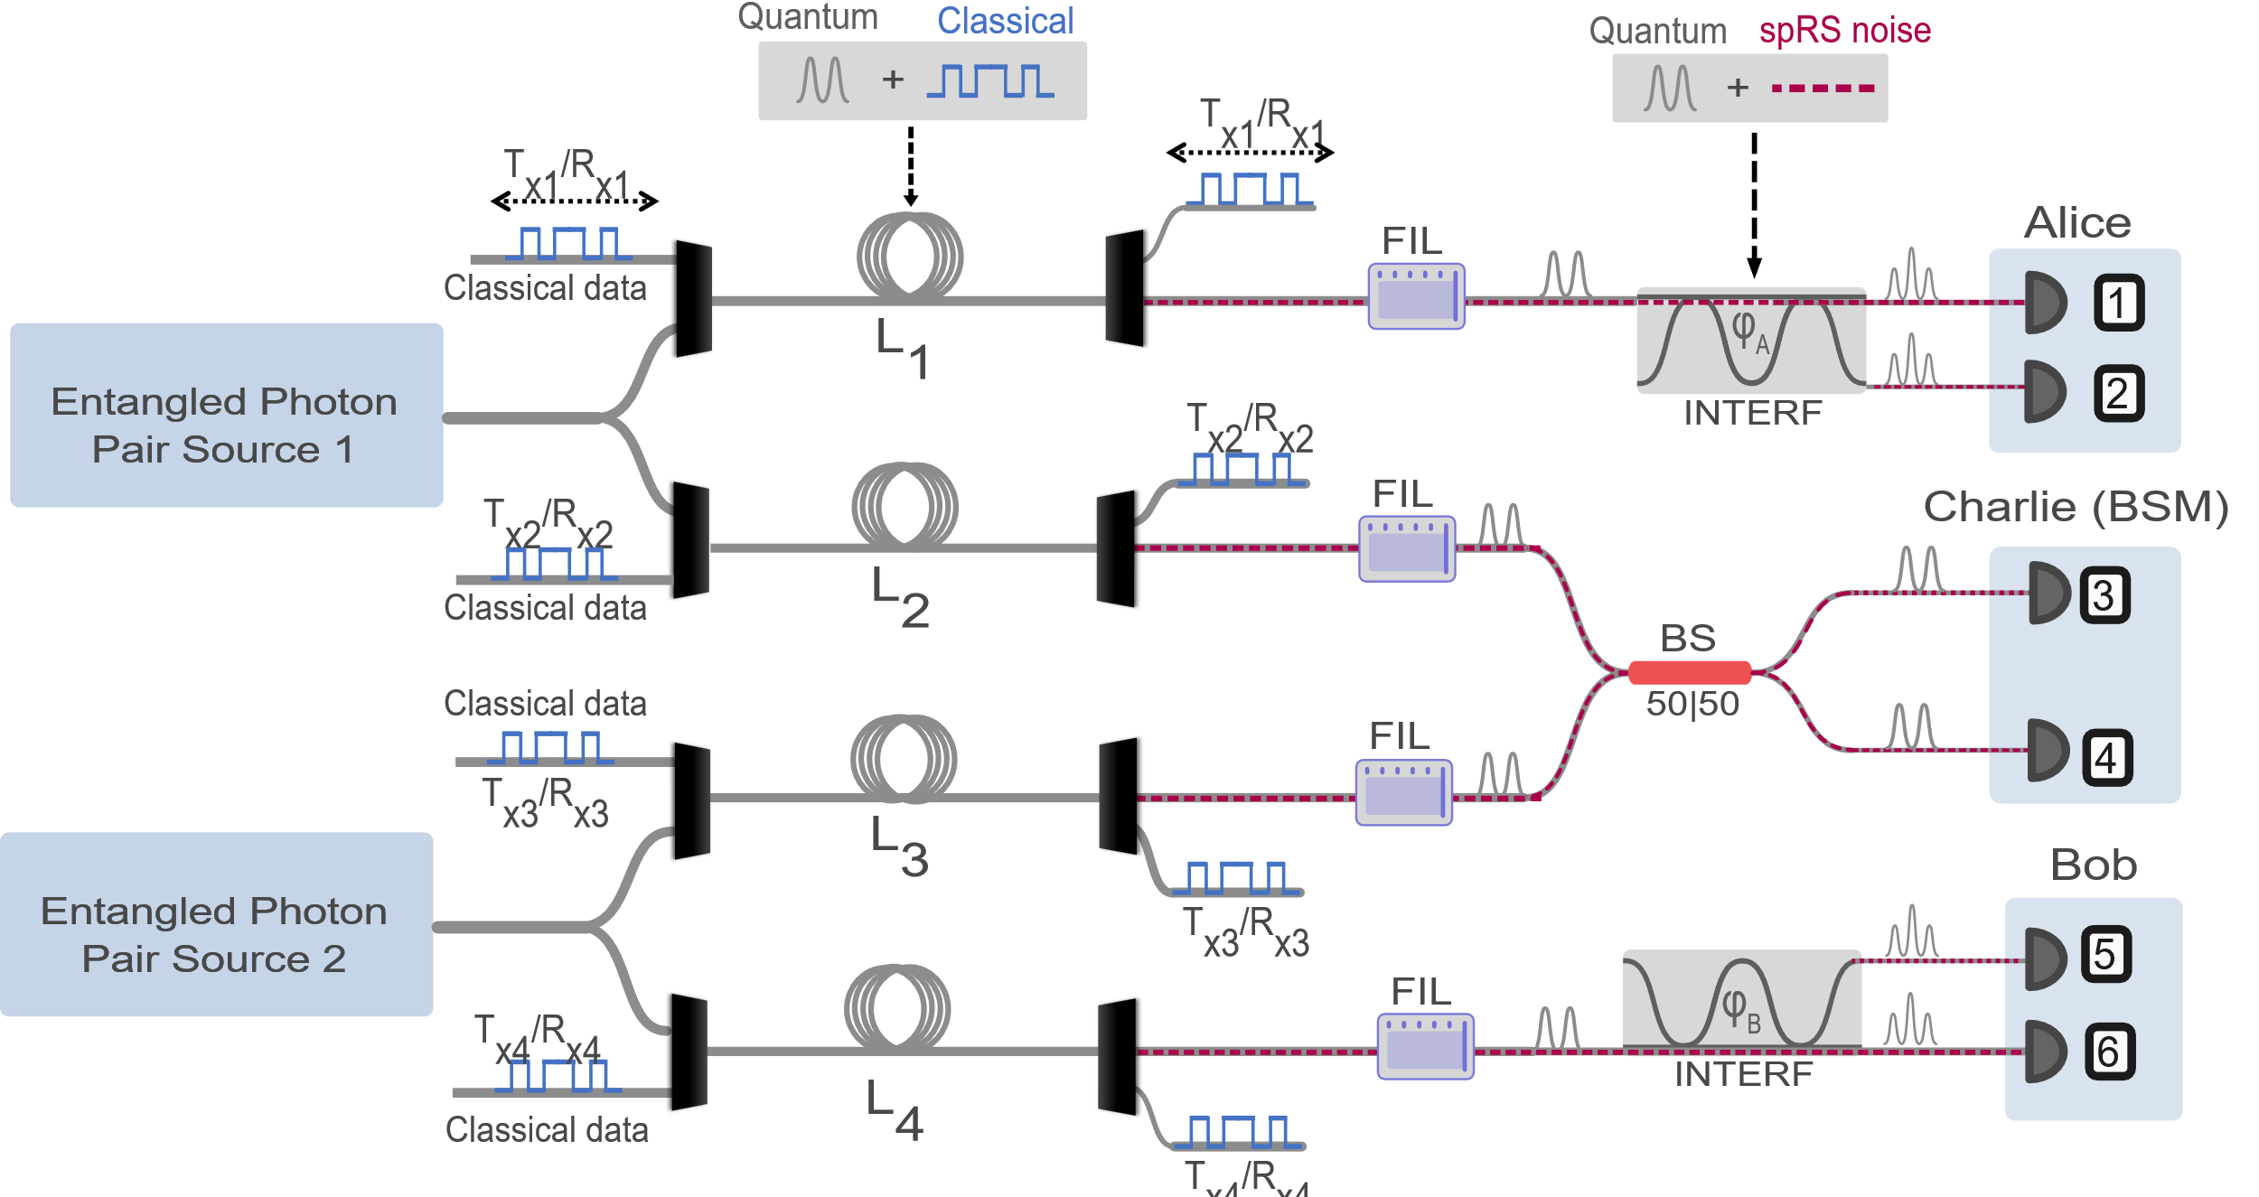
Quantum Entanglement, Teleportation, and Entanglement Swapping Systems Coexisting with Classical Communications
Notes:
Hi Jordan Thomas, a graduate student working under my advisor Prem Kumar at northwestern university. This work is done with my collaborators at international center for advanced internet research, nucrypt LLC and Ciena corporation and I’ll be talking about our recent work on quantum teleportation systems coexisting with conventional classical telecommunications traffic in the same optical fibers.

Slide 2
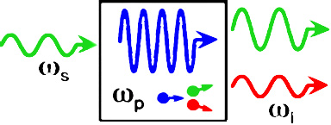
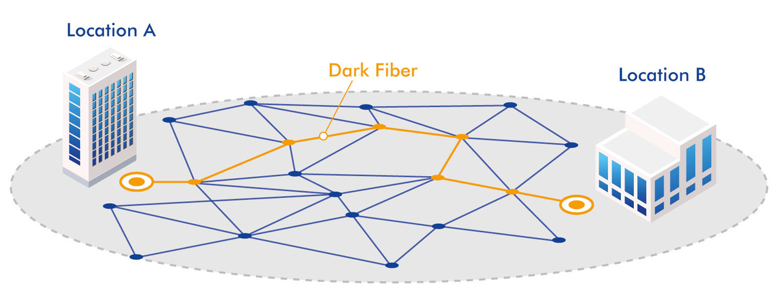
CPCC
Quantum-Classical Coexistence for Scalable Quantum Network Deployment
Dark fiber quantum communications
“Coexistence”
Quantum and classical communications sharing fibers
Quantum
communications
Classical communications
Quantum + classical
-Limits the number of available fiber links
-More costly to lease, maintain, or install quantum dedicated fibers
-Can operate in arbitrary fiber links
-Cost effective
- Resource efficient
Notes:
The main motivation for this work is that scaling the deployment of quantum network technology, and an eventual quantum internet, will benefit from the ability for both quantum and classical communications to coexist in the same fiber infrastructure. This will help ease the availability of fiber links between quantum node locations and reduce costs of leasing and maintaining quantum dedicated fibers.
The main challenge, particularly in standard single mode fibers, is that having both weak quantum signals and strong classical signals in the same fibers is complicated by the fact that the strong classical signals can limit. This means that without careful engineering of the system, either classical system requirements are limited in their power, sacrificing for example classical data rates, or quantum signal fidelity is degraded.

Slide 3
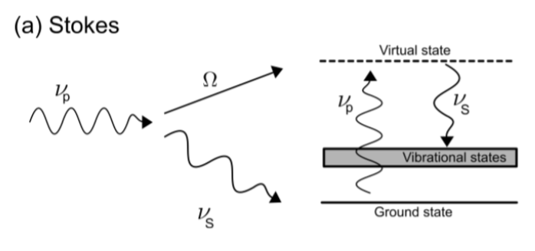
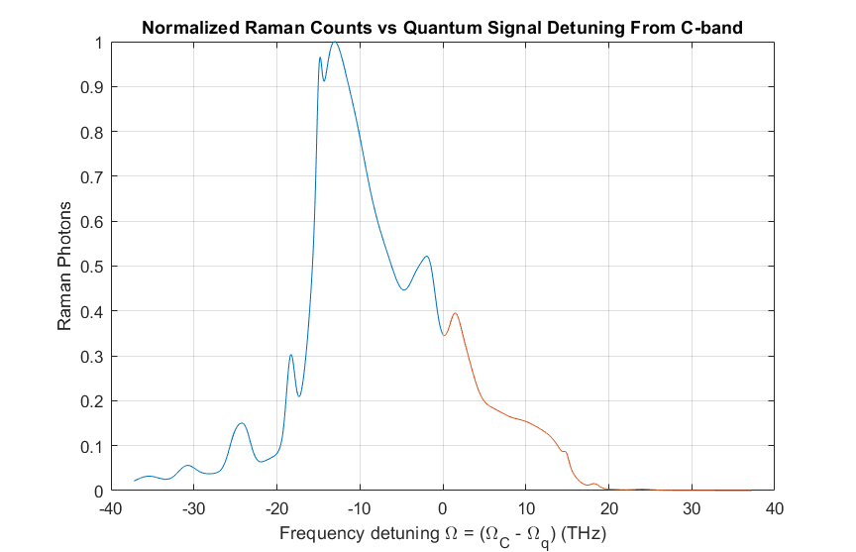
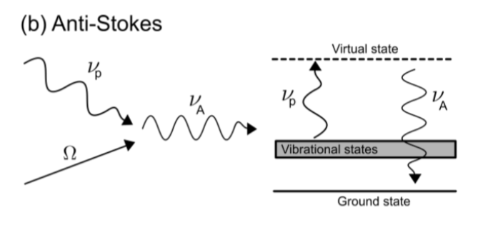
CPCC
Main Limitation:
Spontaneous Raman Scattering Noise
Quantum
(sub photon level)
Quantum + noise
Fiber
Broadband spectrum
Can’t avoid noise entirely
Many local maxima and minima of various strength
highly depends on quantum-classical detuning
Classical
(μW to 100’s of mW)
Classical
pump
Stokes
Anti-stokes
Classical Pump
Simulated based off:
Hollenbeck, D. & Cantrell, C. D. J. Opt. Soc. Am. B/Vol. 19, (2002)
Center for Photonic Communication and Computing
McCormick School of Engineering and Applied Science

Slide 4
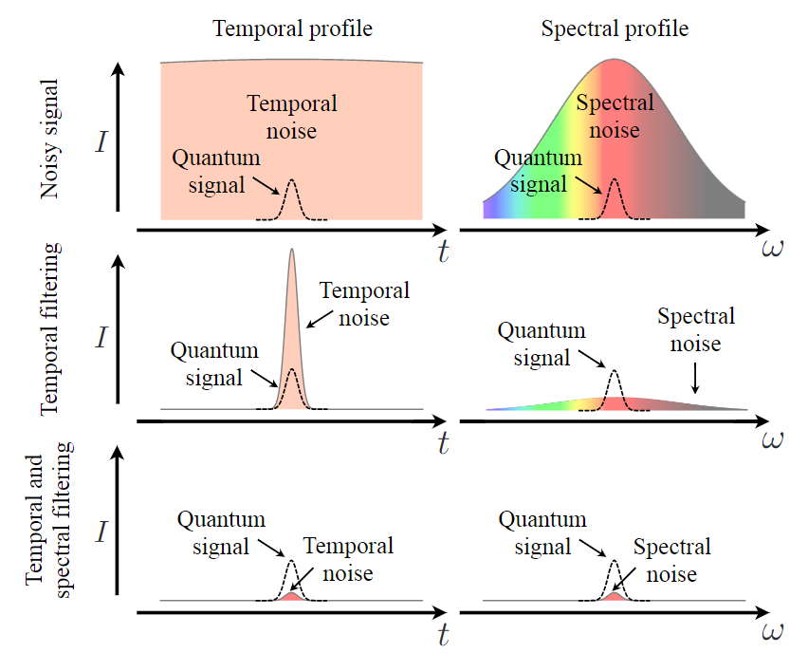
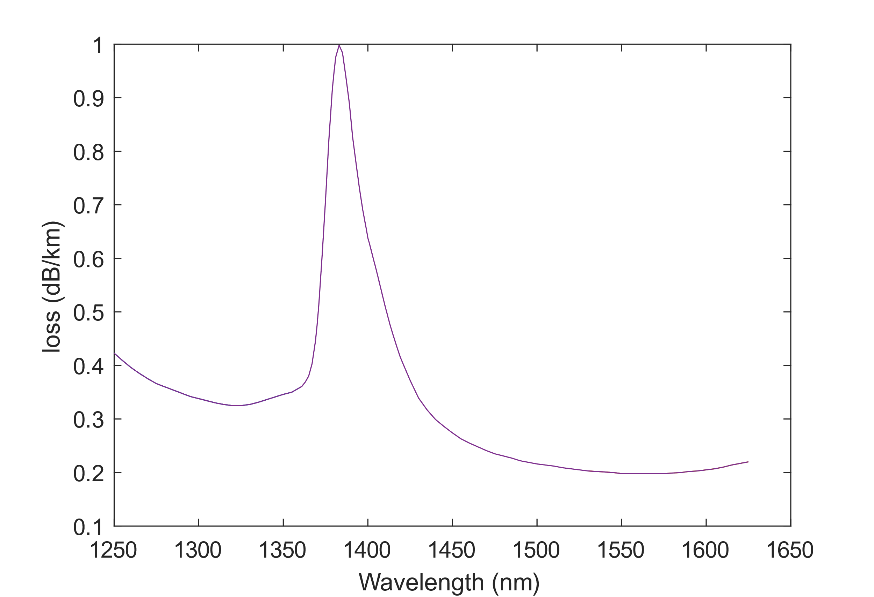
CPCC
Main Raman Noise Reduction Strategies
1. Wavelength Assignment based on Raman noise spectrum
2. Narrow spectral-temporal filtering
Quantum = C-band
Classical = C-band
Loss spectrum
O-band
C-band
L-band
pump
Quantum = C-band
Classical = L-band
Quantum = C-band
Classical = O-band
Quantum = O-band
Classical = C-band
~35 THz
Center for Photonic Communication and Computing
McCormick School of Engineering and Applied Science
Notes:
Place quantum signals in the lowest gain regions of the Raman spectrum
Anti-stokes detuning from the classical signal wavelength
However, must ensure both quantum and classical signals have low loss
Narrow spectral-temporal filtering around quantum signal modes to reject multi-mode uncorrelated spRS noise

Slide 5
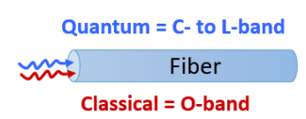
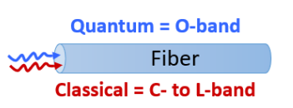
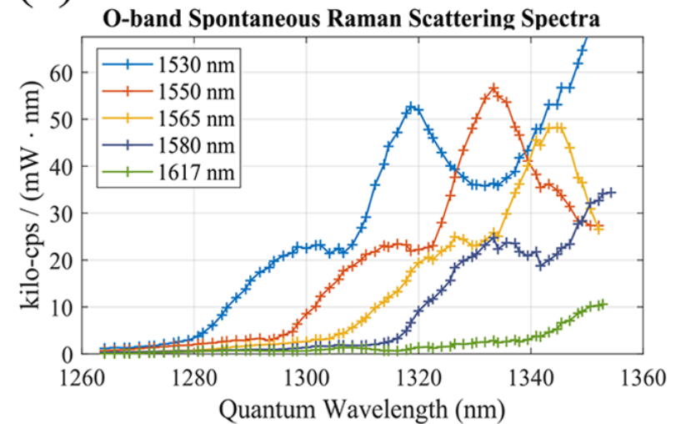
CPCC
What are the Least Noisy Wavelengths for Telecom Quantum-Classical Signals
Fermi/Caltech/Argonne:
Quantum = C-, L-band
Classical = ?
Northwestern:
Quantum = O-band
Classical = ?
Lowest noise O-band classical channels
Lowest noise O-band quantum channels

Slide 6
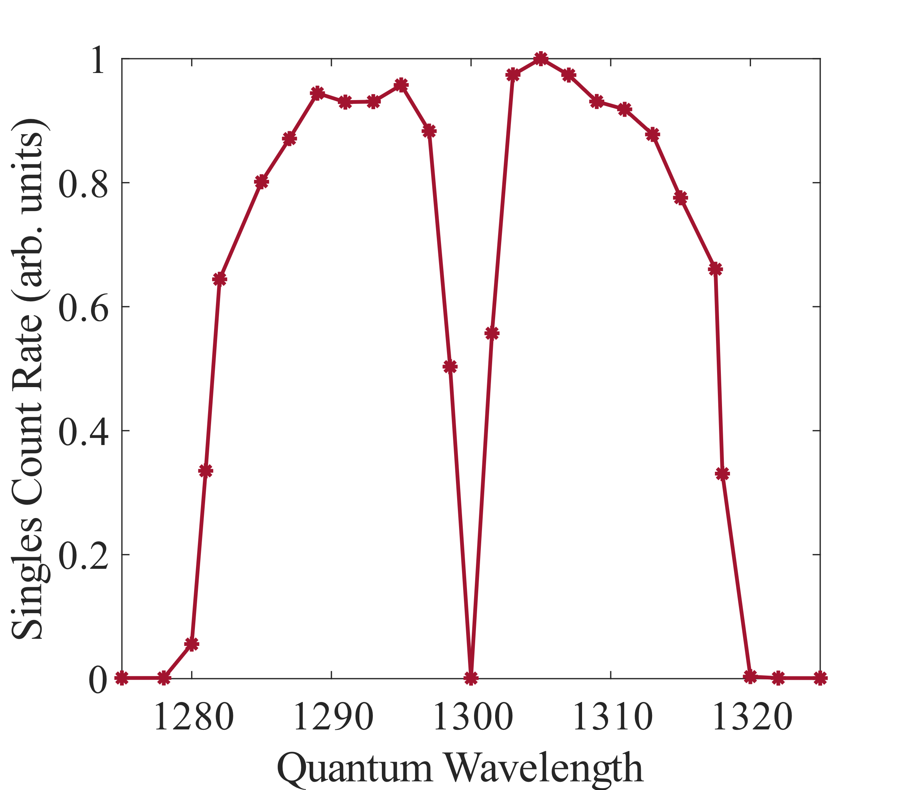
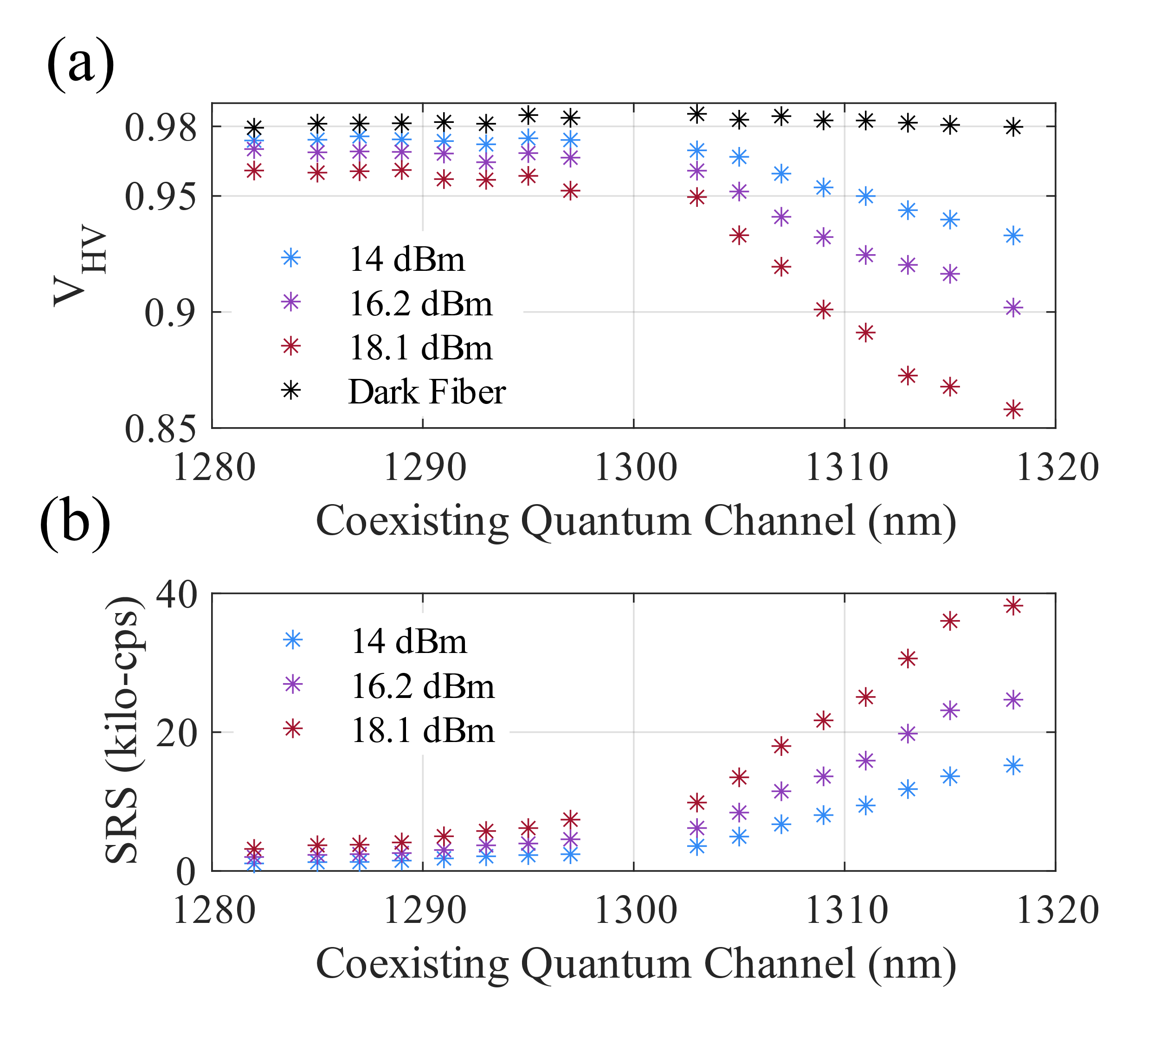
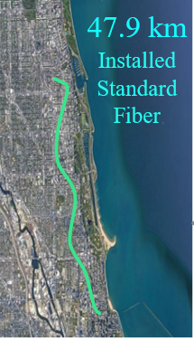
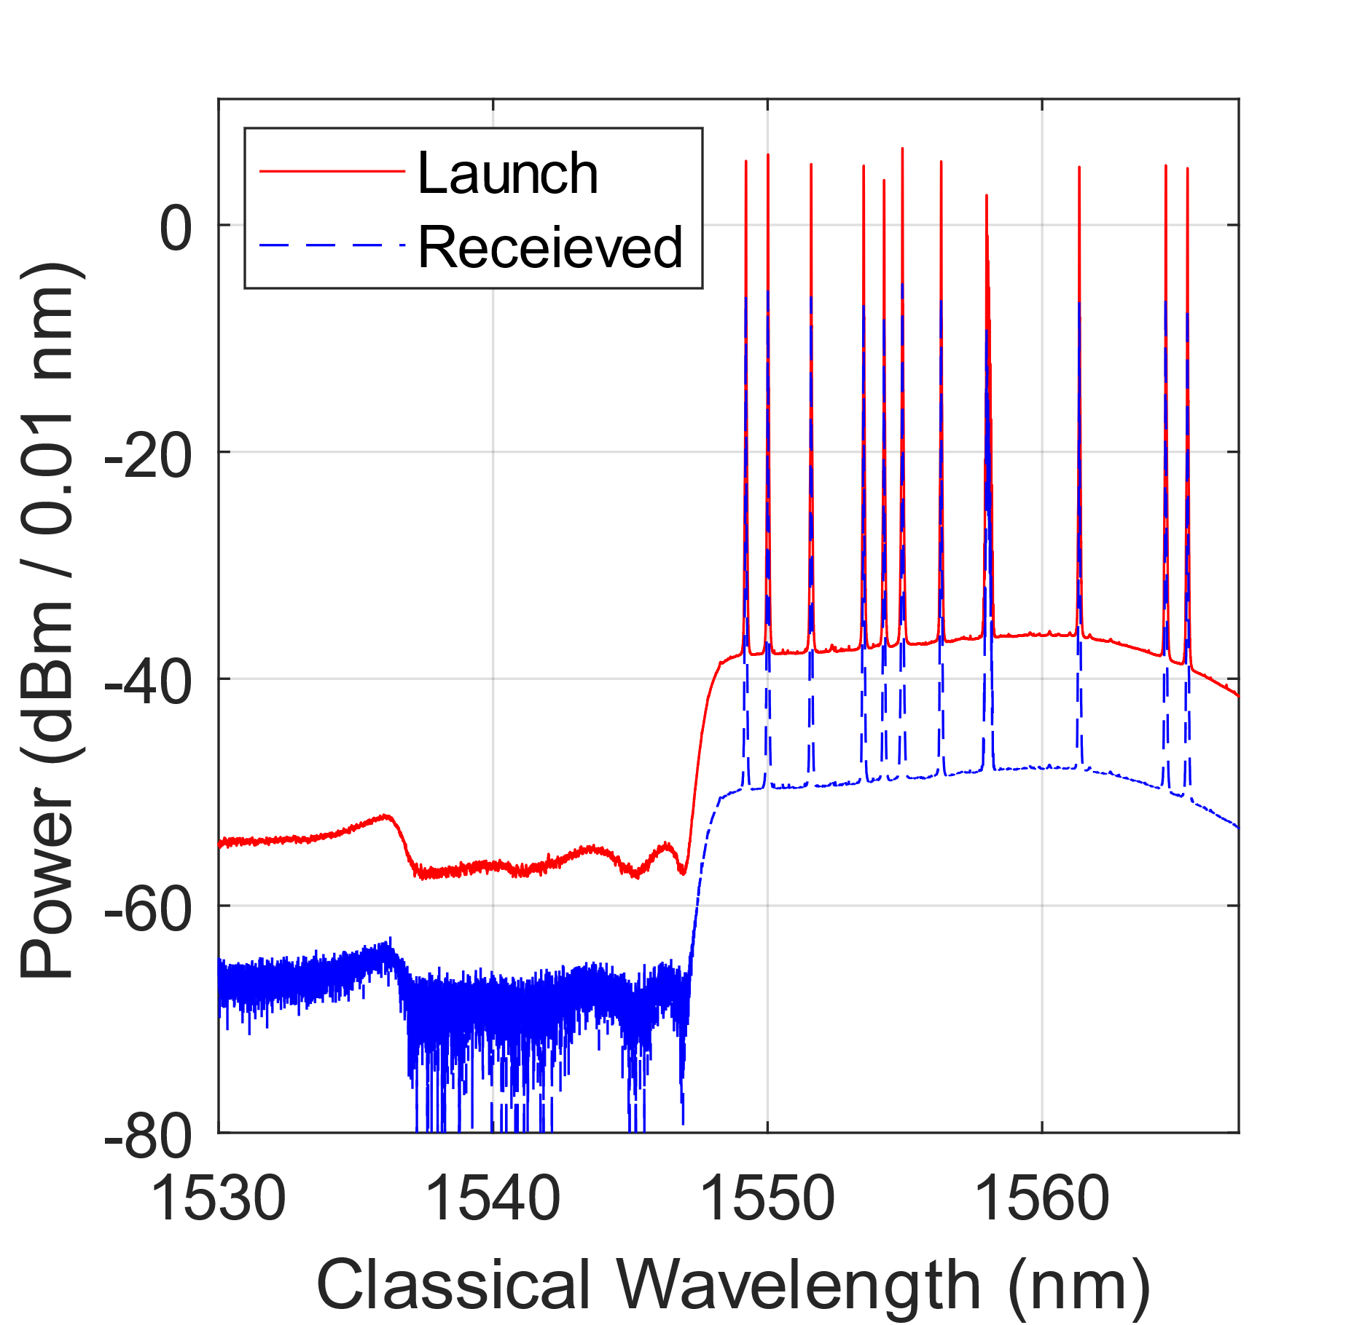
CPCC
Investigating WDM O-band Entanglement and High-Power WDM C-band Classical Communications
O-band Entangled Photon Source Spectrum
(1280 nm-1320 nm)
Impact of noise on 16 different 50-GHz filtered O-band channels across 1280 nm-1320 nm with up to 18.1 dBm C-band power
Entangled two-photon interference visibility
signal
idler
NU
11-channel C-band Classical Source
(1549 nm-1565 nm)
Coexistence
Raman noise count rates
Starlight
Optimized channels clearly outperform others

Slide 7
CPCC
Comparison to state-of-the-art
- Single channel/single photon 1310 nm QKD
- Coexistence over 66 km commercial backbone fiber
21 dBm of WDM C-band power/ Tbps classical rates
- Multi-wavelength and entangled photon
- 18 dBm over 48 km installed fiber
- Found that 1310 nm is generally not best wavelength to choose
Multi-channel
C-band classical
Multi-channel
C-band classical
Multi-λ channel
entangled photons
1310 single photon
(single λ)
Center for Photonic Communication and Computing

Slide 8
CPCC
Quantum State Teleportation and Classical Communications in the Same Fiber
Coexistence has been demonstrated with single photons, entangled photons, and Bell state measurements between single photons: can teleportation, swapping, etc. be performed alongside classical communications?
Case study: Photon encoding initial qubit and one photon of an entangled pair are transmitted to a BSM node, classical signals bypass BSM node to transmit the full length

Slide 9
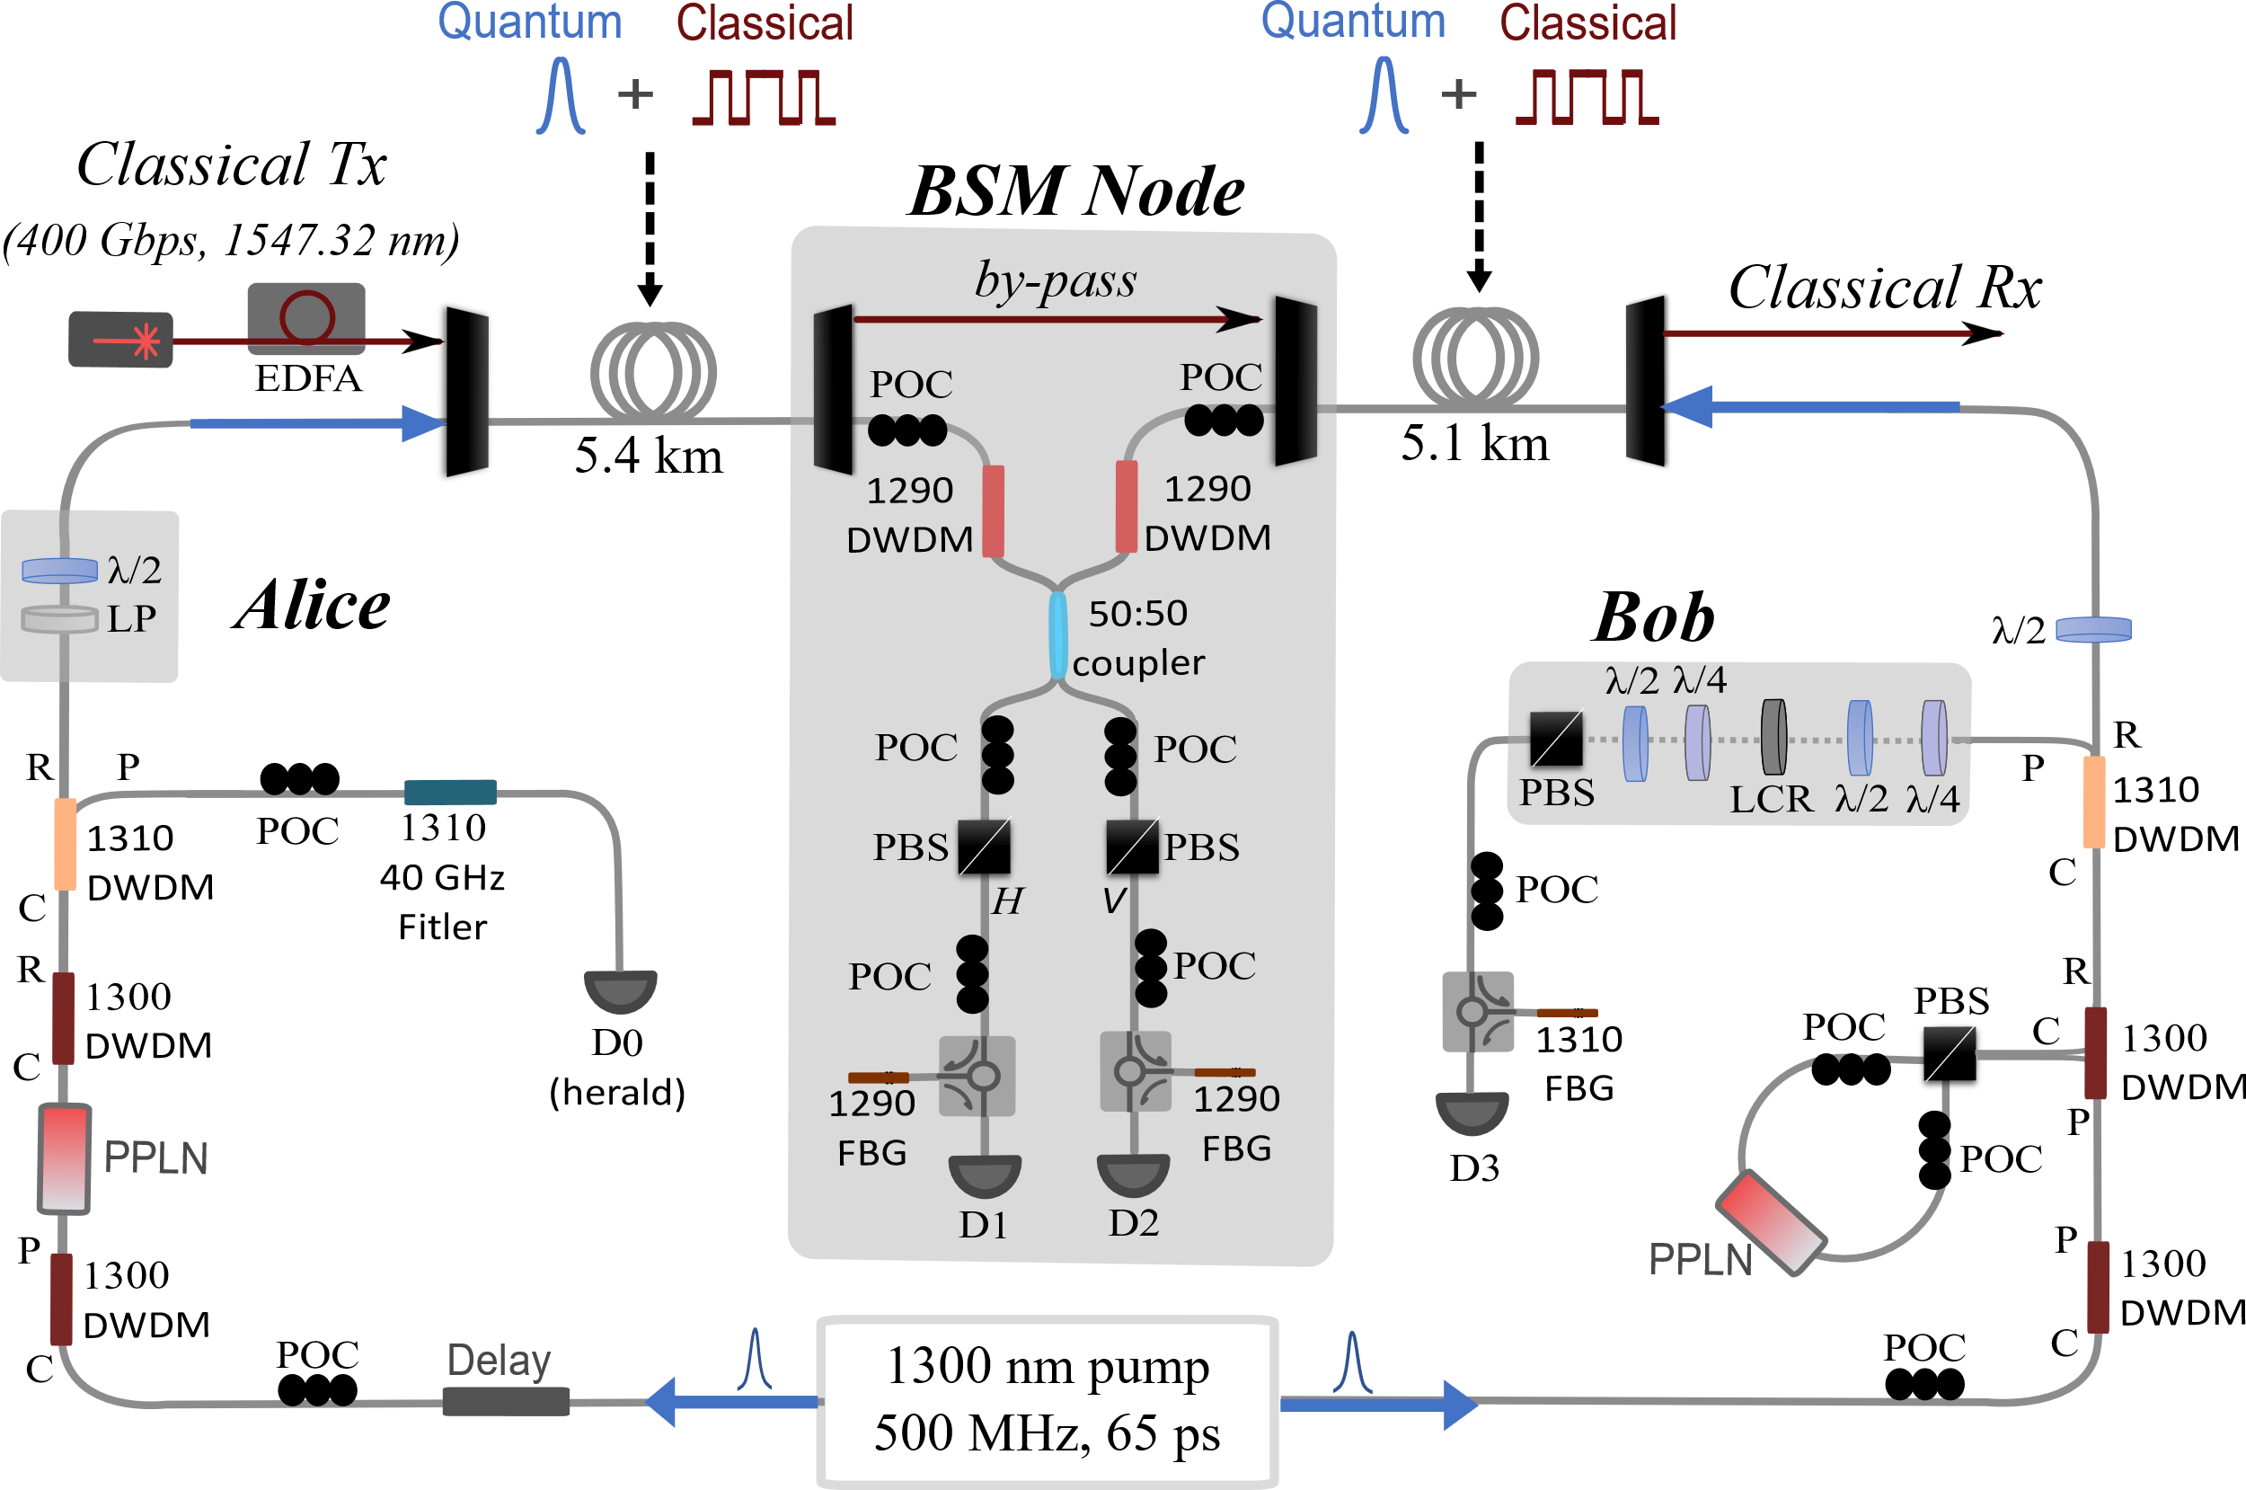
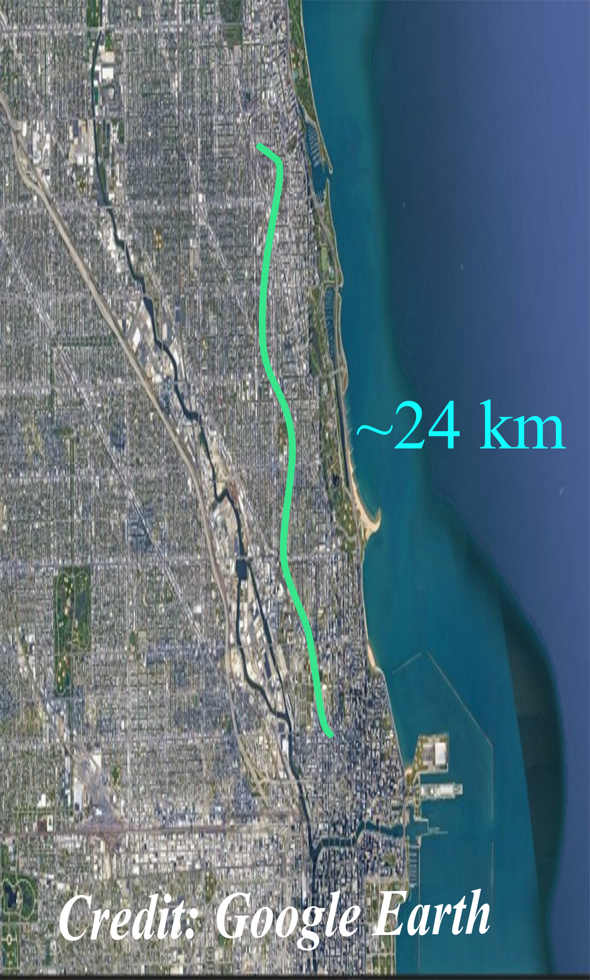
CPCC
O-band Teleportation and 400-Gbps C-band Classical Communications over 10.5 km
Quantum state transfer:
5.4 km+5.1 km = 10.5 km
Classical link distance:
48 km+10.5 km = 58.5 km
Evanston Northwestern lab
Photon Pair Generation:
1290
1300
1310
1290 nm photons→ coexist to BSM node
Classical Tx/Rx at Starlight:
400 Gbps at 1547.32 nm
Ciena WaveLogic 5 Nano 400ZR

Slide 10
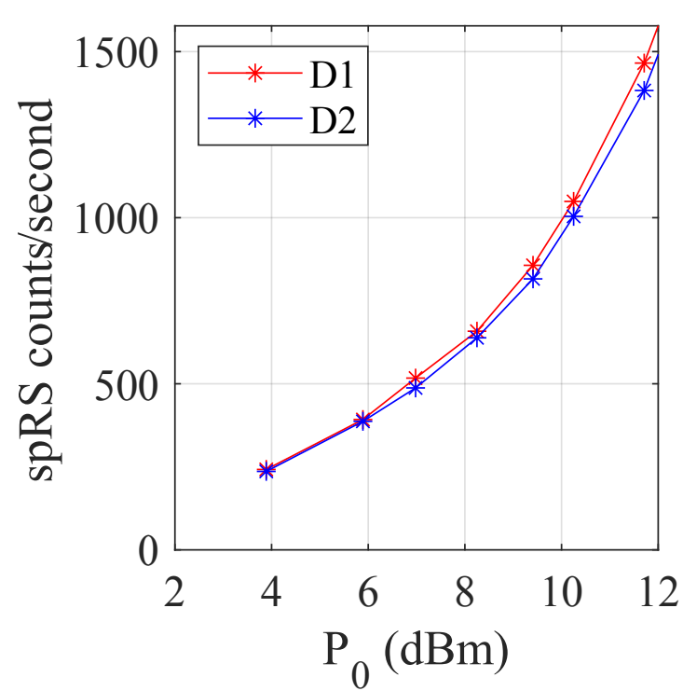
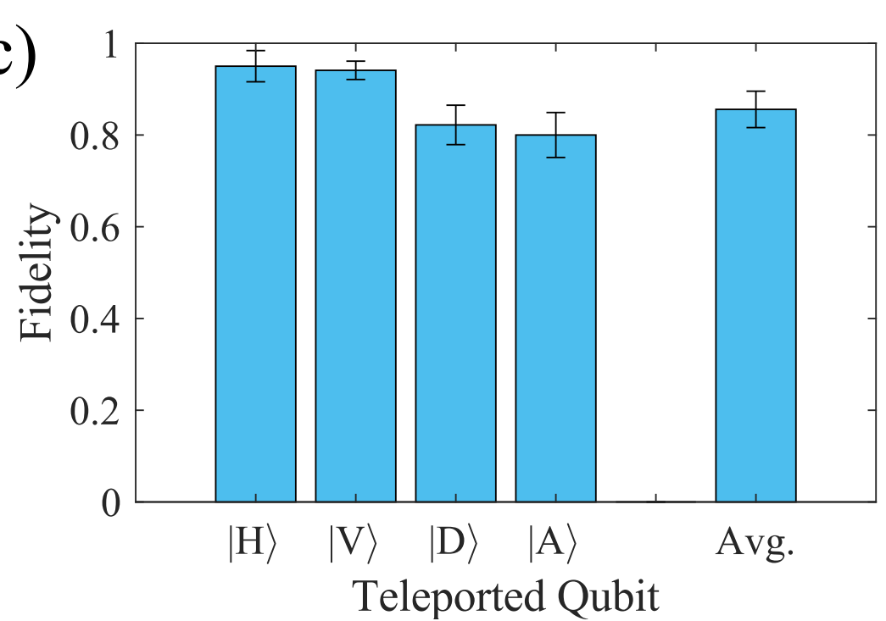
CPCC
Results
Raman noise vs. launch power:
Using optimized wavelengths and narrowband filtering (~8 GHz), classical signal only adds
~100 counts per mW
Teleportation fidelities of Bob’s qubit to Alice’s ideal state with P_{1547 nm} = 11 dBm
~100 counts/s/mW
Nonclassical limit (F > 66.7%)
SNSPD dark count level
McCormick School of Engineering and Applied Science
Notes:
Next, we performed teleportation with the 400G signal transmitted with 11 dBm of power. Here is an example of a 4-fold coincidence fringe as we rotate Bob’s polarization setting for Alice transmitting the diagonal and anti-diagonal state. On the right we show the results of the measured teleported qubit fidelity to Alice’s ideal qubit via quantum state tomography. We obtain an average fidelity for an arbitrary qubit of 85.6 +/- 4% with 11 dBm of power, which is well above the nonclassical limit of 2/3.

Slide 11
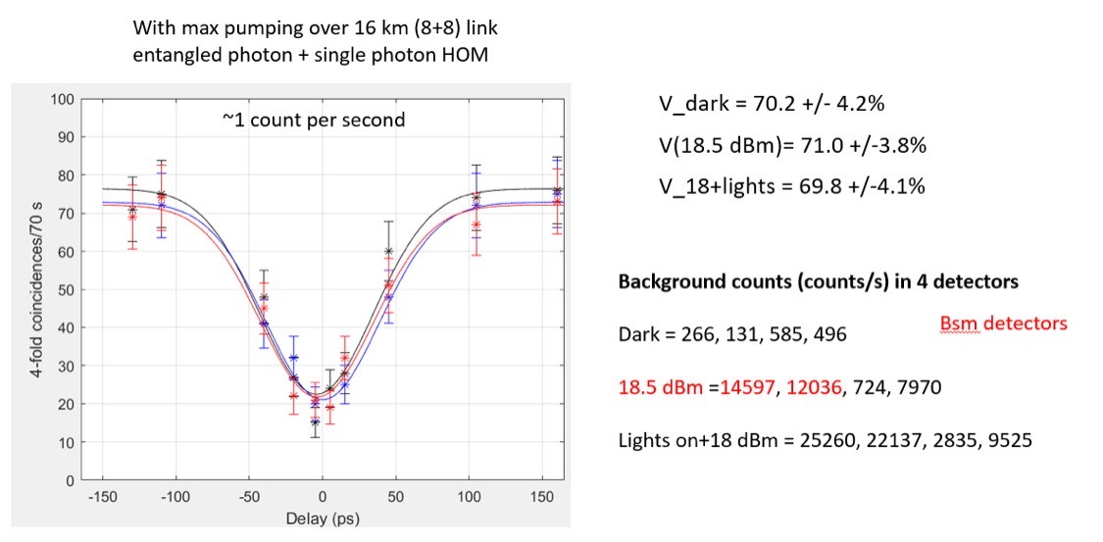
CPCC
Newer results: 16 km, 18 dBm power
Hong-Ou-Mandel interference between heralded single photon and entangled photon with 8 km/8km to BSM node
P_{400 Gbps} = 18 dBm, 16 km
8 km
8 km
In progress: investigating longer distances, higher powers, modeling
Center for Photonic Communication and Computing
McCormick School of Engineering and Applied Science
Notes:
Next, we performed teleportation with the 400G signal transmitted with 11 dBm of power. Here is an example of a 4-fold coincidence fringe as we rotate Bob’s polarization setting for Alice transmitting the diagonal and anti-diagonal state. On the right we show the results of the measured teleported qubit fidelity to Alice’s ideal qubit via quantum state tomography. We obtain an average fidelity for an arbitrary qubit of 85.6 +/- 4% with 11 dBm of power, which is well above the nonclassical limit of 2/3.

Slide 12
CPCC
Entanglement Swapping Coexistence
- With 4 photons transmitting 4 fibers, many possible experiments could be imagined
- Classical signals can co-propagate, counter-propagate, etc.
- Each could have different classical wavelengths
- Choice of fiber lengths in each arm will change how Raman impacts fidelity
Center for Photonic Communication and Computing
Notes:
In conclusion, we have shown that teleportation systems can coexist with high data rate high power classical signals. Due to the noise engineering, we saw little degradation of power up to 10’s of mW C-band power. We note that the fidelities could be improved via the same improvements in arbitrary teleportation systems.
We further note that since our system has 2 photon pair sources, changing Alice’s state to an entangled state would result in entanglement swapping, which due to the low noise levels it is reasonable to conclude we could have noise robust entanglement swapping.

Slide 13
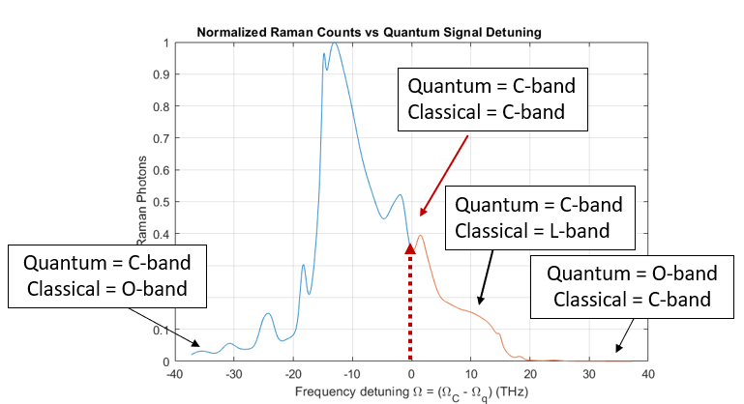
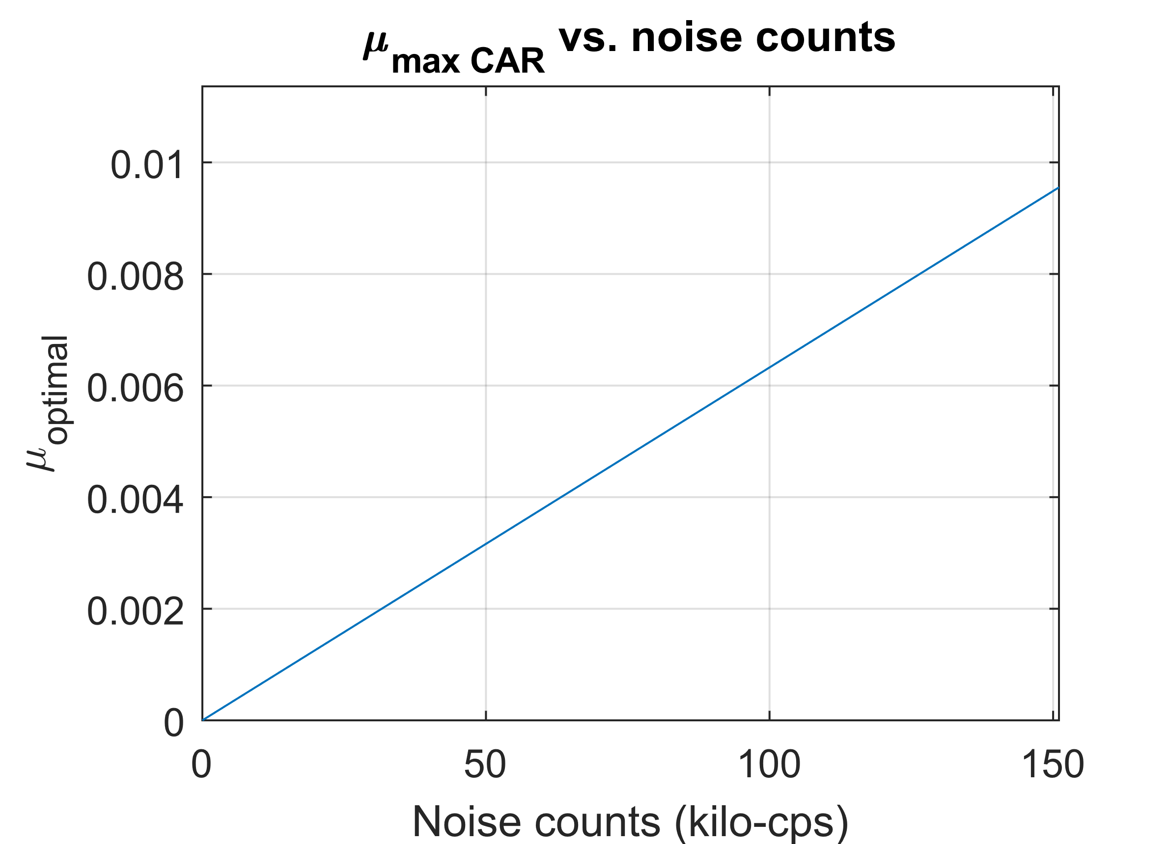
CPCC
Key Parameters to Investigate
- Choice of quantum-classical wavelengths
-Fermi setup is restricted to ~1536 nm quantum signals
- some wavelengths are more noise-optimized (C-band/O-band)
- but all are worth studying (ex. C-band/C-band)
Note: Noise in C-band will be unavoidably much higher than using O-band quantum signals
- How does performance scale as a function of fiber lengths and power?
-Raman will increase, quantum rates will decrease
- How does increased noise impact the optimal pair generation rates to achieve highest fidelity?
-In dark fiber, optimal fidelities will occur at low pair generation rates due to multi-pair emission noise.
-This is not generally true when background counts and transmission losses are increased due to reduced signal-to-noise
Notes:
In conclusion, we have shown that teleportation systems can coexist with high data rate high power classical signals. Due to the noise engineering, we saw little degradation of power up to 10’s of mW C-band power. We note that the fidelities could be improved via the same improvements in arbitrary teleportation systems.
We further note that since our system has 2 photon pair sources, changing Alice’s state to an entangled state would result in entanglement swapping, which due to the low noise levels it is reasonable to conclude we could have noise robust entanglement swapping.

Slide 14
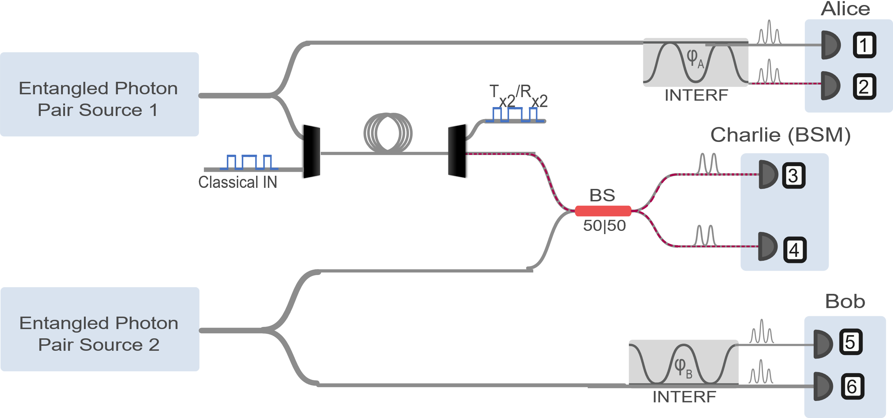
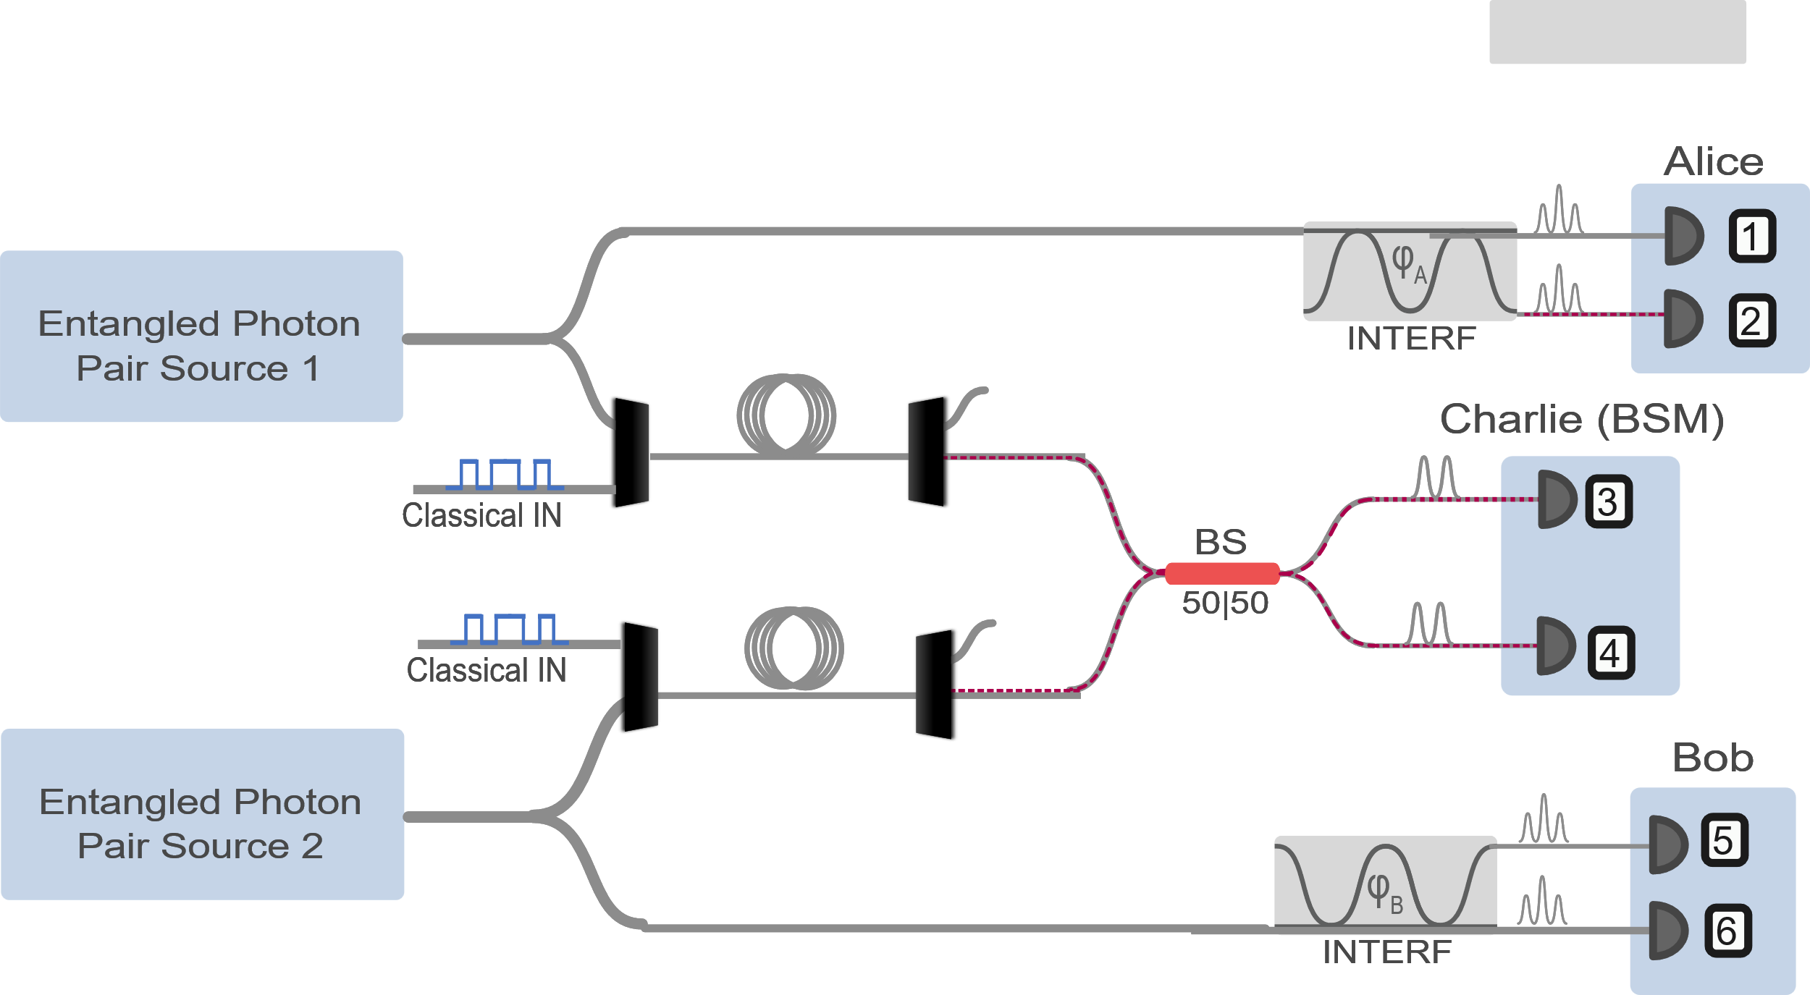
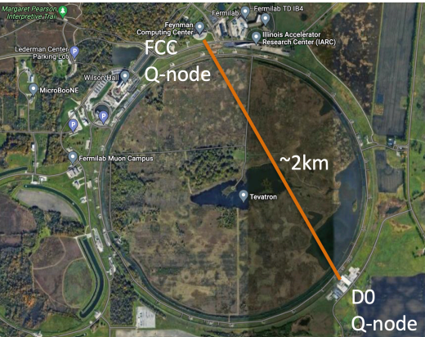
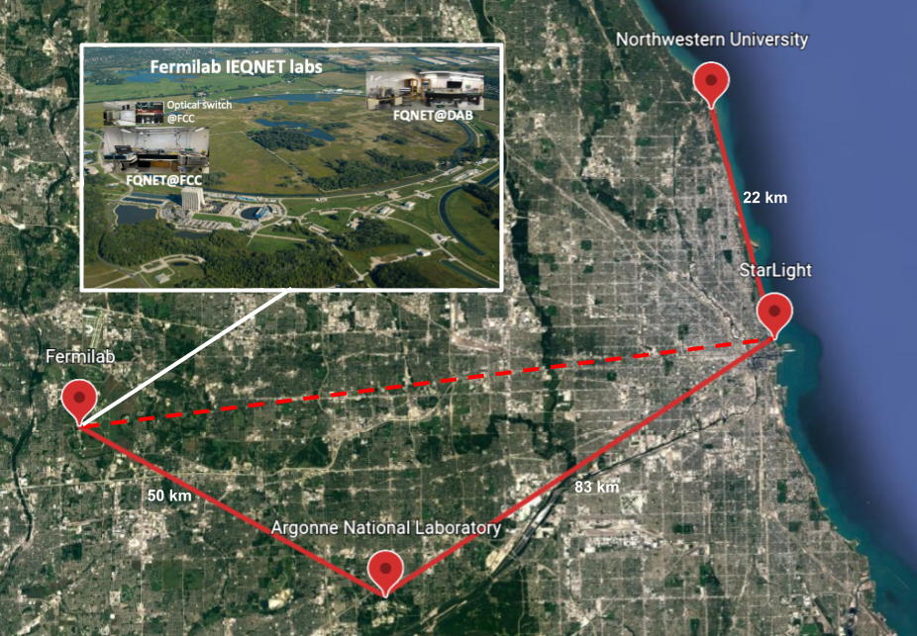
CPCC
Plans for Initial Experimental Tests
- Add in wavelength division multiplexers into the system to MUX and DEMUX classical signals (need to ensure low additional loss)
- Start with continuous wave laser for classical source, eventually move to demonstrate “real” data (Capabilities can be extrapolated from tolerable power levels in CW case to guide design)
- Start by adding spools into different arms of the swapping setup one by one
- Two good experiments to run in the lab:
~2 km spool to emulate Fermi deployed fiber
~60 km to emulate Fermi-Argonne link
- Optimized or non-optimized wavelengths? Could impact MUX/DEMUX design
Notes:
In conclusion, we have shown that teleportation systems can coexist with high data rate high power classical signals. Due to the noise engineering, we saw little degradation of power up to 10’s of mW C-band power. We note that the fidelities could be improved via the same improvements in arbitrary teleportation systems.
We further note that since our system has 2 photon pair sources, changing Alice’s state to an entangled state would result in entanglement swapping, which due to the low noise levels it is reasonable to conclude we could have noise robust entanglement swapping.

