Slide 1


Pretty Advanced Quantum Networking
Kwiat
Quantum
Information
Group
Paul G. Kwiat
Department of Physics
Illinois Quantum Information Science & Technology Center (IQUIST)
University of Illinois Urbana-Champaign

Slide 2
Pretty Advanced Quantum Networking
Kwiat
Quantum
Information
Group
Paul G. Kwiat
Department of Physics
Illinois Quantum Information Science & Technology Center (IQUIST)
University of Illinois Urbana-Champaign

Slide 3
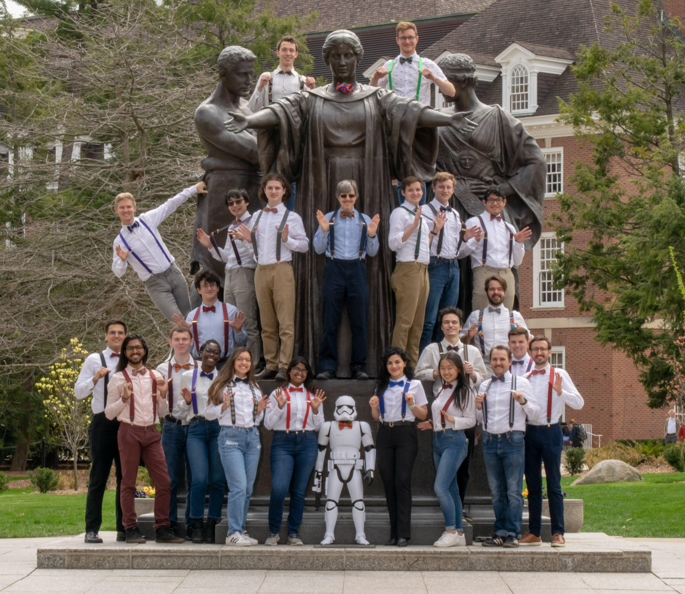
KQC: Kwiat’s
Quantum Consortium
(Cohort, Clan, Collective,
Comrades, …)
Keshav Kapoor
Spencer Johnson
Benjamin Nussbaum
John Floyd
Timur Javid
looking forward to new collaborators, postdocs, students …
Samantha
Isaac
Andrew Conrad

Slide 4

Outline
Overview
Memory-enhanced quantum networking
Problem with fibers
Hybrid network

Slide 5
Current Quantum Networks
Fiber Optic Quantum Link
Fiber Optic Cable
Chicago
(QLAN)
QUIUC-Net (QLAN)
Fiber Optic Cable

Slide 6
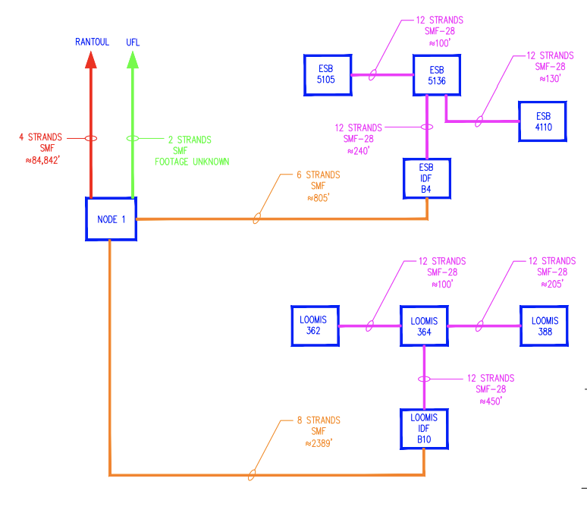
QUIUC-Net Network Schematic

Slide 7
Urbana-Chicago Fiber Link
Fiber Optic Quantum Link
Fiber Optic Cable
Rantoul
Chicago
(QLAN)
QUIUC-Net (QLAN)
Kankakee
Fiber Optic Cable

Slide 8
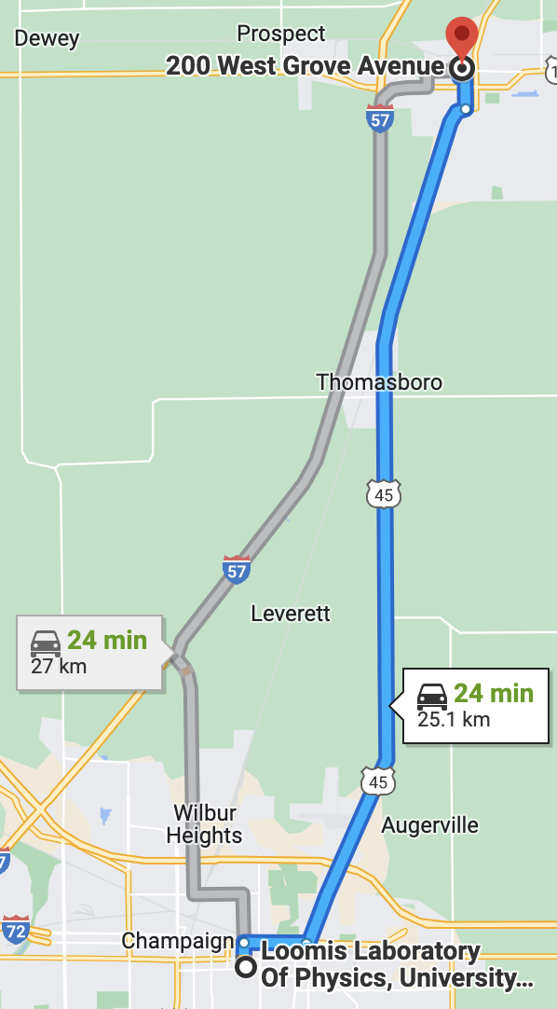
Urbana-Chicago Fiber Link
12 ‘dark’ fibers from Illinois Century Network (ICN)
Fiber Loop from UIUC→Rantoul→UIUC
52.6-km roundtrip fiber
~18.5-dB loss at 1550nm

Slide 9
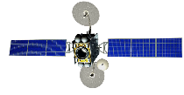
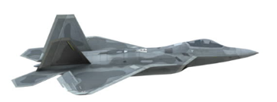
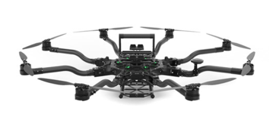

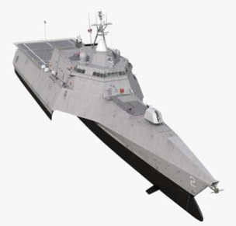
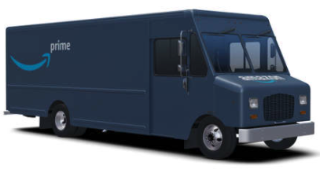
Hybrid Quantum Network
Quantum Satellite
Quantum Satellite
Free-Space Quantum Link
Fiber Optic Quantum Link
Quantum Relay Drone
Quantum Relay Drone
Fiber Optic Cable
CQE-NET
(QLAN)
QUIUC-Net (QLAN)
Fiber Optic Cable
QR
QR
QR

Slide 10


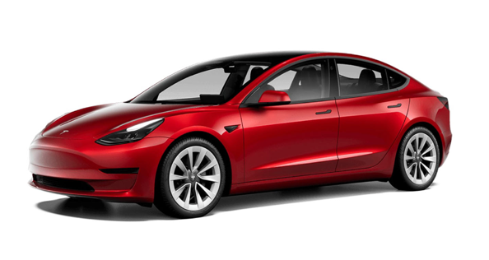
Hybrid Quantum Network
U.S. Quantum Satellite
U.S. Quantum Satellite
Free-Space Quantum Link
Fiber Optic Quantum Link
Quantum Relay Drone
Quantum Relay Drone
Our Work
Fiber Optic Cable
QLAN
QLAN
Fiber Optic Cable

Slide 11
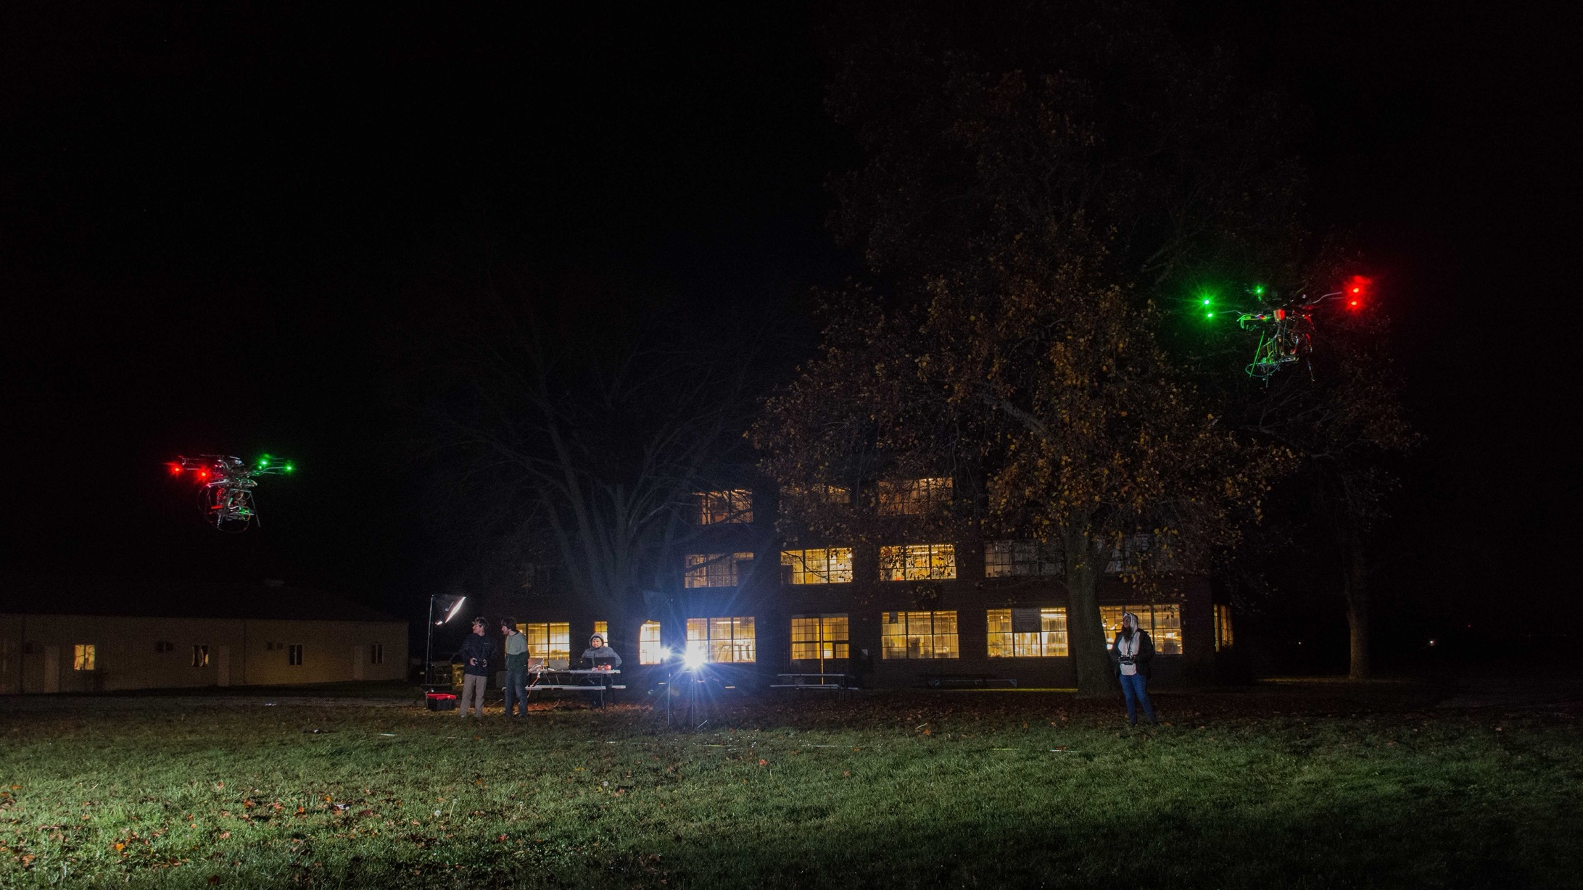
“Stealth” Communication…
Notes:
Current Progress
- Continuous bidirectional locking achieved in 5-m long laboratory tests for ~10 s (0.5-5 Mb projected key per locking interval) for flying → stationary platform
Half-duplex pointing stabilization + locking for >150 s flight
Flight-ready FPGA Time Tagger, single-photon detectors
Custom designed/fabricated TX/RX optical benches
Flight-ready FPGA driver board & IID RC-LED sources for all polarizations with decoy states

Slide 12
Outline
Overview
Memory-enhanced quantum networking
Problem with fibers
Hybrid network

Slide 13
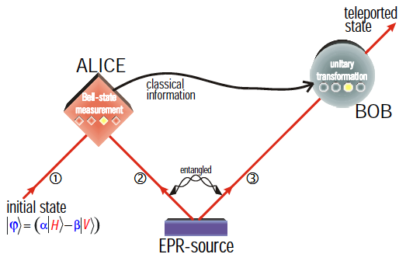
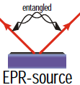
Entanglement Swapping
1
Problem: sources sometimes emit 2 pairs
Solution: drive weakly
drive weekly

Slide 14
Improved Performance via Memory
From Alice
From
Bob
Pockels Cell
Notes:
Multiplexing combines multiple parametric down-conversion sources to produce higher single and swap rates. PDC sources can be combined in two main ways:
Temporally:
With temporal multiplexing, we use the natural repetition rate of the pump to define multiple time bins to combine. This scheme requires a delay-line that delays successful events until the end of the combined time bins. An event is heralded by the photon’s sister, which causes the photon to become trapped in the delay-line using fast switches.
Spatially:
With spatial multiplexing, we spatially combine multiple crystal outputs using a routing system made of polarization beamsplitters and fast switches. Similarly, we herald the production of a photon from one source by measuring the sister photon. Depending on which source clicks, we then alter our routing system to guide the photon to the shared output port.
On the bottom left is a graph that shows the required transmission of our fast switches to allow multiplexing to outperform single-shot methods.

Slide 15
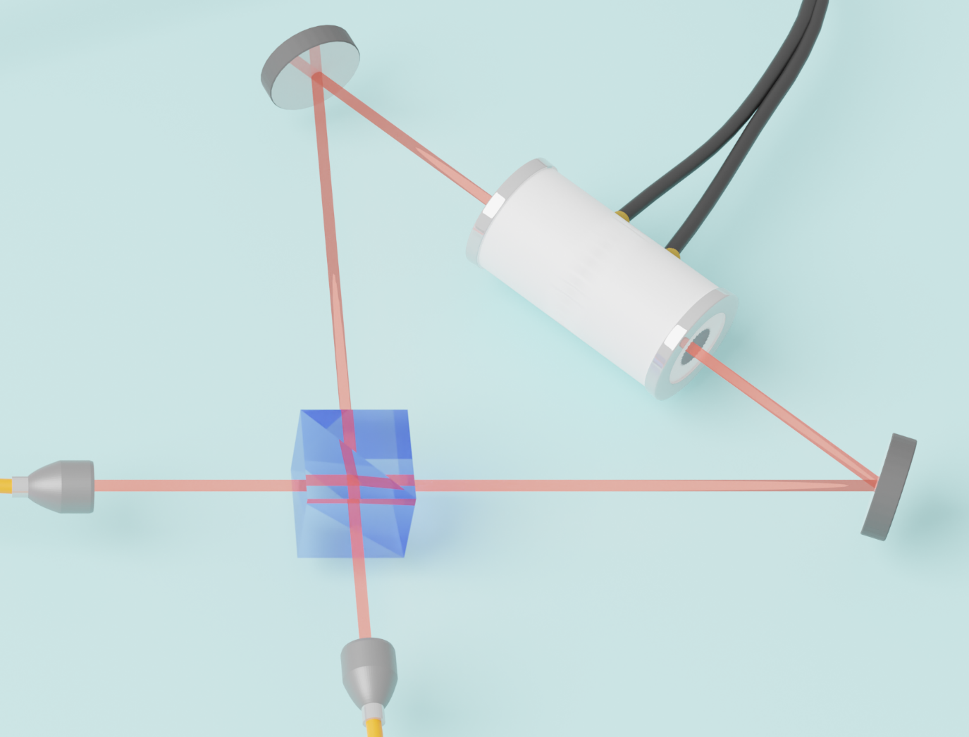
Quantum Memory: low-loss optical delay line Applications to quantum cryptography, quantum “repeaters”, scalable quantum logic, novel quantum communication protocols
Operation:
Horizontal polarization in
Pockel cell switch to Vertical
Circulates N times
Pockel cell switch back to Horizontal to switch out
Performance:
Switch rise/fall ~3 ns
Low loss → only ~1.5%/cycle
But…. 0.985⁵³⁷ = 0!

Slide 16
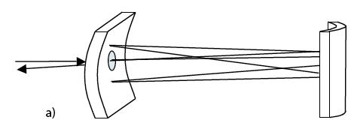
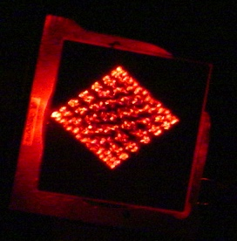
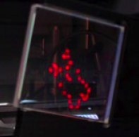
Quantum Memory: low-loss optical delay line Applications to quantum cryptography, quantum “repeaters”, scalable quantum logic, novel quantum communication protocols
Advantages
High bandwidth (~10 nm)
Polarization insensitive
Adjustable time delay (10 ns – 10μs)
Low loss (custom mirror coatings)
Store multiple k-vectors, spatial modes

Slide 17
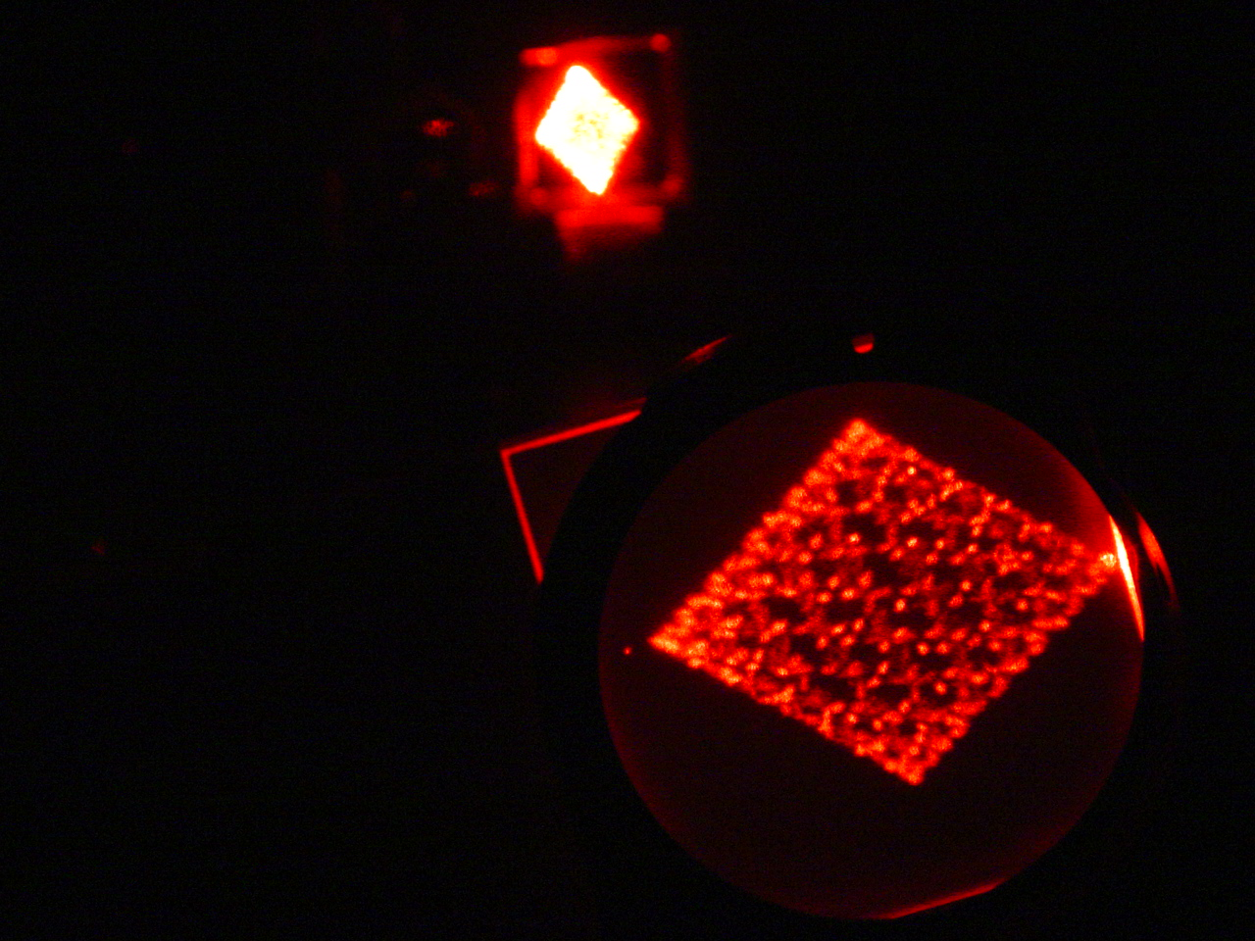
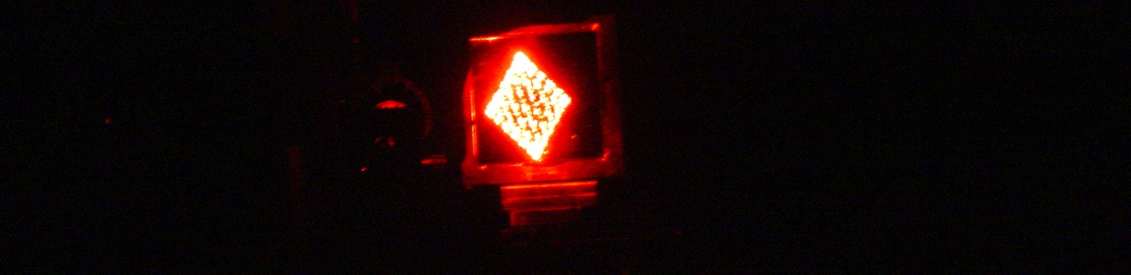
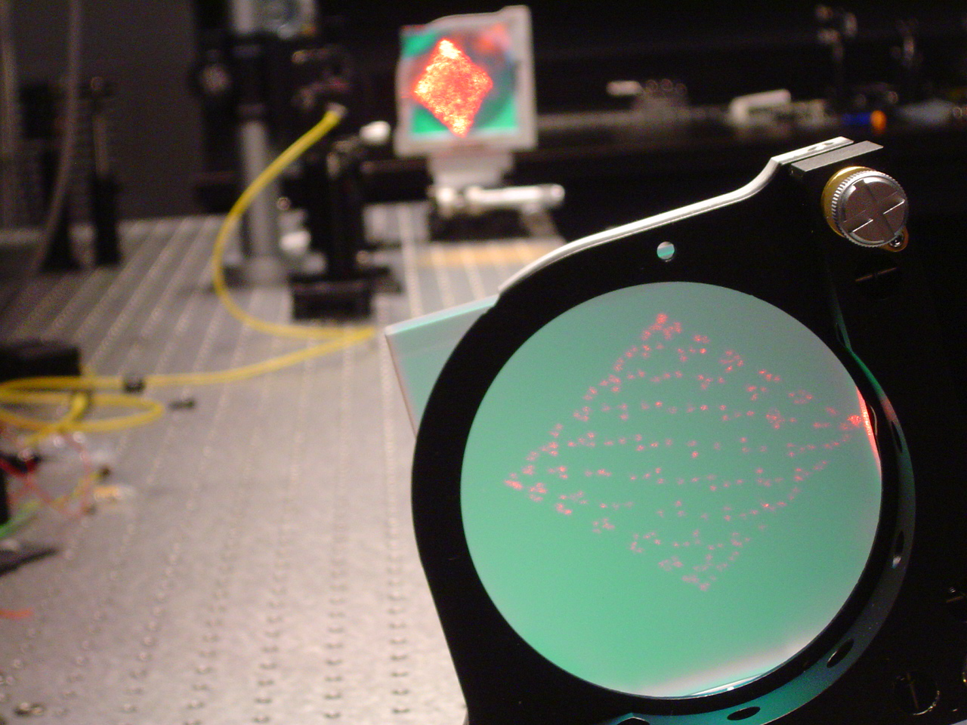
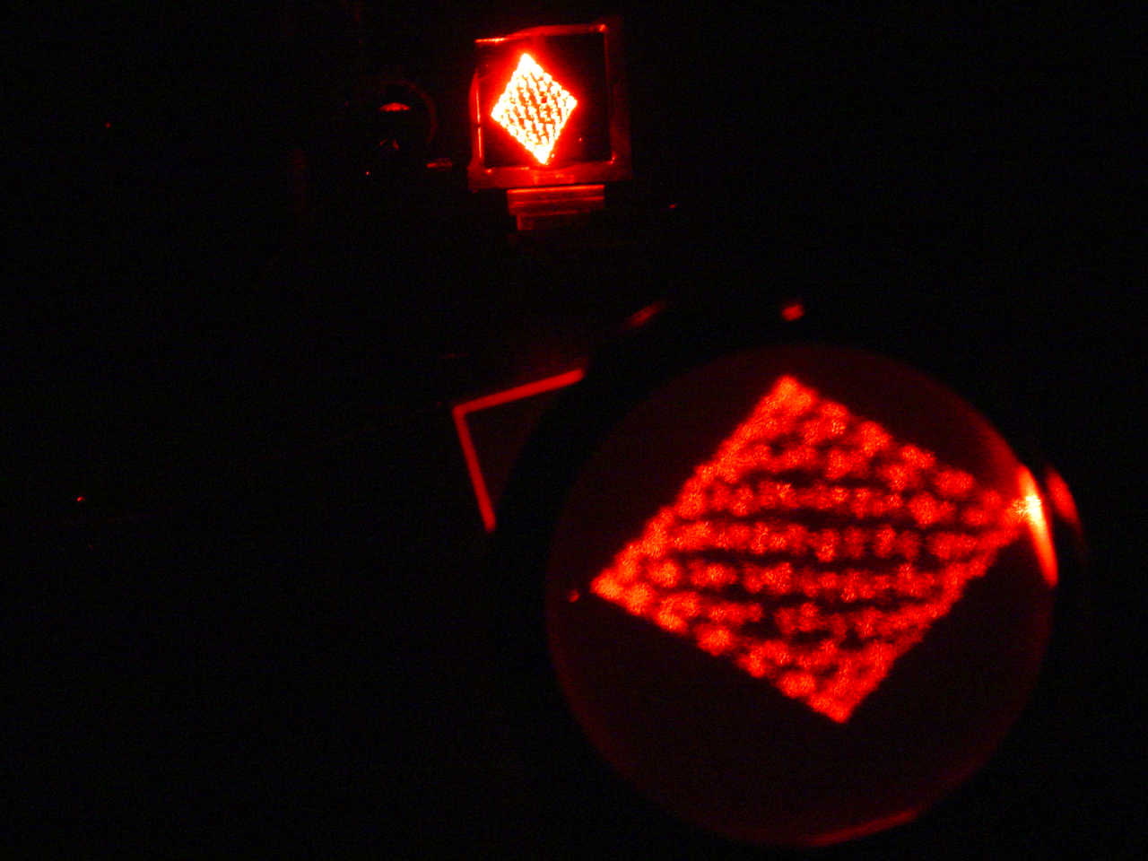

Slide 18
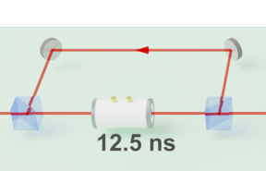
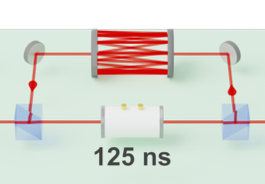
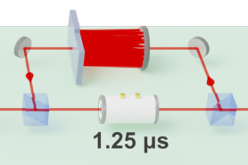
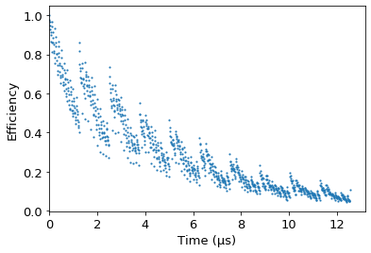
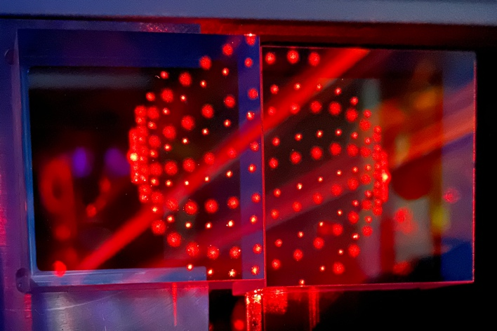
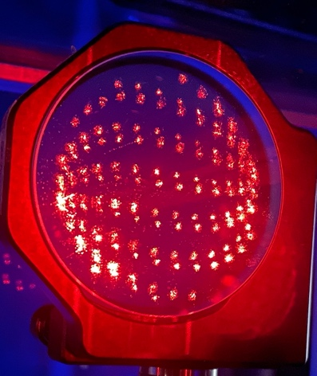
“Digital” Quantum Memory
Flat-mirror cavity
Herriott cell cavity
Modified Herriott cell cavity
T_{537 cycles} ~35%
Number of bounces limited by mirror area
E.g., 1.1-m spacing
→ 339 reflections
→ 1.25-µs delay
Other ‘bases’ may be more optimal than ‘digital’, depending on application
18

Slide 19
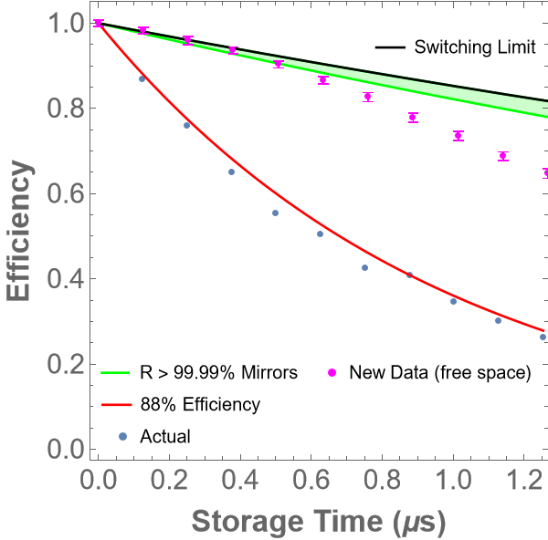
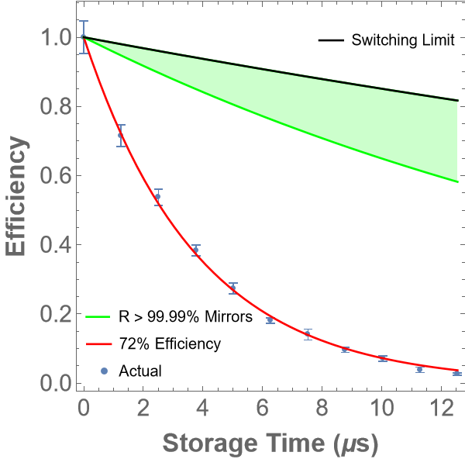
Memory performance limited by mirror reflectivity and polarization-switching efficiency
While fiber-based memories must deal with fundamental dispersion and loss limitations, mirror coatings and active-switching technologies are continuously improving
125-ns loop
end-to-end efficiency
1.25-µs loop
end-to-end efficiency
Can synchronize up to ~1000 time bins. Even better with QND!

Slide 20
Sources, Sources, Sources
Needs:
High brightness = many pairs/second (but NOT many pairs/pulse)
High heralding efficiency = reduced effect of multi-pair events
High purity = factorizable joint spectral amplitude → ‘swappable’ entanglement
Notes:
Multiplexing combines multiple parametric down-conversion sources to produce higher single and swap rates. PDC sources can be combined in two main ways:
Temporally:
With temporal multiplexing, we use the natural repetition rate of the pump to define multiple time bins to combine. This scheme requires a delay-line that delays successful events until the end of the combined time bins. An event is heralded by the photon’s sister, which causes the photon to become trapped in the delay-line using fast switches.
Spatially:
With spatial multiplexing, we spatially combine multiple crystal outputs using a routing system made of polarization beamsplitters and fast switches. Similarly, we herald the production of a photon from one source by measuring the sister photon. Depending on which source clicks, we then alter our routing system to guide the photon to the shared output port.
On the bottom left is a graph that shows the required transmission of our fast switches to allow multiplexing to outperform single-shot methods.

Slide 21
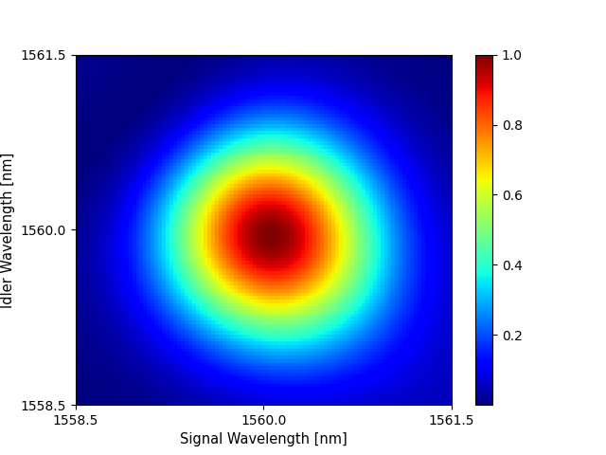
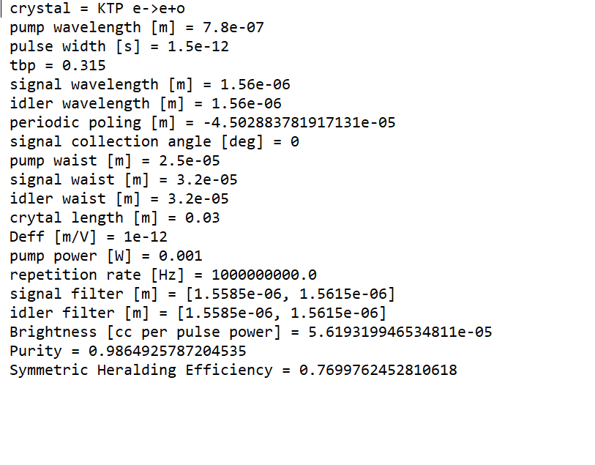
Photon Pair Source – Joint Spectral Intensity Simulation
Expected purity with 1.5ps pump

Slide 22
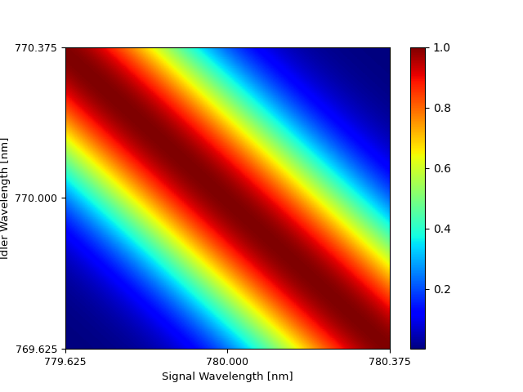
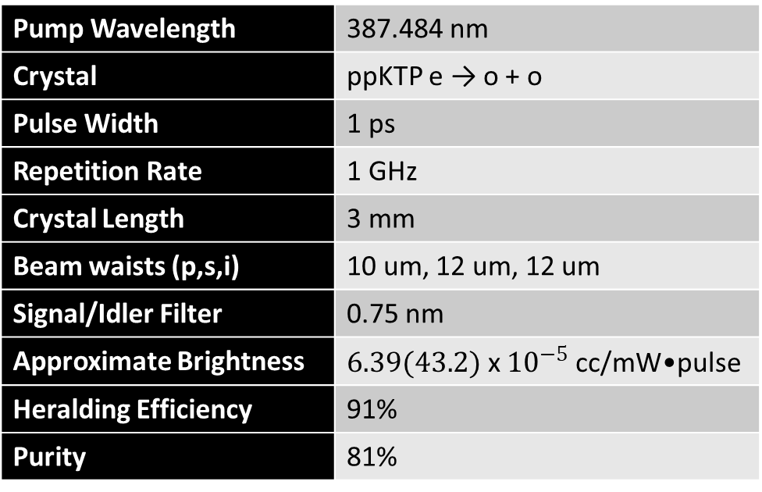
Nearly-degenerate source around 775 nm
Slightly modified poling period to center JSI
Pump Wavelength | 387.484 nm
Crystal | ppKTP e → o + o
Pulse Width | 1 ps
Repetition Rate | 1 GHz
Crystal Length | 3 mm
Beam waists (p,s,i) | 10 um, 12 um, 12 um
Signal/Idler Filter | 0.75 nm
Approximate Brightness | $6.39(43.2)$ x ${10}^{−5}$ cc/mW•pulse
Heralding Efficiency | 91%
Purity | 81%
${}^{∗}$Values have not been experimentally scaled/verified, where the effective nonlinear coefficient is set to 1 (2.6) pm/V.

Slide 23
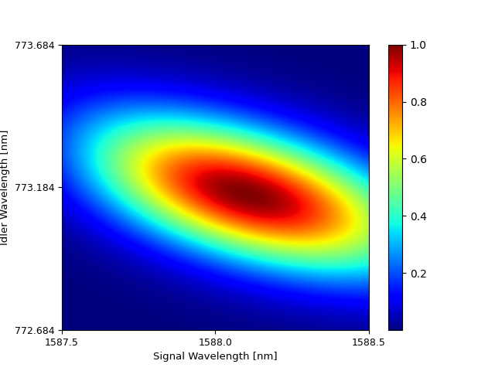
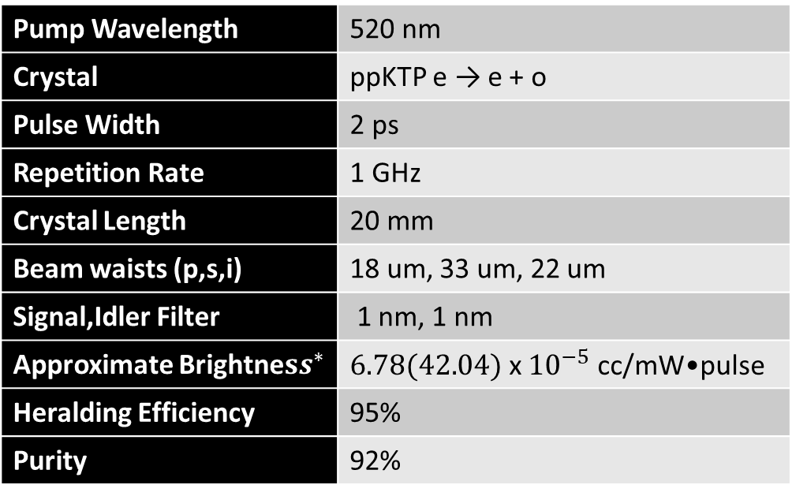
Non-Degenerate Source
Optimized waists for brightness
Pump Wavelength | 520 nm
Crystal | ppKTP e → e + o
Pulse Width | 2 ps
Repetition Rate | 1 GHz
Crystal Length | 20 mm
Beam waists (p,s,i) | 18 um, 33 um, 22 um
Signal,Idler Filter | 1 nm, 1 nm
Approximate Brightne$ss^{∗}$ | $6.78(42.04)$ x ${10}^{−5}$ cc/mW•pulse
Heralding Efficiency | 95%
Purity | 92%
${}^{∗}$Values have not been experimentally scaled/verified, where the effective nonlinear coefficient is set to 1 (2.49) pm/V.

Slide 24
Outline
Overview
Memory-enhanced quantum networking
Problem with fibers
Hybrid network

Slide 25
The Problem with Fiber…
Causes unwanted modifications to polarization.
PLUS these can depend on wavelength
→ “polarization mode dispersion” is effectively decoherence for quantum states encoded in polarization.

Slide 26
Polarization Stability
Send different wavelengths utilizing tunable laser
  1549-1550nm
Measure the polarization after sending light of different wavelengths through the loop over multiple hours
Also measure with polarimeter

Slide 27
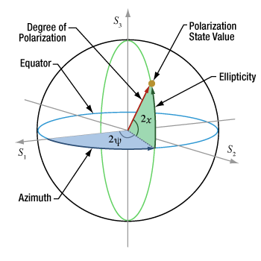
Polarization Stability
Single polarization correction not viable for different wavelengths
Notes:
Theta is the polar angle and phi is the azimuthal angle in all of these plots.

Slide 28
Entanglement Source
Expected purity with 1.5-ps pump
PMD becomes issue given bandwidth of source…

Slide 29
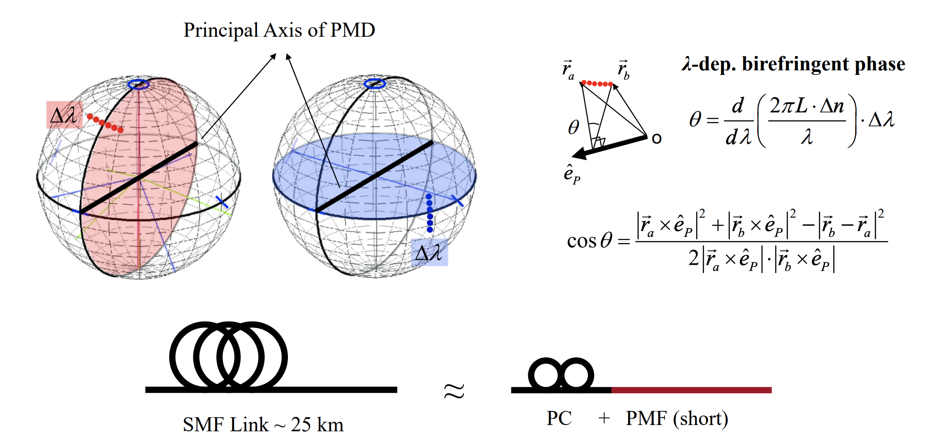
Polarization Mode Dispersion

Slide 30
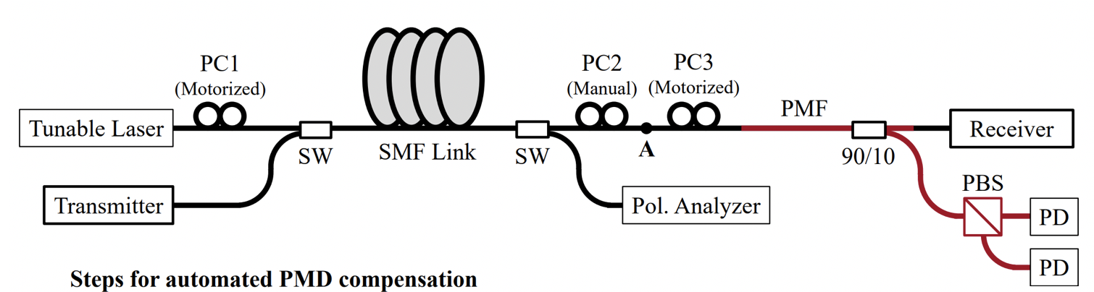
PMD Compensation
We find Principal Axis(PA) from polarimeter
Align laser output to PA with PC1
Send light into compensator
Minimize output in one branch of PBS to align PA axis with PMF axis with PC2
Process tomography at 1560 and 1561nm with and without compensation
  If compensated transfer matrix should not change with wavelength
  If not compensated transfer matrix should change with wavelength

Slide 31
PMD Compensation
a = transfer matrix for the 1560-nm light
b = transfer matrix for the 1561-nm light

Slide 32
Outline
Overview
Memory-enhanced quantum networking
Problem with fibers
Hybrid network

Slide 33
The OTHER Problem with Fiber…
- direct optical path required (or trusted nodes)
- transmission drops exponentially with length
~ -0.2dB/km → T(200 km) = 10⁻⁵
T(1000 km) = 10⁻²⁵ ☹
- quantum repeaters possible, but not yet
- no fiber-free applications
- space, water, battlefield, …

Slide 34
“Stealth” Communication…
Notes:
Current Progress
- Continuous bidirectional locking achieved in 5-m long laboratory tests for ~10 s (0.5-5 Mb projected key per locking interval) for flying → stationary platform
Half-duplex pointing stabilization + locking for >150 s flight
Flight-ready FPGA Time Tagger, single-photon detectors
Custom designed/fabricated TX/RX optical benches
Flight-ready FPGA driver board & IID RC-LED sources for all polarizations with decoy states

Slide 35
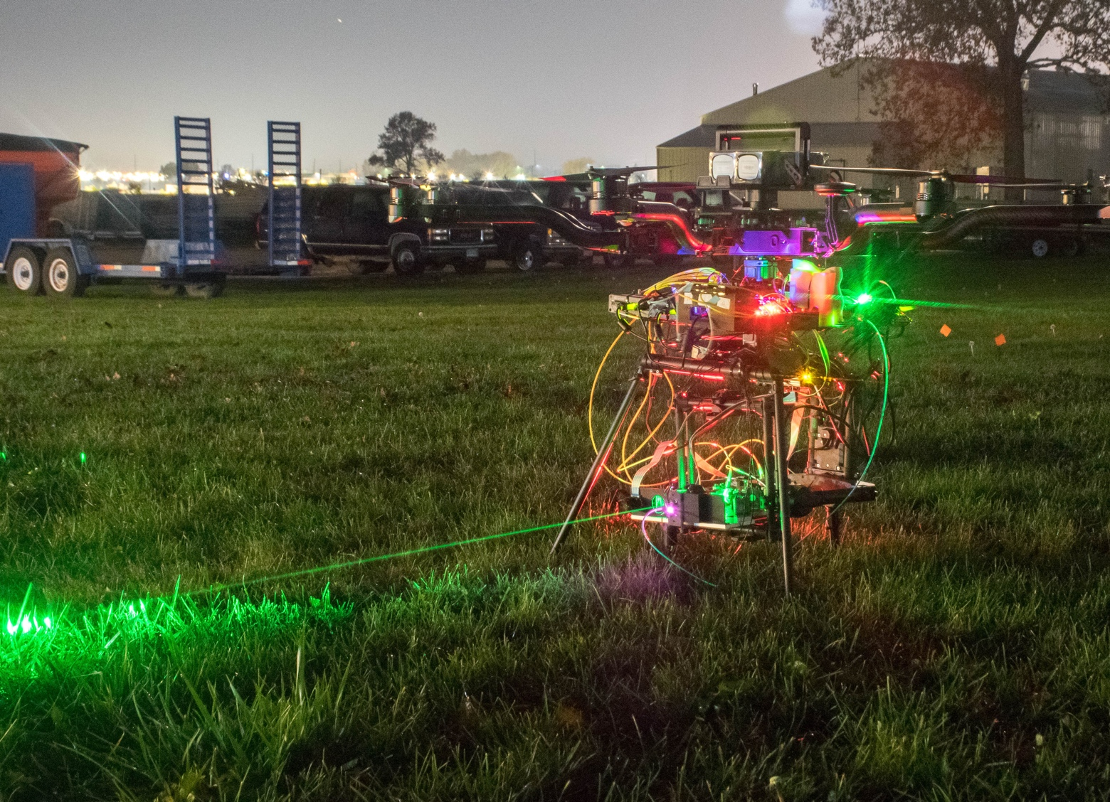
System Design
System Overview:
Quantum Transmitter (Alice)
  Quantum Key Distribution (QKD) source:
    Resonant cavity LED
    Decoy state
    Polarization encoded
  Custom optics benches
Quantum Receiver (Bob)
  Single-Photon Detectors (SPCM-AQ4C)
  FPGA-based Time-Tagger
  Qubit-based Time Synchronization (Post-processing)
Pointing, Acquisition, and Tracking (PAT) system
Mobile Platforms:
  Drone
  Car
Image Courtesy Timur Javid

Slide 36
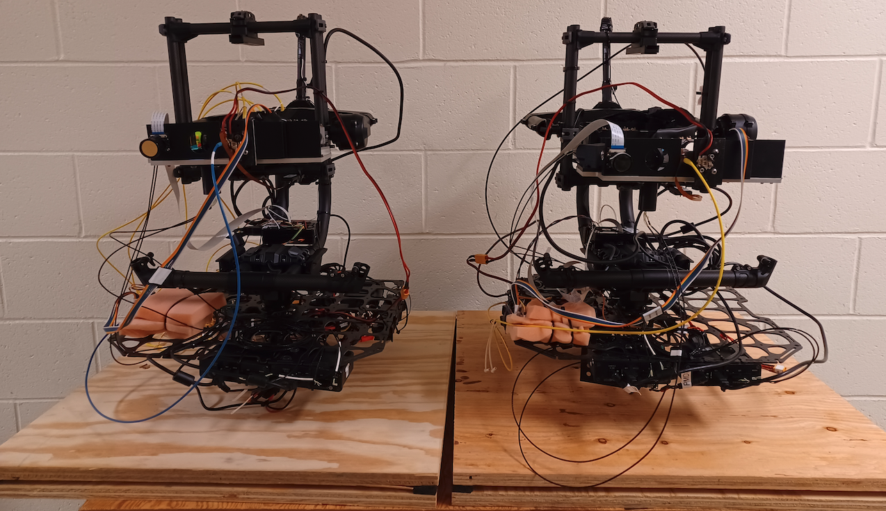
Modular Design
QKD Transmitter (Alice)
QKD Receiver (Bob)
Modular Design:
Our QKD system shares no resources with host mobile platform
  Power
  Control
  Communication
Single quick-release connection with drone
  → Place QKD transmitter (receiver) on other platforms (e.g., vehicle) with no required hardware changes
Gimbal
Optical Benches
Gimbal
PAT Camera
NIR Beacon
NIR Beacon
PAT Camera
Equipment Tray
Equipment Tray
Vibrational Dampers
Notes:
Spend a bit more time
-Not flying configuration (moving ground platform)

Slide 37
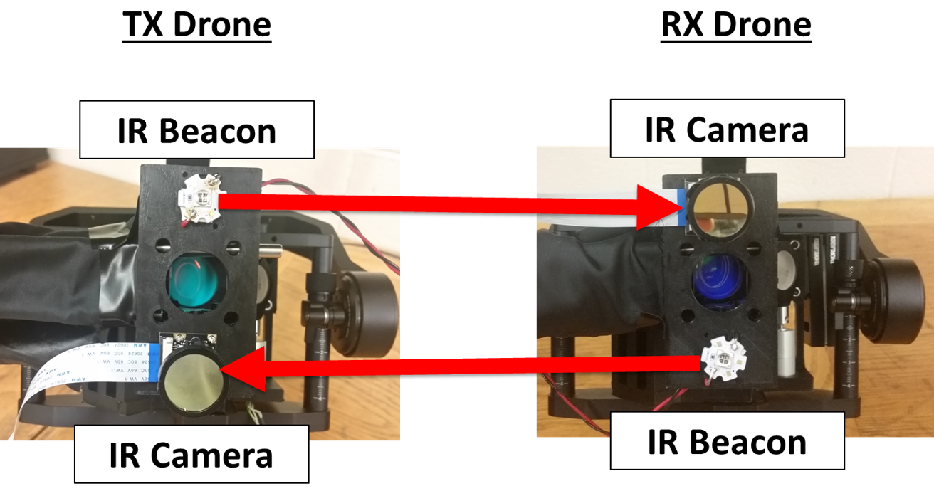
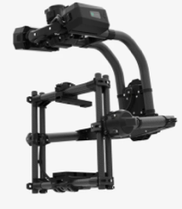

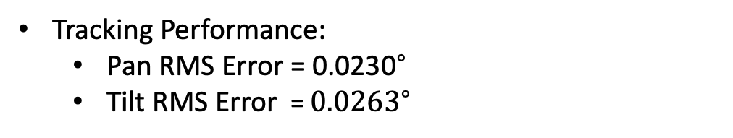
PAT Subsystem (Course Adjustment)
Outer-Control Loop Calibration
Initial Pointing, acquisition, and course pointing
IR Beacon/IR Camera
Image processing to identify location in camera’s reference frame
Feedback Control
Gimbal
(Movi Pro)
Tracking Performance:
  Pan RMS Error = ${\text{0.023}\text{0}}^{∘}$
  Tilt RMS Error = ${0.0263}^{∘}$
Gimbal Jitter Specification = ${\text{0.02}}^{∘}$

Slide 38

PAT Subsystem (Course and f Adjustment)
Outer-Control Loop Calibration
Initial Pointing, acquisition, and course pointing
IR Beacon/IR Camera
Image processing to identify location in camera’s reference frame
Feedback Control
Gimbal
(Movi Pro)
Tracking Performance:
  Pan RMS Error = ${\text{0.023}\text{0}}^{∘}$
  Tilt RMS Error = ${0.0263}^{∘}$
Gimbal Jitter Specification = ${\text{0.02}}^{∘}$

Slide 39
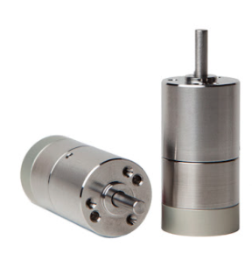

PAT Subsystem (Fine Adjustment)
Transmitter
Receiver
PAT Subsystem (Fine Adjustment)
Co-propagating laser beacons
  Transmitter: 705-nm beacon
  Receiver: 520-nm beacon
Fast Steering Mirrors + Position Sensitive Diode (PSD)
Senses incoming beacon beam Angle of Arrival (AoA)
Raspberry Pi single-board computer
Local (no PAT communication between drones)
FSM
FSM
LRC
IRB
653 nm QKD Source
Free-Space Channel
DM
DM
IRB
LRC
DM
DM
IRC
IRC
Detection/Analysis
BP
LRC – Long Range Camera
IRB – Infrared Beacon
IRC – Infrared Camera
FSM – Fast Steering Mirror
DM – Dichroic Mirror
PSD – Position Sensitive Detector
BP – Narrowband Bandpass Filter
BP
705 nm TX Beacon
PSD
PSD
520 nm RX Beacon
Position Error Feedback Loop
Position Error Feedback Loop
Pointing Error_x = 21.1$μ$rad
Pointing Error_y = 22.9 $μ$rad
Fast Steering Mirrors
(Model LR-17)

Slide 40
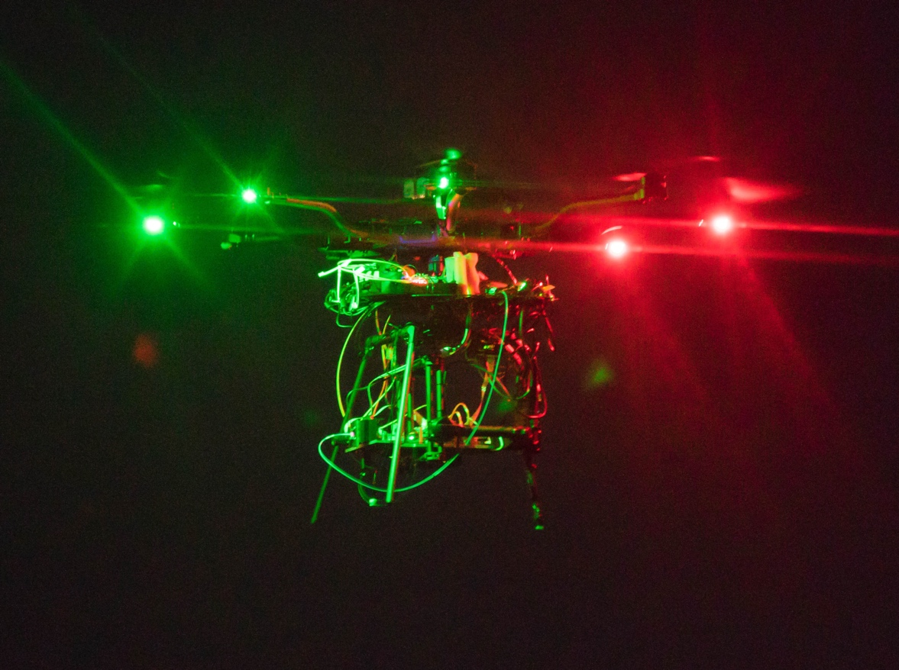
Air-to-Air Classical Locking
Drone Platform
Alta 8 Pro Drone
20 lbs payload capacity
Two 10,000 mA-hr Lithium Polymer Batteries
System Characterization
Classical Air-to-Air Locking into multimode fiber
Average 2.25 dB Channel Loss (60% transmission)
10-meter distance
Locked
→60% Transmission
Control Loops Off
Acquisition
Land
Land
Takeoff
Image Courtesy Timur Javid
Notes:
Duration of flight

Slide 41

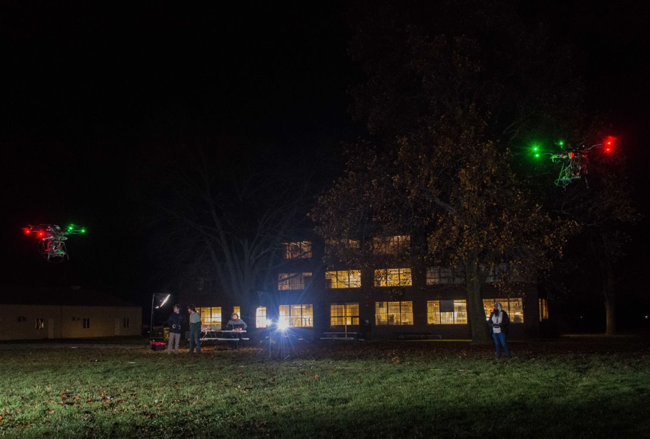
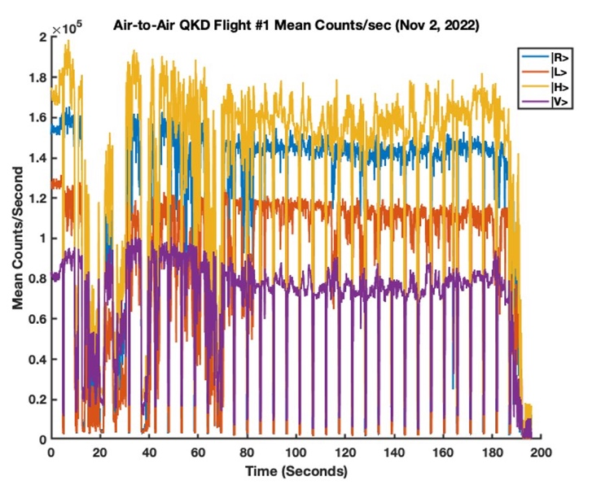
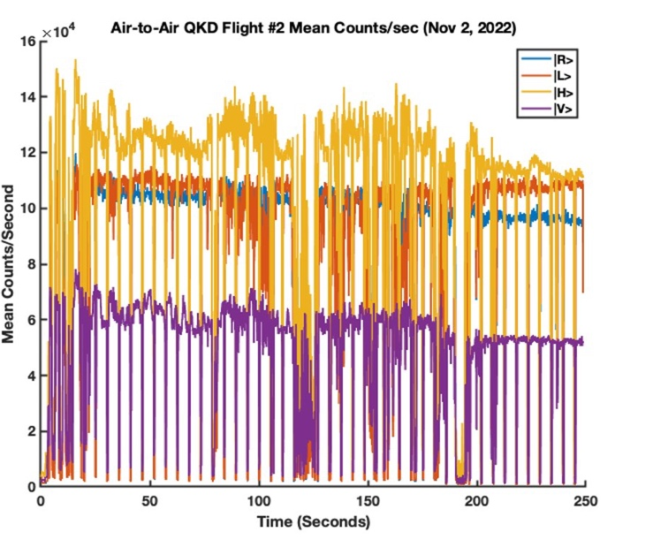
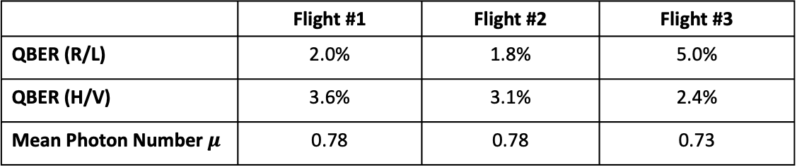
Drone Air-to-Air QKD Flights (Nov 2nd, 2022)
Air-to-Air QKD Setup
Both drones hovering
10-meter distance between drones
Altitude ~5 meters above ground
Quantum Transmission
Average QBER =2.9% (R/L Basis), 3.0% (H/V Basis)
1st demonstration of drone-to-drone QKD
Collaborating with Lütkenhaus group to develop tailor-made finite key analysis
 | Flight #1 | Flight #2 | Flight #3
QBER (R/L) | 2.0% | 1.8% | 5.0%
QBER (H/V) | 3.6% | 3.1% | 2.4%
Mean Photon Number $μ$ | 0.78 | 0.78 | 0.73
Image Courtesy Timur Javid

Slide 42
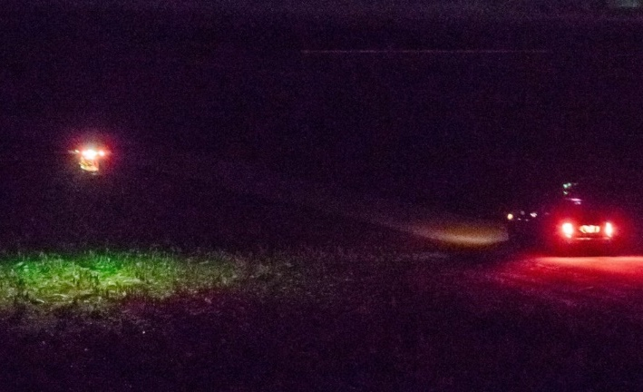
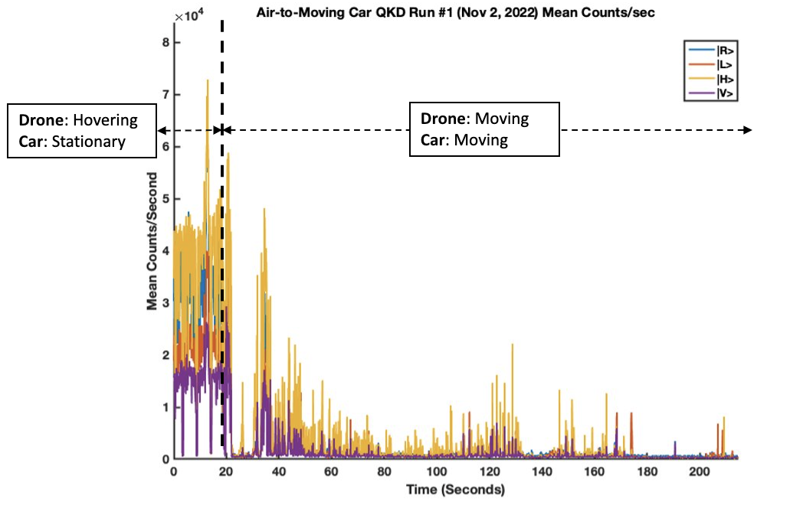
Drone-to-Vehicle Results
Air-to-Car Setup
Drone flying parallel to moving car
Speeds up to 10 mph
Transmitter on drone, receiver on car
Classical Transmission
Average coupling efficiency 38% into multimode fiber
QKD Transmission
Average QBER = 6.4% (R/L Basis), 3.0% (H/V Basis)
Image Courtesy Timur Javid

Slide 43


70 mph Vehicle-to-Vehicle Quantum Transmission
Car-to-Car Quantum Setup
70 mph
Interstate Highway (I-57)
Outer-Control Loop only (Near-IR Beacon)
No alignment lasers
Attenuated laser quantum source
Coupled into multi-mode and single-mode fiber
Achieved 70 mph 28.6 dB SNR into multimode fiber and 17.4 dB SNR into single-mode fiber
We believe this is the first demonstration of a car-to-car quantum link on public highway
Illinois
Highway
Route
Image Courtesy Google Earth

Slide 44


Entanglement Distribution Between Moving Platforms
Goal: Distribute swappable entanglement between different platforms
520 nm from frequency conversion
1560 nm
Clock
Laser
Entanglement
Source A
1588 nm
773 nm
1
Satellite
2
Wavelength relation
for swappable source
2
1
Notes:
Entanglement can be generated on a satellite, or other moving platform, through indistinguishable nonlinear processes. The figure in top right shows the two processes we use are spatially separated.
The entanglement must be swappable. This means there can be no wavelength correlation between photon 1 & photon 2. To satisfy this requirement, we employ strong spectral filtering (at the expense of source brightness)

Slide 45




Entanglement Distribution Between Moving Platforms
Goal: Distribute swappable entanglement between different platforms
Main Challenge: Synchronize entanglement sources, A & B.
1560 nm
Clock
Laser
Entanglement
Source A
1588 nm
1 GHz Clock Doppler Shift
773 nm
20
1
Satellite
Doppler Shift:
0
Clock Frequency Change (kHz)
2
-20
-100
0
100
Ground
Station
Time (s)
Entanglement
Source B
Turbulence:
3
4
τ
Space
Earth
Notes:
The main challenge of this experiment is to synchronize the moving & stationary entanglement sources.
Since we are pumping our source using short pulses of light, Doppler shift on the repetition rate of the laser & turbulence through the atmosphere cause a time-dependent loss in synchronization.
We proposed to remedy this challenge by transmitting our pump & 1588-nm photons down in the same spatial mode. They would then experience the same Doppler shift & turbulence and remain synchronized.

Slide 46
Entanglement Distribution Between Moving Platforms
Goal: Distribute swappable entanglement between different platforms
Main Challenge: Synchronize entanglement sources, A & B.
1560 nm
For longer distances, we need to perform multiple swaps,
which requires high efficiency, non-cryogenic detectors on
satellites.
Clock
Laser
Entanglement
Source A
1588 nm
773 nm
Satellite 1
1
Entanglement Swapping:
2
Satellite 2
When we interfere & measure photons & ,
photons & become entangled.
2
3
Ground
Station 1
1
4
Entanglement
Source B
1
2
3
4
3
A
B
4
Ground
Station 2
Interference
2
Notes:
If synchronization is performed correctly, we can then interfere one photon from each source, photons 2 & 3, to “swap” entanglement to the other photons, 1 & 4.
The newly entangled photons can then be used to connect distant quantum networks, or the process can be repeated to connect networks farther apart.

Slide 47


Entanglement Distribution in Hybrid Network
UAV
Photon a₁
Photon a₂
Photon b₁
Entanglement Source
Photon b₂
Bell State Measure-ment
Node 3
_{(telecom fiber)}
Ground Station Node 1
Ground Station
Node 2

Slide 48
Summary
Overview
Memory-enhanced quantum networking
Problem with fibers
Hybrid network

