Slide 1
Open-source quantum control and readout
Gustavo Cancelo (Fermilab) for the QICK team

Slide 2
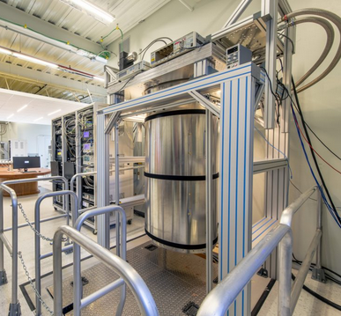
Why do we need a classical control and readout system for a quantum processing system?
Control system
At the human scale the world behaves classical.
For 100 years we have developed instrumentation, actuators, readout systems that are classical.
Math and engineering models are simpler in the classical world. Si is data analysis.
We initialize and readout a quantum system using classical signals. We repeat and iterate the experiment many times to be able to capture its quantum (probabilistic) behavior.
Since quantum systems (e.g. a QPU) are probabilistic in nature with properties such as superposition, and interference and are easily disturbed by interfacing with a classical system. The wavefunction collapses to an eigenmode.
The classical control and readout system has the difficult task of initializing and reading a quantum system to acquire information of its quantum behavior.

Slide 3
Control and readout
There is exchange of information between the classical control and readout and the quantum system.
Information flows from the classical to the quantum during control and from the quantum to the classical during readout.
The ideal quantum control system is one that does not add more noise into a quantum system and is infinitely fast compared to the quantum system dynamics.
Control & readout
QPU
Since qubits and quantum systems are in technical evolution, characterization and calibration are also part of the control and readout systems.
Since there are many implementations for qubits and quantum systems, controls need to be different in nature or be extremely flexible instruments.
Another desirable property for a control system is scalability. In theory a small number (≈ 100) noise-free qubits can tackle extremely complex problems. In practice, today’s noisy qubits require error mitigation, error correction and a large number of physical qubits to achieve quantum supremacy.
Last but not least, we need a control system to be cost effective and accessible.

Slide 4
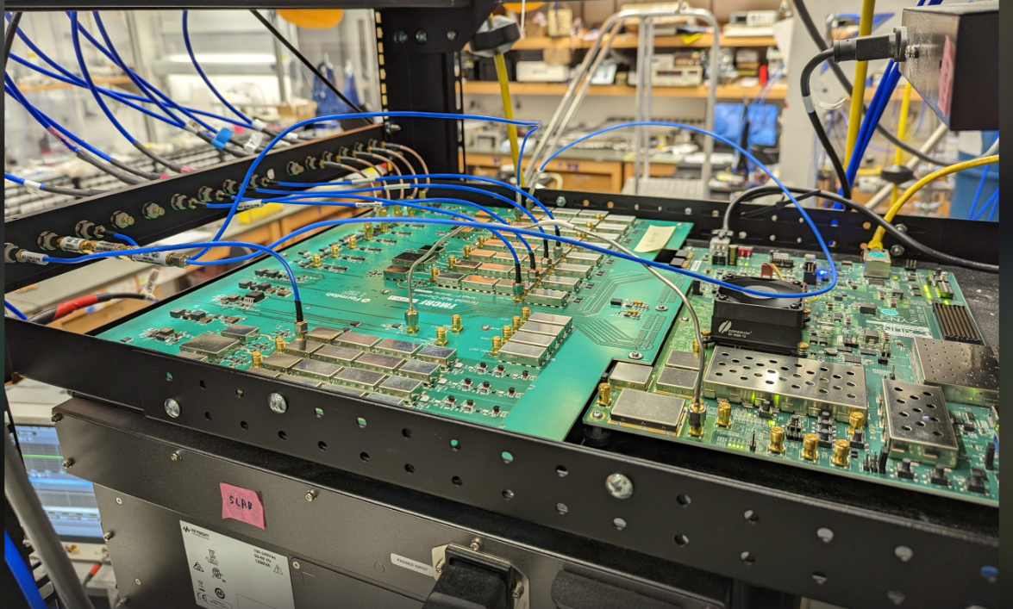
An example of a Control and readout system: QICK
A comprehensive, control and readout system for QIS (Quantum Information Science), including quantum computing (QC), quantum networks (QN) and quantum sensors (QS).
Open source: including hardware schematics/layouts, firmware, software. See https://github.com/openquantumhardware https://qick-docs.readthedocs.io/en/latest/
Easy to use: installation, demos including basic single qubit measurements.
Cost effective: <$1000/qubit, ~$1/detector pixel (e.g. MKID).
Collaborative efforts with academia, DOE labs and industry.
Supported by a growing international community > 350 people, 40 institutions, 10 companies.
Quantum computing
Quantum networks
QICK control
Quantum sensing

Slide 5
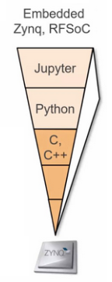
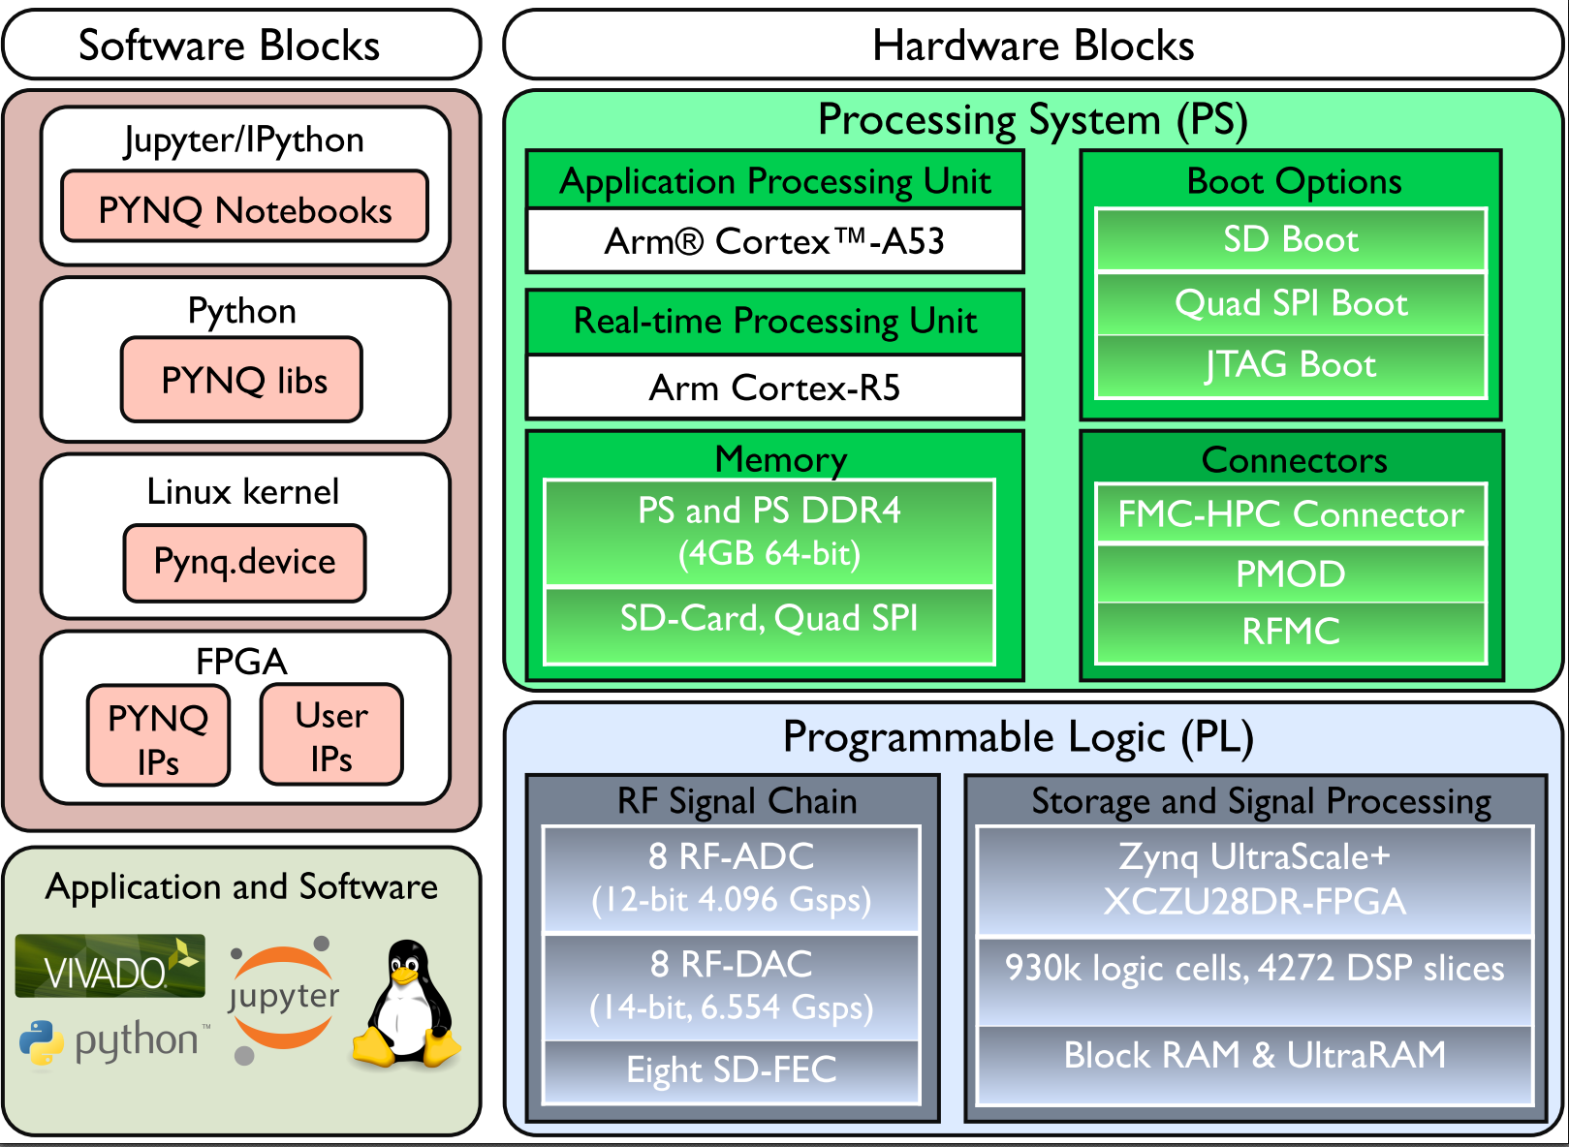
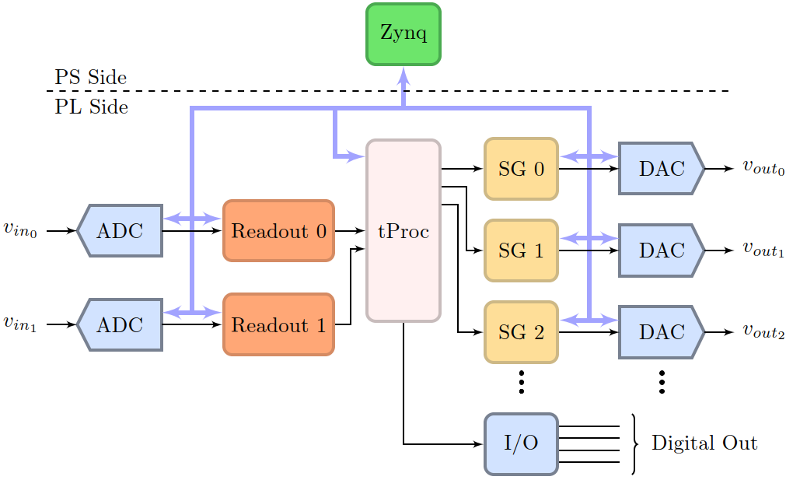
What’s under the hood?
Open source
Hardware: RF, DC, FPGA, PS.
Firmware: SG and readout built in firmware.
Software: your quantum programs are python notebooks with a web interface (PYNQ).
Open source.

Slide 6
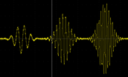
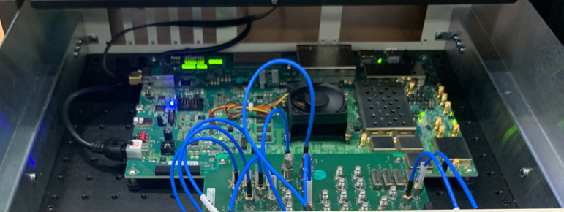
The QICK firmware
Highly configurable to accommodate qubit types and number of channels
Frequency and time multiplexing available on every DAC (and ADC)
DAC1
. . .
f
f₁
f₂
f₃
f_{N}
∆f=200MHz
∆f=200MHz
tPROC (custom RISC processor in logic at 500MHz clock).
Signal generators for multiplexed readout and control.
Input channel multiplexed readout, data filtering, signal processing, buffering.
Trigger (marker) generation/detection.
Multi board synchronization.
Total 50 channels (Out, In, Bias, Trigger) per board.
Scalable to 10,000+ channels.
Multi board stack-up
Gustavo Cancelo

Slide 7
QICK software
PYNQ is an open-source project from AMD® that makes it easier to use Adaptive Computing platforms.
QICK software developed using the PYNQ for ZYNQ AMD platform.
PYNQ is an optimized low level platform (drivers) to communicate the RFSoC PS and PL.
QICK software in python defines classes and methods to operate QICK firmware and hardware in a user friendly and time efficient way.
https://github.com/openquantumhardware

Slide 8
What can you do with QICK?
Directly interface to a single or multi-qubit QPU or sensor: control and readout.
Frequency multiplex control and readout channels as needed.
No muxing is also ok.
Time sync pulses and signals on and across boards.
All running locked to an 80 fs jitter PLL.
Waveforms are parametric, no need to upload more than one type of complex envelope (template).
Typical complex envelopes: Gaussian, DRAG, triangular, soft square, AWG, etc.
Up to 10GHz carrier frequencies generated in digital domain.
No need of analog I-Q mixers nor periodic fancy calibrations.
Large (8GB) memory for AI or Optimal control AWG waveforms, or for long data acquisition buffering.
Trigger or be triggered by other instrumentation.
Couple to AWS cloud (SideQick) or interface to high level open software.
Qibo included QICK as a backend. (Qibo paper: https://arxiv.org/pdf/2009.01845.pdf)

Slide 9
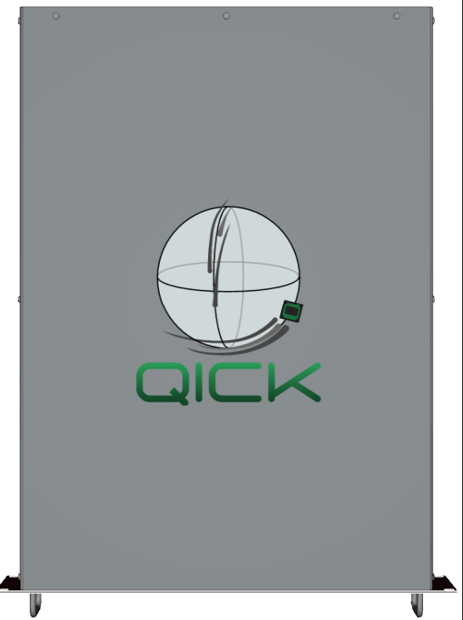
QICK: 32 analog + 32 digital channels in one box
16 DAC outputs from DC to 10GHz all digital mixers.
This is critical need for quantum. => Better experiments.
Minimizes calibrations.
16 ADC inputs from DC to near 10GHz without analog mixers.
Input noise 120K (i.e. 1.2dB)
8 x 20-bit DAC outputs for bias (BW of 10 or 100Hz) ultra low noise, ±10V outputs.
<200ns latency for error correction (fastest in the market).
Optimal filtering, no dead-time 3ns pulses.
100 pico-second pulses for QN.
Accurate timing readout 2ps resolution.
RF multiplexing of 10K detectors per board.
Gustavo Cancelo

Slide 10
Has QICK improved quantum experiments?
I can certainly say that using the QICK has not just let us do experiments more cheaply but has changed the way we think about control and that we do things differently now (David Schuster, Stanford, and QICK team member)

Slide 11
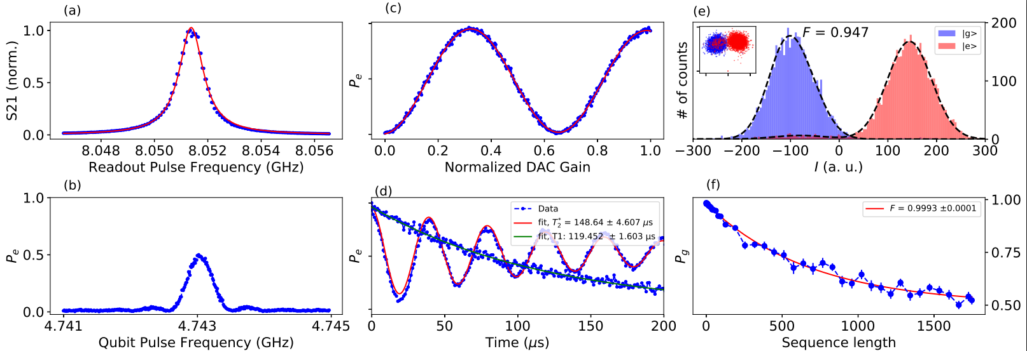
Single qubit characterization (transmon) at Schuster’s lab
Measurements are fully automated using the software and firmware, see demo code at https://github.com/openquantumhardware/qick/tree/main/qick_demos

Slide 12
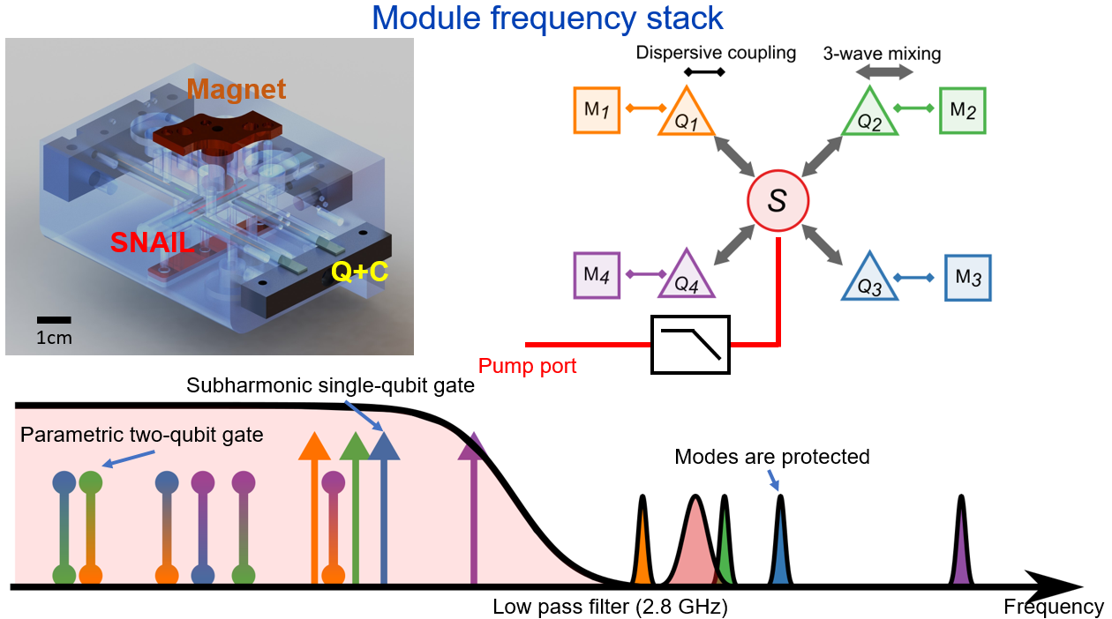
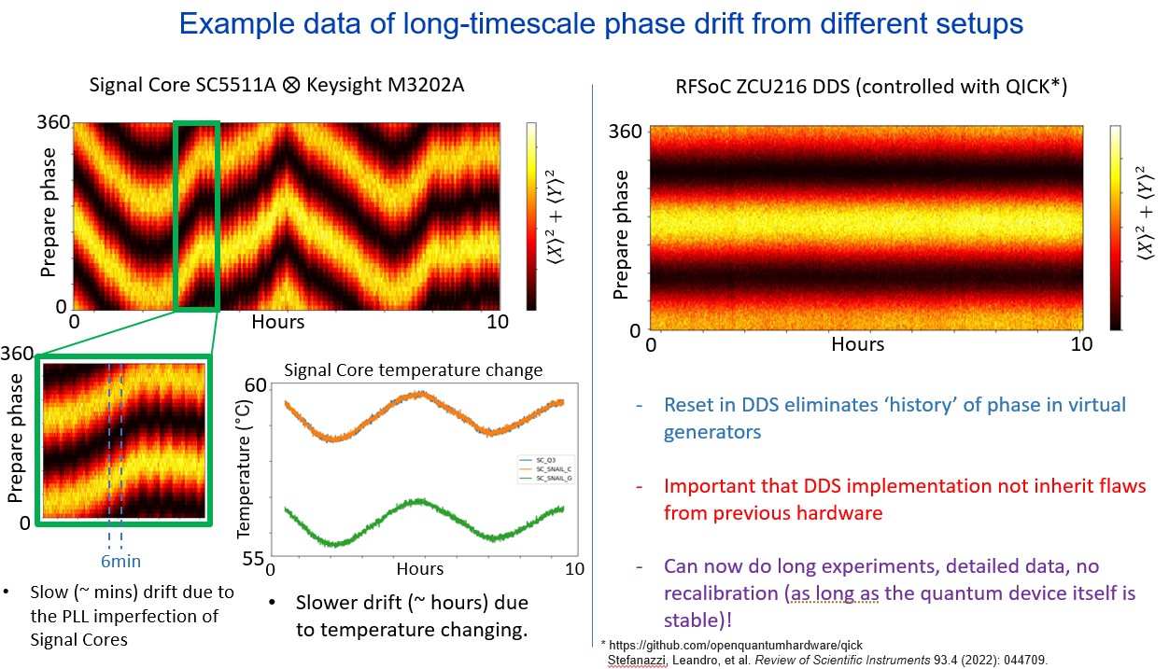
Four qubit-cavity + SNAIL
QICK helped solve a problem of run to run phase coherence that is intrinsically control system architecture and functionality dependent.
QICK functionality is added based on experiment requirements.
Typically, a new feature/functionality added is used by other experiments too.

Slide 13
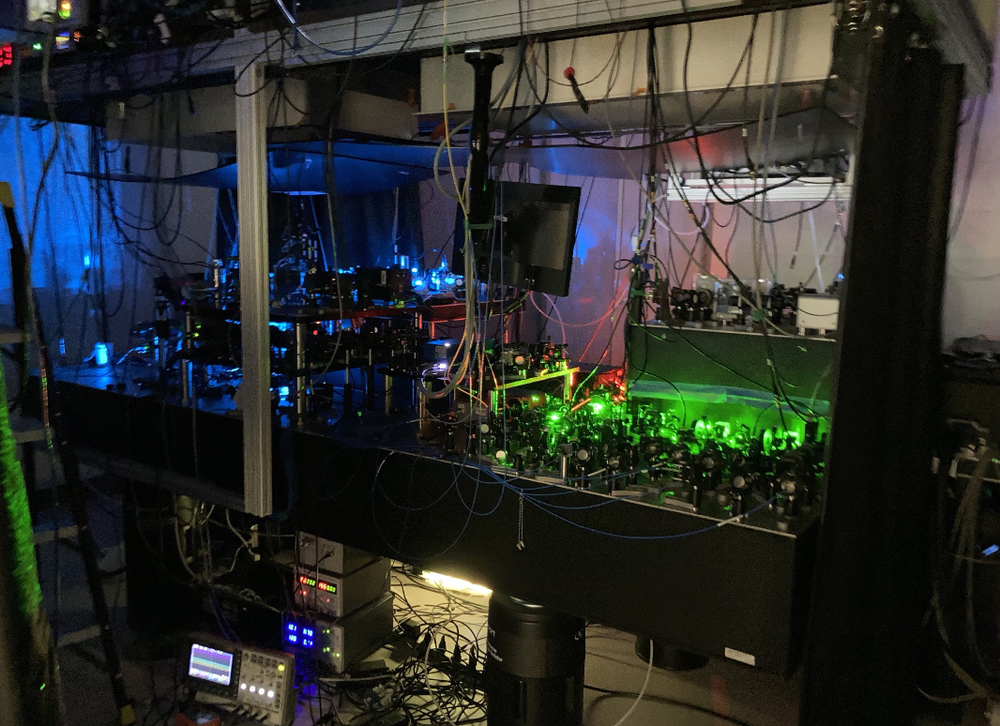
Tweezers control

Slide 15
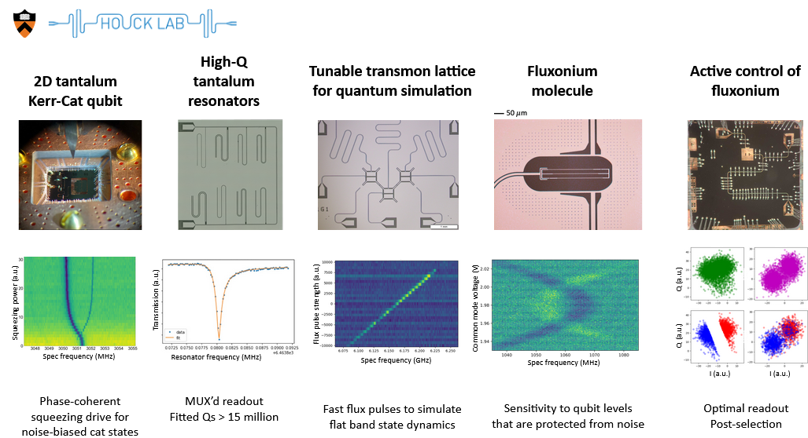
QICK applications: Quantum computing R&D
Credit: Andrew Houck, Sara Sussman (Princeton U.) QICK workshop Jan 12, 2023, Fermilab

Slide 16
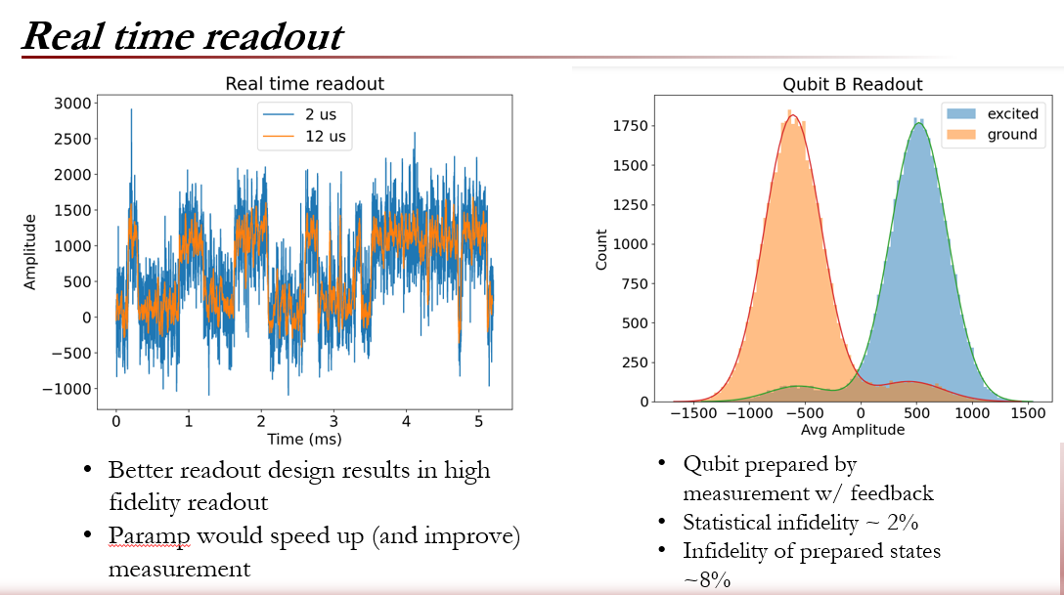
Schuster’s lab (U. Chicago, Stanford)
(prepared by David Schuster and team
QICK workshop Jan 12, 2023, Fermilab)

Slide 17
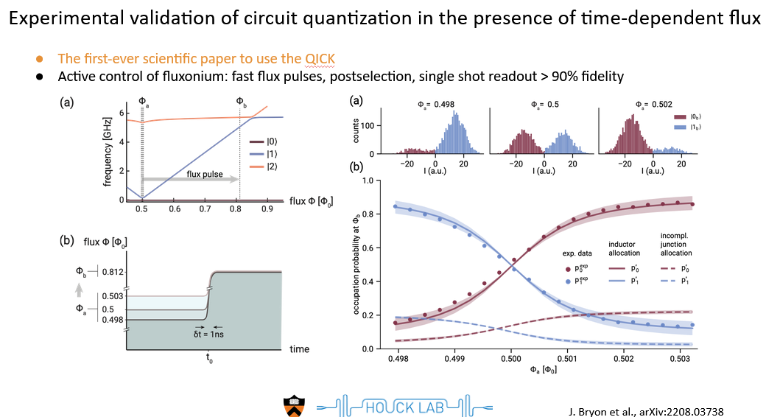
Multi qubit systems with QICK at Princeton and U. Chicago

Slide 18
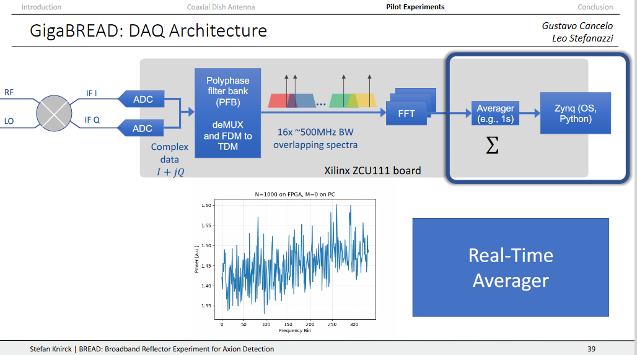
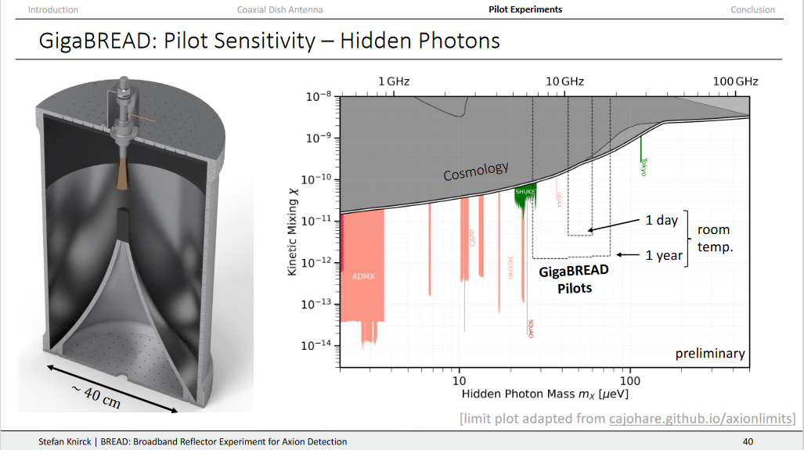
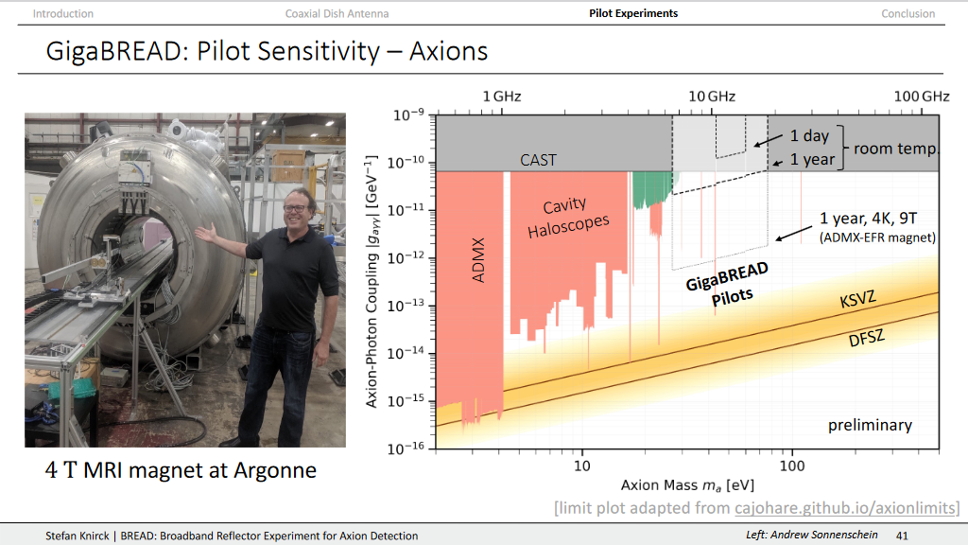
QICK for detectors: Axion BREAD broadband antenna

Slide 19
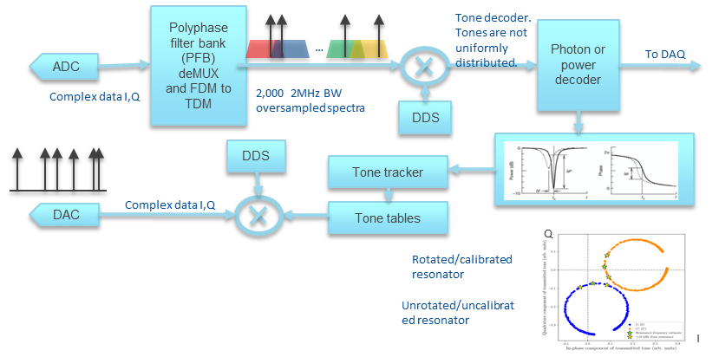
QICK for detectors: MKIDs, QCD, muxed SNSPDs
1024 frequency multiplexed detectors on a single DAC-ADC pair. >2GHz of BW.
>16 GHz per RFSoC board
8K channels/board
Not the same firmware for detectors, but we reuse many firmware and software modules from QC.
Same hardware, same PYNQ software support
Every detector requires some firmware modifications. Often, small mods.
Gustavo Cancelo

Slide 20
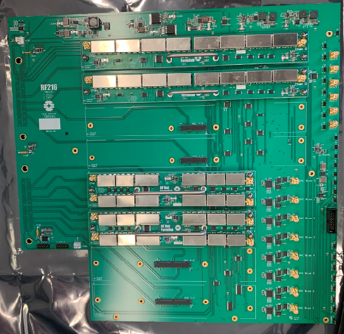

Slide 21
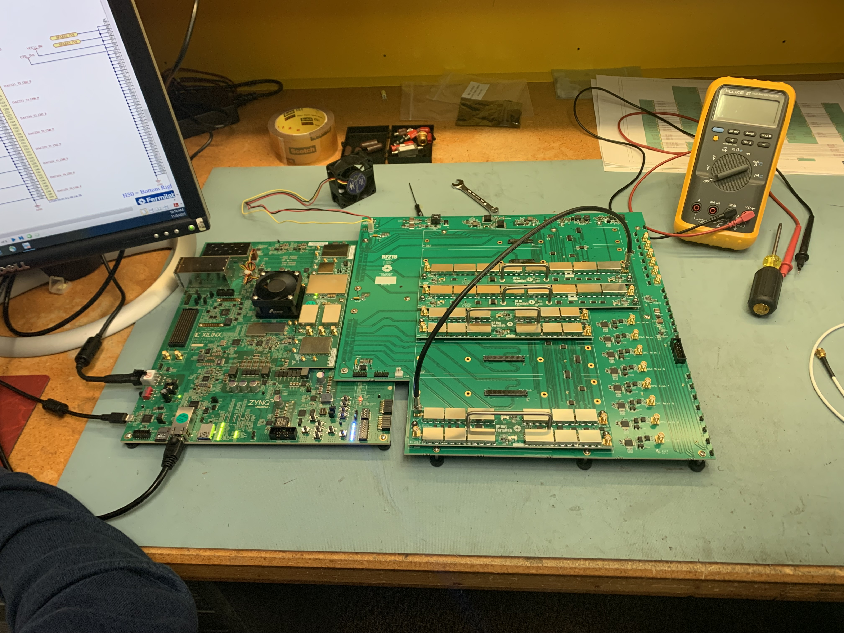

Slide 22
Thank you

