Slide 1
IOTA Proton Injector PLC Briefing
Dean (Chip) Edstrom
12/06/2023

Slide 2
IPI Programmable Logic Controller Summary
In-hand (More or Less):
Source HV PLC: HV Enclosure
Low Energy Beam Transport PLC: RR298
In need of attention:
Beamline Vacuum: RR915
Beamline Magnets: RR978
RF Slow Interlocks: RR282

Slide 3
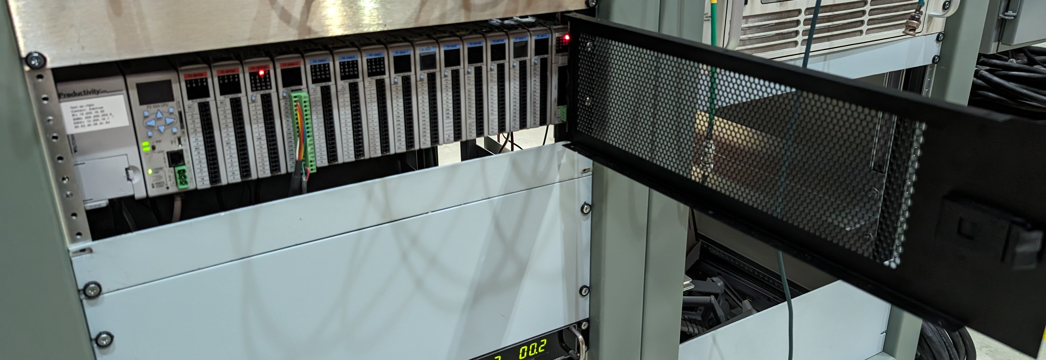
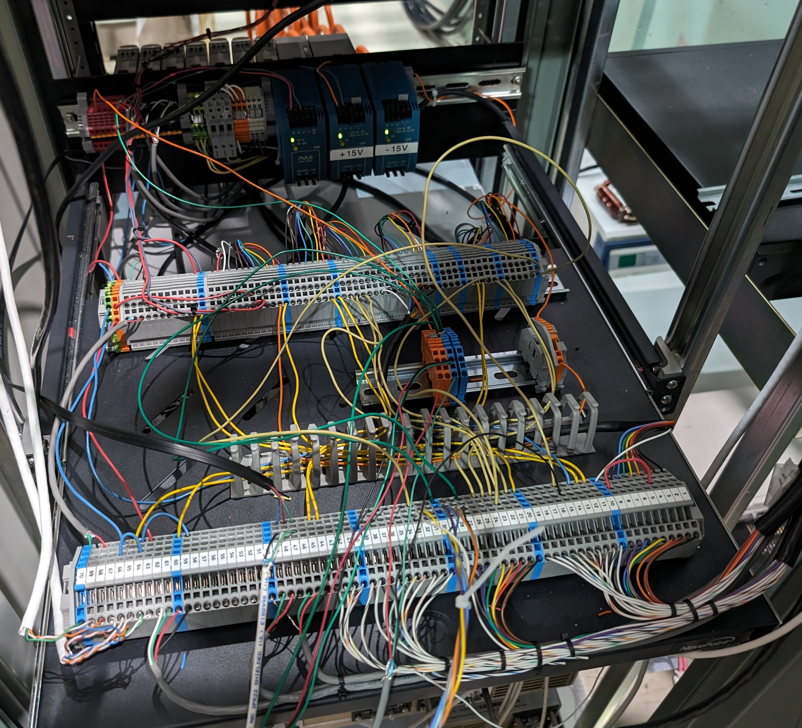
General PLC Installation
Goal: Standardize to facilitate easier wiring & trouble shooting
Door, Panel, Interconnects Shelf, Etc.
https://fast.fnal.gov/?p=dept/plc.rack_kit

Slide 4
IPI Vacuum PLC
Modules:
1x SCM or 2x SCM
(2x only if using RS232 for individual scroll pumps)
1x 16AD-2 or 2x 08AD-2
2x 08TRS or 1x 16TR
2x 16NE3
Components to Connect:
Turbo Control (1x):
1x RS-485
Roughing Pump Cart (2x + 1 pump):
1x Pump Reset Relay (to +24V from pump) to 08TRS...
Gang together by cart.
Monitor ‘cold’ side for relay status
(+1x to 16 Ch Digital Status)
1x ASV Reset Relay (to +24V from pump) to 08TRS...
Gang together by cart?
Monitor ‘cold' side for relay status
(+1x to 16 Ch Digital Status)
1x RS-485 total or individual RS-232 (7 ports total)
1x +24V from pump: 16NE3 (7 channels total)
1x Common from Pump
Wide Range Vacuum Gauge (8x):
1x 24V (100mA Max, 0.9V drop -> run bulk at 25V?)
1x Common
1x Cal Relay (dry pair) to 08TRS
Gang in series between valves
(3x channels total, LEBT/RFQ/MEBT)
1x Readback, 0-10V to 08AD-2
RR915 Acopian DC Bulk Supply (x3)
1x Voltage Monitor to 08AD-2
1x Current Monitor to 08AD-2
1x Alarm Relay to 16NE3 (4 channels total)
Misc Output:
1x RFQ Vacuum Permit to 08TRS (to RF PLC)
1x CDC Valve Close Request to safety system
Status:
Installation is in place…
Need to adjust module compliment

Slide 5
IPI Magnet PLC
Modules:
2x 16NE2
2x 08TRS
1x SCM (only if splitting the VAT load)
Components to Connect:
ZUP Power Supplies: 14x (12 Quads, 2 Spare)
1x or 2x RS-485
1x Interlock to 08TRS (12 Total)
Gensys Power Supplies (Bends): 2x
Remote Device Over IP Preferred
1x Interlock to 08TRS (2 Total)
Klixons: 20x total to 16NE3
12x Quads
2x Dipole Magnets
2x mulitfunction magnets
2x MEBT correctors
2x LEBT correctors
Misc Outputs:
1x Interlock (MFC/HV Correctors) to 08TRS...
Control via eCool bulk?
Status:
RR978 is full of spare/unused power supplies…
We have PLC backplane & CPU in-hand
Most of the Installation components are in-hand

Slide 6
RF Slow Interlocks PLC
Modules:
… WIP (so far, just copied HINS)
Components to Connect:
Water Flow/Temperature Meters (x12 at least…)
Plan for 16?... + Dist flow, RFQ Flow, a few spare?
2x Analog Readbacks Each to 08AD-1 or 16AD-1
1x 24VDC power?
1x Common
1x Flow Switch (24V loop from Low-I distribution)
Klystron Ion Pump
Remote Device over IP
Klystron Thermocouples (x12)
Power Meters (10x)
Remote Device over IP
Still need to be connected
Waveguide Pressure Sensor?
(Setra makes multiple models…)
Klystron Heater (already connected…)
1x Setpoint (0-10V from 08DA-2)
1x Readback (0-10V from 08AD-2)
Voltages…
Misc Inputs:
Klystron Vacuum from PLC (RR915)
Any other interlocks in???
Misc Outputs:
1x $A4 on-demand Trigger
3x Kly Solenoid interlock output to Bulk (twinax)
1x Water/Vacuum Permit to Intlk VME
Additional things to consider:
Klystron Solenoid Readbacks
Klystron Bias Supply Readback

