Slide 1
South Dakota Mission Support Workshop - #2
Joe Pygott, South Dakota Services
Welcome, Introductions, Goals
30 January 2024

Slide 2
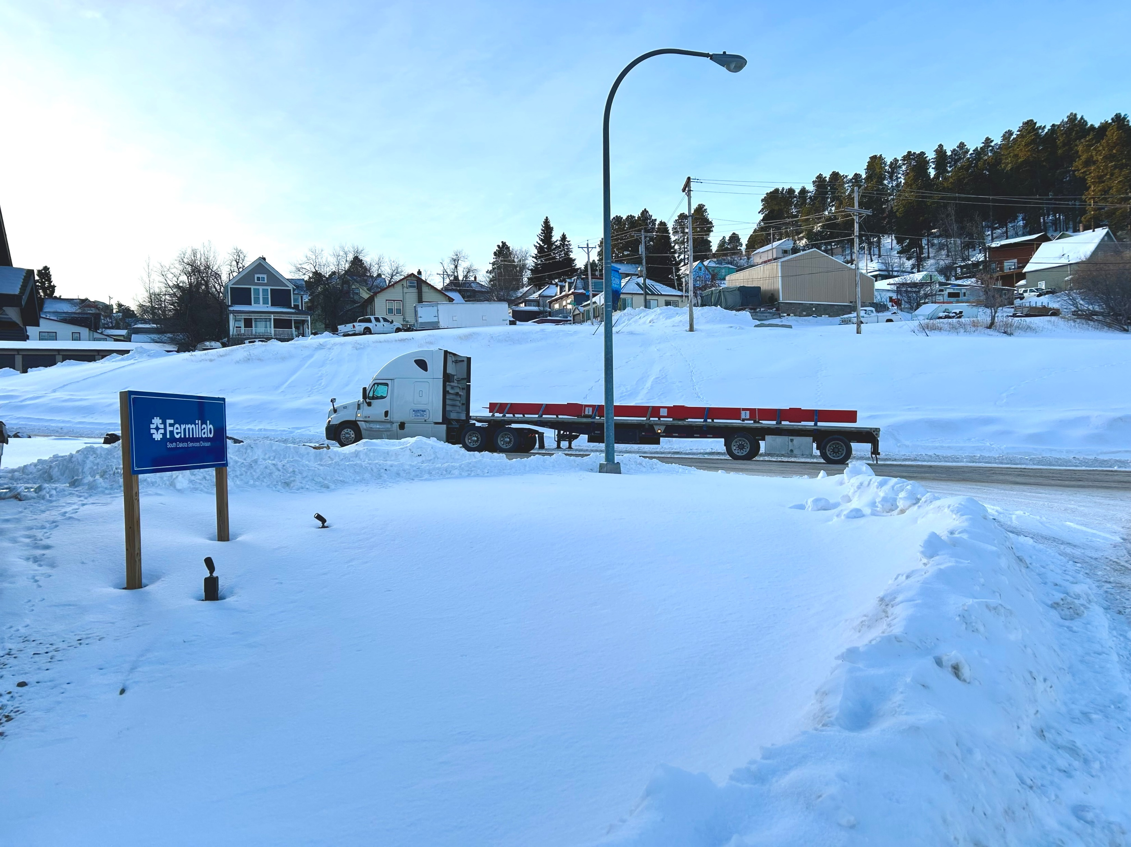
Welcome and Introductions!
1) Name
2) Division
3) Role
4) How long have you been with the lab?
4) Have you ever been to Lead, SD?

Slide 3
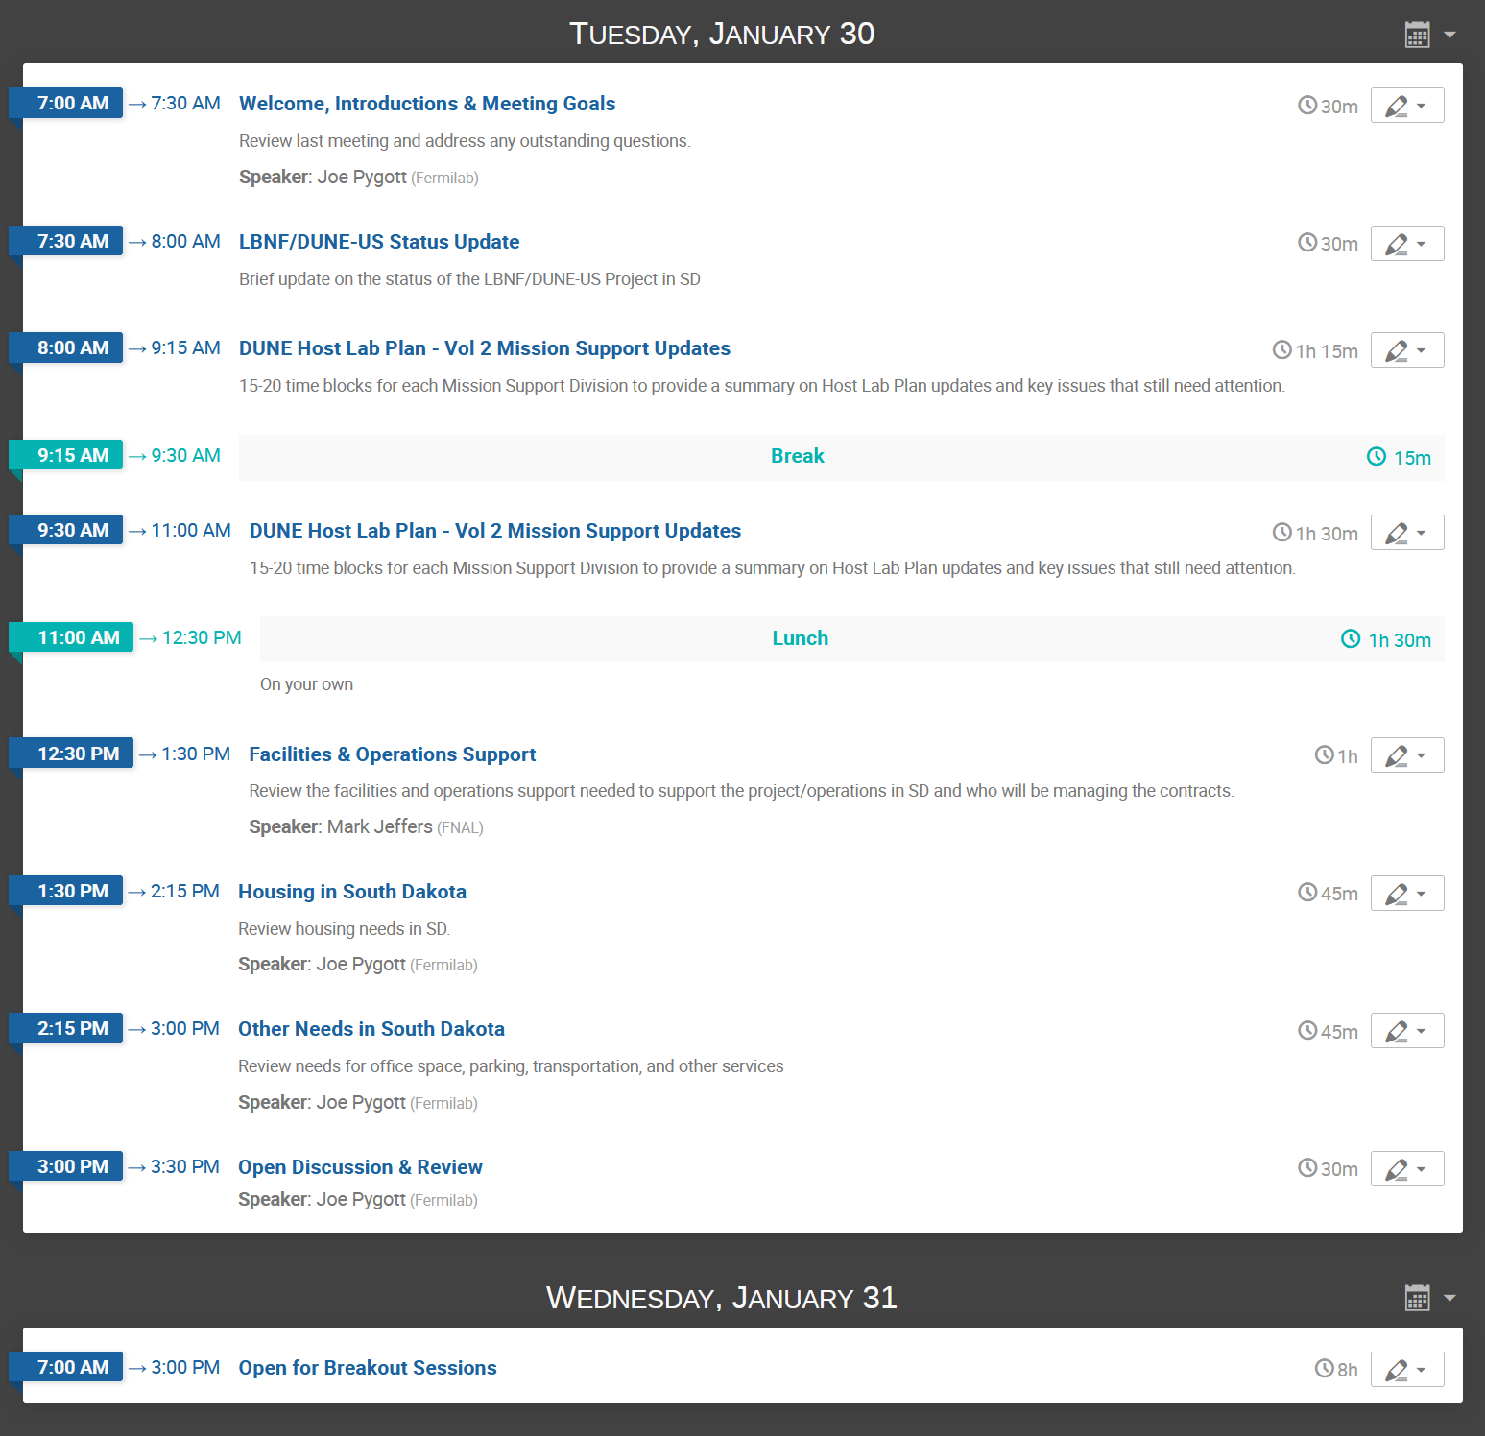
Workshop Agenda

Slide 4
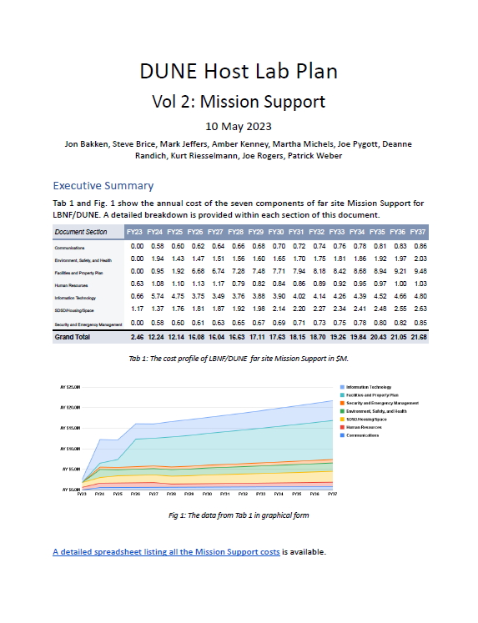
Workshop Goals
Reoccurring Workshop ~3 per year (1 in Batavia, 2 in SD)
To better understand the scope of the LBNF/DUNE-US Project and subsequent operations in South Dakota and the Mission Support needed to be successful
To gain a better understanding of what other Mission Support organizations are doing to support activities in SD
To assure the Mission Support scope is well understood
  Who is doing what?
Identify interfaces and interactions between South Dakota Services, Mission Support organizations and SDSTA
To identify areas of concern & gaps in our planning efforts
Develop milestones and assign actions items

Slide 5
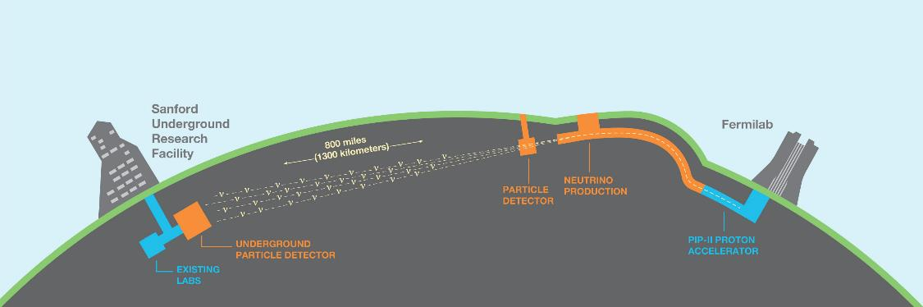
DOE Project Scope - Delivered at Two Sites through Five Subprojects
Far Site – SURF in Lead, SD
Facility/Infrastructure and Far Detectors
Near Site – FNAL in Batavia, IL
Facility/Infrastructure, Neutrino Beamline, and Near Detectors
Three subprojects
Two subprojects
NSCF+B – Near Site Conventional Facilities + Beamline
ND – Near Detectors
FSCF-EXC – Far Site Excavation
FSCF-BSI – Far Site Building & Site Infrastructure
FDC – Far Detectors and Cryogenic Infrastructure

Slide 6
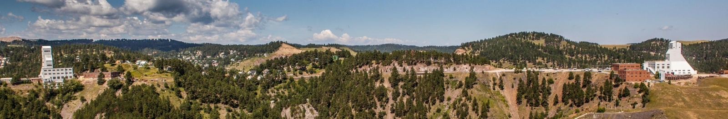
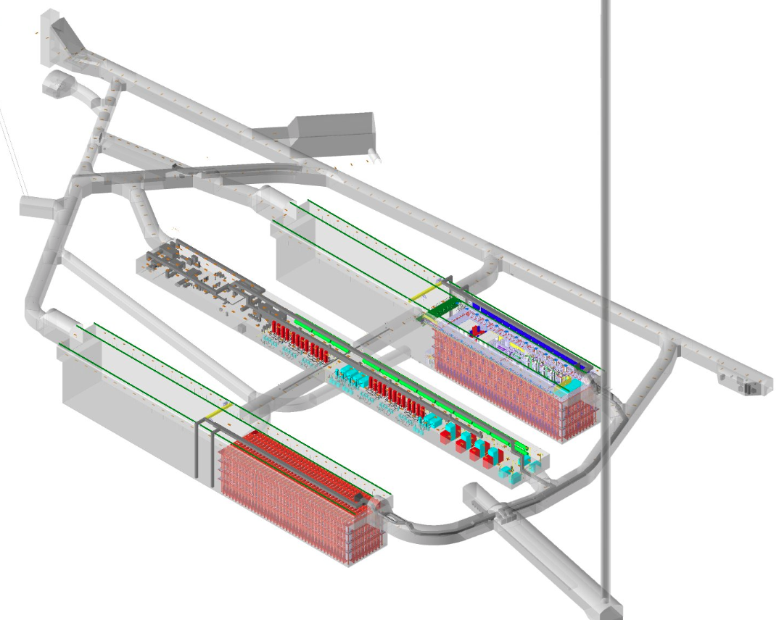
Project “Far Site” is at Sanford Underground Research Facility (SURF) in Lead, SD
Ross shaft headframe
Yates shaft headframe
1.5 km down
SURF is located at the former Homestake Gold Mine, in Lead SD
Property was transferred in 2006 to the South Dakota Science and Technology Authority (SDSTA), a quasi-public agency, to create and operate an underground science facility
SDSTA operates SURF under a cooperative agreement with DOE HEP
DOE has leased areas where the LBNF facilities are being constructed from SDSTA; easements are also in place to allow access and temporary use of various facilities.
FRA has a memorandum of understanding with SDSTA with respect to LBNF/DUNE-US project support, services, and responsibilities.
FRA subcontracts with SDSTA for certain services (e.g., hoist operation & logistics support)
LBNF caverns

Slide 7
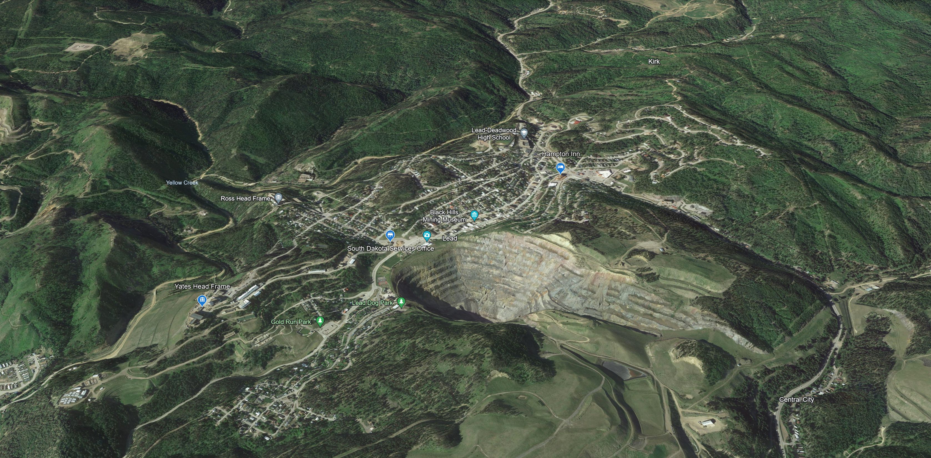
Lead, SD

Slide 8
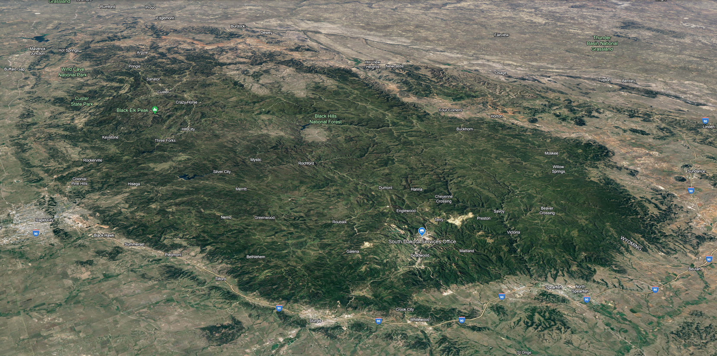
Black Hills Region

Slide 9
Host Lab Plan– Purpose, Approach, Scope
Purpose: To help define and address responsibilities of the host lab for LBNF/DUNE with respect to scientific operations and mission support.
Approach: Creating one comprehensive document separated into two volumes
    Volume 1 – Science Operations
    Volume 2 – Mission Support
Scope:
  Define the near-term support needed from Fermilab to successfully build the LBNF facilities and DUNE detectors and
  Coordination, oversight, and support functions, & appropriate budget and resource planning for Fermilab to serve long-term as the Host Lab for LBNF/DUNE, including the international DUNE collaboration.
Link to Both Volumes of the Host Lab Plan

Slide 10
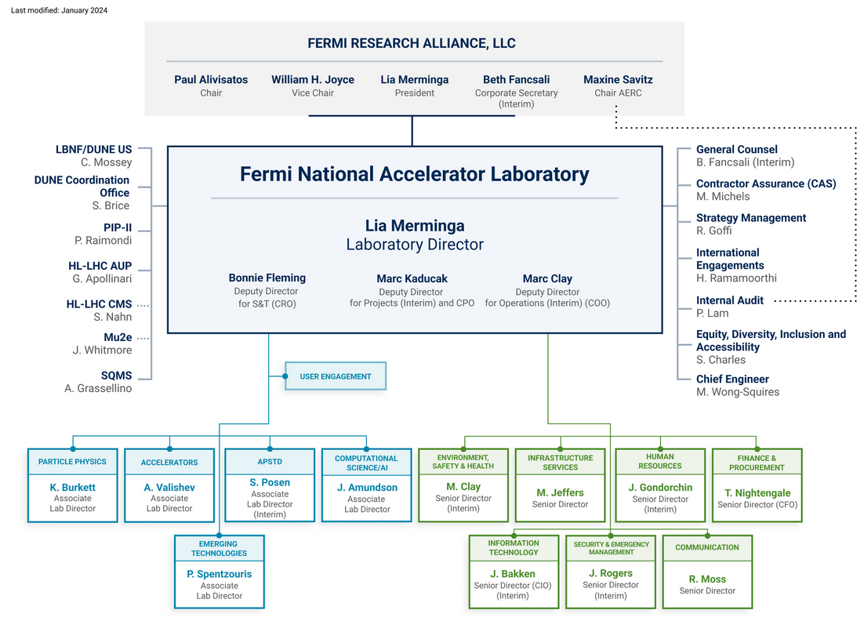
Host Lab Plan– Mission Support
The Mission Support Volume primarily focuses on the Far Detector and Cryogenics (FDC) construction Era
Addresses the immediate business support functions needed to facilitate the installation and integration of the far detectors.
The necessary support functions outlined in the plan are outside of the LBNF/DUNE-US Project scope and are typically “host” services provided to projects occurring at the Fermilab Batavia, IL site.
Host services include:
  Communications
  Fermilab DUNE Coordination Office (including South Dakota Services)
  Environment, Safety, & Health
  Human Resources
  Information Technology
  Infrastructure Service
  Security and Emergency Management
  Finance
  Contractor Assurance
  Equity, Diversity, Inclusion and Accessibility
To help execute the Host Lab responsibilities, the Lab Director chartered the FNAL-DUNE Coordination Office in May 2023 to coordinate and integrate host lab support functions.

Slide 11
Organization
Finance

Slide 12
Organization
Personnel Physically in Lead, SD
South Dakota Services
  Head (Joe Pygott)
  Mission Support Integration Mgr. (Starts 03/04)
  Project Mgr (Patrick Weber [remote])
  Admin Asst (Open – TBH FY24)
  Admin Asst for Housing (TBH FY25)
  Driver (TBH FY25)
Communications
  Communications & Community Relations Mgr. (Zach Burton)
  Comms Admin Asst (TBH FY24)
Environment, Safety and Health SH Functions
  Radiation Physicist (TBH FY24)
  Regulated Waste Technical Specialist (TBH FY25)
Human Resources
  Recruiter and HR Generalist (Luke Mickelson)
  Technical Recruiter (Katie Lutz)
Information Technology
  System Analyst (TBH FY24)
  System Analyst (TBH FY24/25)
  Desktop Support (Matt Bunkowske, NTT)
  Cabling (TBH FY25)
Infrastructure Services
  Logistics Clerk (TBH FY24)
  Operations Engineer/Department Head (TBH FY25)
  Station Engineer/Maintenance Manager (TBH FY25)
  Contracts Manager (TBH FY25)
  Contract Administrator (Maintenance) (TBH FY25)
  Contract Administrator (Service) (TBH FY26)
  Maintenance Planned/Scheduler (TBH FY25)
  DDC Technician (TBH FY26)
  Fire Protection Technician (TBH FY25)
Security and Emergency Management
  Facility Security Manager (Trey Shipman)
  Global Service Associate (Marsha Nichols)
  Program Administrator (TBH FY26)
Finance
  Matrixed support in Batavia
Finance

Slide 13
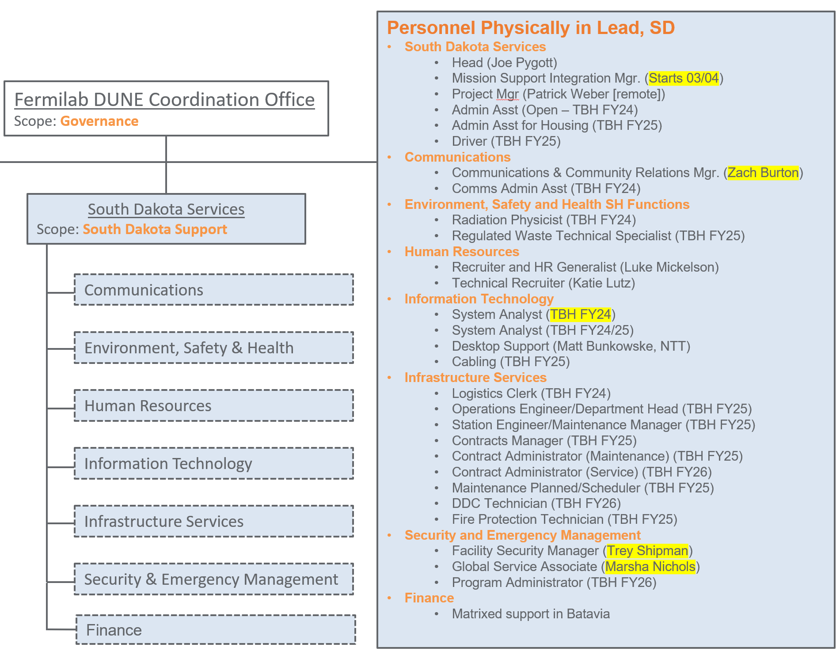
South Dakota Services
Responsible for facilitating services in South Dakota to the Project and the DUNE Collaboration
Interface with the Project and Mission Support Divisions to ensure the necessary support functions are provided
Planning for pre-operational and operational responsibilities once the Project is complete.
Function as the primary point of contact in South Dakota for the Laboratory
Fermilab Mission Support Divisions retain responsibility for providing their respective expertise and services at the Far Site.

Slide 14
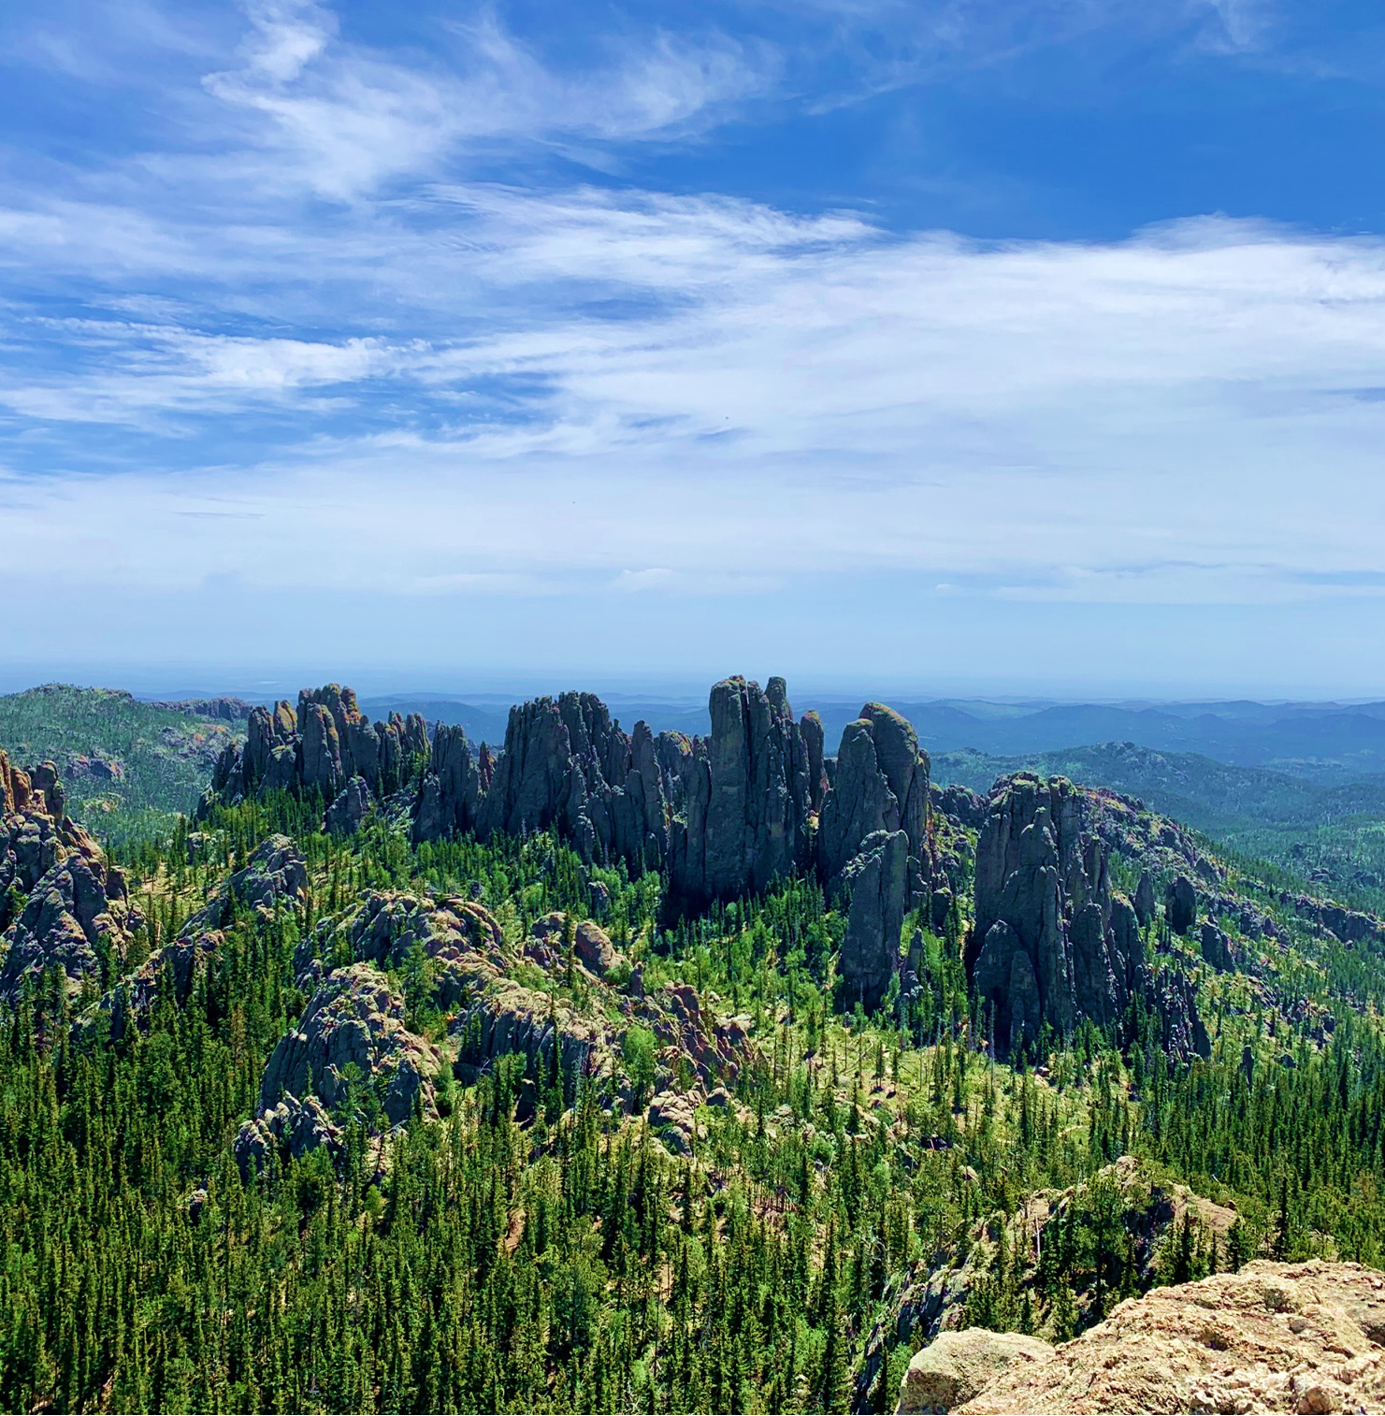
Planning for Work in South Dakota
Preparing to shift from planning to execution
People (employees, users, subcontractors)
Defining services (Project, Mission Support, SDSTA)
Advancing procurements
  Host Lab support
    Office Space
    Housing
    Parking & Transportation
    Badging & Access
    Computing Support
    Site Security
    Communications
    Rental Cars
    Hotels
    User Support

Slide 15
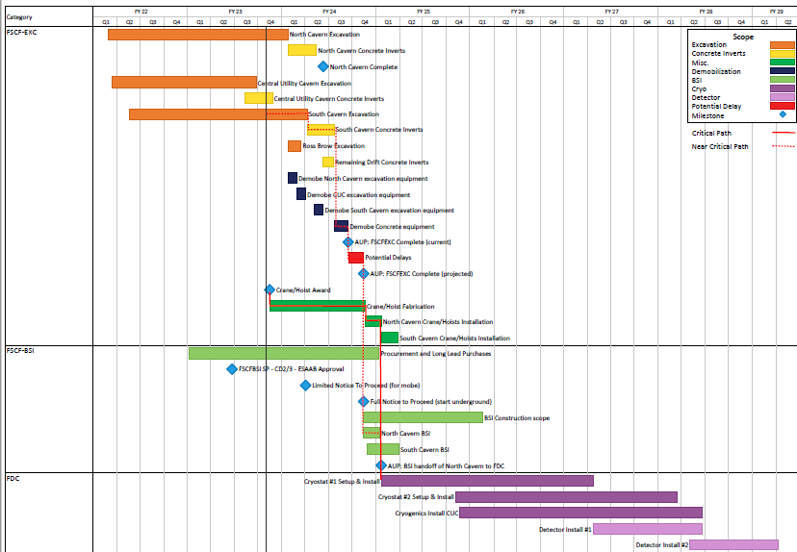
LBNF/DUNE-US Far Site Schedule
Handoffs from FSCF/EXC and FSCF/BSI are very clear
FDC work begins in North Cavern with warm structure #1 installation (Oct 2024)
Significant planning to understand and define conditions at handover and during co-working timeframe
FDC interfaces to FSCF/EXC, FSCF/BSI defined
Phased Transition to Operations for LBNF/DUNE

