Slide 1
South Dakota Housing
Joe Pygott
30 January 2024

Slide 2
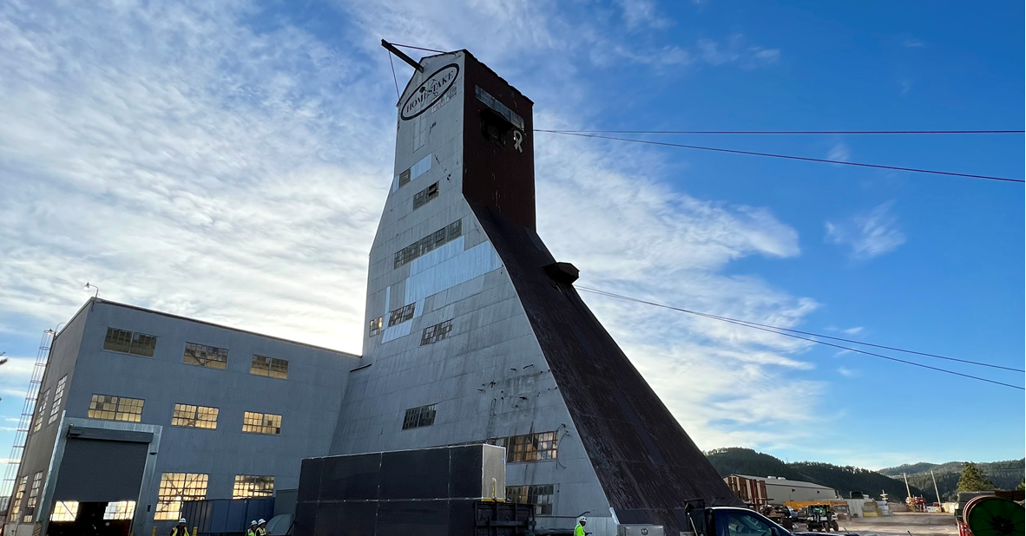
Agenda
Who Needs Housing
Categories of Housing
Actions Taken
Survey Results
RFI Responses
Current Plan
Actions Needed
Discussion

Slide 3
Who Needs Housing
LBNF/DUNE-US Project – Department of Energy (DOE) funded project personnel including members of the FDC management team who participate in a management rotation to supplement the South Dakota-based installation team and participate in installation activities. Personnel include staff of FRA, other national labs, and universities. Travel for these individuals is funded by the project.
Fermi Research Alliance (FRA) prime contract funded personnel include Fermilab management and subject matter experts providing Host Lab Services and expertise to the LBNF/DUNE-US Project. Travel for these individuals is funded through FRA operations or indirect funding, depending on the division involved and the finalizing for overhead rules for SD costs.
DUNE Collaboration members include members of institutions from across the world providing expertise during the FDC installation and DUNE commissioning. These individuals are not funded by LBNF/DUNE-US but have a user association with Fermilab. Travel for these individuals is funded by their respective home institution.

Slide 4
Categories of Housing
Short Term
Stays that are less than two weeks in duration.
Medium Term
Defined as a stay of more than two weeks and up to twelve months per stay. Typically for people that will not be permanently relocating to SD.
Long Term
Defined as a stay of more than one year and is typically considered more permanent and may be the individual's responsibility to provide.

Slide 5
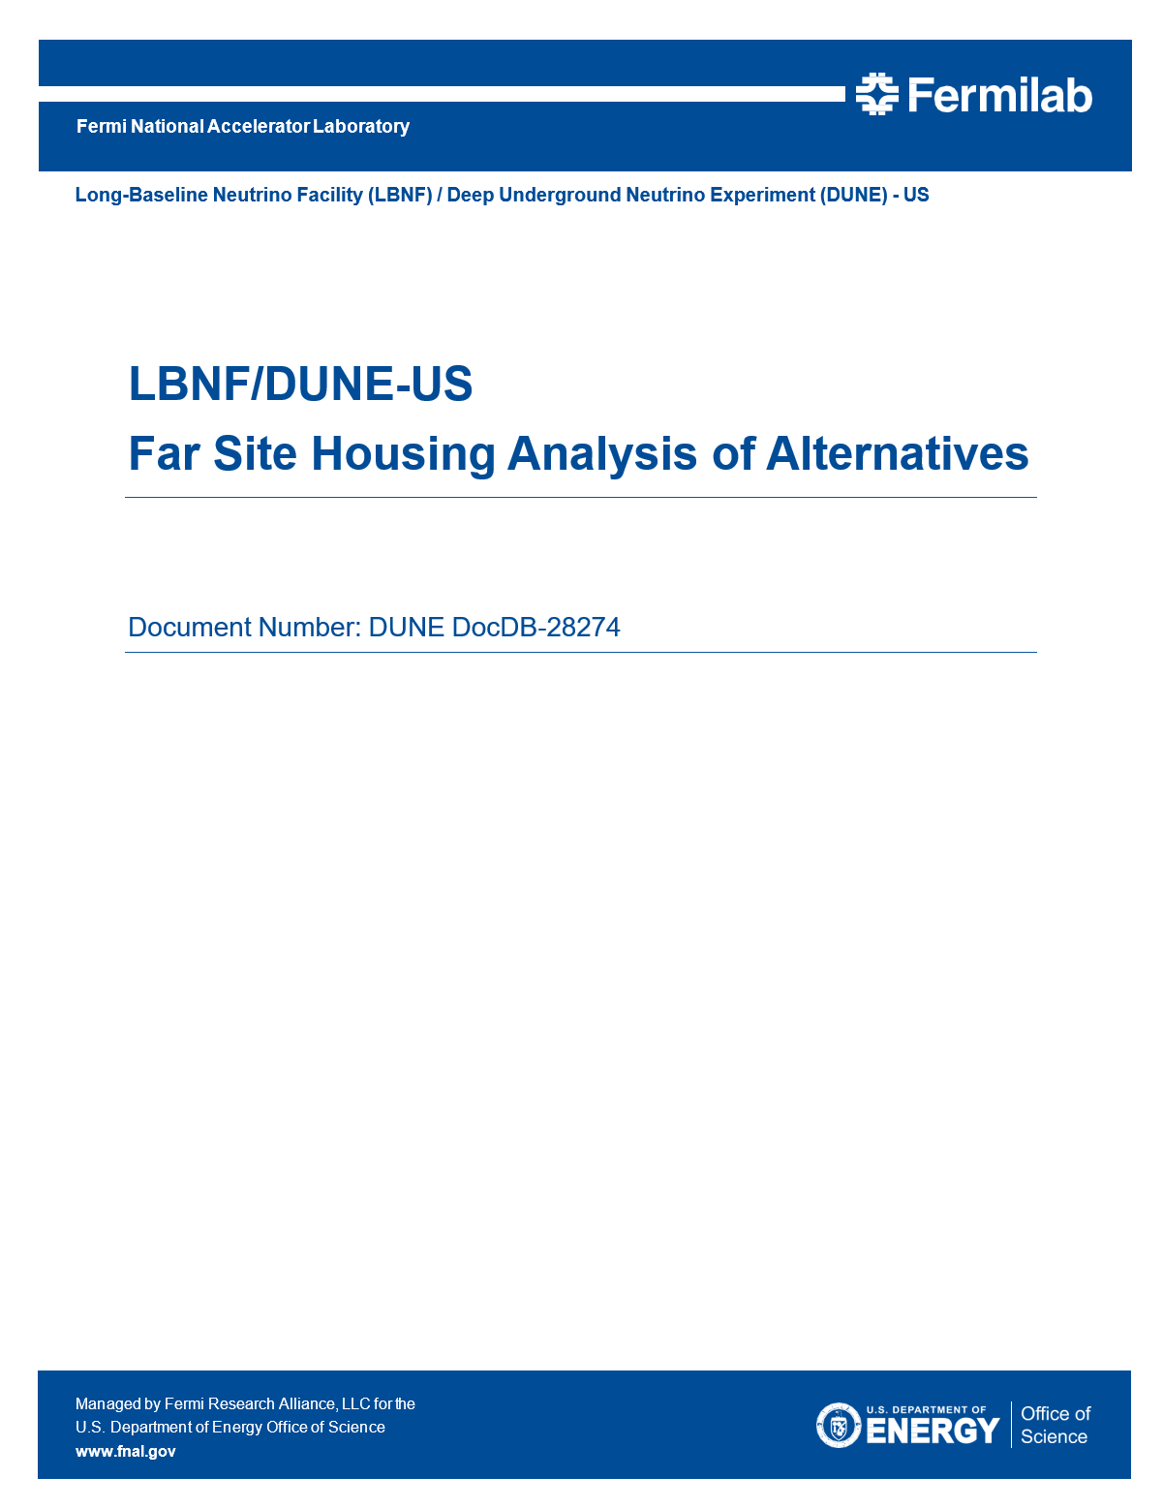
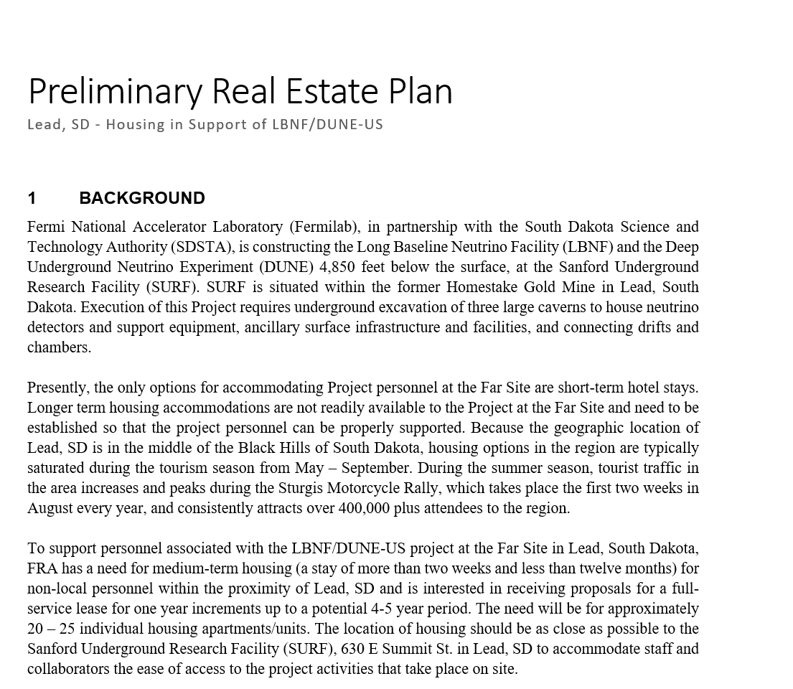
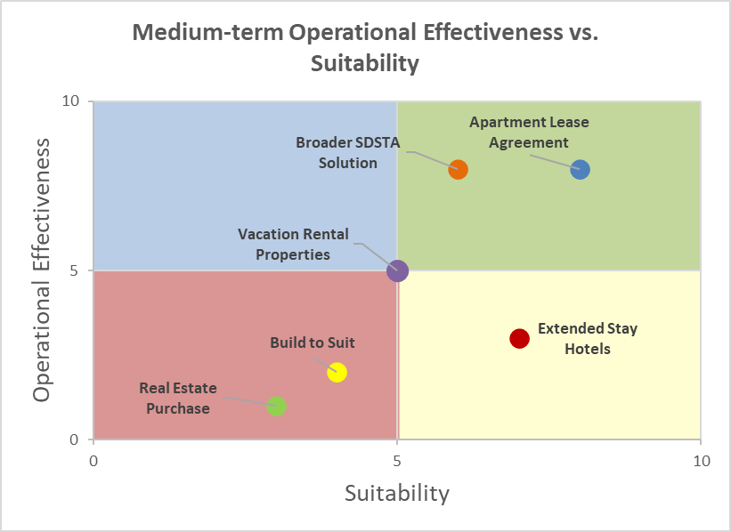
Actions Taken
Working with the Project, DUNE Collaboration, Procurement, and DOE
Received approval from DOE on:
  Far Site Housing AoA
  Preliminary Real Estate Plan
  Issuance of a Housing Request for Information (RFI)
Distributed survey on housing and office space needs to stakeholders
Interface with local Economic Development Corp. and City of Lead
Working with SDSTA for offering housing solutions

Slide 6
Survey Results

Slide 7
Survey Results

Slide 8
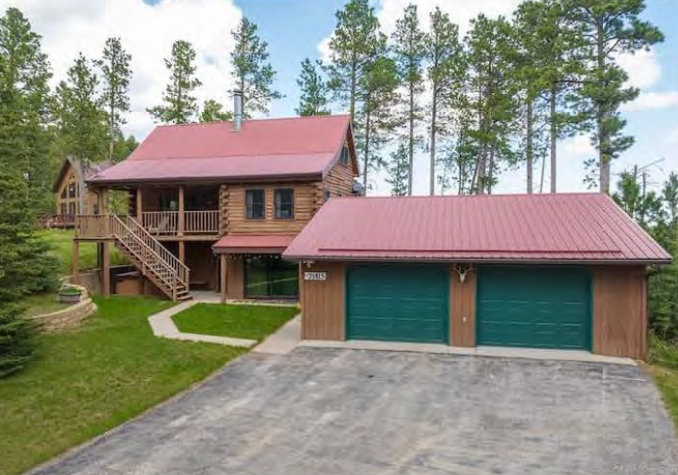
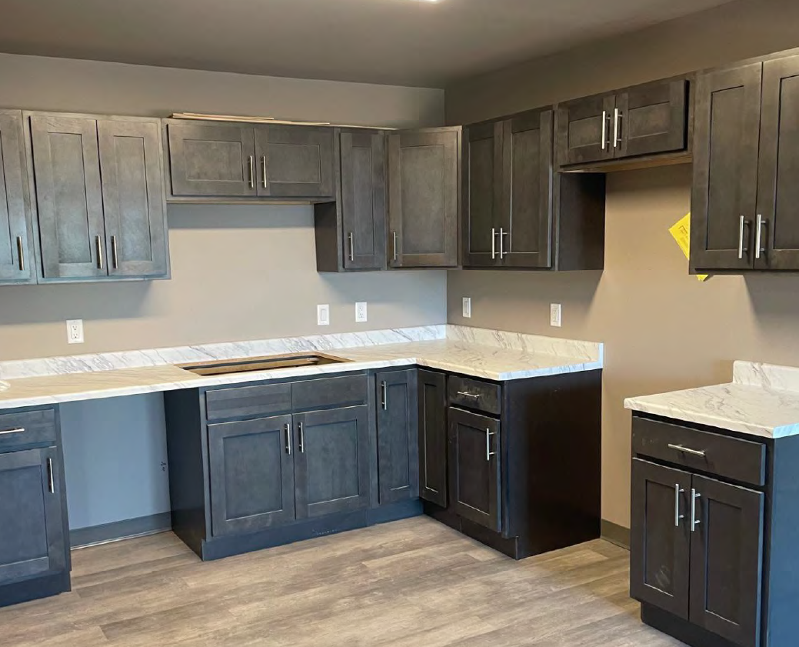
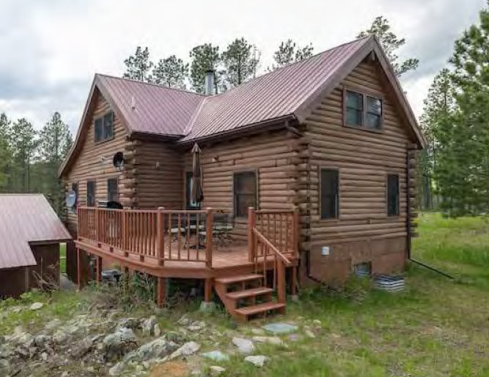
Housing RFI Responses
RFI Issued: 12/07/2023 - RFI Closed: 1/26/2024
  Potential Offerors Contacted: 21
  RFI Responses Received/Completed: 15
Number of Bedrooms: 68
Housing Types & Quantity:
  House = 6 each
  Hotel = 12 each
  Apartment = 5 each
  Duplex = 2 each
  Land Only = 1 each
Property Locations (per town):
  Lead = 9 each properties (bedrooms/sleeping quarters = 38 each)
  Deadwood = 4 each properties (bedrooms/sleeping quarters = 25 each)
  Whitewood = 1 each properties (land option only)
  Beulah, WY = 1 each properties (bedrooms/sleeping quarters = 5 each)
Additional Notes:
  Many units are not ADA compliant, as many are houses/duplexes.
  Units range from rooms in private homes to apartments with various square footage.
  Some, include shared common spaces as indicated per RFI Response.

Slide 9
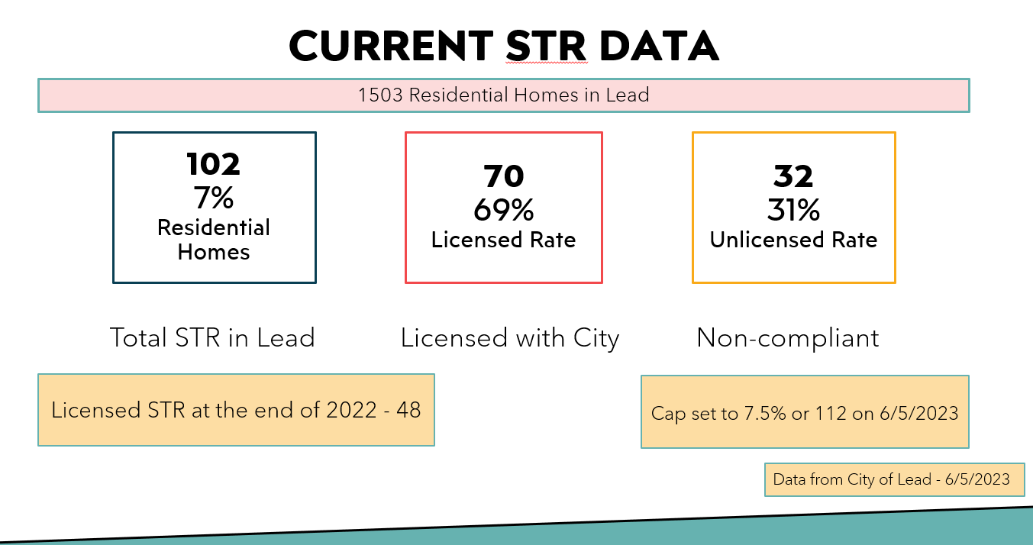
Lead Short-term Rentals (STR)

Slide 10
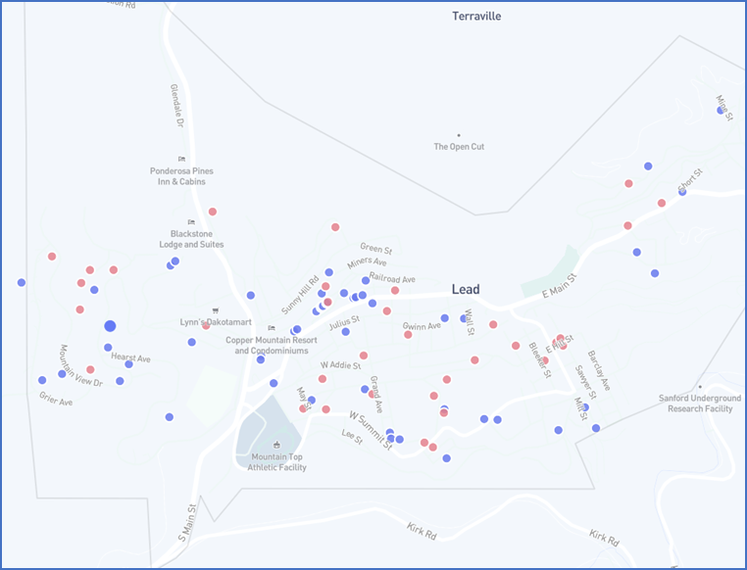
Lead Short-term Rentals
Rented on a daily/weekly basis for more than 14 days in a calendar year
Current & pending STR within Lead
Several within walking distance to SURF
Some may rent long term if possible

Slide 11
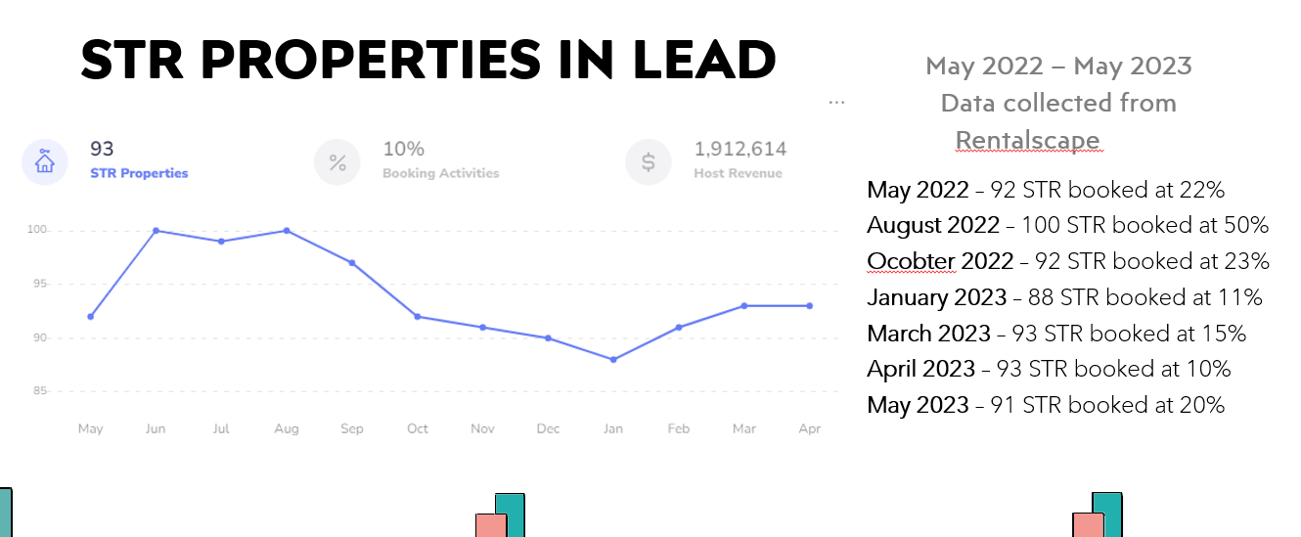
More Lead STR Data
STR nightly rate:
  Highest daily rate is $1,200/night during the Rally, Kool Deadwood Nights
  This property averages $900/night during summer months with a 75% booking rate
  Lowest daily rate $76/night
  Large range of nightly rate in Lead

Slide 12
Current Plan for Housing in/near Lead, SD
1st component: FRA leases housing for FRA and Project personnel
  DOE Operations funds will be used to make the leases. Project reimburses Ops for the housing it uses
  South Dakota Services is working with Procurement and FSO on this component
  FRA has been told it is not allowed to use DOE funds to provide housing for collaboration (even with full cost recovery)
2nd component: SDSTA leases housing and makes it available to any SDSTA user
  SDSTA would effectively be running a long term stay hotel
  Users pay for stay with personal credit card and are reimbursed by the Project or their home institution (i.e. the normal TA process at Fermilab)
  SDSTA charges rates that would enable full cost recovery (including administrative overhead and occupancy)
  Need to make sure that reimbursement times do not create an undue financial burden on our junior colleagues
  SDSTA has been told it is not allowed to use DOE funds to do this
  SDSTA determining if other funding could be used
  We need solid housing demand data in order to minimize the risk that SDSTA are taking so they feel comfortable making this commitment
3rd component: South Dakota Services provides local resources to collaborators to secure their own housing

Slide 13
Actions Needed
Release Request for Proposal for housing (medium-term housing needs start in Fall 2024)
Continue to work with SDSTA
Verify allowable vs. unallowable costs
Need to incorporate SD housing with the associated Fermilab housing policies & procedures
Liability and waiver form
Security requirements
Determine applicability of the Domestic Extended Assignment Policy and housing per diem
Develop mechanism for cost transfers to take place (i.e., Project reimburses Ops for the housing it uses)
Develop a management plan for SD housing that maximizes occupancy of leased space
Develop the housing resources and guidance for our partners & collaboration members

Slide 14
Discussion/Questions
Questions?

