Slide 1
Other Needs in South Dakota
Joe Pygott
30 January 2024

Slide 2
Office Space
Current 23
Planned Additional 28
Total 51
Ross Dry Building
Current Space 14
LBNF Excavation & BSI have 14 workstations on main floor, 1 medium conference room (10-15 occupancy) and a small nook for visitors
Basement is mostly storage, and we use one space for Arup construction administration
Planned Future Space (timing uncertain) 12
Adds 12 workstations on main floor
South Dakota Services Office
Current Space 9
9 workstations on main floor
1 large conference room (15-20 occupancy), 1 small conference room (5-8 occupancy)
Planned Future Space (~Feb. 2024 depending on furniture arrival) 16
Reconfigure main floor to add 2 additional workstations
14 workstations in basement
Move main floor small conference room to basement

Slide 3
SD Office Space – Current Estimates
Personnel
Currently 25 assigned personnel in SD
Planned ~17 additional FTE expected to be located in SD middle of next year
Currently up to 1x per month there are 10+ visitors, this will increase over the next 6 months
Total personnel within 10 months ~ 52 plus an additional ~15 shared space = ~65
Workstations
Current workstations available 23 (14+9)
Planned 39 (23+16) workstations available February 2024
Potential 51(39+12) workstations (when?) Ross Dry is completed

Slide 4
Survey Results

Slide 5
Other Needs
Parking
Transportation
Other Space Needs
Parking is limited on site at SURF and within Lead
Rental car availability can be limited due to seasonal tourism
Locker room/Dry space
General User Office support for our visiting partners regarding:
User Experience & Support
Conference/Training
Possibility of supplemental parking
Parking within walking distance
Local busing/transit companies
Cab service
Some city ordinances limit ride sharing (Uber/Lyft)
Local area amenities
Housing
Schools/Daycare
Transportation

Slide 6
Compilation of Concerns/items to think about – from September Workshop
Procurement Support
Engagement with local business
Fractional duties of responsibilities
Policy alignment – specifically with housing
Funding availability
Employee retention/staffing
User Support/resources
Lead times for needing services, i.e., Occupational Medicine
Security requirements for leased space, emergency response, etc.
Office space requirements – certain groups may have different requirements
Is there a need for locker room space?

Slide 7
Compilation of Concerns/items to think about - continued
Tight timelines for hiring and execution
Support from other functions of the lab
Communication systems, i.e., radios
UPS protection for networking and other systems
Badging access, training
Talking points to share with the media at recruiting events
Tracking of funding/charging starts Oct 1

Slide 8
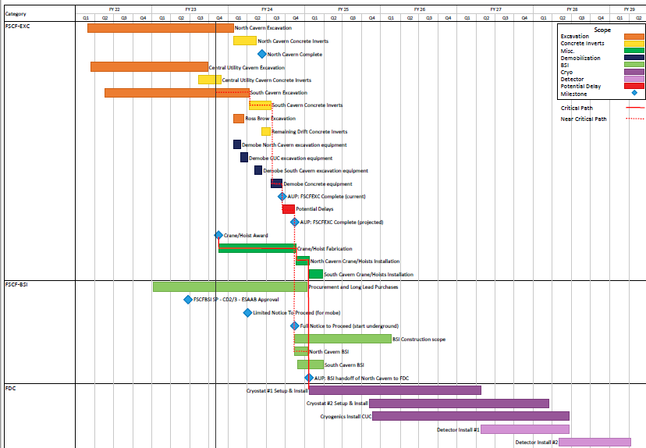
LBNF/DUNE-US Far Site Schedule
Handoffs from FSCF/EXC and FSCF/BSI are very clear
FDC work begins in North Cavern with warm structure #1 installation (Oct 2024)
Significant planning to understand and define conditions at handover and during co-working timeframe
FDC interfaces to FSCF/EXC, FSCF/BSI defined
Phased Transition to Operations for LBNF/DUNE

Slide 9
Discussion/Questions
Questions?

