Slide 1
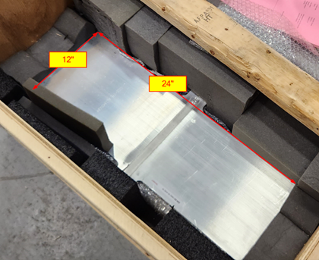
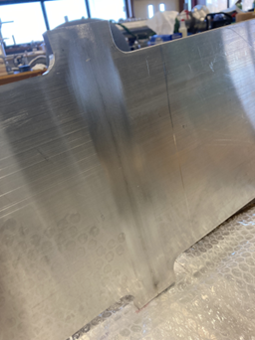
LBNF - Beamline – Target Complex
Horns
Continued work on drawings of inner and outer conductors of Horns B & C.
Fabrication of redesigned electrical break between Horn A Prototype outer conductor and the collection water tank is in progress
Friction Stir Welding vendor verification continues
SDSMT is to rework weld
German vendor samples returned and will now be x-ray (QA./QC)
Negotiating with PNNL to do samples
Horns Power Supply
Many purchase requisitions being generated for full power supply for the Horns Test Stand at MI-8.
Components are arriving
Electrical work has started at MI-8 to support Test stand power supply and water-cooling system.

Slide 2
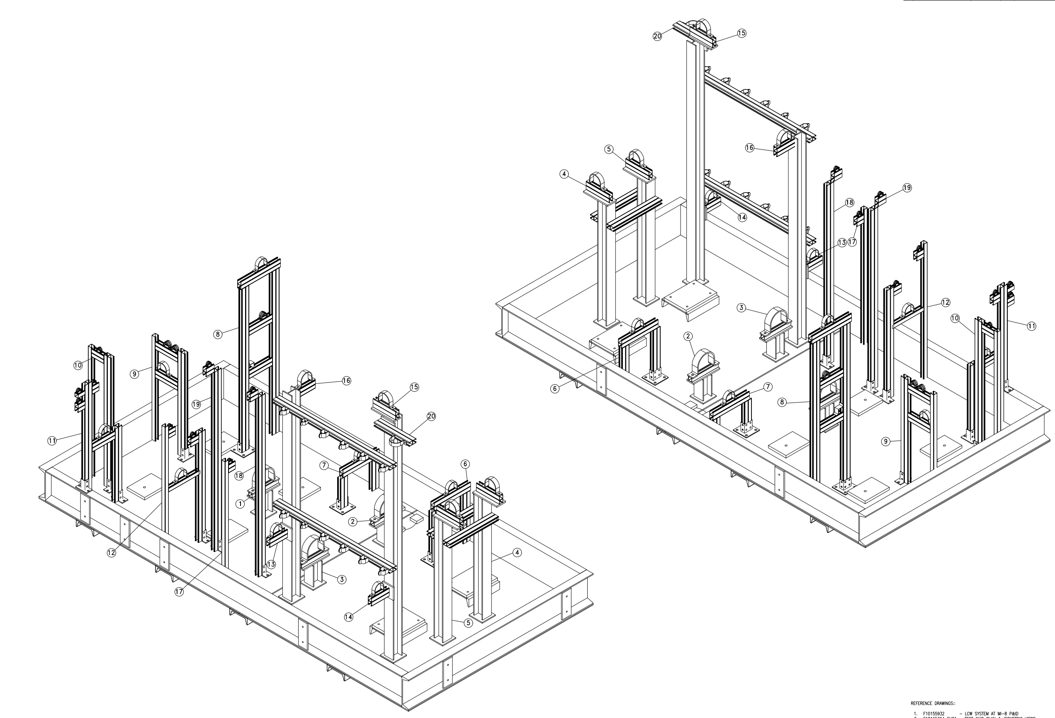
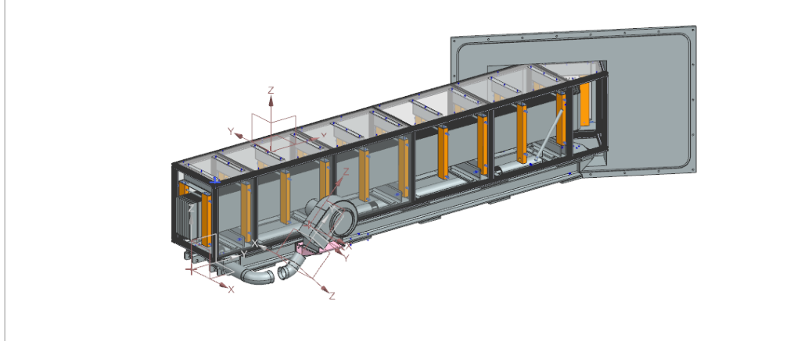
LBNF - Beamline – Target Complex
Test Stand
Frame at MI-8 was aligned and leveled.
Stripline
Modeling of segment to go through 5-foot thick wall between Power Supply Room and Target Hall
Water Cooling Systems
Design work continues for
Intermediate Systems for the TC & AC
Horn B RAW
Horn C RAW
Controls
Horn Test Stand
Absorber Complex
Completed
Absorber RAW
Horn Test Stand Specifications for fabrication
Now with Procurement
Prototype Gas Control System
Electrical connections needed

Slide 3
Interface Work
Meetings continue about busy area above target and Horn A
Target helium cooling piping
Horn A water cooling piping
Horn A Stripline connection
Stripline Block nitrogen cooling ducting
Instrumentation cabling to target and Horn A
Horn Level System
Location
Heat Exchanger He to H2O
Battlement utility feed trhus
Future ALARA considerations
Ability to remove everything

