Slide 1
Project Activities for MSD
Mayling Wong-Squires
AD Operations Friday 9am Meeting
15 December 2023

Slide 2
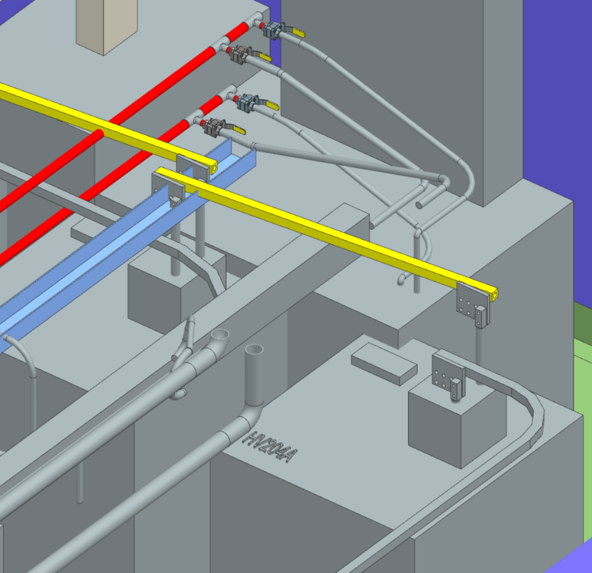
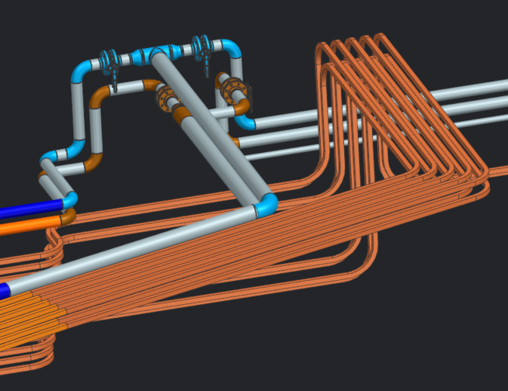
LBNF LCW System Update Dave Hixson, Scott Oplt, Will Derylo
LBNF-05 Power Supply Room
LCW piping to the power supplies and bus nearly complete.
Preliminary bus lay-out complete. The bus layout will need to be reviewed and approved by PESD engineers.
Once the bus layout is approved, the bus shielding design will begin.
LBNF Pump Room
Preliminary lay-out is complete.
Developing Cad models for the pump room components. Some components are complete, and more are under development.
Will begin final Cad models of the LCW piping system soon.
LBNF Primary Beamline
Developing Cad models for the beamline components. Many components are complete and there are many more to develop.
Final Cad models of the LCW and bus mains are mostly complete.
Developing cad models of the magnet LCW connections

Slide 3
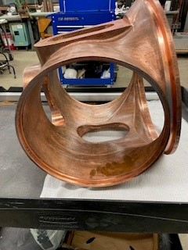
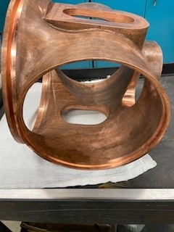
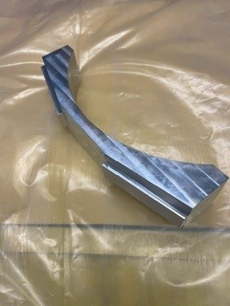
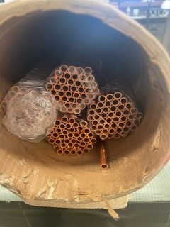
PIP-II – RF Cavity Patrick Minton, Rafal Dlugopolski, Mike Piekarski, Ken Klotz
The first article for the center section of the cavity has been completed. And the remaining five casting have been approved for production.
The inner package bus bars have been received, inspected and are being prepped for cooling tubing brazing.
New potting epoxy has been ordered to assemble the aluminum cone castings for the Booster cavity tuners.
Funding for purchase of the ceramic isolators has finally been secured and the purchase is underway.
Technicians have started inventory consumables and other production parts, in preparation to being assembly of cavity subcomponents
An offer is pending for a new technician needed for PIP-II Cavity production.
Center Cavity Section
Cavity Cradle
Inner Cooling Tubing

Slide 4
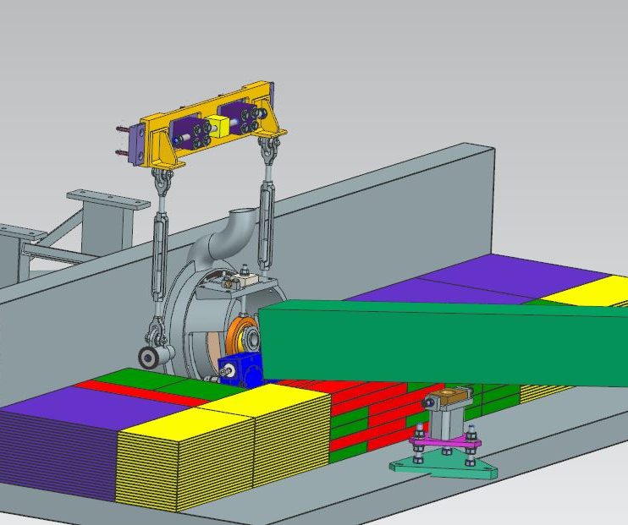
Mu2e Project Update Christine Ader, Dirk Hurd, Dan Vrbos, Jason Kubinski, Jason Morin
Working on the installation plan for the exit collimator. Parts will be order soon. It will have steel shot poured inside of it after installation.
Design of the shielding block layout between the entrance and exit collimator is being finalized.

Slide 5
Hi-Lumi – LHC – Accelerator Upgrade Project Bob Steinberg, Alex Chen, James Williams
Quantity 10 cryo-assemblies are being built by APS-TD at ICBA for CERN (pictured to the right)
CA01 did not pass the leak check requirements, prompting assistance from AD-MSD
List of tasks include identifying root causes and potential solutions, authoring a detailed leak testing procedure, procuring necessary vacuum equipment, overseeing CA02-CA10 tests
Root causes identified and presented to project leadership
Leak test procedure is completed and has passed preliminary review at CERN
CA02 leak test scheduled for January (tests are approx. quarterly)

