Slide 1
Benchmark Models for the Intensity Frontier

Slide 2
Why Study Benchmarks?
Benchmarks provide a quantitative study of the capabilities of experiments
Benchmarks provide the opportunity to demonstrate connections across the Intensity Frontier program
Benchmarks provide the opportunity to demonstrate connections across the Frontiers
Everyone else does it, we’re left out if we don’t!

Slide 3
Benchmark Models for the Intensity Frontier
Supersymmetry: pMSSM flavor studies
Warped Extra Dimensions: Randall Sundrum flavor studies
Neutrino models that reach across the frontiers
Dark Photons and Axions
We discussed these and formulated plans for study

Slide 4
The pMSSM Model Framework
The phenomenological MSSM (pMSSM)
Most general CP-conserving MSSM with R-parity
Minimal Flavor Violation, First 2 sfermion generations are degenerate w/ negligible Yukawas
No GUT, SUSY-breaking, high-scale assumptions!
19/20 real, weak-scale parameters (Neutralino/Gravitino LSP)
scalars:
m_{Q1}, m_{Q3}, m_{u1}, m_{d1}, m_{u3}, m_{d3}, m_{L1}, m_{L3}, m_{e1}, m_{e3}
gauginos: M₁, M₂, M₃
tri-linear couplings: A_{b}, A_{t}, A_{τ}
Higgs/Higgsino: μ, M_{A}, tanβ
(Gravitino: M_{G})
Supersymmetry without Prejudice
Berger, Cahill-Rowley, JLH, Ismail, Rizzo

Slide 5
Study of the pMSSM (Neutralino/Gravitino LSP)
Scan with Linear Priors
Perform large scan over
Parameters
100 GeV ≤ m_{sfermions} ≤ 4 TeV
50 GeV ≤ |M₁, M₂, μ| ≤ 4 TeV
400 GeV ≤ M₃ ≤ 4 TeV
100 GeV ≤ M_{A} ≤ 4 TeV
1 ≤ tanβ ≤ 60
|A_{t,b,τ}| ≤ 4 TeV
(1 ev ≤ m_{G} ≤ 1 TeV) (log prior)
Subject these points to
Constraints from:
Flavor physics
EW precision measurements
Collider searches
Cosmology
~225,000 models survive constraints for each LSP type!

Slide 6
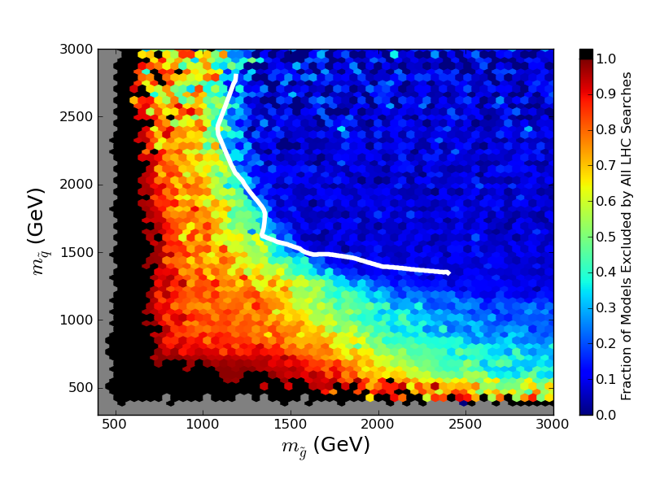
Effects of LHC Searches on Neutralino LSP Sample
ATLAS Simplified Model Limit

Slide 7
at LHC

Slide 8
How to Include Flavor?
Perform an expansion in MFV - Expand in squark mass matrix – no additional parameters required!
Determine if future precision measurements can observe these effects
Will study benchmark models in detail + full pMSSM model set
Make assumptions in neutrino sector for charged lepton processes
Add well-determined choices for phases by hand
Opportunity to study observables across the frontiers!
Work will be finished in time for Snowmass!

Slide 9
Warped extra dimensions as a model for flavor
slide from
Martin Bauer

Slide 10
slide from Martin Bauer

Slide 11
slide from Martin Bauer

Slide 12
slide from Martin Bauer

Slide 13
Neutrino Benchmarks: Reach across the Frontiers
slide from Mohapatra

Slide 14
slide from Ruiz

Slide 15
slide from Mohapatra

Slide 16
slide from Mohapatra

Slide 17
LR Model
slide from Ruiz

Slide 18
slide from Essig

Slide 19
slide from Essig

Slide 20
Summary
Many interesting benchmarks proposed with interesting flavor properties and that connect across the frontiers
Much work to be done in time for Snowmass!

