Slide 1
Developing a Reconfigurable Spallation Target System – Using the Experience from the SNS
Tony Gabriel
University of Tennessee
April 2013
Neutron Oscillation Collaboration
Notes:
Expected reviewers:
Uschi Steigenberger (ISIS)
Guenter Muhrer (LANL)
Two others …

Slide 2
Creating a Multi-functional, Reconfigurable Spallation Target System is a Funding Requirement
Target Systems (including the enclosure building) are expensive (on the order of $200M).
The more experiments that can be included in a given configuration reduces the cost of each experiment.
If the Target Systems can be modified, it can be used for more experiments in the future.
R&D is required and driven by funding requirements to develop such a system!
The Target System being developed for neutron oscillation will include this approach.

Slide 3
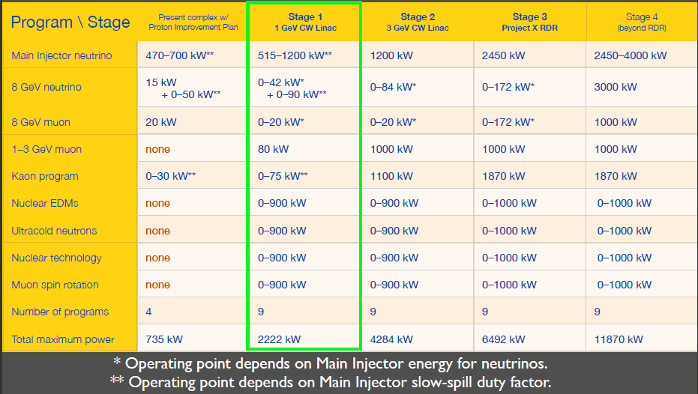
Example Research Program, definitive space of accelerator parameters on Project X website
Project X Campaign

Slide 4
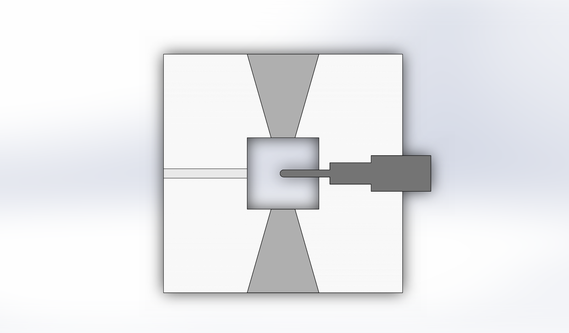
Top View: Reconfigurable Target Station
Experimental Area
Moves down into hot cell below
Hot Cell Area
Experimental
Target Cart Assembly
Proton Beam
Volume
Moves down into hot cell below
Experimental Area

Slide 5
At the Start of the SNS Target Systems, The Team attacked 4 Major Design Goals
Design a Hg target system to produce room temperature and cold neutrons at high intensity using a one MW proton beam that would satisfy the requirements of the scattering instruments. (60 pulses per sec of <1 micro-sec width, 18 Beam Lines (6 Split), and Linac/accumulator ring)
Design a system that could be operated safely.
Design a system that could be built within the cost and schedule limits. ($105M Construction, $35M R&D, 7yrs construction, 11 yrs total)
Design a system that can be maintained (Efficient remote handling is a major driving requirement).

Slide 6
Target R&D Program Has Addressed Key Design and Operational Issues
Steady state power handling.
  Cooling of target/enclosure window – wettability.
  Hot spots in Hg caused by recirculation around flow baffles.
Thermal Shock.
  Pressure pulse loads on structural material.
  Cavitation induced erosion (so-called pitting issue, K).
Materials issues.
  Radiation damage to structural materials.
  Compatibility between Hg and other target system materials.
Demonstration of key systems:
  Mercury loop operation.
  Remote handling.
Nuclear data.

Slide 7
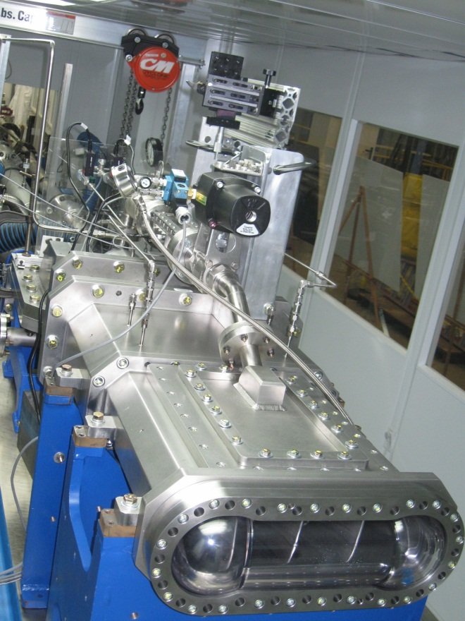
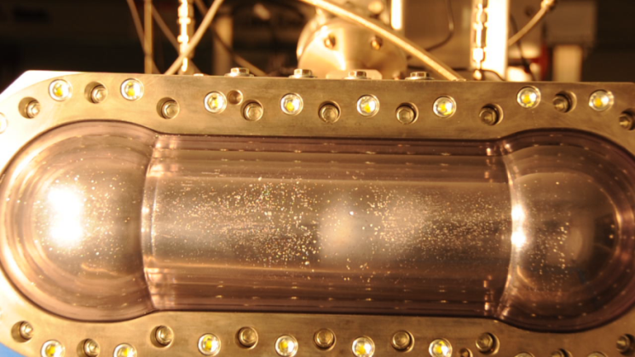
Mercury target development activities at the TTF are still going on.
Target Test Facility is now operable with an experimental target that can support small gas bubble and gas wall testing
  Bulk mercury flow is exactly prototypic to SNS
  Two orifice bubblers are currently installed
Some measurements have been made with optical system and the Acoustic Bubble Spectrometer
Some success has been obtained

Slide 8
Categories for R&D for the Various Types of High- Powered (High Energy Density) Target Systems
Reconfigurable Target Stations
Fixed Targets or Rotating Targets
Liquid Targets or Solid Targets
Target Material (W(Ta), Pb, C, Pb/Bi, Hg, Cu, etc.)
Target Container Material (SS-316LN, etc.)
Coolant Materials (Water, Hg, etc.)
Supporting Systems (Remote Handling, Safety Systems, Heat Exchangers, Coolant Pumps, etc.)
Environmental Considerations
Waste disposal

Slide 9
Target R&D Program Should Address Key Design and Operational Issues
Steady state power handling.
  Cooling of target/enclosure window – wettability.
  Hot spots in liquid metals caused by recirculation around flow baffles.
  Temperature profile in solid targets.
Thermal shock.
  Pressure pulse loads on structural material.
  Cavitation induced erosion in liquid targets (so-called pitting issue, K).
  Energy deposition and breakage profile in solid targets.
Materials issues.
  Radiation damage to structural materials.
  Compatibility issues between materials .

Slide 10
Target R&D Program Has Addressed Key
Design and Operational Issues (Cont’d)
Development and demonstration of key systems.
  Liquid target loop operation.
  Remote handling.
  Heat exchangers.
Material and Nuclear Data.
In beam testing of prototypes.
Address reliability

Slide 11
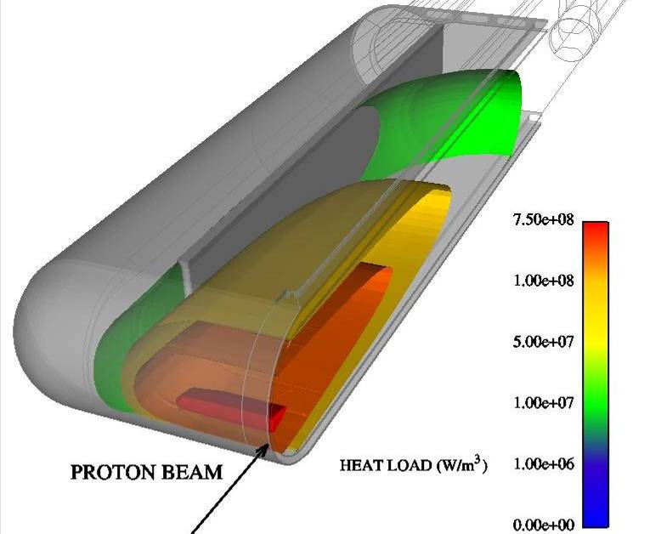
The constant-volume heating process for each beam pulse leads to a large pressure pulse in the mercury
Peak energy deposition in Hg for a single pulse = 13 MJ/m^{3 *}
  Peak temperature rise is only ~ 7 K for a single pulse, but rate of rise is 10⁷ K/s!
This is an isochoric (constant volume) process because beam deposition time (0.7 μs) << time required for mercury to expand
  Beam size / sound speed ~ 30 μs
Local pressure rise is 38 MPa (380 atm compared to static pressure of 3 atm!)*
Mercury expansion and wave reflection at the vessel interface lead to tension and cavitation of the mercury
* SNS @ 2 MW

Slide 12
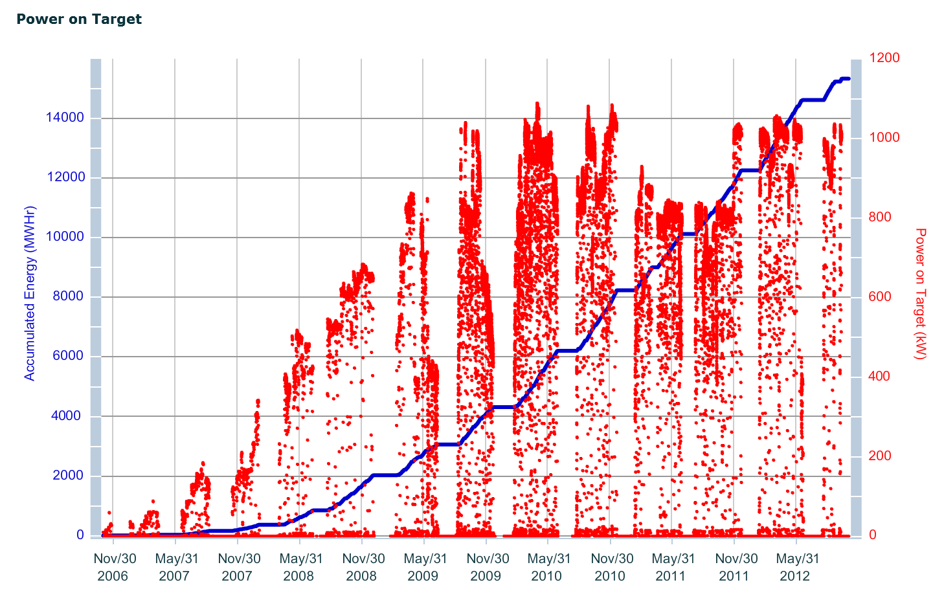
Energy and power on target from October 2006
T6 & T7
T2
T3
T4
T5
T1
Notes:
Neutron production ended Dec. 20, 2011
Target #4 will be replaced during the winter maintenance period

Slide 13
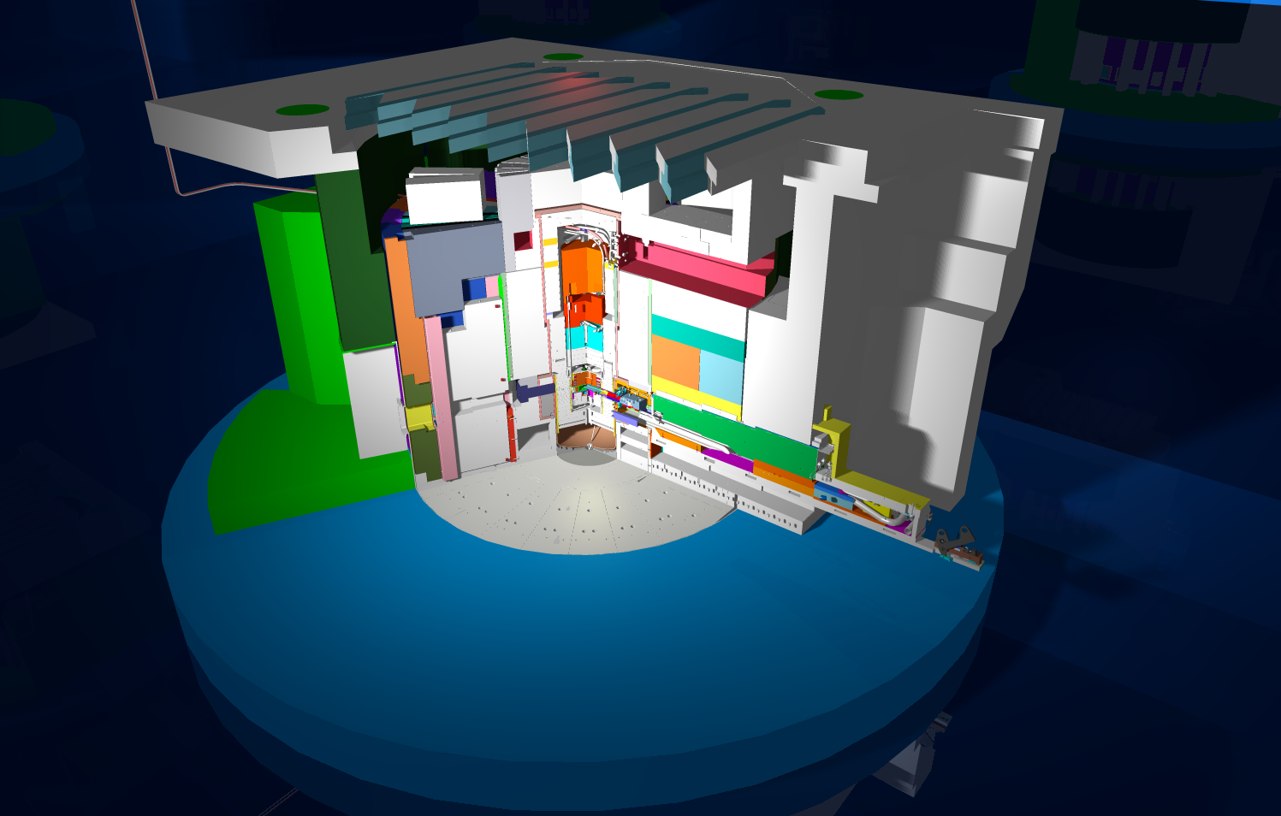
Spallation Neutron Source Target Station at ORNL
Monolith Shine Shield Beams
Top Block
Neutron Path
Shutter
Target Nose
CVI

Slide 14
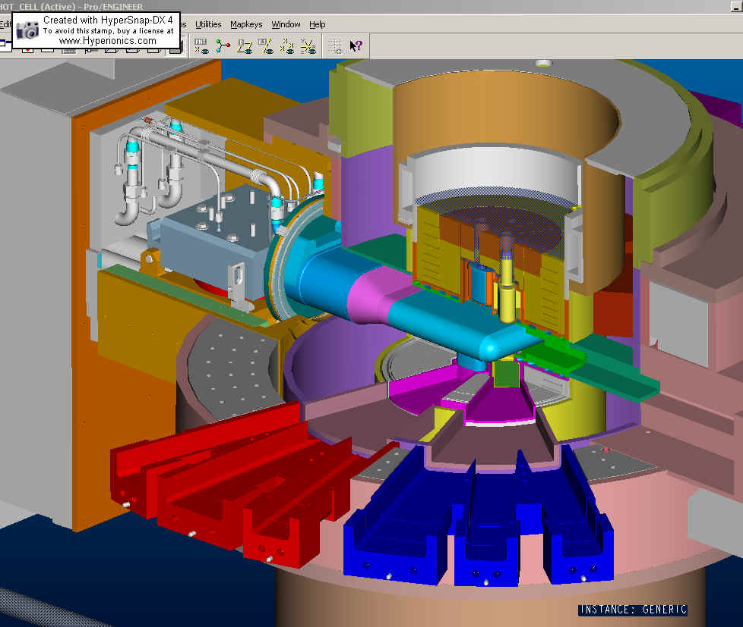
The mercury volume of the SNS target module fits within the upper and lower portions of the Inner Reflector Plug
Target Module with jumpers
Inner Reflector Plug
Target Inflatable seal
Outer Reflector Plug
Core Vessel water cooled shielding
Proton Beam
Core Vessel Multi-channel flange

Slide 15
Why was mercury chosen for the SNS target?
The SNS provides world-leading intense neutron beams (current) by exploiting higher accelerator power
High-power operation increases the heat removal demand in stationary, solid targets (e.g., tungsten or tantalum) necessitating greater volume fractions of coolant
  Neutron intensity suffers as spallation zone becomes more spread out
  At ~1.5 MW, further gains in intensity with higher power has diminishing return
Liquid metals (LM) can serve as both spallation target and coolant
LM can serve the purpose for the life of the facility, reducing waste impact
Mercury is liquid at room temperature and has good nuclear properties for a pulsed source
  No heating systems needed to maintain liquid state
  Minimal decay heat

Slide 16
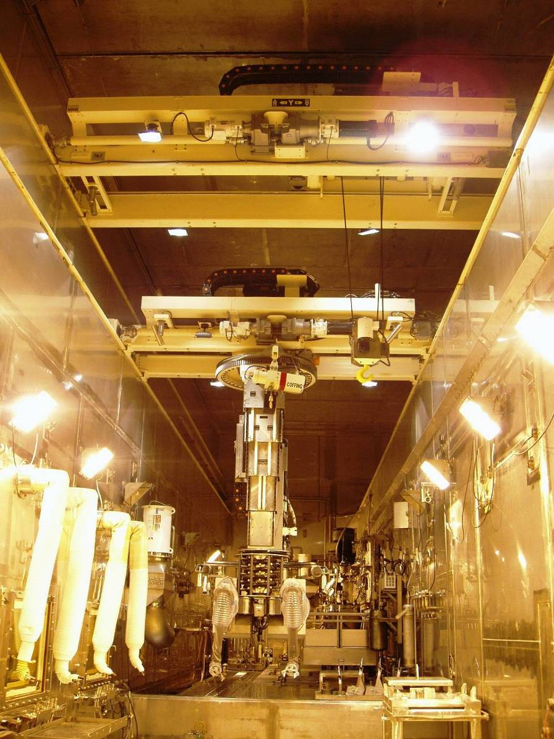
Remote Handling System from SNS
SNS system
  Robotic bridge crane – 20 ton capacity for FRIB
  Robotic bridge servomanipulator transporter
    Equipped with 500 lb aux hoist
  Window workstations for specific maintenance & waste handling operations
  All RH systems hands-on maintained
T. Burgess, 8 February 2011

Slide 17
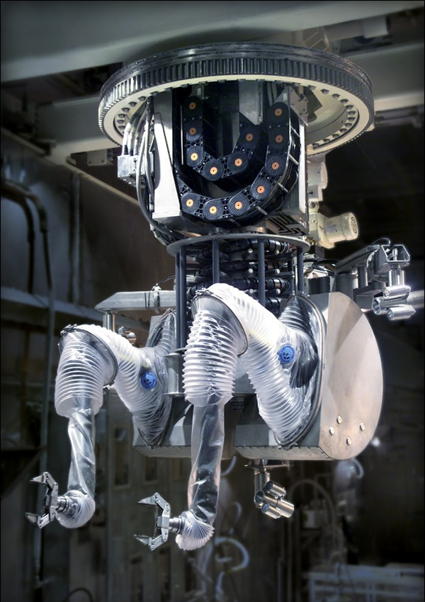
RH Upgrade Option
Servomanipulator Bridge & Manipulator
SNS Servomanipulator Bridge & Manipulator
  Telerob EMSM 2B
  Dual-arm, high performance servo-manipulator (SM) provides full cell coverage
  Master arm position control with force feedback
  Digital control
  Three on-board CCTV cameras
  500 lbf capacity auxiliary hoist
  Force Ratio Control 2:1 up to 20:1
  55 lbf (25 kg) continuous /100 lbf (45 kg) peak capacity
T. Burgess, 8 February 2011
, Slide 17
, Slide 17

Slide 18
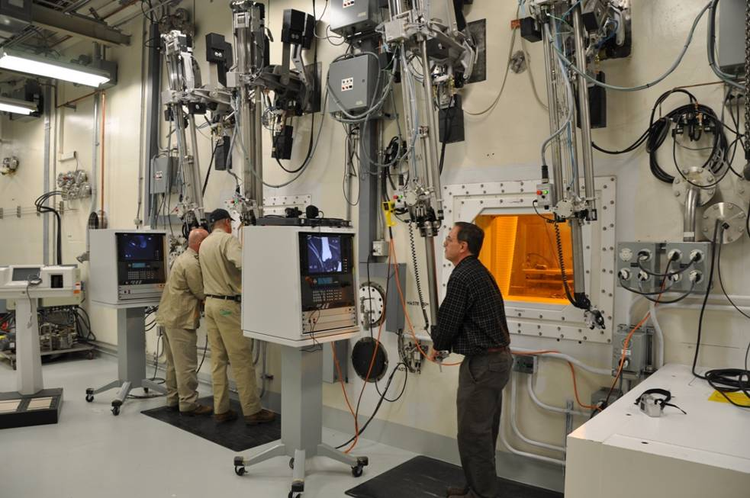
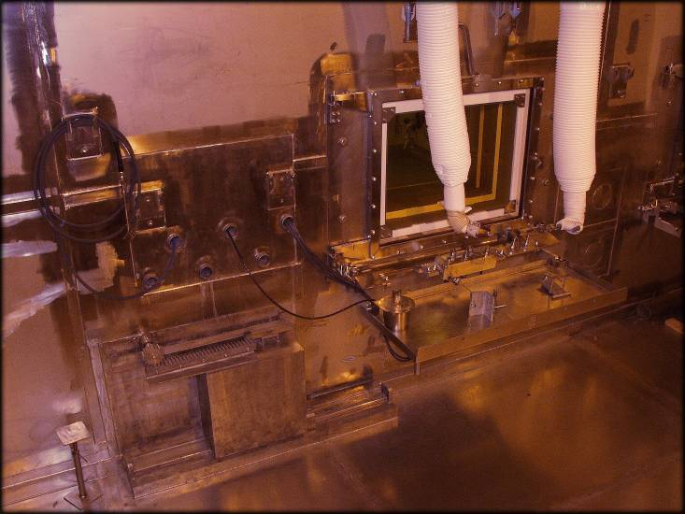
Master Slave Manipulators (MSM)
SNS CRL Model F example
  100 lbf (45 kg) peak capacity
Excellent for repetitive tasks in limited volume location (limited reach)
Relatively low cost
Can be coordinated with RH control room, video system and mobile systems control
Provides many remote tool service interfaces
,

Slide 19
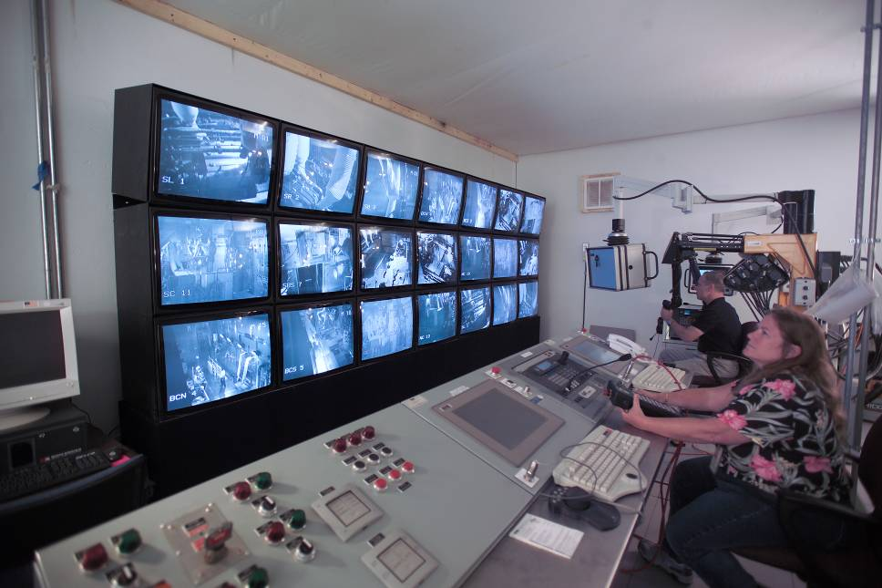
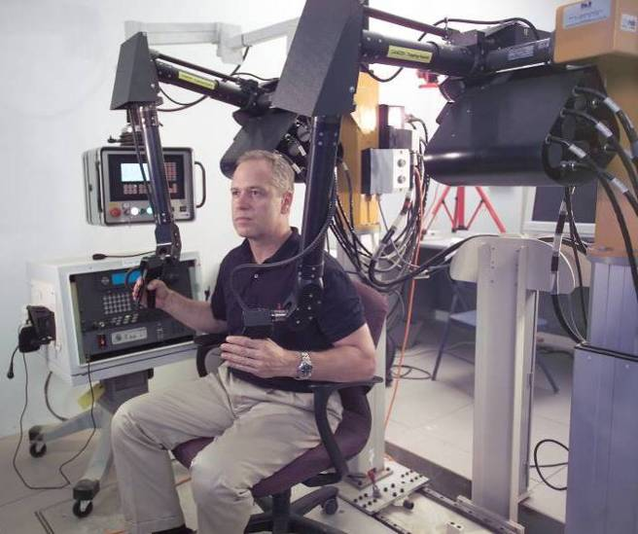
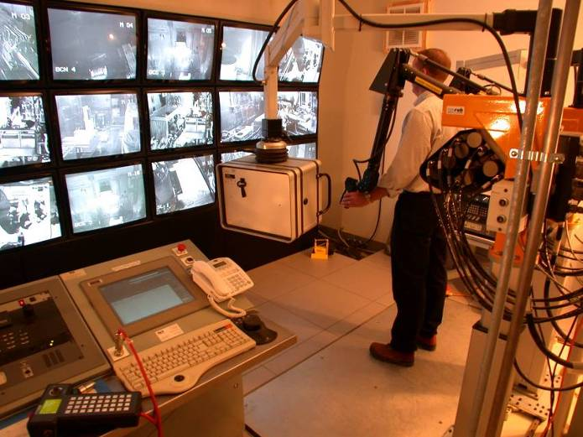
SNS Remote Handling Control Room
The servo master station and attendant video systems are co-located with the bridge and cell utility control systems to unify operations.
Interconnected bridge, video and audio controls at each window workstation are also required to facilitate efficient operator interface
T. Burgess, 8 February 2011
, Slide 19

Slide 20
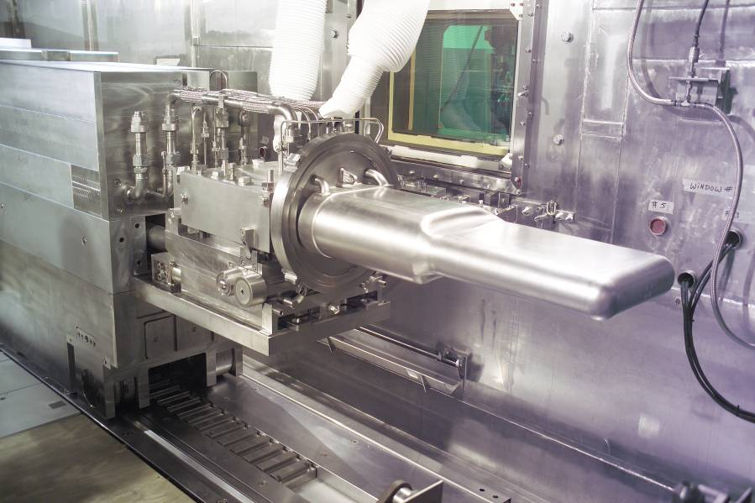
Target Module Replacement
Target Replacement
  Target Maintenance Environment
    Target Service Bay
    Maintenance Equipment
    Radiation and Contamination
  Target Replacement Operations
  Target Replacement Lessons Learned
Replacement of the target modules is accomplished using only remote handling tooling and procedures (hands-on operations are not possible)
While the tooling and procedures utilized enable successful replacement of the targets, continuous process improvement is employed to ensure successful replacements
SNS Target Module

Slide 21
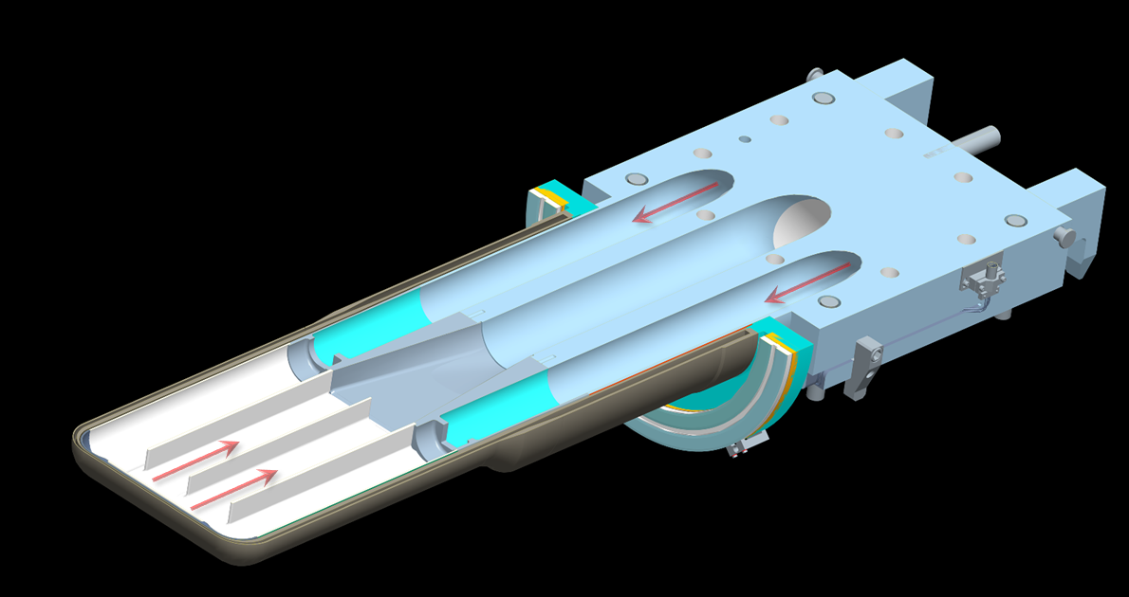
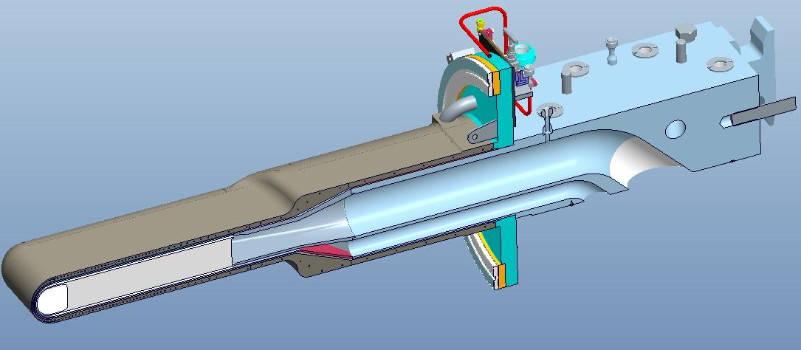
The target has three mercury supply channels and one common return channel
Water Shroud
Mercury
Passages
Mercury Vessel

Slide 22
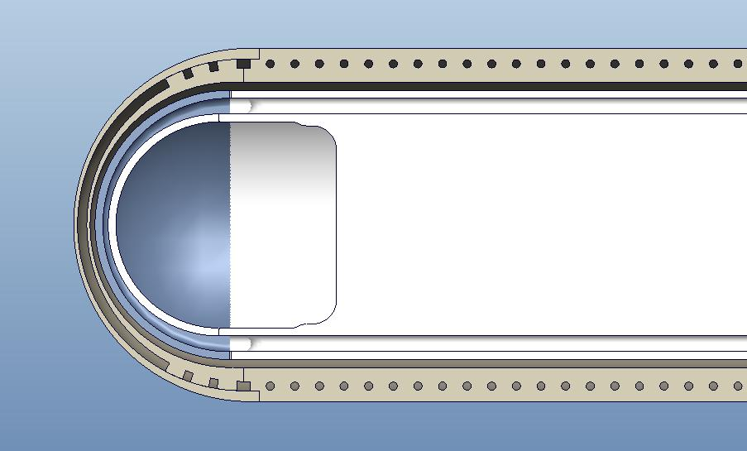
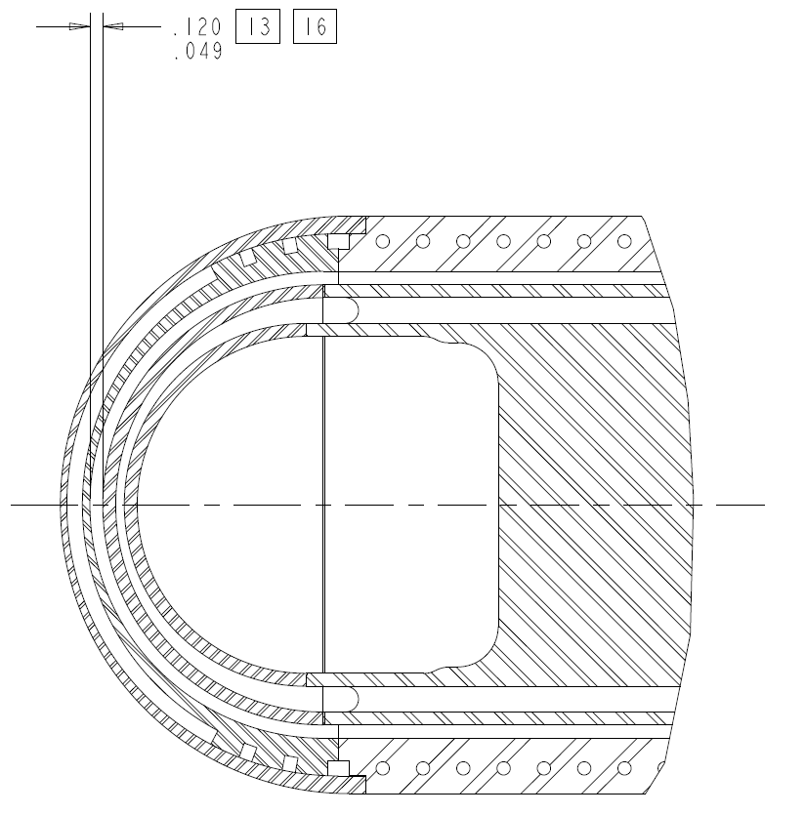
The beam passes into the bulk mercury through four stainless steel shells
Water Shroud
Mercury Vessel
Blue area indicates mercury vessel volume and boundary
Window Flow ~ 17 GPM
Window Flow Speed (Max) ~ 2.4-3.5 m/s
Interstitial Space

Slide 23
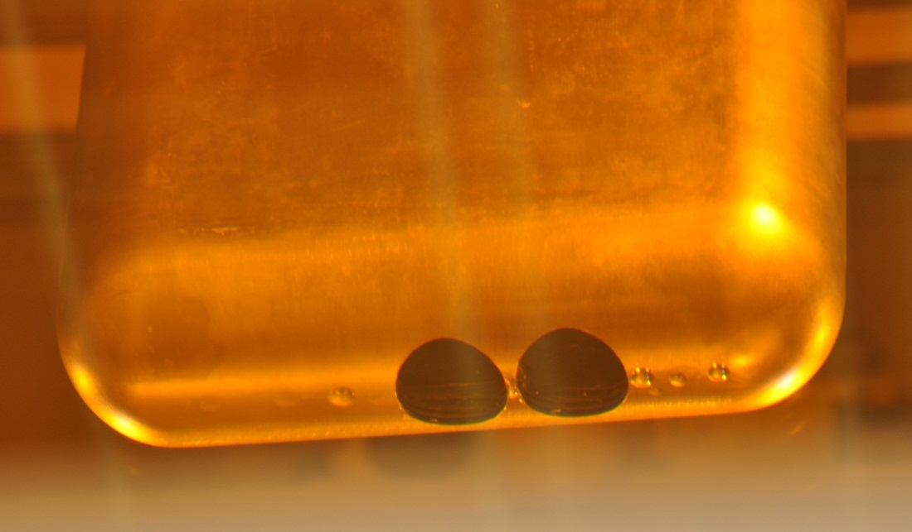
Substantial effort has been expended to understand cavitation damage through Post-Irradiation Examination (PIE)
Two to five hole cuts have been made in T1-T4
  Three were done on T5
We have performed
  Through shield-wall photography
  Direct photography of disk specimens
  Internal examinations by video scope and compact cameras
5
6
7
8
1
2
3
4
Holes cut in beam window from Target #1
Specimens from T1 & T2 were selected for detailed examination and analysis by B&W Technical Services Group

Slide 24
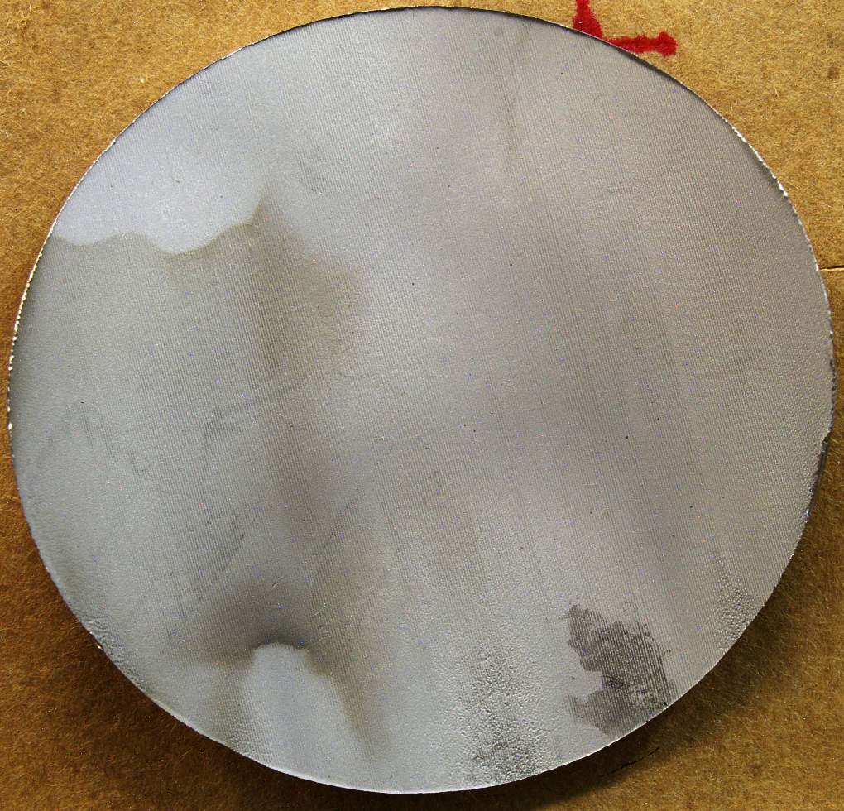
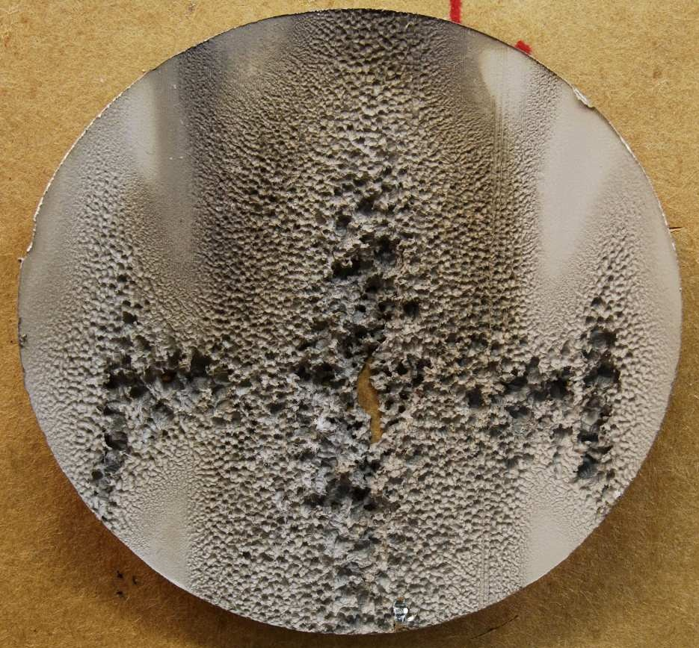
T1 inner wall center and offset specimens surface facing bulk mercury volume
T1: 3055 MW-hrs; P_{ave} = 336 kW
Lines from wire cut EDM
act as cavitation nucleation sites
Offset
Center
Future target procurements will specify electro-polishing
Multiple through-wall holes
All specimen diameters are 60 mm, except T2 are 57 mm. Views oriented as during operation.

Slide 25
Why have the last two mercury target modules indicated premature end-of-life?
The first five devices lived for an average exposure of ~2900 MW-hrs with only one end-of-life condition (T3 at 2791 MW-hrs)
T6 indicated failure at ~690 MW-hrs and T7 indicated failure at ~100 MW-hrs
Possible causes:
  Sensor malfunction (common mode)
  Operational issue (beam density, beam position, energy, etc.)
  Installation issue (bolt torques, seal integrity, etc.)
  Manufacturing issue (weld integrity, tolerances, etc.)
  Material issue (material specification, material processing, etc.)

Slide 27
Upgrades at SNS and Other Physics Research
+ Beam Energy Increase to 1.3 GeV?
+ Second Target Station?
(10 Hz, 400KW, Rotating Pb Target)?
+ Additional Target Stations?
+ Additional Physics and Materials Research?
(nEDM experiment -- Potential neutrino physics at SNS goes back to 1994 {later referred to as ORLAND} -- Coupons at the target location for radiation damage studies)
+ Beam pulses – 1 msec or 690 ns
+ Beam dumps?

