Slide 1
Future e⁺e⁻ Flavor Facilities
(Tom Browder, University of Hawaii)
The Super B Factory (Belle II/SuperKEKB)
Will briefly discuss synergy with tau-charm facilities.
Apologies: Borrowed slides from many hardworking Belle II, SuperB, SuperKEKB collaborators. Oversimplified new physics issues and only have time to cover a few examples.
Related talks by Leo Piilonen (VPI) on Belle II as well as Dave Hitlin (Caltech) on LFV

Slide 2
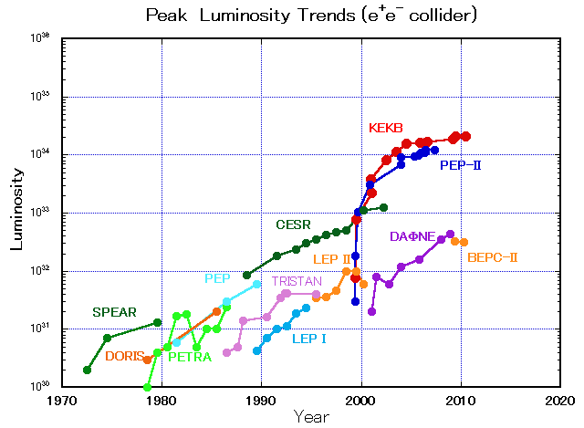
SuperKEKB is the intensity frontier
10³⁶
40 times higher luminosity
KEKB
PEP-II

Slide 3

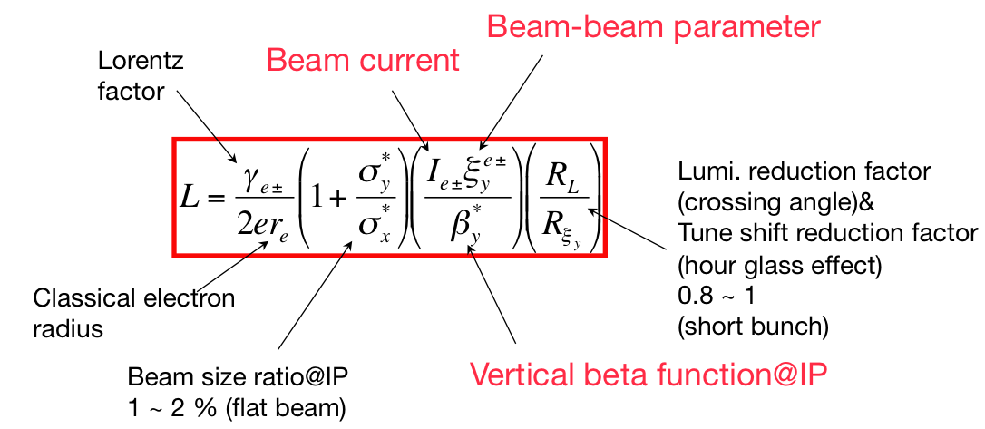
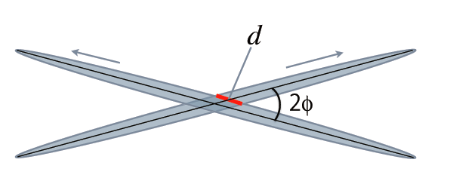
How to make a Super Flavor Factory
-
-
Smaller β_{y}*
(2) Increase beam currents
(3) Increase ξ_{y}
Schematic view of beam collisions with a large, 83 mrad, crossing angle.
Notes:
3

Slide 4
Compare the Parameters for KEKB and SuperKEKB
 | KEKB Design | KEKB Achieved : with crab | SuperKEKB Nano-Beam
Energy (GeV) (LER/HER) | 3.5/8.0 | 3.5/8.0 | 4.0/7.0
β_{y}* (mm) | 10/10 | 5.9/5.9 | 0.27/0.30
β_{x}* (mm) | 330/330 | 1200/1200 | 32/25
ε_{x} (nm) | 18/18 | 18/24 | 3.2/5.3
ε_{y} /ε_{x} (%) | 1 | 0.85/0.64 | 0.27/0.24
σ_{y}(μm) | 1.9 | 0.94 | 0.048/0.062
ξ_{y} | 0.052 | 0.129/0.090 | 0.09/0.081
σ_{z} (mm) | 4 | 6 - 7 | 6/5
I_{beam} (A) | 2.6/1.1 | 1.64/1.19 | 3.6/2.6
N_{bunches} | 5000 | 1584 | 2500
Luminosity (10³⁴ cm⁻² s⁻¹) | 1 | 2.11 | 80
Nano-beams are the key (vertical spot size is ~50nm !!)
Y. Ohnishi et al.
Notes:
The jump from CESR to the B factories (PEP-II, KEKB) was not significant in per bunch parameters. However, the number of bunches and the beam currents were much larger. There is greater than order of magnitude reduction in beam size and emittance.

Slide 5

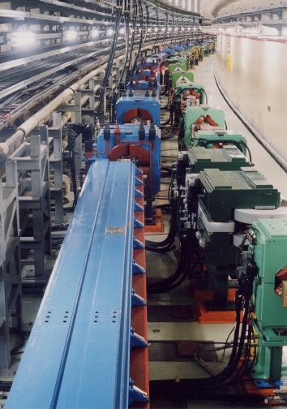


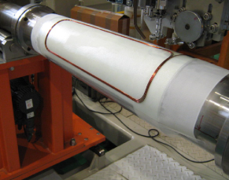

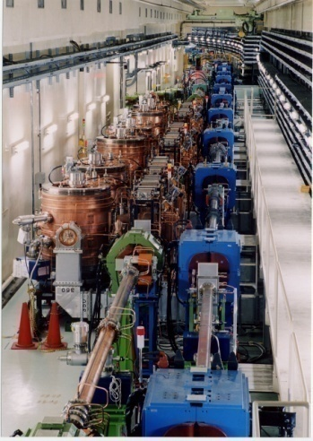

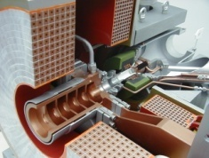
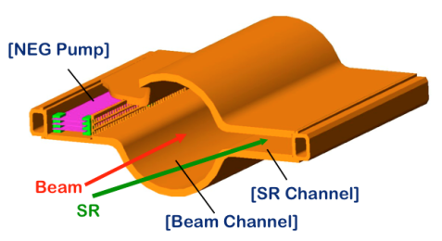
KEKB to SuperKEKB
Belle II
Colliding bunches
New IR
e- 2.6 A
New beam pipe
& bellows
New superconducting /permanent final focusing
quads near the IP
e+ 3.6 A
Replace short dipoles with longer ones (LER)
Add / modify RF systems for higher beam current
Low emittance positrons to inject
Positron source
Redesign the lattices of HER & LER to squeeze the emittance
Damping ring
New positron target / capture section
TiN-coated beam pipe with antechambers
Low emittance gun
Low emittance electrons to inject
To obtain x40 higher luminosity

Slide 6
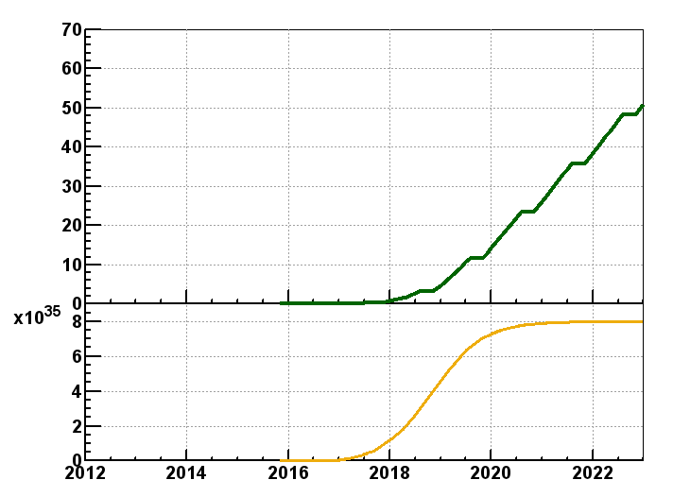
SuperKEKB luminosity projection
Belle/KEKB recorded ~1000 fb⁻¹ . Now change units to ab⁻¹
Goal of Belle II/SuperKEKB
Integrated luminosity
(ab⁻¹)
9 months/year
20 days/month
Commissioning starts
in early 2015.
Shutdown
for upgrade
Peak luminosity
(cm⁻²s⁻¹)
Calendar Year
Notes:
Commissioning starts in 2015, first without final focus superconducting quads then with quads. Belle is tested with cosmics in late 2015, is commissioned with beam and then starts taking data in 2016.

Slide 7
Belle II Detector
KL and muon detector:
Resistive Plate Counter (barrel outer layers)
Scintillator + WLSF + MPPC (end-caps , inner 2 barrel layers)
EM Calorimeter:
CsI(Tl), waveform sampling (barrel)
Pure CsI + waveform sampling (end-caps)
Particle Identification
Time-of-Propagation counter (barrel)
Prox. focusing Aerogel RICH (fwd)
electrons (7GeV)
Beryllium beam pipe
2cm diameter
Vertex Detector
2 layers DEPFET + 4 layers DSSD
positrons (4GeV)
Central Drift Chamber
He(50%):C2H6(50%), small cells, long lever arm, fast electronics

Slide 8
SuperKEKB/Belle II schedule
Calendar
2010
2011
2012
2013
2014
2015
2016
2017
・・・
Japan FY
2010
2011
2012
2013
2014
2015
2016
2017
・・
Mar. 2013
Jan. 2015
SuperKEKB construction
Detector upgrade to Belle II
SuperKEKB operation
Belle II roll in
QCS install
VXD install
Belle roll out
KEKB
operation
Dismantling KEKB
Accelerator tuning
BEAST
Fabrication and tests of ring components
Physics run
Install and set up
Electricity and cooling facility
MR & DR buildings
DR tunnel
Upgraded Linac operation
for SuperKEKB, PF, PF-AR
Linac
Linac upgrade / operation for PF&PF-AR

Slide 9

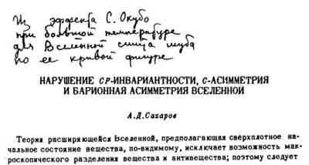

Are we done ? (Didn’t the B factories accomplish their mission, recognized by the 2008 Nobel Prize in Physics ?)
BAU: KM (Kobayashi-Maskawa) mechanism still short by 10 orders of magnitude !!!

Slide 10
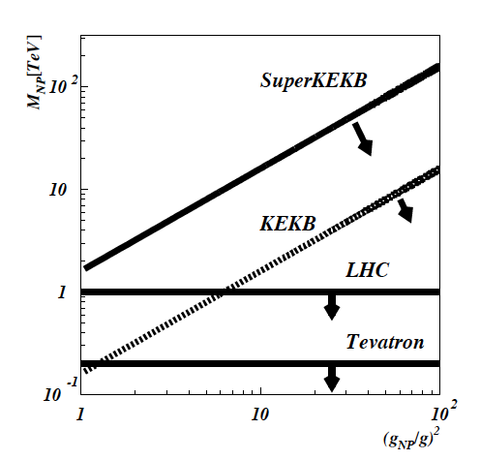
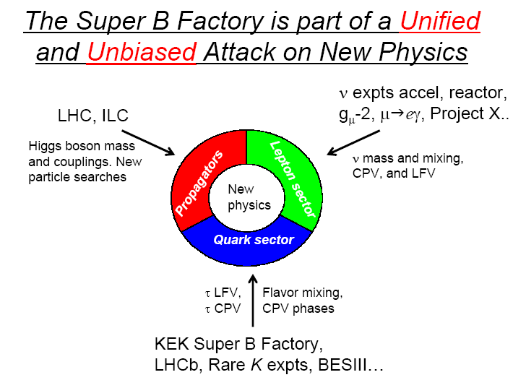
Why the SFF is so important.
A Super Flavor Factory (SFF) studies processes that are 1-loop in the SM but may be O(1) in NP : FCNC, mixing, CPV.
Current experimental bound is
O(10-100) TeV depending on NP coupling.
Thus if the LHC finds NP at O(1 TeV) it
must have a non-trivial flavor structure.
Coupling
Minimal Flavor Violating (MFV)
Enhanced Flavor coupling
Even if no new particles are found at the LHC, current SM couplings provide sensitivity to new particles at a SFF.
There must be new sources of CPV to explain the BAU (Baryon Asymmetry of the Universe)

Slide 11
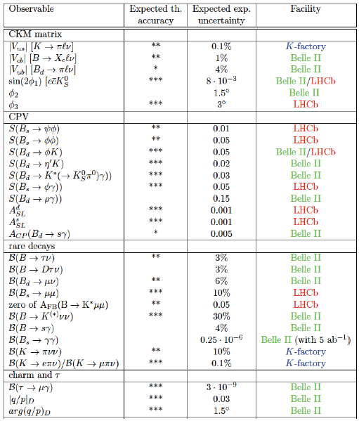
Complementarity of Belle II SFF physics reach and LHCb upgrade
Hard to reduce this table of diverse physics capabilities to a simple and memorable message.
Slide from B. Golob

Slide 12

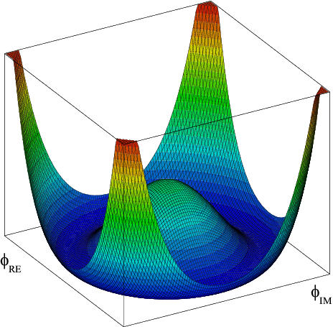
The Higgs boson is now established by experimental results from ATLAS and CMS.
.
Does the GP have a “brother” i.e. the charged Higgs ?
Measurements at a “Super B factory” and direct searches at hadron colliders take complementary approaches to this important question.
Notes:
This prompted Leon Lederman to write a new book entitled “Beyond the God Particle”
Sensitivity from tau nu, D(*) tau nu decays and b→s gamma.
Hadron colliders directly search for H+ →tau nu.

Slide 13
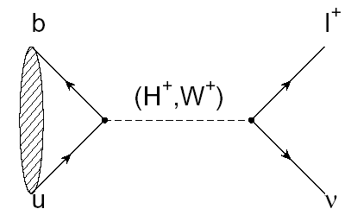
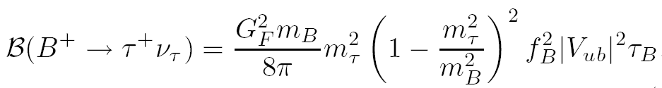

B⁺→τ ⁺ υ_{τ}
(Decays with Large Missing Energy)
Sensitivity to new physics from a charged Higgs
The B meson decay constant, determined by the B wavefunction at the origin
(|V_{ub}| taken from indep. measurements.)

Slide 14
Consumer’s guide to charged Higgs
Higgs doublet of type I (couples with equal strength to upper and lower generations)
Higgs doublet of type II (couples with different strength to u and d-type quarks, tan(β) = v_{u}/v_{d} (favored NP scenario e.g. MSSM)
Higgs doublet of type III (not type I or type II; anything goes)

Slide 15
Why measuring Β−>τν is non-trivial
e⁺
ϒ(4S)
B⁻
B⁺
Most of the sensitivity is from tau modes with 1-prong
ν_{τ}
ν_{e}
ν_{τ}
B⁻→X
B⁺→τ⁺ν_{τ}, τ⁺→e⁺ν_{e}ν_{τ}
The experimental signature is rather difficult: B decays to a single charged track + nothing
(This will be difficult at a hadron collider)

Slide 16
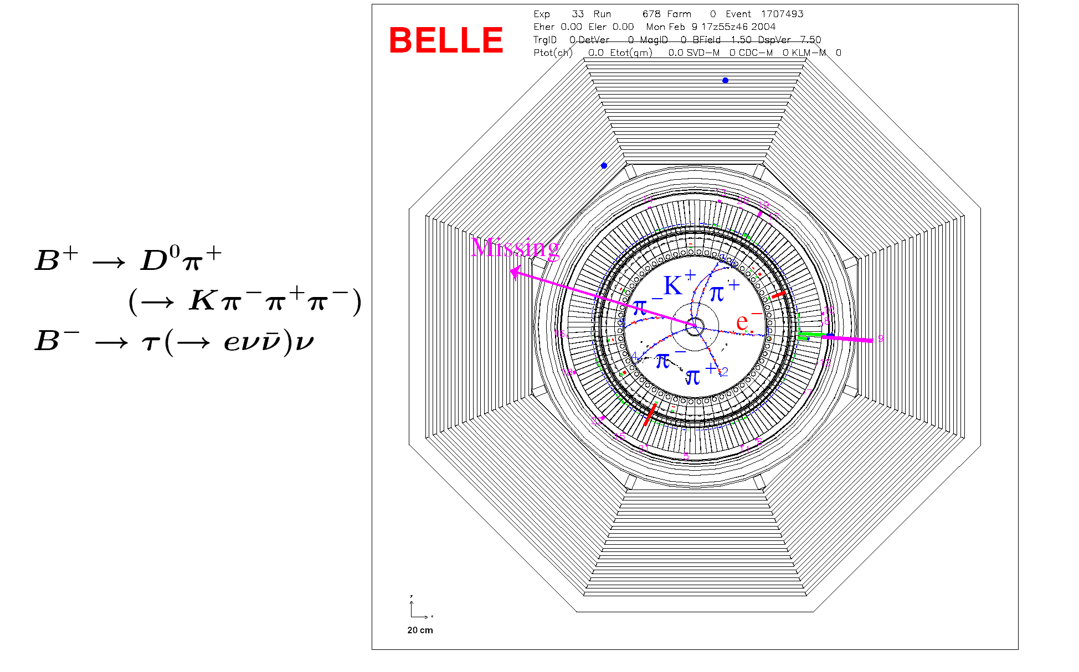
Example of a Missing Energy Decay (B⁻ → τ⁻ ν_{τ} ) in Data
The clean e+e- environment makes this possible

Slide 17
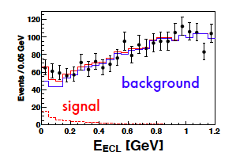
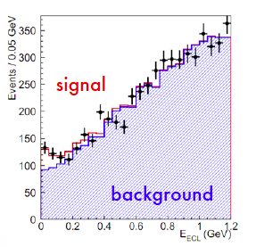
Belle measurement with full data sample and hadronic tags
63±22.5
Idea: With the “single B meson beam”, we look for a single track from a τ, missing energy/momentun and extra calorimeter energy close to zero.
143±35.5
Semileptonic tags
With the full B factory statistics only “evidence”. No single observation.
The horizontal axis is the “Extra Calorimeter Energy”

Slide 18
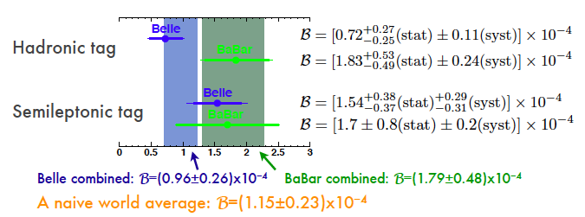
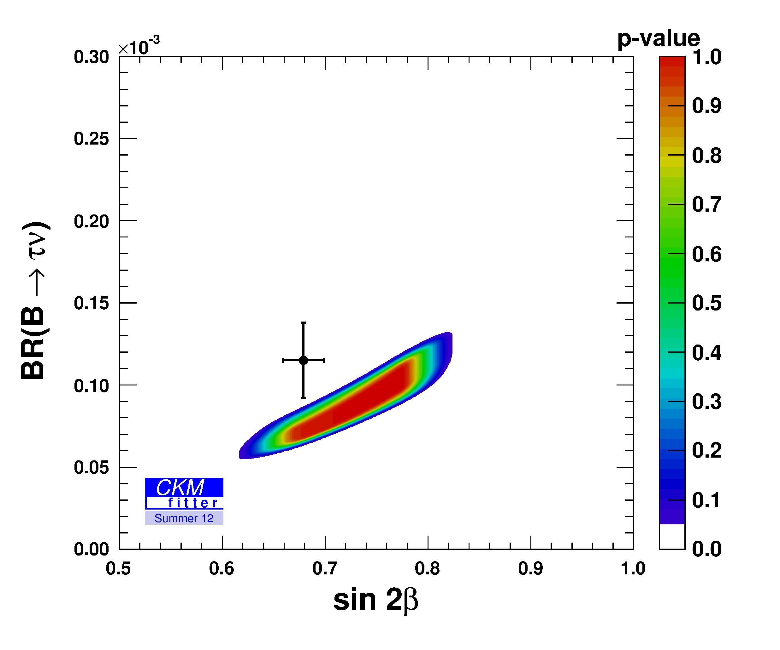
CKMfitter world averages

Slide 19
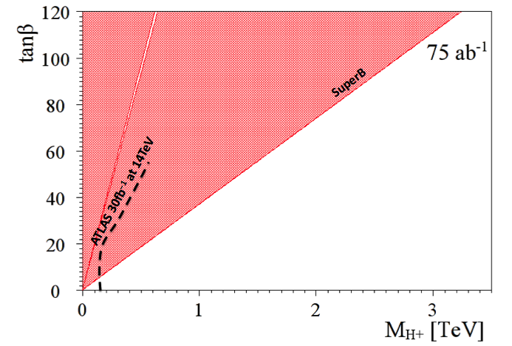
Complementarity of SFF and LHC
(Slide adapted from A. Bevan)
The current combined limit places a stronger constraint than direct searches from LHC exps. for the next few years.
Currently inclusive b to sγ rules out m_{H+} below ~400 GeV/c² range (independent of tanβ)
This region is allowed
http://arxiv.org/abs/1208.2788

Slide 20
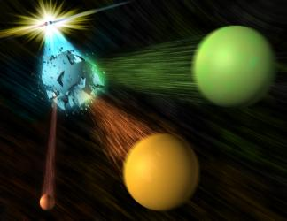
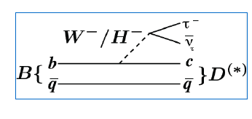
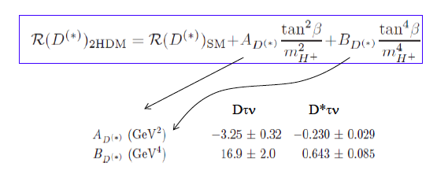

Slide adapted from A. Soffer

Slide 21
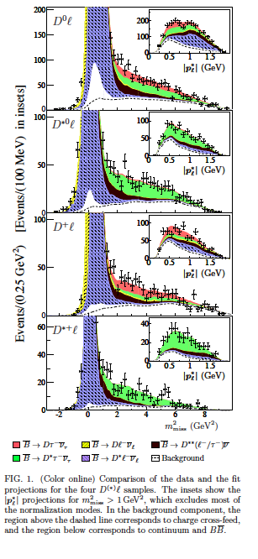
Example from a recent BaBar paper
Signals in B→D^{(*)} τυ (489±63, 888±63)
Missing mass variable:
m_{miss}² =p_{miss}²=(p[e⁺e⁻]-p_{tag}-p_{D(*)}-p_{l})²
P_{l}* = momentum of lepton in B rest frame
Production of B meson pairs at threshold is critical to the separation of backgrounds from the missing energy/ momentum signal.

Slide 22
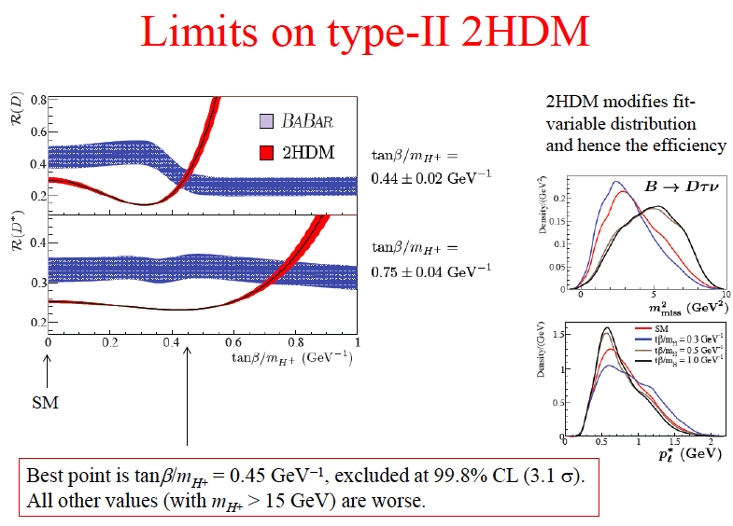

Slide 23
BaBar collaboration, Phys. Rev. Lett. 109, 101802 (2012)
“However, the combination of R(D) and R(D*) excludes the type II 2HDM charged Higgs boson with a 99.8% confidence level for any value of tan(β)/m_{H+}”
In other words, found NP but have killed the 2HDM model

Slide 24
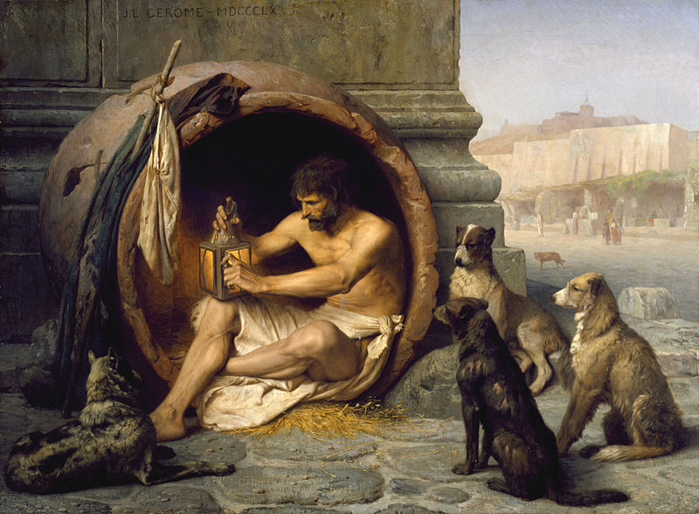
In other words, found NP but have killed the 2HDM model
BaBar B→D^{(*)}τυ excess at the 3.5σ level. Belle will report their final results on this mode soon. Could the two-Higgs NP model be viable again ?
To resolve these new physics issues related to the charged Higgs, need Super Flavor Factory statistics (reduce statistical errors by ~x10).

Slide 25
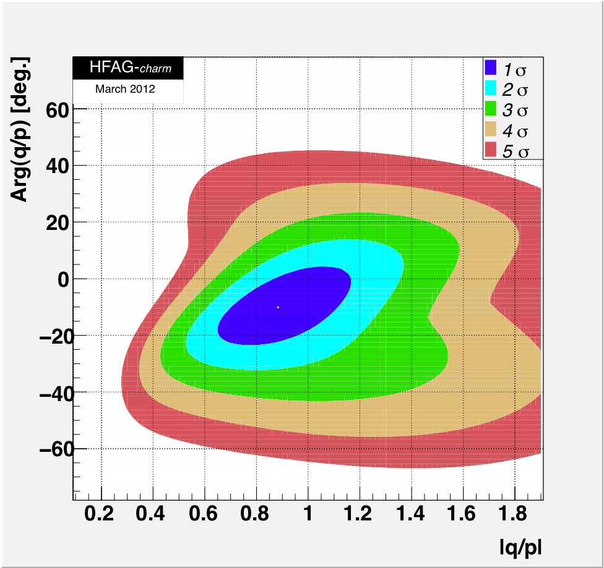
D mixing: Another new physics phase !
CPV in D system negligible in SM
CPV in interf. mix./decay:
The existence of D mixing (if x is non-zero) allows us to look for another poorly constrained new physics phase but this time from up-type quarks.
(c.f. CPV in B_{s} mixing)
Current WA sensitivity ~±15⁰, 50 ab⁻¹ go below 2⁰

Slide 26
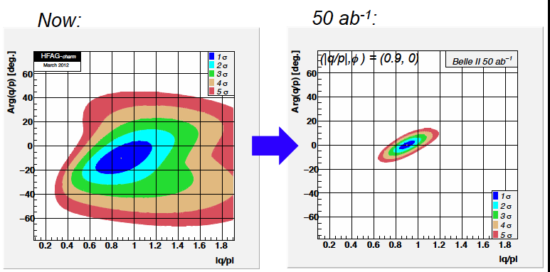
CP Phase in D mixing at Belle II
Based on a slide by Alan Schwartz

Slide 27
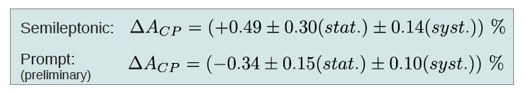
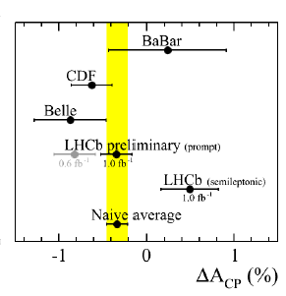
Enigma of charm direct CPV
ΔA_{CP}=A(K⁺K⁻)-A(π⁺ π⁻)
Naïve average from LHCb alone
Is there an effect ? Are systematics under control ?
If the result stabilizes at 0.3%, is NP still required ?

Slide 28
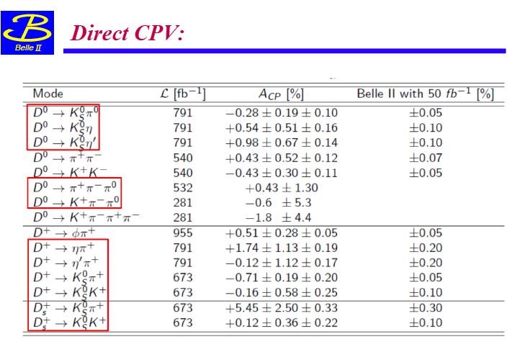
Belle II Direct CPV reach in charm and potential for NP diagnosis
(Missing entry D→π⁰ π⁰ below)
Can achieve useful sensitivity in a variety of modes. Measures individual CP asymmetries rather than differences of asymmetries. Systematics are small and can be calibrated from data.

Slide 29
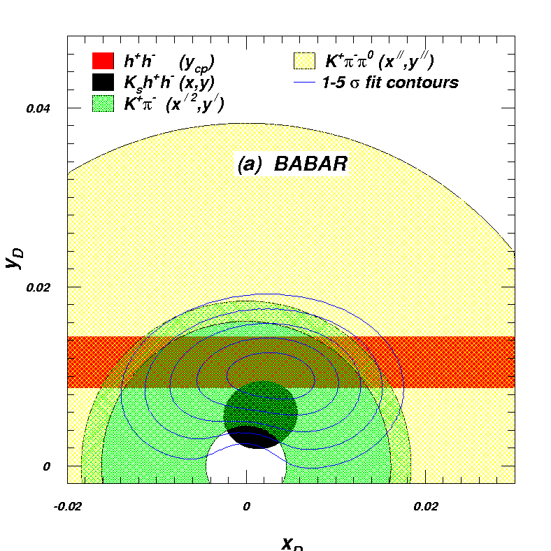
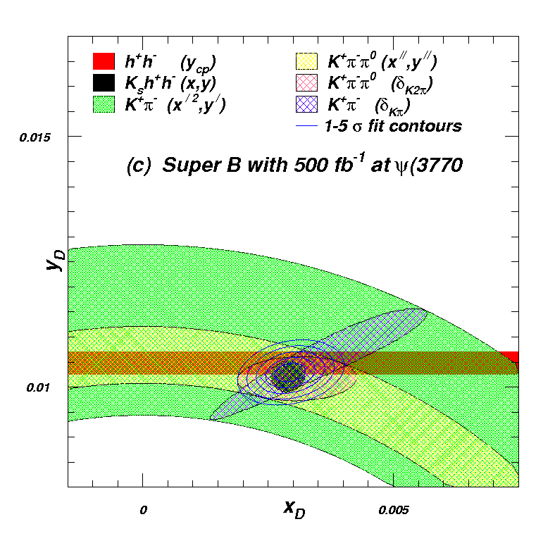
SFF/tau-charm factory synergy for Charm Mixing
Collect data at threshold and at the 4S.
  Benefit charm mixing and CPV measurements.
  Also useful for measuring the Unitarity triangle angle γ/φ₃ (strong phase in D→Kππ Dalitz plot).
Without data from a tau-Charm at threshold the mixing parameter determination would remain systematically limited on this timescale.
(Dominated by D→K_{S}hh contribution, where the Dalitz Model limits precision on x and y)
BES III will give us an important improvement over CLEO-c with K_{S}hh Dalitz plot measurements, is it enough?
Slide from A. Bevan

Slide 30

Super-c-tau in Novosibirsk
E = 700 – 2500 MeV
Round beams L = 10³⁴ cm⁻²s⁻¹
Monochromatization L ~ 10³² cm⁻²s⁻¹
Long. Polarization L ~ 10³⁴ cm⁻²s⁻¹
Transverse polarization for precise energy calibration
There are also proposals for a machine in Turkey, an upgrade of BESIII and a machine at Tor Vegata (INFN, Italy)

Slide 31
Super-c-tau layout @Novosibirsk
The tunnel is already available.

Slide 32
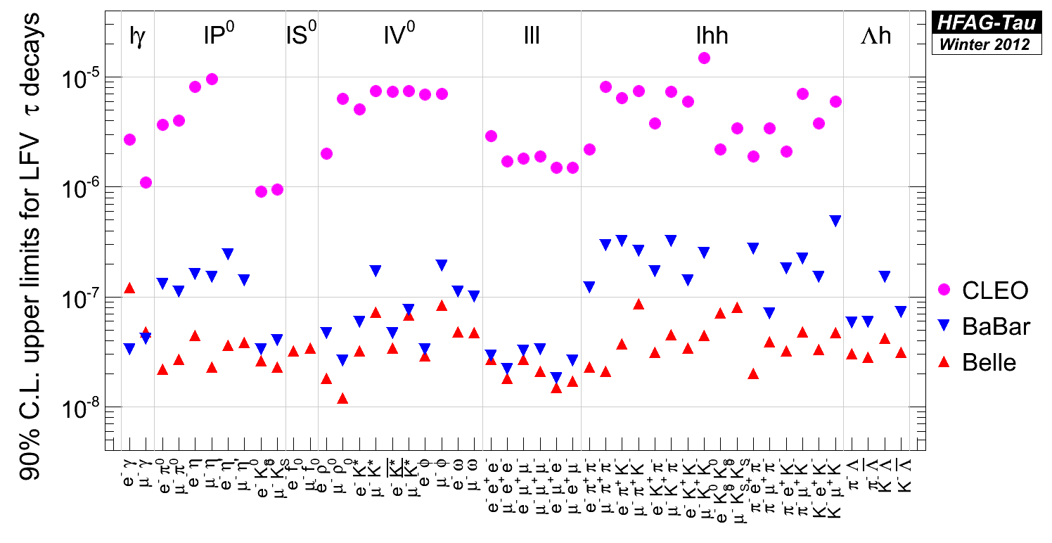
Current experimental status of tau LFV
A Super Flavor Factory moves some of the ULs or sensitivities to the 10⁻⁹ level.

Slide 33
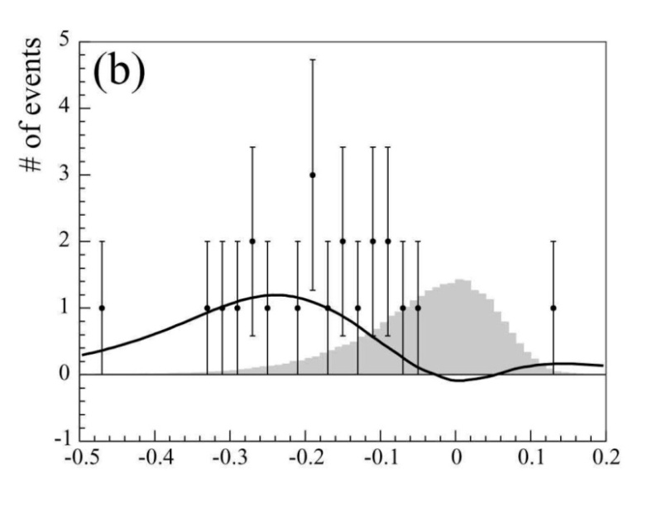
Lepton Flavor Violation in the τ sector
Find or constrain τ → μ γ
γ
expected sig.
B ∼5x10⁻⁷
Belle, PLB66, 16 (2008), 535 fb⁻¹
μ
τ
kinematic variables
for signal isolation:
ΔE=E^{CM}(μγ)-E^{CM}(beam)
M_{inv}=m(μγ)
main background from
“ISR”, which means
ee→ τ(μνν) τ(πν) γ_{ISR}
polarized beam(s) can
help in reducing this
background
(assuming SM couplings!)
e
e
τ
π
signal
ν
ν
ν
γ
μ
τ
e
e
τ
π
background
ν
N.B. Statistics limited: This is a SFF project not tau-charm

Slide 34
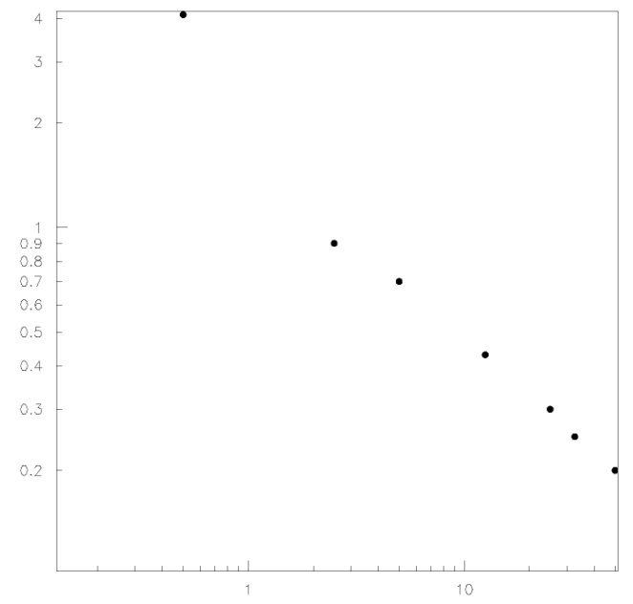
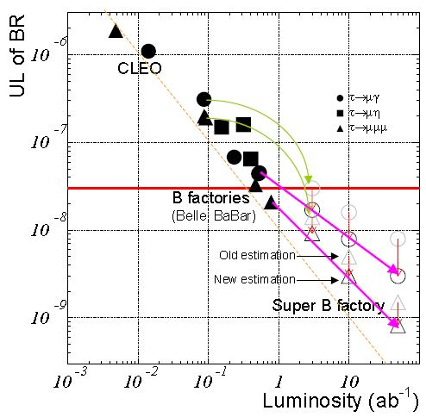
Luminosity scaling of sensitivities for τ → μ γ
UL_{90%}
B(τ → μ γ)
[10⁻⁸]
toy MC study
Search for τ → μ γ
4
2
1
0.4
0.2
w/o polarization:
UL_{90%}(B(τ → μ γ)) ∼ 3x10⁻⁹ @ 50 ab⁻¹
τ → 3l, l h⁰ decays are background free
UL_{90%}(B(τ → μ γ)) scales as 1/ L up to ~10ab⁻¹
B(τ → μ γ)<4.4 x 10⁻⁸
∼ ∝1/L
∼ ∝1/√L
0.2 1 10 L[ab⁻¹]
τ → μ γ
τ → μμμ
τ → μη
Updated
expected
sensitivities
on τ LFV decays
Belle, PLB66, 16 (2008), 535 fb⁻¹
K. Inami, PANIC 2011

Slide 35
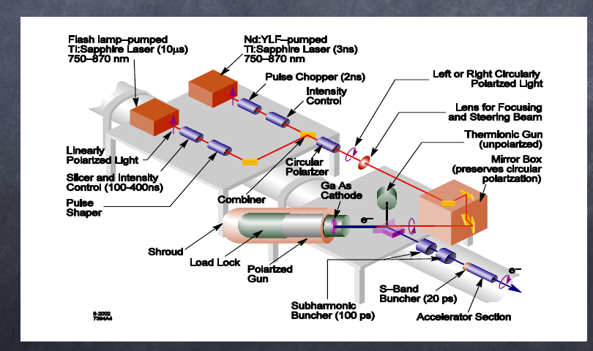
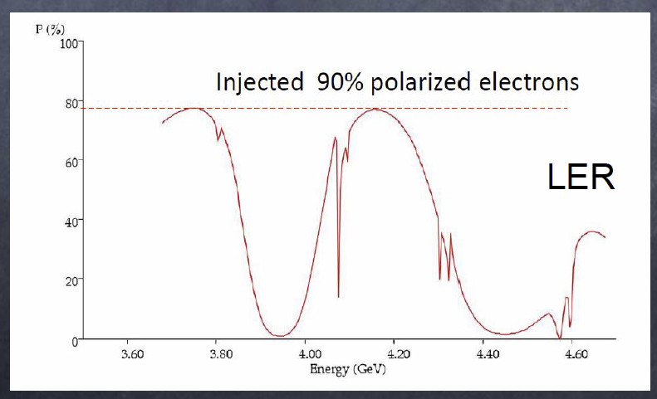
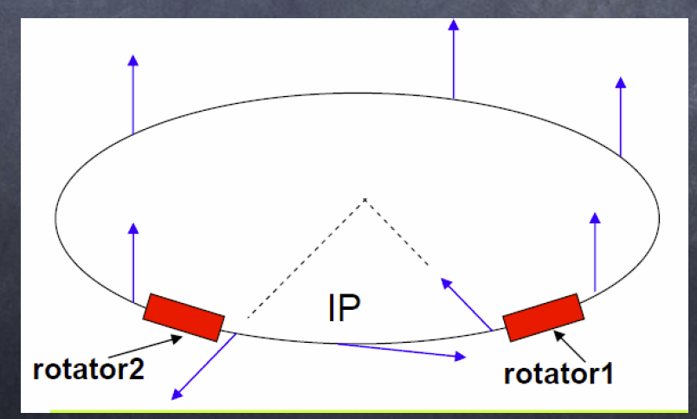
A polarized electron beam can produce polarized τ pairs. A proposal was worked out for INFN SuperB.
a)
Some basic requirements:
Polarized electron gun (like at SLC)
Operation at beam energies away from depolarizing resonances
Spin rotators to rotate the electron spin to the longitudinal direction at the IP. A machine lattice that avoids depolarizing effects from vertical bends and solenoids.
b)
c)
Not practical in initial operation of SuperKEKB (no space in straight sections). Upgrade may be possible (U. Wienands)
Slide adapated from D. Hitlin

Slide 36
e⁺ e⁻ Super Flavor Factory Summary
SuperKEKB/Belle is the intensity frontier facility for B mesons, charm mesons and tau leptons.
Unique new physics capabilities and unique detector capabilities (“single B meson beam”, neutrals, neutrinos), clean environment with good systematics, which are critical for the next round of NP searches e.g. charged Higgs.
A tau-charm factory will provide important complementary information for a super flavor factory (SFF) and can carry out some unique measurements (strong phase needed for D mixing measurements or precise tau mass determination).

Slide 37
Backup Slides

Slide 38
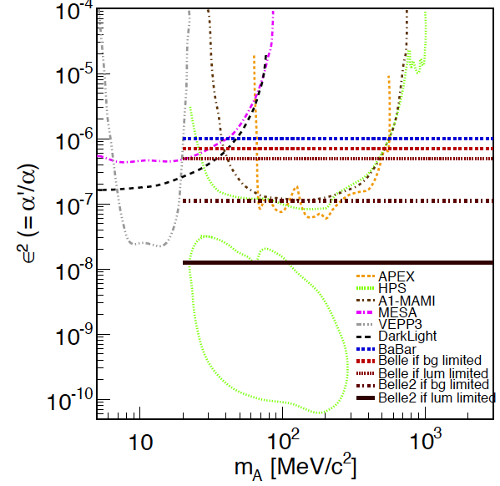
Belle II sensitivity for the dark sector

Slide 39
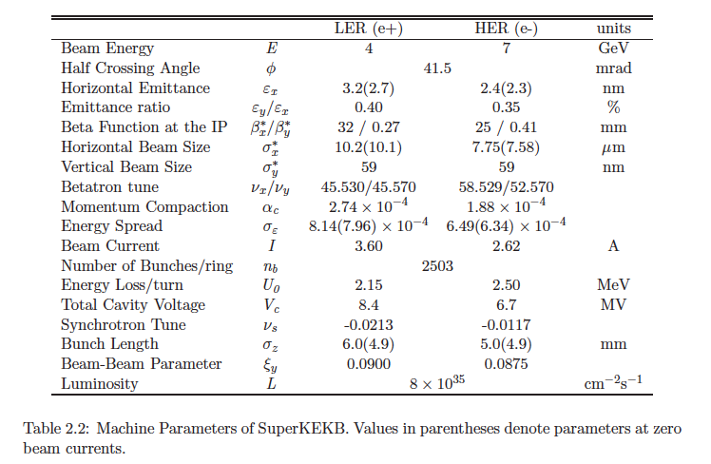
SuperKEKB TDR parameters

Slide 40
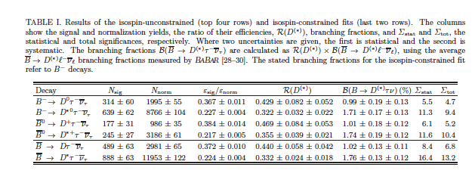
BaBar Yields and Experimental Details for final B-→D* tau nu result

Slide 41
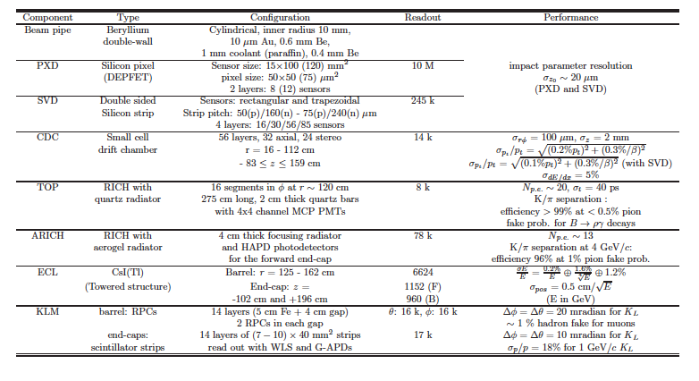
Table of Belle II detector performance parameters
(Skip this slide) For reference only.

Slide 42
Diogenes the Cynic in a painting by Jean-Leon Gerome
Notes:
A portrait of the original cynic. Knee-jerk interpretation: Diogenes is the theorist, dogs represent loyal and hard working experimentalists.

Slide 43
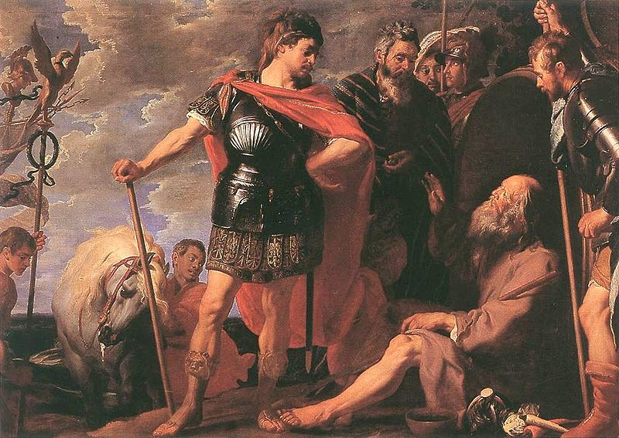
Interview of Diogenes the Cynic with Alexander, painting by Caspar de Crayer
Notes:
Theorist and funding agency

Slide 44
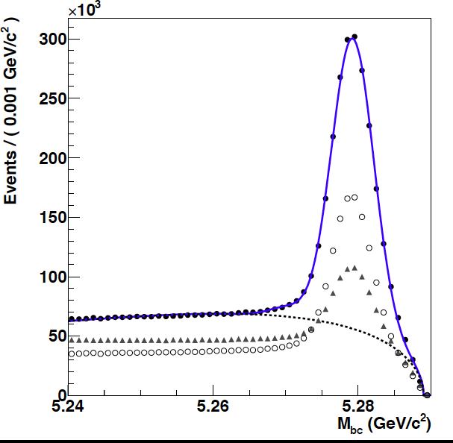
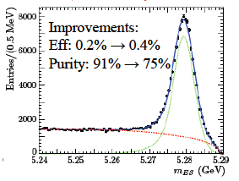
Unique capability
Belle data
BaBar data
In addition to excellent neutral detection from a crystal calorimeter, and good Cerenkov particle id, (Super) B-factories can fully reconstruct one B meson. This gives the equivalent of a “single B meson beam “

Slide 45
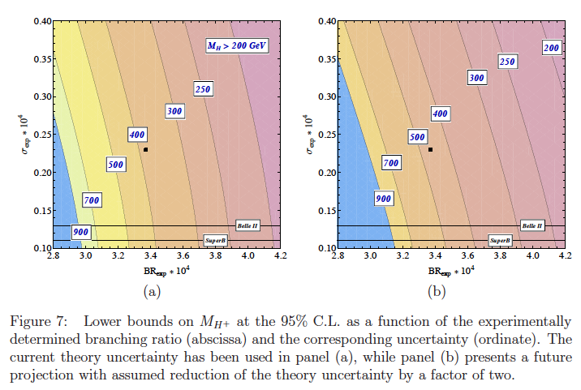
From paper by T. Hermann, M. Misiak, M. Steinhauser

Slide 46
Charge:
ritchie@physics.utexas.edu to teb@phys.hawaii.edu Mar 19
Hi. At the Argonne Intensity Frontier workshop, we (the Quark Flavor
Physics working group) are going to have a joint parallel session with
the Charged Leptons working group.
The theme of this session is sort of the unity of flavor physics (quark
and lepton) as a coherent field. We're aiming to have four talks,
one theory and three experimental talks organized around different
types of facilities (e+e-, pp aka LHC, and Project X). We want
the emphasis of the theory talk to be showing that new physics may
show up in many different flavor (quark and lepton) observables,
so that a broad program of B, charm, K, mu, and tau experiments is needed.
For the e+e- talk, we've written this charge for the speaker:
e+e- machines - The goal of the talk is to identify key measurements
that are enabled by these facilities (SuperKEKB/Belle II, BES III,
other possible tau/charm factories) for B's, charm, and taus (including
the effect of longitudinally polarized electrons), and to discuss
the likely evolution of these capabilities over the rest of this
decade and during the next. The likely evolution over time of
luminosities and other important machine or detector parameters
should be included.

