Slide 1
Probing the quantum vacuum with lasers
Aaron S. Chou (Fermilab)
Intensity Frontier Workshop
4/25/2013
(Thanks to Albert Stebbins and Bob Wald for useful and ongoing discussions)

Slide 2
DOE OHEP Mission Statement:
Text from proposed Fermilab mission statement

Slide 3
Black hole entropy suggests a relationship between gravity and thermodynamics
S_{BH} = A_{BH} × (M_{pl}/2)² = A_{BH}/(2 λ_{pl})²
R. Bousso
The shocking thing is not holography, but rather the bandwidth limit….

Slide 4
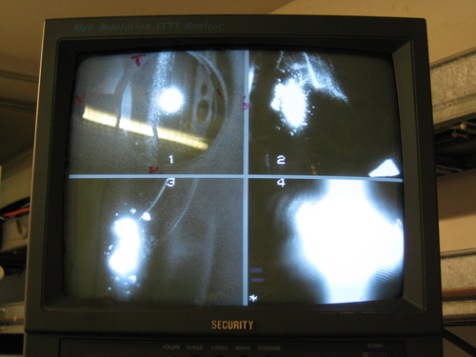
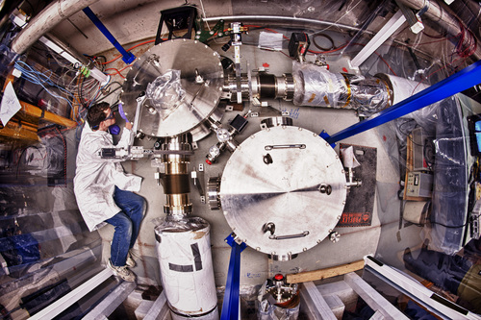
Fermilab E-990: Holometer
Beamsplitter
N End Mirror
E End Mirror
Fringe at AS (dark) port
Already commissioning two 40m interferometers and beginning hunt for Planck-suppressed noise due to the bandwidth limit of spacetime

Slide 5
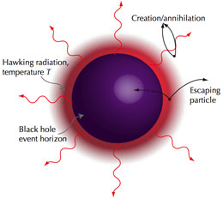
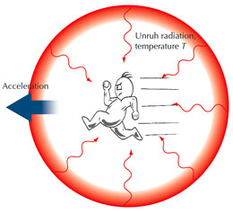
What about testing Hawking-Unruh radiation?
http://www.extreme-light-infrastructure.eu/High-field_5_2.php
Acceleration of charged particles always gives radiation, independently of the causal force. This radiation is usually time-dependent – synchrotron radiation, bremmstrahlung, because the acceleration is time-dependent.
An event horizon is necessary to allow “stationary” acceleration, resulting in a steady-state, time-independent radiation spectrum.
For example, to maintain a fixed position relative to the black hole, one needs to be in constant acceleration relative to the infalling geodesic.

Slide 6
Dictionary of gravity, acceleration, thermodynamics
Entropy = horizon area
Event horizon in the case of black holes
Particle horizon in the case of uniform acceleration
Cosmological horizon in the case of uniformly accelerated expansion
Temperature T = surface gravity g* = acceleration a = 1/r_{horizon}
Gives typical wavelength of the blackbody Hawking-Unruh radiation
Radiation power ~ T⁴ = a⁴
Flux = 1 photon per horizon-crossing time per horizon area
Need strong fields to achieve large accelerations a > 1 eV corresponding to detectable radiation
Best RF cavities are not enough: (50 MV/m) / m_{e} = 2×10⁻⁵ eV
The highest laboratory electric fields are achieved with pulsed lasers

Slide 7
ELI-Ultra High Field Facility
The highest intensity pillar location is still to be decided. The laser power will reach the 200 PW or 100 000 times the power of the world electric grid. It will depend, among other things, on the laser technology development and validation. It could be built on one of the existing three sites or in a new country. With the possibility of going into the ultra-relativistic regime, ELI will afford new investigations in particle physics, nuclear physics, gravitational physics, nonlinear field theory, ultrahigh-pressure physics, astrophysics and cosmology (generating intensities exceeding 10²³ W/cm²). It will offer a new paradigm in High Energy Physics.

Slide 8
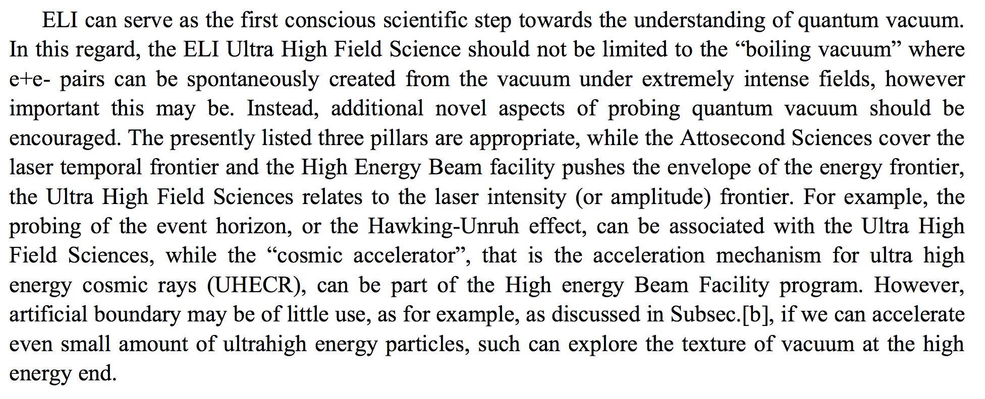
The Laser Intensity Frontier
2009 Scientific Advisory Committee report on Europe’s Extreme Light Infrastructure (ELI) project

Slide 9
Serendipity

Slide 10
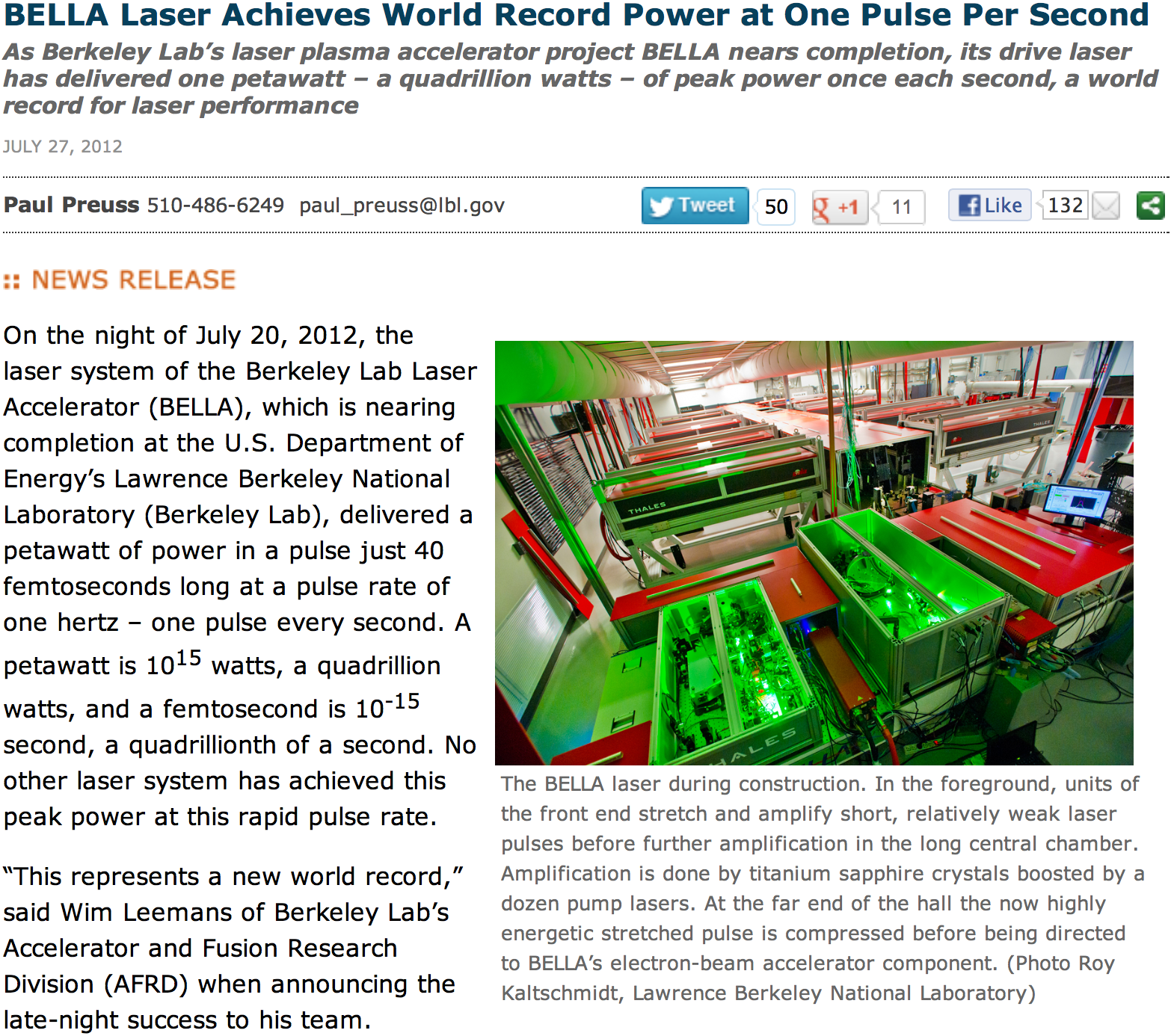
10³⁴ photons/s at 1 Hz rep.

Slide 11
Comparison of light sources
Using transverse electric field of 800 nm laser to accelerate e.g. electrons
Light source | Power density [W/m²] | Transverse E-field [V/m] | Acceleration temperature [eV] | Max electron boost/cycle γ = 2eE/m_{e}ω | Boosted radiation energy [keV]
BELLA (LBL) | 10²⁵ | 6×10¹³ | 30 | 40 | 1.2
ELI (future) | 2×10²⁷ | 9×10¹⁴ | 420 | 560 | 235
Schwinger critical field | 10³³ | 1.3×10¹⁸
S [W/m²] = E×H = sqrt(ε/μ) E²

Slide 12
Hawking-Unruh Effect
Consider quantizing fields in a frame corresponding to a uniformly accelerating trajectory:
Due to a time-varying Doppler shift, the creation and annihilation operators are related to those in an inertial Minkowski frame via unitary Boguliubov transformations.
The vacuum state in the accelerated frame is a thermal blackbody distribution of Minkowski frame particles (Unruh/Wald, 1984) with thermal density matrix
The vacuum has temperature T = acceleration a.
If a detector is placed in this trajectory of constant acceleration, its energy levels will be populated following the thermal distribution of the vacuum.
In thermal equilibrium, the detector cannot extract energy from the vacuum

Slide 13
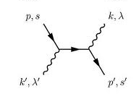
Thermalization and fluctuations of accelerated systems
The accelerated detector presumably thermalizes by absorption of Unruh photons from the thermal bath.
In the case of a single accelerated electron, there are no internal energy levels, and so interactions with the thermal bath occur via Thompson scattering
The recoil and radiation reaction of the electron results in a deviation from the trajectory of uniform acceleration, and thus gives observable radiation in the lab frame. (Chen, Tajima, 1998)

Slide 14
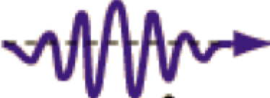
Thermal emission time (in boosted electron frame)
From Stefan-Boltzmann Law
Thermal bath emits keV Unruh photons at a rate of dN/dt = 1/(10⁻¹⁸ s)
Infrared laser period (proper time):
γ×π/ω_{laser}≈100×π/(1 eV) = 2×10⁻¹³ s

Slide 15
Photon-electron scattering rate (in boosted frame)
From Stefan-Boltzmann Law
Scattering rate ≈ T³×σ_{Thompson} ≈ T³ α² /m_{e}²
= (1 keV)³ × (1/137)² ×(500 keV)⁻² = 1 / (2×10⁻¹³ s)
1 scattering event per half-cycle
(2 fs in lab frame)
Infrared laser period (proper time):
γ×π/ω_{laser}≈100×π/(1 eV) = 2×10⁻¹³ s

Slide 16
Radiation has keV energies in the lab frame due to Lorentz boost
Light source | Power density [W/m²] | Transverse E-field [V/m] | Acceleration temperature [eV] | Max electron boost/cycle γ = 2eE/m_{e}ω | Boosted radiation energy [keV]
BELLA (LBL) | 10²⁵ | 6×10¹³ | 30 | 40 | 1.2
ELI (future) | 2×10²⁷ | 9×10¹⁴ | 420 | 560 | 235
Schwinger critical field | 10³³ | 1.3×10¹⁸
S [W/m²] = E×H = sqrt(ε/μ) E²

Slide 17
The background is classical Larmor dipole radiation
Total Unruh power / Larmor power per half cycle (Chen, Tajima, 1998)
~ 10⁻⁴
For a Petawatt laser
with a₀=20
Unruh power = Larmor power at the Schwinger critical field eE = m_{e}²
or equivalently when the acceleration temperature T = m_{e}
For now we have to deal with the large Larmor background.

Slide 18
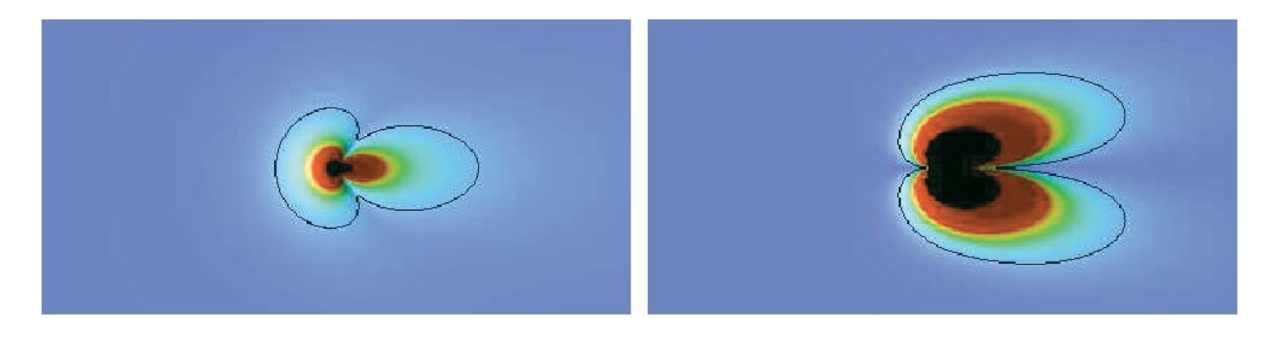
Distributions of boosted photon energies: Larmor dipole radiation has blind spots in the forward and backward directions
Unruh
Larmor
30 keV 0 keV 30 keV
30 keV 0 keV 30 keV
Unruh radiation dominates over Larmor radiation when looking in a forward cone of angle
Chen, Tajima, 1998;
Schutzhold, Schaller, Habs, 2006
For 1 Hz rep rate BELLA laser with a₀=20 → Solid angle acceptance ~ 10⁻⁴
1 interaction / laser cycle → need 10⁴ seconds per Unruh event.

Slide 19
Thompson scattering of Unruh radiation gives two-photon emission of Einstein-Podolsky-Rosen states?
Emission of photon in accelerated frame
= emission of spin-correlated photon in lab frame
Absorption of photon in accelerated frame
= emission of photon in lab frame
Look for x-ray pairs with correlated polarizations.
(Schutzhold, Schaller, Habs, 2006)

Slide 20
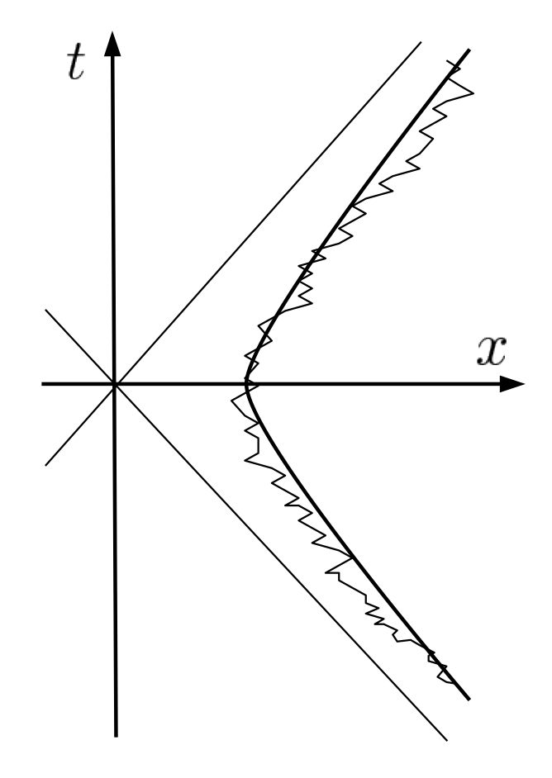
What is the Unruh radiation power source?
For undisturbed, uniformly-accelerated trajectories, the detector is in thermal equilibrium with the Unruh radiation, and hence there can be no net emission of radiative power in any frame. (Ford, O’Connell, 2006, many others)
→ One cannot extract energy from the vacuum!
The backreaction from absorption and emission of photons causes a “quivering motion” about the classical trajectory. (Chen, Tajima, 1999)
The power source is the agent of the acceleration, e.g. the laser field or rocket thrusters exerting a force on the particle
The fluctuation-dissipation theorem implies that the acceleration is only quasi-uniform due to the thermal friction of the vacuum

Slide 21
Does the quantum vacuum cause a frictional force resisting acceleration of charged particles?
An accelerated system should thermalize with the Hawking-Unruh radiation. This requires energy to be deposited into the system.
What is the energy source for the Hawking-Unruh radiation bath itself? Is the experimentalist responsible for populating this thermal distribution?
Thermal fluctuations in the accelerated frame correspond to particle emission in the inertial Minkowski frame (Unruh/Wald, 1984)
To maintain steady-state acceleration, the experimentalist is required to provide the power for the resulting blackbody radiation.
F_{accel} – F_{friction} = ma gives a lower-than-expected maximum boost, which is perhaps observable via the x-ray spectrum
In the case of the observer firing retro-rockets and maintaining a fixed position relative to a black hole event horizon, is the Hawking radiation powered by the retro-rockets, or is it powered by black hole evaporation?
Do black holes evaporate? Is there really a black hole information paradox?

Slide 22
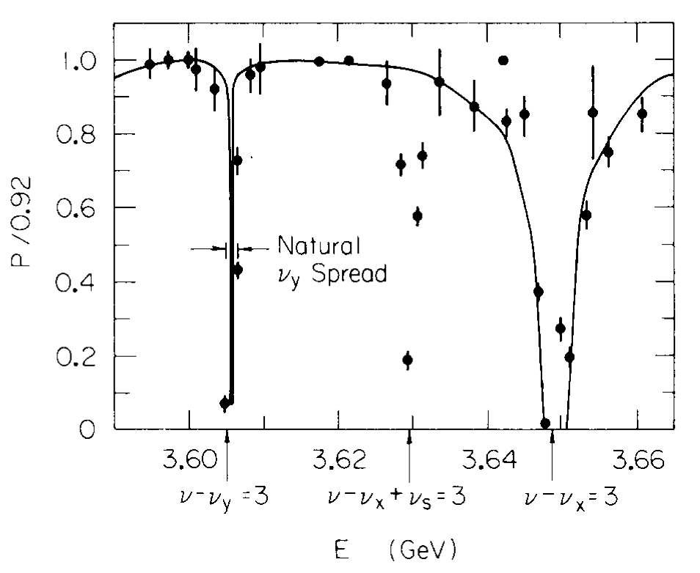
The Sokolov-Ternov effect = vacuum friction on centripetal acceleration?
Sokolov, Ternov, 1964;
Bell, Leinaas, 1982;
Unruh, 1998;
Akhmedov, Singleton, 2007;
Electrons in a storage ring undergo constant centripetal acceleration. Synchrotron radiation carries away the angular momentum, and tends to flip spins to align with the external B field.
The maximum e- polarization achievable in a storage ring is 92%, due to stochastic collisions with Unruh photons causing random spin-flips?
However g→0 limit is not consistent with Unruh…. (J.D. Jackson)

Slide 23
Summary
Hawking-Unruh radiation has never been observed, though theorists are confident that it exists, and have performed intricate thought experiments for over 30 years.
Modern lasers are just now achieving the high fields required to achieve an observable acceleration temperature and event rate.
Theoretical calculations are for hypothetical steady-state trajectories of constant acceleration, and do not address questions of how a real system transitions from Minkowski spacetime to the accelerated state
How does the accelerated system thermalize?
How does the vacuum thermalize?
Does Hawking/Unruh radiation really exist or is the thermalization due to the transformation of the quantum vacuum?
What is the power source?
Studies may yield insights on the quantum vacuum of the uniformly accelerating deSitter universe
Can we solve the 10¹²⁰ cosmological constant problem?

Slide 24
Backup slides

Slide 25
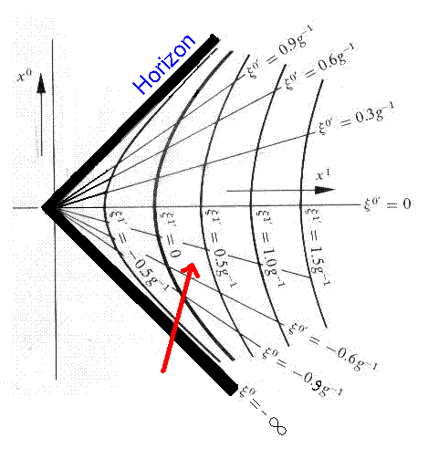
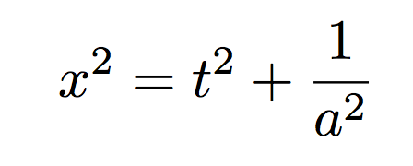
Rindler coordinates for trajectories of constant acceleration
t
Relativistic formula
Low-velocity limit →
x
Parameterize with Rindler coordinate τ
Trajectories are hyperbolae with closest approach x(0)=1/a to the origin

Slide 26
A 2-level atom in a uniformly accelerating frame develops a thermal population of its levels.
Transition rate per unit time between levels of a 2-level atom is the Fourier transform of the scattering potential w.r.t. the energy transfer:
The scattering potential is the vacuum Green’s function:
In the accelerating coordinates:
This is periodic in imaginary time, and has a sequence of poles at t=i(ε+n×2π/a) for integer n.

Slide 27
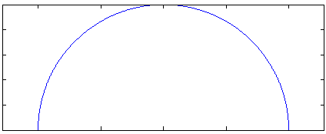
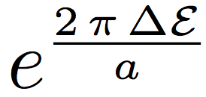
Perform integral by analytically continuing and summing the poles
×
×
i8π/a
×
i6π/a
×
i4π/a
×
i2π/a
×
0
x=
Sum of exponentials gives the usual thermal transition rates with kT=a/2π

Slide 28
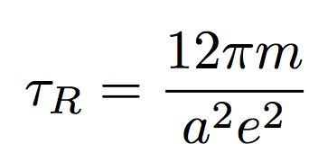
Concern: Thermalization time of Unruh detector
(Iso, Yamamoto, Zhang, 2011)
In the lab frame,
= 1.5×10⁻¹³ s for a=100 eV.
This is much longer than the half-period of the laser = 2×10⁻¹⁵ s.
However, as long as the detector absorbs and emits one photon, then it is not required for it to be in the uniformly accelerated trajectory long enough to achieve thermal equilibrium with the Unruh thermal bath.

