Slide 1
Charged Lepton’s message to Snowmass
Unique opportunities for discovery
US facilities can host world leading experiments
Integral part of a greater program
Intensity Frontier All Hands Meeting, 4/27/13

Slide 2
Andy Cohen from joint session with heavy quarks:
Unique opportunities for discovery
Focus on scales
Sell discoveries
Charged lepton processes can:
  Discover what stabilizes the weak scale if it is just out of reach of the LHC
  Discover the scale of flavor generation up to ~10⁴ TeV
Unique probe is charged lepton flavor violation

Slide 3
David McKeen:
Unique opportunities for discovery

Slide 4
Roni Harnik: Synergies with the Higgs
Integral part of a greater program
Use higgs to generate neutral currents
μ e transitions
τ μ transitions

Slide 5

Integral part of a greater program
Joint heavy quark & charged leptons
+
Joint atoms nucleons nuclei & charged leptons
e
e
N
N
τ
μ
μ
μ
τ
e
b
s
τ
τ
μ
e
b
d
s
d

Slide 6
Joint heavy quark & charged leptons
+
Joint atoms nucleons nuclei & charged leptons
Integral part of a greater program
12 GeV upgrade
μ
μ
b
s
μ
b
μ
s
Abhay Deshpande
electron-Ion collider
Marina Artuso

Slide 7
David McKeen:
Charge radius of the proton
Integral part of a greater program
Bob Bernstein:
correlations between
μ LFV versus τ LFV
e
μ
Many ways to explain this but “forced” into dark photon-like scenarios by neutrino scattering and neutron scattering data
Phase space drastically reduced by adding a third observable: θ₁₃.

Slide 8
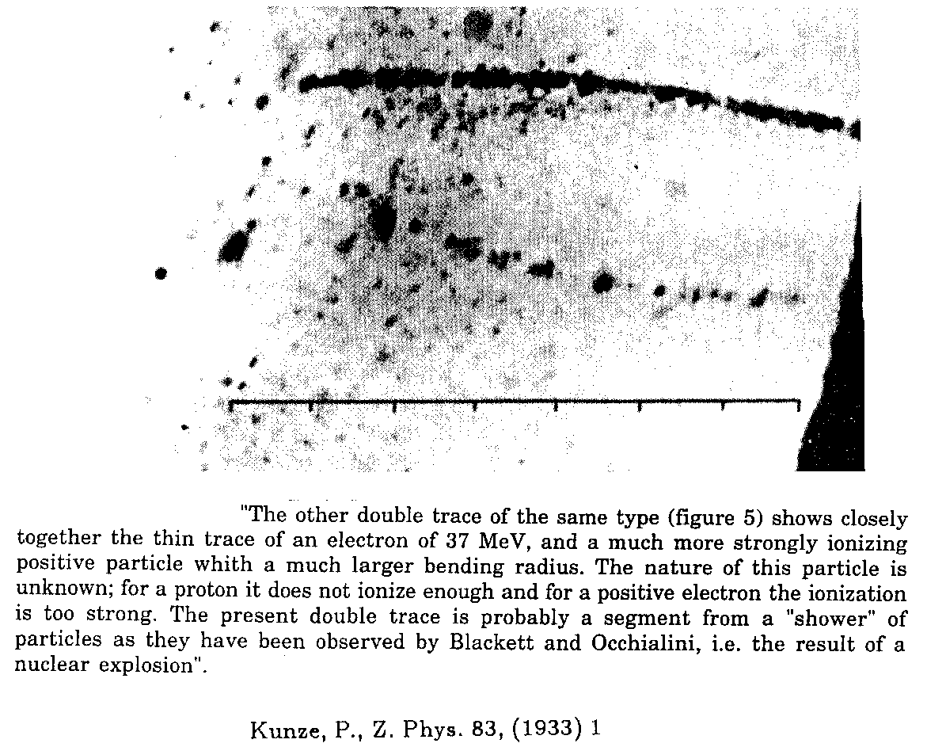
time
US facilities can host world leading experiments
1936:
Muon discovered

Slide 9
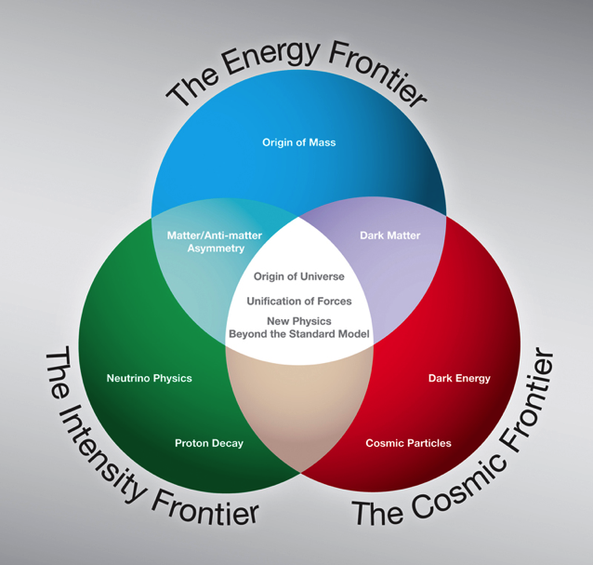
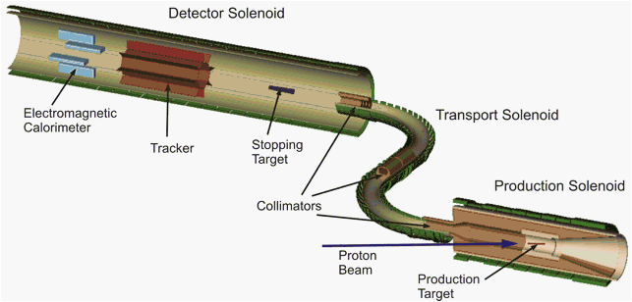
time
US facilities can host world leading experiments
1936:
Muon discovered
2008:
P5 says do MECO-like experiment at Fermilab
Mu2e is born

Slide 10
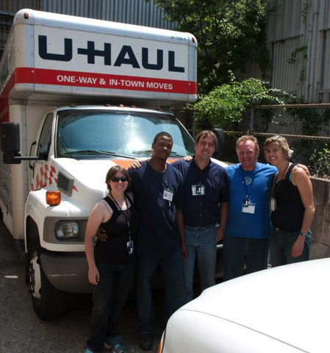
time
US facilities can host world leading experiments
1936:
Muon discovered
2008:
P5 says do MECO-like experiment at Fermilab
2009:
Go from experiment to program:
g-2 takes off
What we could afford summer 2011
What we are doing summer 2013

Slide 11
time
US facilities can host world leading experiments
1936:
Muon discovered
2008:
P5 says do MECO-like experiment at Fermilab
2009:
Go from experiment to program:
g-2 takes off
2011:
Rockville
Kaladi Babu
‘”Rockville diagram”
Consensus that a diverse program is required to understand LFV
Clear:
What we want to do.
Unknown:
How we can do it.

Slide 12
time
US facilities can host world leading experiments
1936:
Muon discovered
2008:
P5 says do MECO-like experiment at Fermilab
2009:
Go from experiment to program:
g-2 takes off
2011:
Rockville
2013:
Snowmass
Rockville:
  What we need to do
Snowmass:
  How are we going to do it?
Two fundamental questions (or branch points):
  Can we discover flavor violation?
  Can we understand flavor violation?

Slide 13

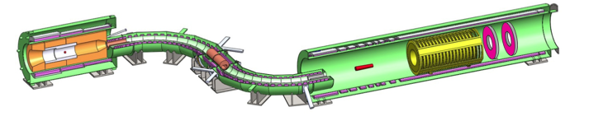
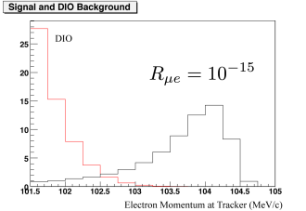
Goal: Discover CLFV if it is below 10⁴ TeV
Doug Glenzinski

Slide 14
Branch: Discover CLFV not violated.
Move on to 10x sensitivity
Doug Glenzinski
30% duty cycle
μ2e with the booster
μ2e with stage 1 Project X
90% duty cycle
Longer signal window
No antiproton background

Slide 15
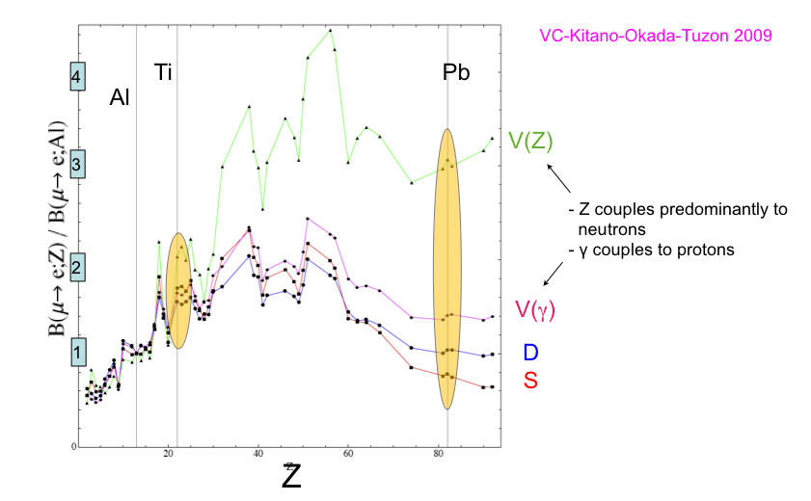
Branch: Discover CLFV is violated(!)
Now try and understand why:
Vincenzo Cirigliano

Slide 16
Branch: Discover CLFV is violated(!)
Now try and understand why:
Doug Glenzinski

Slide 17
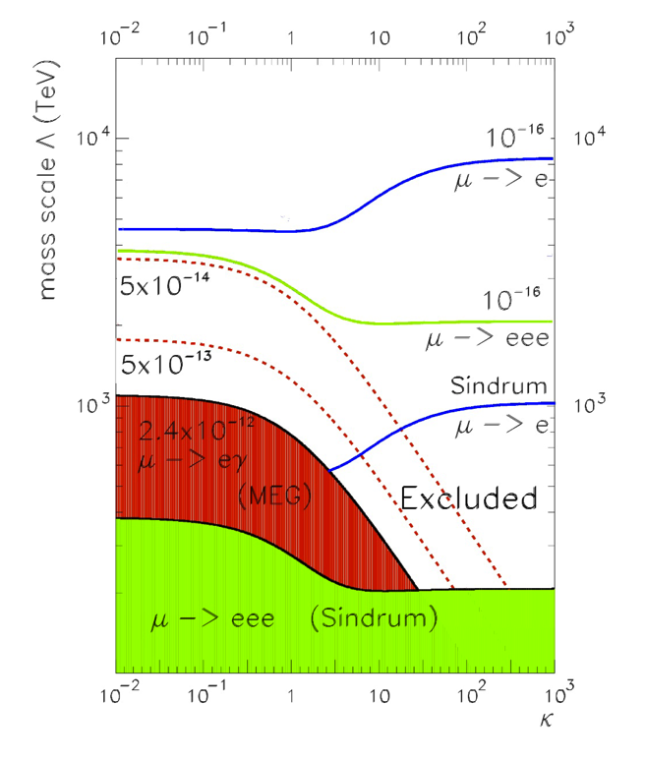
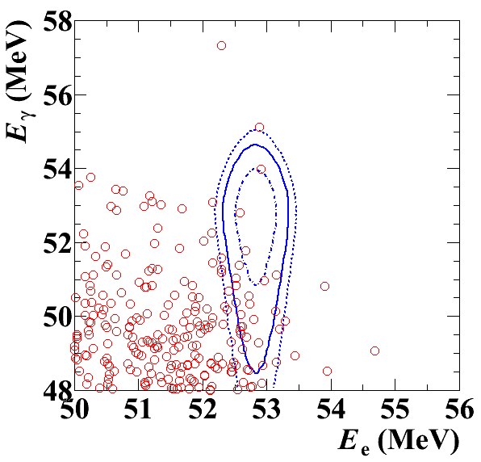
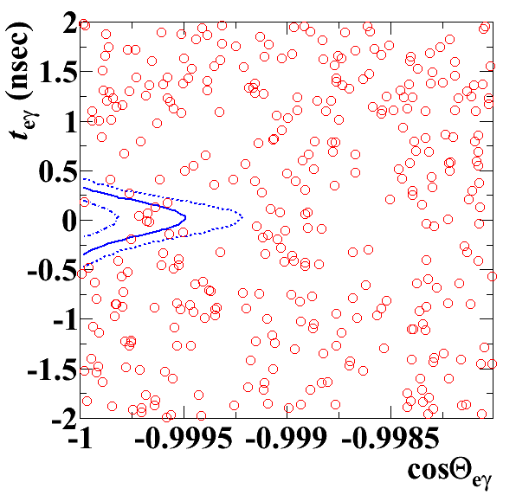
Branch: Discover CLFV is violated(!)
Now try and understand why:
Gordon Lim
Can we do better than PSI?

Slide 18
Branch: Discover CLFV is violated(!)
Now try and understand why:
Chih-hsiang Cheng
Bertrand Echenard
Same spectrometer for μ3e(!)

Slide 19
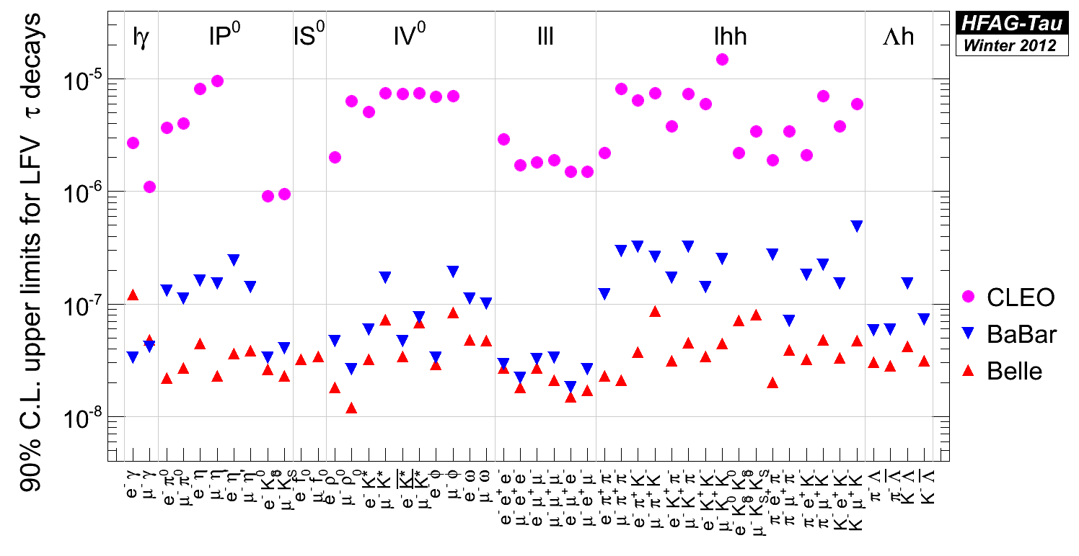
Branch: Discover CLFV is violated(!)
Now try and understand why:
Browder, Artuso, Hitlin…
Taus will be essential for understanding CLFV
Now an off shore program with one exception: e2τ at an EIC
Deshpande

Slide 20
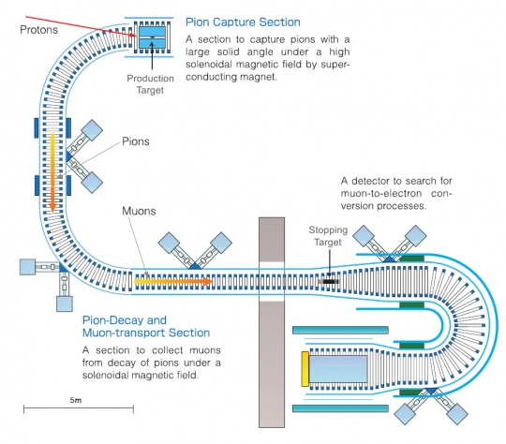
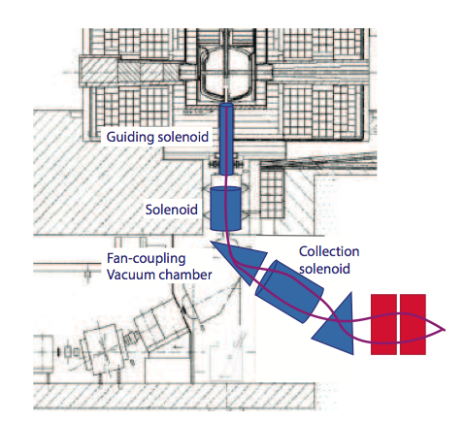
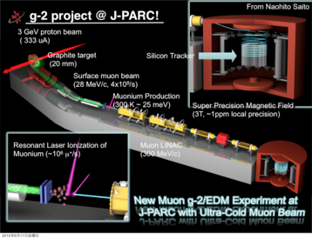
This is exciting physics so there is stiff competition
Peter Winter
JPARC
PSI
This is not an open ended opportunity

Slide 21
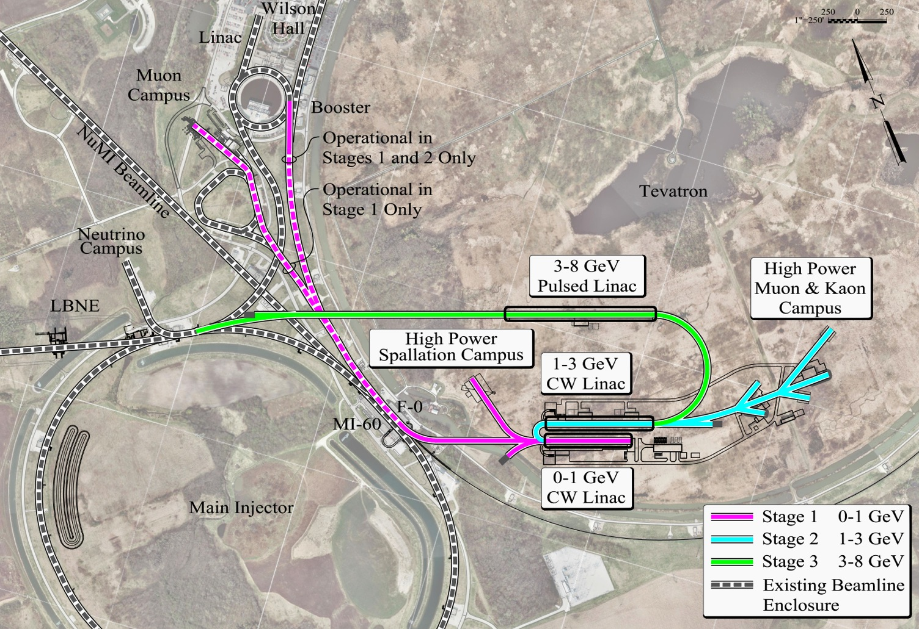
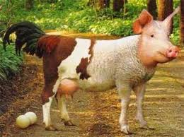
Ron Ray
US facilities can host world leading experiments
μ2e I
μ2e II
g-2
μ3e++
μ2e III
Peter Winter:
Egg-laying-wool-milk-sow
+ Jlab and EIC programs

Slide 22
Charged Lepton’s message to Snowmass
Unique opportunities for discovery
US facilities can host world leading experiments
Integral part of a greater program

