Slide 1
Surface muon beam at PSI and Project X
Peter Winter Argonne National Laboratory

Slide 2
Outline
General introduction to surface / cloud muons
Muon beam facilities overview
General considerations for muon beam
Experimental requirements
Proton target
Beam channel
Muon stopping target
What could the future bring (PSI, Project X, ...)?

Slide 3
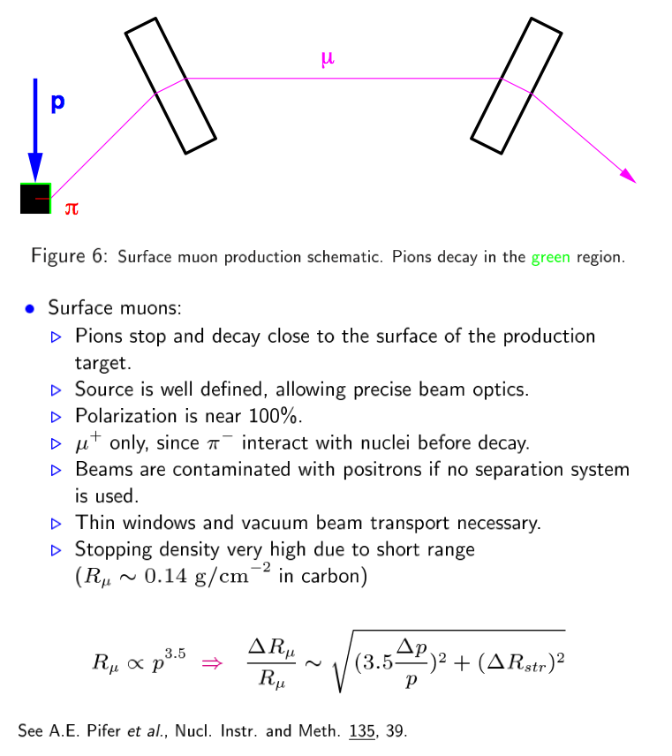
Surface mouns (p_{μ} = 29.8 MeV/c)

Slide 4
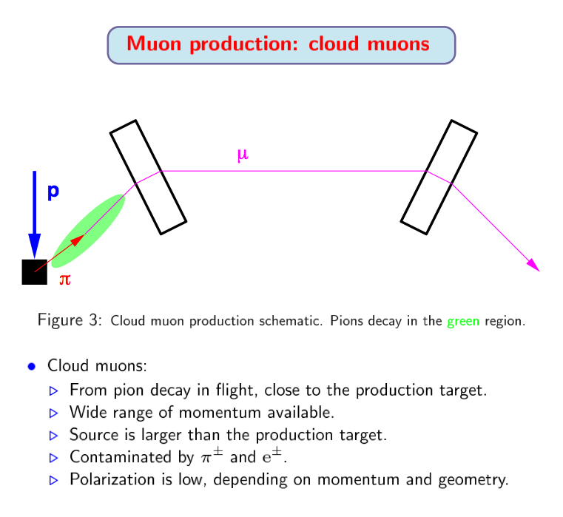
Cloud mouns (p_{μ} > 30 MeV/c)

Slide 5
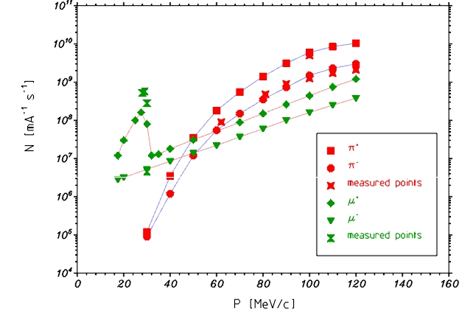
Muon beams
πE5 beamline PSI
N_{μ} [mA⁻¹ s⁻¹]
p_{μ} [MeV/c]
http://aea.web.psi.ch/beam2lines/

Slide 6
Facilities overview

Slide 7
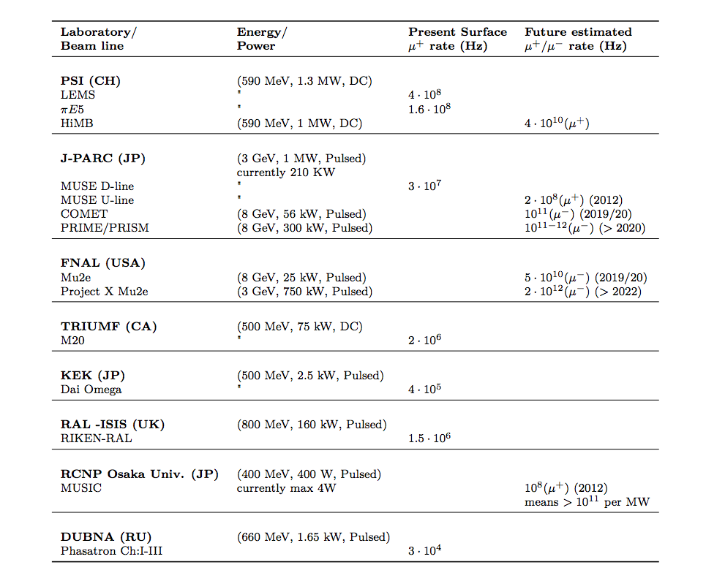
Muon beams

Slide 8
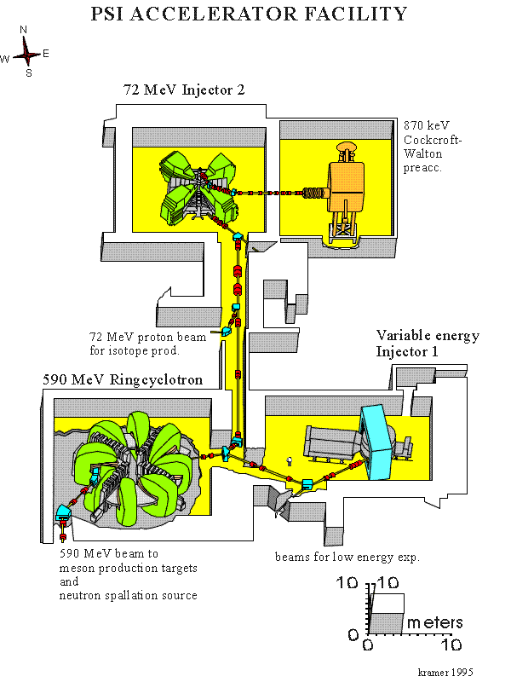
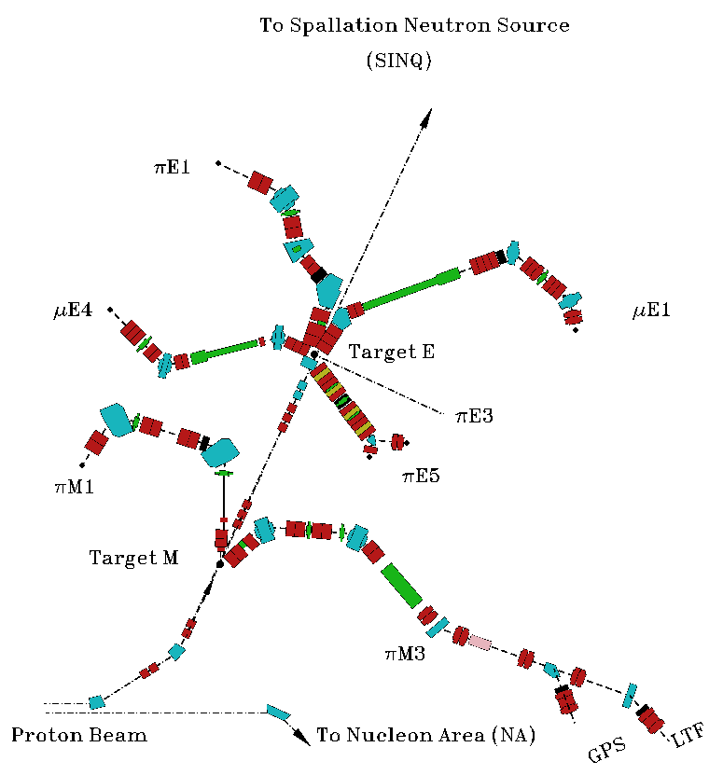
Muon beams at PSI
http://aea.web.psi.ch/beam2lines/

Slide 9
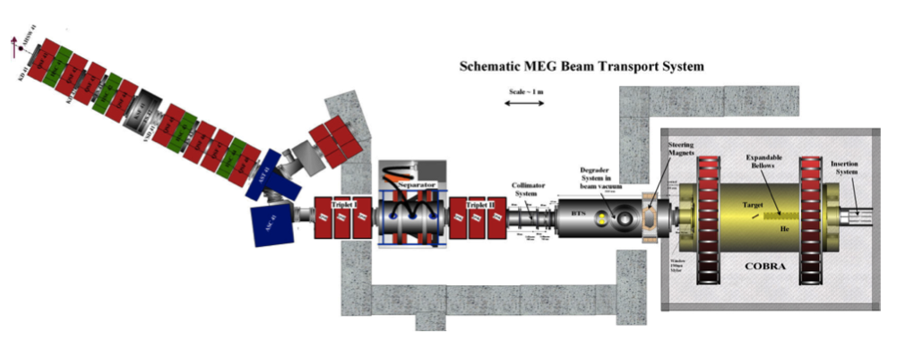
πE5 at PSI
175° relative to proton beam
dipole and focussing quadrupole channel
Solid angle: 150 mSr
Δp / p = 10% (acceptance)
Spot size: 15mm, 20mm
2 * 10⁸ muons/s @ 2.4mA (590 MeV)

Slide 10
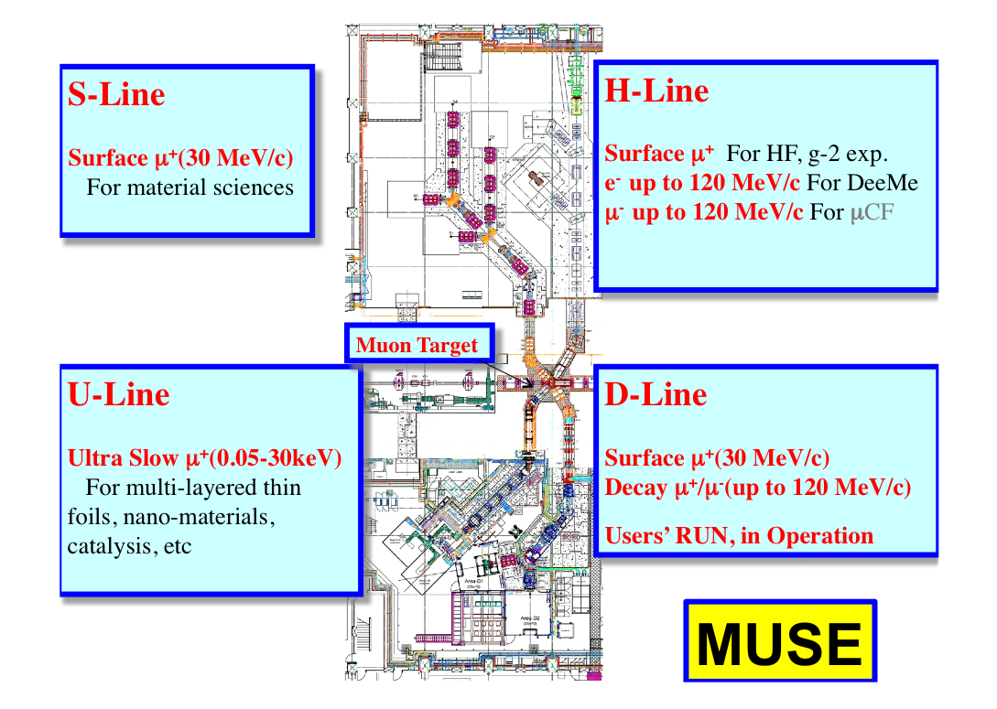
Muon beams: J-PARC

Slide 11
Some muon experiments
Experiment | Beam | Momentum | Rates | Beamline
MEG | μ⁺ | 29.8 MeV/c | 3 * 10⁷/s | πE5 @ PSI
MuLan | μ⁺ | 29.8 MeV/c | 8 * 10⁶/s | πE3 @ PSI
TWIST | μ⁺ | 29.8 MeV/c | <5 * 10³/s | TRIUMF
MuCap / MuSun | μ⁻ | 34 MeV/c | 1 * 10⁵/s | πE3 @ PSI
SINDRUM II | μ⁻ | 88 MeV/c | 1.2 * 10⁷/s | μE1 @ PSI
Material science community (muSR) using surface muons as well!

Slide 12
Some muon experiments
Experiment | Beam | Momentum | Rates | Beamline
MEG | μ⁺ | 29.8 MeV/c | 3 * 10⁷/s | πE5 @ PSI
MuLan | μ⁺ | 29.8 MeV/c | 8 * 10⁶/s | πE3 @ PSI
TWIST | μ⁺ | 29.8 MeV/c | <5 * 10³/s | TRIUMF
MuCap / MuSun | μ⁻ | 34 MeV/c | 1 * 10⁵/s | πE3 @ PSI
SINDRUM II | μ⁻ | 88 MeV/c | ~ 10⁷/s | μE1 @ PSI
Mu2e | μ⁻ | ~40 MeV/c | 5 * 10¹⁰ /s | FNAL
MEG upgrade | μ⁺ | 29.8 MeV/c | 7 * 10⁷/s | πE5 @ PSI
μ⁺ -> e⁺e⁻e⁺ (Ph. I) | μ⁺ | 29.8 MeV/c | <1 * 10⁸/s | πE5 @ PSI
μ⁺ -> e⁺e⁻e⁺ (Ph. II) | μ⁺ | 29.8 MeV/c | 2 * 10⁹/s | HIMB @ PSI
MEG, μ3e:
DC μ⁺ beam: Accidental background ~ R_{μ}² (see pulsed mode comments at end of slides)
Mu2e:
Pulsed μ⁻ beam: Wait until beam background gone (π, e, ...) are gone

Slide 13
Muon beams: General considerations
1
protons
Proton beam: momentum, power and beam structure

Slide 14
Surface muons – ISIS study (2010) - II
No gain is achieved in going to higher energies for this particular target geometry and material
Sergei Striganov Fermilab Project X Muon Spin Rotation Forum October 18, 2012

Slide 15
New Geant4 generator vs HARP data: INCL 4.2 already in Geant4, INCL HE coming soon?
Sergei Striganov Fermilab Project X Muon Spin Rotation Forum October 18, 2012

Slide 16
Conclusion – surface muon beam
ISIS study claims that intensity/watt of surface muon beam at Project X energies is about 3-7 times lower than at 500 MeV
This result is based on GEANT4 model which underestimates measured cross section of positive pion production about few times at 2–8 GeV
Our crude estimate predicts nearly same surface beam intensity/watt for 2 GeV and 590 MeV protons
Direct simulation of surface muons based on developed approximation of low energy pion yield is need to make more solid conclusion
Optimization study of target geometry and material should be performed in new energy range
Sergei Striganov Fermilab Project X Muon Spin Rotation Forum October 18, 2012

Slide 17
Muon beams: General considerations
2
p-target
1
protons
Proton beam: momentum, power and beam structure
Target: Material, cooling, size

Slide 18
Muon beams: General considerations
2
p-target
1
protons
3
proton transmission
Proton beam: momentum, power and beam structure
Target: Material, cooling, size
Proton transmission: Neutron facility or last in chain

Slide 19
Proton target
Target material and shape for high yields of pions (muons)
Cooling: Low heat production and high dissipation
Minimize secondary particles (e, π, γ, n)
Target size influences channel acceptance and beam spot
Low activation
Long lifetime (mechanical stress, fatigue)

Slide 20
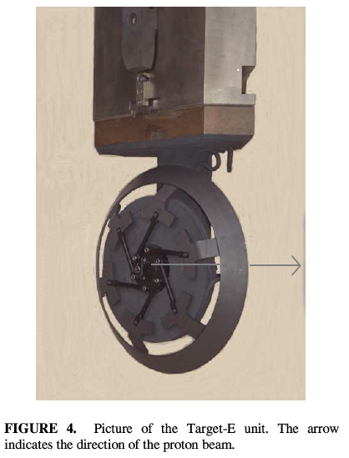
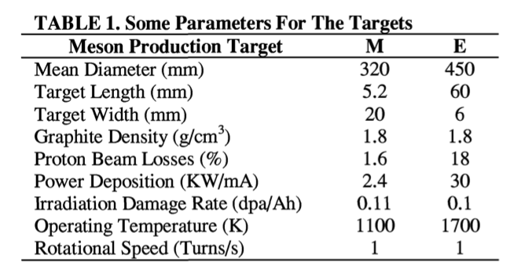
PSI target E
6 cm long rotating graphite ring, radiation cooled
~70 kW power deposited at 2.4mA (590 MeV protons)

Slide 21
Muon beams: General considerations
2
p-target
1
protons
3
proton transmission
4
muon beam
Proton beam: momentum, power and beam structure
Target: Material, cooling, size
Proton transmission: Neutron facility or last in chain
Muon beam: Momentum, rates, polarization

Slide 22
Muon beams: General considerations
2
p-target
1
protons
3
proton transmission
4
muon beam
E x B
5
Beam channel
Proton beam: momentum, power and beam structure
Target: Material, cooling, size
Proton transmission: Neutron facility or last in chain
Muon beam: Momentum, rates, polarization
Beam channel: Acceptance, transmission, momentum bite Δp/p, contamination (π, e)

Slide 23
Muon beams: General considerations
2
p-target
1
protons
3
proton transmission
4
muon beam
E x B
6
Stopping target
5
Beam channel
Proton beam: momentum, power and beam structure
Target: Material, cooling, size
Proton transmission: Neutron facility or last in chain
Muon beam: Momentum, rates, polarization
Beam channel: Acceptance, transmission, momentum bite Δp/p, contamination (π, e)
Muon stopping target: Shape, beam spot

Slide 24
Current MEG target

Slide 25
Current MEG target
New target in MEG upgrade has two options:
160mm surface muons at 15°
140mm sub-surface muons at 15°

Slide 26
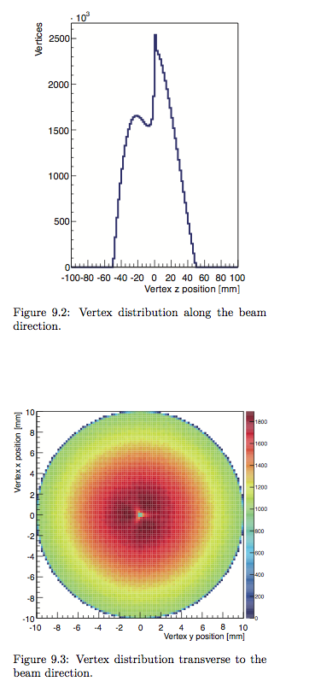
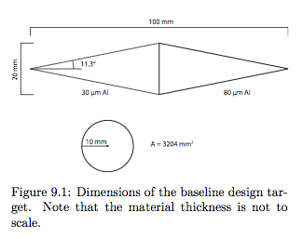
μ3e at πE5
Double cone shaped to spread out vertices for suppression of accidental background

Slide 27
Surface muons in the future
HIMB at PSI
Mu2e beam channel with surface muons
Muons in the Project X era

Slide 28
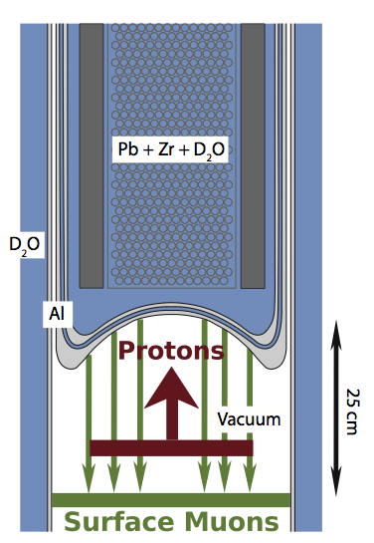
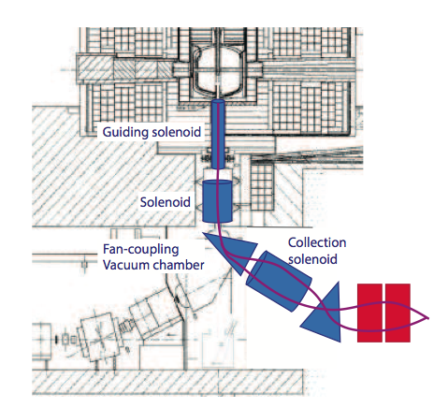
High intensity muon beam
Use spallation neutron source target

Slide 29
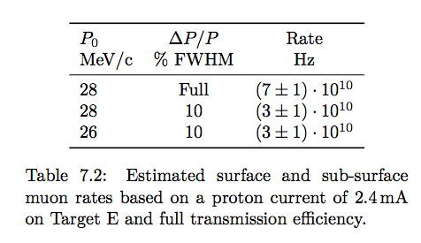
High intensity muon beam

Slide 30
1 MW @ 1 GeV
3 MW @ 3 GeV
200 kW @ 8 GeV
2 MW @ 120 GeV
as;lkjfda;lskdjf;salkjfd
Argonne National Laboratory • Brookhaven National Laboratory • Fermi National Accelerator Laboratory • Lawrence Berkeley National Laboratory
Pacific Northwest National Laboratory • Oak Ridge National Laboratory / SNS • SLAC National Accelerator Laboratory
Thomas Jefferson National Accelerator Facility • Cornell University • Michigan State University • ILC/Americas Regional Team
Bhaba Atomic Research Center • Raja Ramanna Center of Advanced Technology • Variable Energy Cyclotron Center • Inter University Accelerator Center

Slide 31
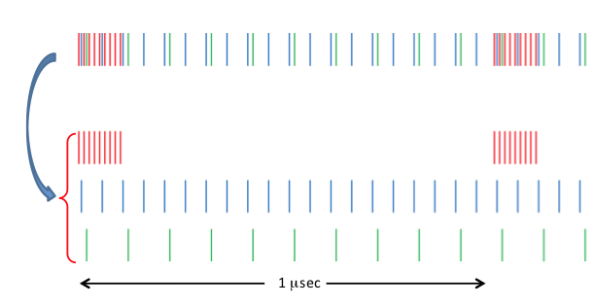
An example: Bunch structure
Area 1: 700 kW at 1MHz and 80 MHz substructure
Area 2: 1540 kW at 20 MHz
Area 3: 770 kW at 10 MHz

Slide 32
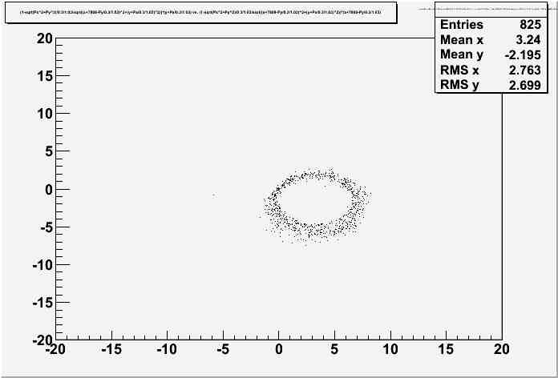
Mu2e with pulsed surface muons
Jim Miller’s quick simulation:
Start with surface muon point source at Mu2e production target
Plot point of closest approach along z-axis of detector solenoid
Study stopping efficiency in thin cylindrical target in more realistic setup
Need sparator for beam background or pulsed mode
But what about the pulsed mode for accidental background (~ rate²)?

Slide 33
DC versus pulsed: Electron pileup
DC beam with rate R
time

Slide 34
DC versus pulsed: Electron pileup
DC beam with rate R
Pulsed beam with averaged rate R
time

Slide 35
DC versus pulsed: Electron pileup
DC beam with rate R
Pulsed beam with averaged rate R
Electrons from DC beam
time

Slide 36
DC versus pulsed: Electron pileup
DC beam with rate R
Pulsed beam with averaged rate R
Electrons from DC beam
Electrons from pulsed beam
time

Slide 37
DC versus pulsed: Electron pileup
DC beam with rate R
Pulsed beam with averaged rate R
Electrons from DC beam
Electrons from pulsed beam
Histogram Δt between every electron and all others
Δt’s for one electron
time

Slide 38
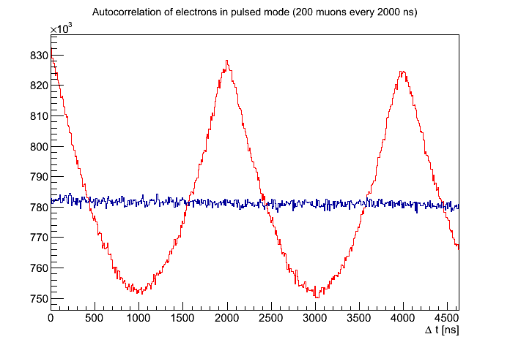
DC versus pulsed: Electron pileup
Ratio at Dt = 0 is only 1.06, i.e. accidental rate would increase by ~13%

Slide 39
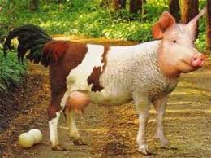
Summary
2
p-target
1
protons
3
proton transmission
4
muon beam
E x B
6
Stopping target
5
Beam channel
Optimization of muon beamline has many knobs
Should look more into existing studies and continue from there
Study Mu2e beamline in more details for μ⁺ surface beam
Future experimental requirements play important role in finding best strategy (cost, resources, physics, time, ...)
It’s hard to get the “Egg-laying-wool-milk-sow” but one shoud study which compromises might be feasible (multi-purpose or many beamlines)

