Slide 1


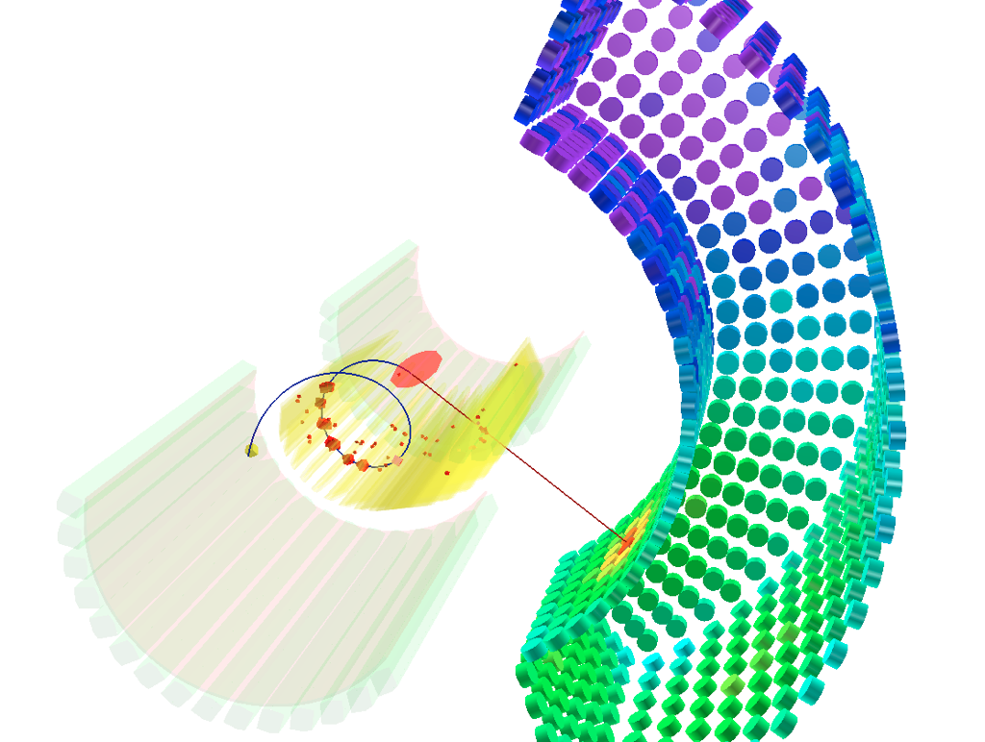


Recent results & future plans of the MEG experiment
Intensity Frontier Workshop April 2013: Charged Lepton Processes
GORDON LIM

Slide 2
Flavor violation
2/27
Introduction Experiment Analysis Results Upgrade Conclusions
c
s
Quarks
  Quark mixing observed by various accelerator experiments
  Standard Model: CKM mixing matrix
u
d
t
b
ν_{μ}
Neutrinos
  Neutrino oscillations observed by various neutrino experiments
  Standard Model: PMNS mixing matrix
ν_{e}
ν_{τ}
Charged leptons
  Not observed
μ
?
e
?
τ

Slide 3
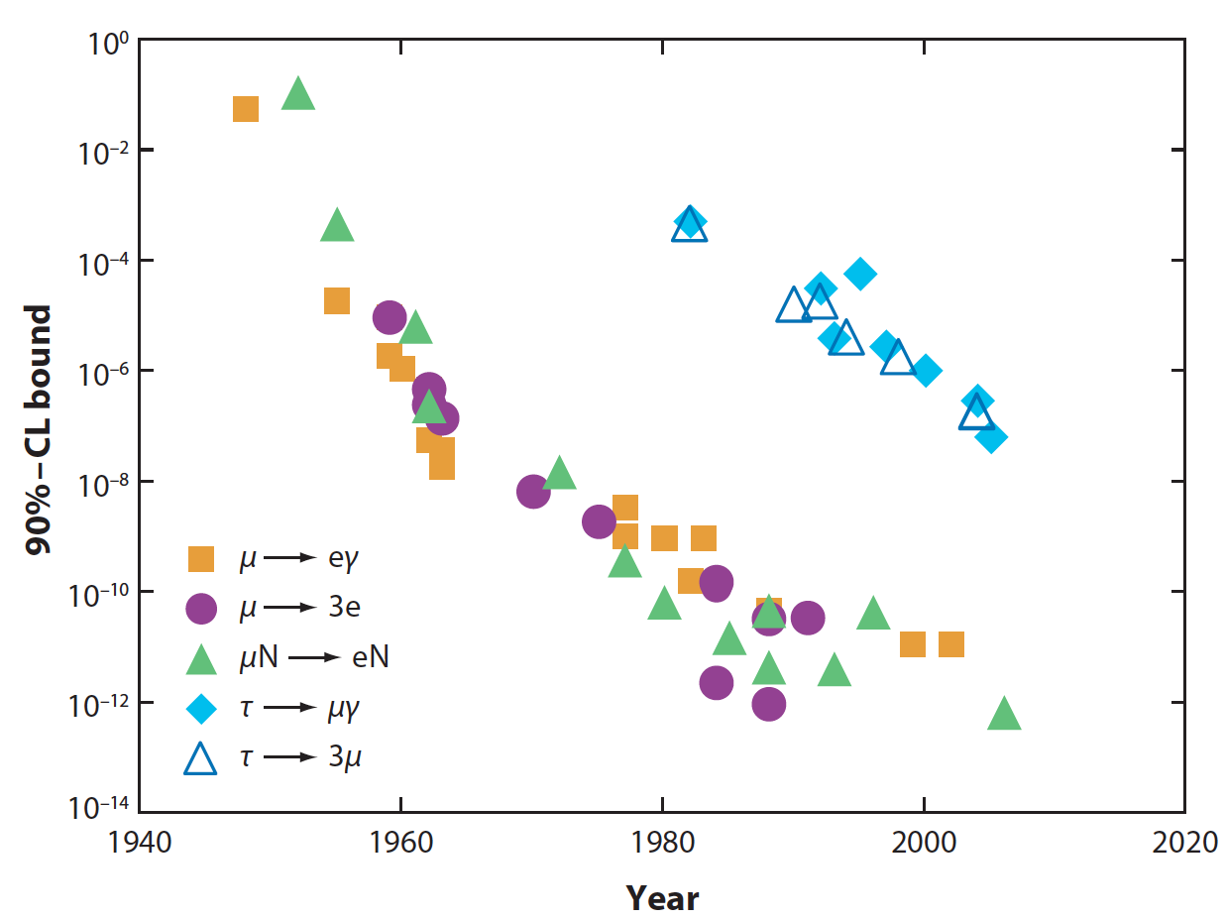
Search for charged lepton flavor violation
3/27
Introduction Experiment Analysis Results Upgrade Conclusions
Historical overview of selected charged lepton flavor violation searches:
Marciano, Mori & Roney,
Annu. Rev. Nucl. Part. Sci. 2008 58:315–41
Belle @ KEKB
SINDRUM I & II @ PSI
MEG @ PSI
branching ratio
Previous result:
PRL 107 (2011) 171801
Processes involving muons are best constrained: Muons are copiously produced at high-intensity proton accelerators and have precisely measurable final states

Slide 4

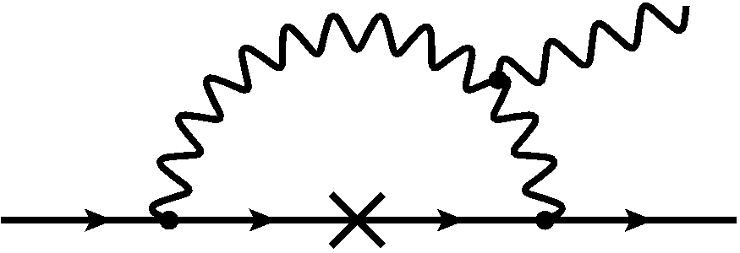
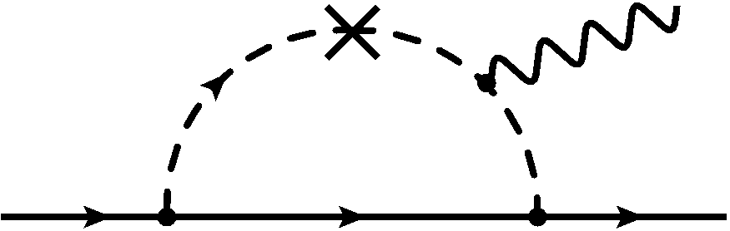




Why ?
4/27
Introduction Experiment Analysis Results Upgrade Conclusions
Standard Model:
Beyond the Standard Model,
e.g. SUSY-GUT scenarios:
impossible to detect
very small but not impossible
Observation of is clear sign of new physics!

Slide 5













Detection principle
5/27
Introduction Experiment Analysis Results Upgrade Conclusions
Signal:
Background 1: Radiative muon decay (BR ≈ 1.4%)
Background 2: Accidental overlap
Photon can come from:
Radiative muon decay
Positron annihilation in flight
Positron Brehmstralung
Accidental background dominant, detector resolutions crucial!

Slide 6
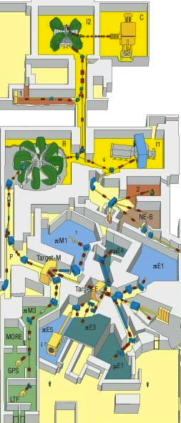
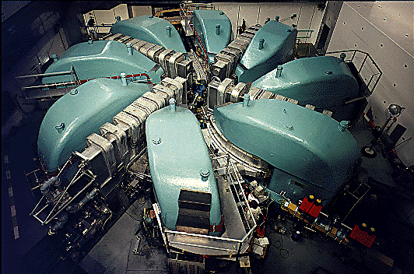






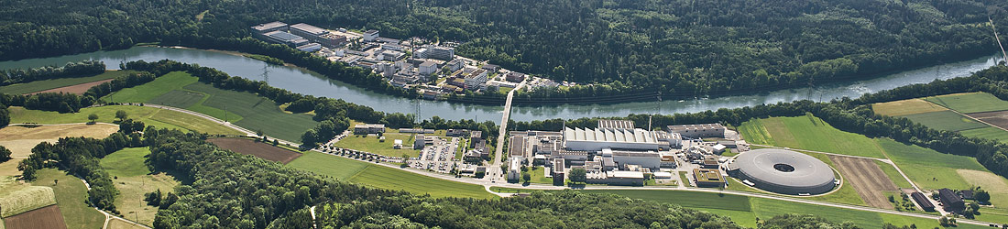


6/27
Introduction Experiment Analysis Results Upgrade Conclusions
The MEG experiment
The MEG Collaboration: 60 physicists, 12 institutes,
from
cyclotron
Detector location: The Paul Scherrer Institut near Zürich, Switzerland
590 MeV
The world’s most intense continuous low momentum positive muon beam

Slide 7
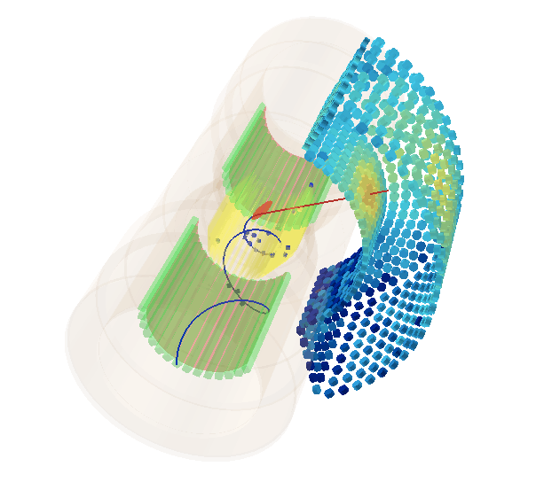
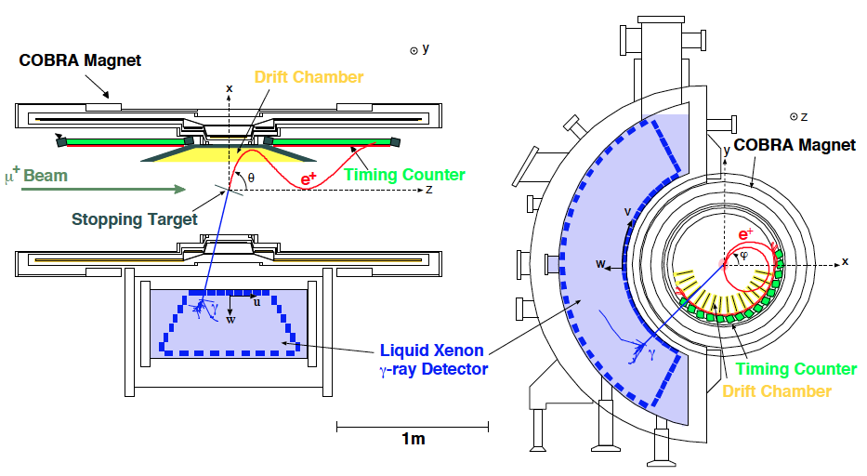
The MEG detector
7/27
Introduction Experiment Analysis Results Upgrade Conclusions
Eur. Phys. J. C 73
(2013) 2365
3D view:
Top view:
Front view:
μ⁺
γ
Stopping Target
e⁺
Dedicated detector with asymmetric coverage (Ω_{MEG}/4π = 11%):
Liquid Xenon photon calorimeter with excellent position, time and energy resolutions
Low-mass positron spectrometer with gradient B-field for fast positron sweep out
Stable, well monitored & calibrated detector (arsenal of calibration & monitoring tools)
High performance DAQ system (multi-GHz waveform digitization of nearly all 3k channels)

Slide 8
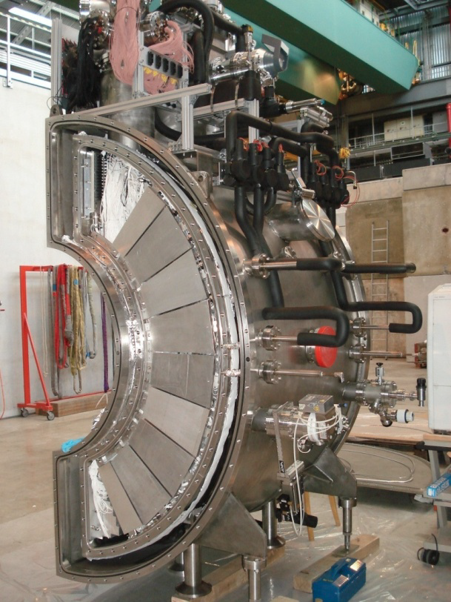
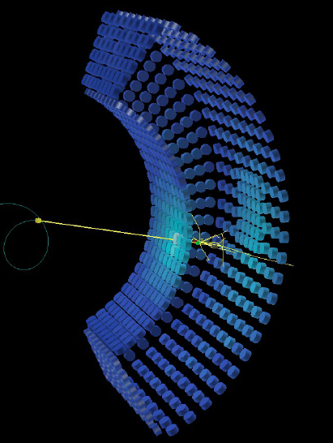
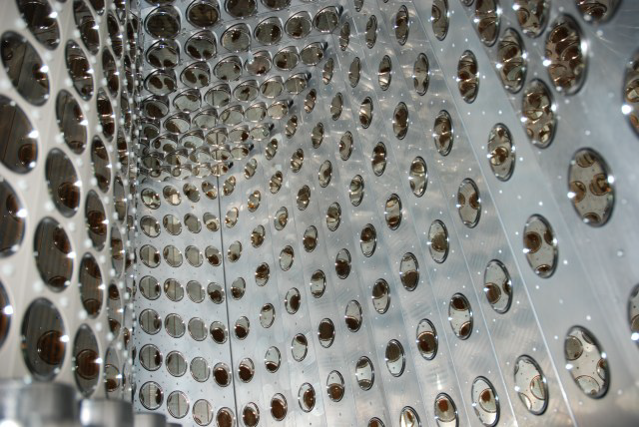
Photon calorimeter
8/27
Introduction Experiment Analysis Results Upgrade Conclusions
Eur. Phys. J. C 73
(2013) 2365
Liquid Xenon scintillation:
High light yield: 40k photons/MeV
Fast response: τ_{decay} = 45 ns
High stopping power: X₀ = 2.8 cm
No self-absorption: λ_{abs} > 1 m
Detector:
Fiducial volume: 800 liter (largest in the world)
Homogeneous volume
Solid angle coverage ≈ 11 %
Total stopping power ≈ 14 X₀
Read-out by 846 wall-mounted PMTs, digitized @ 1.6 GHz
Cathode area coverage ≈ 40 %

Slide 9
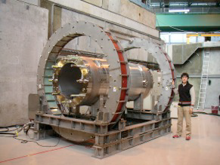
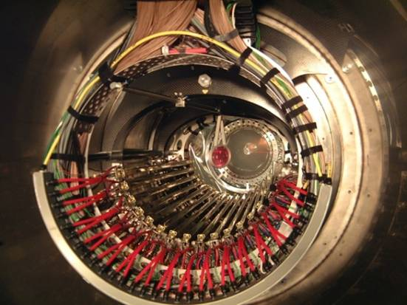
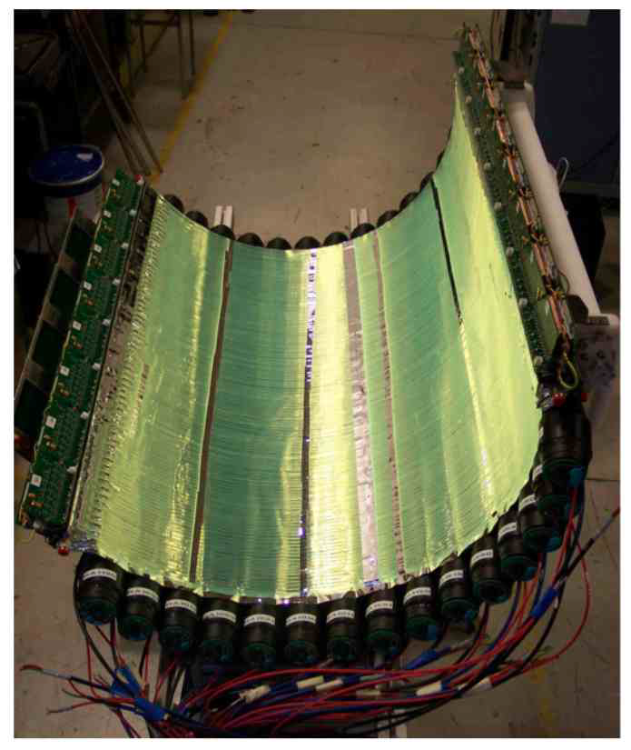
Positron spectrometer
9/27
Introduction Experiment Analysis Results Upgrade Conclusions
Eur. Phys. J. C 73
(2013) 2365
Superconducting COBRA magnet:
Solenoidal gradient B-field: 0.5 - 1.3 T (COnstant Bending RAdius, quick sweep out)
0.2 X₀ fiducial thickness
Helium environment
Drift chambers:
16 radially staggered double-layered modules
Each layer contains 9 axial drift cells equipped with very thin Vernier cathode pads
Open-frame module design (total radiation length along e⁺ trajectory ≈ 2x10⁻³ X₀)
Counting gas: He (50%) + C₂H₆ (50%)
Timing Counters (x2):
15 axial scintillation bars, PMT read-out
128 semi-circular scintillation fibers, APD read-out

Slide 10
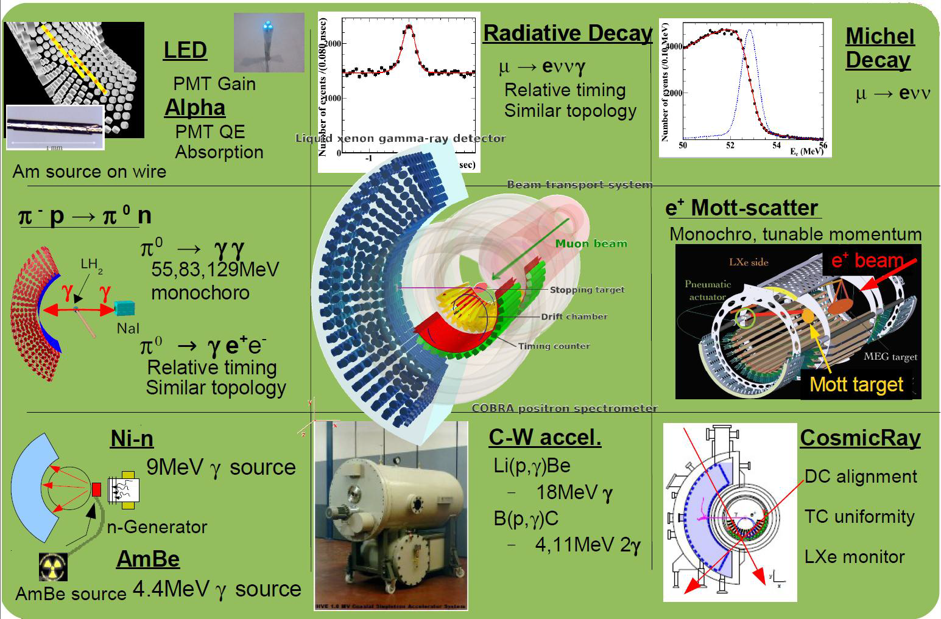
Calibration & Monitoring
10/27
Introduction Experiment Analysis Results Upgrade Conclusions
Eur. Phys. J. C 73
(2013) 2365

Slide 11
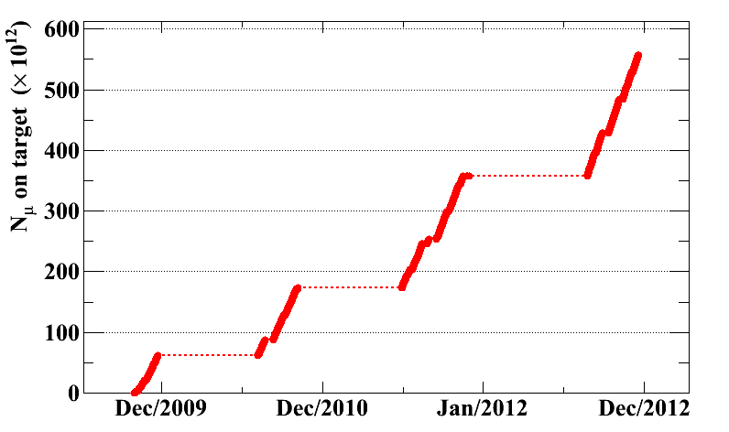
History
11/27
Introduction Experiment Analysis Results Upgrade Conclusions
Stable data-
taking runs
every year
since 2009:
Analysis of 2009 - 2010 data:
PRL 107 (2011) 171801
Analysis of 2009 - 2011 data:
Accepted by PRL [arXiv:1303.0754]
(this presentation)

Slide 12
Detector performance
12/27
Introduction Experiment Analysis Results Upgrade Conclusions
 | 2009 | 2010 | 2011
Photon energy | 1.00 MeV (w>2cm) 1.27 MeV (w<2cm) | 1.00 MeV (w>2cm) 1.27 MeV (w<2cm) | 0.90 MeV (w>2cm) 1.27 MeV (w<2cm)
Positron momentum (core fraction) | 0.31 MeV (80%) | 0.32 MeV (79%) | 0.31 MeV (85%)
Positron-photon angle | 15.0 mrad (θ) 8.9 mrad (ϕ) | 16.1 mrad (θ) 9.0 mrad (ϕ) | 16.2 mrad (θ) 8.9 mrad (ϕ)
Positron-photon timing | 156 ps | 123 ps | 127 ps
Trigger efficiency | 91% | 92% | 97%
Muon stopping rate | 2.9x10⁷ s⁻¹ | 2.9x10⁷ s⁻¹ | 2.9x10⁷ s⁻¹
Total detector live time | 43 days (real) 35 days (DAQ) | 67 days (real) 56 days (DAQ) | 113 days (real) 81 days (DAQ)
Total number of muons stopped on target | 0.7x10¹⁴ | 1.1x10¹⁴ | 1.9x10¹⁴

Slide 13
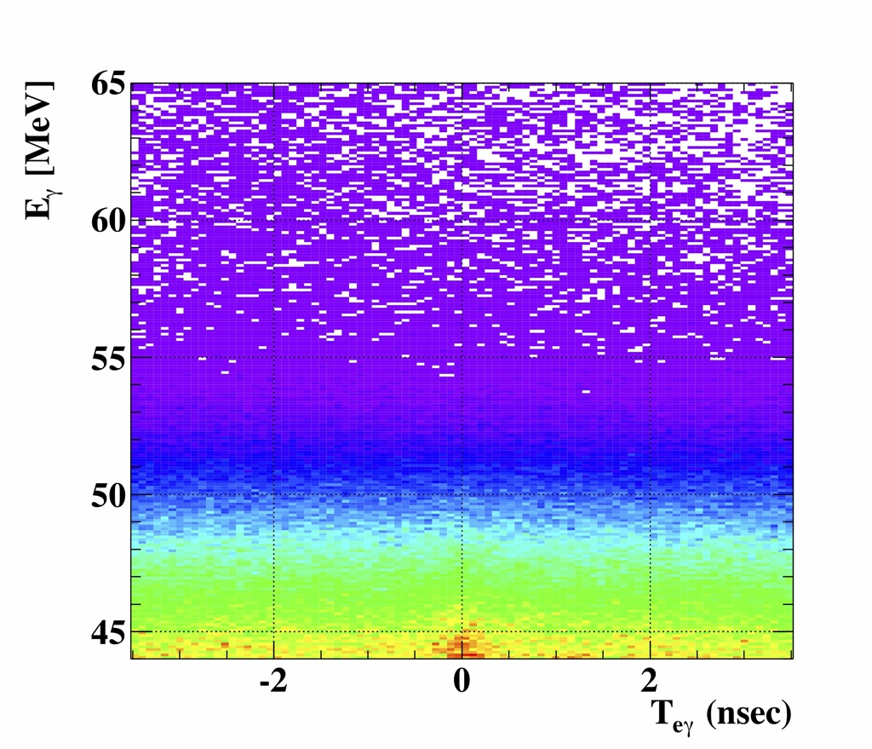

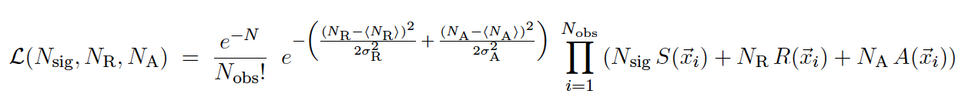
Data analysis
13/27
Introduction Experiment Analysis Results Upgrade Conclusions
Analysis technique:
Events characterized by 5 observables:
Blindness policy: Blind box defined by E_{γ} and T_{eγ} . Events inside this box are not used in the development of the analysis.
Search method: The number of signal (N_{sig}), radiative muon decay (N_{R}) and accidental background events (N_{A}) in the analysis window are determined using a maximum likelihood fit:
Left time
sideband
Blinding &
Analysis-box
Right time
sideband
Energy sideband
Gaussian constraints on the number
of background events, derived from
time sidebands
S, R, A: PDFs describing the three event categories
derived from sidebands & dedicated calibration data and considered event-by-event

Slide 14
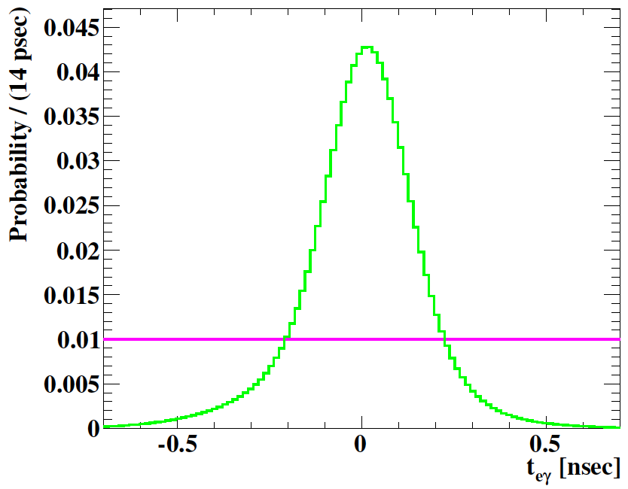
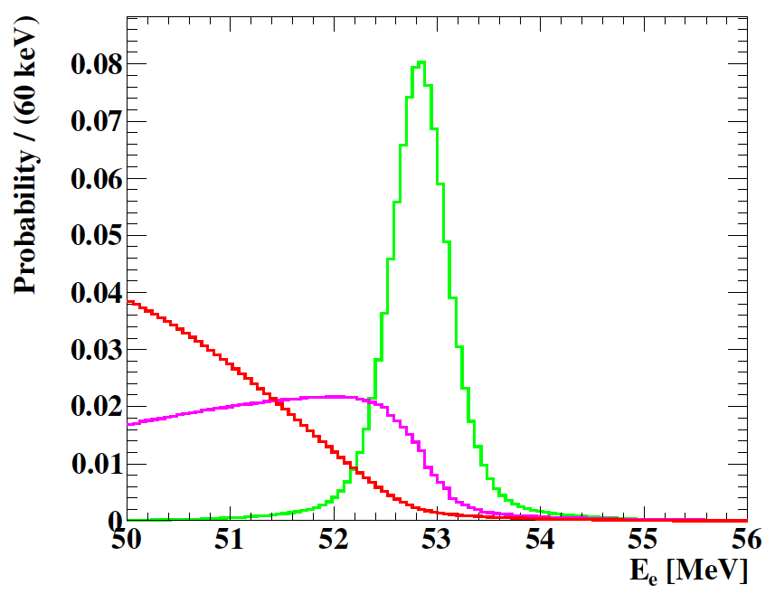
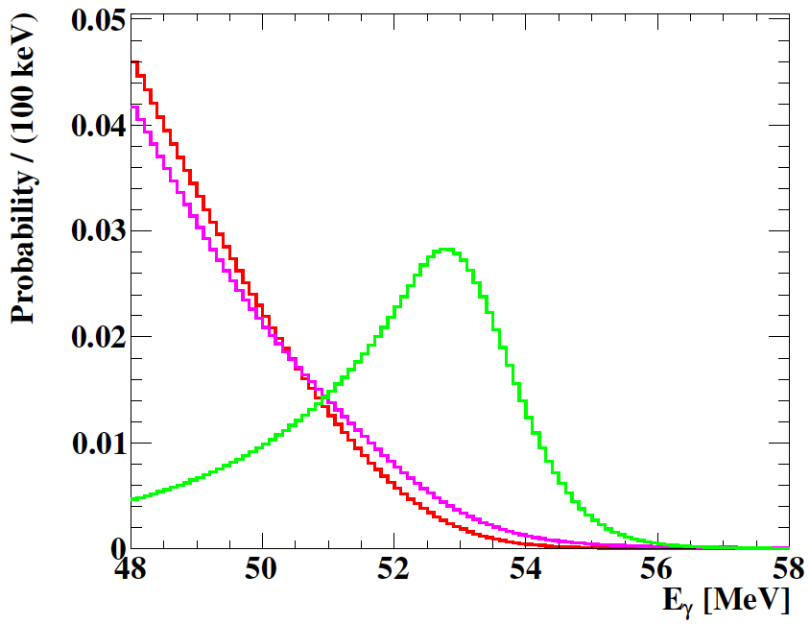



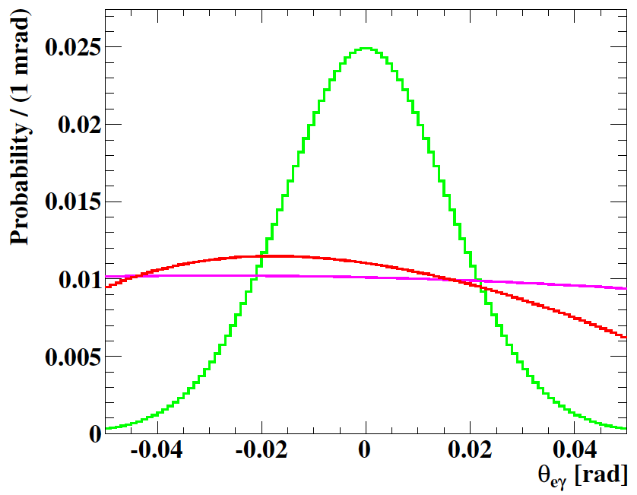
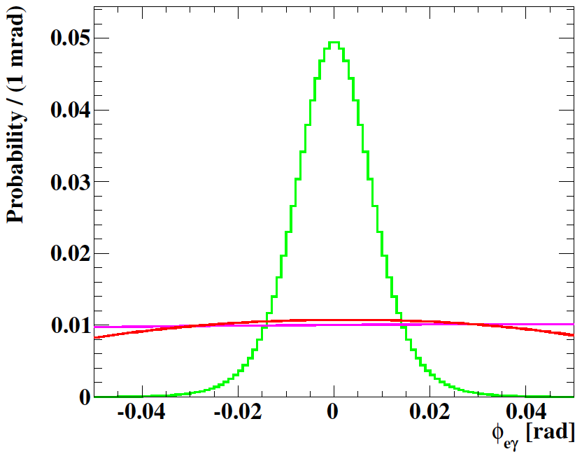


PDFs 2009-2011
14/27
Introduction Experiment Analysis Results Upgrade Conclusions
S: Energy sideband
R: Energy sideband
A: Flat
S: Michel data
R: SM + detector response
A: Time sideband
S: CEX data
R: SM + detector response
A: Time sideband
S: CEX + Michel 2-turn data
R: SM + detector response
A: Time sideband
S: CEX + Michel 2-turn data
R: SM + detector response
A: Time sideband
(averaged PDFs,
normalized to 1)

Slide 15
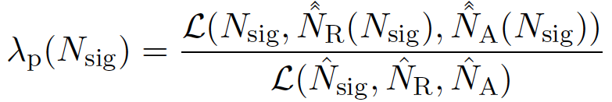
Data analysis
15/27
Introduction Experiment Analysis Results Upgrade Conclusions
Analysis technique:
Branching ratio normalization
The number of signal events in the analysis region is normalized to the number of Michel decays measured with an unbiassed trigger during data-taking after applying the same analysis selection criteria (insensitive to variations in beam rate or detector conditions). Cross-checked with the number of radiative muon decays measured in the E_{γ} sideband.
k₂₀₀₉ = (1.20 ± 0.06) x 10¹²
k₂₀₁₀ = (2.52 ± 0.09) x 10¹²
k₂₀₁₁ = (4.05 ± 0.16) x 10¹²
Confidence interval calculation
The calculation of the confidence interval of N_{sig} follows a frequentist approach using profile likelihood ratio ordering (Feldman-Cousins), where N_{R} and N_{A} are treated as nuisance parameters and are profiled using:
where the hat and double hat denote the best estimates maximizing the likelihood for floating and fixed N_{sig} respectively. Systematic uncertainties of PDF parameters are taken into account by fluctuating the PDFs according to their uncertainties.

Slide 16
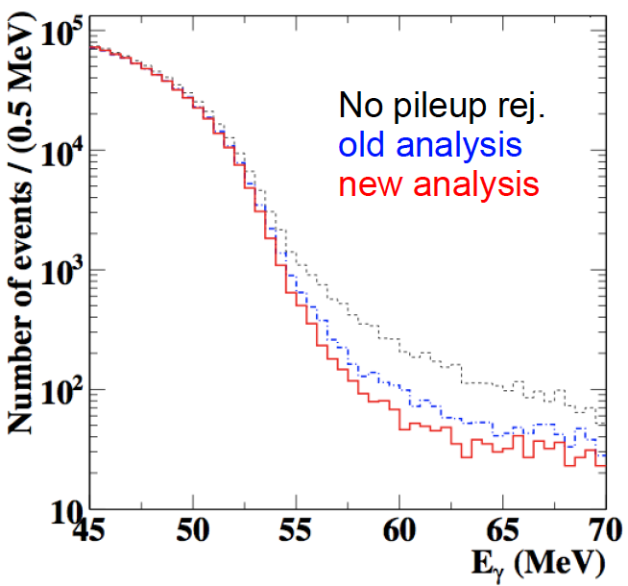
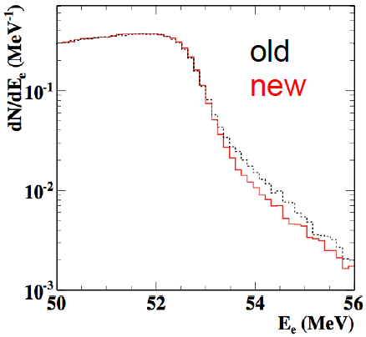
Data analysis
16/27
Introduction Experiment Analysis Results Upgrade Conclusions
arXiv:1303.0754
Analysis improvements:
New calorimeter waveform analysis
Improved multiple photon pile-up elimination, improves efficiency and energy resolution
New spectrometer waveform filtering
  Drift-chamber noise reduction, improves angular resolution
New spectrometer track fit algorithm
  Improved detector model, improves efficiency and enables the use of event-by-event errors in the likelihood function
  7% + 7% increase in efficiency
no pile up
old algorithm
new algorithm
old track fit
new track fit

Slide 17
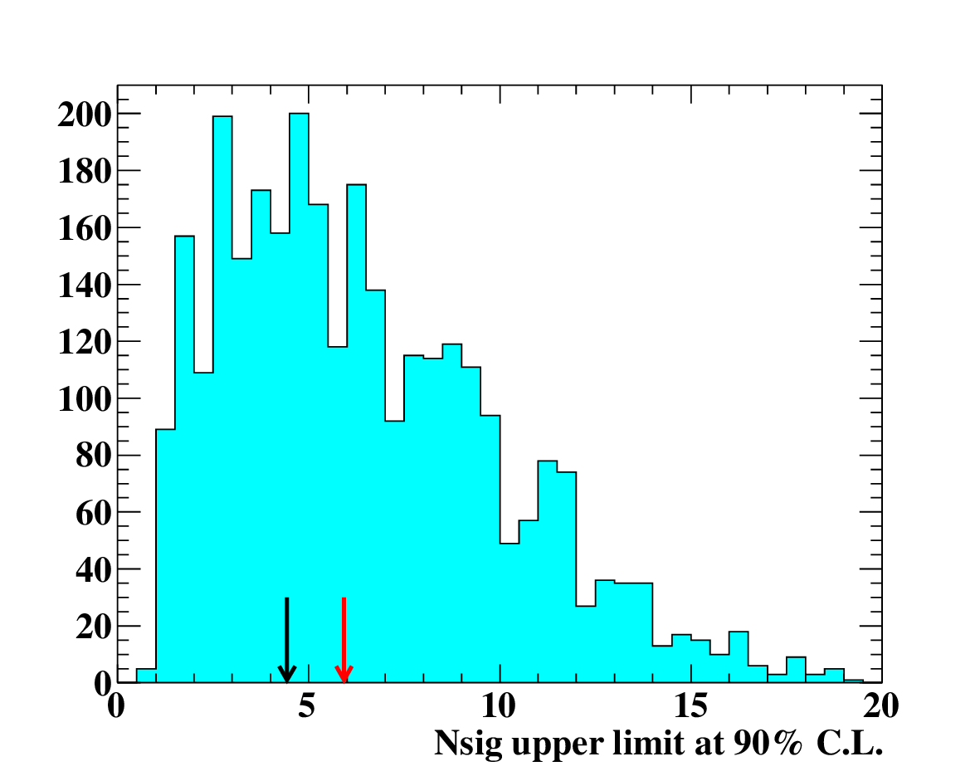
Sensitivity 2009-2011
17/27
Introduction Experiment Analysis Results Upgrade Conclusions
arXiv:1303.0754
Sensitivity is defined as the median upper limit at 90% C.L. of an ensemble of pseudo-experiments in which N_{sig} = 0 and N_{R} (N_{A}) is taken randomly from a Poissonian with a mean equal to the expected N_{R} (N_{A}) in the analysis region
Expected # of background events in the analysis region extrapolated from time sidebands:
N_{R} = 169 ± 17
N_{A} = 2415 ± 25
toy MC
normalize
median
2x improvement of our previous sensitivity

Slide 18
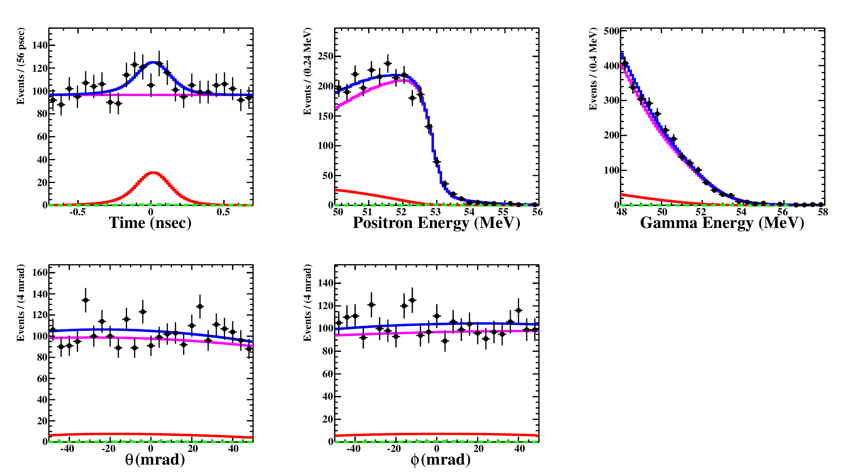
Fit result 2009-2011
18/27
Introduction Experiment Analysis Results Upgrade Conclusions
arXiv:1303.0754
Averaged PDFs normalized to the fitted # of events (Signal, RMD, Accidental BG, Total):
N_{obs} = 2574
N_{sig} = -0.4 ^{+4.8}_{-1.9}
N_{R} = 167 ± 24
N_{A} = 2413 ± 37
(MINOS 1.645 σ errors)

Slide 19
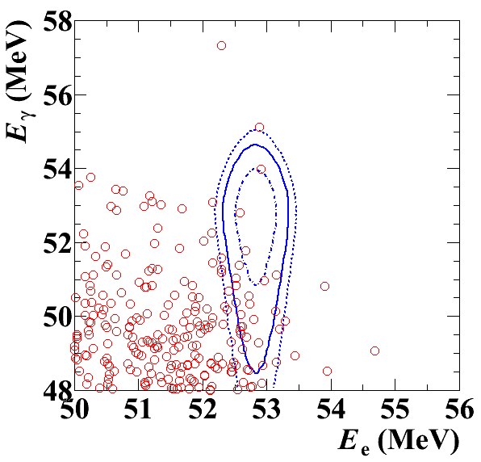
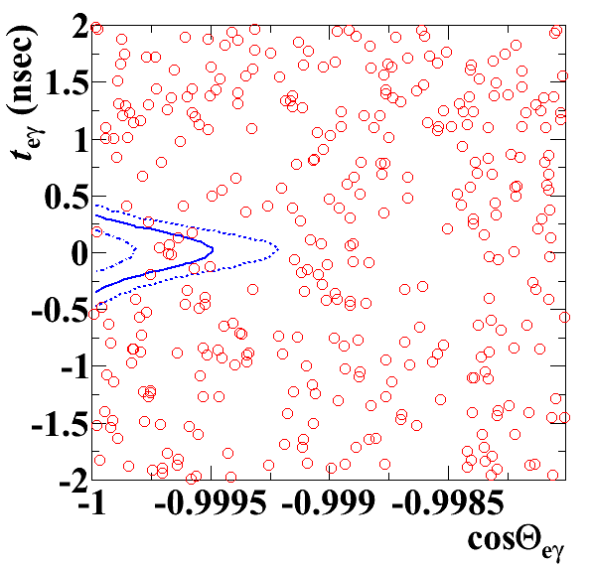
Event distributions 2009-2011
19/27
Introduction Experiment Analysis Results Upgrade Conclusions
arXiv:1303.0754
signal PDF contours at 1, 1.64 and 2 sigma
cos(Θ_{eγ}) < -0.9996
|T_{eγ}| < 0.244 ns
51 < E_{γ} < 55.5 MeV
52.4 < E_{e} < 55 MeV
(Θ_{eγ} = opening angle between photon and positron)

Slide 20
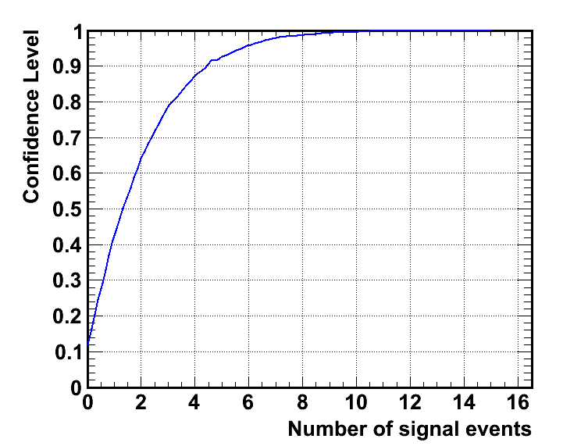
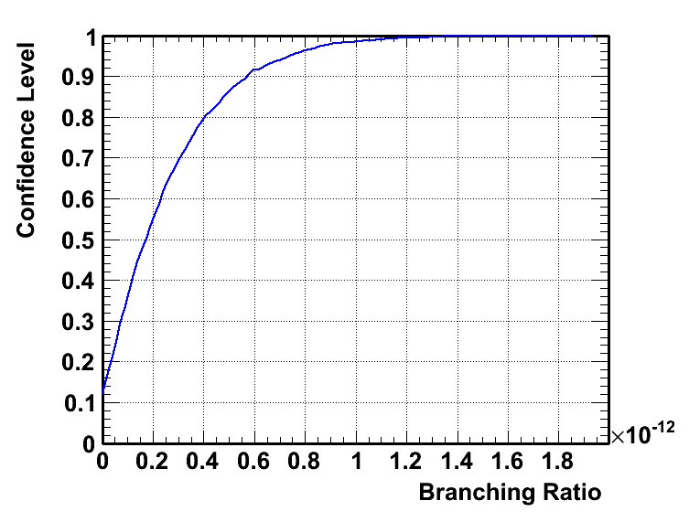
Confidence interval 2009-2011
20/27
Introduction Experiment Analysis Results Upgrade Conclusions
arXiv:1303.0754
Calculated confidence level curve:
normalize
4x improvement of our previous upper limit

Slide 21
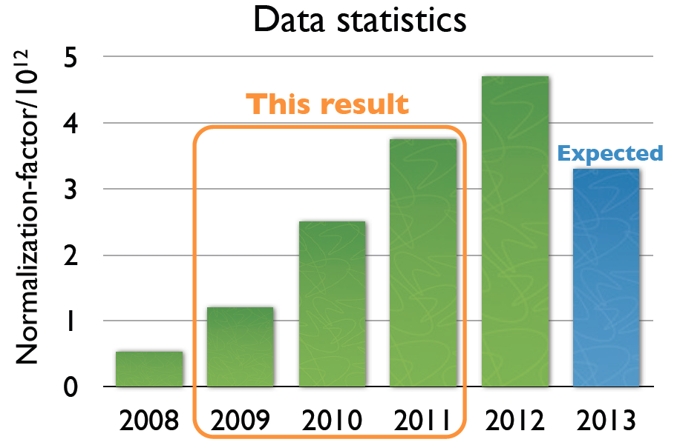
Summary & Outlook
21/27
Introduction Experiment Analysis Results Upgrade Conclusions
Summary:
Combined 2009-2011 analysis result consistent with null signal, resulting in a factor 4 improvement of the world’s most stringent upper limit on μ → eγ :
Outlook:
Physics data taking will resume next month and continue until September
Data statistics is expected to double with 2012 + 2013 runs
MEG is aiming for a sensitivity of O(10⁻¹³) after 2013
But that is not all…

Slide 22
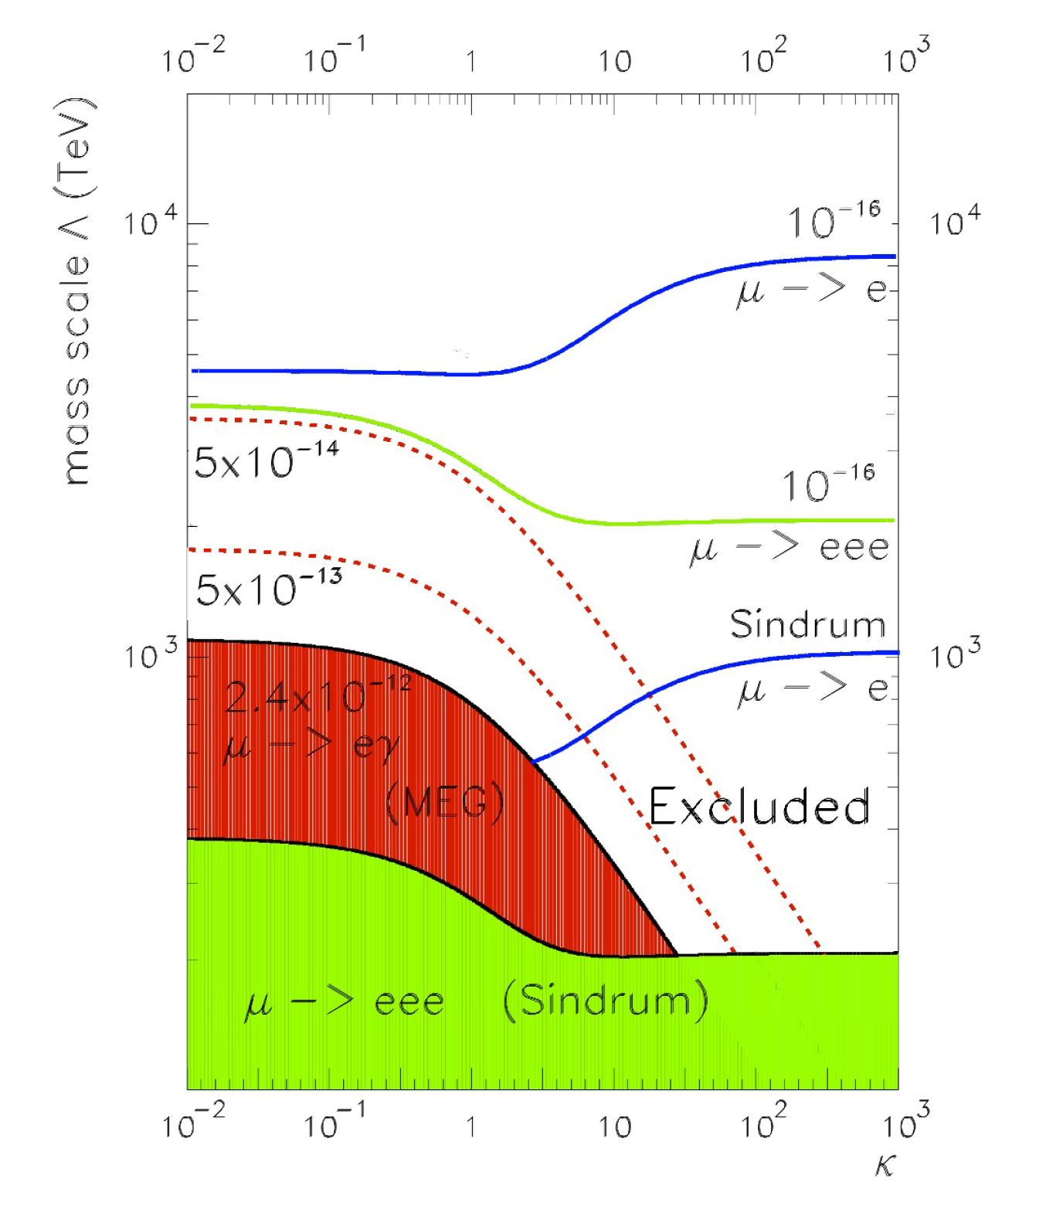
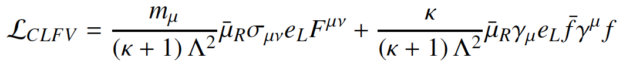
MEG upgrade
22/27
Introduction Experiment Analysis Results Upgrade Conclusions
arXiv:1301.7225
Motivation:
The comparison between μ → eγ versus μ → 3e and μ → e conversion is usually done in a model-independent way by using an effective BSM Lagrangian:
which contains two possible terms contributing to cLFV.
While μ → eγ proceeds only via the first “loop” term (i.e. κ = 0), μ → e conversion and μ → 3e decay may proceed also through the second “contact” term (i.e. κ = ∞).
In SUSY - GUT models, cLFV is generated via the loop term.
A. de Gouvea and N. Saoulidou. Fermilab’s Intensity Frontier.
Annu. Rev. Nucl. Part. Sci., 60:513–38.

Slide 23
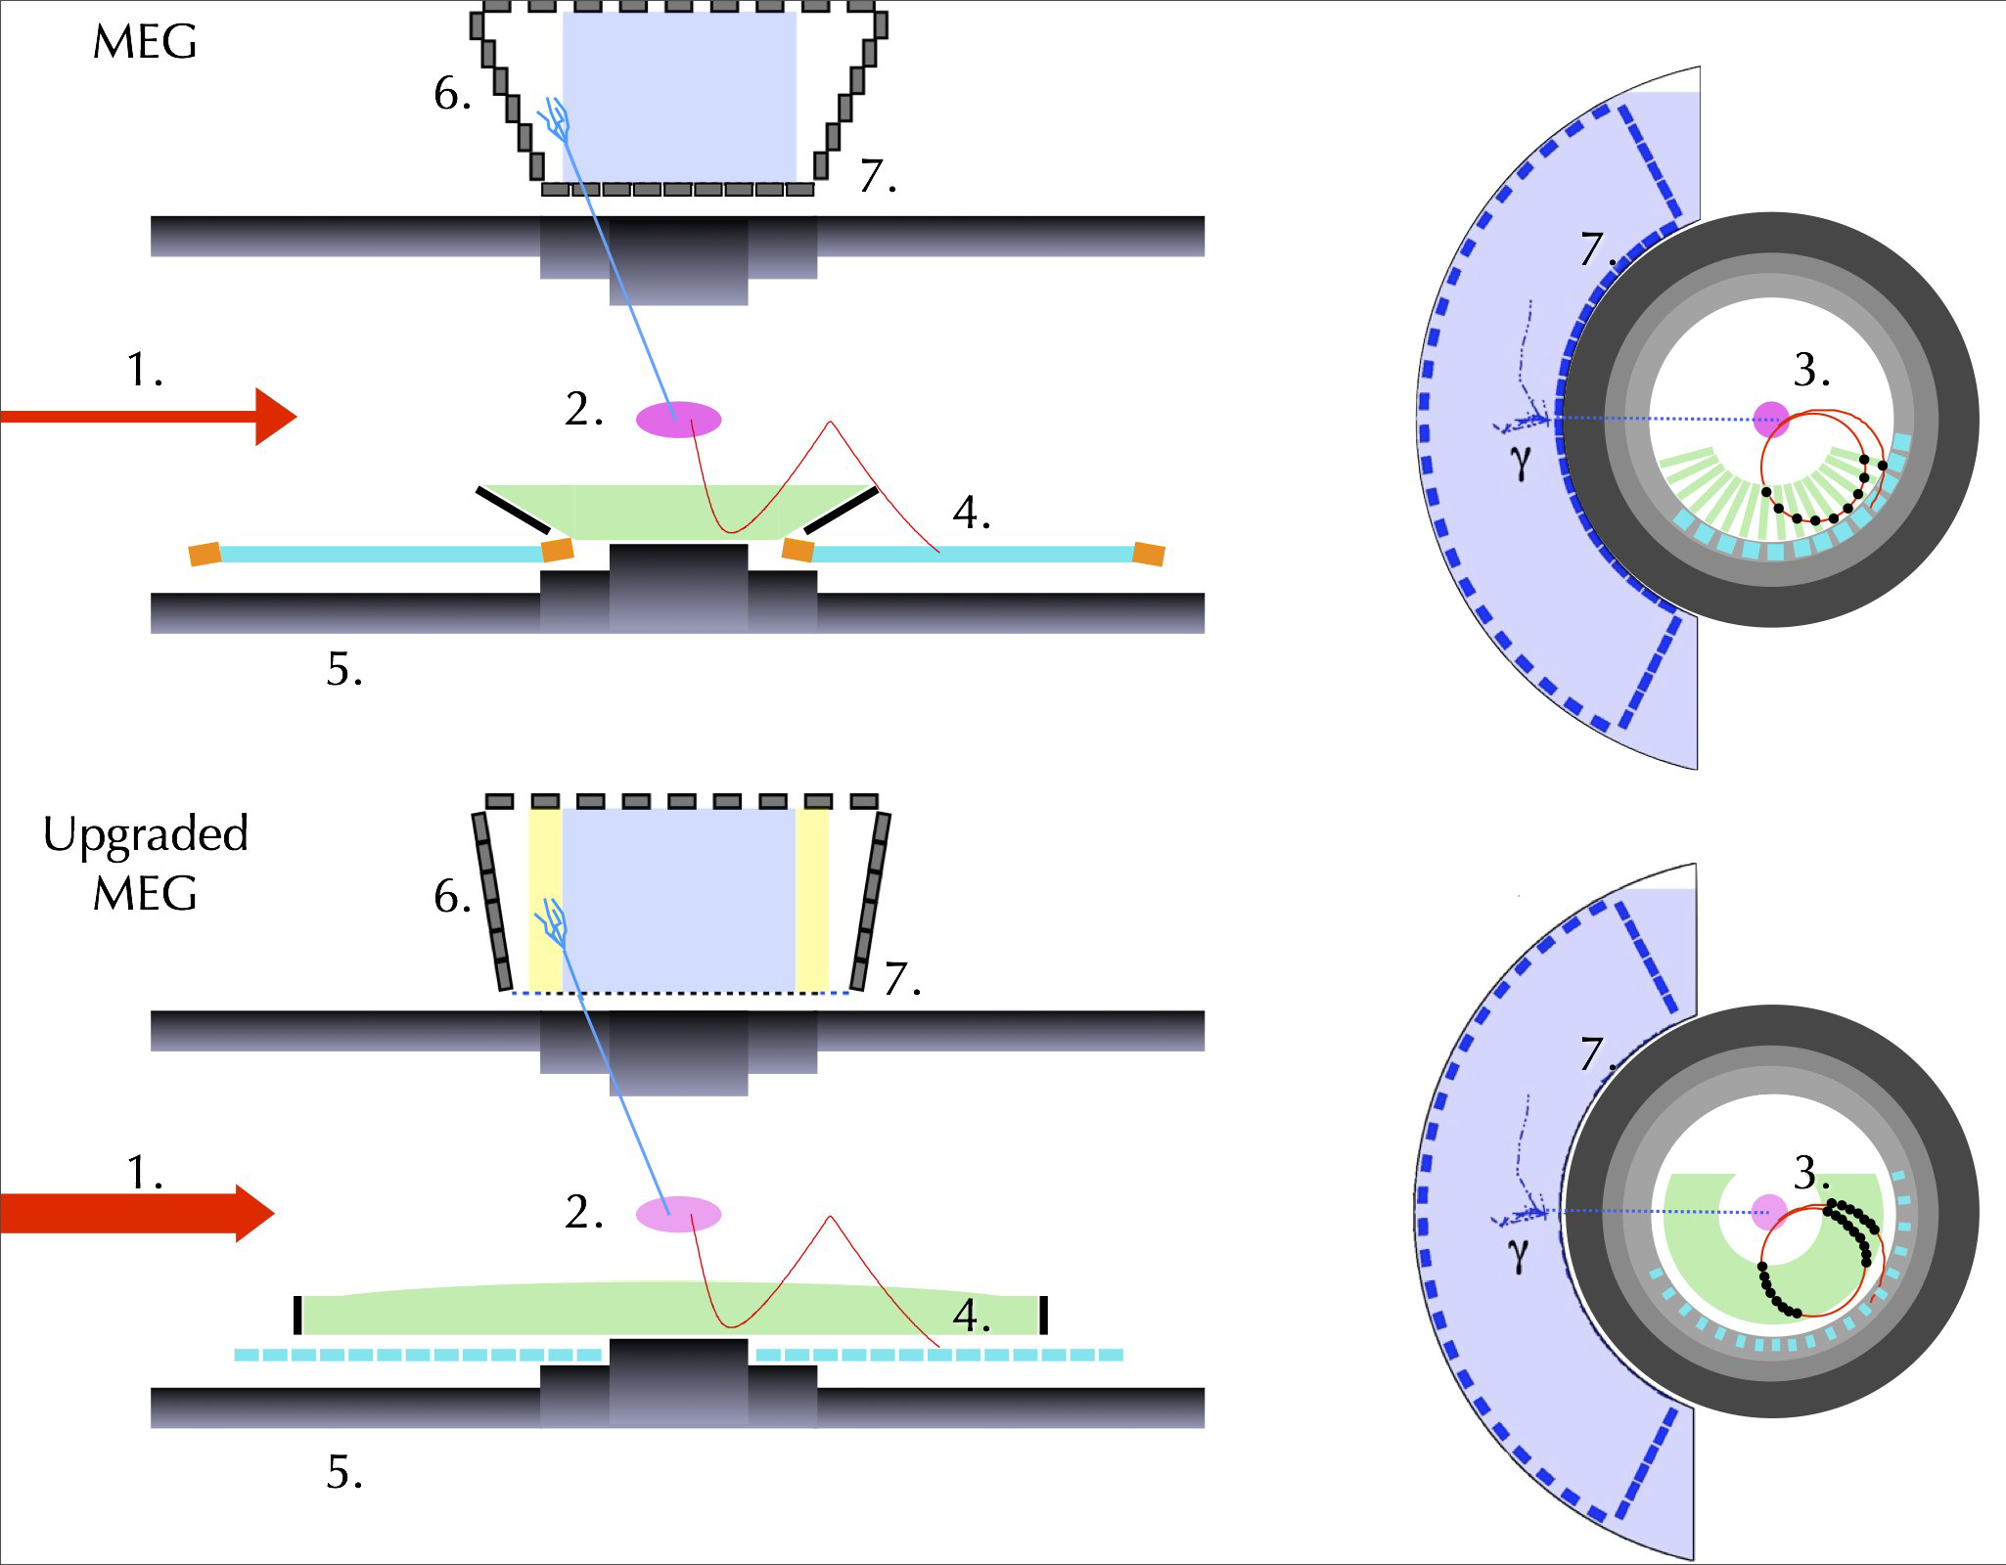
MEG upgrade
23/27
Introduction Experiment Analysis Results Upgrade Conclusions
arXiv:1301.7225
Upgrade:
Goal: 10x improvement of sensitivity
  higher beam rate
  better resolutions
  larger acceptance
  moderate costs
Upgrade designs based on previous experience
Approved by PSI in January 2013
Detector upgrades:
Increased beam intensity (7x10⁷ μ/s)
Thinner (140 μm) or active target
Larger single-volume stereo-wire drift chamber
Pixelated timing counter with SiPM readout
New high-bandwidth DAQ boards
Larger LXe volume with SiPM readout
Timeline:

Slide 24
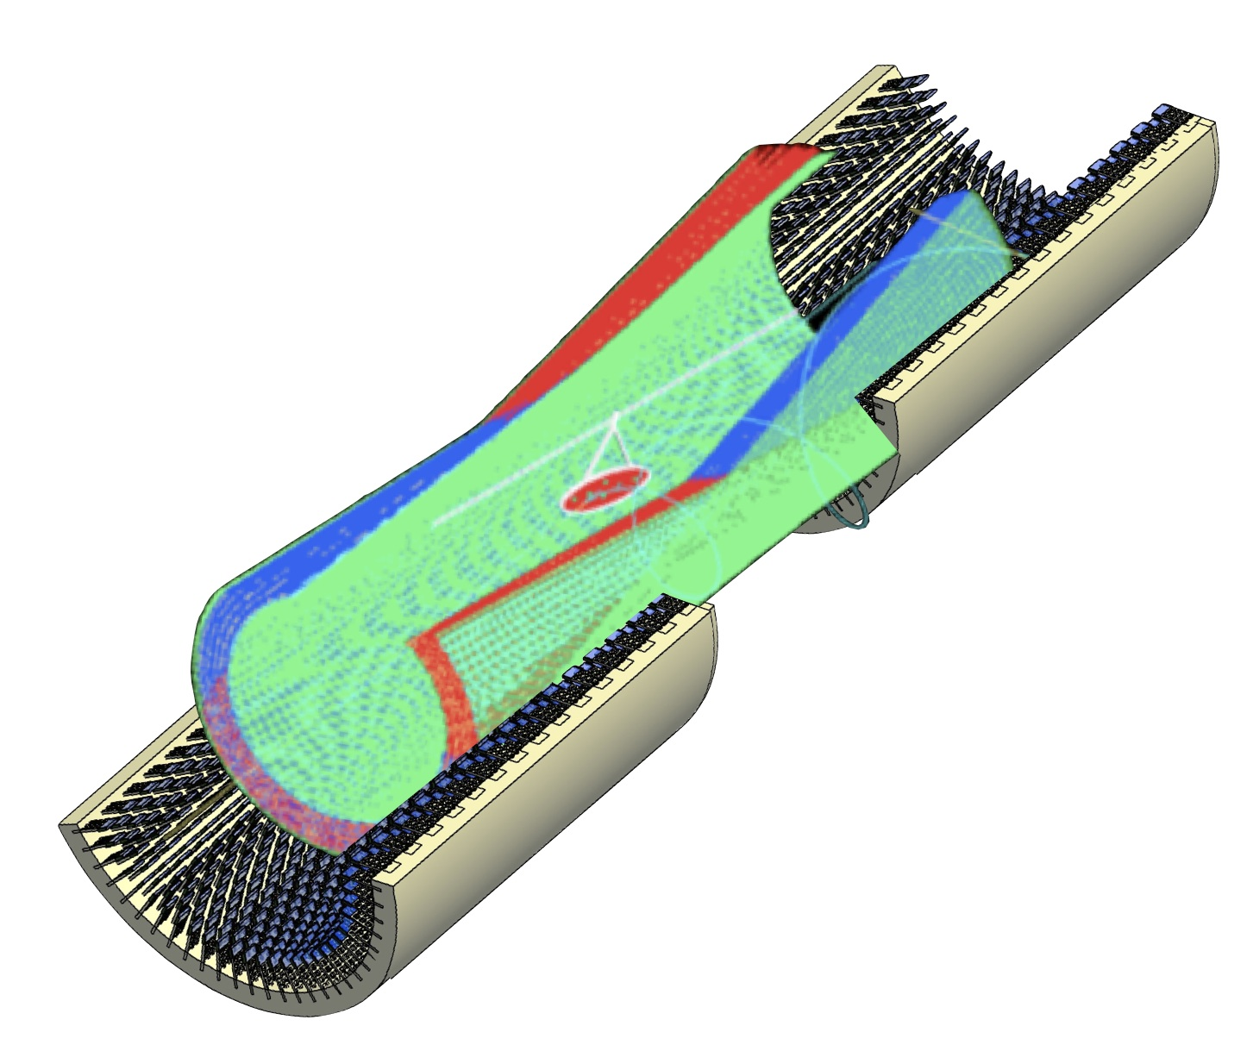
Drift chamber
24/27
Introduction Experiment Analysis Results Upgrade Conclusions
arXiv:1301.7225
Goals:
sustain higher muon rate & ageing
better resolutions
larger combined DC-TC acceptance
Design:
inspired by the KLOE experiment
single volume gaseous detector using low mass gas (He:iC₄H₁₀ = 90:10)
10 radial layers of longitudinal wires
with stereo angle (7°- 8°) for hit reconstruction in the beam direction
thin wires and small cell size (7x7 mm²)
z = 0 cm
~1380 anode wires (25 μm)
~7500 field wires (40 μm)
z = ±90 cm
180 cm
Expected resolutions:
momentum: ~130 keV
angle: ~4 mrad (θ), ~5 mrad (φ)
vertex: ~1.6 mm (Z), ~0.7 mm (Y)
DC-TC efficiency: ~90 %
most challenging element
of the upgrade

Slide 25
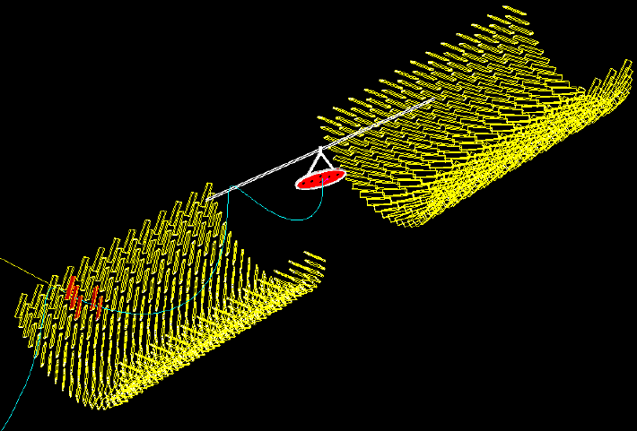
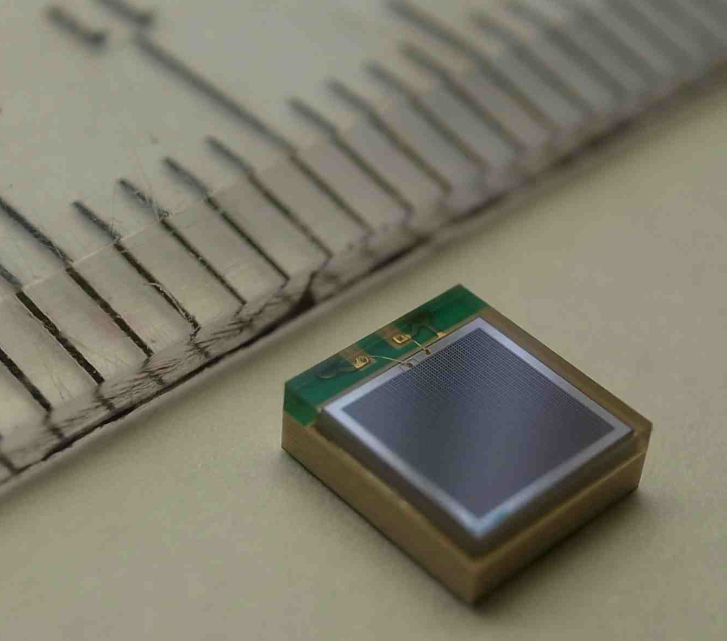
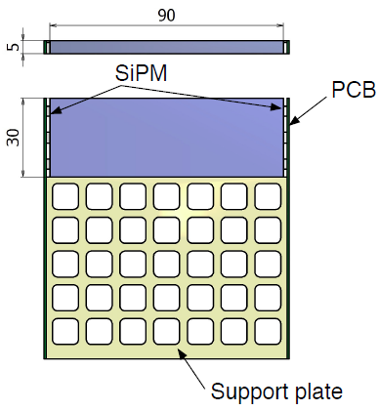
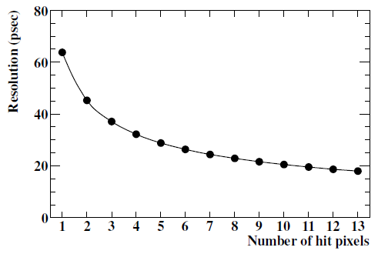
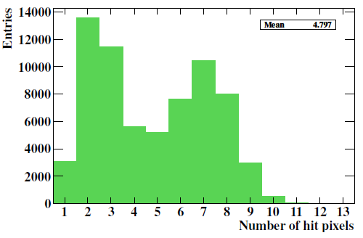
Timing Counter
25/27
Introduction Experiment Analysis Results Upgrade Conclusions
arXiv:1301.7225
Goals:
sustain higher muon rate
better resolution
Design:
pixelated scintillation counter
several hundred tiles, each tile read out by 6 SiPMs
proven technology by the PSI μSR group
Advantages:
improved resolution by using multiple hits and reduced contributions from electronics and calbrations
operational in high rate environment
operational in a B-field and Helium gas
SiPM = Silicon-based photosensor coupled to a Geiger-mode avalanche photodiode array
current TC resolution

Slide 26
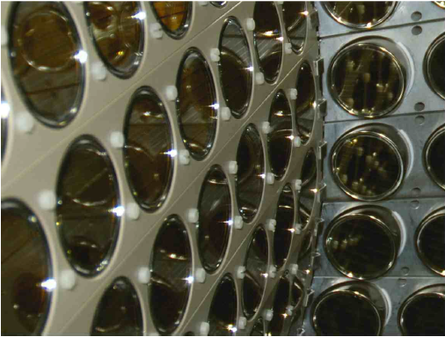
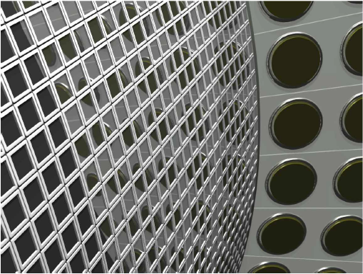
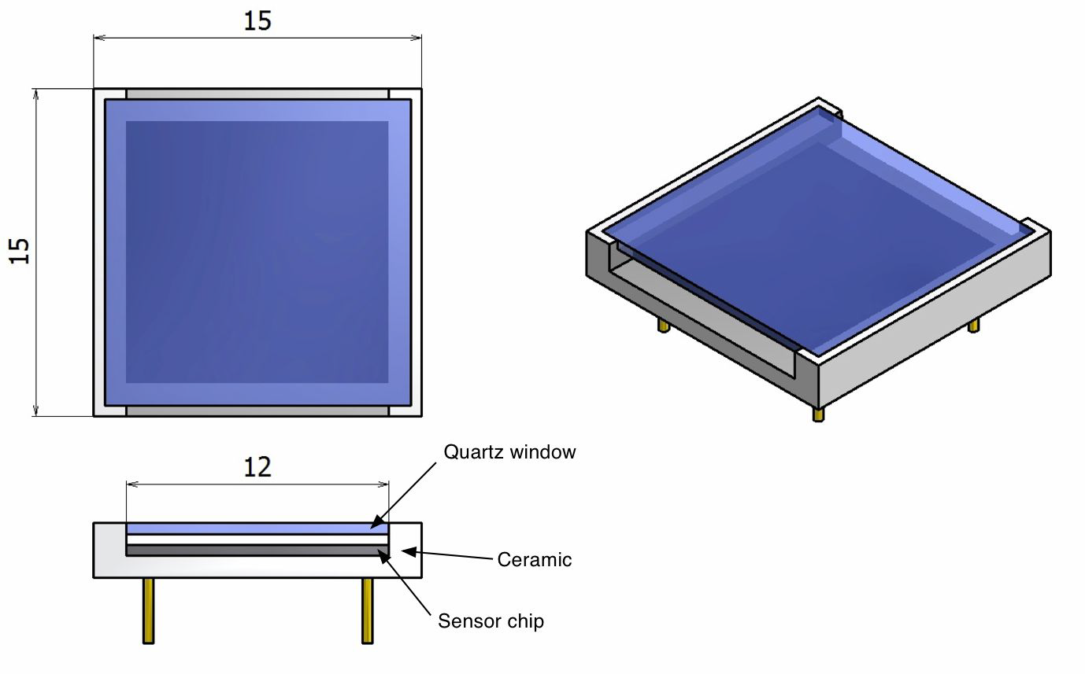
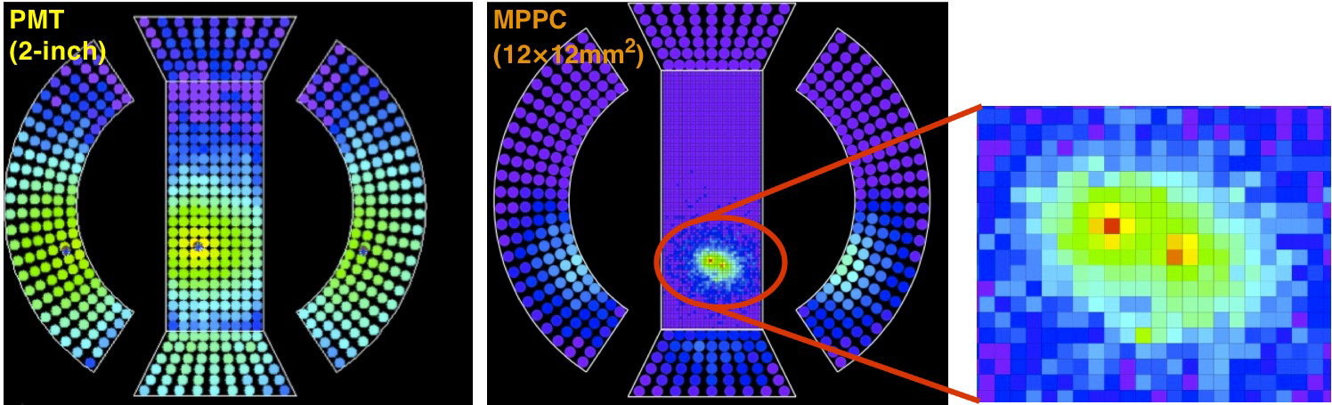
Calorimeter
26/27
Introduction Experiment Analysis Results Upgrade Conclusions
arXiv:1301.7225
Goals:
Improve non-uniform photosensor coverage on inner face
Improve response at acceptance edge
Design:
replace PMTs on inner face by SiPMs
extend inner face along z-direction
modify PMT layout at lateral faces
Advantages:
improved energy & position resolutions for shallow and acceptance edge events
improved detection efficiency
improved pile-up handling
Current: 216 PMTs (2”) on inner face
New: ~4000 SiPMs (12x12 mm²) on inner face
SiPM

Slide 27
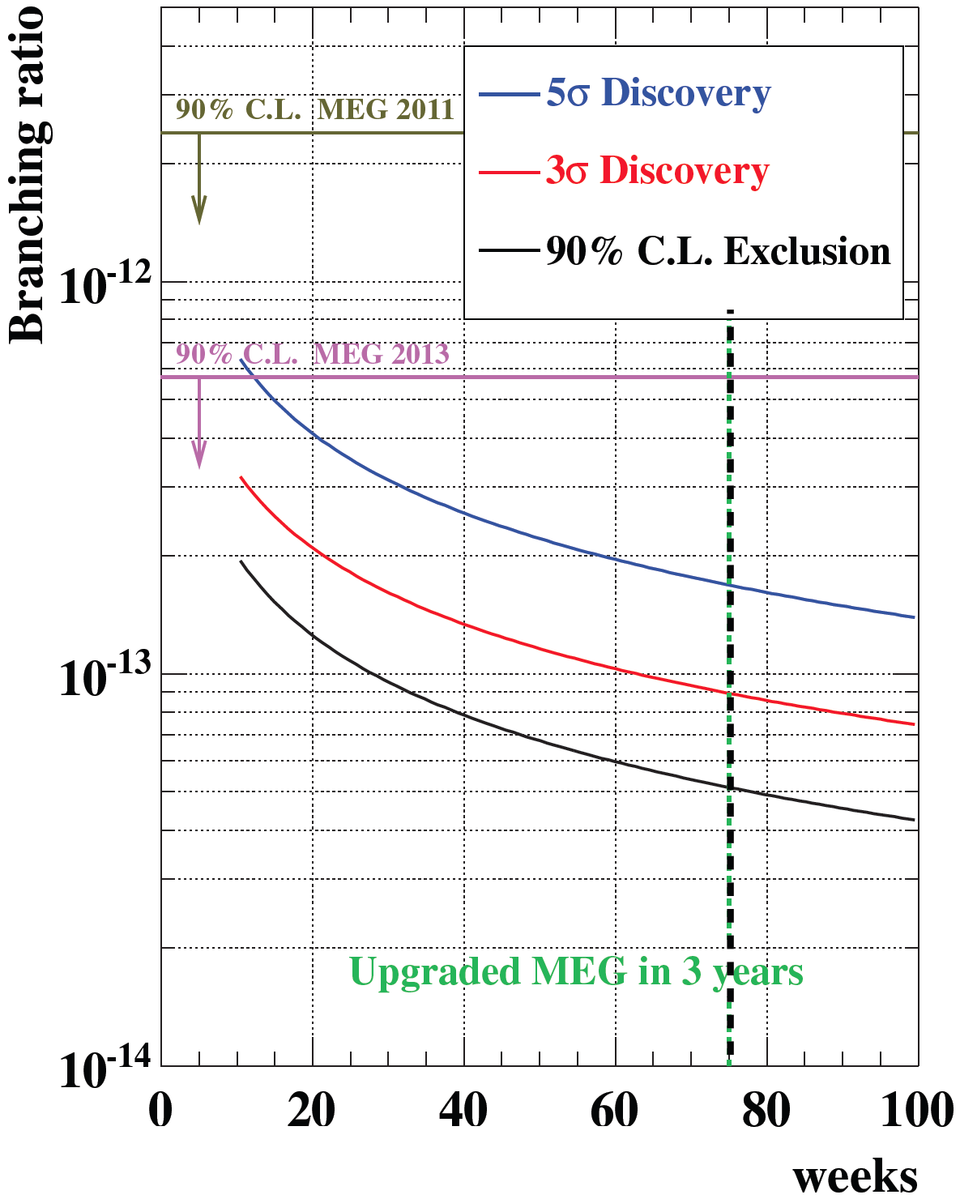
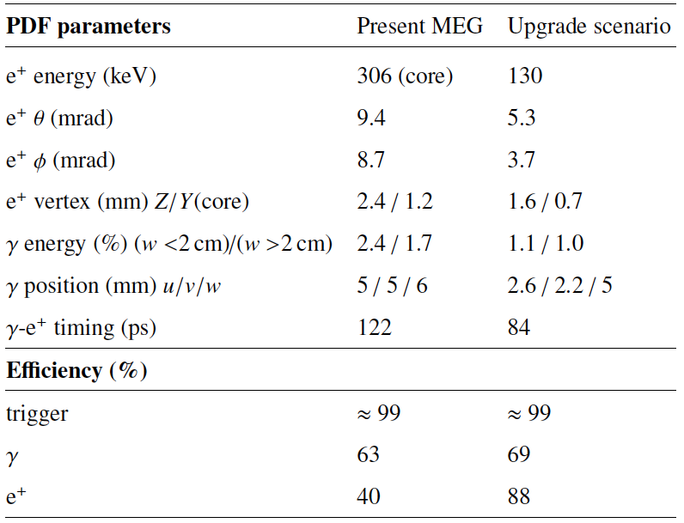
Conclusions
27/27
Introduction Experiment Analysis Results Upgrade Conclusions
arXiv:1301.7225
New MEG result:
Upgrade resolutions & efficiency:
Upgraded MEG in 3 years
beam rate 2.9x10⁷ μ/s 7x10⁷ μ/s

Slide 28
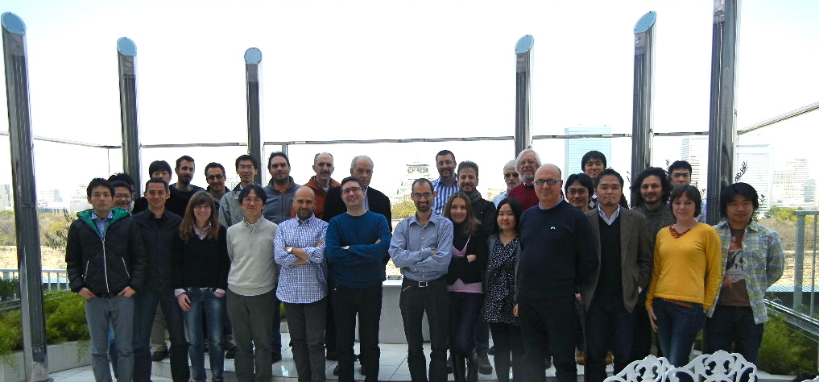
Thank you for your attention!
On behalf of the MEG Collaboration

Slide 29
Back up
29/27
Introduction Experiment Analysis Results Upgrade Conclusions

Slide 30










in new physics
30/27
Introduction Experiment Analysis Results Upgrade Conclusions
Extra
Dimensions
Little
Higgs
M.Blanke et al., Acta Phys.
Polon. B41 (2010) 657
K.Agashe et al., PRD 74 (2006) 053011
S. Antusch et al., JHEP 11 (2006) 090
SUSY –
GUT
SUSY –
Seesaw
G.Isidori et al., PRD 75 (2007) 115019
b-physics constraints
favored by recent reactor & accelerator neutrino experiments

Slide 31
in new physics
31/27
Introduction Experiment Analysis Results Upgrade Conclusions
Extra
Dimensions
Little
Higgs
MEG
SINDRUM II
SINDRUM II
MEG
M.Blanke et al., Acta Phys.
Polon. B41 (2010) 657
K.Agashe et al., PRD 74 (2006) 053011
S. Antusch et al., JHEP 11 (2006) 090
SUSY –
GUT
MEG
SUSY –
Seesaw
MEG
E821 (g-2)_{μ}
E821 (g-2)_{μ}
Babar, Belle
G.Isidori et al., PRD 75 (2007) 115019
b-physics constraints
favored by recent reactor & accelerator neutrino experiments

