Slide 1

Proton Decay in Orbifold GUTs
Stuart Raby
Intensity Frontier
April 26, 2013

Slide 2
Outline
Evolution of SUSY GUTs
4 dimensional SUSY GUTs
5 dimensional orbifold GUTs
String orbifolds orbifold GUTs
Conclusions

Slide 3
Supersymmetric Grand Unified Theories
M_{Z} << M_{G} “natural”
Explains charge quantization & Families
Unification of gauge couplings
Yukawa coupling unification
+ family symmetry fermion mass hierarchy
Neutrino masses via See-Saw
LSP - dark matter candidate
Baryogenesis via leptogenesis
SUSY desert LHC probes physics at M_{Pl}
SUSY GUTs “natural extension of SM”

Slide 4
Outline
4 dimensional SUSY GUTs
5 dimensional orbifold GUTs
String orbifolds orbifold GUTs
Conclusions

Slide 5
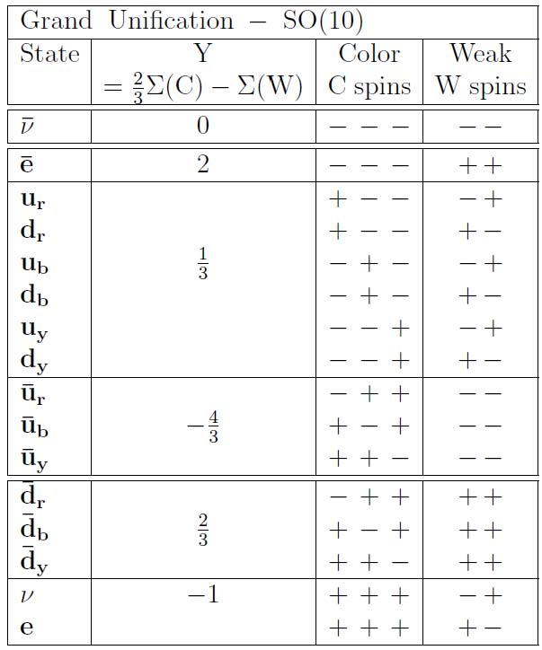
Grand Unification - SO( 10 ) GUT
Georgi
Fritzsch & Minkowski
spinor repsn.
of SO( 10 )
tensor product
of 5 spin ½
w/even no. + signs
Georgi & Glashow

Slide 6
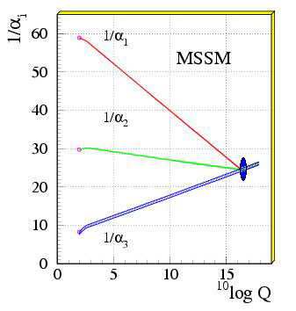
Gauge coupling unification
Dimopoulos, Raby
& Wilczek
PRD24, 1681 (1981)
LEP data !!
Amaldi, de Boer
& Furstenau,
PLB260, 447 (1991)

Slide 7
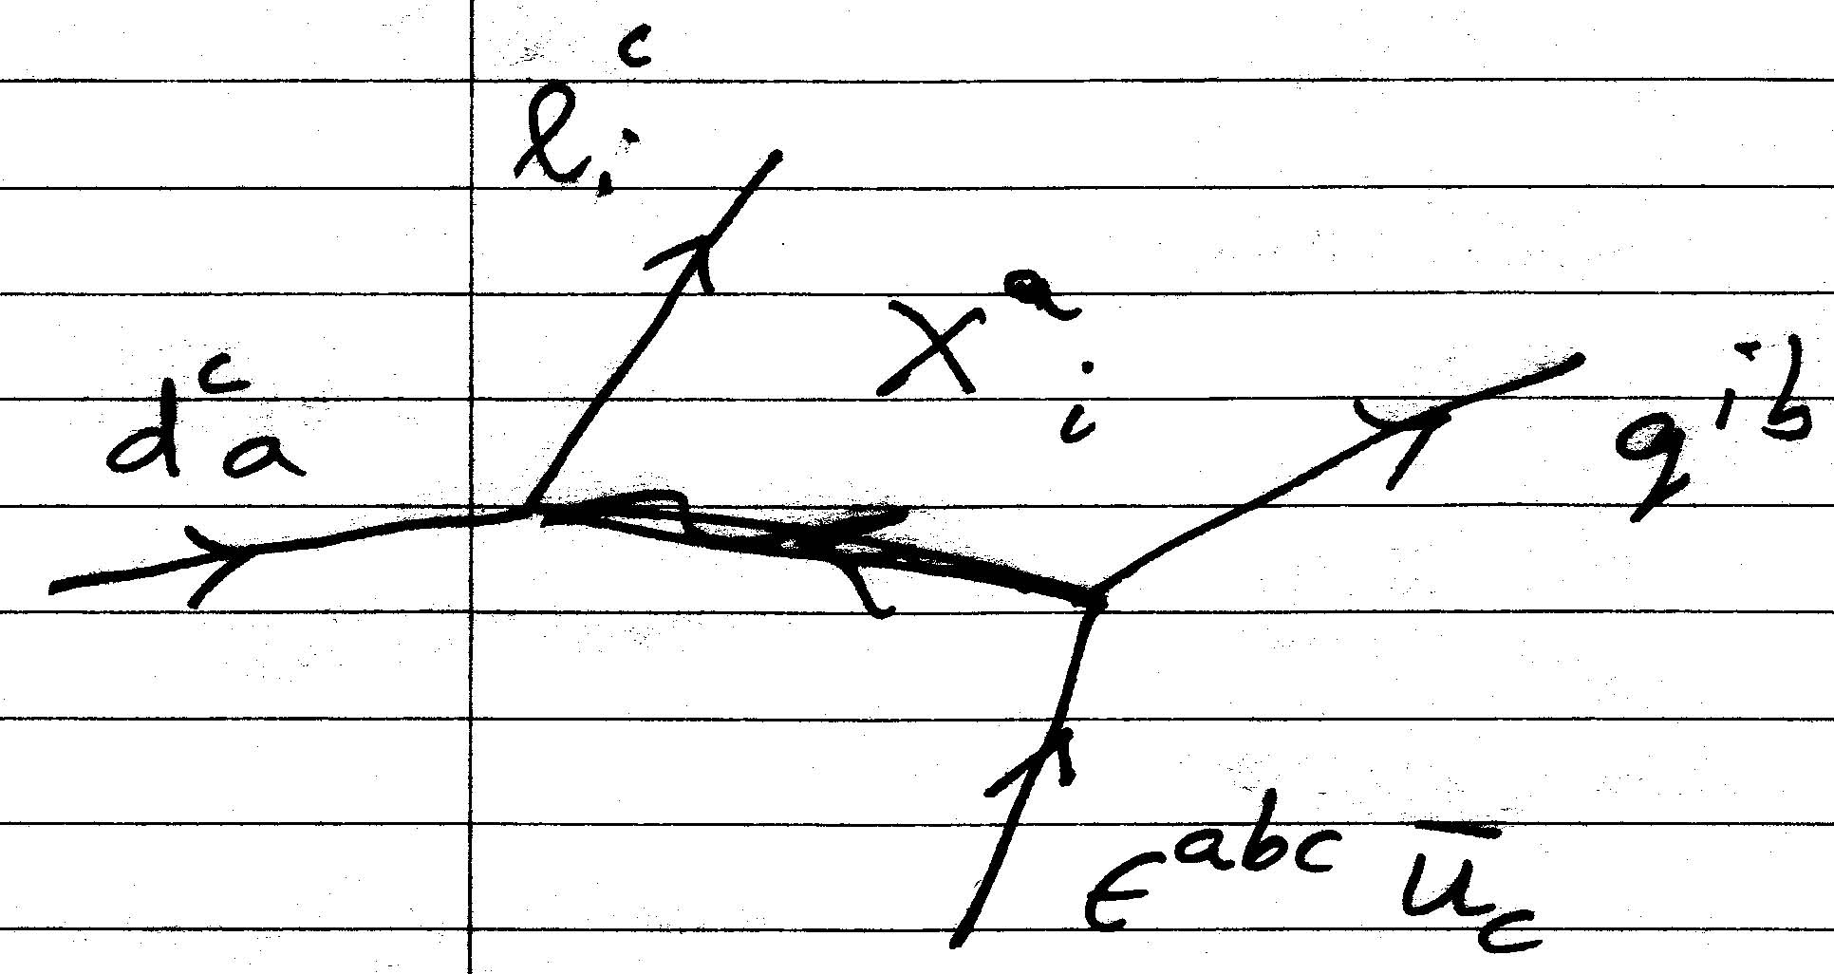
Proton decay - dim 6 operators

Slide 8
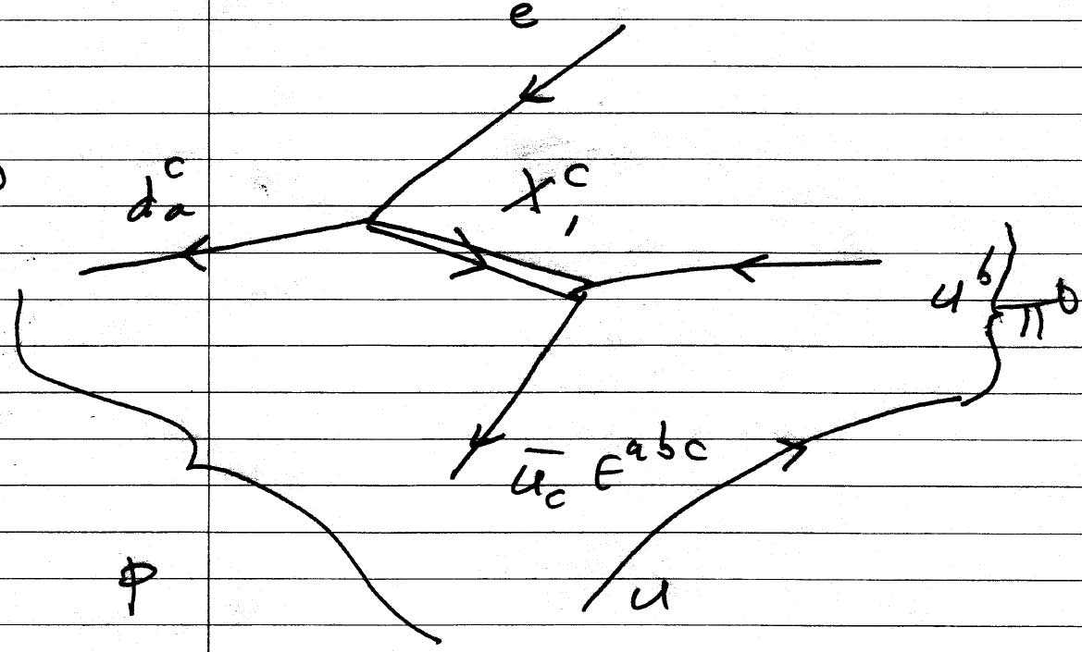

Slide 10
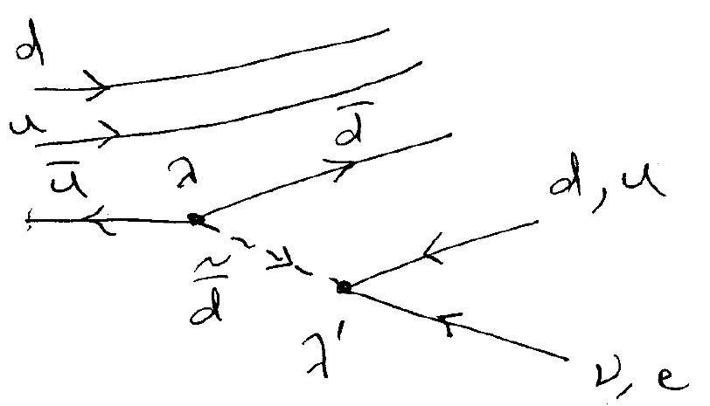
Proton decay - dim 4 operators
P

Slide 12
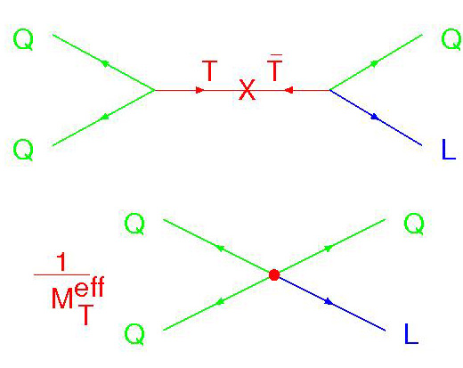
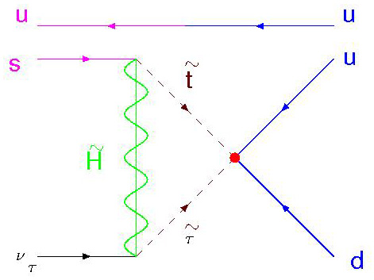
Proton decay - dim 5 operators

Slide 14
Dim 5 B & L violating operators

Slide 15
Most complete 4D SUSY GUTs
“From minimal to realistic supersymmetric
SU(5) grand unification”
Altarelli, Feruglio & Masina
JHEP 0011(2000)040
“Constraining Proton Lifetime in SO(10)
with Stabilized Doublet-Triplet Splitting”
Babu, Pati & Tavartkiladze
JHEP 1006 (2010) 084

Slide 16
Problems of SUSY GUTs
GUT symmetry breaking
Higgs doublet-triplet splitting
Missing partner mechanism SU(5)
Missing VEV mechanism SO(10)

Slide 17
Outline
4 dimensional SUSY GUTs
5 dimensional orbifold GUTs
String orbifolds orbifold GUTs
Conclusions

Slide 18
Orbifold GUTs in 5 or 6 dimensions
GUT symmetry breaking
Doublet-Triplet splitting
Kawamura; Hall & Nomura; Contino, Pilo, Rattazzi & Trincherini; Altarelli, Feruglio & Masina; Dermisek & Mafi; H.D. Kim & Raby; Asaka, Buchmuller & Covi; Lee; Hebecker & March-Russell; H.D.Kim, Raby & Schradin

Slide 19

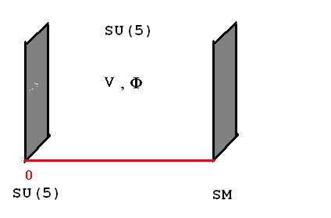
Hall & Nomura SU(5) GUT on M x S¹/(Z₂ x Z’₂)
GUT symmetry breaking
Higgs D-T splitting
via orbifold BCs
b-τ Yukawa
unification
1st & 2nd
families
in bulk
Brane states
Suppress
proton decay
Bulk states

Slide 20
G.C. Unif. & Proton decay > 4D
  5D Orbifold
  GUT
KK modes
0
πR
M_{c} ~ 1/πR < M_{G} < M*
Dienes et al., Hall & Nomura,
Kim & S.R., Feruglio et al.

Slide 21
G.C. Unif. & Proton decay > 4D
Enhanced !!
Dim 6 amp. ~ 1 / M_{C}²
  5D Orbifold
  GUT
M_{C}
Brane
0
R
M_{c} ~ 1/R < M_{G} < M*

Slide 22
G.C. Unif. & Proton decay > 4D
Suppressed !!
Dim 6 amp. ~ 1 / M_{C}²
  5D Orbifold
  GUT
M_{C}
Bulk
0
R
M_{c} ~ 1/R < M_{G} < M*

Slide 23
  Orbifold GUTs in 5 or 6 dimensions :
GUT breaking via Orbifold “Parity”
Higgs doublet - triplet splitting via Orbifold “P”
NO proton decay via Dim 5 operators
due to R symmetry (model dependent)
Proton decay via Dim 6 operators can be
suppressed, BUT typically enhanced
(model dependent)
Matter localization determines Yukawas

Slide 24
Outline
4 dimensional SUSY GUTs
5 dimensional orbifold GUTs
String orbifolds orbifold GUTs
Conclusions

Slide 25
UV completion
Orbifold GUTs in 5 or 6 dimensions
Derived from heterotic string in 10 D
Kobayashi, Raby & Zhang; Forste, Nilles, Vaudrevange & Wingerter; Buchmuller, Hamaguchi,
Lebedev & Ratz; JE Kim, JH Kim & Kyae; Buchmuller, Ludeling & Schmidt; Lebedev, Nilles,
Raby, Ramos-Sanchez, Ratz, Vaudrevange & Wingerter

Slide 26
Road to the MSSM with R-parity
Lebedev et al. – 0708.2691[hep-th]
Find 15 models from orbifold compactification
of E(8)xE(8) heterotic string
MSSM spectrum at low energy
Exact R parity
Light Higgs
Non-trivial charged fermion masses
Neutrino masses via See-Saw

Slide 27
Compactify E(8)xE(8) heterotic string
on (T²)³/(Z₃ x Z₂) + Wilson lines [ A₂, A₃ ]
Local SO(10) GUT

Slide 28
Compactify E(8)xE(8) heterotic string
on (T²)³/(Z₃) + A₂ only ( R₅ >> l_{s} )
SU(6) orbifold GUT
BULK
After Z₂ -
Two light
Families on
SU(5) brane
Z’₂ = Z₂ + A₂
SU(4)xSU(2) brane

Slide 29
“Benchmark” model 1 - Spectrum

Slide 30
Conclusions
Evolution of SUSY GUT Model Building
Bottom up
4D SUSY GUT + family symmetry
test predictions via global analysis
Lift to 5D ( or 6D ) orbifold GUT
Top down
Derive from heterotic string,
M or F theory includes Gravity !!

Slide 31
Problems with String constructions
μ problem - Why is μ << M_{G} ???
Dimension 5 proton decay is
unsuppressed !!!

Slide 32
Unique symmetry
Lee, Raby, Ratz, Ross, Schieren,
Schmidt-Hoberg & Vaudrevange
arXiv:1009.0905 [hep-ph]
arXiv:1102.3595 [hep-ph]
Kappl, Peterson, Raby, Ratz, Schieren
& Vaudrevange
arXiv:1012.4574 [hep-th]

Slide 33
Unique discrete R symmetry consistent
with SO(10)

Slide 36
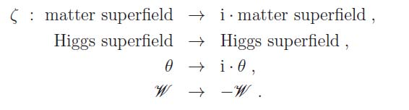
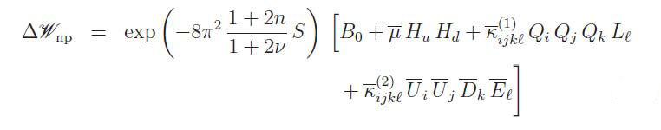
Non-perturbative effects

Slide 37


Slide 38
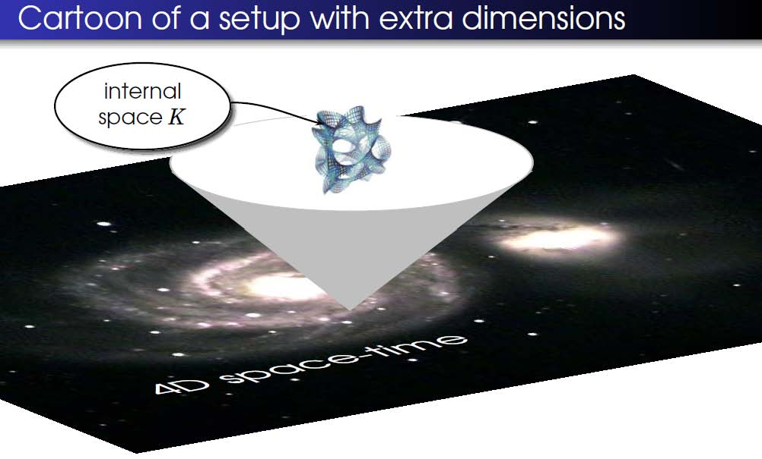
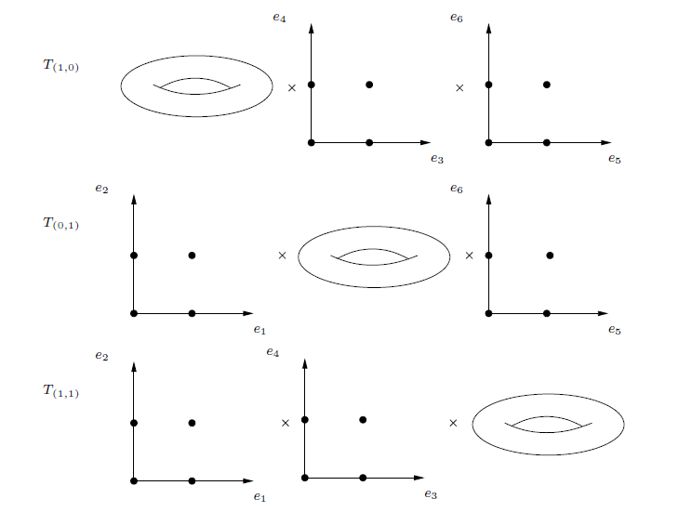
String Theory - fluctuating strings in
10 space-time dimensions
E(8)xE(8) heterotic string compactified
on (T²)³ /(Z₂ x Z₂ ) orbifold w/
Kappl, Peterson, Raby, Ratz, Schieren & Vaudrevange
NPB 847, 325 (2011)
Two light
Families on
SO(10) fixed pts

Slide 39
heterotic orbifolds
E(8)xE(8) heterotic string compactified
on (T²)³ /(Z₂ x Z₂ ) orbifold
exact MSSM spectrum
F = D = 0 verified
comes partially from the Lorentz
symmetry of the internal dimensions
μ = 0 due to
gauge – top Yukawa unification
non-trivial Yukawa matrices
local SO(10) gauge symmetry
D(4) family symmetry

Slide 40
Conclusions
Top down analysis, i.e. Embed SUSY GUT
in String Theory
Need to have μ << M_{G}
Need to suppress dimension 5 operators
symmetry &
Proton decay via Dim 6 ops. dominates
Proton decay rate typically enhanced !!!

