Slide 1
FSPA Updates
Michael Balcewicz on behalf of the FSPA Officers UEC Monthly Meeting
December 19, 2023

Slide 2
Events and Upcoming Plans
We are restarting early career seminars starting January 4th, emails were sent out earlier this week
Winter FSPA event has been submitted for approval
26/09/23
FSPA Updates

Slide 3
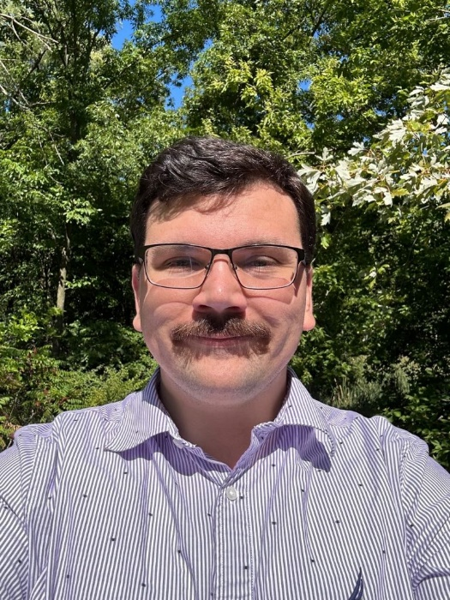
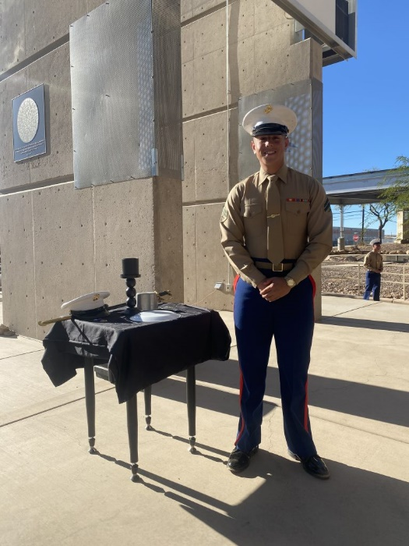
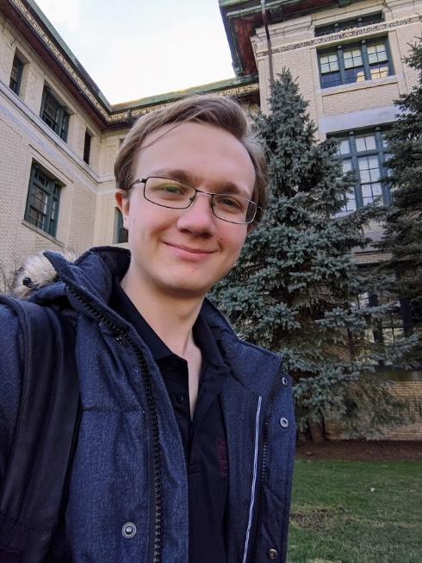
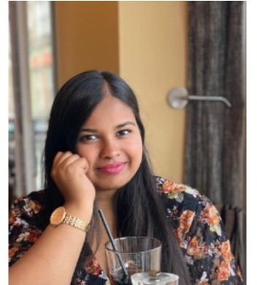
Thank you!
26/09/23
FSPA Updates

