Slide 1
Risk Methodology and Guidance
Lucas Taylor
Fermilab Head of Project Risk
LBNF-DUNE Risk Manager
PIP-II Risk Manager
Associate Project Manager, HL-LHC CMS Upgrades
LBNF-DUNE FDC I&I risk workshop, 16 January 2024

Slide 2
Risk Management Process
Project follows best practices:
Fermilab Risk Management Procedures for Projects” PPP-doc-65
1.
Plan Risk Management
2.
Identify
Risks
6.
Monitor and Control Risks
3.
Qualitative
Risk Analysis
5.
Plan Risk
Responses
A structured risk process helps deliver the project on-time and within budget
4.
Quantitative
Risk Analysis
It is also mandated by DOE Order 413.3b

Slide 3
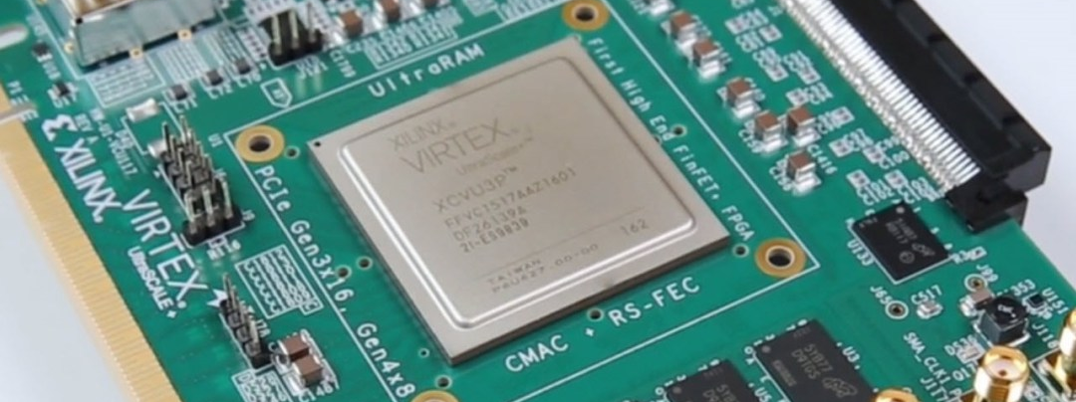
Terminology [ISO 31000] Risk: Effect of uncertainty on objectives
Fermilab Risk Management Procedures for Projects, PPP-doc-65
Threats may or may not happen, and have negative impacts → we aim to minimize them
Example: Magnet damaged in transit
Opportunities may or may not happen, and have positive impacts → we aim to maximize them
Example: Vendor develops better or cheaper Si chip
Uncertainties may have positive or negative impacts → we aim to manage them
Examples: Inflation, foreign exchange rates, or commodity prices may fluctuate up and down
Some uncertainties have 100% probability
g-2 experiment
CMS and other experiments
All projects

Slide 4
Terminology [ISO 31000] Risk: Effect of uncertainty on objectives
Impact probability distribution functions
Probability
Risk threat
Mean
Costs may increase
Finish may be later
Example: technical problems
Threats may or may not happen, and have negative impacts → we aim to minimize them
Example: Magnet damaged in transit
Opportunities may or may not happen, and have positive impacts → we aim to maximize them
Example: Vendor develops better or cheaper Si chip
Uncertainties may have positive or negative impacts → we aim to manage them
Examples: Inflation, foreign exchange rates, or commodity prices may fluctuate up and down
Some uncertainties have 100% probability
Min
Max
Likely
Impact
Mean
Example: vendor delays
Max
Min
Impact
Likely
Probability
Risk Opportunity
Mean
Costs may decrease
Finish may be earlier
Example: new partner contributions
Max
Min
Likely
Impact
Probability
Risk Uncertainty
Costs may increase or decrease
Finish may be earlier or later
Risk probability can be 100%
Example: exchange rates vary
Min
Max
Likely
Impact

Slide 5
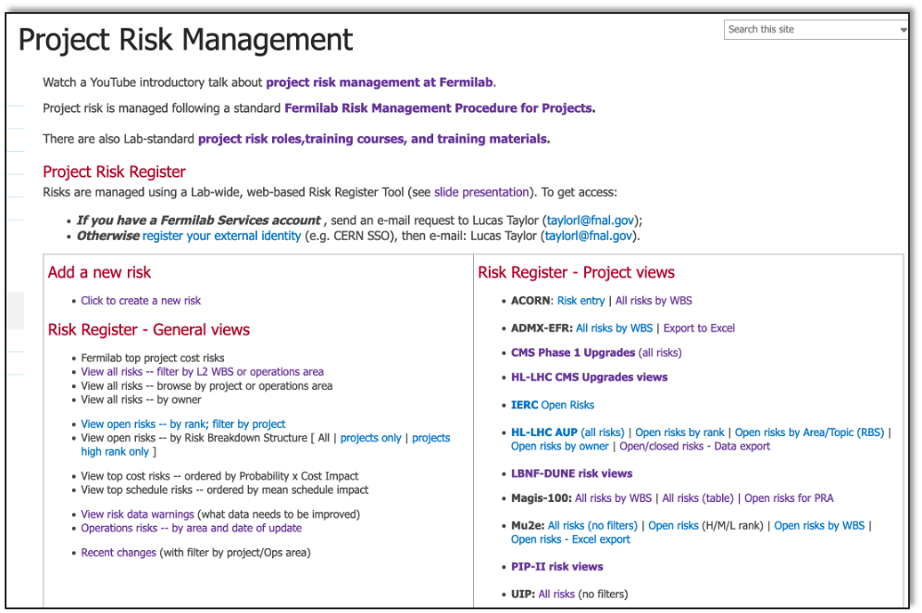
LBNF-DUNE Risk Register
https://go.usa.gov/xArzB
Login with Fermilab services account
request permissions from taylorl@fnal.gov
LBNF-DUNE specific views

Slide 6
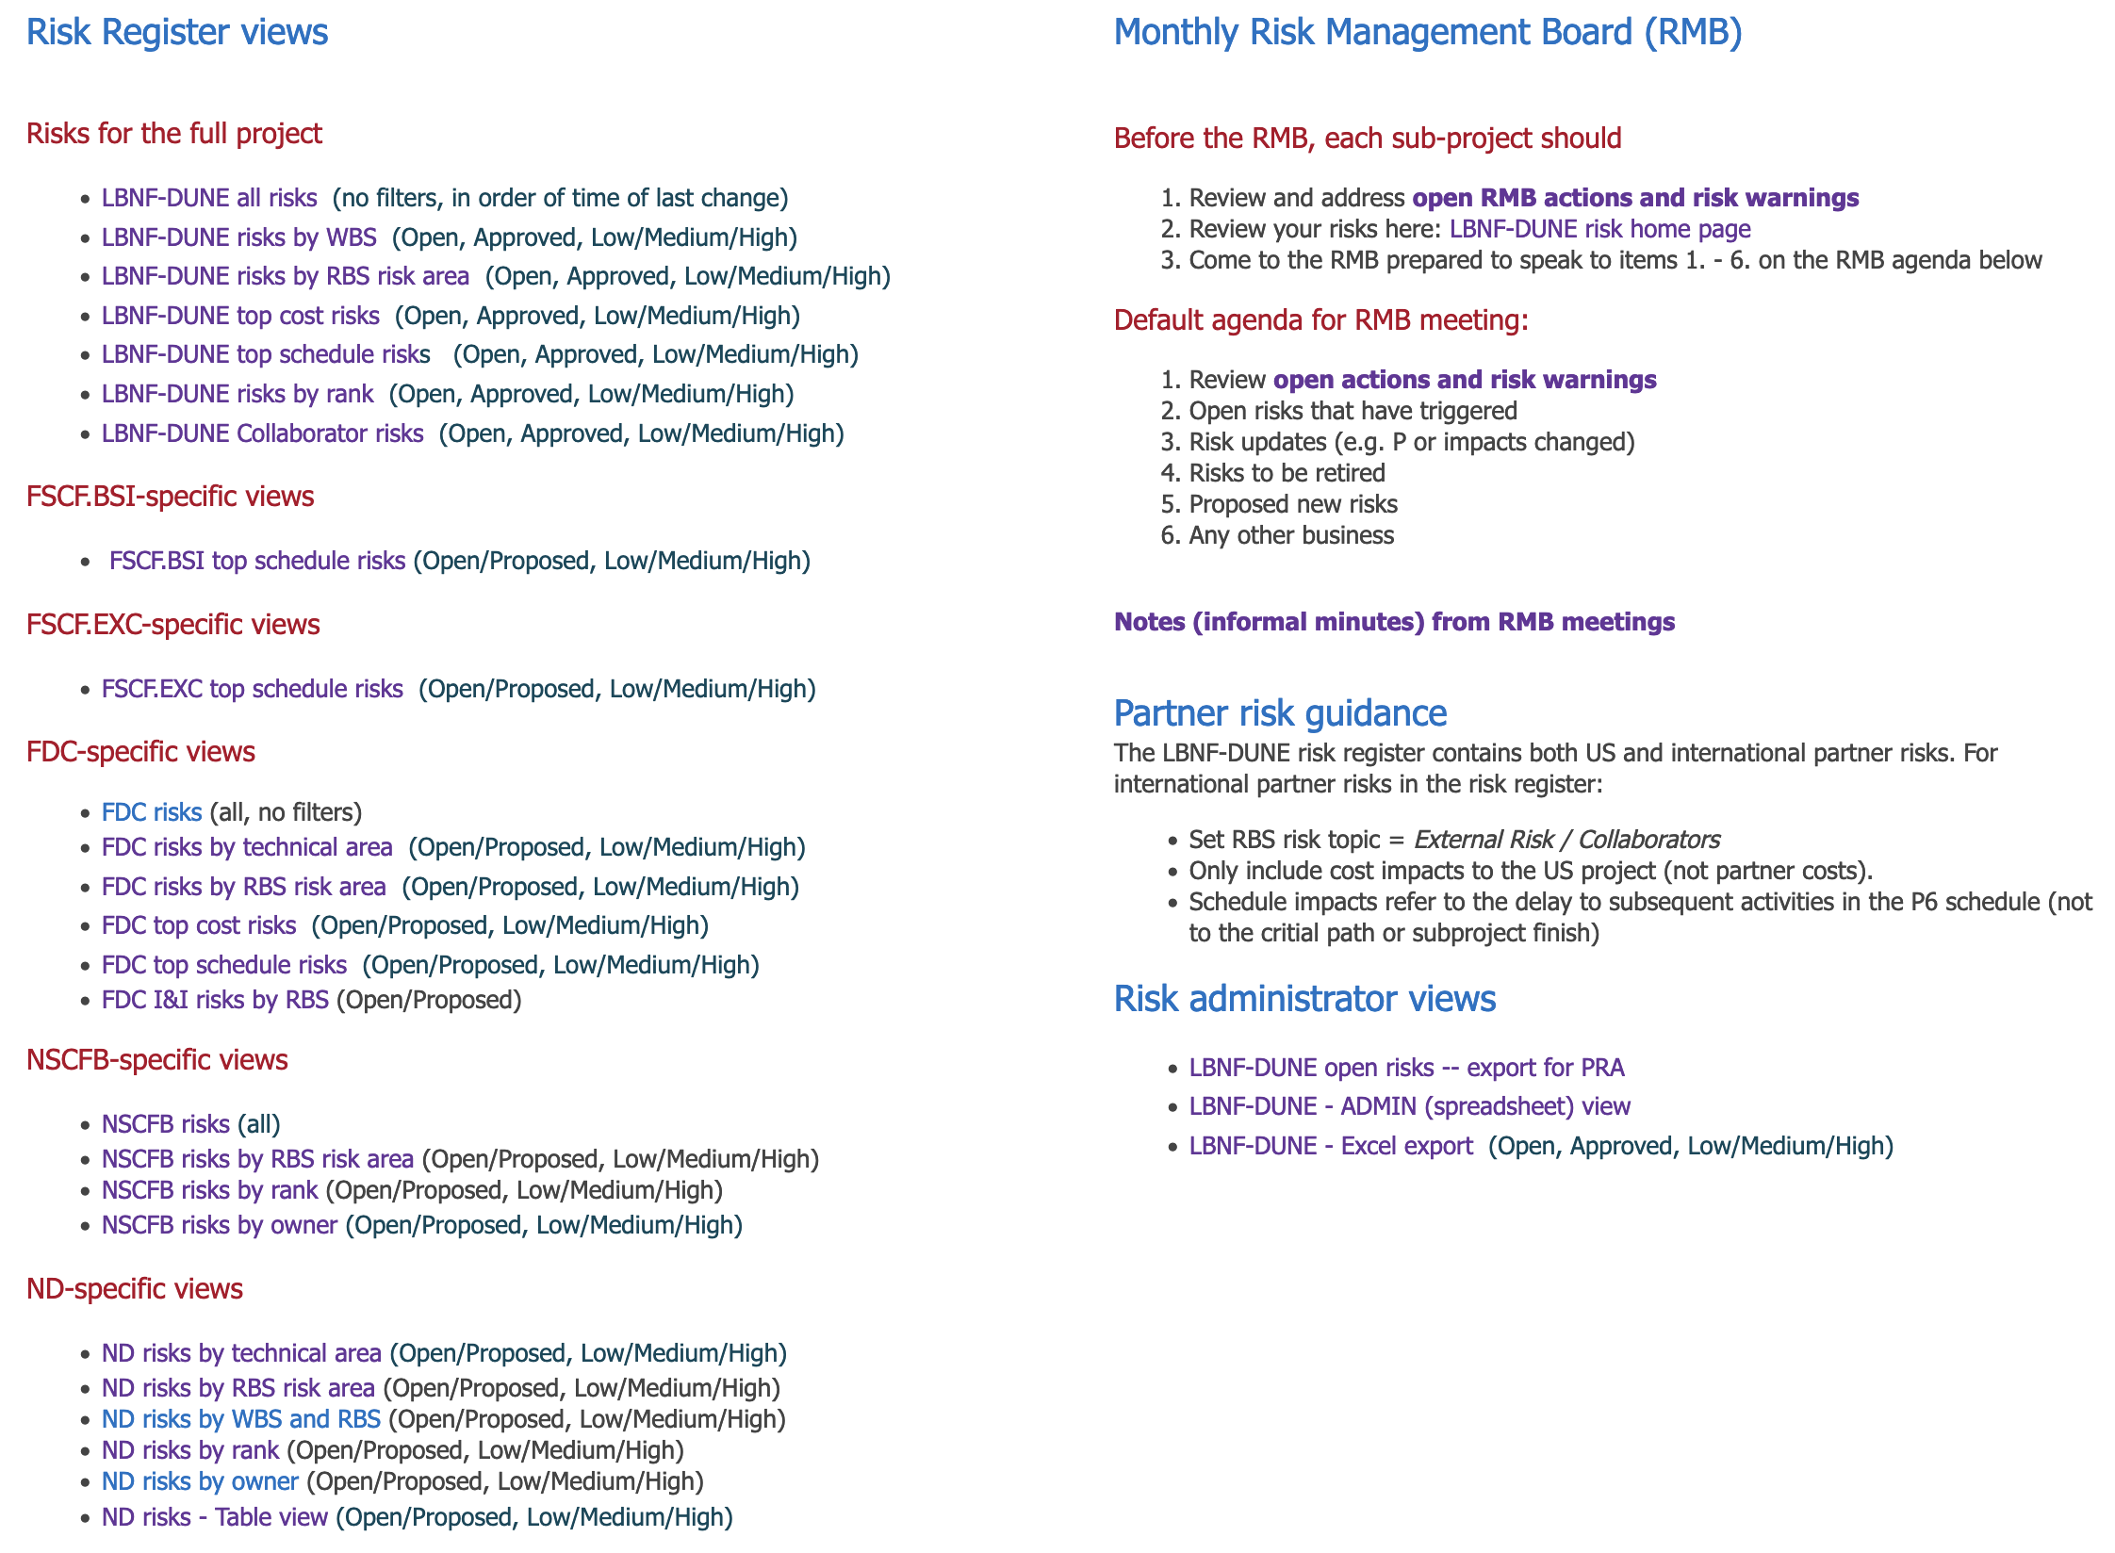
FDC Risk Register views
https://go.usa.gov/xArzB
Action items per risk
FDC views
I&I view

Slide 7
FDC I&I risks (Open / Proposed)
68 risks
65 Threats, 3 Uncertainties, 0 Opportunities
19 risks
25 risks
24 risks
4 risks
6 risks
5 risks
4 risks
5 risks
1 risk
5 risks
3 risks
2 risks
1 risk
8 risks
3 risks
3 risks
8 risks
9 risks
1 risk
Review RBS to look for potential gaps in the risk analysis

Slide 8
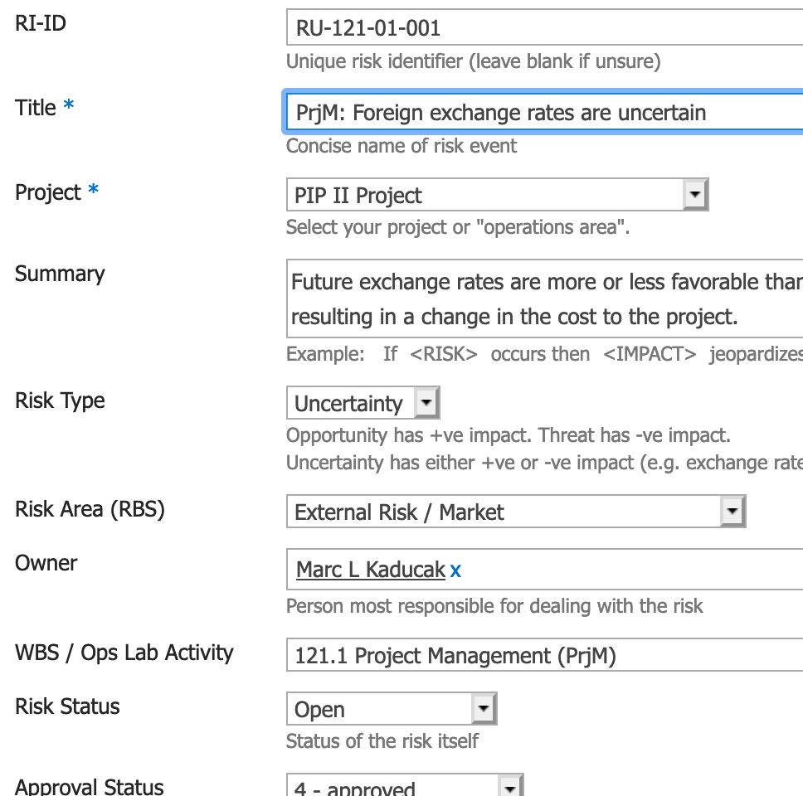
Adding proposed new risks
https://go.usa.gov/xArzB
Data stored per risk:
Metadata: ID, Title, Summary, Project, Risk Type, RBS, Owner, WBS, Status, Start / End Dates …
Risk Mitigations – pre-emptive actions in baseline plans
Risk Responses – that only are executed if the risk occurs
Risk Probability from 0% – 100% (post-mitigation)
Technical, Cost, Schedule impacts
1-point (single value), 2-point (range), or 3-point (triangle)
Web form to document risk
Add new risk
Probability
Mean
Min
Max
Impact
Likely
(point estimate)

Slide 9
Risk mitigations and Risk response plans
Inherent Risk
Mitigations – are actions taken before a risk occurs, to reduce its probability and impacts
Examples: ES&H, prototyping, multiple vendors, spares, safety training, financial controls, IT security
Often part of standard working practices
Mitigation costs are part of the base budget
Mitigation
actions
(in base plans)
Residual Risk
Risk responses – are actions taken only after a risk occurs, to deal with the consequences
Examples: respond to fire, rework non-compliant items, replace hardware, restore hacked IT system
Risk response costs use contingency
Risk
Event
Impacts
Responses

Slide 10
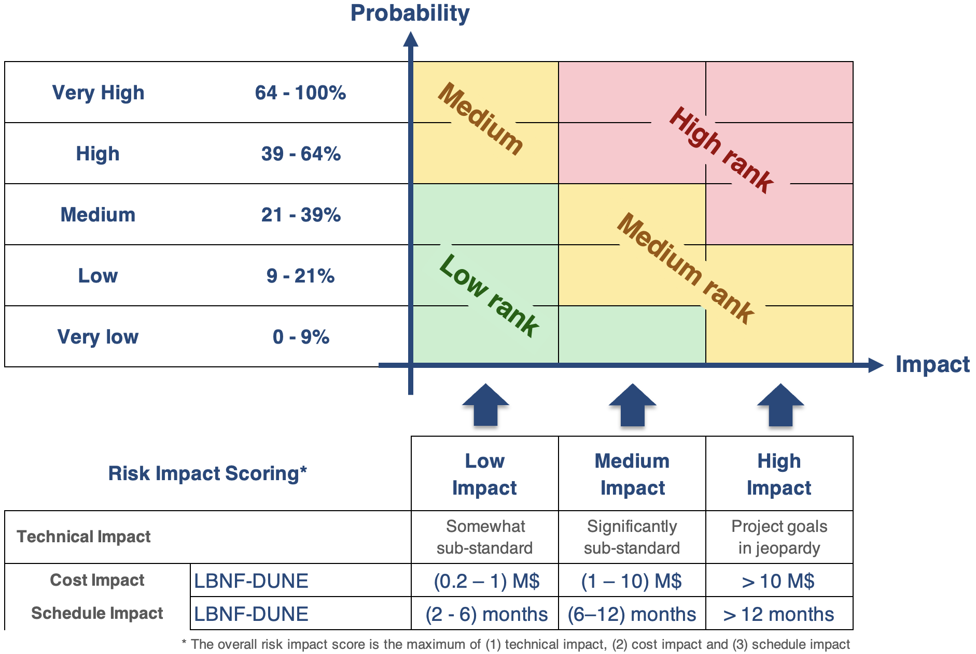
LBNF-DUNE Risk Ranking
Risks are ranked using a 2-D matrix of Probability vs. Impact
High rank: Potential failure to meet project goals → Project Director / Project Manager
Medium rank: Significant impact on objective(s) → L2 Manager
Low rank: Modest impact on objective(s) → L3 Manager

Slide 11
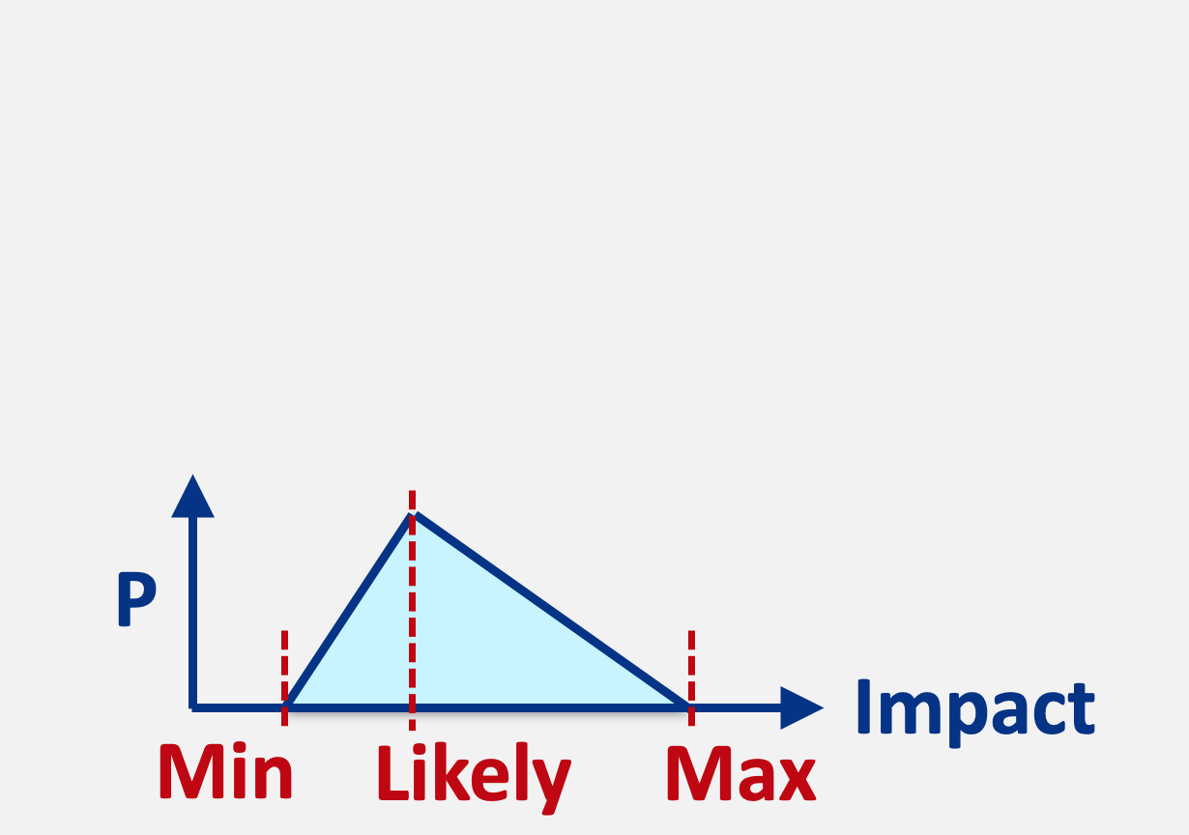
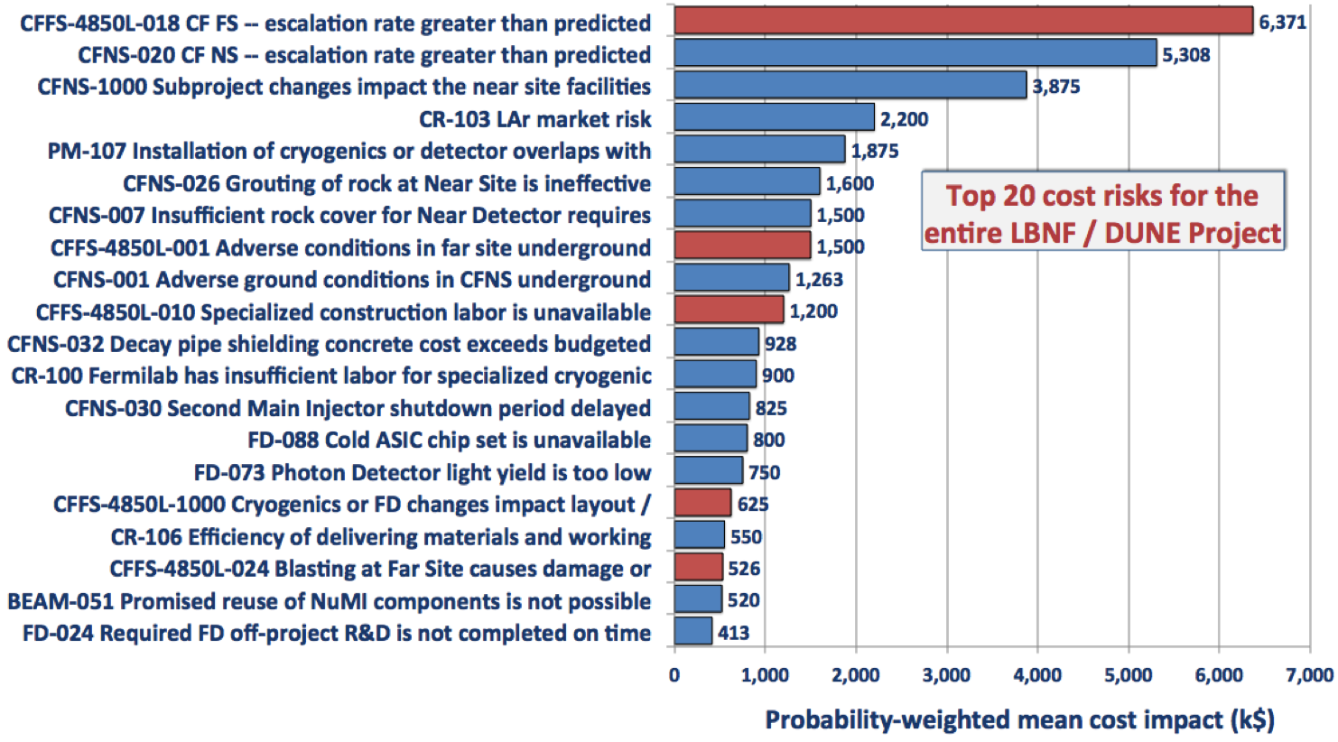
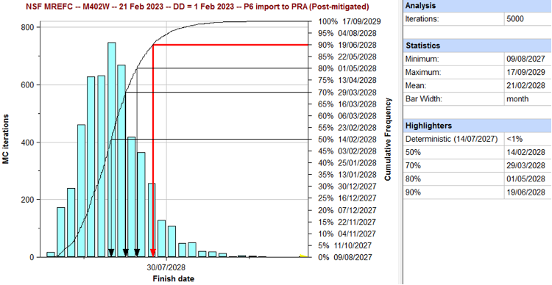
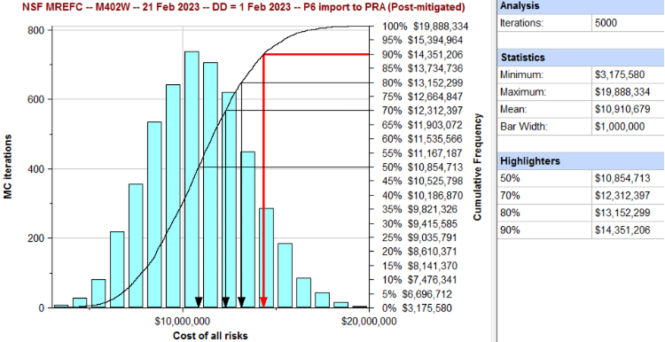
Risk Monte Carlo Model
Project schedule
(e.g. P6)
Risk Register
(e.g. Excel)
All the project’s work activities
Logical links between activities
Activity costs and durations
Associated estimate uncertainties
Risk probabilities
Cost impacts
Schedule impacts
Aggregates cost and schedule impacts of all the project’s risks
Risks occur – or not – according to their probabilities
Sample risk cost and schedule impact distributions
Generate a new risk-adjusted project outcome (scenario)
Repeat 1000s of times
Risk MC Tool
(e.g. Primavera Risk Analysis - PRA)
Risk tools: @Risk (Palisade), Crystal Ball (Oracle), Polaris (Booz Allen Hamilton), Primavera Risk Analysis (Oracle), Acumen RISK (Deltek) Risky Project (Intaver Institute), JACS (Tecolote), Full Monte (Barbecana), Safran Risk
Cost of all risks
Probability-weighted impacts
Project
Finish
Date
Example: NSF MREFC CMS Upgrades project
Example: NSF MREFC CMS Upgrades project
“Tornado” charts of cost and schedule risk drivers
11.2 months of schedule contingency at 90% CL
$14.4M of risk-based cost contingency at 90% CL
We manage risk and contingency to ensure project will finish on time and within budget

Slide 12
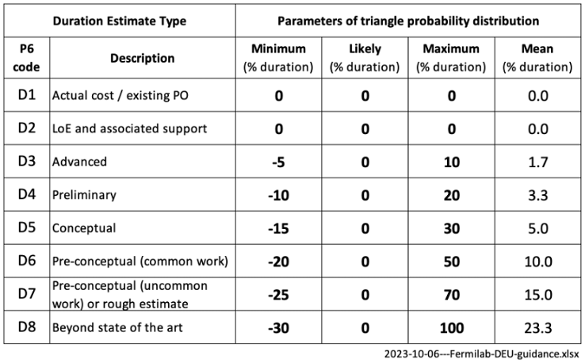
Duration Estimate Uncertainty
Numerous sources of modest delays are taken into account in the risk MC model, by assigning Duration Estimate Uncertainty (DEU) to each activity in the P6 schedule
Hence we do NOT need to carry explicit risks for every possible source of delay
DEU is modeled by a triangle probability function
Mature estimates have narrower spreads
Uncertainty is skewed to longer durations
Probability
Mean
Min
Max
Likely
Duration
Duration Estimate Uncertainty
Duration Estimate Type is a Lab standard P6 field

Slide 13
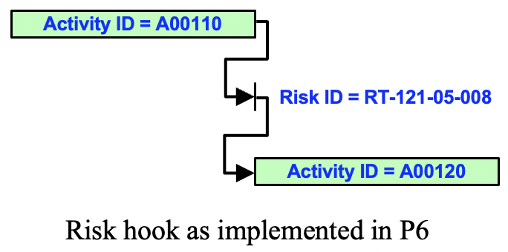
Risk Hook activities in P6
Risk hook activities mark places in the P6 schedule where risks may occur and hence cause impacts
Example: RT-121-05-008 “Module damaged in transit”
P6 risk hook logic (finish-to-start links) is as follows:
Predecessor (P6 ID = A00110 Transport module)
→ Risk hook (Risk ID = RT-121-05-008)
→ Successor (P6 ID = A00120 Module acceptance)
In P6: risk hooks have zero cost and zero duration
In risk MC: if risk triggers, risk hook acquires a cost impact and duration based on risk register impacts
As a result of all the stochastic risks, the total project cost increases and the finish is delayed
Need to document risk the hook logic in the Risk Register (Impacted Activities field)

Slide 14
Risk lessons learned / guidance
Start early with risk and follow best practices
Create an open culture for risk discussions
to ensure risks are handled effectively
1.
Plan Risk Management
Schedule risk is often more challenging than cost risk
Carefully monitor critical path, risk-adjusted finish dates, float and schedule contingency
Capture risk data as numerical values not qualitatively (e.g. “unlikely”)
2.
Identify
Risks
6.
Monitor and Control Risks
Risk estimates only need to be roughly accurate – risk is intrinsically imprecise
Refine risk processes
as the project progresses
Be wary of low probability, high impact risks – impacts can be hard to handle if the risk occurs
3.
Qualitative
Risk Analysis
5.
Plan Risk
Responses
Use a risk MC model
to aggregate uncertainties and risks
Rule of thumb #2:
Schedule contingency (at 90% CL) is typically 25 – 35% of remaining duration
(~3-4 months per year of duration)
4.
Quantitative
Risk Analysis
Rule of thumb #1:
Cost contingency (at 90% CL) is typically 30 - 40% of base cost to go
(~2/3 estimate uncertainty and ~1/3 risk)

