Slide 1
SQMS Center Progress and Highlights and response to PAC recommendations
Anna Grassellino,
SQMS Center Director

Slide 2
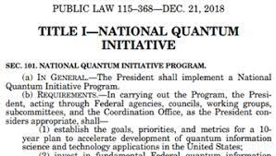
National QIS Research Centers
Build on SC’s long history of stewarding national
initiatives:
National Nanotechnology Initiative, Energy (Bioenergy Research Centers, Energy Innovation Hubs, Energy Frontier Research Centers), Computing (Exascale Computing Project)…
Be an integral (and leading) part of SC QIS portfolio
Represent the “all of SC” strategy
Embody a national imperative – urgency, scale, and impact
Slide from Harriet Kung, Deputy Director for Science Programs, U.S. DOE SC

Slide 3
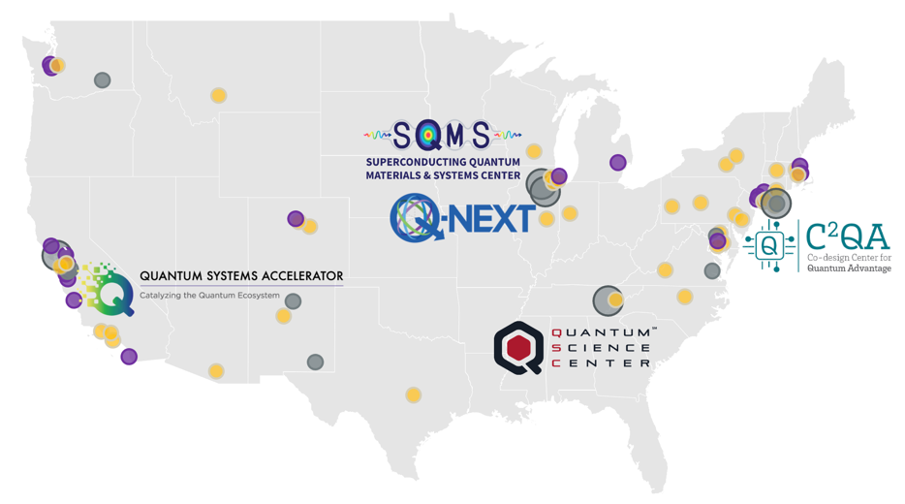



The Five DOE National QIS Research Centers
Unique institutional partnerships boost joint efforts in academia, industry and national labs
1,500+ experts
600+ students
& postdocs
at 115 institutions in
in 21 US states & DC
Lead DOE
national lab
National lab/
science inst.
University
Tech
company
DOE NQISR Centers
leverage unique
capabilities, expertise
and facilities to
achieve bold scientific
and technological goals.
Together, we are…
Training a new and diverse
quantum workforce
Fostering technology transfer
– rapid cycle from discovery
to commercialization
Answering fundamental
open questions in QIS
Leveraging DOE user facilities
for advanced materials analysis
and device fabrication
Accelerating scale-up
Developing national standards
Notes:
Presenter: Anna
Nearly 600 students and postdocs
Academia – students
National Labs- training technicians
National Labs – space

Slide 4


A DOE National Quantum Information Science Research Center
31
500+
Partner Institutions
Collaborators
SQMS brings together hundreds of experts from more than 30 DOE national labs, academia, industry and other federal and international entities to bring transformational advances in QIS
[excerpt]

Slide 5
Outline – bottom line up front
SQMS Mission: bring transformational advances in QIS
Vision: use/achieve unique strengths in quantum technology – be leaders – and employ them for advancing fundamental physics; also partner with leading quantum computing industry – Rigetti, IBM – to use their platforms
Technology progress at SQMS in 2023 extraordinary:
  Achieved world leading qubit coherence; commissioned quantum garage, first 2D quantum processor at FNAL, progress in 3D platform (coherence, photon counting), round robin experiment with underground measurements, involving 10 testbeds around the world (including new testbeds at NU, Gran Sasso, Pisa, UK, Livermore)
  Key to advance computing and for paving the way to synchronized observatories/experiments
Excellent science progress (next talk) – dozens of experiments in more than 5 different physics areas! DarkSRF published on PRL and paved the way to a whole science thrust using cavities and qubits to search for new physics
Excellent progress in ecosystem and workforce development, launch of new QIS school
Passed DOE mid-term review with outstanding reviews
We have established a mission-driven, center-wide coordinated effort, engaging communities with deep scientific and technological knowledge vital for the advancement of QIS

Slide 6
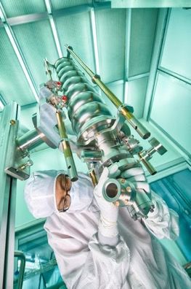
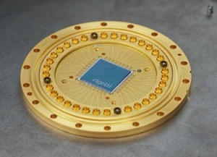
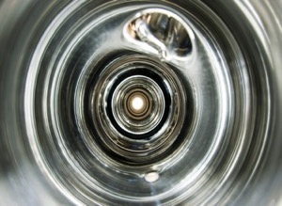
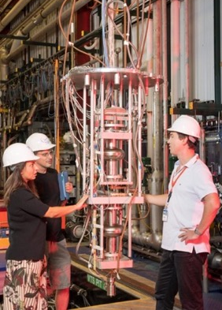
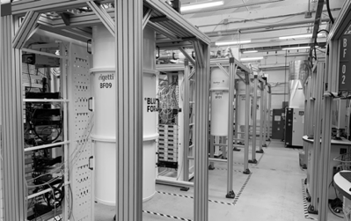
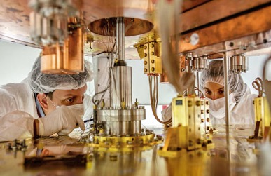
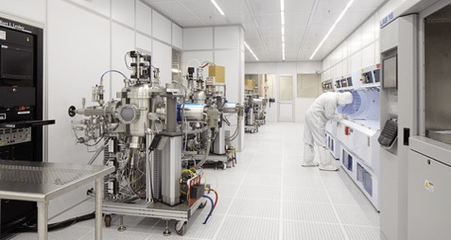
SQMS Mission
“Bring together the power of national labs, industry and academia to achieve transformational advances in the QIS major cross-cutting challenge of understanding and eliminating the decoherence mechanisms in superconducting 2D and 3D devices, with the goal of enabling construction and deployment of superior quantum systems for computing and sensing."

Slide 7


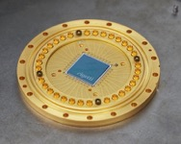
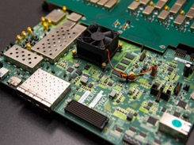
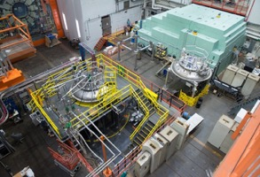





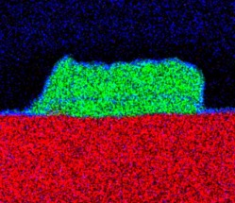
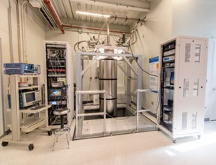
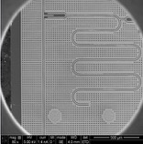
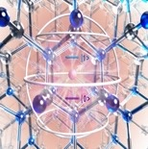
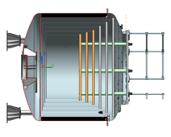
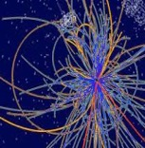
SQMS: a quantum decade of new scientific tools and discovery
From 1 - 10
3D high coherence qubits prototype
Quantum Sensors for fundamental physics
Mid scale QPU prototypes
@ Fermilab
High-Q Quantum Interconnects
(computing and sensor networks)
Larger scale quantum computing/sensing platforms
2022
2025
2030
Commercial transmon qubit improvement in coherence > 10
Materials Research for high coherence qubits
New quantum testbeds and foundries commissioned
Colossal fridge commissioned 20mK
Solving complex problems in HEP, CMP, medicine, climate, national security

Slide 8
SQMS Center Research: multidisciplinary, integrated, synergistic approach
SRF high Q devices
FNAL
Superconducting qubits
Rigetti, NIST, NU, FNAL, INFN, Colorado Boulder, Rutgers, NPL, RHUL
Theory and Applied Superconductivity
FNAL, NU, Temple, IIT, LSU
Scale up and integration
FNAL, Rigetti
Cryogenics
FNAL, NU, Royal Holloway, Form Factor
Material Science
Ames Lab, NU, FNAL
Controls and electronics
Rigetti, NIST, NU, FNAL
Particle Physics
FNAL, UIUC, Stanford, INFN, John Hopkins
Computational Science,
QIS Theory
NASA Ames, Colorado Mines, Rigetti, NU, Arizona
Industry use cases
Goldman Sachs, Lockheed Martin, Rigetti, NYU
Condensed Matter Physics
Ames Lab, NU, NASA Ames, LSU

Slide 10
S&T Highlights/major milestones

Slide 11
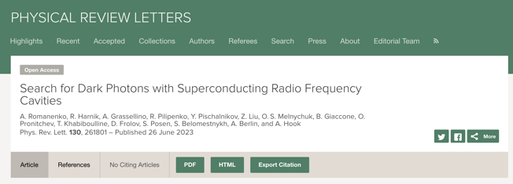

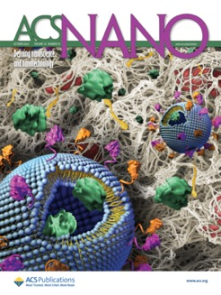
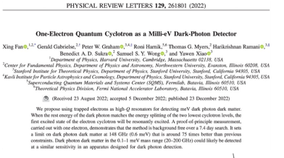
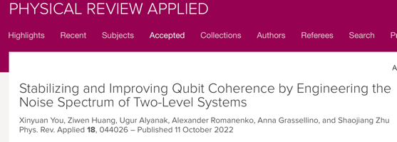

Publications
Over the first 3 years, produced >170 papers, of which >85 in peer reviewed journals (just in FY23 SQMS published >50 papers in high impact peer reviewed journals)

Slide 12
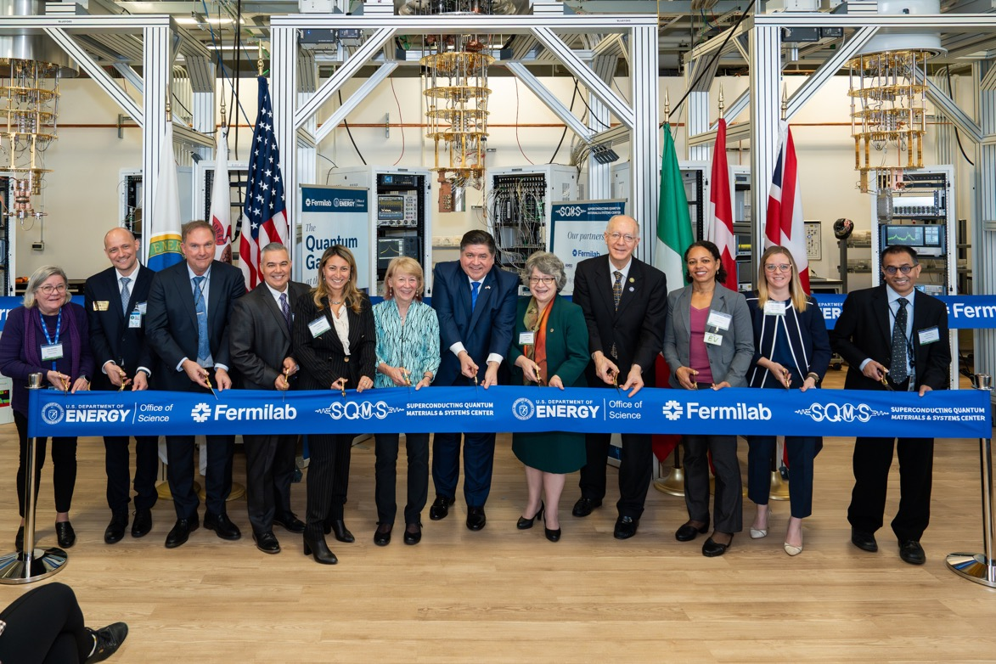
The Quantum Garage at the SQMS Center, Fermilab
Ribbon Cutting Ceremony, November 2023

Slide 13
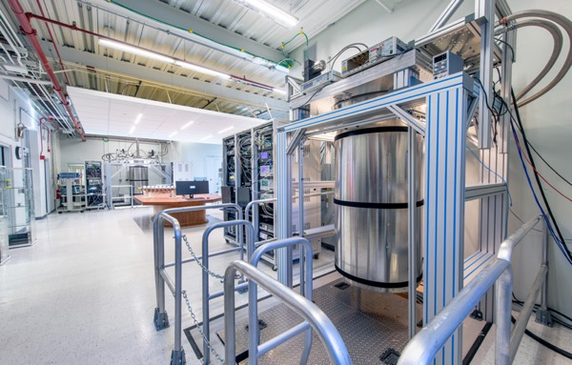
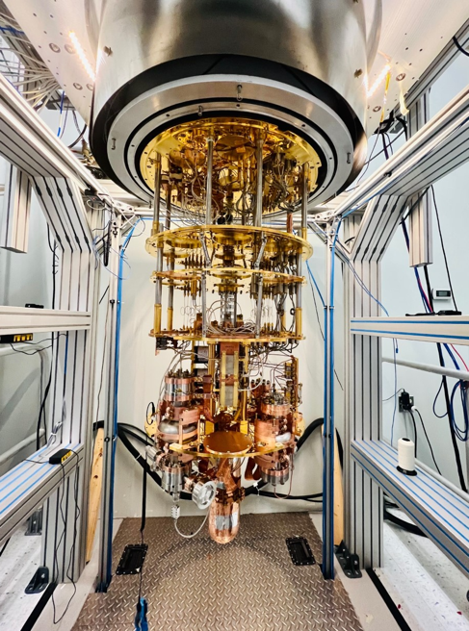
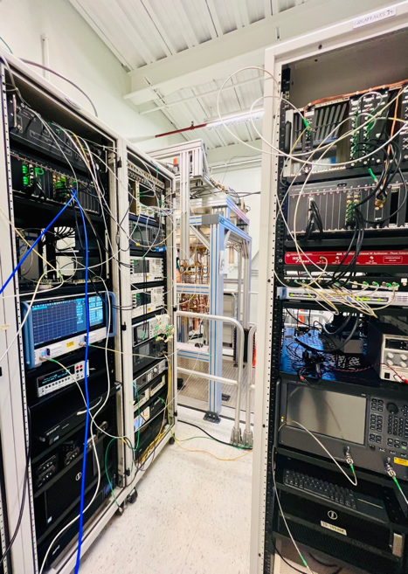
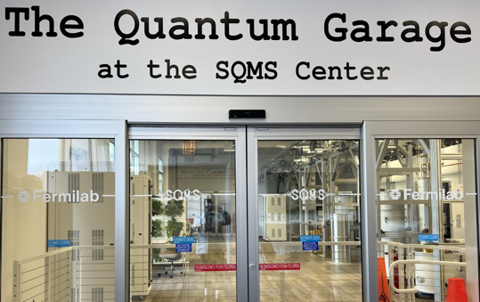
SQMS facilities: deployed fleet of new quantum testbeds and fab capabilities
With 8 extra large dilution refrigerators, hundreds of qubits and cavities, nanofab tools and materials science capabilities, SQMS quantum research facilities/tools are among the largest and most advanced nationally and internationally

Slide 14
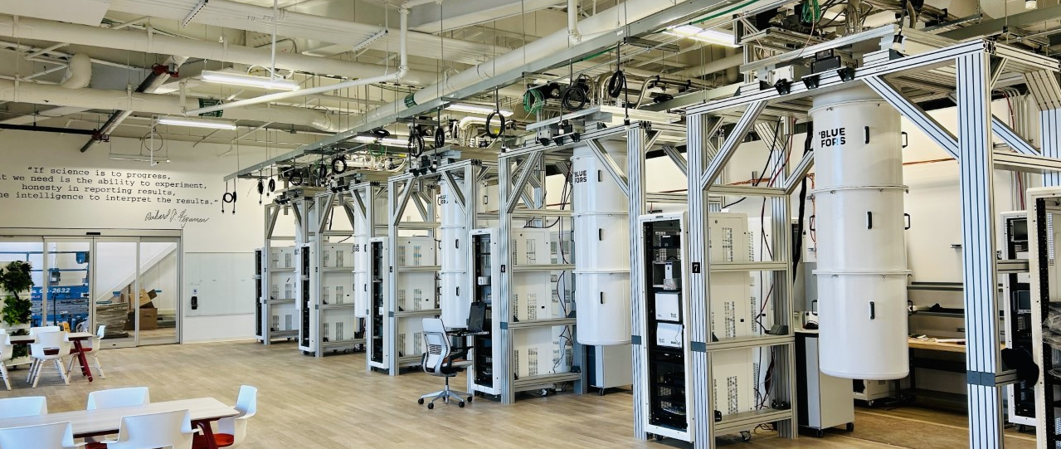
The Quantum Garage @ the SQMS Center (Fermilab)
New DOE National Quantum facilities to advance science and economy

Slide 15
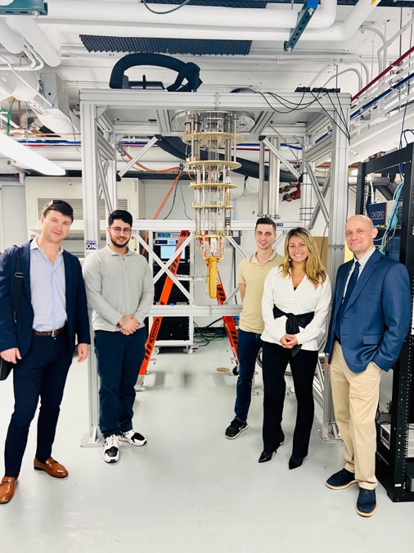
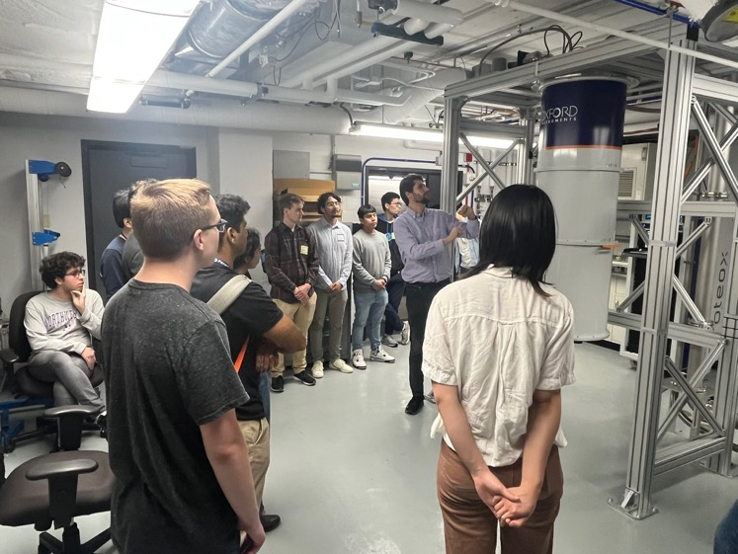
Completed and commissioned new SQMS quantum testbed at Northwestern University

Slide 16
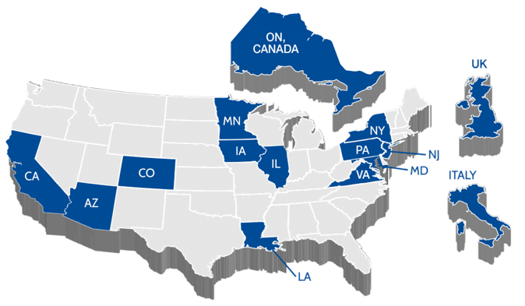
First international qubit metrology round robin experiment
SQMS has launched the first, large scale, international experiment to prepare identical quantum testbeds and exchange/measure qubit devices at >10 different test sites around the world
SQMS Qubit Test Sites:
Rigetti Computing
Livermore
NIST
CU Boulder
Fermilab
Northwestern
Waterloo IQC
UK NPL
Royal Holloway
INFN Gran Sasso
University of Pisa
LA
  Effort is key to advance quantum computing and for paving the way to synchronized observatories/experiments

Slide 17
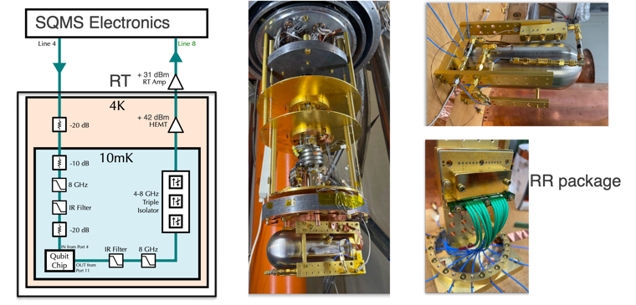
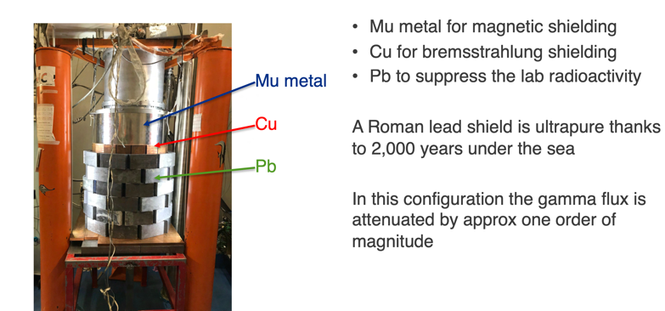
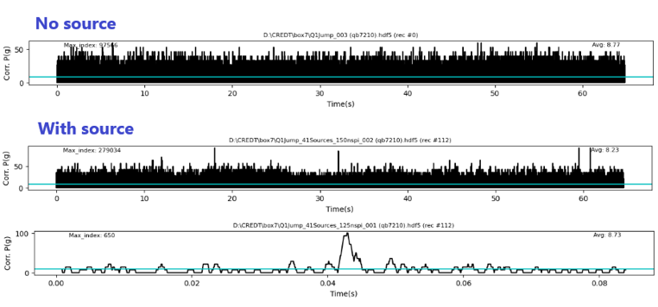
Fermilab and INFN Gran Sasso qubit exchange experiments ongoing (effect of environmental rad on qubit performance)
First experiments measuring very high coherence qubits above and underground, with and without radiation source, new measurement protocols – Cardani, Roy, Van Zanten, Grassellino et al

Slide 18
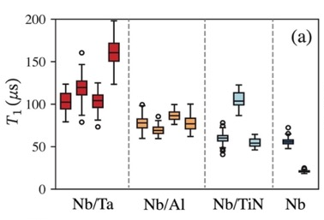
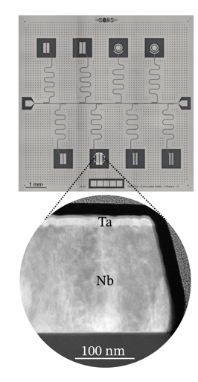
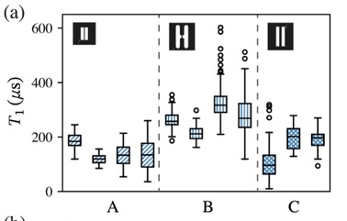
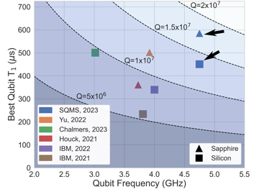
SQMS National Nanofabrication Taskforce
Pushing the Frontier of Transmon Qubit Coherence
SQMS FNAL group has now achieved leading values thanks to innovations
in materials research and nanofabrication process development
Top published transmon qubit coherence times
Group | Best T₁ (μs) | Freq. (GHz) | Substrate | Primary Material | Publication Year
Yu | 503 | 3.8-4.7 | Sapphire | Ta, dry etch | 2022
SQMS | 451 | 4.5-5 | Silicon | Ta/Nb, dry etch | 2023
Houck | 360 | 3.1-5.5 | Sapphire | Ta, wet etch | 2021
IBM | 340 | ~4 | Silicon | Nb, dry etch | 2022
IBM | 234 | 3.808 | Silicon | Al, dry etch | 2021
SQMS | 198 | 4.5-5 | Sapphire | Ta/Nb, dry etch | 2023
Group | Best T₁ (μs) | Freq. (GHz) | Substrate | Primary Material | Publication Year
SQMS | 602 | 4.5-5 | Sapphire | Ta/Nb, dry etch | 2023
Yu | 503 | 3.8-4.7 | Sapphire | Ta, dry etch | 2022
Chalmers | 501 | 2.8-5 | Silicon | Al, dry etch | 2023
SQMS | 451 | 4.5-5 | Silicon | Ta/Nb, dry etch | 2023
Houck | 360 | 3.1-5.5 | Sapphire | Ta, wet etch | 2021
IBM | 340 | ~4 | Silicon | Nb, dry etch | 2022
arXiv:2304.13257v2

Slide 19
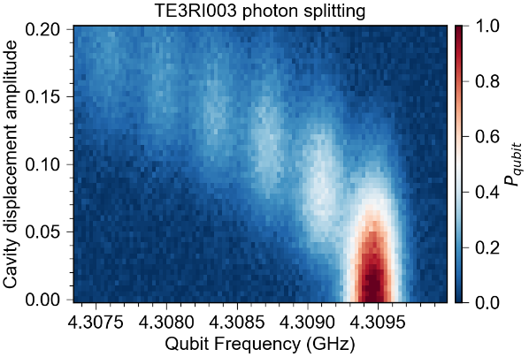
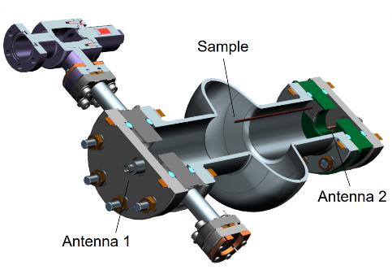
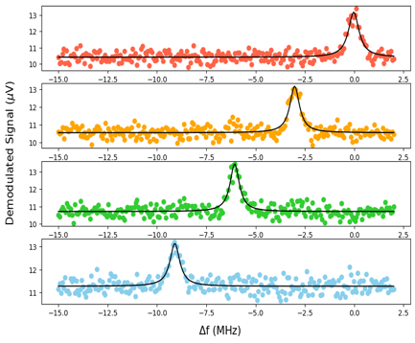
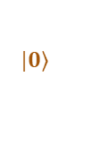
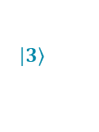

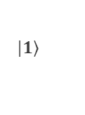
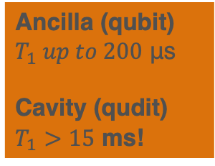
Superconducting qudits – SRF based architecture
Ancilla (qubit)
$T_{1} up to 200$ μs
Cavity (qudit)
$T_{1}>15$ ms!
$$|\left.0\right\rangle$$
Weak off-resonance coupling facilitates selective cavity state-control using the (ancilla) qubit!
Cavity frequency becomes qubit-state dependent and viceversa
$$|\left.1\right\rangle$$
$$|\left.2\right\rangle$$
$$|\left.3\right\rangle$$
Photon counting!

Slide 20
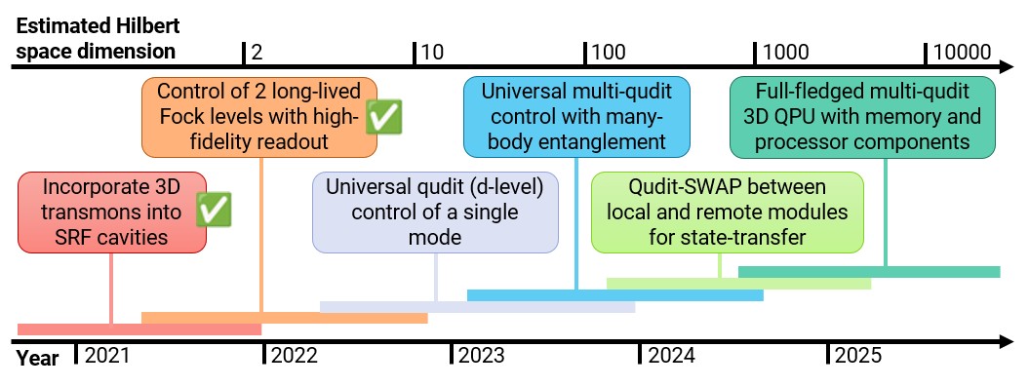
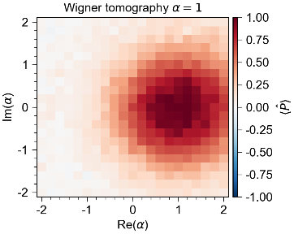
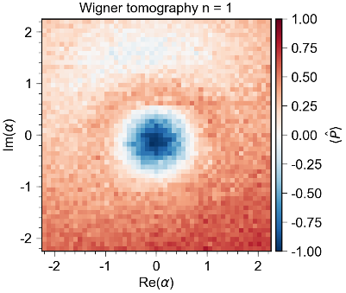

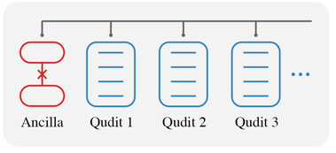

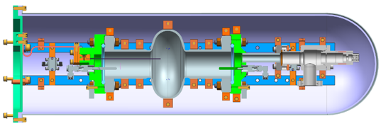

Progress towards SQMS 3D cavity QPU

Slide 21


Technology Highlight: First 9-qubits quantum processor installed and operational at Fermilab SQMS labs
First commercial superconducting quantum processor (Rigetti Computing) installed and operated at a DOE national laboratory
1/9/24
Romanenko | Technology

Slide 22

Integrating Materials Advancements Into a Full System:
2D SQMS Quantum Processor with Rigetti Computing
9-qubit Rigetti QPU installed and operated at FNAL
9-qubit QPU prototype with higher qubit coherence installed and operated at FNAL
36-qubit QPU with higher qubit coherence preserved into full processor
Installed and operated at FNAL

Slide 23



DarkSRF published on PRL: set world’s most stringent limits on dark photon existence in certain mass range

Slide 24
Ecosystem, Workforce Development, Awards and Leadership

Slide 25




SQMS Ecosystem Stewardship
Overarching Goals
SQMS 2023 interns
Develop a diverse QIS workforce
1
2
Accelerate innovation in
quantum technology
by
1- Leveraging DOE investments in unique capabilities and user facilities
2- Creating synergies:
Quantum schools
US-QIS School, first 5-center joint school
Hands-on Quantum Internship
Carolyn B. Parker Fellowship
>500
External students trained
(SQMS schools & internships)
federal agencies
private sector
academia

Slide 26


The U.S. QIS School: first school to be host by the 5 DOE quantum centers; SQMS leading the first edition at FNAL
Largest U.S. school to educate in quantum information science including lab experience;
More than 300 applicants, accepted 150 participants : students, professionals from labs and industry
More than 40 instructors, top national experts in QIS from the 5 quantum centers (DOE, academia, industry)

Slide 27







USQIS SCHOOL 2023

Slide 28





SQMS has led the organization of several international workshops and conference sessions

Slide 29





Awards, Grants and International Leadership
Silvia Zorzetti, DOE Early career Award, RENEW grant
Mustafa Bal, DOE Nuclear Physics Quantum Horizon Grant
Anna Grassellino, New Horizon Prize Breakthrough Foundation, serving on international advisory boards
Eleanor Rieffel, testifying at NQI reauthorization Congress hearing
SQMS Center featured on quantum.gov as leader in international cooperation

Slide 30




Slide 31
Response to PAC recommendations
The PAC recommends the Laboratory streamline procedures to improve the efficiency of the procurement process for SQMS Center in coordination with the overall lab efforts to improve procurement.
Large procurements concluded or in final phase. Quantum garage built and commissioned. Nanofab lab tools and supporting infrastructure procurements ongoing. SQMS finance team communicates periodically with procurement team to push to keep various procurements moving.
The PAC recommends the SQMS center explore opportunities for collaboration with other groups at FNAL, particularly on quantum sensors.
SQMS currently brings together over 100 researchers (theory and experimentalists) from across the lab PPD, Theory, APS-TD, Scientific Computing Div, FQI and the SQMS division. Rich collaboration in quantum sensors area, and computing. SQMS Ecosystem Board includes FNAL CRO. Nationally and internationally dozens of particle physicists from other labs and academia. (see later presentation). If further funding resources were available, other areas could include: CMS p.p., detectors for future colliders, neutrino experiments.

Slide 32


Science Thrust - Focus Area Quantum Sensing for Fundamental Physics
Goal: Harness SQMS technological advancements
for fundamental physics discovery
Deliverables/metrics: Develop and deploy search schemes with detection
sensitivity orders of magnitude compared to state-of-the-art
See progress highlights in next talk
DarkSRF paved the way for many of the experiments ongoing at SQMS (next talk)
Orders of magnitude in sensitivity reach improvement via the SQMS advancements

Slide 33



Science Thrust - Focus Area Algorithms, Simulations, Benchmarking
Goal: Investigate and develop quantum algorithms and simulations enabled by the groundbreaking SQMS 3D and 2D prototypes through co-design principles
Deliverables/metrics: Simulations of the dynamics of theories approximating QCD, simulate LHC physics, plasma early universe conditions, quantum materials far from equilibrium, intermediate electron/phonon SC
See progress highlights in next talk
SQMS computational and simulation science goals mapped to prototypes
Qubits considered for a D4 gauge field theory test simulation on the Rigetti hardware.

Slide 34













SQMS theorists and experimentalist ‘co-design’ to develop new experiments
SRF + QIS capabilities enable new particle searches of unprecedented sensitivity and precision
R. Harnik
co-design
Y. Kahn
A. Berlin
P. Graham
Theory
Options for mode setups + sensitivity
S. Rajendran
B. Giaccone
J.. Sauls
Prototypes
Materials and Devices
S. Posen
Systems design, testing
(measure cross-talk, Q for various modes, readout)
Improved Q, sensitivity, controls
C. Braggio
See progress highlights in next talk
R. Cervantes
A. Romanenko
G. Gabrielse
Notes:
high Q cavity technology within the SQMS center has enabled the development of NEW sensors to explore Dark Sector physics as well as precision tests of QED and the standard model
Multi-disciplinary team employing co-design to develop new sensors and detectors
Approach pushes beyond existing performance high Q cavity technology ….
A good example is the development of new cavity designs to search for Axion DM candidates or the underlying existence of an Axion field as physics beyond the standard model

Slide 35


