Slide 1
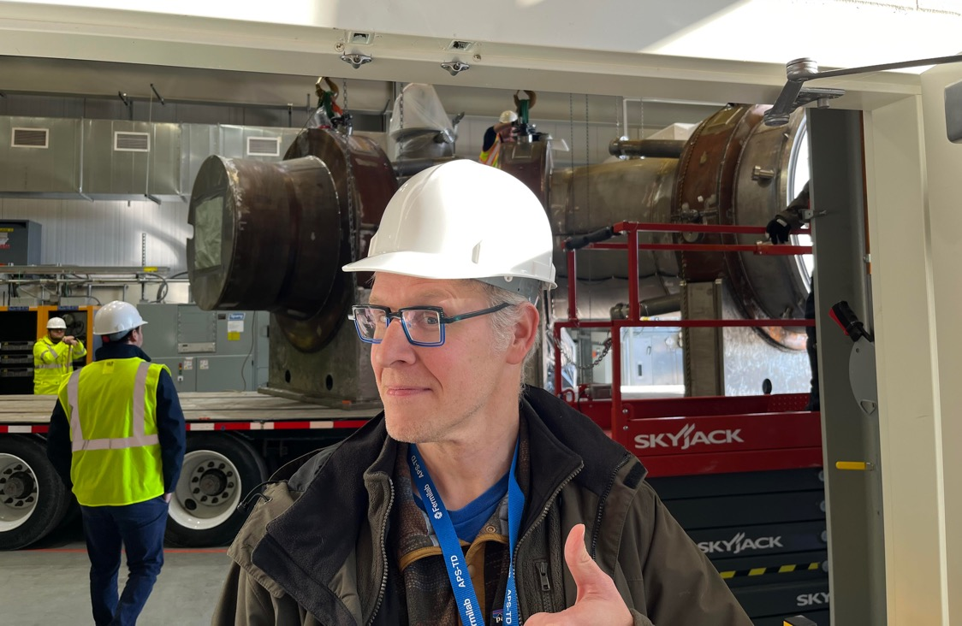
Mu2e Progress
Transport solenoid being delivered to the Mu2e Building
Brendan Casey
Fermilab
Physics Advisory Committee Meeting
January 8, 2024
Andy Hocker,
L2 Manager for the Solenoids

Slide 2
Charged Lepton Flavor Violation
γ
l₁⁺
h
l₂
l₂
l₂
l₂
h
l₁⁻
l₁
Signal:
A neutrinoless charged lepton flavor changing process
l₁
l₁
l₁
l₂
l₂
l₁
l₂
h₂
l₂⁺
l₁⁺
Z , H
l₁
l₁⁻
l₂⁻
h₁
h₂
h₁
l₁
h₂ = h₁ = N
Physics background:
suppressed by (Δm²_{ν}/m²_{W})², rates O(10⁻⁵⁰),
can be ignored at current levels of sensitivity
Experimental goal:
find a way to suppress the standard weak decays
l₁
x
l₂
ν₁
ν₂
l₁
ν₁
l₂
W
ν₂
γ
The highest sensitivities to these processes are achieved by studying muon interactions

Slide 3
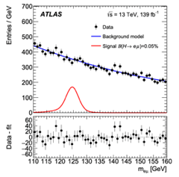
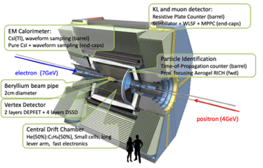
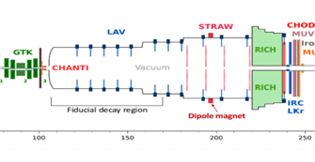
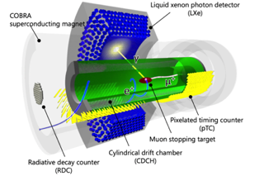
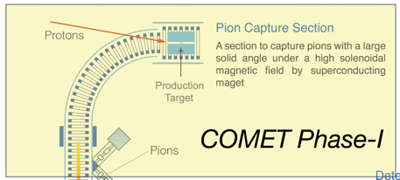
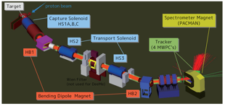
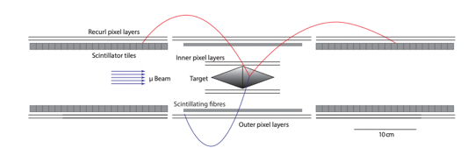
We are not alone!
MEG-II
Data on tape
LHC
Data on tape
Belle II
Data on tape
NA62
Data on tape
COMET
Phase-1 Solenoid in place.
Engineering run complete
DeeMee
Engineering run complete
Mu3e
Engineering run complete, data in 2026
All have unique sensitivity to regions of CLFV parameter space and all have discovery potential ‘around the corner’
The race is on!

Slide 4


The $μN→eN$ Advantage
γ
e
μ
μ
N
e
Electron has half the muon mass
Nucleus absorbs the recoil and electron energy is above spectrum from weak decay
$$p_{e}\left(μ→eγ\right)$$
$$p_{e}\left(μN→eN\right)$$
Advantage: | Strong correlation between photon and positron in angle and time
Challenge: | Backgrounds from accidental coincidence of two decays
Advantage: | Signal is above the decay in orbit spectrum
Challenge: | Requires precise tracking resolution with no tails

Slide 5
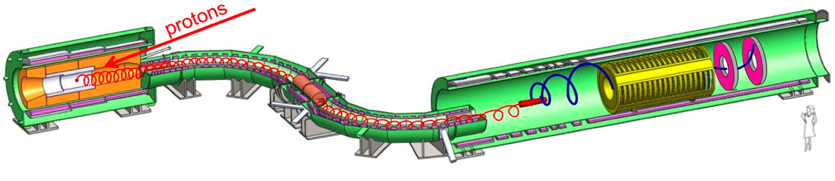
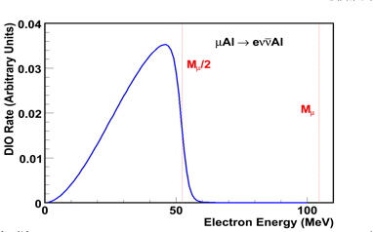
Mu2e Experimental Overview
25m of solenoids designed to maximize captured muons and remove backgrounds (10¹⁰ stopped μ/sec)
Curved transport solenoid provides sign and momentum selection and avoids line of sight from production target to detector
Protons enter here, hit target, make pions
Muons stop on aluminum target
Graded solenoid directs low momentum particles into transport solenoid
Graded solenoid directs electrons to the detector
High momentum Backgrounds exit out the front
signal
“Hollow” tracker has low acceptance for SM decays and high acceptance for signal

Slide 6
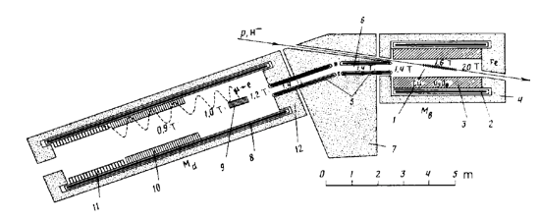
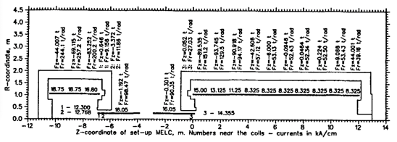
History of the Mu2e Approach
Djilkibaev R.M. and Lobashev V.M., Sov.J.Nucl.Phys. 49(2), 384, (1989).
Multi-graded solenoid approach first proposed in 1989 by Djilkibaev and Lobashev as the MELC experiment at Dubna.
Canceled in 1995
Next proposed in 1997 by Molzon as the MECO experiment at Brookhaven.
Canceled in 2005
Next proposed in 2007 by Miller, Molzon, and Prebys as the Mu2e experiment at Fermilab.
After more than three decades from the original proposal, we are at the verge of finally doing this experiment.
The collaboration is in place and ready to get this experiment completed this decade!

Slide 7
Status

Slide 8
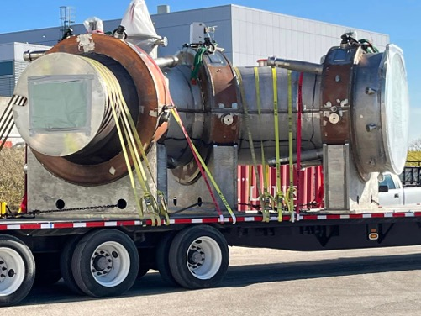
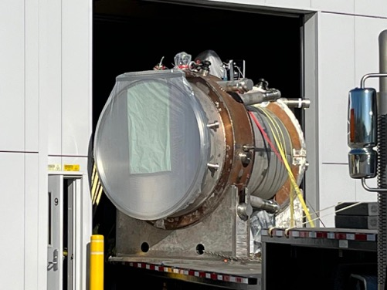
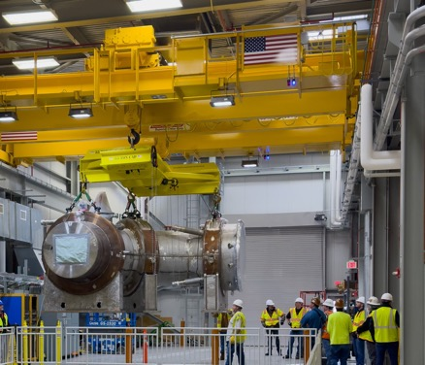
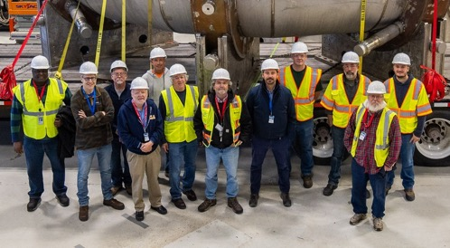
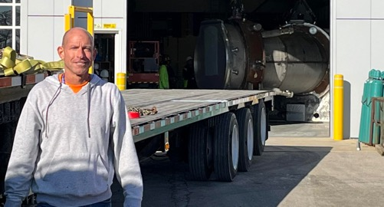
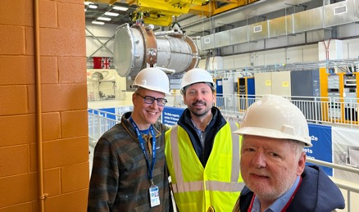
Upstream Transport Solenoid now in place!

Slide 9
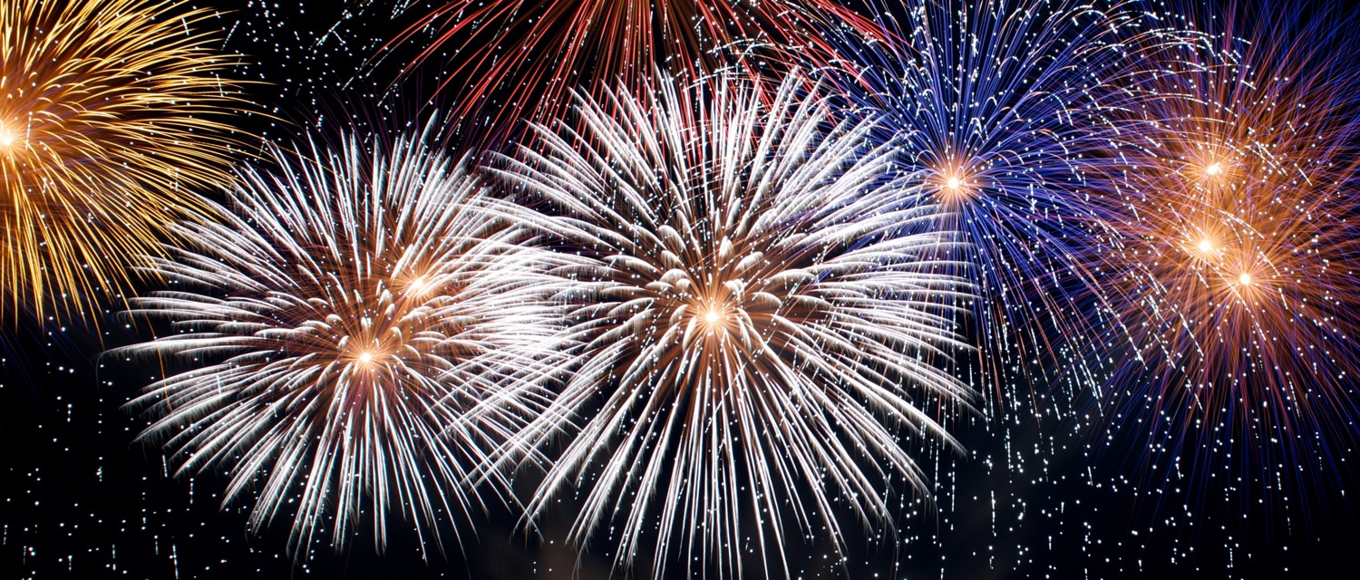
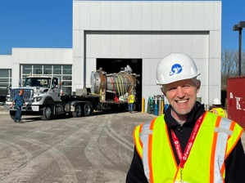
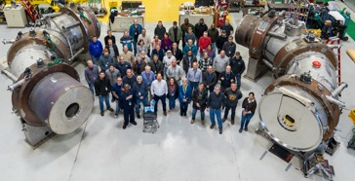
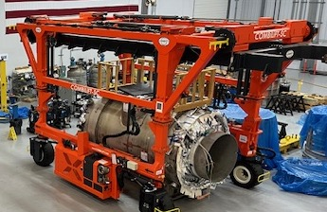
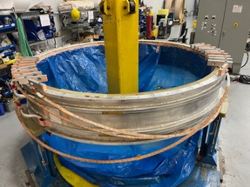
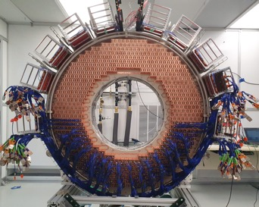
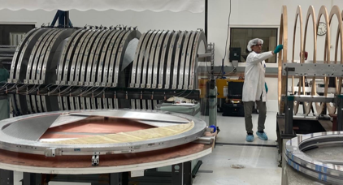
2024: A year of milestones with many things arriving in the Mu2e Hall!
12/7/23
Upstream Transport Solenoid Delivered
2/24
Downstream Transport Solenoid Delivery
4/24
Production Solenoid Delivery
10/24
Detector Solenoid Delivery
8/24
Calorimeter Delivery
10/24
Tracker Delivery

Slide 10
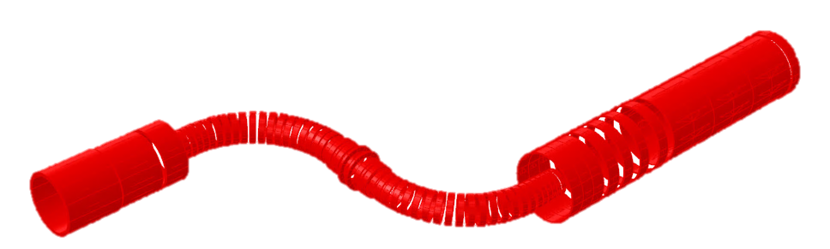

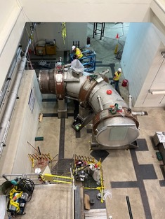
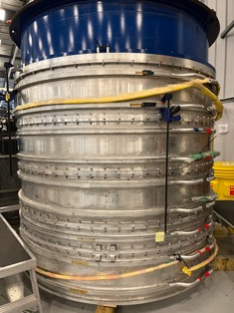
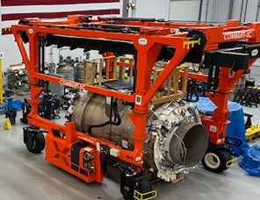
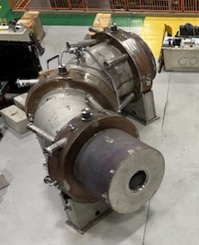
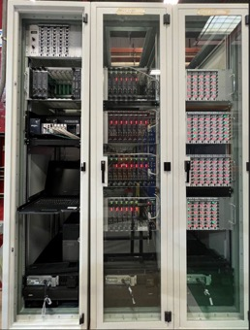
Solenoids and infrastructure
The last coil!
Quench protection rack
Production solenoid in final outfitting at vendor
Detector solenoid cold testing
Upstream transport solenoid in Mu2e hall
Downstream transport solenoid in HAB (CDF)

Slide 11
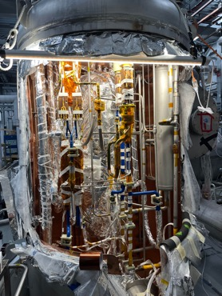
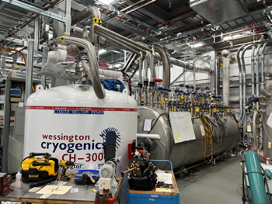
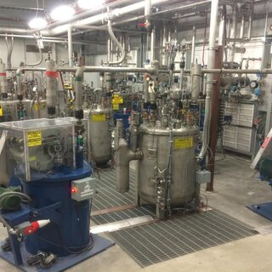
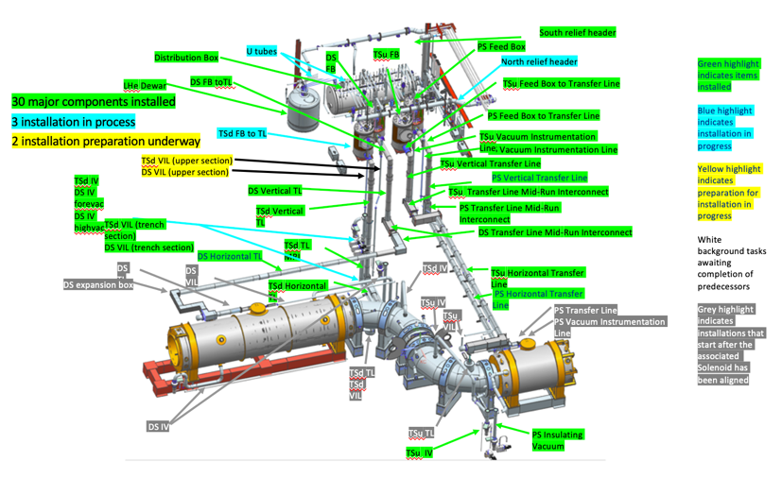
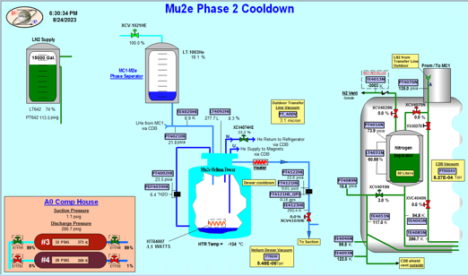
Solenoids and Infrastructure
LHe production recycled from g-2
(who recycled from Tevatron)
Distribution boxes and dewar in Mu2e building
Inside a feedbox
8/23: First LHe delivered from g-2 to Mu2e!

Slide 12
Solenoids and infrastructure takeaways
Excellent progress on all fronts.
Cryo plant is now connected and ready. Capacity and purity upgrades underway.
  Cryogen delivery was the leading cause of downtime for g-2
Technical resources were surged onto Mu2e infrastructure in 2023.
  This has greatly paid off but most infrastructure is still on a ‘just in time’ schedule. Continuing the surge in 2024.
Magnet power supplies and related infrastructure are also on a ‘just in time’ schedule
  Collaboration post docs are now helping out with EE supervision starting with the quench protection system.
The end is in sight for the solenoids but the schedule has slipped by several months
  Schedule impact will be shown in a few slides
  Alleviating this by front loading work on the transport solenoids while waiting for the production and detector solenoids.

Slide 13
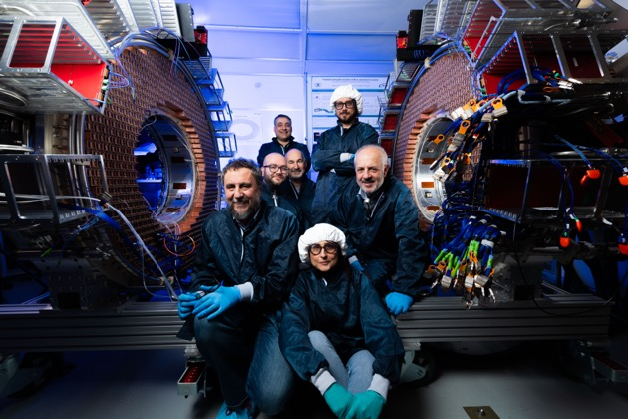
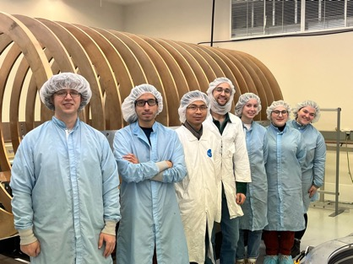
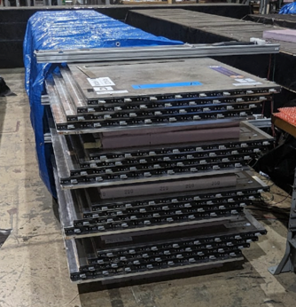
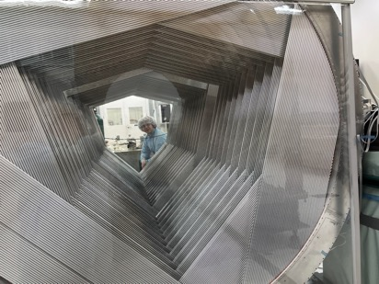
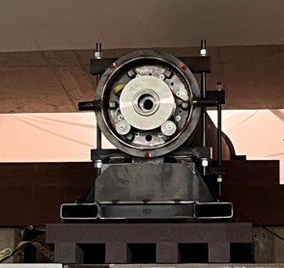
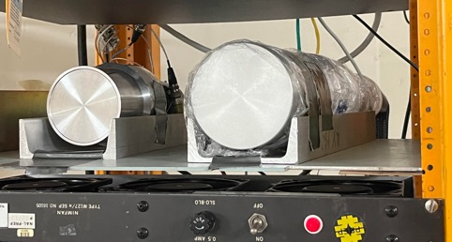
Detectors @ Fermilab
Calorimeter disks
Cosmic ray veto modules
Tracker frame
Tracker planes
LaBr₃
HPGe
Extinction Monitor collimator
Stopping target monitors

Slide 14
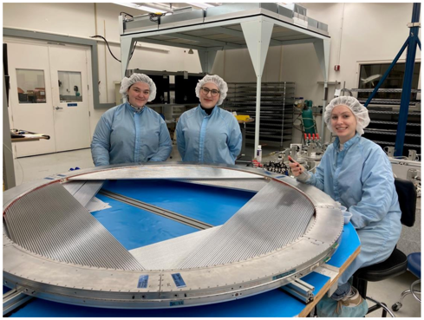
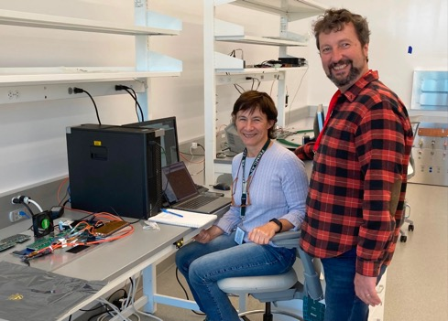
Detectors take aways
Detector construction is in excellent shape
Performance tests so far have all been to spec, although tracker leak rate is borderline
  Continue to monitor, find, and fix small leaks
Readout electronics have had a huge uncertainty due to COVID related supply chain disruptions
  It looks like we’ve turned the corner, and now most electronic components (FPGAs, CPUs) have been delivered and boards are showing up
The center of gravity of grad student, postdoc, and technical support needs is moving from collaborating institutions to Fermilab to support installation, integration, and commissioning

Slide 15
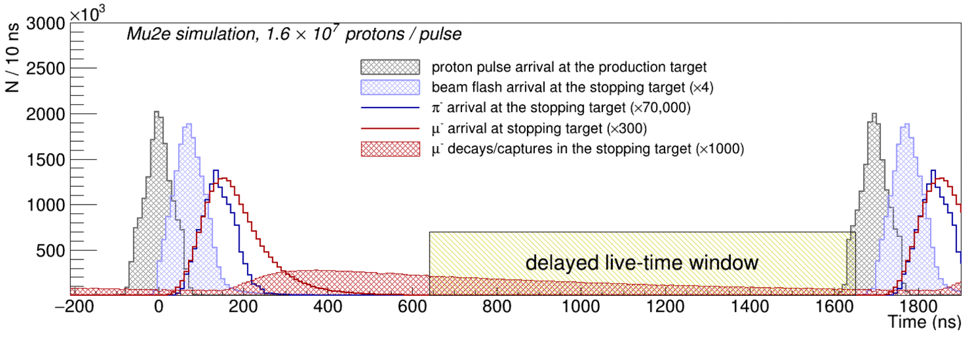
Beam delivery
Key to Mu2e is the solenoid and detector geometry that gives high acceptance to signal and low acceptance to background. Second key is a bunched beam that removes the remaining backgrounds in the detector acceptance.
No prompt background here as long as there are no protons between pulses (extinction @ 10⁻¹⁰)
High efficiency slow extraction gets us signal here

Slide 16
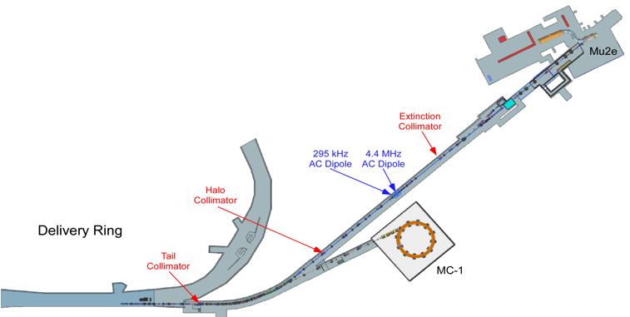
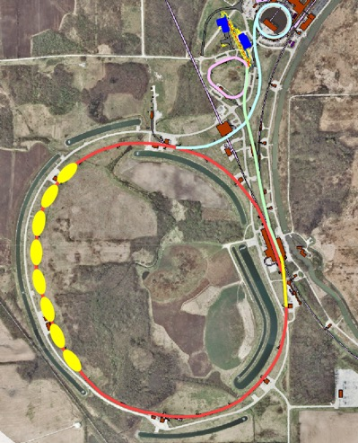
Beam delivery
Recycler beam is stored in the delivery ring and slow extracted to the experimental hall
Beam from the Booster is rebunched in the Recycler
Diagnostic Absorber
Performed lots of commissioning in parallel to g-2 running
g-2 negative muon run was canceled to increase priority of Mu2e studies
Studies now behind schedule due to accelerator start up delays

Slide 17
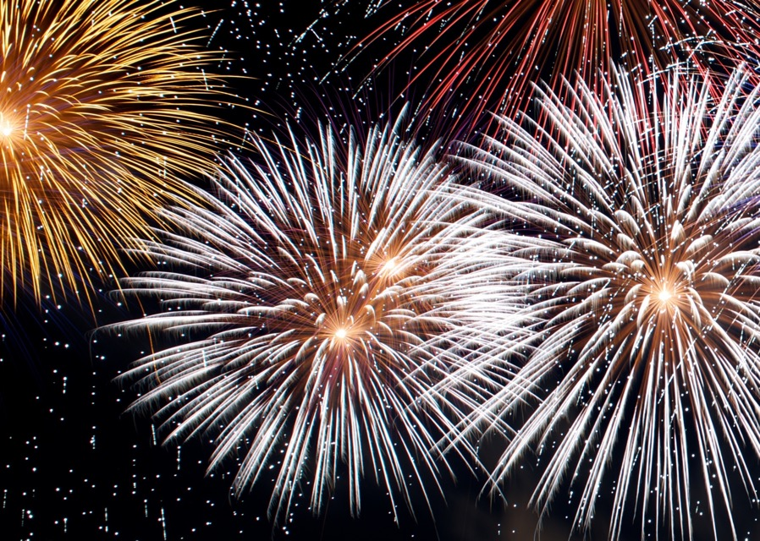
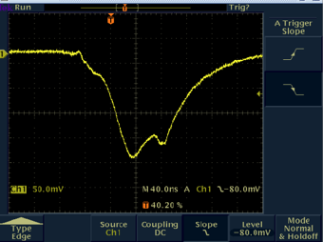
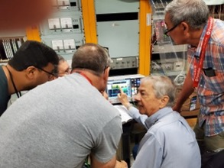


Beam Delivery Milestones and Setbacks
4/14/2022
Pulsed beam delivered to diagnostic absorber
7/7/2023
Slow extraction demonstrated with prototype septum
Setback:
Electrostatic septa are having problems holding voltage
2/1/2023
Helenka Casler receives PhD on instrumentation used to confirm Mu2e slow extraction

Slide 18
Beam Delivery Takeaways
Accelerator performance is key to Mu2e’s success. Both in terms of protons on target and background rejection
The requirements are stringent, and we’ve anticipated that meeting them will take significant commissioning, particularly for slow extraction and extinction
  Fermilab made sacrifices to the physics program to advance the commissioning schedule
  We are already finding problems, so these tough decisions were the correct decisions
We had a long list of commissioning tasks this year that are now on hold
  We have prioritized the list including items that must happen this year to inform decision branch points.
  Bob Bernstein will go through this in his talk

Slide 19






Online systems
Now working on integration
Each subsystem has performed a vertical slice test
‘Horizontal’ slice
Tracker
Calo
This goes here
Cosmic Ray veto
Stopping target monitor
New integration test stand area in Helen Edwards Building

Slide 20


Offline computing, algorithms, analysis
5 σ sensitivity: 5 signal events, 0.1 background events
Functionality of all systems demonstrated with a mock data challenge from 2020-2022
Computing readiness review held May, 2023. Pointed out opportunities to use more standard tools.
Collaboration is working with Fermilab computing to integrate standard Fermilab tools.
Expect about a year long cosmic ray run that should be enough to completely determine initial calibrations for all systems and get everything production ready
Solenoid
Tracker
Calo

Slide 21

Collaboration updates
The collaboration is growing.
In the last 12 months:4 new institutions, Y new collaborators
We have a staffing plan for full time postdocs and grad students
We have reorganized the collaboration’s org chart to prepare for transitioning from construction to operations
Grad students | Target* | 25
 | Planned** | 16
Postdocs | target | 25
 | planned | 20
Co-Spokespersons
B. Bernstein (FNAL)
S. Miscetti (INFN)
We’ve communicated the gaps to funding agencies
Analysis Coordinators
D. Brown (LBNL)
B. Echenard (Caltech)
Operations Managers
G. Rakness (FNAL)
Y. Wu (ANL)
*Target is what we think we need
**Planned is the sum of all hires expected at all institutions

Slide 22
Schedule

Slide 23
Items on the critical path to first physics
Hatch blocks
Component | Notes
Detector solenoid | Delivered, installed, cooled and powered
Inner detectors | Inserted into solenoid
External shielding | installation
Final focus | installation
Cosmic ray veto | Construct supports, install
Hatch blocks | Install
Accelerator readiness rev. | Before completion of hatch blocks
Beam to experiment | Soon after completion of hatch blocks
CRV
shielding
Detectors
Detector Solenoid

Slide 24

Schedule
Need about 7 months after solenoids are checked out before we are ready with beam
  Dominated by installation tasks, not commissioning tasks
Need about 7 months of beam time to commission and get first 10% of data on tape

Slide 25
Schedule take aways I
The schedule driver is the detector solenoid and the delivery schedule has slipped by several months since the last PAC meeting
We no longer expect to be able to get physics data on tape before January 2027
Lab will be working with all stakeholders to revisit the long shutdown schedule
We are actively advancing all work that can be advanced
  E.g.: recently made a major replan of solenoid work to make progress on the transport solenoids while we are waiting for the production and detector solenoids.
We will do everything we can to be ready once the solenoids arrive
  Long cosmic ray run with the detector in the Mu2e hall begins in 2025.
  Beam commissioning has already begun.

Slide 26
Schedule take aways II
There are major construction tasks that cannot start before the solenoids are all in place and ready, mainly the shielding, cosmic ray veto system, and the accelerator final focus.
  Although we are still investigating ways to speed those tasks up
Although we are making great progress, there is still a lot of uncertainty about the solenoid delivery dates.
We feel confident in our schedule once the solenoids are delivered and the conclusions that we need 7 months of construction and installation time once the solenoids are ready and we need 7 months of beam time to commission the experiment and get 10% of our physics data on tape.

Slide 27
Our ask
5 σ sensitivity: 5 signal events, 0.1 background events
First run expectations assuming 10¹⁹ POT, i.e. 10% of our approved data set
We ask the PAC to endorse the physics case of our first run and a schedule that gets us physics data on tape before an extended shutdown
We ask that the PAC endorse the experiment getting sufficient beam time this year to address critical issues with accelerator performance that must be answered this year.
  More on this in Bob Bernstein’s talk this afternoon

Slide 28

Conclusions
Charged lepton flavor violation has a strong physics case, endorsed by the last three P5 panels, and is being pursued globally
We are nearing completion of the construction phase of an experiment with excellent sensitivity to this process
Despite solenoid delays, the team is keeping all other aspects of the construction project on track and is doing everything possible to be ready for physics data taking
Beam commissioning is very advanced and has already reveled issues. We need beam time this year to stay on track
We thank the PAC for their time and support and welcome their input

